Slide 1

Unit 4: Digital Promotions
CO 4: execute promotional strategies using Google Ads, YouTube, and specialized professional platforms.
Digital Marketing & SEO
2505CS313
Mr. Prashant Parmar
Darshan Institute of Management
prashant.parmar@darshan.ac.in
9586371604

Slide 2
Outline
  Google Ads
  Types of Google ads campaigns
  Google ads extensions/assets
  Video Marketing & YouTube
  Email Marketing
  Social Media Marketing (LinkedIn, X, Snapchat)
  WhatsApp for Business


Slide 3
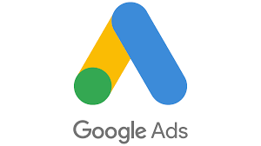
Google Ads

Slide 4
Introduction to Google Ads
What is Google Ads?
  Formerly known as Google AdWords, it is an Online Advertising Platform developed by Google.
  Unlike Social Media ads (which are "Interruption-based"), Google Ads are "Intent-based." Users are actively searching for a solution, making them high-value leads.
Ecosystem Reach
  Google Search: Ads on the SERP (Search Engine Results Page).
  Google Display Network: 2 million+ websites and apps.
  YouTube & Gmail: Integrated placements across Google services.

Slide 5
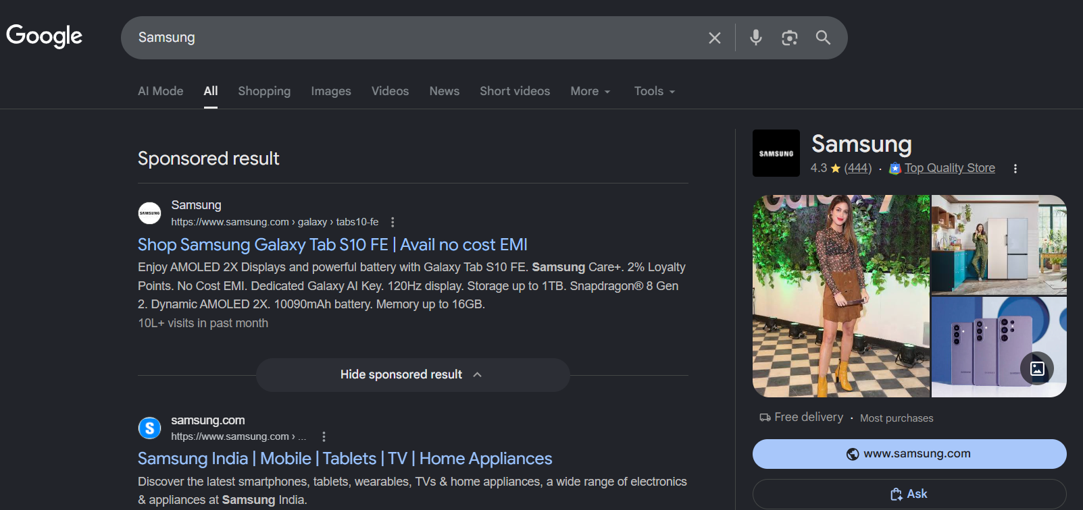
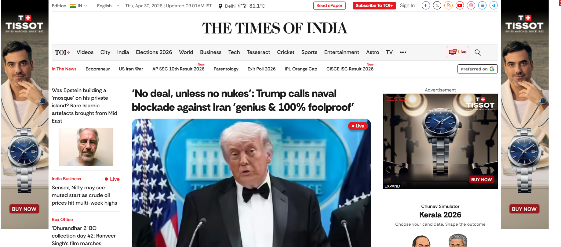
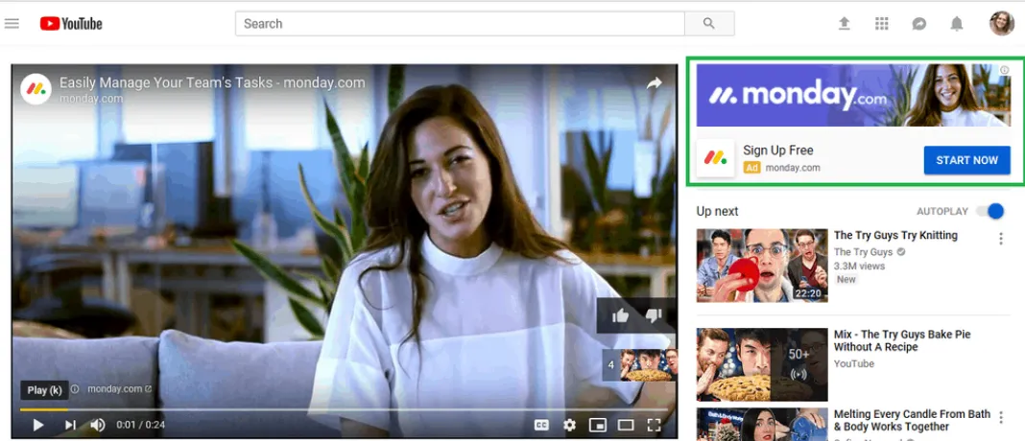
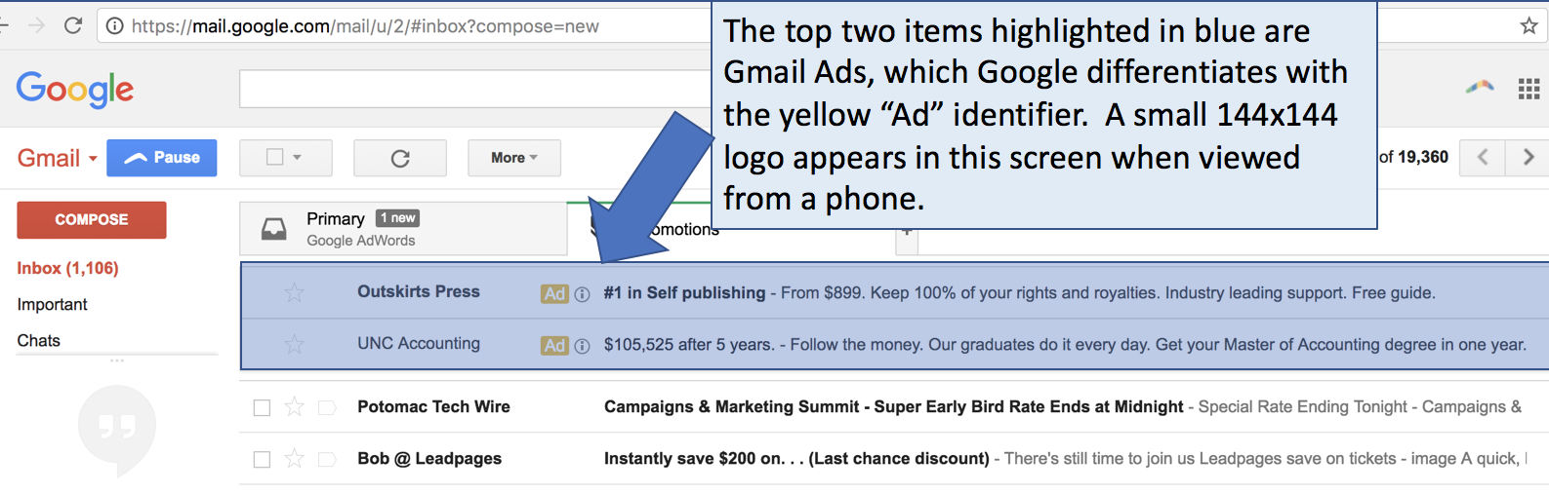
Google Ads Screenshots

Slide 6
Types of Google Ads Campaigns
Search Campaigns
Performance Max (PMax) Campaigns
Display Campaigns
Video Campaigns
Shopping Campaigns
App Campaigns
Demand Gen Campaigns

Slide 7
Types of Google Ads Campaigns (Search Campaigns)
Meaning: Text-based ads that appear directly on the Google Search engine results page (SERP) when users actively query specific keywords.
How to Use:
  Capture high-intent users at the exact moment they are actively looking for your specific product, service, or immediate solution.
  Research high-intent commercial keywords, organize them into tight ad groups,
  set match types (Exact, Phrase, Broad),
  write compelling Responsive Search Ads (RSAs), and attach assets (sitelinks, callouts, lead forms).
Example:
  An emergency plumbing service bids on the keyword "burst pipe repair near me".
  When a homeowner types this into Google, a text ad appears at the top with a direct click-to-call button.

Slide 8
Types of Google Ads Campaigns (Performance Max (PMax) Campaigns)
Meaning: A goal-based, automated campaign type that uses AI to serve ads across all Google inventory (Search, YouTube, Display, Discover, Gmail, Maps) from a single setup.
How to Use:
  Maximize total conversion volume or revenue across Google’s entire advertising inventory from a single automated setup.
  Define a conversion goal (leads or sales)
  Upload a comprehensive asset group (headlines, descriptions, high-res images, videos, logos),
  Set audience signals to guide machine learning, use Smart Bidding (Target CPA or Target ROAS).
Example:
  An online mattress brand provides Google with product images, video reviews, and customer purchase lists.
  Google automatically identifies high-potential buyers across YouTube, Gmail, and Search to drive maximum checkout revenue.

Slide 9
Types of Google Ads Campaigns (Display Campaigns)
Meaning: Visual banner and rich-media ads placed across the Google Display Network (GDN), reaching users while they browse millions of third-party websites, apps, and news portals.
How to Use:
  Build broad brand awareness and cost-effectively retarget past website visitors across millions of third-party websites and apps.
  Upload responsive display banner assets (images, brand logo, concise copy) and target audiences using
  Custom segments,
  In-market categories
  Remarketing lists (users who visited your site but didn't convert).
Example:
  An airline runs banner ads on travel blog websites and retargets users who searched for flights to Paris with a 15% discount banner to encourage booking completion.

Slide 10
Types of Google Ads Campaigns (Video Campaigns)
Meaning: Video ads delivered across YouTube and Google video partner networks designed to build brand awareness, convey complex stories, and drive action.
How to Use:
  Drive emotional engagement, brand recall, and product education through visual storytelling on YouTube and video partner networks.
  Host video creatives on YouTube, select an ad format (Skippable in-stream, Non-skippable 15s, or 6-second Bumper ads),
  Set bidding (Target CPM or CPV),
  Target specific viewer demographics, interests, or relevant YouTube channels.
Example:
  Facebook runs a 30-second skippable demo video on YouTube targeting viewers watching YouTube influencer.

Slide 11
Types of Google Ads Campaigns (Shopping Campaigns)
Meaning: Product-focused listings showing an image, title, price, store name, and ratings directly on Google Search and the dedicated Shopping tab.
How to Use:
  Showcase physical retail products directly with images, pricing, and ratings to capture users comparing items before a purchase.
  Link a Google Merchant Center product data feed to Google Ads,
  organize products into custom product groups (by brand, category, or margin),
  optimize product feed titles and attributes for search queries.
Example:
  A shoe retailer sells running shoes. When a user searches "waterproof trail running shoes size 10“.
  Google pulls the product photo, INR 1300 price tag, and 4.8-star rating into a visual card at the top of the search results.

Slide 12
Types of Google Ads Campaigns (App Campaigns)
Meaning: Automated campaigns specifically designed to drive mobile application installs and post-install in-app events across Search, Google Play, YouTube, and Display.
How to Use:
  Scale mobile application installs and drive post-install in-app engagements.
  Link your Google Play Console or Apple App Store listing, set your optimization target (Cost per Install - CPI or Cost per Action - CPA).
  Provide short text ideas and media assets.
  Let Google generate and test placement combinations.
Example:
  A food delivery app runs a campaign targeting Android users searching for "dinner delivery" on Google Play and watching food recipe videos on YouTube.
  Optimizing for first-order completions.

Slide 13
Types of Google Ads Campaigns (Demand Gen)
Meaning: AI-driven, highly visual and immersive campaigns running on Google's top feed surfaces.
    YouTube (including Shorts)
    Discover
    Gmail
  Capture mid-funnel interest before users search.
How to Use:
  Upload high-impact visual creatives (vertical 9:16 Shorts videos, standard landscape videos, and image carousels).
  Pair them with first-party Customer Match data, and build Lookalike segments to find new prospects.
Example:
  A direct-to-consumer skincare brand uploads vertical user-generated review videos and carousel images to target lookalike segments of past buyers browsing YouTube Shorts and the Google Discover feed.

Slide 14
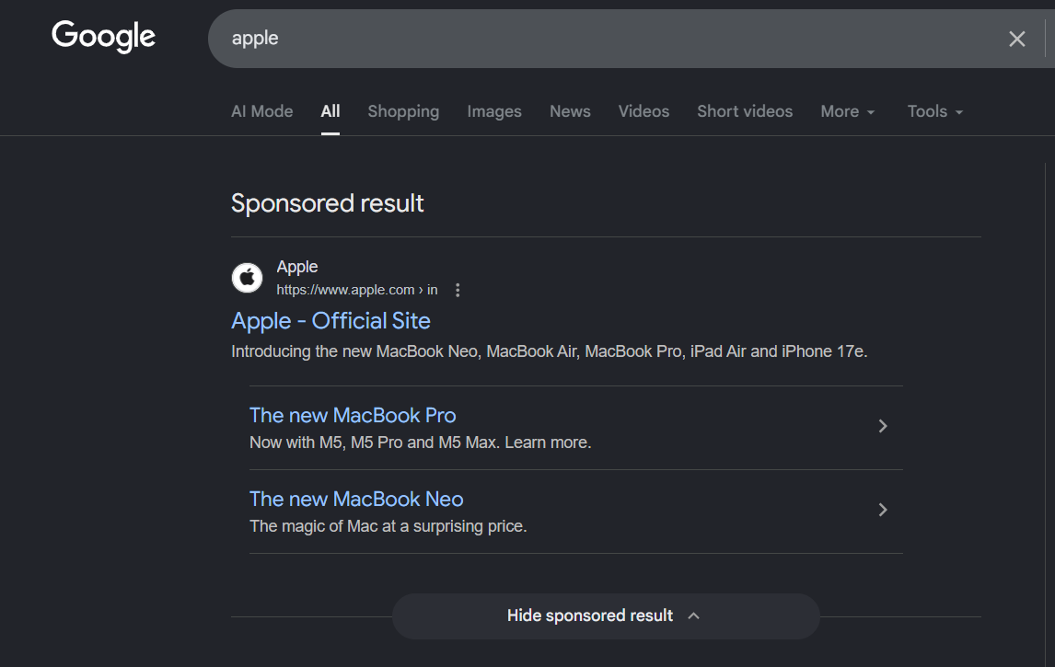
Types of ads Image (Continue…)
Identify the type of ad.
Search ads

Slide 15
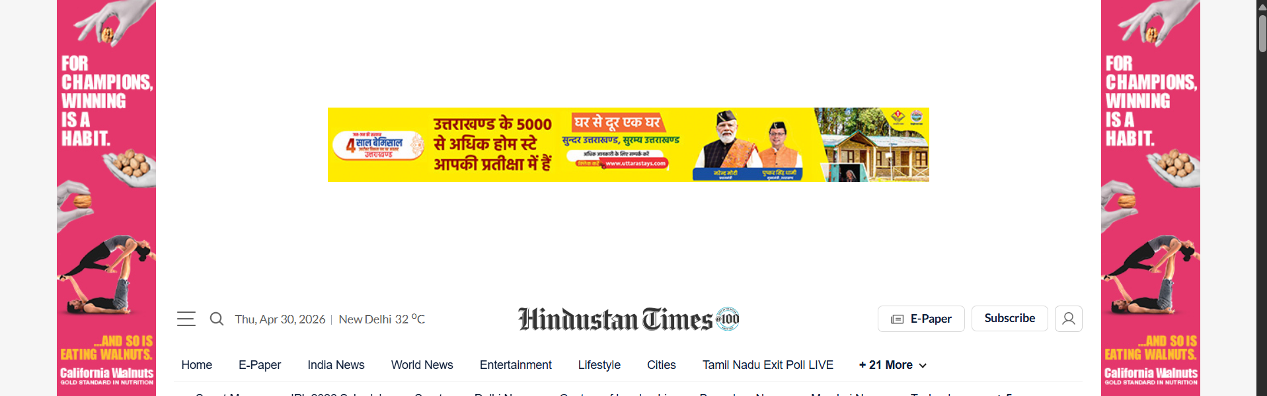
Types of ads Image (Continue…)
Identify the type of ad.
Display ads

Slide 16
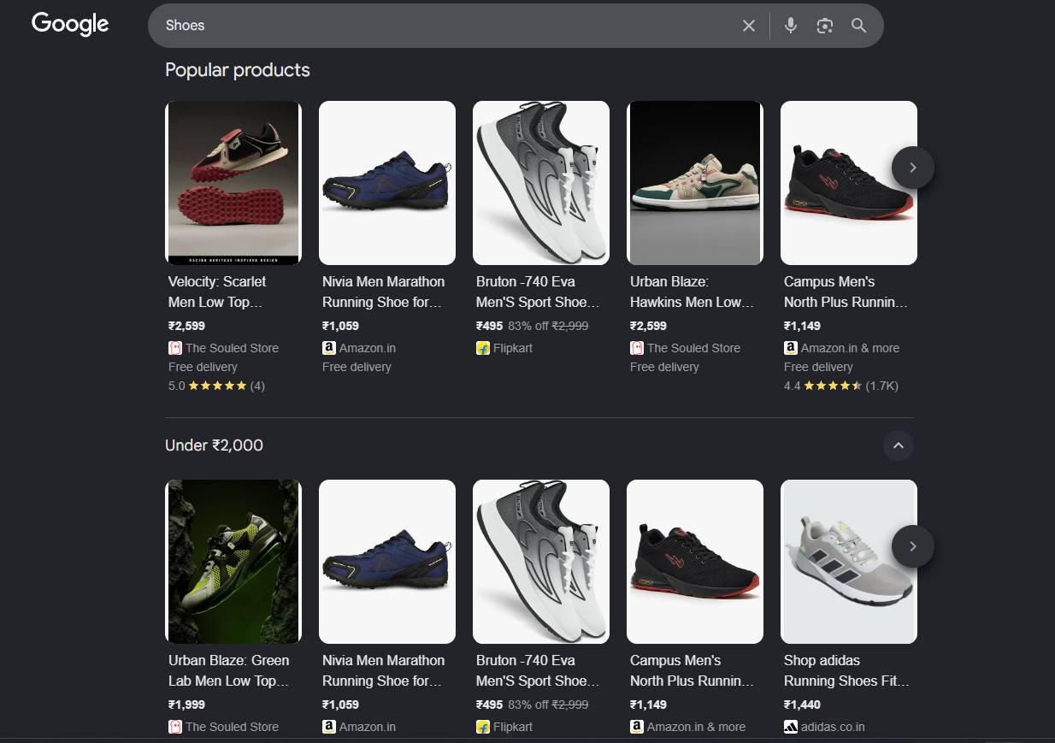
Types of ads Image (Continue…)
Identify the type of ad.
Shopping ads

Slide 17
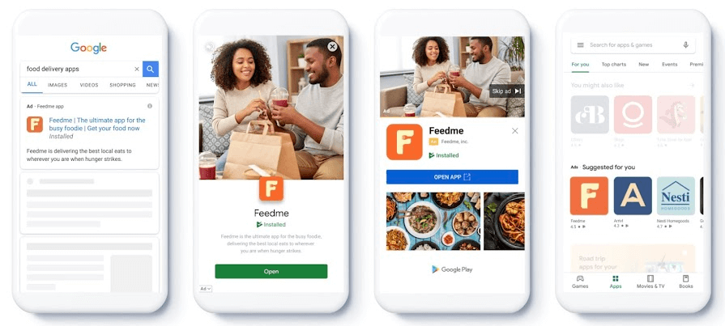
Types of ads Image (Continue…)
Identify the type of ad.
App Install ads

Slide 18
Google ads extensions/asset
Google ads extension is also known as assets are additional pieces of information added to your Google Ads to make them more useful and attractive.
They can include:
  Headlines
  Descriptions
  Website links (Sitelinks)
  Images
  Call buttons
  Location information
  App links and other business information
They give customers more reasons and ways to interact with your business.

Slide 19
How Do Assets Work?
Google Ads automatically selects the most relevant assets for each user's search.
Different combinations may appear for different people and searches.
More relevant assets can make your ad larger, more visible, and more engaging.
Assets can help increase clicks, calls, website visits, and conversions.
Some assets require manual setup, while others can be automatically created by Google.

Slide 20
Types of Google Ads Assets
Headline Assets
  Headlines are the main titles of your advertisement. They grab the customer's attention.
  Example: Learn Digital Marketing from Experts
Description Assets
  Descriptions provide more information about your product, service, or offer.
  Example: Join practical classes and gain industry-ready skills.
Sitelink Assets
  Sitelinks provide additional links to specific pages of your website.
  Example: Courses | Fees Structure | Contact Us | Apply Now

Slide 21
Types of Google Ads Assets (Continue…)
Callout Assets
  Callouts highlight important benefits or unique features of your business.
  Example: Free Demo | Certified Trainers | Placement Support
Call Assets
  Call assets allow customers to call your business directly from the advertisement.
  Example: Call Now: +91 XXXXX XXXXX
Location Assets
  Location assets show your business address and help customers find your physical location.
  Example: Visit Our Training Centre in Rajkot

Slide 22
Types of Google Ads Assets (Continue…)
Image Assets
  Image assets add relevant pictures to make your advertisement more attractive and informative.
  Example: Photo of students attending a digital marketing workshop
Price Assets
  Price assets display the prices of your products or services directly in the ad.
  Example: SEO Course – ₹8,000
Promotion Assets
  Promotion assets highlight special discounts, sales, or limited-time offers.
  Example: Get 20% Off on Course Registration

Slide 23
Types of Google Ads Assets (Continue…)
Structured Snippet Assets
  These assets show a list of specific products, services, brands, or categories offered by a business.
  Example: Services: SEO, Google Ads, Social Media Marketing
App Assets
  App assets encourage customers to download your mobile application.
  Example: Download Our Learning App
Lead Form Assets
  Lead form assets allow interested customers to submit their details directly through the advertisement.
  Example: Fill the form to get a Free Career Consultation.

Slide 24
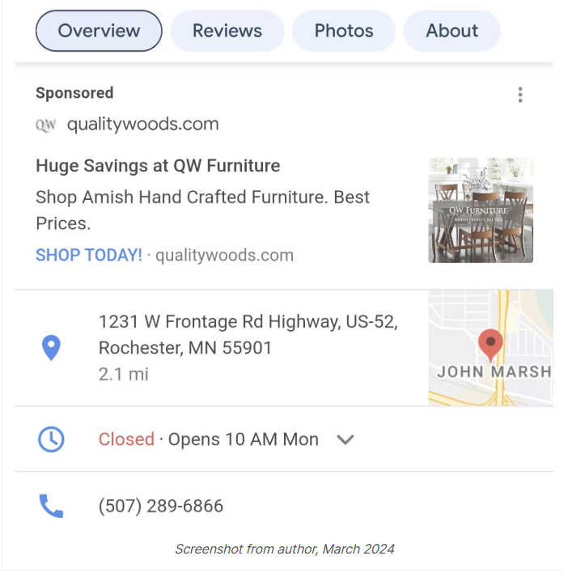
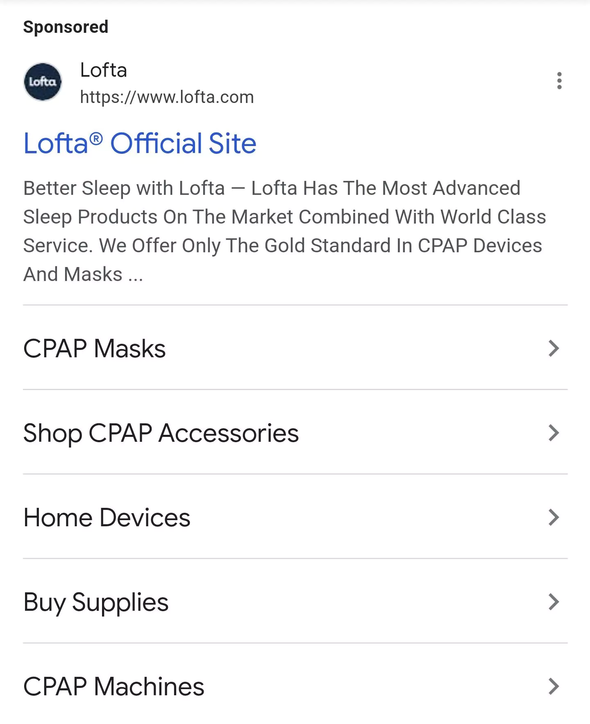
Identify Google Ads Assets (Continue…)

Slide 25
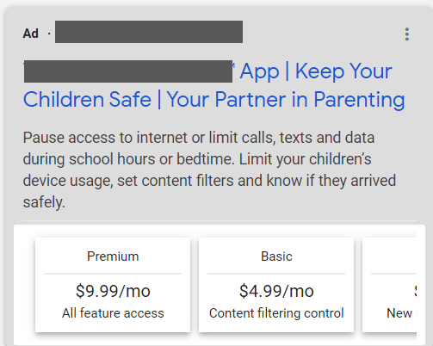
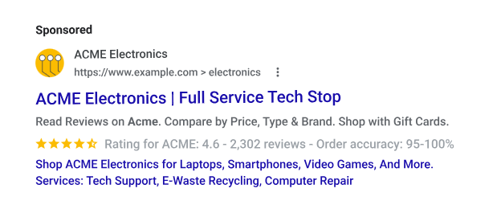
Identify Google Ads Assets (Continue…)

Slide 26
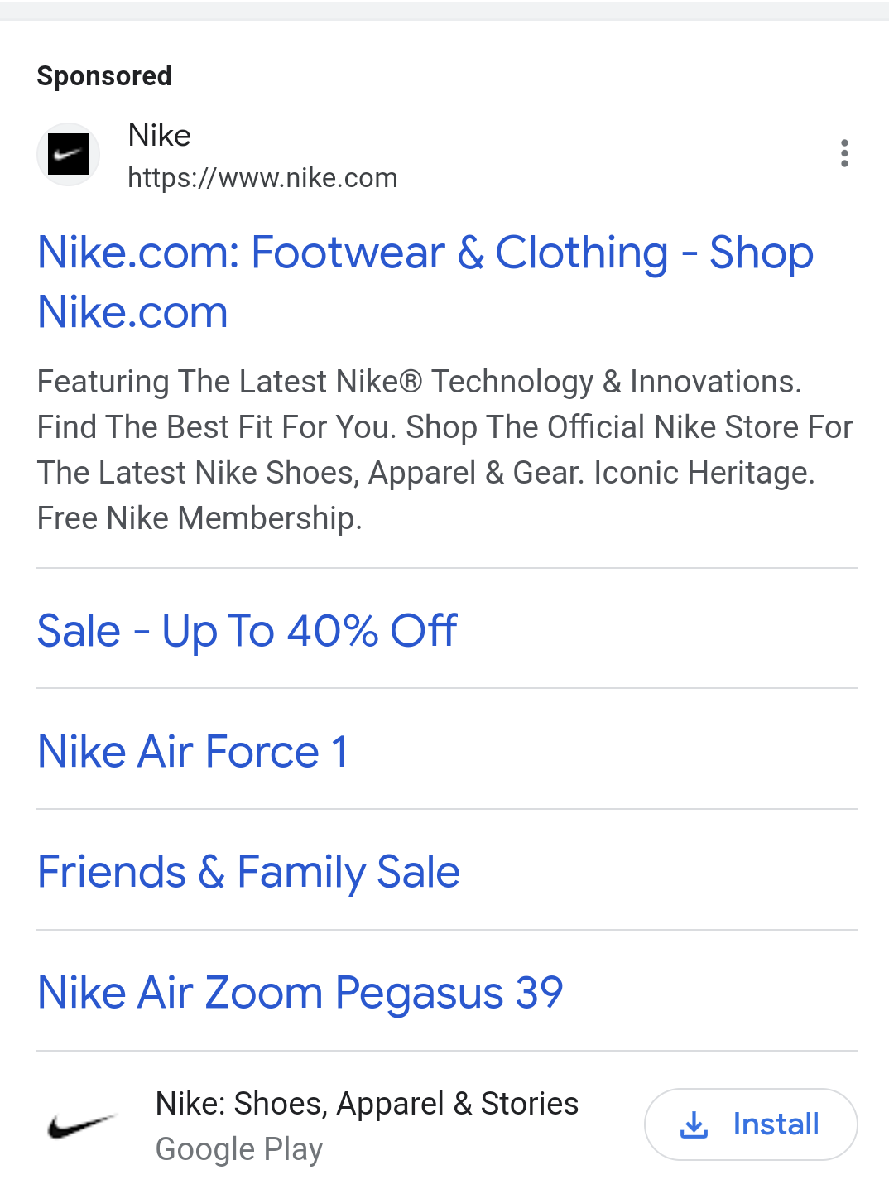
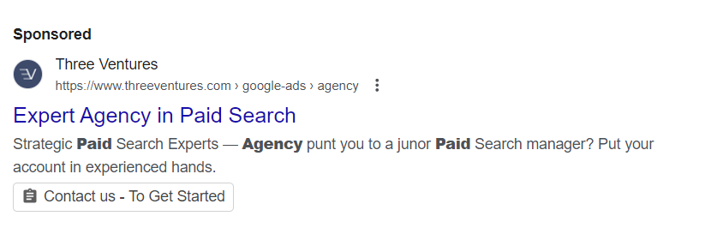
Identify Google Ads Assets

Slide 27
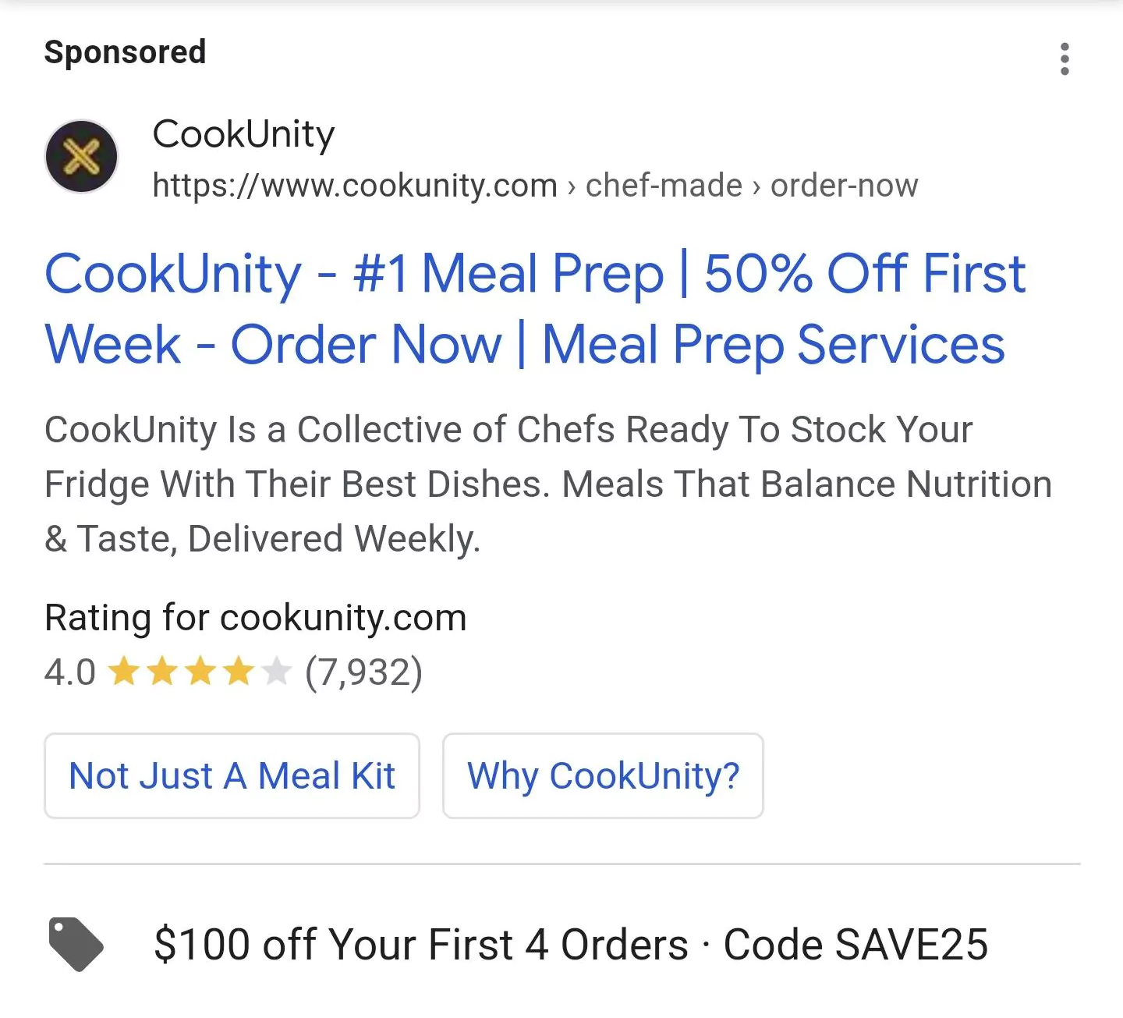
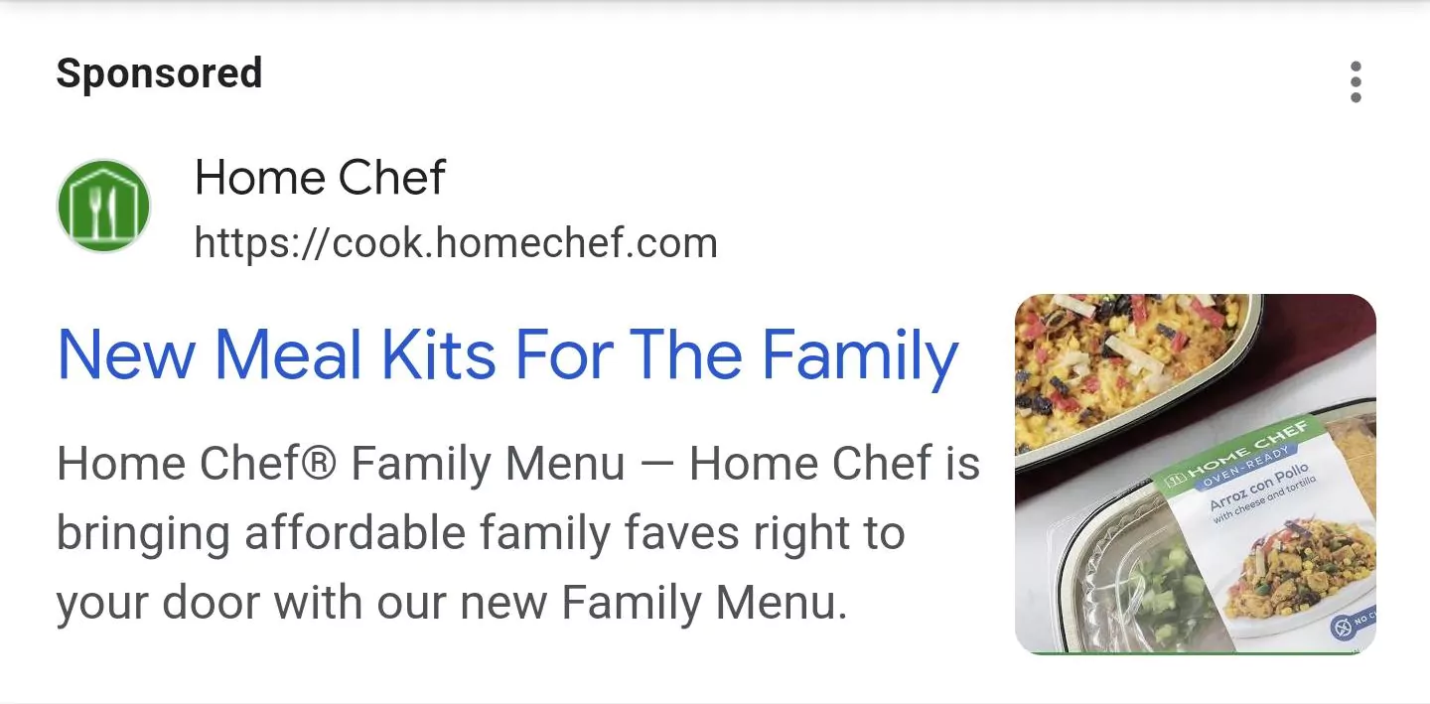
Identify Google Ads Assets (Continue…)

Slide 28
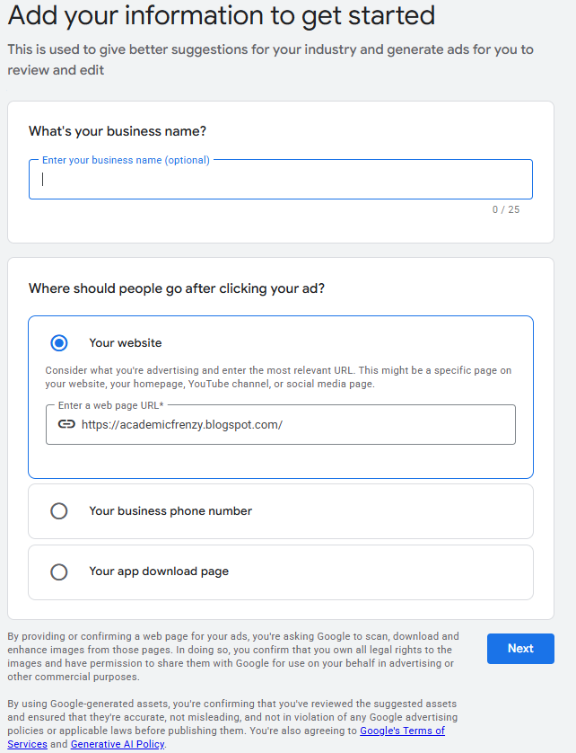
Google ads campaign
Business Name: Enter the optional business/brand name in the top input box.
Destination URL: Select where users will land after clicking the ad (website URL, business phone number, or app download page).
Input Website URL: Enter the landing page URL ([https://academicfrenzy.blogspot.com/] to allow Google to scan the site for asset generation and ad relevancy.

Slide 29
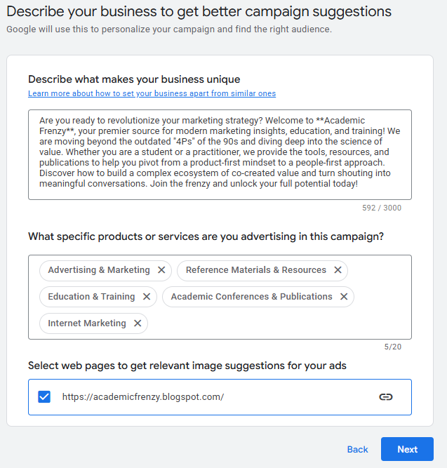
Google ads campaign (Continue…)
Business Description & Category Tagging
Describe Business Uniqueness: Provide a detailed description of the brand's offerings, value proposition, and purpose (e.g., modern marketing education, value co-creation) to assist Google AI in targeting.
Select Categories: Tag specific products and services being promoted (e.g., Advertising & Marketing, Education & Training, Reference Materials & Resources, Academic Conferences & Publications, Internet Marketing).
Select Source Pages: Confirm the website URL to pull image assets directly from the site.

Slide 30
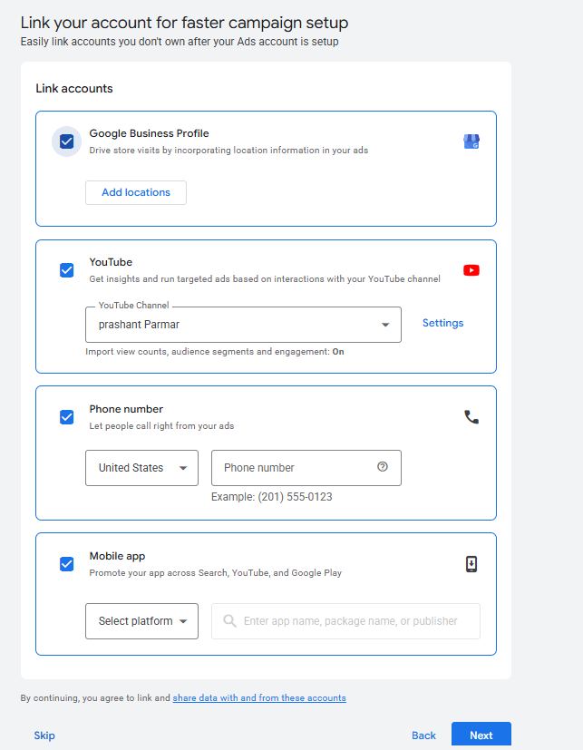
Google ads campaign (Continue…)
Link Associated AccountsGoogle Business Profile: Link a Google Business profile to show physical location extensions and drive local visits.
YouTube Channel: Connect a YouTube channel (prashant Parmar) to leverage video engagement data and run targeted video-based promotions.
Call Extensions: Add a regional phone number to enable direct click-to-call functionality. Mobile App: Link an app store listing if promoting an Android or iOS application.

Slide 31
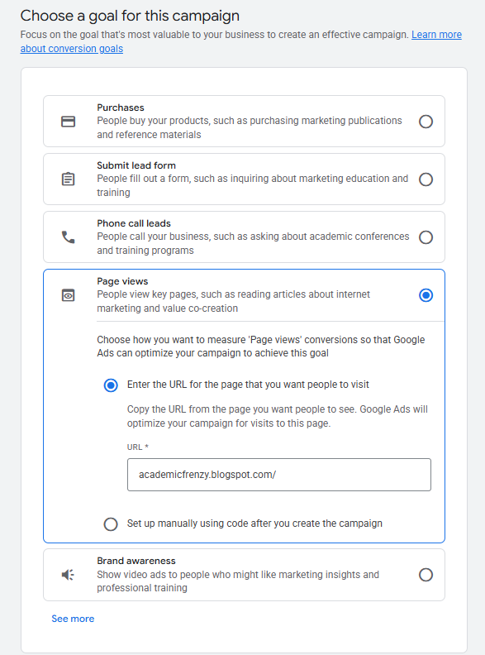
Google ads campaign (Continue…)
Campaign Conversion GoalSelect Objective: Choose the conversion goal for the campaign (options include Purchases, Submit lead form, Phone call leads, Page views, or Brand awareness).
Configure Page Views: In this setup, select Page views as the primary conversion goal.
Measurement Tracking: Choose Enter the URL for the page that you want people to visit and confirm the target URL to track visits without immediate manual tag implementation.

Slide 32
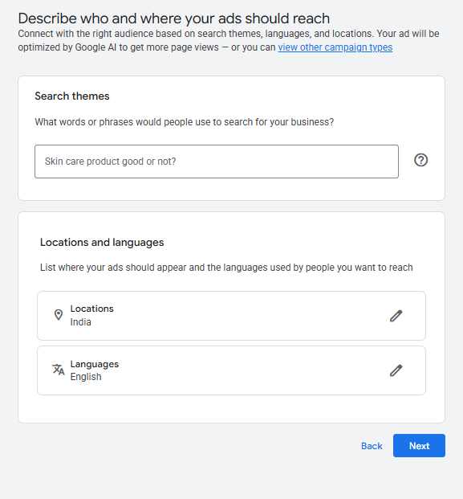
Google ads campaign (Continue…)
Audience Targeting (Themes, Location, & Language)
Search Themes: Enter relevant search keywords and queries representing user intent (e.g., "Skin care product good or not?").
Geographic Locations: Define the target countries/regions where ads will be served (set to India). Target Languages: Set the audience language preference (set to English).

Slide 33
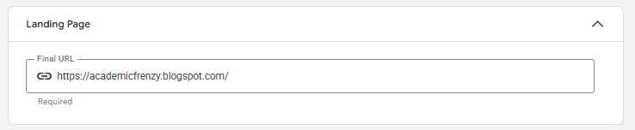
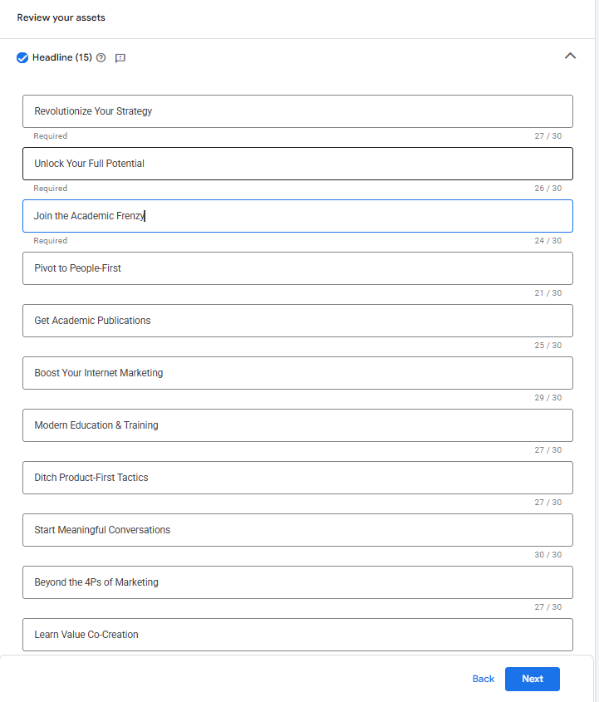
Google ads campaign (Continue…)
Landing Page Confirmation & Short Headlines
Final URL Verification: Confirm the destination link
Short Headlines: Provide multiple concise headlines (up to 30 characters each) highlighting core benefits for Google's responsive ad rotation.

Slide 34
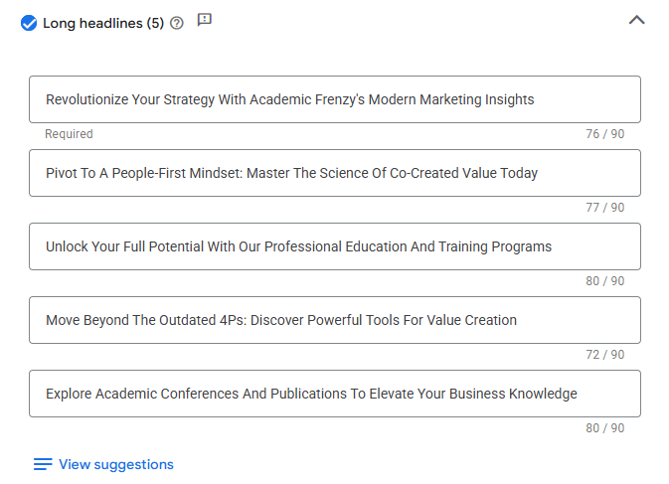
Google ads campaign (Continue…)
Long Headlines Asset Creation
Long Headlines: Provide expanded headline variations (up to 90 characters each) to appear on larger ad placements and cross-network formats.
Key Messaging: Emphasize modern marketing insights, shifting from product-first to people-first mindsets, and academic publications.

Slide 35
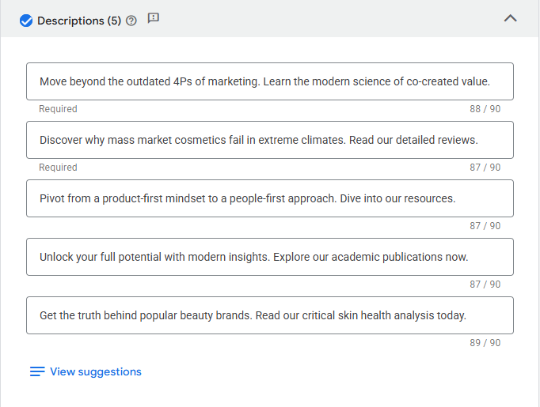
Google ads campaign (Continue…)
Ad Descriptions Setup
Detailed Descriptions: Add informative description lines (up to 90 characters each) elaborating on specific topics, courses, or article reviews.
Content Alignment: Mix general marketing themes (e.g., moving beyond the 4Ps) and targeted post topics (e.g., cosmetic reviews, skin health analyses).

Slide 36
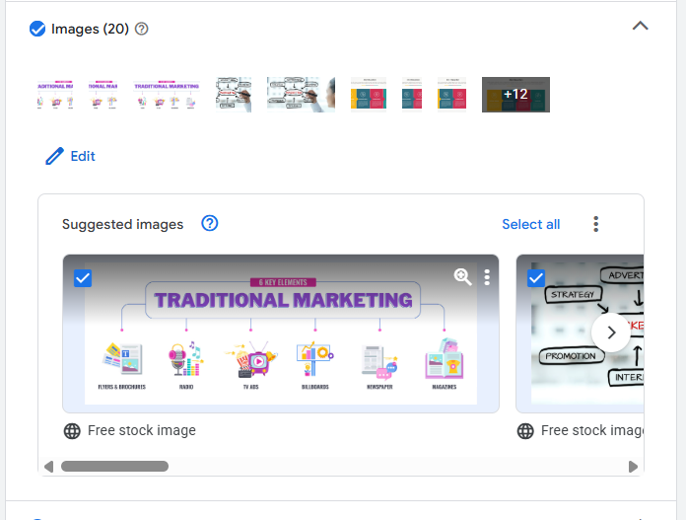
Google ads campaign (Continue…)
Visual Assets (Images)
Image Selection: Add up to 20 marketing images to accompany responsive ads.
Source Options: Review and select from free stock images or AI-extracted graphics sourced directly from the website.

Slide 37
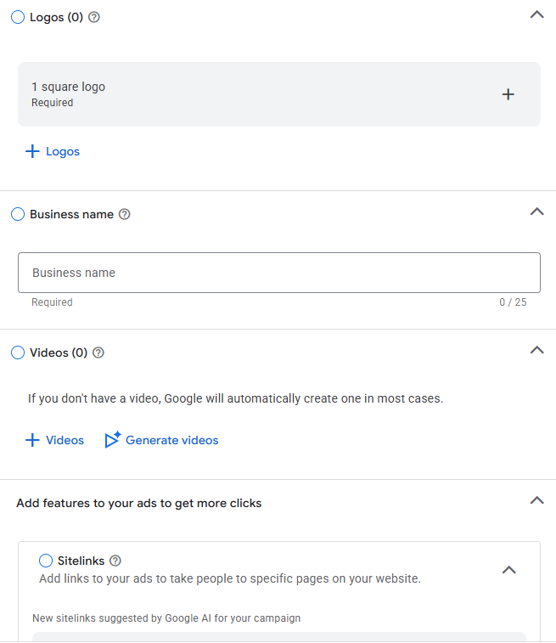
Google ads campaign (Continue…)
Branding & Ad Extensions (Assets)
Logos: Upload at least one square brand logo (required).
Business Name: Fill in the verified public business name (up to 25 characters).
Videos: Upload video assets or allow Google to automatically generate video variations. Sitelinks: Add sitelink extensions to direct users to specific sub-pages on the website to improve click-through rates.

Slide 38
Google Ads Bidding
What is Google Ads Bidding?
  An automated auction system where advertisers compete for ad placement on Google Search, YouTube, Display, and partner sites.
How It Works:
  Every search triggers an auction. Your ad rank depends on your bid, ad quality (Quality Score), and expected impact of ad assets.
You don’t just pay to win; you pay for performance and relevance.

Slide 39
Google Ads Bidding (Continue…)
Manual vs. Smart Bidding
Manual CPC (Cost-Per-Click):
  You set maximum bids per keyword. Offers full control but requires constant monitoring and manual adjustment.
Smart Bidding (Automated):
  Uses machine learning to optimize bids in real time at the exact moment of an auction.
Auction-Time Signals:
  Smart Bidding evaluates device, location, time of day, browser, and user intent for every query.

Slide 40
Google Ads Bidding (Continue…)
Common Smart Bidding Strategies
Maximize Clicks:
  Drives the highest possible traffic within a set daily budget (best for brand awareness).
Maximize Conversions:
  Focuses on getting the highest volume of leads or sales without exceeding your budget.
Target CPA (Cost Per Acquisition):
  Automatically bids to hit a specific cost per lead or conversion.
Target ROAS (Return on Ad Spend):
  Bids to achieve a specific revenue-to-spend ratio (ideal for e-commerce).

Slide 41
Choosing the Right Strategy
Goal | Recommended Bid Strategy | Metric to Track
Site Traffic / Awareness | Maximize Clicks | CTR, Impressions, CPC
Lead Generation | Target CPA / Max Conversions | Cost/Lead, Conversion Rate
E-Commerce Revenue | Target ROAS / Max Conversion Value | ROAS, Total Revenue
Brand Protection | Target Impression Share | Absolute Top Impression %

Slide 42
Video Marketing (YouTube)

Slide 43

Introduction to Video Marketing
Video marketing is the strategic use of video content to promote
  Brand
  Product & Service
  Engage with a target audience
  Drive measurable conversions.
Unlike text, video combines visual, auditory, and kinetic elements, allowing for higher information retention and emotional connection.

Slide 44
Importance of Video Marketing
Higher Engagement
  Video content attracts more attention & generates higher Engagement compared to text or images.
Better Product Understanding
  Demonstrates products/services clearly through visuals, making it easier for customers to understand.
Increased Conversion Rates
  Videos influence purchase decisions and help convert viewers into customers.
Boosts SEO Ranking
  Websites with video content rank higher on search engines, increasing visibility.
Strong Brand Awareness
  Videos create emotional connections and improve brand recall.
Highly Shareable Content
  Easy to share across platforms, increasing reach and potential virality.

Slide 45
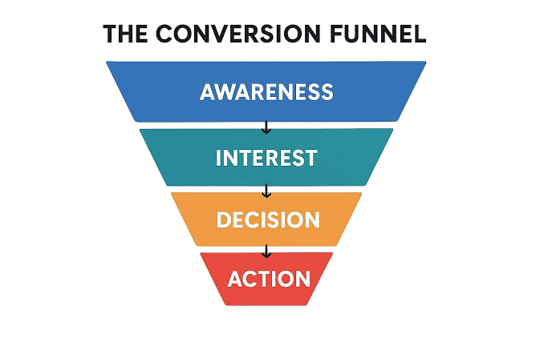
YouTube Advertising Formats
YouTube provides a diverse array of advertisement formats tailored to specific marketing objectives,
Top-of-funnel brand awareness
Bottom-of-funnel conversions.
  In-Stream: Ads that play within the video player (before, during, or after the main content).
  In-Feed: Ads that appear in places of discovery, such as search results or the "watch next" sidebar

Slide 46
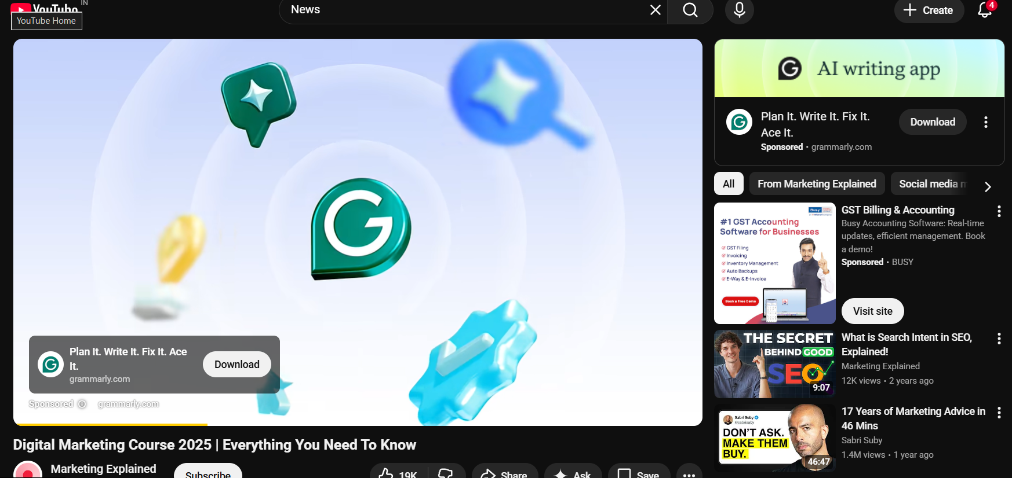
Types of YouTube Ads (Continue…)
In-Feed: Ads that appear in places of discovery, such as search results or the "watch next" sidebar.
In-Feed
In-Stream

Slide 47
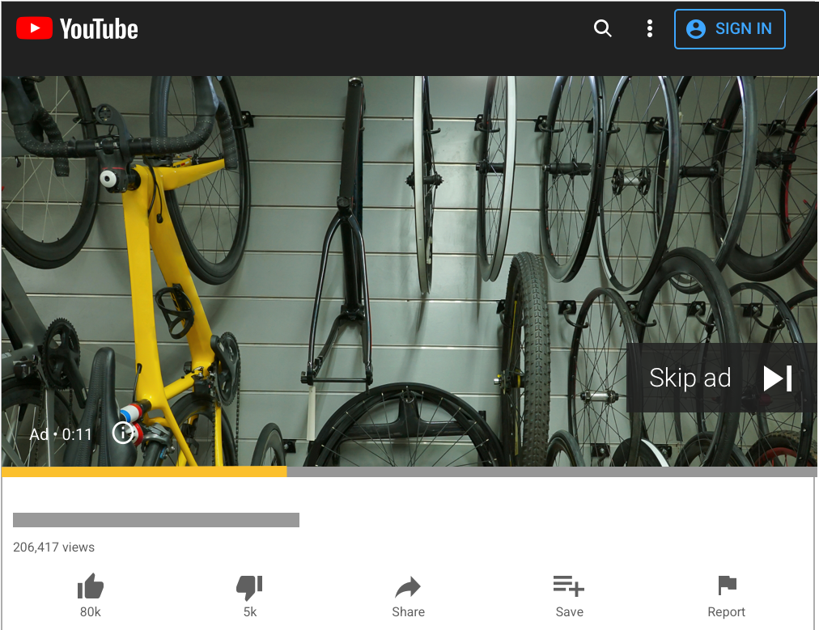
Types of YouTube Ads (Continue…)
Skippable In-Stream Ads
  These advertisements play before, during, or after other videos. After 5 seconds, the viewer is provided with the option to "Skip.“
  Advertisers are charged only when a viewer watches 30 seconds of the video (or the full duration if it is shorter than 30s) or interacts with the ad (e.g., clicking a Call-to-Action).

Slide 48
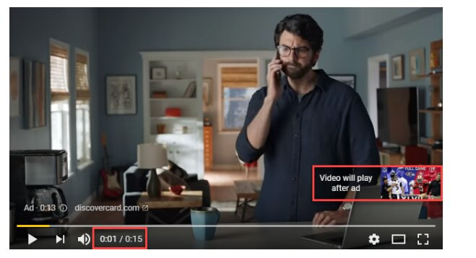
Types of YouTube Ads (Continue…)
Non-Skippable In-Stream Ads
  These ads must be viewed in their entirety before the main video content can be accessed. They do not provide a skip option.
  Advertisers pay based on impressions (Target CPM), focusing on reaching a specific number of viewers rather than active clicks or full views.

Slide 49
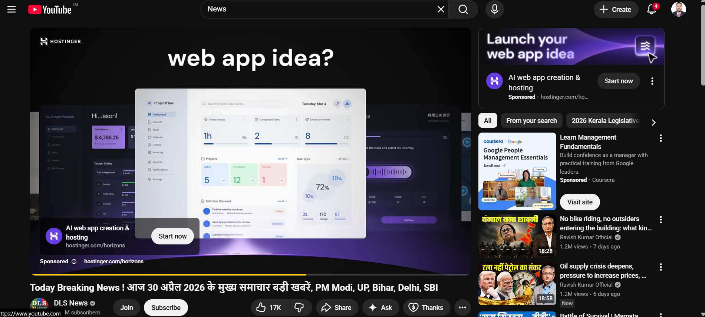
Types of YouTube Ads (Continue…)
Bumper Ads
  Short, non-skippable video advertisements with a mandatory maximum duration of 6 seconds.
  Similar to non-skippable ads, Bumper ads use Target CPM bidding to maximize reach and frequency.

Slide 50
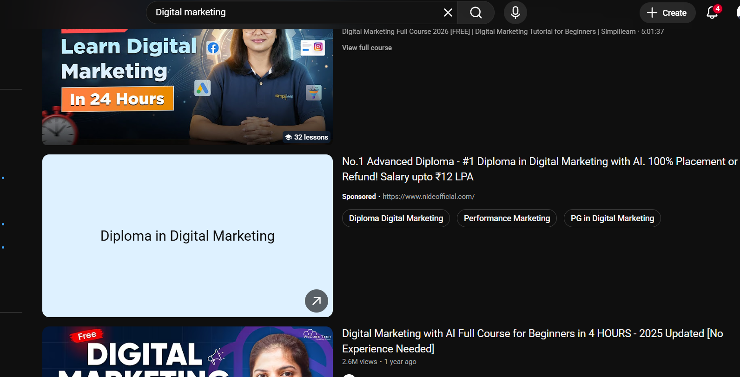
Types of YouTube Ads (Continue…)
In-Feed Video Ads
  These ads consist of a thumbnail image and text. They appear in locations where users are actively searching for or browsing content, such as
    YouTube Search Results.
    The "Up Next" / Recommended sidebar.
    The YouTube Home mobile feed
  Advertisers are charged only when a user actively clicks on the thumbnail to initiate the video playback (CPC/CPV).
In-fed Video Ads

Slide 51
Types of YouTube Ads (Continue…)
Format | Placement | Length | Bidding | Primary Goal
Skippable In-Stream | Inside Video | No Max (15s+ rec) | CPV | Awareness / Leads
Non-Skippable | Inside Video | 15–20 Seconds | CPM | High Impact Awareness
Bumper Ads | Inside Video | 6 Seconds (Max) | CPM | Reach & Frequency
In-Feed Ads | Search / Feed | No Max | CPC/CPV | Consideration / SEO

Slide 52
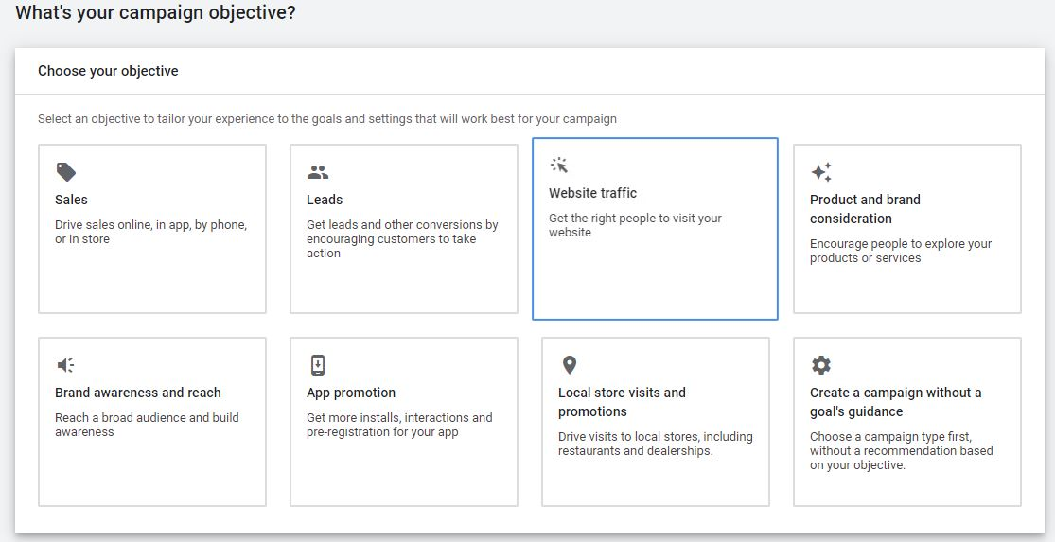
YouTube Setup

Slide 53
YouTube Setup (Continue…)
Audience Targeting Parameters
  Filtering audiences based on quantifiable characteristics such as Age, Gender, Parental Status, and Household Income.
  Interest-Based Segments
    Affinity Segments: Reaching users based on their long-term habits and lifestyle interests (e.g., "Tech Enthusiasts").
    In-Market Segments: Targeting users who are actively researching or intending to purchase a specific product or service.
  Content-Based Targeting
    Keywords: Aligning ads with specific search terms used on YouTube or Google.
    Topics & Placements: Restricting ads to appear on specific video categories

Slide 54
YouTube Analytics
YouTube Analytics
  Watch Time The total amount of time (measured in hours) viewers have spent watching the video ad. This is a primary signal for the YouTube recommendation algorithm.
  Average View Duration The estimated average minutes watched per view for a selected video and date range. It indicates the video's ability to maintain viewer interest.
  Impression Click-Through Rate The percentage of users who clicked on the video ad after seeing the thumbnail.
    Formula- CTR = (Clicks/Impressions)x100
  Views vs. Engaged Views A "view" is typically counted at the 30-second mark, while Engaged Views track users who watch at least 10 seconds and then engage with the ad.

Slide 55
YouTube Analytics (Continue…)
Advanced Retention and Conversion Tracking
  Audience Retention Curve: A visual representation of how many viewers stayed for every second of the video.
  Conversion Tracking: The process of using a Google Tag or API integration to track actions taken after the ad view, such as a product purchase or a form submission.
  View-Through Conversions (VTC): Measures a conversion that occurs when a customer sees an ad but does not click it, yet completes a conversion on the site later.

Slide 56
Advantage of YouTube marketing
Long-Lasting Traffic: Videos stay searchable on Google and YouTube for years, unlike social media posts that vanish in days.
Builds Trust Fast: In-depth tutorials, demos, and reviews show proof, making customers much more confident to buy.
Smart Targeting: Powered by Google Ads data, you can target viewers based on what they actually search for online.
All-in-One Formats: Use Shorts for quick awareness, long videos for detailed explanations, and live streams to launch products.
Free Hosting & Deep Analytics: Zero hosting costs, plus precise data on exactly when viewers watch or click away.

Slide 57
Disadvantages of YouTube Marketing
High Effort & Cost: Requires good cameras, mics, lighting, scripts, and editing to look professional.
Slow Growth: Extremely crowded platform; building an organic following usually takes months of consistent uploads.
Constant Distractions: YouTube constantly recommends competitor videos and entertaining content next to yours.
Easy to Skip: Viewers skip ads after 5 seconds or use ad blockers, meaning bad hooks waste your budget immediately.
Placement Risks: Automated ad spots might place your brand next to controversial or low-quality content.

Slide 58
Top YouTube Marketing Trends
TV Screen Viewing: More people watch YouTube on Smart TVs, driving brands to make cinematic, living-room-quality ads.
Shoppable Videos: Viewers can click and buy products tagged directly inside Shorts, regular videos, and live streams.
AI Dubbing & Testing: Brands use AI to test video thumbnails automatically and translate voiceovers into multiple languages instantly.
Fast-Paced Editing: No long intros; top creators cut straight to the point in the first 3 seconds to keep viewer attention.
Video Podcasts (Vodcasts): Businesses use recorded studio interviews with chapter markers and bite-sized Shorts to pull in high-value leads.

Slide 59
Reference links
To be read by students.
  https://engaiodigital.com/youtube-advertising/

Slide 60
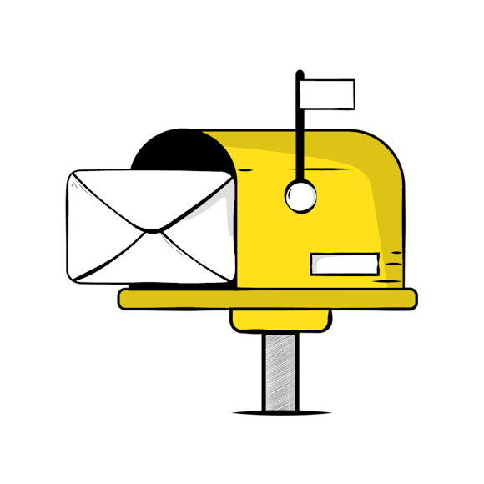
Email Marketing

Slide 61
Introduction to Email Marketing
Email marketing is a direct digital marketing channel
Businesses send targeted commercial and informational messages to a specific list of subscribers.
Unlike broadcast media or rented social feeds, email establishes a direct, permission-based line of communication to a customer’s personal inbox.

Slide 62
Importance of Email Marketing
Commercial Value & Efficiency
  Exceptional Return on Investment (ROI): Email regularly generates returns of roughly $36 to $40 for every $1 spent
  High Conversion Efficiency: Subscribers on an email list have already shown interest in the brand.
  Cost-Effective Scalability: Sending a campaign to 50,000 subscribers takes virtually the same operational effort as sending it to 500.
Audience Ownership & Channel Security
  Email guarantees direct delivery straight to the recipient's mailbox.
  Platform Independence: An email list represents owned digital real estate, the customer contact base remains intact.
  Stable Identity Tracking: Email addresses remain the primary anchor for professional and personal identity over decades.

Slide 63
Importance of Email Marketing
Automated Workflow Execution
  24/7 Lead Nurturing: Automated systems work continuously in the background
  Revenue Recovery Workflows: High-impact automations like abandoned-cart sequences automatically remind shoppers to complete their orders.
  Subscriber Re-engagement: Automated re-engagement loops can flag inactive subscribers.
Transparent Measurement & Optimization
  Clear Diagnostic Metrics: Core metrics—including open rate, click-through rate (CTR), conversion rate, bounce rate, and unsubscribe rate—offer clear visibility into campaign health.
  Systematic A/B Testing: Marketers can readily test different variables.
  Direct Revenue Attribution: E-commerce integrations enable brands to track transactions directly back to specific campaigns.

Slide 64
Types of Email marketing
Promotional Emails
  Sales and Discounts
  Product Launches
  Event Invitations
Informational & Content-Driven Emails
  Email Newsletters
  Company Announcements
Automated Lifecycle (Drip) Campaigns
  Welcome Sequences
  Onboarding Series
  Lead Nurturing Sequences
Behavioral & Triggered Emails
  Cart Abandonment Emails
  Browse Abandonment Emails
  Re-engagement (Win-Back) Campaigns
Transactional Emails
  Order and Shipping Confirmations
  Account Alerts & Security
  Billing and Invoice Notices
Feedback and Review Requests
  Customer Satisfaction Surveys
  Product Review Invitations.

Slide 65
Email Marketing Campaign
Goal Setting: Define what you want to achieve (e.g., welcome new users, announce a product, or recover abandoned carts).
Audience Segmentation: Group subscribers by location, purchase history, or interests to send relevant messages.
Compelling Copy & Subject Line: Write a short, punchy subject line to boost open rates and clear copy with a single Call to Action (CTA).
Responsive Design: Ensure emails look clean and load quickly on both mobile devices and desktop screens.
A/B Testing: Test two variations of subject lines, send times, or button colors to see which performs better.

Slide 66
Email Marketing Analytics
Open Rate: Percentage of delivered emails opened by recipients; measures subject line effectiveness.
Click-Through Rate (CTR): Percentage of recipients who clicked a link inside your email; measures content engagement.
Conversion Rate: Percentage of people who completed the intended action (e.g., bought a product or downloaded a guide).
Bounce Rate: The rate of undelivered emails (soft bounce = temporary inbox issue; hard bounce = invalid email address).
Unsubscribe Rate: Percentage of users opting out of your list; helps gauge content relevance and send frequency.

Slide 67
LinkedIn

Slide 68
Introduction to LinkedIn
The world’s largest professional network, designed for B2B relationship-building, career growth, and business branding.
Put your company or personal brand in front of industry professionals and key decision-makers.
Attract high-intent B2B leads by showcasing solutions to professional challenges.
Recruit top talent by highlighting company culture, job openings, and workplace values.
Establish authority by sharing valuable industry trends, insights, and case studies.

Slide 69
LinkedIn objective
Awareness
  Brand Awareness: Maximize impressions to put your business, products, or personal profile in front of relevant industry professionals.
Consideration
  Website Visits: Drive qualified traffic from LinkedIn feeds directly to your landing pages, blog posts, or product pages.
  Engagement: Encourage interactions such as likes, comments, shares, video views, and company page follows.
  Video Views: Expose high-value video content to an audience likely to watch.
Conversions
  Lead Generation: Capture verified user information using native Lead Gen Forms pre-filled with LinkedIn profile data.
  Website Conversions: Track and optimize for key actions on your external site, such as demo bookings, purchases, or whitepaper downloads.
  Job Applicants: Promote open roles to qualified candidates to drive direct applications.

Slide 70
Profile Optimization & Content Strategy
High-Impact Visuals: Use a professional headshot and a custom banner image stating your value proposition clearly.
Action-Oriented Headline: Replace simple job titles with what you actually achieve (e.g., "Helping SaaS companies scale organic traffic").
About Section Hook: Write a concise summary focusing on problems you solve, notable achievements, and how to reach you.
Content Formats: Mix single-image posts, text-only insights, native video, and multi-page PDF carousels (ideal for step-by-step guides).
Consistent Schedule: Post 2–4 times weekly and actively reply to comments within the first hour to boost algorithmic reach.

Slide 71
LinkedIn Ads Formats & Analytics (Sponsored Content )
Single Image Ads:
  What it is: A traditional post featuring a single static image, headline, text copy, and a link/CTA button.
  Best for: Promoting blog posts, events, product launches, or simple announcements.
  Key tip: Use clean visuals with minimal text on the image; let your copy and headline do the work.
Video Ads:
  What it is: Autoplaying in-feed videos.
  Best for: Product demos, customer testimonials, thought leadership interviews, and storytelling.
  Key tip: Add captions/subtitles (over 70% of professionals watch feed videos on mute). Keep the hook within the first 3 seconds.

Slide 72
LinkedIn Ads Formats & Analytics (Sponsored Content ) Continue…
Carousel Ads:
  What it is: A swipeable series of 2 to 10 visual cards with individual links and descriptions.
  Best for: Telling a sequential story, showcasing multiple product features, or breaking down a case study step-by-step.
  Key tip: Use continuous visual designs across slides to encourage users to swipe through to the end.
Document Ads:
  What it is: In-feed promotional posts allowing members to read and download multi-page documents (PDFs, slide decks, whitepapers) directly within the feed.
  Best for: Gating or ungating long-form B2B research, e-books, and reports.
  Key tip: You can choose to gate the document behind a Lead Gen Form after the user previews the first few pages.

Slide 73
LinkedIn Ads Formats & Analytics (Sponsored Content ) Continue…
Event Ads:
  What it is: Feed ads that pull details directly from a LinkedIn Event page (date, time, host, format).
  Best for: Driving registrations for webinars, panel discussions, and in-person summits.
Thought Leader Ads (Boosted Personal Posts):
  What it is: Promotes a post published by an individual executive or employee rather than the official company page.
  Best for: Leveraging personal authenticity, founder branding, and higher organic trust.

Slide 74
LinkedIn Ads Formats & Analytics (Sponsored Message)
Message Ads (formerly Sponsored InMail):
  What it is: A targeted, personalized direct message from an individual sender with a clear subject line and a single CTA button.
  Best for: Direct invitations to VIP events, personalized product pitches, or exclusive content downloads.
Conversation Ads:
  What it is: Interactive "choose-your-own-path" automated chat experiences featuring multiple branching clickable response buttons
  Best for: Qualifying leads, guiding users based on their specific intent, and boosting response rates.

Slide 75
LinkedIn Ads Formats & Analytics (Dynamic & Sidebar Ads)
Spotlight Ads:
  What it is: Tailored ads showing the member's profile photo next to your company logo, directing them to a landing page or product.
  Best for: Driving clicks to high-intent conversion pages.
Follower Ads:
  What it is: Similar personalized design, but with an instant "Follow" button.
  Best for: Quickly building an organic follower base for your LinkedIn Company Page.
Text Ads:
  What it is: Compact text-based ads with a small square thumbnail, a 25-character headline, and a 75-character description.
  Best for: Low-cost brand visibility, steady impressions, and pay-per-click (PPC) traffic on desktop.

Slide 76
LinkedIn Ads Formats & Analytics (Lead Gen Forms)
Lead form
  How it works: When a user clicks your CTA, a form opens inside LinkedIn with their verified profile data (name, email, job title, company, seniority) already filled in.
  Best for: High-converting B2B lead generation with minimal user effort

Slide 77
Snapchat

Slide 78
Introduction to Snapchat Marketing
Snapchat marketing refers to using Snapchat’s camera-first, visual communication platform.
It’s used to build brand awareness, drive engagement, and generate sales through organic content and paid campaigns.
Snapchat emphasizes direct, peer-to-peer sharing, short-lived content, and interactive augmented reality
Core demography
  Young Audience
  High Frequency
  Global Scale

Slide 79
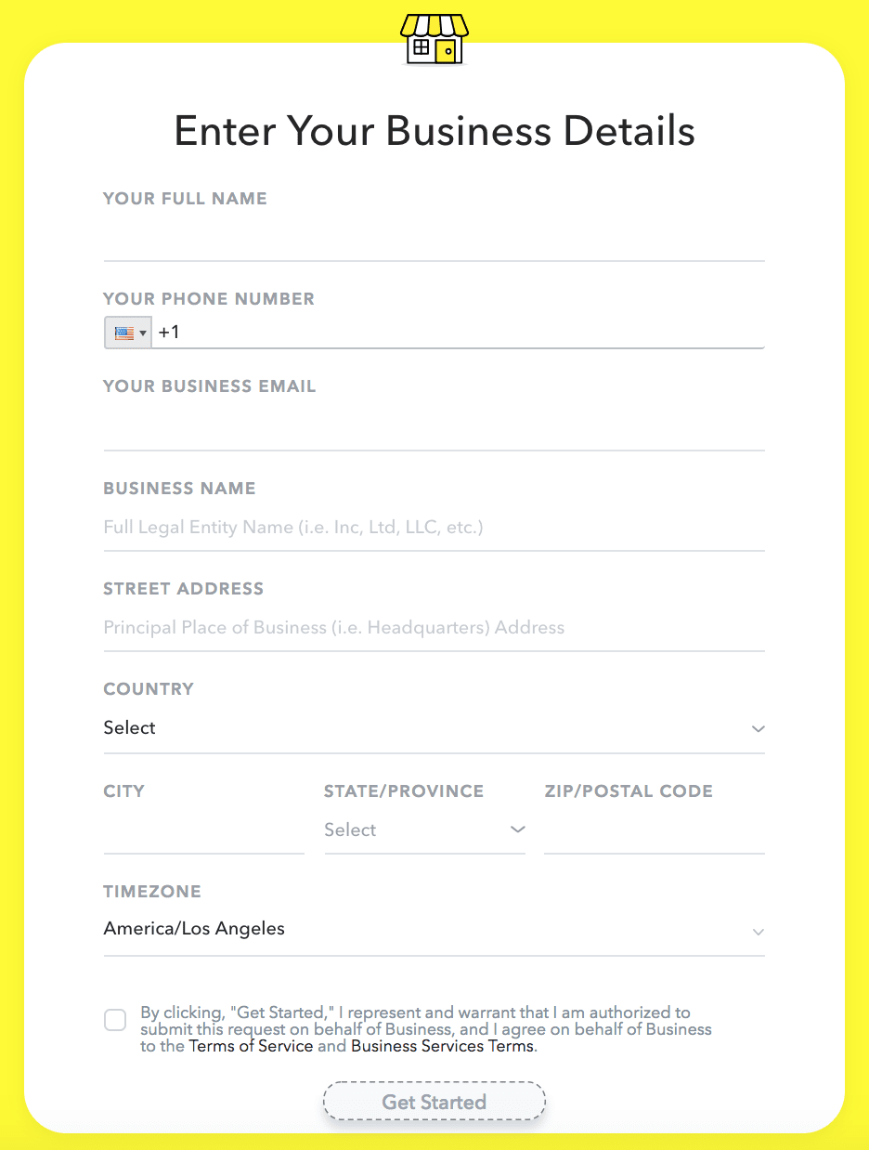
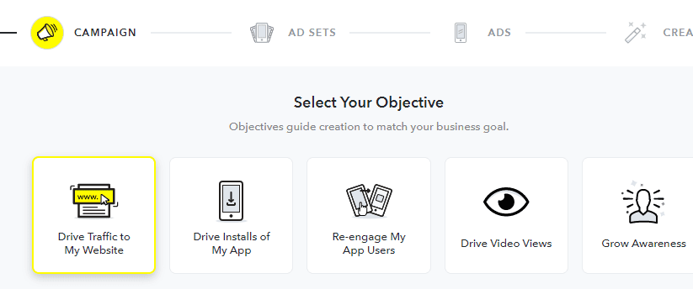
Snap chat ads manager
A Snapchat Business Account is the central hub for managing your brand’s organic presence, team permissions, and paid ad campaigns on Snapchat.
Core Features
Snap Ads Manager
Public Profile for Business
Multi-User Access & Roles:
Snap Pixel & Events Manager
Product Catalog
AR Lens Management

Slide 80
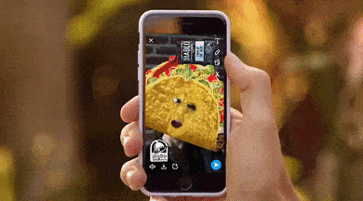
Story Ads
Story Ads allow you to reach Snapchatters by placing a branded tile in Snapchat’s Discover section that opens into a collection of 1 - 10 images or videos.
Story Ads are a great way to get your brand’s message across in an easily consumable fashion, whether that’s showing off a suite of products, releasing a movie, or always-on branding.

Slide 81
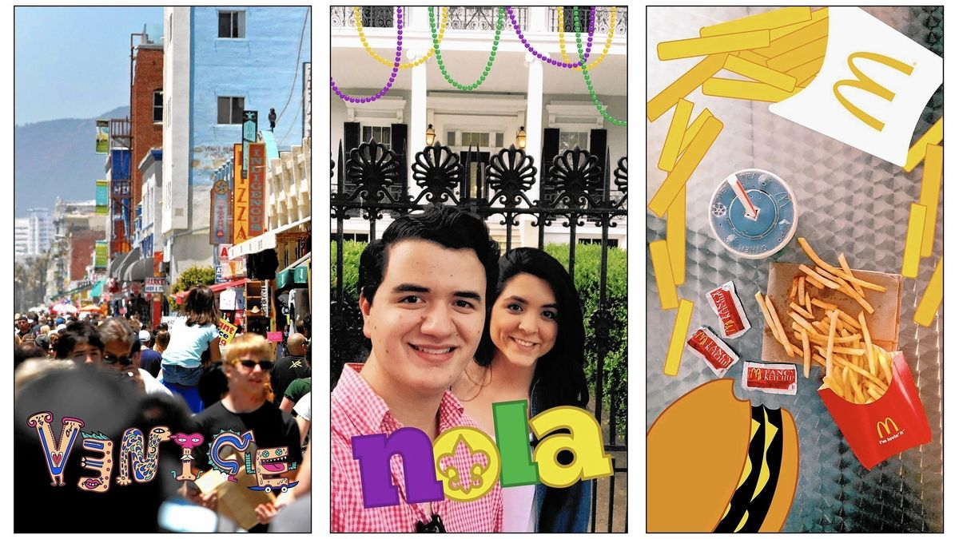
Snapchat Ads
There are three formats represent the foundational advertising units that defined Snapchat's ads.
1. Snapchat Sponsored Geofilters
  What it is: Static graphic overlays that users can apply to their photos or videos after capturing a Snap.
  How it works: They are tied to a specific geographic fence. When users take a Snap within that boundary and swipe left or right, your branded frame or illustration appears.
  Best for: Local retail foot traffic, event activations (concerts, sports events, festivals), conferences, and regional brand awareness.
  Key advantage: High organic reach; when users send a filtered Snap to friends or post it to their Story, your brand gets shared peer-to-peer.

Slide 82
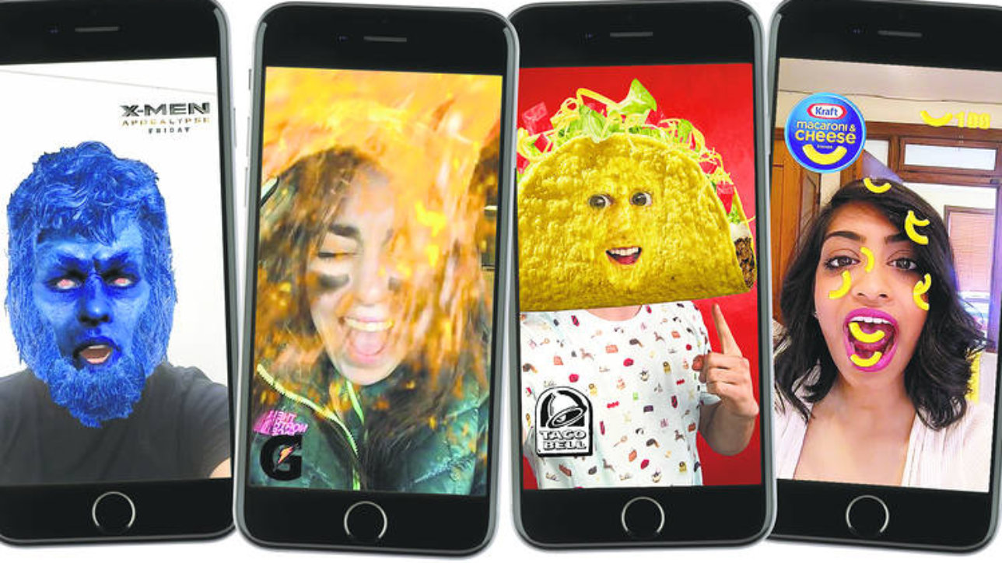
Snapchat Ads (Continue…)
2. Snapchat Sponsored Lenses
  What it is: Interactive, real-time Augmented Reality (AR) experiences that modify a user’s face or environment via the camera.
  Face Lenses: Track facial features to add 3D objects, makeup, character transformations, or interactive prompts .
  World Lenses: Use the rear camera to project 3D branded objects, mascots, or virtual products directly into the user’s physical surroundings.
  Best for: Virtual product try-ons, massive cultural brand moments, and movie/game launches.
  Key advantage: Massive engagement time; users actively play with Lenses rather than passively watching an ad.

Slide 83
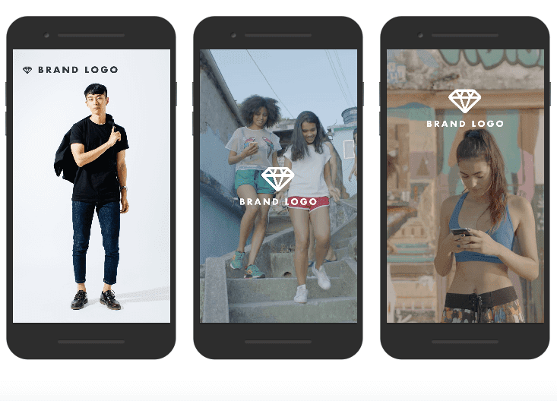
Snapchat Ads (Continue…)
3. Snap Ads (Now often called Single Image/Video Ads)
  What it is: Full-screen, vertical (9:16) video or image ads that play with sound between organic user Stories and publisher content.
  How it works: Typically 3 to 180 seconds long (usually optimized under 10 seconds). They include a swipe-up Call to Action (CTA) at the bottom.
  Web View: Opens a mobile webpage directly inside the app for browsing or e-commerce purchases.
  App Install: Promotes app downloads with a direct link to Google Play or the App Store.
  Long-Form Video: Teases a 10-second hook that swipes up into a full-length trailer or video.
  Best for: Direct-response marketing, lead generation, website traffic, and performance campaigns.

Slide 84
X (Formally Twitter)

Slide 85
Introduction to X Marketing
X marketing refers to using X (formerly Twitter) to promote a brand, product, service, person, or organization.
X is a real-time, conversation-driven social media platform where users share short posts, news, opinions, images, videos, links, and other content.
Unlike platforms that primarily focus on visual discovery, X is strongly centered around conversations, trends, opinions, and timely information.
Businesses can use X through:
  Organic marketing – unpaid posts and engagement.
  Paid advertising – promoted content and X Ads.

Slide 86
Objectives of X Marketing
Brand Awareness: Increase visibility and recognition of the brand.
Engagement: Encourage likes, replies, reposts, quotes, and conversations.
Website Traffic: Drive users to websites, blogs, landing pages, or online stores.
Lead Generation: Generate potential customer inquiries and prospects.
Sales: Promote products, services, offers, and launches.
Customer Service: Respond to customer questions and complaints quickly.
Thought Leadership: Establish expertise in a particular industry or subject.
Community Building: Develop an active community around a brand or topic.

Slide 87
X Marketing Strategy
1. Define Marketing Objectives
Clearly determine what the organization wants to achieve.
Examples:
  Increase followers
  Generate website visits
  Increase product awareness
  Generate leads
  Improve customer engagement
2. Identify Target Audience
  Identify: Age, Location, Interests, Profession, Behaviour, Needs, Problems.
  Understand what type of content the audience consumes and shares.

Slide 88
X Marketing Strategy (Continue…)
3. Optimize the X Profile
An effective business profile should include
  Recognizable profile photo/logo
  Professional banner image
  Clear username
  Concise bio
  Website link
  Location, where relevant
  Relevant keywords
  Consistent brand identity

Slide 89
X Marketing Strategy (Continue…)
4. Develop Content Strategy
Create different types of posts:
  Educational content
  Industry news
  Product updates
  Promotional content
  Threads
5. Engage With the Audience
  Reply to comments.
  Answer questions
  Quote relevant posts.
  Monitor brand mentions.

Slide 90
X Marketing Strategy (Continue…)
6. Use Hashtags
  Use relevant hashtags to improve content discovery.
  Avoid using irrelevant or excessive hashtags.
  Create a branded hashtag when appropriate.
  Monitor trending hashtags before participating.
7. Monitor Performance
Important metrics include
  Impressions
  Engagements
  Link clicks
  Video views
  Profile visits
  Followers

Slide 91
X Advertising / Twitter Ads
X Ads are paid promotional activities used to reach a selected audience beyond organic content.
Businesses can use advertising to achieve objectives such as:
  Awareness
  Website traffic
  Engagement
  Video views
  App promotion
  Leads/conversions

Slide 92
Basic X Advertising Process
1. Create/Access an X Ads Account
  Log in to the organization's X account.
  Access the advertising interface.
  Provide required business and billing information.
2. Define Campaign Objective
  Select the objective according to the desired outcome.
3. Select Target Audience
Audience targeting can be based on factors such as:
  Demographic Targeting
  Interest-Based Targeting
  Behavior/Intent-Based Targeting

Slide 93
WhatsApp for Business

Slide 94
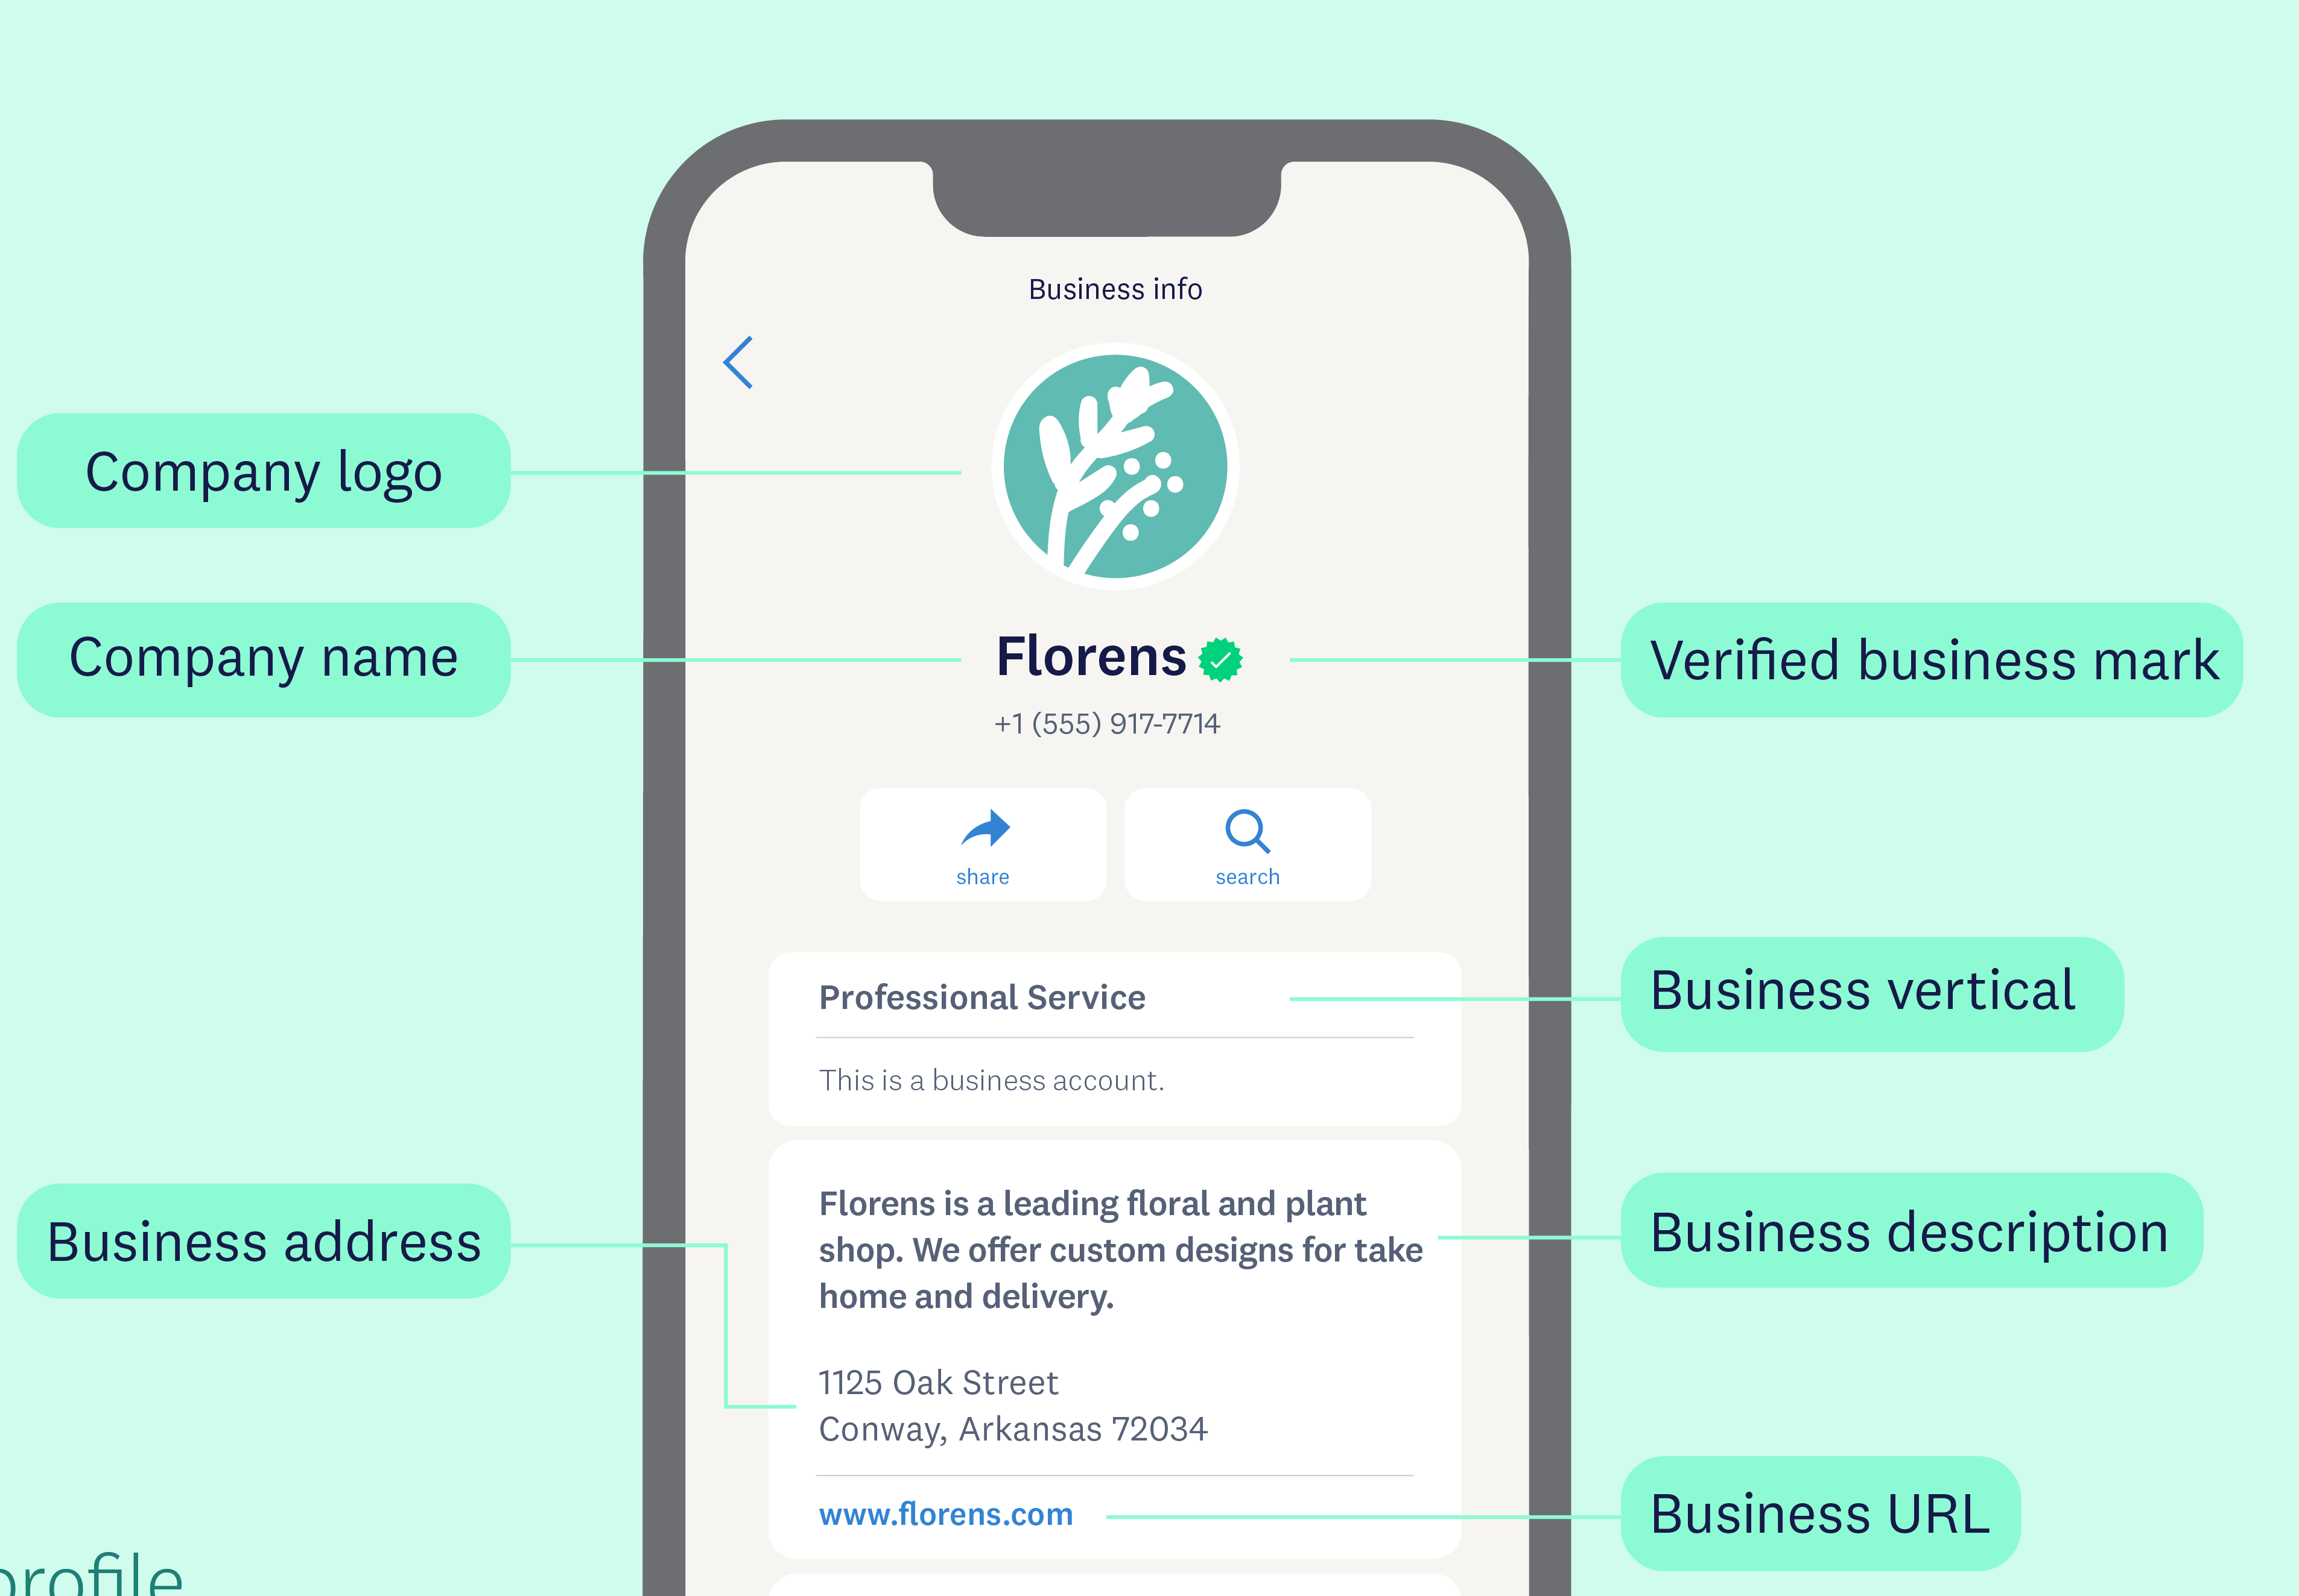
WhatsApp
WhatsApp is a popular messaging application that allows people to communicate instantly over the internet. It was launched in 2009 and is now owned by Meta Platforms.
It enables users to send text messages, voice notes, images, videos, documents, and even make voice and video calls
Company Business profile
on WhatsApp

Slide 95
WhatsApp Versions
The WhatsApp ecosystem is bifurcated into three distinct tiers, each engineered for a specific scale of interaction and technical complexity.
  WhatsApp (Personal): A consumer-facing application designed for private, one-to-one communication. It lacks professional branding, automation, or analytics, making it unsuitable for commercial operations.
  WhatsApp Business App (SMBs): A free-to-use mobile application tailored for micro and small businesses. It allows for a basic business profile, manual product catalogs, and simple automation tools like "Quick Replies.“
  WhatsApp Business API / Platform (Enterprise): A programmable, cloud-based interface designed for medium to large enterprises. It is not a standalone app but a backend solution that requires integration with a CRM or a third-party dashboard. It supports high-volume messaging, advanced AI chatbots, and multi-agent support.

Slide 96
Product Catalog Management
Product Catalog Management is a core feature that transforms a chat interface into a functional e-commerce storefront.
  Product Showcasing: Businesses can upload up to 500 products or services. Each entry includes a title, price, description, website link, and unique product code.
  Media Assets: Supports up to 10 high-definition images or videos per product, allowing for a comprehensive visual demonstration.
  Collections: Organizations can categorize products into specific "Collections" (e.g., "New Arrivals," "Best Sellers") to simplify user navigation.
  Technical Constraint (Compliance): Every item is subject to the WhatsApp Commerce Policy. Products are only visible to customers once they pass an automated review by Meta’s safety systems.

Slide 97
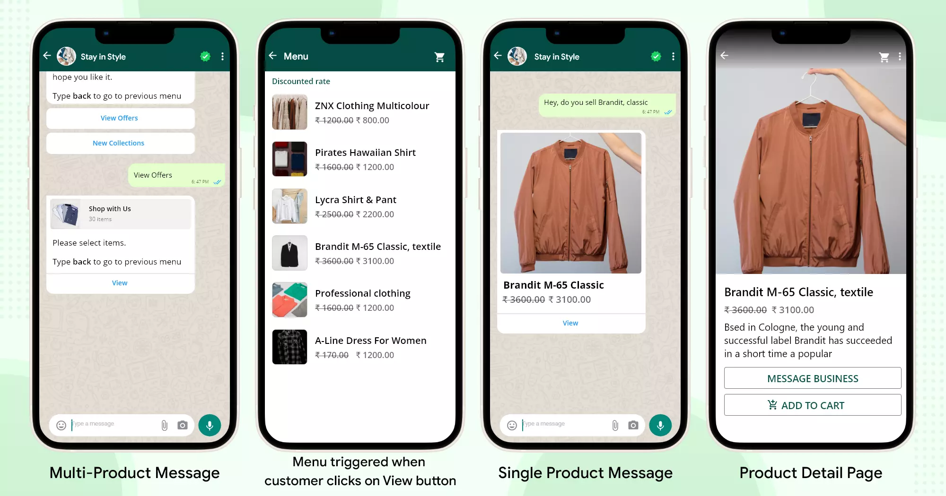
WhatsApp Product Catalog

Slide 98
Seamless Shopping and Conversational ROI
In-Chat Browsing: Customers can browse the entire inventory without leaving the application. This "one-stop" experience reduces the "drop-off" rate often seen when redirecting users to external websites.
Cart Functionality: Users can select multiple items from the catalog, add them to a "Cart," and send the entire order as a single message to the business.

Slide 99
Digital Marketing & SEO
2504MN313
Mr. Prashant Parmar
Darshan Institute of Management
prashant.parmar@darshan.ac.in
9586371604

