Slide 1

Unit 5: Search Engine Optimization (SEO)
CO 5: apply SEO tactics and strategic marketing models to improve organic search rankings.
Digital Marketing & SEO
2505CS313
Mr. Prashant Parmar
Darshan Institute of Management
prashant.parmar@darshan.ac.in
9586371604

Slide 2
Outline
  Foundations of SEO
  Tactics, Ethics, and Optimization
  Ranking and the SERP Process
  Industry Standard SEO Tools


Slide 3
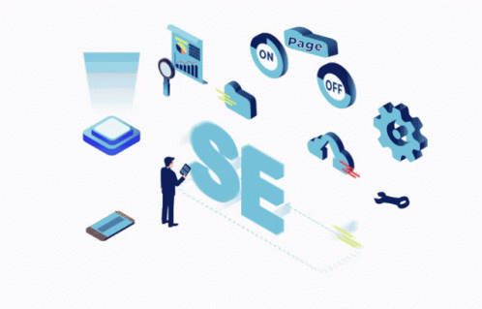
Foundations of SEO
Notes:
Gif Reference: https://encrypted-tbn0.gstatic.com/images?q=tbn:ANd9GcSAgZS4gjlCFFF0V6V5onMupHdGRdFzYKQ20eUOjLXQ&s

Slide 4
Introduction to Search Engine Optimization (SEO)
Search Engine Optimization (SEO) is the systematic process of improving a website's technical configuration, content relevance, and link popularity so its pages become easily findable, more relevant, and popular toward user search queries.
The Concept of "Organic" Traffic: SEO focuses exclusively on unpaid rankings. Unlike paid advertising, which provides temporary visibility, SEO builds a sustainable, long-term digital asset.

Slide 5
Difference Between SEO and SEM
SEO is the act of improving the visibility of a website's outcomes on specific search engines through unpaid forms of online advertising. It is used to increase traffic to a website by improving its rank on the search engine pages.
SEM is the act of improving the visibility of a website outcomes on specific search engines through paid advertisements. It includes Search Engine Optimization, contextual advertising, AdSense, social networking, pay-per-click (PPC), AdWords, and so on.
Reference: https://www.geeksforgeeks.org/techtips/difference-between-seo-and-sem/

Slide 6
The Critical Need for SEO in Modern Business
Visibility and Brand Authority: High rankings on the Search Engine Results Page (SERP) serve as a psychological endorsement. Users perceive top-ranking sites as more trustworthy and authoritative in their respective industries
Sustainable ROI (Return on Investment): While SEO requires an initial investment in time and resources, it does not have a "Cost-Per-Click." Once a page ranks high, it continues to drive traffic 24/7 without additional media spend.
User Experience (UX) Enhancement: Google’s ranking factors—such as page load speed, mobile responsiveness, and intuitive navigation—are synonymous with a high-quality user experience. Optimizing for SEO is, by extension, optimizing for the customer.
The "First Page" Imperative: Data indicates that approximately 75% of users do not click past the first page of search results. In a competitive digital economy, if a business is not on Page 1, it is essentially invisible to its target audience.

Slide 7
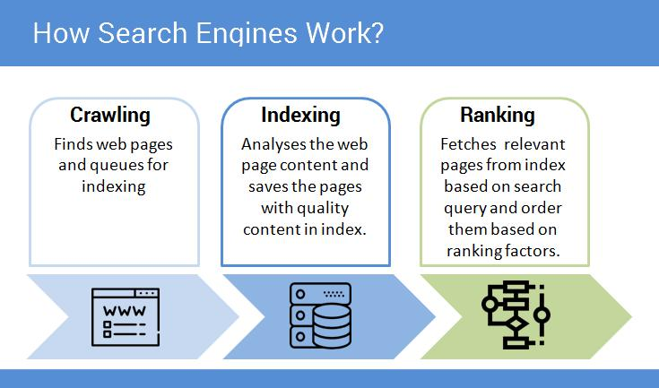
The Three-Stage Process SEO
Crawling (Discovery)
Indexing (Storage)
Ranking (Retrieval)

Slide 8
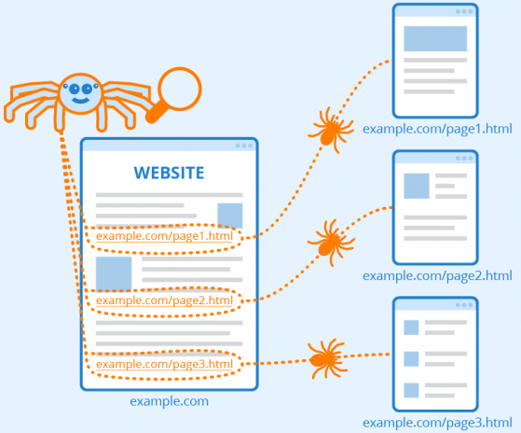
Crawling
Crawling is the first step where search engine bots explore the web by following links between pages. These bots continuously scan billions of websites to discover new content and updates. Website owners can guide crawler behavior using the robots.txt file, which restricts or allows access to certain pages.
Uses bots (spiders/crawlers) to scan websites
Follows links from one page to another
Identifies new and updated content

Slide 9
Indexing
After crawling, search engines process and store the information in a structured database called the search index. During indexing, the system analyzes page content, keywords, images, and metadata to understand the topic of the page. If a webpage is not indexed, it will not be visible in search results.
Analyzes content (text, images, metadata)
Stores data in a search index database
Uses keyword extraction and categorization
Only indexed pages appear in results

Slide 10
Ranking
Ranking is the final stage where the search engine decides the order of results shown to users. When a query is entered, the algorithm evaluates hundreds of factors to determine relevance and quality. The goal is to present the most useful and accurate information at the top of the results page.
Matches user query with indexed data
Uses algorithms to rank results
Considers multiple factors:
  Keywords
  Backlinks
  Page speed
  User experience
  Location

Slide 11
Tactics, Ethics, and Optimization
Notes:
Gif Reference: https://encrypted-tbn0.gstatic.com/images?q=tbn:ANd9GcSAgZS4gjlCFFF0V6V5onMupHdGRdFzYKQ20eUOjLXQ&s

Slide 12
SEO Tactics & Methods
White Hat SEO (Ethical/Sustainable)
  White Hat SEO refers to ethical optimization techniques that prioritize user satisfaction over search engine manipulation. These methods ensure that content is valuable, accessible, and relevant. Although results may take time, they provide long-term stability and build trust with both users and search engines.
  Key methods: High-quality content creation, Site speed optimization, Mobile-friendly design, Organic link building
  Outcome: Long-term, stable rankings, No risk of penalties, Strong brand credibility.

Slide 13
SEO Tactics & Methods
Black Hat SEO
  Black Hat SEO involves unethical practices designed to trick search engines into ranking a website higher. These techniques exploit loopholes in algorithms but do not provide real value to users. While they may deliver quick results, they are highly risky and often lead to severe consequences.
  Common techniques: Keyword stuffing, Cloaking, Private Blog Networks
  Outcome: Fast but temporary results, High risk of penalties, Possible permanent removal

Slide 14
SEO Tactics & Methods
Grey Hat SEO
  Grey Hat SEO includes practices that operate in a legal but ethically uncertain space. These techniques may work temporarily but carry potential risks, especially as search engine algorithms evolve. What is acceptable today may become penalized in the future.
  Examples: Buying expired domains, Redirecting authority, Aggressive automation
  Outcome: Moderate risk, Uncertain long-term sustainability, May turn into Black Hat over time.

Slide 15
SEO Tactics & Methods
Content Relevance: The cornerstone of SEO. Content must satisfy the user’s "Search Intent" and be comprehensive, original, and updated.
On-Page Optimization
  On-page SEO refers to the elements you control directly on your website to help search engines understand your content.
  HTML Elements (Structural Tags)
    Title Tags: The most important on-page element. It should be less then 60 characters and include the primary keyword.
    Meta Descriptions: A brief summary of the page shown on the SERP. While not a direct ranking factor, it heavily influences Click-Through Rate (CTR).
    Header Tags (H1-H6): Organizing content hierarchically. H1 is for the main title, H2 for sub headers, etc.
  URL Structure: URLs should be "Slug-based" and human-readable.
  Image Alt-Text: Textual descriptions of images.
    Technical value: Help bots see the image
    Accessibility: Allows scree readers to describe the image.

Slide 16
SEO Tactics & Methods
Content Relevance: The cornerstone of SEO. Content must satisfy the user’s "Search Intent" and be comprehensive, original, and updated.
Off-Page Optimization
  Off-page SEO involves activities taken outside of your own website to impact your rankings within search engine results pages.
  Backlinks (The Vote of Confidence)
    Links from one website to another. Google views these as "votes" of authority.
    A single link from a high-authority site (like an educational or a major news outlet) is worth more than hundreds of low-quality links.
    Anchor Text: The clickable text in a hyperlink; it helps search engines understand the context of the linked page.
  Social Signals: While not a direct ranking factor, frequent shares and mentions on platforms like LinkedIn or X (Twitter) indicate content relevancy and drive traffic, which indirectly boosts SEO.
  Local SEO (Geo-Targeting) Google Business Profile Essential for local businesses to appear in the Map Pack.

Slide 17
Ranking and the SERP
Notes:
Gif Reference: https://encrypted-tbn0.gstatic.com/images?q=tbn:ANd9GcSAgZS4gjlCFFF0V6V5onMupHdGRdFzYKQ20eUOjLXQ&s

Slide 18
Understanding SEO Ranking & Factors
In the context of SEO, ranking refers to the specific position a URL occupies on the Search Engine Results Page (SERP) for a given query. A "Number 1" ranking implies that the page is the first organic result displayed after the advertisements and SERP features.
The Primary Ranking Pillar: Relevance
  Google’s algorithm analyzes whether the content provides a direct and comprehensive solution to the user’s query.
  Modern search engines do not just match keywords; they use Natural Language Processing (NLP) to understand the context and relationships between concepts.

Slide 19
Understanding SEO Ranking & Factors
The Authority Pillar: Domain Authority (DA) & Backlinks
  Backlink Profile: Authority is largely determined by the "Link Equity" passed from other reputable websites.
  Domain Authority (Moz): A predictive score (1–100) that estimates a website's ability to rank based on its cumulative link strength and historical trustworthiness.
The Infrastructure Pillar: Technical Health & Core Web Vitals
  Core Web Vitals: A set of specific factors that Google considers important in a webpage's overall user experience.
    LCP (Largest Contentful Paint): Measures loading performance (Target: less then 2.5 seconds).
    INP (Interaction to Next Paint): Replaced FID in 2024 to measure responsiveness to user actions (Target: less then 200 ms).
    CLS (Cumulative Layout Shift): Measures visual stability (Target: score < 0.1)
  Mandatory use of HTTPS to protect User data.

Slide 20
Search Engine Result page (SERP)
Query Analysis & Classification
  The search engine first classifies the user's "Search Intent" to determine what type of content to display.
    Informational (Know): The user is looking for knowledge or an answer to a question (e.g., "What is the green transition?").
    Navigational (Go): The user wants to reach a specific website or physical location (e.g., "Darshan University login").
    Transactional (Do/Buy): The user is ready to make a purchase or complete a task (e.g., "Buy SEMrush subscription").

Slide 21
Search Engine Result Page (SERP)
The Modern SERP Landscape
  Key SERP Features
    Featured Snippets ("Position Zero"): A direct answer extracted from a webpage and displayed at the very top. It is designed to provide immediate utility for informational queries.
    Knowledge Panels: Information boxes that appear on the right side of the screen for entities (people, places, organizations). The data is pulled from the Knowledge Graph, not just a single website.
    Local Pack: A localized feature displaying a map and a list of three businesses relevant to the user’s location. This is critical for driving physical footfall.
    AI Overviews (2026): Algorithmic summaries generated by AI that synthesize information from multiple top-ranking sources into a single, cohesive response at the top of the SERP.

Slide 22
Industry Standard SEO Tools
Notes:
Gif Reference: https://encrypted-tbn0.gstatic.com/images?q=tbn:ANd9GcSAgZS4gjlCFFF0V6V5onMupHdGRdFzYKQ20eUOjLXQ&s

Slide 23
SEMrush Keyword Research
SEMrush facilitates the identification of high-value search terms by providing data on Monthly Search Volume (MSV) and Keyword Difficulty (KD%).
Competitor Analysis
  Allows marketers to view the exact keywords for which competitors are ranking.
  Provides estimates of organic traffic and the monetary value of that traffic.
Site Audit (Technical Health Check)
  Automatically scans websites to identify "Crawl Errors," such as broken links (404s).
  Detects performance issues like slow-loading pages and duplicate content that may trigger search engine penalties.

Slide 24
Moz (The Authority Benchmark)
Moz Domain Authority (DA) is a search engine ranking score developed by Moz that predicts how likely a website is to rank in search engine results pages (SERPs). Ranging from 1 to 100, a higher DA score indicates a greater ability to rank. It is a comparative metric, not a direct Google ranking factor, based on link data
DA is calculated by evaluating multiple factors, primarily the number of linking root domains, total backlinks, and Moz's Spam Score.
It uses a logarithmic scale (1–100). It is much easier to increase your score from 10 to 20 than from 70 to 80.
It is designed to be a competitive metric to compare your website's strength against competitors.

Slide 25
Ahrefs
Ahrefs is a comprehensive, subscription-based SEO and digital marketing platform used for competitor research, backlink analysis, keyword research, and website audits. It boasts one of the largest web crawlers, providing real-time data to help users improve organic search rankings, analyze traffic, and plan marketing strategies.
Site Explorer: Allows in-depth analysis of any website’s organic traffic, paid search ads (PPC), and backlink profile.
Keywords Explorer: Provides extensive data on search volume, keyword difficulty, and ranking ideas across multiple search engines.
Content Gap Analysis: A strategic tool that identifies specific topics or keywords where competitors are gaining traffic, but the user's website is currently missing content.

Slide 26
Digital Marketing & SEO
2504MN313
Mr. Prashant Parmar
Darshan Institute of Management
prashant.parmar@darshan.ac.in
9586371604

