Slide 1

Unit-02
Introduction to AR/VR
Introduction to Advanced Technologies (2305CS302)
CO2 : At the end of this course, students will be able to,
explain the fundamentals of AR/VR technologies and
hardware design for AR/VR applications
Prof. Vaseem Ghada
Master of Computer Application
vaseem.ghada@darshan.ac.in
9879531513

Slide 2

Outline
Basics of AR/VR
Technology and features of augmented reality and virtual reality
Comparison of AR and VR
Challenges with AR and VR
AR systems and functionality
Visualization techniques for augmented reality
Enhancing interactivity in AR environments
Evaluating AR systems
Real-time computer graphics
Flight simulation
Virtual environment requirement
Benefits of virtual reality and augmented reality
Disadvantages of virtual reality and augmented reality
Application of AR/VR
Looping

Slide 3
Basics of AR/VR
Section - 1

Slide 4
What are AR, VR and XR?
Modern technologies create digital experiences that interact with the real world or create artificial worlds.
The three important technologies are:
  AR – Augmented Reality
  VR – Virtual Reality
  XR – Extended Reality
Technology | Meaning | What the user sees
AR | Augmented Reality | Real world + digital objects
VR | Virtual Reality | Completely virtual world
XR | Extended Reality | Umbrella term covering AR, VR and related technologies

Slide 5
What are AR, VR and XR?
Easy exampleImagine you are learning about the human heart.
  AR:You point your mobile camera at a textbook and a 3D beating heart appears on the book.
  VR:You wear a VR headset and enter a virtual human body, where you can examine the heart from inside.
  XR:XR refers broadly to technologies that combine or extend real and virtual experiences.

Slide 6
Augmented Reality (AR)
Augmented Reality is a technology that adds computer-generated digital information or objects to the real-world environment.
The important point is AR does not completely replace the real world; it enhances it.
Common AR devices
  Smartphones
  Tablets
  AR glasses
  Smart glasses
  Head-mounted displays
Example:
📱
REAL ROOM
+ 🪑 3D CHAIR
+ Price / Information

Slide 7
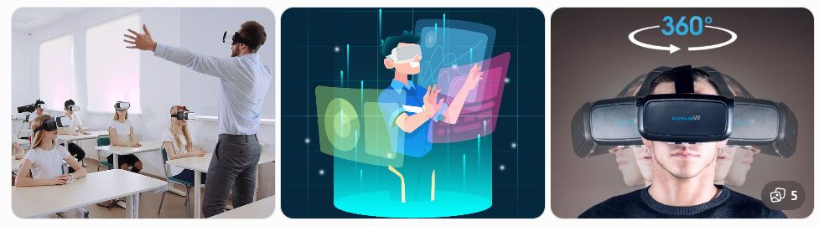
Virtual Reality (VR)
Virtual Reality is a technology that creates a computer-generated environment in which the user can feel immersed and interact with a virtual world.
Unlike AR, VR attempts to replace the user's view of the real world
Example:
  A medical student can wear a VR headset and enter a virtual operating room.
  Examine virtual organs
  Practice surgery
  Interact with virtual equipment
  Practice without risk to a real patient

Slide 8
What is XR?
XR is a term used for “extending” our reality with the help of technology. It is essentially an umbrella term for all the immersive technologies, the ones we already have today – Augmented Reality (AR), Virtual Reality (VR), and Mixed Reality (MR) – plus the ones still to be created.
These immersive technologies transform the reality we experience by either blending the real, digital, and virtual worlds or by creating a new world altogether. A metaverse, considered to be the next generation of the internet, is a virtual environment where users can interact with each other in a digital space, similar to the real world.
It defines a collective sharing space by combining physical reality.
The metaverse is a massively scalable, persistent network of interconnected virtual worlds focused on real-time interaction where people can work, socially interact, transact, play and even create. Unlike our universe, we can have more than one metaverse.

Slide 9
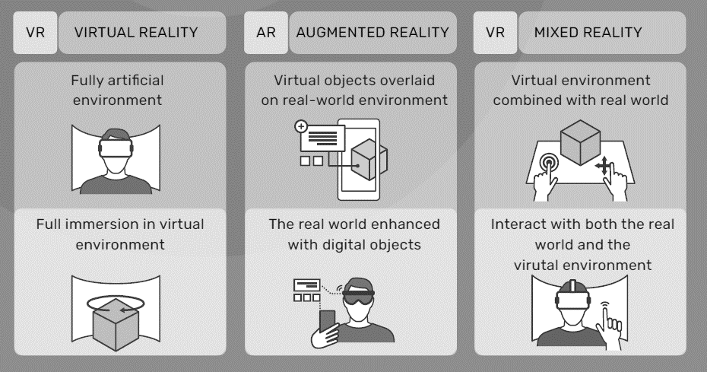
AR-VR-MR

Slide 10
comparison of AR and VR
Section - 2

Slide 11
Comparison of AR, VR, and XR
Features | AR | VR | XR
Full form | Augmented Reality | Virtual Reality | Extended Reality
Real world visible | Yes | Generally no | Depends on technology
Digital objects | Added to real world | Entire environment is digital | Real + digital
Immersion | Low to medium | High | Varies
Typical device | Smartphone/AR glasses | VR headset | AR/VR/MR devices
Example | Pokémon GO | VR gaming | Industrial XR
Main purpose | Enhance reality | Simulate reality | Extend interaction between real & virtual

Slide 12
AR Vs VR
User Interaction:
  AR: Users can interact with both the virtual and physical worlds simultaneously. AR applications typically involve recognizing real-world objects and providing relevant digital information or interactive elements.
  VR: Users are entirely immersed in the virtual environment. Interactions are limited to the virtual space and are often achieved through controllers, gestures, or other input devices.
Hardware Requirements:
  AR: AR experiences can be delivered through devices like smartphones, tablets, smart glasses, or headsets with cameras and sensors for recognizing the user's environment.
  VR: VR requires head-mounted displays (HMDs) that cover the user's eyes and ears, fully blocking out the real world. These headsets often come with motion-tracking capabilities and controllers.

Slide 13
AR Vs VR
Immersion:
  AR: AR preserves the user's awareness of the real world, as digital content is superimposed on it. The level of immersion is generally lower than VR.
  VR: VR offers a high level of immersion as users are fully surrounded by the virtual environment, leading to a more immersive and sometimes isolating experience.
Use Cases:
  AR: AR finds applications in a wide range of fields, including gaming, navigation, education, marketing, and industrial training. It is particularly useful for enhancing real-world experiences with additional information or interactive elements.
  VR: VR is commonly used in gaming, simulation, training, education, architectural visualization, and entertainment. It allows users to experience scenarios and environments that might not be feasible or safe in the real world.

Slide 14
Challenges with AR and VR
Section - 3

Slide 15
Challenges with AR and VR
Hardware Limitations:
  Both AR and VR rely on specialized hardware, such as headsets and sensors, to deliver immersive experiences. These devices can be expensive, bulky, and may require substantial computing power. Improving the affordability, comfort, and portability of these devices remains a challenge.
User Experience:
  Achieving a seamless and realistic user experience is crucial for the success of AR and VR applications. Issues like motion sickness, latency, and tracking accuracy can negatively impact the overall user experience and need to be minimized.
Content Creation:
  Creating compelling and engaging content for AR and VR can be complex and time-consuming. Developers need to consider factors like spatial mapping, 3D modeling, and real-time rendering to ensure high-quality experiences.

Slide 16
Challenges with AR and VR
Interaction Design:
  Designing intuitive and natural ways for users to interact with AR and VR environments is challenging. Developing user interfaces that work seamlessly within these immersive contexts is an ongoing area of research and improvement.
Safety Concerns:
  In VR, users are fully immersed in a virtual world, which can lead to potential safety hazards if they are not aware of their physical surroundings. Ensuring user safety while using VR is a critical challenge.
Privacy and Security:
  AR and VR applications often collect and process a significant amount of user data, which raises concerns about privacy and security. Protecting user information and preventing unauthorized access to personal data is essential.

Slide 17
Challenges with AR and VR
Content Accessibility:
  Ensuring that AR and VR experiences are accessible to people with disabilities can be challenging. Designing inclusive experiences that cater to individuals with visual, auditory, or mobility impairments requires careful consideration.
Social Acceptance and Adoption:
  AR and VR are still relatively new technologies, and some people may be hesitant to adopt them due to concerns about social isolation, privacy, or potential adverse effects on health. Increasing public awareness and acceptance is a challenge.
Connectivity and Bandwidth:
  High-quality AR and VR experiences often require robust internet connectivity and high bandwidth. In areas with limited internet infrastructure, delivering a smooth and immersive experience can be challenging.

Slide 18
AR-VR systems and functionality
Section - 4

Slide 19
AR-VR systems and functionality
AR-VR system
Head-Mounted Display (HMD): The HMD is a wearable device that is worn on the user's head, covering their eyes and ears. It typically consists of two screens or lenses, one for each eye, to provide a stereoscopic view. The HMD is a critical component that delivers visual and auditory stimuli to immerse the user in the AR or VR environment.
Cameras and Sensors: For AR capabilities, the MR system includes cameras and sensors to capture the user's real-world environment. These cameras collect data about the user's surroundings and track their movements, enabling the system to overlay virtual content accurately onto the physical world.
Motion Tracking: The MR system uses motion tracking technology to monitor the user's head and body movements. This ensures that the virtual content aligns correctly with the user's perspective, providing a more realistic and immersive experience.
Processing Unit: A powerful processing unit, often integrated into the HMD or connected to the system, handles the real-time rendering of the virtual content and other computations required for a smooth AR or VR experience.

Slide 20
AR-VR systems and functionality
User Input Devices: MR systems include various user input devices, such as controllers, hand gestures, voice recognition, and other peripherals that allow users to interact with the virtual environment or control the system.
Content Management and Rendering Software: The MR system relies on specialized software to manage and render AR and VR content. This software handles spatial mapping, object recognition, and overlays virtual content onto the real world for AR or creates fully immersive virtual environments for VR.
Interaction and User Interface Design: MR systems require intuitive and user-friendly interaction designs to ensure that users can seamlessly navigate between the real and virtual worlds. Creating effective user interfaces for MR is an ongoing area of research and development.

Slide 21
AR-VR systems and functionality
AR-VR Functionality
  The functionality of Augmented Reality (AR) and Virtual Reality (VR) differs significantly due to their distinct approaches to blending virtual and real-world experiences. Here's an overview of the functionality of each technology:
Overlaying Virtual Content: AR technology superimposes digital content, such as images, videos, 3D models, and text, onto the user's real-world environment. Users can see and interact with both virtual elements and physical objects simultaneously.
Real-time Interaction: AR applications enable users to interact with virtual objects in real-time. Users can manipulate and control digital content, triggering responses based on their actions in the physical world.

Slide 22
AR-VR systems and functionality
Functionality of Augmented Reality (AR):
Contextual Information: AR recognizes the user's surroundings, such as objects, locations, or scenes, and provides relevant information or context-specific data in real-time. This feature is especially useful for navigation, tourism, or product information.
Spatial Mapping: AR systems use sensors and cameras to understand the physical space and anchor virtual content to specific points in the environment. This ensures that virtual elements stay in place relative to real-world objects, enhancing the sense of realism.

Slide 23
AR-VR systems and functionality
Functionality of Virtual Reality (VR):
Immersive Experience: VR aims to fully immerse users in a computer-generated environment, entirely replacing their real-world surroundings. Users wear head-mounted displays (HMDs) to block out the real world and immerse themselves in the virtual environment.
Simulating Virtual Environments: VR creates computer-generated worlds, enabling users to explore and interact with these environments as if they were physically present. Users can move around and interact with objects in the virtual space.
Presence and Telepresence: VR technology provides a strong sense of presence, making users feel like they are physically inside the virtual environment. It can also facilitate telepresence, enabling users to feel as if they are in a different physical location.
Interactivity: VR environments are interactive, allowing users to engage with objects and perform actions using specialized controllers, gestures, or other input devices.

Slide 24
Visualization techniques
Section - 5

Slide 25
Visualization techniques
Visualization Techniques for Augmented Reality (AR):
Marker-based AR: This technique uses specific markers or visual cues in the real world to trigger the display of virtual content. When the AR system recognizes these markers through cameras and sensors, it overlays relevant virtual objects on top of them.
Marker less AR: Also known as SLAM (Simultaneous Localization and Mapping), this technique allows AR applications to recognize and track real-world objects and scenes without the need for specific markers. SLAM technology uses computer vision algorithms and sensors to map the environment and anchor virtual content accordingly.
Projection-based AR: This technique projects virtual content directly onto physical objects or surfaces, creating a seamless integration between the real and virtual worlds. Projection-based AR can be used for interactive displays, art installations, and advertising.
Spatial Mapping: AR systems use spatial mapping techniques to understand the physical environment and create a 3D map of the surroundings. This enables virtual objects to interact realistically with the real-world environment and align properly with physical objects.

Slide 26
Visualization techniques
Visualization Techniques for Virtual Reality (VR)
3D Rendering: VR relies heavily on 3D rendering techniques to create realistic virtual environments. High-quality 3D rendering ensures that virtual objects and environments appear visually appealing and immersive.
Stereoscopic Rendering: VR headsets provide separate images for each eye, creating a stereoscopic 3D effect. Stereoscopic rendering enhances depth perception and contributes to a more convincing sense of presence.
Field of View (FOV): The FOV defines the extent of the virtual environment that a user can see through the VR headset. Expanding the FOV enhances immersion and reduces the perception of a "screen-door effect“.
Texturing and Lighting: Texturing and lighting techniques are crucial for creating visually compelling virtual environments. Realistic textures and lighting enhance the sense of realism and create a more immersive experience.

Slide 27
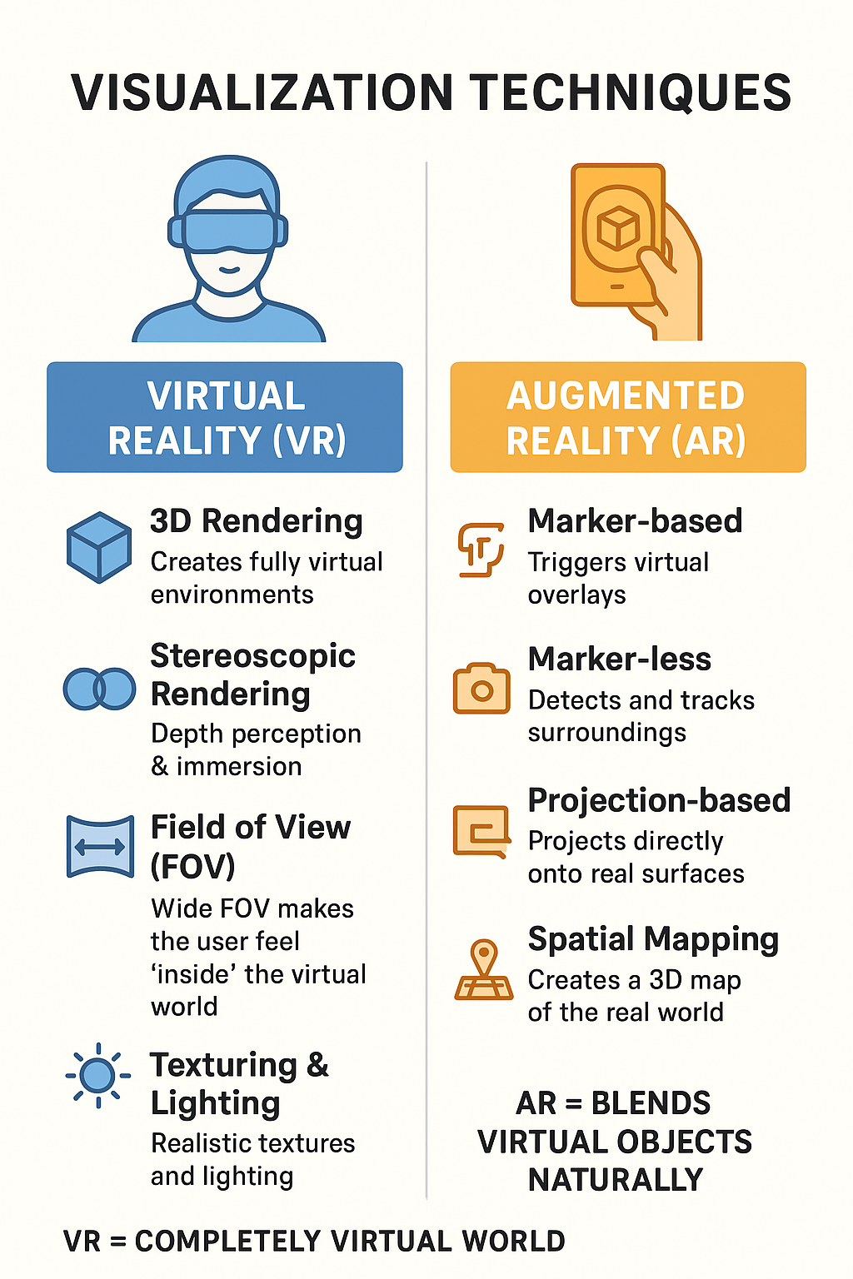
Visualization techniques
Virtual Reality (VR) | Augmented Reality (AR)
Uses 3D rendering to create fully virtual environments. | Uses markers (images/objects) to trigger virtual overlays.
Shows separate images to each eye for depth perception and immersion. | Uses SLAM (marker-less) to detect and track surroundings without markers.
A wide FOV makes the user feel “inside” the virtual world. | Projection-based AR projects digital content directly onto real surfaces.
Realistic textures and lighting make VR scenes look natural and immersive. | Spatial mapping creates a 3D map of the real world so virtual objects align properly.
To build a completely virtual world that feels real. | To blend virtual objects naturally into the real world.

Slide 28
Enhancing interactivity in AR-VR environments
Section - 6

Slide 29
Enhancing interactivity in AR-VR environments
Enhancing interactivity in AR-VR environments is crucial for creating more engaging and immersive user experiences. Here are some techniques and strategies to improve interactivity in AR-VR environments:
Natural User Interfaces (NUIs): Implement intuitive and natural user interfaces that allow users to interact with AR-VR environments using familiar gestures, voice commands, or other natural movements. NUIs make the interaction more intuitive and reduce the learning curve for users.
Hand and Gesture Tracking: Enable accurate hand and gesture tracking to allow users to interact with virtual objects in a more tactile and realistic manner. This can include grabbing, dragging, rotating, and resizing virtual content with their hands.
Spatial Interaction: Design AR-VR environments that respond to users' physical movements and positions. Users can move closer to or farther away from virtual objects, lean in to inspect details, or walk around them to explore from different angles.

Slide 30
Enhancing interactivity in AR-VR environments
Object Interaction: Allow users to interact with virtual objects by touching, manipulating, or even assembling them. Users can pick up, rotate, and move virtual objects as if they were interacting with physical objects.
Haptic Feedback: Integrate haptic feedback into AR-VR experiences to provide users with a sense of touch and tactile feedback when interacting with virtual objects. Haptic feedback enhances the feeling of presence and realism.
Multi-User Interaction: Enable collaborative experiences where multiple users can interact with the same AR-VR environment simultaneously. This fosters social engagement and cooperation, making the experience more interactive and enjoyable.
User-Created Content: Allow users to create and customize virtual content within the AR-VR environment. Providing tools for content creation and personalization empowers users and increases engagement.

Slide 31
Enhancing interactivity in AR-VR environments
Interactive Storytelling: Design narratives and experiences that respond to user interactions, giving users a sense of agency and influence over the AR-VR environment's outcome.
Real-time Feedback: Provide immediate and meaningful feedback to users' interactions. This feedback can be visual, auditory, or haptic, reinforcing the sense of presence and responsiveness within the environment.
AI and User Adaptation: Implement artificial intelligence algorithms to adapt the AR-VR environment based on user behavior and preferences. AI can personalize the experience and optimize interactivity based on individual user interactions.
By implementing these techniques and strategies, developers can create AR-VR environments that offer enhanced interactivity, leading to more enjoyable and immersive user experiences. The continuous improvement of hardware and software technologies will also play a significant role in advancing interactivity in AR-VR environments.

Slide 32
Evaluating AR-VR systems
Section - 7

Slide 33
Evaluating AR-VR systems
Evaluating AR-VR systems is essential to determine their effectiveness, user experience, and overall performance. Here are some key aspects to consider when evaluating AR-VR systems:
User Experience (UX): Assess the user experience by gathering feedback from users who have used the AR-VR system. Consider factors such as ease of use, intuitiveness of interaction, comfort, and overall satisfaction.
Immersion: Evaluate the level of immersion provided by the AR-VR system. A more immersive experience should make users feel fully engaged and present in the virtual environment.
Realism: Examine the realism of the virtual content and interactions. High-quality visuals, realistic animations, and accurate physics contribute to a more convincing experience.
Performance: Analyze the performance of the AR-VR system, including frame rates, latency, and responsiveness. Smooth performance is crucial to prevent motion sickness and maintain a sense of presence.
Tracking Accuracy: Evaluate the accuracy of the system's tracking, both for head and body movements in VR and object recognition in AR. Precise tracking enhances the realism and interaction.

Slide 34
Evaluating AR-VR systems
Content Quality: Assess the quality and variety of AR and VR content available in the system. High-quality content is essential for keeping users engaged and interested in the experience.
Interactivity: Evaluate the level of interactivity provided by the AR-VR system. The system should allow users to interact with virtual objects and environments seamlessly and intuitively.
User Safety: Ensure that the AR-VR system considers user safety. Users should be aware of their physical surroundings in both AR and VR environments to prevent accidents.
Comfort and Ergonomics: Assess the comfort and ergonomics of the hardware, such as headsets and controllers, to ensure extended use does not cause discomfort or fatigue.
Application and Use Cases: Consider the specific use cases and applications for which the AR-VR system is designed. Evaluate how well the system meets the requirements and objectives of these applications.
Cost-Effectiveness: Consider the cost-effectiveness of the AR-VR system, including the hardware, software, and content. Balance the system's capabilities with the budget and intended use.

Slide 35
Real-time computer graphics in AR-VR
Section - 8

Slide 36
Real-time computer graphics in AR-VR
Real-time computer graphics play a crucial role in delivering immersive and interactive experiences in Augmented Reality (AR) and Virtual Reality (VR) environments.
These graphics techniques enable the rendering and display of virtual content in real-time, ensuring that users can interact with the AR-VR environments without noticeable delays or lags.
Here are some key real-time computer graphics techniques used in AR-VR:
Rendering Engines: Real-time rendering engines are the backbone of AR-VR systems. These engines use advanced algorithms and optimizations to generate high-quality graphics at interactive frame rates, typically 30 frames per second or higher. Examples of real-time rendering engines used in AR-VR include Unity3D, Unreal Engine, and OpenGL.
Shading and Lighting: Real-time shading techniques, such as Phong shading, Gouraud shading, or more advanced physically-based rendering (PBR), are used to compute how light interacts with virtual objects and surfaces. These techniques simulate lighting effects in real-time, creating realistic and visually appealing environments.

Slide 37
Real-time computer graphics in AR-VR
Level of Detail (LOD): In AR-VR, objects at varying distances from the user need different levels of detail to maintain performance. LOD techniques adjust the complexity of 3D models based on the user's distance, ensuring efficient use of resources and consistent performance.
Occlusion Culling: AR-VR environments often involve a mix of real-world and virtual objects. Occlusion culling techniques determine which virtual objects are visible to the user, considering occlusions caused by real-world objects, and only render the necessary content, saving computational resources.
Texturing: Real-time texture mapping and compression techniques allow high-resolution textures to be applied to virtual objects without significant performance impact. This enhances the visual quality of the AR-VR experience.
Dynamic Shadows: Real-time shadow mapping techniques create dynamic shadows cast by virtual objects and real-world elements. This enhances the sense of depth and realism in AR-VR environments.
Post-Processing Effects: Post-processing effects, like bloom, motion blur, and depth of field, are applied to the rendered images to enhance visual quality and cinematic feel in real-time.

Slide 38
Real-time computer graphics in AR-VR
Particle Systems: Particle systems are used to create dynamic effects such as smoke, fire, water splashes, and explosions in AR-VR environments. These effects add realism and interactivity to the virtual scenes.
Stereoscopic Rendering: For VR, real-time stereoscopic rendering techniques are used to create separate images for each eye, providing a sense of depth and three-dimensionality.
Real-time computer graphics in AR-VR are continually evolving with advancements in hardware and software technologies, enabling increasingly realistic and immersive experiences for users.

Slide 39
Flight simulation AR-VR
Section - 9

Slide 40
Flight simulation ARVR
Flight simulation in the context of Augmented Reality (AR) and Virtual Reality (VR), often referred to as AR-VR flight simulation, is a cutting-edge application that combines the realism of flight simulation with the immersive capabilities of AR and VR technologies.
It offers pilots and aviation enthusiasts an even more engaging and authentic experience by leveraging the benefits of AR and VR in the flight training and entertainment industries.
Here's how AR and VR enhance flight simulation:
AR Flight Simulation:
Real-world Overlay: AR flight simulation overlays virtual flight instruments, navigation data, and other critical information onto the pilot's real-world view. This allows pilots to practice flying using AR glasses or a transparent AR display while still seeing the actual cockpit and environment.
Enhanced Situational Awareness: AR provides pilots with real-time information, such as altitude, airspeed, and navigation waypoints, without the need to shift their focus to the instrument panel. This improves situational awareness and safety during flight.

Slide 41
Flight simulation ARVR
Training Scenarios: AR can recreate various training scenarios, such as emergency procedures, instrument approaches, and navigational exercises, while keeping the pilot engaged with their real surroundings.
VR Flight Simulation:
Immersive Cockpit Experience: VR flight simulation places pilots inside a fully virtual cockpit, providing an immersive and realistic experience. Users can interact with virtual controls and instruments using specialized VR controllers.
360-Degree Views: VR enables pilots to look around and observe their virtual environment from any angle. This freedom of movement enhances the sense of presence and allows for better monitoring of the virtual flight environment.
Adverse Weather and High-Risk Training: VR allows pilots to practice flying in adverse weather conditions or challenging scenarios that would be difficult or risky in real aircraft. This enhances pilot training and preparation for real-world situations.

Slide 42
Virtual environment requirement AR-VR
Section - 10

Slide 43
Virtual environment requirement AR-VR
Creating a virtual environment for Augmented Reality (AR) and Virtual Reality (VR) applications involves specific requirements to ensure an immersive and realistic experience.
These requirements may vary based on the complexity and purpose of the virtual environment, but here are some key considerations:
Graphics Quality: High-quality graphics are essential for a convincing and immersive AR-VR experience. The virtual environment should have realistic textures, detailed 3D models, and visually appealing visual effects.
Realism and Detail: Pay attention to realistic lighting, shadows, and reflections to enhance the sense of presence in the virtual environment. Details such as environmental sounds and background noises also contribute to the realism.
Interaction and User Input: Design the virtual environment to allow for user interaction. Users should be able to manipulate objects, perform actions, and navigate the environment using controllers, hand gestures, or voice commands.

Slide 44
Virtual environment requirement AR-VR
Performance Optimization: Optimize the virtual environment to ensure smooth rendering and maintain a high frame rate. This requires efficient use of computational resources and balancing visual quality with performance.
Spatial Mapping and Tracking: In AR applications, spatial mapping is crucial for understanding the physical environment and aligning virtual content accurately. For VR, accurate head and body tracking are essential to maintain the illusion of presence.
Scene Management: Implement efficient scene management techniques to handle various elements in the virtual environment. This includes managing object visibility, culling off-screen objects, and handling different LOD (Level of Detail) levels.
Multi-platform Support: If the AR-VR application is intended for various devices and platforms, ensure compatibility across different hardware configurations and operating systems.
Real-time Interactivity: For AR-VR applications, real-time interactivity is crucial. Users should experience immediate responses to their interactions to maintain immersion.

Slide 45
Virtual environment requirement AR-VR
Immersive Audio: High-quality spatial audio is vital to create an immersive environment. Positional audio helps users identify the direction of sounds, enhancing realism.
User Comfort: Consider user comfort and safety. Avoid motion sickness triggers, provide adequate space for movement, and incorporate comfort settings for users with different preferences.
Accessibility: Ensure that the virtual environment is accessible to users with disabilities. Provide options for adjusting font sizes, colors, or enabling voice commands for users with visual or motor impairments.
Content Variety: Offer diverse and engaging content in the virtual environment to cater to a wide range of user interests and preferences.
By meeting these requirements, AR-VR developers can create compelling and enjoyable virtual environments that captivate users and provide a truly immersive experience. Continuous testing, user feedback, and improvements are crucial to refining and enhancing the virtual environment to meet user expectations and needs.

Slide 46
Benefits of virtual reality and augmented reality
Section - 11

Slide 47
Benefits of VR
Virtual Reality (VR) and Augmented Reality (AR) offer a wide range of benefits in various industries and applications. Here are some of the key benefits of VR and AR.
Benefits of Virtual Reality (VR):
Immersive Learning and Training: VR provides a safe and controlled environment for training and simulations. It is extensively used in industries like aviation, healthcare, military, and engineering to train professionals and students in realistic scenarios without real-world risks.
Enhanced Visualization and Design: VR enables architects, engineers, and designers to visualize their creations in a 3D virtual space. This allows for better design evaluation, collaboration, and quicker iterations, leading to more efficient and innovative projects.
Therapeutic Applications: VR is used in therapeutic interventions for pain management, exposure therapy for phobias, and mental health treatments. It provides a distraction from pain and helps patients confront and overcome their fears in a controlled environment.
Virtual Tourism: VR enables virtual travel and exploration of distant locations, historical sites, and cultural landmarks, offering a unique and accessible form of tourism.

Slide 48
Benefits of virtual reality and augmented reality
Entertainment and Gaming: VR offers immersive and interactive gaming experiences that allow players to step into the game world and experience a heightened sense of presence and realism.
Remote Collaboration: VR facilitates remote collaboration by bringing geographically dispersed teams together in virtual meeting spaces. This enhances communication, teamwork, and productivity

Slide 49
Benefits of AR
Benefits of Augmented Reality (AR):
Real-time Information Overlay: AR overlays digital information onto the user's real-world environment, providing real-time data and context-specific details. This is particularly useful for navigation, industrial maintenance, and educational purposes.
Enhanced Retail and Marketing: AR enhances customer experiences by allowing them to visualize products in their physical space before purchasing. It can also provide interactive product information and marketing campaigns.
Hands-free Assistance: AR enables hands-free access to instructions and data, which is valuable in healthcare, manufacturing, and logistics.
Training and Skill Development: AR supports on-the-job training by displaying step-by-step instructions and virtual guides for complex tasks.
Interactive Education: AR enhances learning experiences by transforming static materials into interactive 3D models and augmented content.

Slide 50
Benefits of AR
Maintenance and Repair: AR assists technicians and field workers in maintenance and repair tasks by providing visual instructions and overlays on equipment.
Design and Visualization: AR allows users to visualize and interact with virtual objects in their real-world surroundings, making it useful in interior design, architecture, and product prototyping.
Both VR and AR offer unique advantages in different domains, revolutionizing how we learn, work, and experience the world. As these technologies continue to evolve, their applications are likely to expand, providing even more benefits across various industries.

Slide 51
Disadvantages of VR
While Virtual Reality (VR) and Augmented Reality (AR) offer numerous benefits, they also come with some disadvantages and challenges. Here are some of the main disadvantages of VR and AR:
Disadvantages of Virtual Reality (VR):
Motion Sickness: Some users may experience motion sickness, dizziness, or nausea when using VR headsets, especially during rapid movements or inconsistent motion tracking. This discomfort can limit extended use and may affect certain individuals more than others.
Cost: High-quality VR hardware and software can be expensive, making it less accessible to some users. The initial investment in VR equipment, such as headsets and powerful PCs, can be a barrier for widespread adoption.
Social Isolation: VR is an immersive and solitary experience. Spending extended periods in virtual worlds may lead to social isolation and reduced face-to-face interactions, which can have psychological and emotional impacts.

Slide 52
Disadvantages of VR
Health Concerns: Extended use of VR may lead to eye strain, fatigue, and discomfort due to the intense focus on close-up screens and limited eye movements. Additionally, users may neglect real-world needs like physical exercise or proper rest during prolonged VR sessions.
Limited Physical Interaction: While VR can simulate a wide range of interactions, it is not as tactile as the real world. Users cannot physically touch or feel virtual objects, which can limit the realism of certain experiences.
Content Quality and Variety: The availability of high-quality VR content may be limited, particularly in niche areas or specialized industries. Some VR experiences might lack depth or substance, leading to shorter attention spans for users.

Slide 53
Disadvantages of AR
Disadvantages of Augmented Reality (AR):
Dependency on Mobile Devices: Most AR experiences rely on smartphones or tablets, which may limit the user's field of view and can be distracting when interacting with the real world.
Privacy and Security Concerns: AR applications often require access to the user's camera, location, and other personal data, raising privacy and security concerns if mishandled or exploited.
Information Overload: AR overlays digital information onto the real world, which can lead to information overload, visual clutter, and cognitive fatigue for users.
Calibration and Tracking Issues: AR relies on accurate spatial mapping and object recognition, which may encounter difficulties in certain environments or with specific objects, leading to inaccurate overlays or tracking problems.
Physical Safety Concerns: Users engaged in AR experiences may become less aware of their physical surroundings, potentially leading to accidents or collisions with real-world obstacles.

Slide 54
Disadvantages of AR
Development Complexity: Creating robust AR applications can be technically challenging and time-consuming, as it requires precise tracking, calibration, and alignment of virtual content with the real world.

Slide 55
Applications of AR-VR
Section - 12

Slide 56
Applications of AR-VR
Viewing, analyzing and operating, complex assemblies
Plant layout planning
Inventory management & logistics
Maintenance and Repair
Design and Development
Customer support
Quality assurance
Mechanical operation
Science
Training
Real-time employee instruction

Slide 57
Applications of AR,VR
Viewing, analyzing and operating, complex assemblies
  AR/VR enables interactive 3D visualization of complex machinery and systems
  Engineers can manipulate virtual models to study internal components and their functioning
  Helps in troubleshooting and testing without needing physical prototypes
Plant Layout Planning
  VR simulations allow planners to walk through digital models of factories
  Helps in space optimization, ergonomics assessment, and safety checks
  AR can overlay future layouts on current setups for comparative planning
Inventory Management & Logistics
  AR headsets can guide warehouse workers by highlighting items to be picked or stored
  Real-time data overlay for tracking inventory levels
  Improves efficiency and accuracy in logistics operations

Slide 58
Applications of AR,VR
Maintenance and Repair
  AR provides step-by-step instructions overlaid on real equipment
  Reduces dependency on manuals and enhances technician efficiency
  Remote experts can guide on-site workers using AR annotations
Design and Development
  VR enables immersive prototyping—test product aesthetics and usability before physical models
  Teams can collaborate on designs in real time across geographies
  AR helps in modifying and comparing design alternatives directly on a physical model
Customer Support
  AR can help customers with product installation and troubleshooting using their smartphones or AR glasses
  VR environments can be used for interactive demonstrations or product tours

Slide 59
Applications of AR,VR
Quality Assurance
  AR can overlay ideal specifications on real components to detect defects.
  Automates and enhances inspection accuracy in manufacturing.
Mechanical Operations
  VR can simulate mechanical processes for testing and training.
  Operators can practice complex procedures safely in a virtual environment.
Science
  VR creates immersive learning environments for complex scientific phenomena (e.g., molecular structures, space exploration).
  AR aids in field research by overlaying data onto real-world environments.

Slide 60
Applications of AR,VR
Training
  VR provides risk-free simulations for training in hazardous or delicate tasks (e.g., surgery, firefighting, aerospace).
  AR enhances on-the-job training with contextual instructions.
Real-Time Employee Instruction
  AR headsets deliver real-time, context-aware guidance while employees perform tasks.
  Reduces training time and improves job performance consistency.

Slide 61
Introduction to Advanced Technologies (2305CS302)
Prof. Vassem Ghada
Master of Computer Application
vaseem.ghada@darshan.ac.in
9879531513

