Slide 1


Unit-03
Introduction to
Machine Learning
Introduction to Advanced Technologies (2305CS302)
CO3 : At the end of this course, students will be able to,
classify machine learning algorithm and artificial neural networks.
Prof. Vaseem Ghada
Master of Computer Application
vaseem.ghada@darshan.ac.in
9879531513

Slide 2

Outline
Introduction to Machine Learning
Working of Machine Learning
Machine Learning Terminology
Life Cycle of Machine Learning
Classification of Machine Learning
  Supervised Learning
  Unsupervised Learning
  Reinforcement Learning
Tools & Technology for Machine Learning
Overview of Artificial Neural Networks
Looping

Slide 3
Introduction to Machine Learning
Section - 1

Slide 4










What is Human Learning?
Human beings learn from the past experiences.
Human beings receive training at early stage of life to
walk, speak, think, etc.

Slide 5
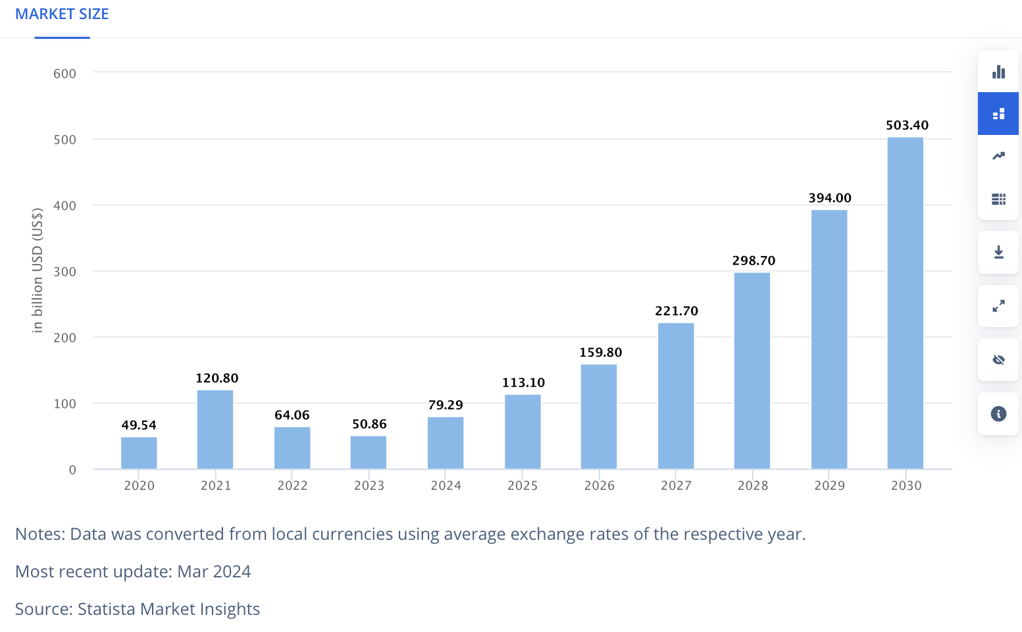
ML – Market size
Ref:https://www.statista.com/outlook/tmo/artificial-intelligence/machine-learning/worldwide#global-comparison

Slide 6
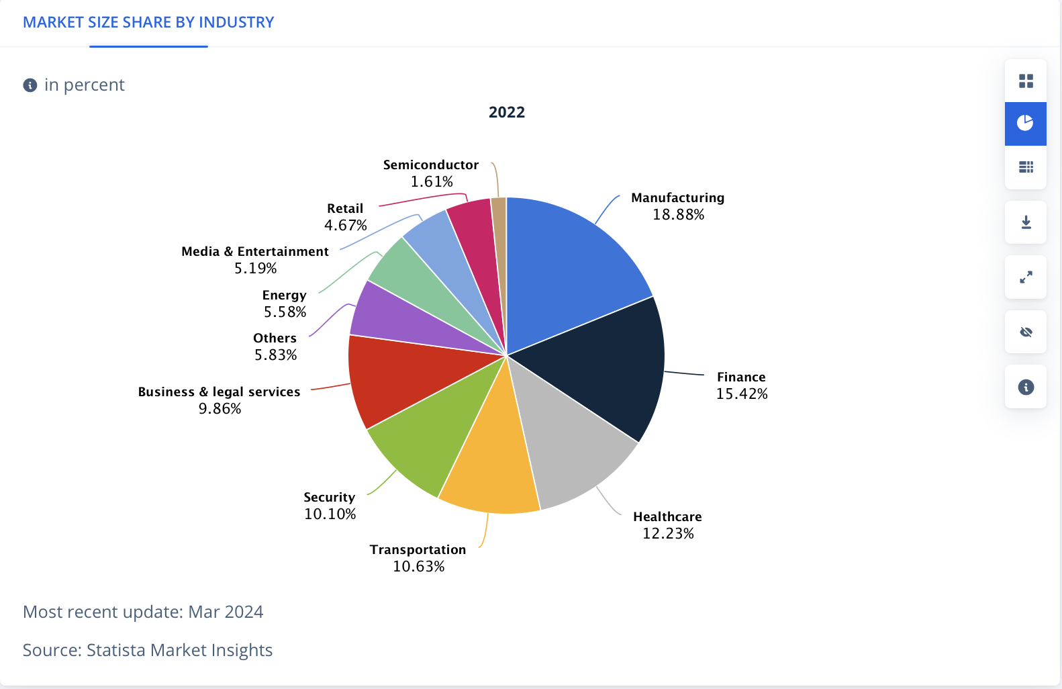
ML – Market size share by industry
Ref:https://www.statista.com/outlook/tmo/artificial-intelligence/machine-learning/worldwide#global-comparison

Slide 7
Machine Learning - Statistic/Insight
Category | Statistic/Insight
Adoption | 48% of businesses globally use machine learning.
Use Cases | - 57% of companies use machine learning to improve the consumer experience. - 49% use it for marketing and sales.
Market Growth | The machine learning market is expected to grow at a CAGR of 38.8% from 2022 to 2029.
Employment | Employment opportunities for machine learning engineers are expected to grow at a rate of 22% globally from 2020 to 2030.
AI Adoption | 91.5% of top companies invest in artificial intelligence.
AI in Financial Services | IBM identifies financial services as the leading sector for AI adoption.
Process Automation | Process automation is the most common application for AI and machine learning.
Ref: https://learn.g2.com/machine-learning-statistics#:~:text=57%25%20of%20companies%20and%20businesses,businesses%20globally%20use%20machine%20learning.

Slide 8
ML System
Data
Output
Traditional Programing
Computer
Program
Data
Computer
Program
Machine Learning
Output

Slide 9
Big Picture
Artificial intelligence
A technique which enables machines to mimic human behaviour
Artificial intelligence
Machine Learning
Subset of Al technique which use statistical methods to enable machines to improve with experience
Machine Learning
Deep Learning
Subset of ML which make the computation of multi-layer neural network feasible
Deep Learning

Slide 10
History of ML
1950s: Foundations
  Alan Turing: Turing Test (1950) – Can machines think?
  Arthur Samuel: Coined "Machine Learning" and created a Samuel's Checkers Player(1959).
  Perceptron (1958): Frank Rosenblatt developed the first neural network model.
1960s-1970s: Rise of Symbolic AI
  Expert Systems dominated (e.g., DENDRAL - how scientists form and discover hypotheses.).
  Limited progress due to computational constraints and lack of large datasets.
1980s: Connectionism Revival
  Introduction of Backpropagation (1986): A breakthrough in training neural networks.
  Neural networks gained traction for pattern recognition tasks.

Slide 11
History of ML
1990s: Statistical Learning
  Shift from rule-based systems to statistical approaches.
  Development of SVMs (Support Vector Machines) and Ensemble Methods.
2000s: Big Data and GPUs
  Growth of large datasets (e.g., ImageNet).
  GPUs accelerated deep learning computation.
2010s: Deep Learning Revolution
  Breakthroughs in computer vision (AlexNet, 2012) and NLP (transformers).
  Applications expanded to healthcare, autonomous vehicles, and more.

Slide 12
Definition
Tom M. Mitchell (1997)
A computer program is said to learn from experience E with respect to some class of tasks and performance measure P, if its performance at tasks in T, as measured by P, improves with experience E
Arthur Samuel (1959)
Machine learning is the field of study that gives computers the ability to learn without being explicitly programmed.
Ian Goodfellow, Yoshua Bengio, and Aaron Courville (2016):
Machine learning is the science of getting computers to act without being explicitly programmed, by extracting patterns and insights from data
Ethem Alpaydin (2004):
Machine learning develops algorithms that can learn from and make predictions on data.
Kevin P. Murphy (2012)
Machine learning is a set of methods that can automatically detect patterns in data and then use the uncovered patterns to predict future data or other outcomes of interest

Slide 13
When to Use Machine Learning ?
When the Problem Is Too Complex for Coding
In a situation where the problem is so complex or big that you cannot hope to write all the rules to solve it and where a partial solution is viable and interesting, you can try to solve the problem with machine learning.
When the Problem Is Constantly Changing
Some problems may continuously change with time so that the programming code must be regularly updated.
That results in the frustration of software engineers working on the problem, an increased chance of introducing errors, diﬃculties of combining “previous” and “new” logic, and significant overhead of testing and deploying updated solutions.
When It Is a Perceptive Problem
Today, it’s hard to imagine someone trying to solve perceptive problems such as speech, image, and video recognition without using machine learning

Slide 14
When to Use Machine Learning
When It Is an Unstudied Phenomenon
If we need to be able to make predictions of some phenomenon that is not well-studied scientifically, but examples of it are observable, then machine learning might be an appropriate.
When It Is Cost-Effective
The cost of training the model includes human labor and, in some cases, the expensive hardware needed to train deep models.
Model maintenance includes continuously monitoring the model and collecting additional data to keep the model up to date

Slide 15
When Not to Use Machine Learning
Every action of the system or a decision made by it must be explainable.
Every change in the system’s behavior compared to its past behavior in a similar situation must be explainable.
The cost of an error made by the system is too high.
Getting the right data is too hard or impossible.
You can solve the problem using traditional software development at a lower cost.
A simple heuristic would work reasonably well.
You build a system that will not have to be improved frequently over time.

Slide 16
ML Applications
Medical Diagnosis
Stock Market Trading
Image Recognition
Speech Recognition
Online Fraud Detection
Email Spam Detection
Traffic Prediction
Product recommendation
Language Translation
Self Driving Car

Slide 17
Working of Machine Learning
Section - 2

Slide 18
Working of ML
Machine learning is a sub-discipline of Artificial Intelligence.
Machine Learning is the field of study that gives computers the capability to learn without being explicitly programmed.
Task Done
Data
Start
No Error
Evaluate
Study the problem
Train ML Algo
Error
Analyze
Error

Slide 19
Life Cycle of Machine Learning
Section - 3

Slide 20
Machine Learning Project life cycle
business analyst & data analyst
data engineer & data labeler
data analyst
Goal Definition
Data collection & preparation
Feature engineering
Model training
Model evaluation
Business problem
Model maintenance
Model monitoring
Model serving
Model Deployment
data analyst & data labeler
DevOps
Machine Learning

Slide 21
Machine Learning Project life cycle
Problem Definition
  Define the business or research problem.
  Identify objectives, success metrics, and constraints.
  Understand the potential impact of ML on solving the problem.
Data Collection & Preparation
  Gather relevant data from various sources (databases, APIs, web scraping, etc.).
  Ensure data aligns with the problem's needs in terms of scope, quality, and scale.
  Clean the data: Handle missing values, remove duplicates, and address inconsistencies.
  Normalize or standardize features to ensure compatibility with ML algorithms.
  Split the dataset into training, validation, and testing subsets.
  Perform exploratory data analysis (EDA) to understand data distributions and patterns.
Feature Engineering
  Select or create meaningful features from raw data to improve model performance.
  Techniques include: Feature selection , Feature transformation , Feature creation

Slide 22
Machine Learning Project life cycle
Model Training
  Train the model using the training dataset.
  Optimize model parameters using techniques like gradient descent.
  Monitor performance using metrics like accuracy, precision, recall, etc.
Model Evaluation
  Evaluate the model on the validation dataset to tune hyperparameters.
  Assess performance using appropriate metrics accuracy, precision, recall, etc.
  Perform cross-validation for robust evaluation.
Model Deployment
  Integrate the trained model into production environments.
  Options for deployment:
    Batch processing (offline).
    Real-time inference (APIs, cloud services).

Slide 23
Machine Learning Project life cycle
Model Serving
  Ensures the model is operational and accessible to users.
  Serving in Batch Mode - In batch serving, predictions are generated for a large dataset all at once and stored for later use.
  In on-demand serving, predictions are generated dynamically in response to a specific user request.
Model Monitoring
  Model Monitoring detects performance issues or changing data distributions.
  The process of tracking a deployed model’s performance, accuracy, and reliability in production.
Model Maintenance
  Model Maintenance addresses issues found during monitoring and improves the model's accuracy and reliability.
  Activities aimed at ensuring the model remains accurate, relevant and efficient over time.

Slide 24
Machine Learning Terminology
Section - 4

Slide 25



ML Terminology
A method, function, or series of instructions used to generate a machine learning model.
Examples: include linear regression, decision trees, support vector machines, and Naïve Bayes.
A mathematical representation of a real-world process learned from data.
A model defines the relationship between features and label.
Models are created/learned when you train an algorithm on a dataset.
Example: A spam filter
Algorithm
Model

Slide 26


ML Terminology
With respect to a dataset, a feature represents an attribute and value combination.
A Feature is the input used for prediction or classification.
Input variables for the model
Example : "email length" and "presence of keywords”
In supervised learning, a label is the "answer" or "result" portion of an Model.
Target outcomes.
Example: "Spam" or "Not Spam"
Feature
Label

Slide 27


ML Terminology
Data used to teach the model .
Training means creating or learning the model.
During training the model is given labeled examples.
Training enables the model to gradually learn the relationships between features and label.
Example: set of emails labeled as spam or not for training.
Data used to evaluate the model.
Testing means applying the trained model to unlabeled examples.
That is, you use the trained model to make useful predictions.
Example: unseen emails
Training
Testing

Slide 28
Tools & Technology for ML
Section – 5

Slide 29
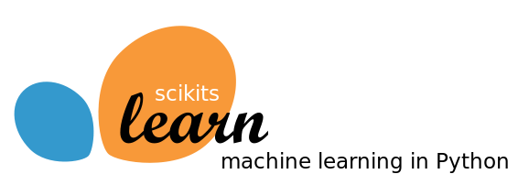
Tools used for Machine Learning : Scikit-learn
The Scikit-learn library is one of many Scikit libraries that build on the capabilities provided by NumPy and SciPy to allow Python developers to perform domain specific tasks.
Scikit-learn library focuses on data mining and data analysis, it provides access to following sort of functionality:
  Classification
  Regression
  Clustering
  Dimensionality reduction
  Model selection
  Pre-processing
Scikit-learn is the most important library we are going to learn in this subject

Slide 30

Tools used for Machine Learning : Keras and TensorFlow
Keras is an application programming interface (API) that is used to train deep learning models.
An API often specifies a model for doing something, but it doesn’t provide an implementation.
TensorFlow is an implementation for the keras, there are many other implementations for the keras like
  Microsoft’s cognitive Toolkit, CNKT
  Theano

Slide 31
Classes in Scikit-learn
Understanding how classes work is an important prerequisite for being able to use the Scikit-learn package appropriately.
Scikit-learn is the package for machine learning and data science experimentation favored by most data scientists.
It contains wide range of well-established learning algorithms, error functions and testing procedures.
Install : conda install scikit-learn
There are four class types covering all the basic machine-learning functionalities,
  Classifying
  Regressing
  Grouping by clusters
  Transforming data

Slide 32
Choosing a correct algorithm in Scikit-learn
Get more data
>50
samples
Start
Predicting a category?
Predicting a Quantity?
No
Yes
Not working
Do you have Labeled data?
Clustering
Regression
<100K
samples
<100K
samples
no. of category known
Randomized
PCA
No Algo
SGD
Regressor
Few features are important
Linear SVC
SGD
Classifier
<10K
samples
<10K
samples
<10K
samples
Text data?
KMeans
RidgeRegressor
kernel
approximation
Mini Batch
KMeans
Lasso
Kernel
approximation
Isomap
SVR(kernel=‘linear’)
Spectral
Embedding
ElasticNet
Spectral
Clustering
Mean Shift
Dimensionality
Reduction
Naïve
Bayes
Kneighbors
Classifier
SVC
EnsembleRegressor
Ensemble
Classifiers
GMM
VBGMM
Classification
SVR(kernel=‘rbf’)
LLE

Slide 33
Classification of ML Techniques
Section - 6

Slide 34
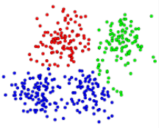
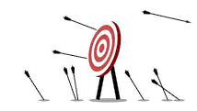

Classification of ML Techniques
Machine Learning
Supervised Learning
Unsupervised Learning
Reinforcement Learning
Task driven / predict value
Data driven / identify clusters
Learn from mistakes

Slide 35
Supervised Learning
Section – 6.1

Slide 36

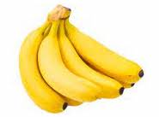
Supervised Learning
Labeled data
???
Apple
Banana
Apple
Prediction
Algorithm
Its an Apple
Banana
Banana
Apple
Apple
Apple
Apple
Training Data Set
Here we Use Label Data to train Classifier (Supervised Learning)

Slide 37
Machine Learning Process for Supervised Learning
Test Data
Model Testing
Collecting data
Cleaning data
Splitting data
Update Parameters
Model Deployment
Train Data
Model Training

Slide 38
Supervised Learning
Also called predictive learning. A machine predicts the class of unknown objects based on prior class-related information of similar objects.
The major motivation of supervised learning is to learn from past information.
A machine needs the basic information to be provided to it. This basic input, or the experience in the paradigm of machine learning, is given in the form of training data.
Example:
  Predicting the results of a game
  Predicting whether a tumour is malignant or benign
  Predicting the price of domains like real estate, stocks, etc.
  Classifying texts such as classifying a set of emails as spam or non-spam

Slide 39
Unsupervised Learning
Section – 6.2

Slide 40
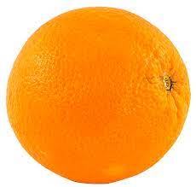
Unsupervised Learning
Input Data
Clustering
Algorithm
Here we don’t use Label Data to train Classifier(Unsupervised Learning)
  Finding similarities between data according to the characteristics found in the data and grouping similar data objects into clusters

Slide 41
Unsupervised Learning
Also called descriptive learning. A machine finds patterns in unknown objects by grouping similar objects together.
In unsupervised learning, the objective is to take a dataset as input and try to find natural groupings or patterns within the data elements or records.
Therefore, unsupervised learning is often termed as descriptive model and the process of unsupervised learning is referred as pattern discovery or knowledge discovery.
One critical application of unsupervised learning is customer segmentation.
Clustering is the main type of unsupervised learning. It intends to group or organize similar objects together.
For that reason, objects belonging to the same cluster are quite similar to each other while objects belonging to different clusters are quite dissimilar.
Clustering, Dimensionality Reduction, Density Estimation, Association Rule Learning are the type of unsupervised learning.

Slide 42
Reinforcement Learning
Section – 6.3

Slide 43
Reinforcement Learning
Input Data
Environment
Reward
Best
Action
State
Algo
Selection
Agent
Reinforcement Learning Model

Slide 44
Reinforcement Learning
It use feedback is called a reward, or reinforcement.
1) The agent(decision-maker) observes the current state of the environment(The system or scenario with which the agent interacts.).
2) Based on the state, the agent chooses an action according to its policy(The agent's strategy, mapping states to actions.).
3) The environment responds to the action by:
  Transitioning to a new state
  Providing a reward.
4) The agent updates its policy using the feedback.
Steps 1–4 repeat, with the goal of maximizing the total reward over time.
Reinforcement learning is like training a dog, where the agent (dog) learns to take actions based on rewards from interacting with its environment.
The key components include the agent (dog), environment (surroundings), state (current situation), action (behavior), and reward (feedback).

Slide 45
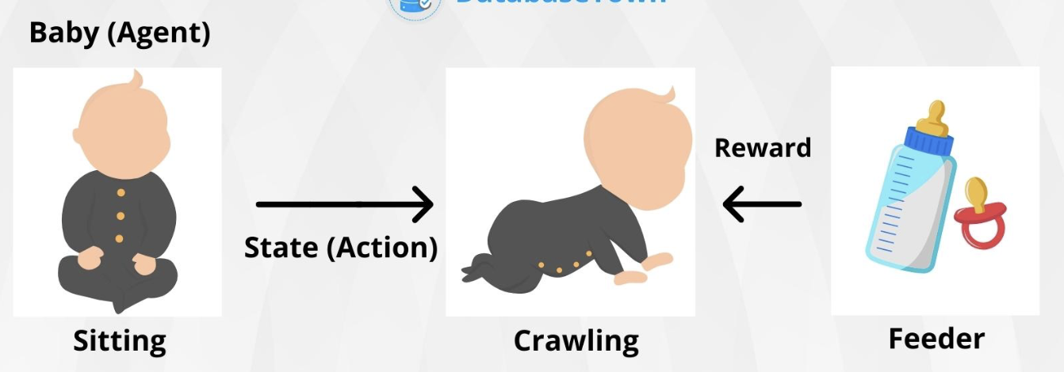
Reinforcement Learning
The dog learns through trial and error, associating positive rewards like treats with correct actions and negative rewards with incorrect ones.
Initially, the dog explores various actions to identify what yields rewards, then exploits this knowledge to consistently perform rewarding actions.
Concepts like positive reinforcement (rewarding good behavior) and shaping (rewarding gradual improvements) are central to both dog training and reinforcement learning.
Ref: https://databasetown.com/basics-of-reinforcement-learning/

Slide 46
Supervised vs. Unsupervised vs. Reinforcement
Supervised Learning | Unsupervised Learning | Reinforcement
Input data is labeled | Input data is unlabeled | Sequential interaction data
Has a feedback mechanism | Has no feedback mechanism | Reward signals
Data is classified based on the training dataset | Assigns properties of given data to classify it | The model learn and updates itself through reward.
Divided into Regression & Classification | Divided into Clustering & Association | No Types
Used for prediction | Used for analysis | Used for Maximize rewards
Algorithms include: decision trees, logistic regressions, support vector machine | Algorithms include: k-means clustering, hierarchical clustering, apriori algorithm | Algorithms include:Q-Learning, Sarsa
A known number of classes | A unknown number of classes | A unknown number of classes

Slide 47
Overview of Artificial Neural Networks
Section - 7

Slide 48

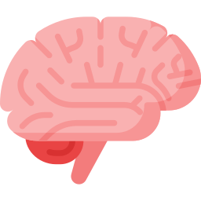
Brain vs Computer
Brain
The Machine
Pattern Recognition
Association
Complexity
Noise Tolerance
Calculation
High Precision
Logic

Slide 49
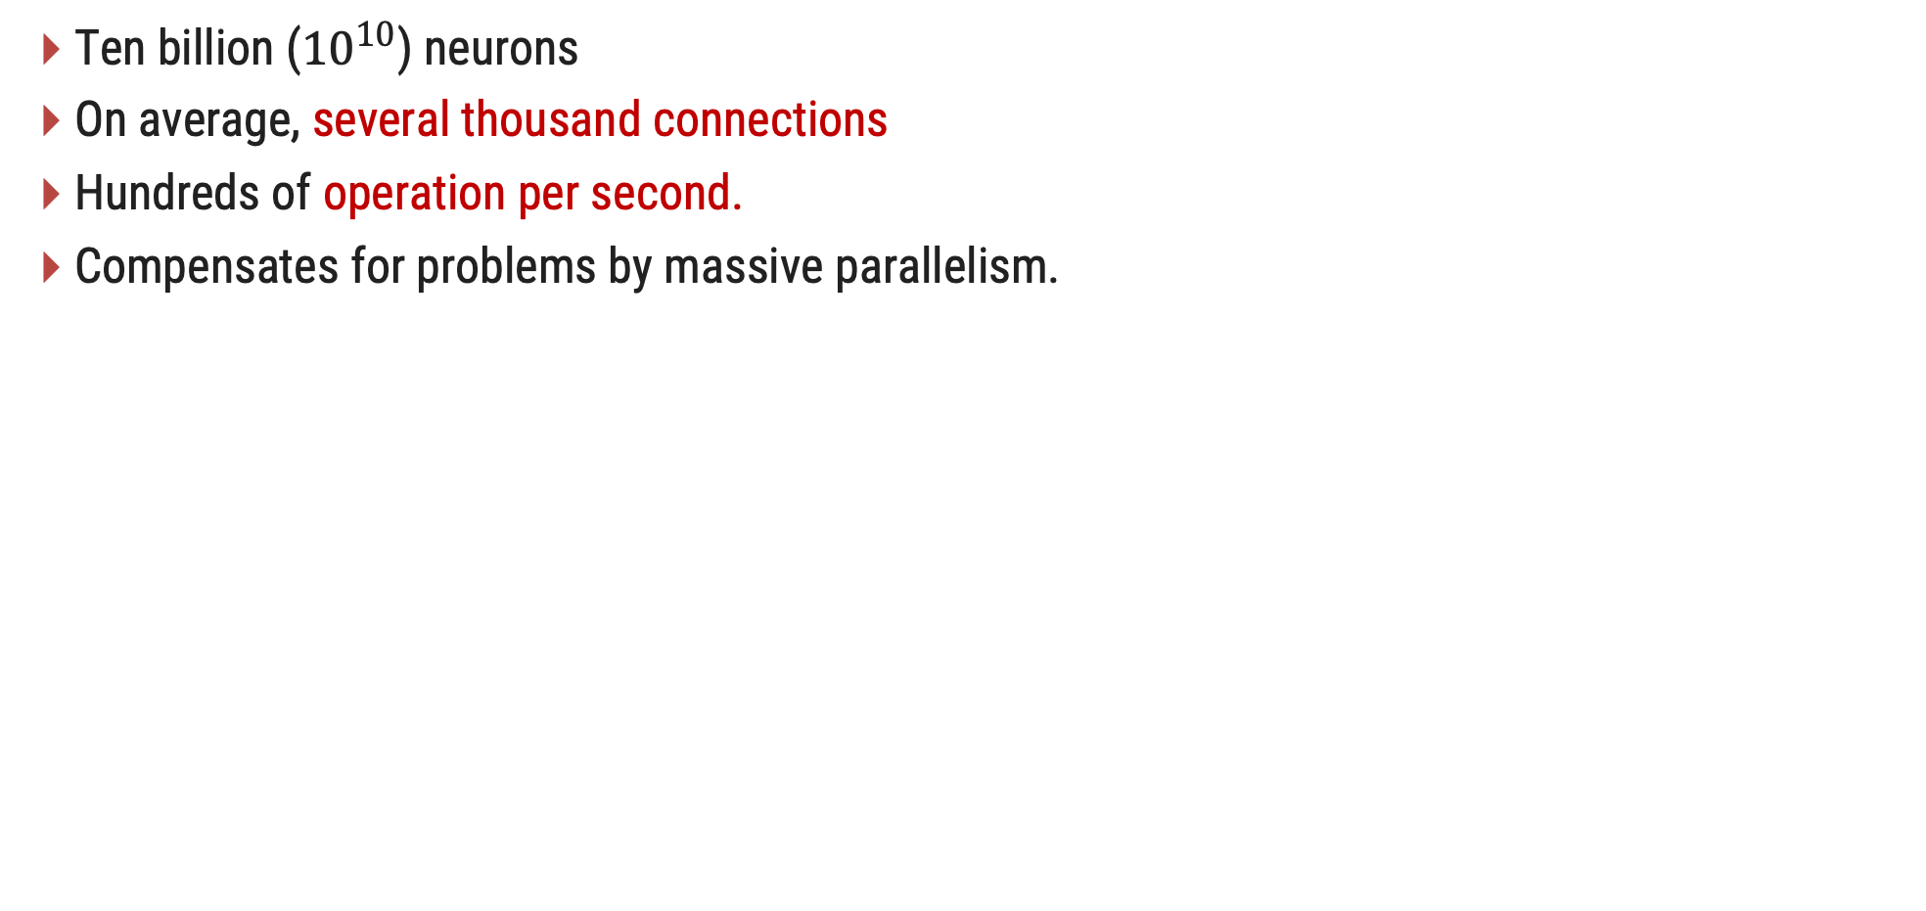
Features of the Brain
Ten billion (${10}^{10}$) neurons
On average, several thousand connections
Hundreds of operation per second.
Compensates for problems by massive parallelism.

Slide 50
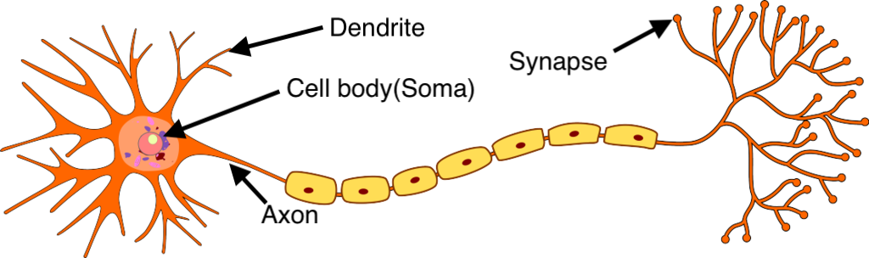
Biological Neurons
A neuron has a cell body, a branching input structure (the dendrIte) and a branching output structure (the axon).
Axons connect to dendrites via synapses
Electro-chemical signals are propagated from the dendritic input, through the cell body, and down the axon to other neurons
A neuron only fires if its input signal exceeds a certain amount (the threshold) in a short time
period.
Synapses vary in strength
  ﻿﻿Good connections allowing a large signal
  ﻿﻿Slight connections allow only a weak signal
  ﻿﻿Synapses can be either excitatory or inhibitory
Ref:https://www.google.co.in/url?sa=i&url=https%3A%2F%2Fsaurabhnativeblog.medium.com%2Fwhat-is-the-relation-between-artificial-and-biological-neuron-18b05831036&psig=AOvVaw3aGnAj7eK-CjHZ4PrPC19u&ust=1741006389878000&source=images&cd=vfe&opi=89978449&ved=0CBcQjhxqFwoTCJiK4K2464sDFQAAAAAdAAAAABAI

Slide 51
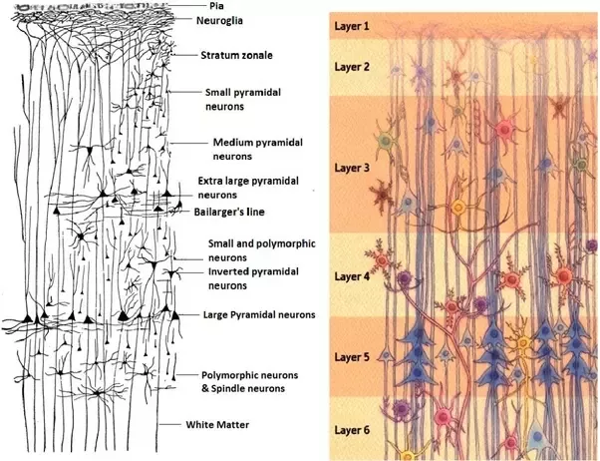
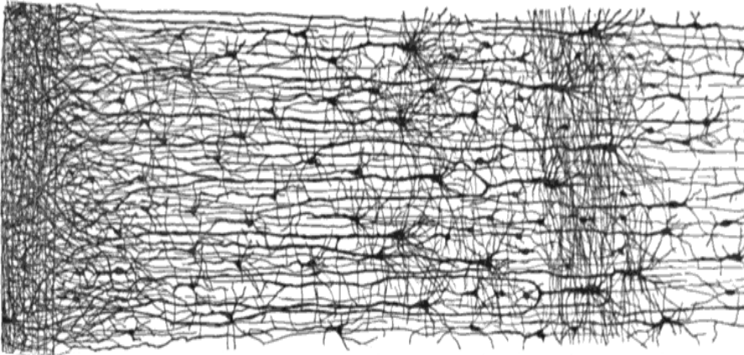
Biological Neurons
biological neurons are organized in a vast network of billions, with each neuron typically connected to thousands of other neurons.
Highly complex computations can be performed by a network of fairly simple neurons, much like a complex anthill can emerge from the combined efforts of simple ants.
The architecture of biological neural networks (BNNs) is still the subject of active research, but some parts of the brain have been mapped, and it seems that neurons are often organized in consecutive layers, especially in the cerebral cortex.
Multiple layers in a biological neural network (human cortex)

Slide 52
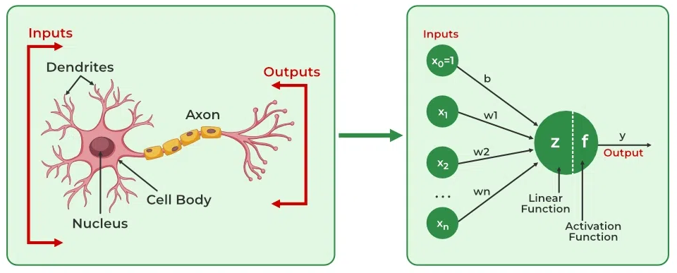
Artificial Neurons vs Biological Neurons
Biological Neuron | Artificial Neuron
Dendrite | Inputs
Cell nucleus or Soma | Nodes
Synapses | Weights
Axon | Output
Image reference : https://www.geeksforgeeks.org/artificial-neural-networks-and-its-applications/

Slide 53








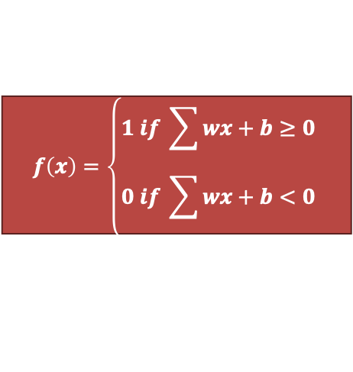

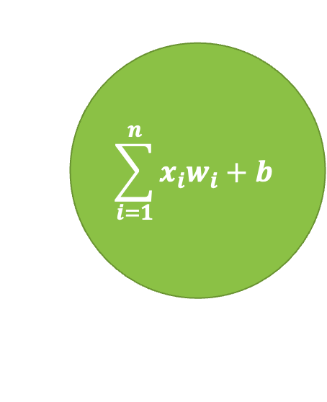

Artificial Neurons - Perceptron
$$x_{1}$$
$${ w}_{1}$$
$$x_{2}$$
$$\sum_{i=1}^{n}{x_{i}w_{i}}+b$$
$${ w}_{2}$$
$$f\left(x\right)=\left\{\begin{aligned}1 if \sum{wx}+b≥0 \\ 0 if \sum{wx+b<0}\end{aligned}\right.$$
$$x_{3}$$
$${ w}_{3}$$
$$\hat{y}$$
$$∙$$
$$∙$$
$$∙$$
Output
$${ w}_{n}$$
Activation
$$x_{n}$$
Summation and bias
Input

Slide 54
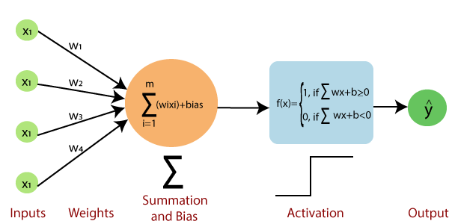
Basic Components of a Single Layer Perceptron
Input layer of the perceptron is made of artificial input neurons and takes the initial data into the system for further processing.
Activation Function: A neuron can be activated or not, is determined by an activation function. The activation function determines the output of the perceptron based on the weighted sum of the inputs and the bias term.
The perceptron is typically trained using a supervised learning algorithm such as the perceptron learning algorithm or back-propagation. During training, the weights and biases of the perceptron are adjusted to minimize the error between the predicted output and the true output for a given set of training examples.
Weight represents the strength of the connection between units. Each input neuron is associated with a weight.
Net sum calculates the total sum. A Bias term is added to the input layer to provide the perceptron with additional flexibility in modelling complex patterns in the input data.
Output: The output of the perceptron is a single binary value, either 0 or 1, which indicates the class or category to which the input data belongs.

Slide 55
Artificial Neural Networks
Computational models inspired by the human brain.
Algorithms that try to mimic the brain.
Massively parallel, distributed system, made up of simple processing units (neurons)
Synaptic connection strengths among neurons are used to store the acquired knowledge.
Knowledge is acquired by the network from its environment through a learning process

Slide 56
History of ANN
Year | Researcher(s) | Contribution
1943 | Warren McCulloch & Walter Pitts | Modeled neurons using electrical circuits.
1949 | Donald Hebb | Introduced Hebbian learning—neural pathways strengthen with use.
1950s | Nathanial Rochester (IBM) | First attempt to simulate a neural network (failed).
1959 | Bernard Widrow & Marcian Hoff | Developed ADALINE & MADALINE for binary pattern recognition and echo cancellation.
1962 | Widrow & Hoff | Developed a weight-adjusting learning rule for perceptrons.
1972 | Kohonen & Anderson | Independently developed similar networks using matrix mathematics.
1975 | - | First multilayered neural network (unsupervised learning).
1982 | John Hopfield | Introduced bidirectional connections in neural networks.

Slide 57
History of ANN
Year | Researcher(s) | Contribution
1982 | Reilly & Cooper | Developed a 'Hybrid network' with multiple layers using different strategies.
1982 | US-Japan Conference | Japan announced its Fifth Generation computing effort, leading to renewed US interest and funding.
1986 | David Rumelhart & others | Developed backpropagation networks, enabling multilayered learning.
Present | - | Neural networks are widely used, with ongoing research into specialized hardware (digital, analog, and optical chips) for efficiency.
Ref:https://cs.stanford.edu/people/eroberts/courses/soco/projects/neural-networks/History/history1.html

Slide 58
Different Network Topologies
1) Single Layer feed-forward networks:
Single layer
network
Input Record : x_{i}
w_{ij}
Input Layer
Output Layer

Slide 59
Different Network Topologies
2) Multi-layer feed-forward networks(Multilayer Perceptron):
Multilayer Perceptron
Input Record : x_{i}
w_{ij}
Input Layer
Hidden Layer
Output Layer

Slide 60
Multi-layer feed-forward networks
The inputs are fed simultaneously into the input layer.
The weighted outputs of these units are fed into hidden layer.
The weighted outputs of the last hidden layer are inputs to units making up the output layer.
A network containing two hidden layers is called a three-layer neural network, and so on.
The network is feed-forward in that none of the weights cycles back to an input unit or to an output unit of a previous layer.
INPUT – Records without class attribute with normalized attributes values.
INPUT VECTOR – X = { x1, x2, …. xn} where n is the number of (non class) attributes.
INPUT LAYER – There are as many nodes as non-class attributes i.e. as the length of the input vector.
HIDDEN LAYER – the number of nodes in the hidden layer and the number of hidden layers depends on implementation.
OUTPUT LAYER – corresponds to the class attribute.(There are as many nodes as classes )

Slide 61
Characteristics of Artificial Neural Network
It is basically a mathematical model.
It contains huge number of interconnected processing elements called neurons to do all operations.
Information stored in the neurons are basically the weighted linkage of neurons.
The input signals arrive at the processing elements through connections and connecting weights.
It has the ability to learn, recall and generalize from the given data by suitable assignment and adjustment of weights.
The collective behavior of the neurons describes its computational power, and no single neuron carries specific information.

Slide 62
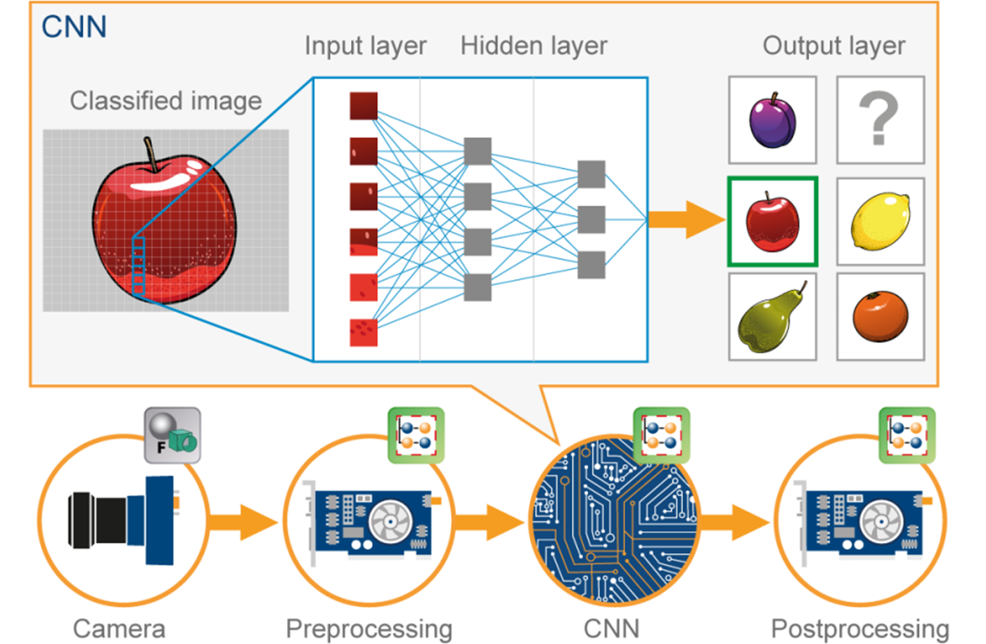
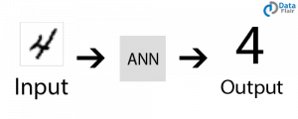
Applications of ANN
Image Processing and Character recognition:
  ANN has an ability to take in a lot of inputs, process them to infer hidden as well as complex, non-linear relationships, ANNs are playing a big role in image and character recognition.
  Character recognition like handwriting has lot of applications in fraud detection (e.g. bank fraud) and even national security assessments.
  Image recognition is an ever-growing field with widespread applications from facial recognition in social media, cancer detention in medicine to satellite imagery processing for agricultural and defense usage.

Slide 63
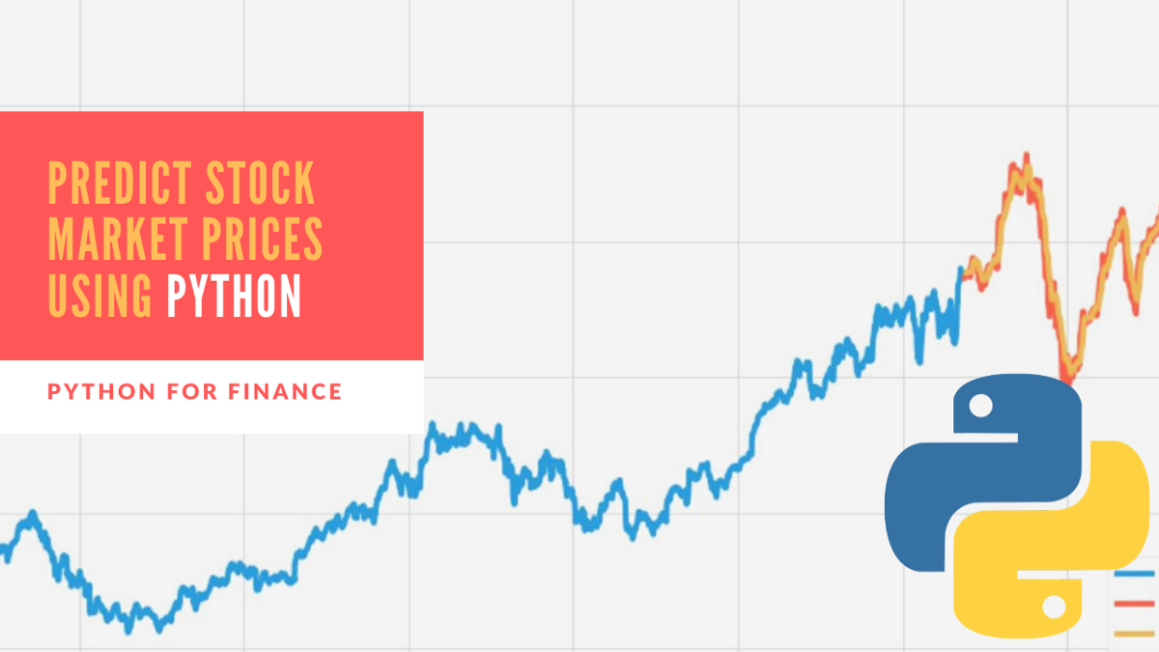
Applications of ANN
Forecasting:
  Forecasting is required extensively in everyday business decisions (e.g. sales, financial allocation between products, capacity utilization), in economic and monetary policy, in finance and stock market.
  More often, forecasting problems are complex, for example, predicting stock prices is a complex problem with a lot of underlying factors.

Slide 64
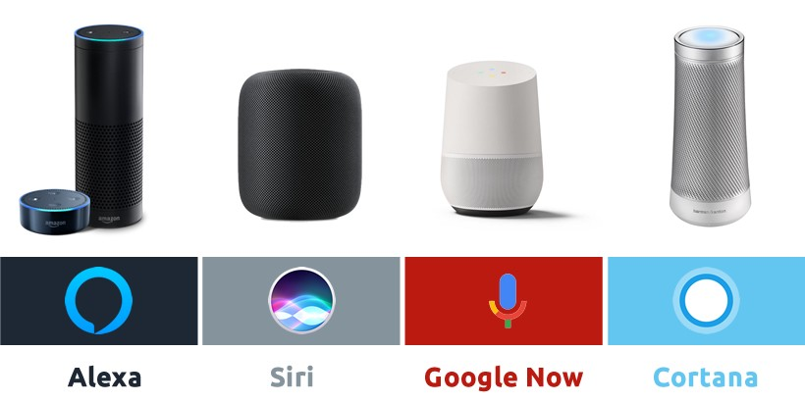
Applications of ANN
Speech Recognition:
  Speech recognition has many applications, such as home automation, mobile telephony, virtual assistance, hands-free computing, video games, and so on. Neutral networks are widely used in this area.
  We can say its a direct example of applications in virtual assistants or chatbots.
  Nowadays, Google smart home, Alexa, Siri, Google assistance or Cortana are known to most of us.

Slide 65
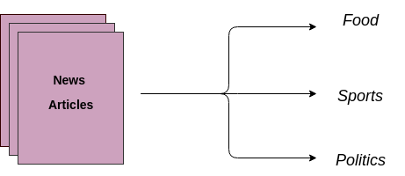
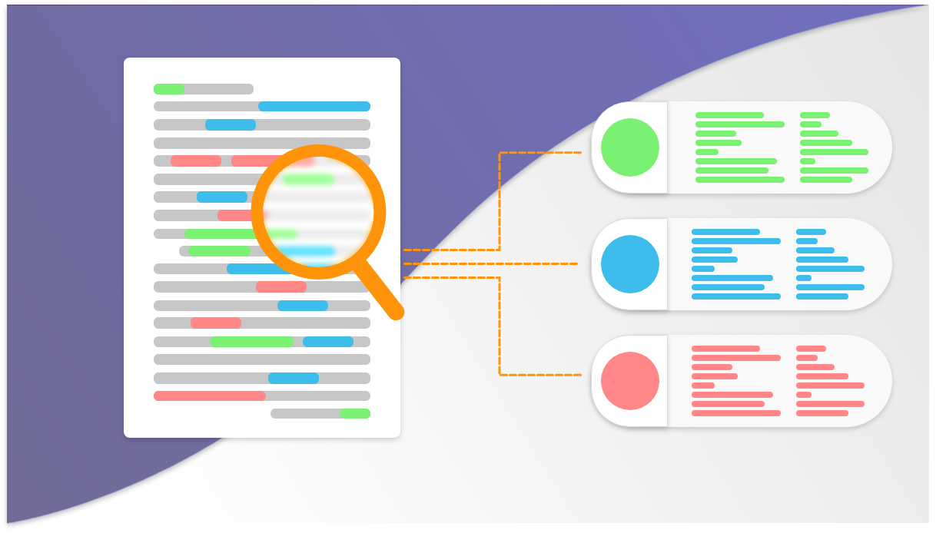
Applications of ANN
Text Classification and Categorization:
  Text classification is an essential part of document search and filtering, online web searches and language identification and sentiment analysis.
  Neural networks are actively used for this kind of task. Named entity recognition and parts of speech tagging are some of the application that comes under the domain of Natural Language Processing (NLP).
  The widely used models are Recurrent Neural Networks (RNN) and Long-Short Term Memory (LSTM) networks. Though, CNN is also used for some of the applications.

Slide 66
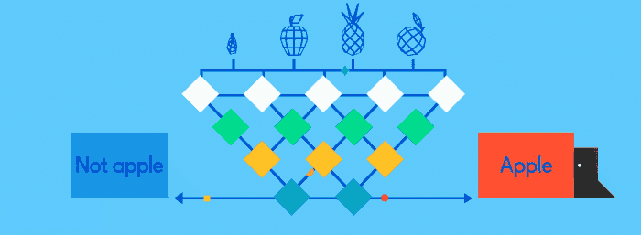
Applications of ANN
Image classification or labelling:
  Convolution Neural Network or Feed-forward neural network with back-propagation is generally used for image classification. A model is selected based on the dataset for training and features of interest.
  Transfer learning can be done using any pre-trained model if the dataset of your problem is similar to the dataset of the pre-trained model that you are choosing.
  There are many pre-trained image classification models that are trained on millions of images of different hundreds and thousands of classes. Some of the models are ResNet, GoogLeNet, InceptionV3, VGG16, ImageNet and many more are available.
Image Source: https://towardsdatascience.com/activation-functions-neural-networks-1cbd9f8d91d6

Slide 67

Applications of ANN
Language Generation and Document Summarization:
  Natural Language Generation and Paraphrasing and document summarization are widely used to generate the documents and summarize multi-documents.
  Their applications can be found in generating text-based reports from data tables, automated reports writing, summarizing medical reports, generating stories and novels, etc.

Slide 68
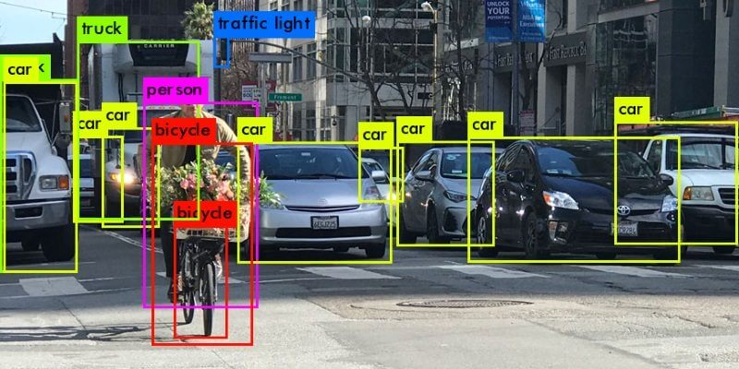
Applications of ANN
Object detection:
  Object detection from images is widely used to detect any object and classify it based on that.
  It needs large training dataset with all the coordinates of the object of interest clearly specified. The widely used object detection models are YOLO (You Only Look Once) and SSD (Single Shot Object Detectors).

Slide 69

Applications of ANN
Healthcare:
  Artificial Neural Networks are used in Oncology to train algorithms that can identify cancerous tissue at the microscopic level at the same accuracy as trained physicians.
  Various rare diseases may manifest in physical characteristics and can be identified in their premature stages by using Facial Analysis on the patient photos.
  The full-scale implementation of Artificial Neural Networks in the healthcare environment can only enhance the diagnostic abilities of medical experts and ultimately lead to the overall improvement in the quality of medical care all over the world.

Slide 70
Introduction to Advanced Technologies (2305CS302)
Prof. Vaseem Ghada
Master of Computer Application
vaseem.ghada@darshan.ac.in
9879531513

