Slide 1


Unit-05
Fundamental of Blockchain
& Cryptocurrency
Introduction to Advanced Technologies (2305CS302)
CO5 : At the end of this course, students will be able to,
discuss basics of blockchain technology and its architecture.
Prof. Vaseem Ghada
Master of Computer Application
vaseem.ghada@darshan.ac.in
9879531513

Slide 2

Outline
Introduction of Blockchain
Origin of Blockchain
Blockchain Solution
Components of Blockchain
Block in Blockchain
Decentralization and Distribution
Types of Blockchain
  Public Blockchain
  Private Blockchain
Consensus Algorithm
  Proof of Work
  Proof of Elapsed Time
  Proof of Stake
  Delegated Proof of Stake
Looping
Consensus Algorithm
  Proof of Authority
  Practical Byzantine Fault Tolerance
  Proof of Stake Anonymous
  Proof of Importance
Cryptocurrency – Bitcoin
  Introduction of Bitcoin and the cryptocurrency
  Cryptocurrency Basics
  Types of Cryptocurrency
  Cryptocurrency usage

Slide 3
Introduction of Blockchain Technology
Section - 1

Slide 4
Introduction
Technically, Blockchain is defined as a distributed, replicated peer-to-peer network of databases that allows multiple non-trusting parties to transact without a trusted intermediary and maintains an ever growing, append-only, tamper-resistant list of time-sequenced records.
In short, Blockchain is a type of distributed ledger that sits on the internet for recording transactions and maintaining a permanent and verifiable record-set of information.
2008 - A Peer-to-Peer Electronic Cash System (Satoshi Nakamoto)
2009 - Bitcoin

Slide 5
Bitcoin and Blockchain
Meaning: Bitcoin is a cryptocurrency, while Blockchain is a ledger or database of information.
Usage: Bitcoin is limited to currency transactions, while the blockchain has numerous applications.
Transparency: Bitcoin has a high degree of anonymity.
On the other hand, Blockchain is quite transparent as it is expected to work across multiple industry applications.
Though Bitcoin will continue to hold the coveted position of the world’s first decentralized cryptocurrency, its operational significance is considerably reducing with the blockchain technology taking the limelight into various industry sectors like Healthcare, Travel, Education, Government, and others.

Slide 6
Origin of Blockchain, Blockchain Solution
Section - 2

Slide 7
Origin of Blockchain
1991: Concept introduced by Haber and Stornetta.
2008: Bitcoin launched by Satoshi Nakamoto.
First real-world application of blockchain technology.

Slide 8
1st-Gen Blockchain (2008-2013): The Origin of Bitcoin
In 2009, Bitcoin became the first application of Blockchain technology. Satoshi Nakamoto formed the Genesis block.
The first generation of blockchain promised transparency, immutability, accountability and security in transactions.
However, the protocols used in this necessitated the use of heavy mining hardware and significant resources leading to problems in scalability, interoperability, and speed.
To date, Bitcoin is one of the slowest cryptocurrency, taking about 10 minutes to confirm a transaction.

Slide 9
2nd-Gen Blockchain (2013-2015): Transactions with Smart Contracts
The second-generation sought to overcome the limitations of the Bitcoin.
Thus emerged Ethereum in 2013, when it was realized that the underlying technology of Bitcoin could be used for all kinds of B2C and other general applications.
It still used the Proof-of-work algorithm and had less-than-optimal speed.
Though Ethereum required lesser energy to maintain, there were still concerns about future scalability.
However, with the hosting of Smart Contracts that made available new functionalities, Ethereum was the go-to blockchain for Enterprise use.

Slide 10
3rd-Gen Blockchain (2015-2018): Distributed Applications
This generation saw the arrival of Hyperledger from the Linux Foundation and Decentralized Applications (DApps) of Ethereum.
Though the Hyperledger is a platform that can plug in any consensus mechanism, Smart Contracts of Ethereum opened up the possibility of a Proof-of-Stake consensus mechanism.
The focus of the generation was consensus mechanisms that can bring greater interoperability and boost network speeds.
Promoting cross-chain transactions, using sharding (a type of database partitioning that separates vast databases into smaller, faster, and more easily managed parts) and establishment of parallel chains are only some of the approaches being taken by the third generation blockchain solutions.
However, EOS and TRON have taken over the DApps market due to the scaling issues still inherent in the Ethereum platform.

Slide 11
4th-Gen Blockchain (2018–Future)
Blockchain technology’s future appears optimistic as many governments and organizations are investing heavily in innovations and applications.
A significant innovation on the horizon is called blockchain scaling.
A scaled blockchain is expected to accelerate the processing speeds, without sacrificing security significantly.
This is done by assessing the computing power required to validate each transaction and then dividing the work efficiently.
Progress in this front is yet to be seen, but the outlook has been positive and more is expected on this front.
Focus: Integrating blockchain into Industry 4.0, IoT, AI, and enterprise infrastructure
Goals: Mass adoption, real-time data processing, user-friendly interfaces, regulation compliance

Slide 12
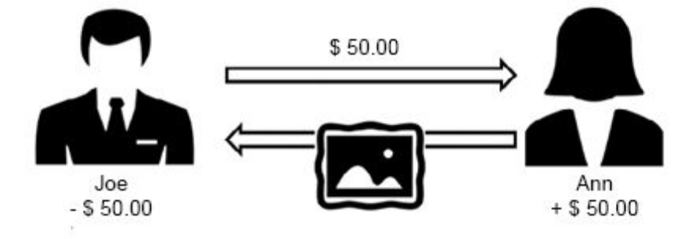
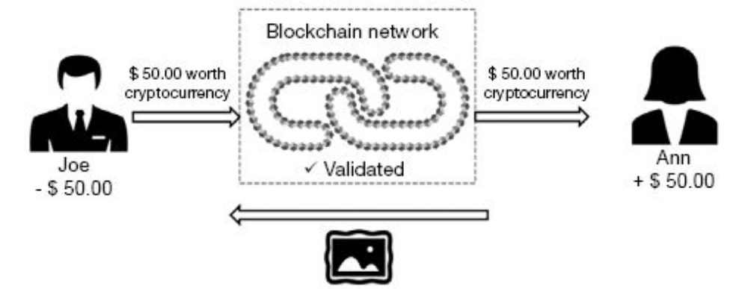
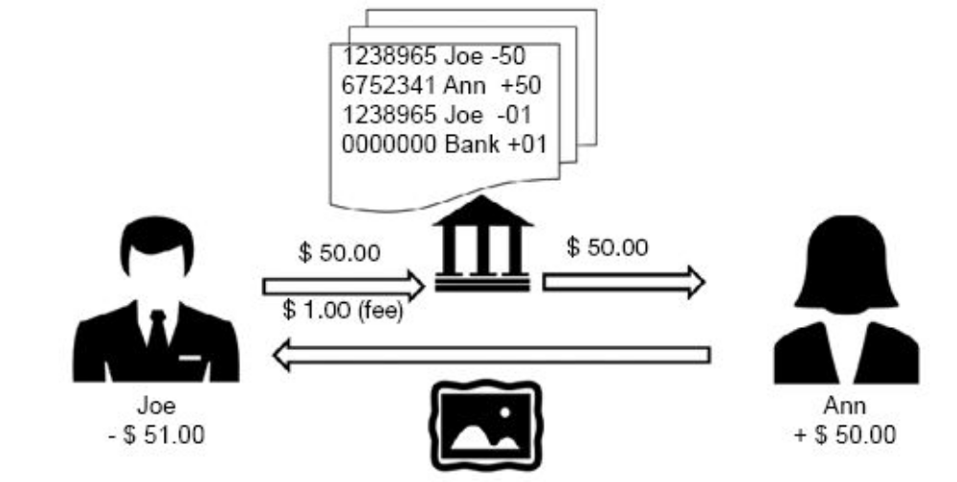
Traditional v/s Blockchain Transactions
Figure : Physical transaction
Figure : Blockchain transaction
Figure : Traditional online transaction

Slide 13
Components of Blockchain
Section - 3

Slide 14
Components of Blockchain
Node
Ledger
Wallet
Nonce
Hash
Mining
Consensus Protocol

Slide 15
Components of Blockchain
Node: Participant in the network
Block: Holds data and metadata
Chain: Sequence of blocks
Transaction: Record of action
Consensus Algorithm
Smart Contracts

Slide 16

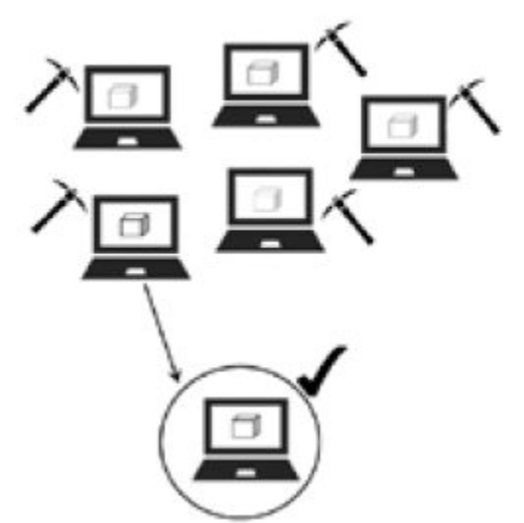
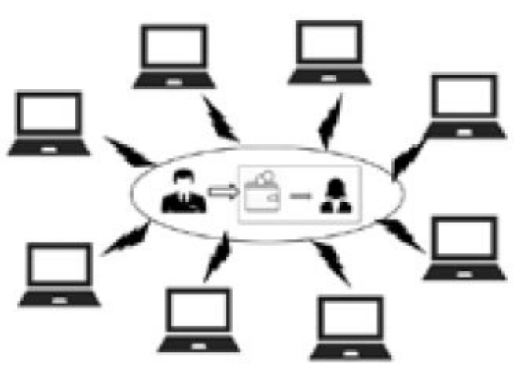

Blockchain Transaction in a Nutshell
Step 1: Joe requests the proposed transaction
Step 4: Miners compete to solve the complex mathematical puzzle.
Step 2: The proposed transaction is broadcast to the network
Step 5: The nodes verify the miner’s work.
Step 3: Miners verify the transaction and bundle it into a block along with other transactions

Slide 17


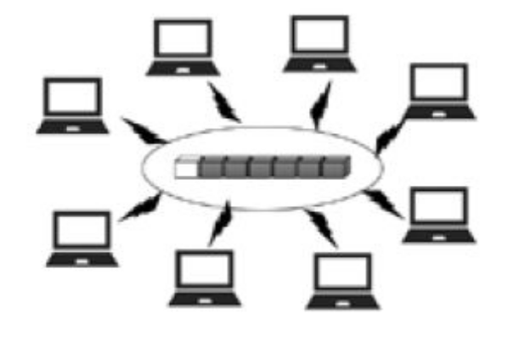
Blockchain Transaction in a Nutshell
Step 6: Block is added to the blockchain.
Step 8: Transaction completion Ann receives 0.5 BTC in her wallet The transaction is complete.
Step 7: The updated copy of the blockchain is circulated throughout the network.

Slide 18
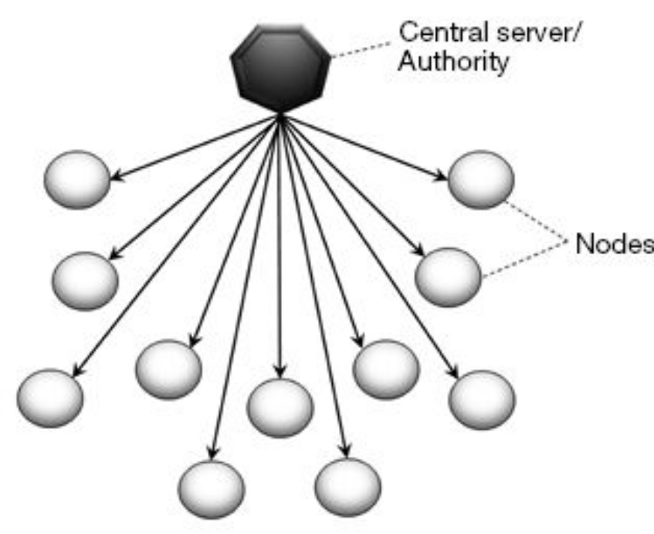
Centralization
In centralized systems, only a central authority or administrator has the power to maintain and update the database. Thus, data flows are controlled and managed by the central authority.
The central authority maintains the database by defining the rules and procedures users can have on adding, deleting, or updating the data.
All the nodes (computers and devices) connected to the network are subject to access granted by the central authority.
In simple words, the central authority makes all the decisions. A failure at the centre means the collapse of the entire system.
Centralized network

Slide 19
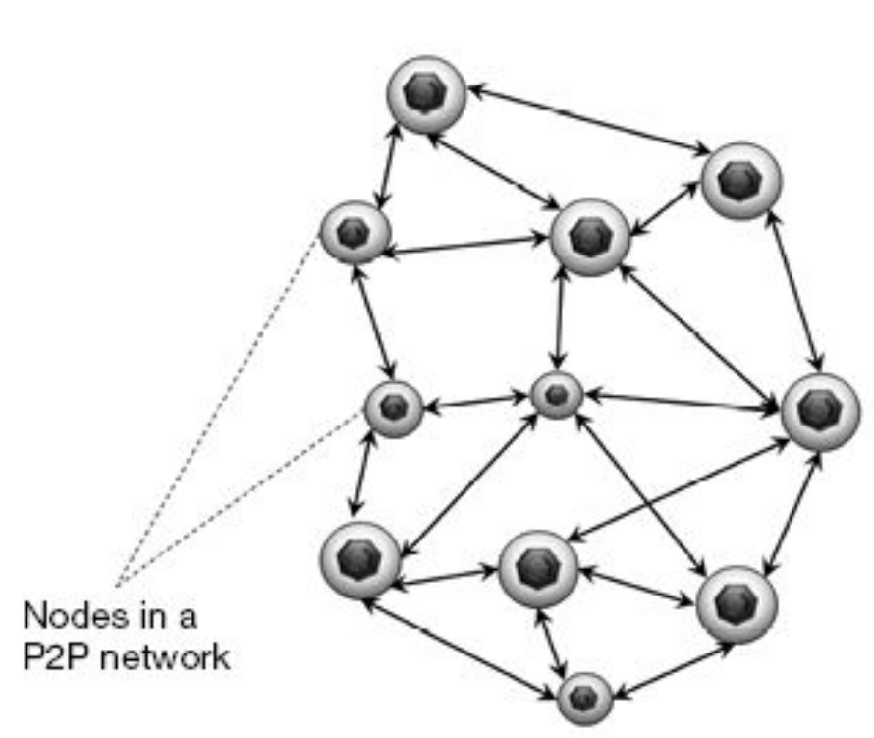
Decentralization
Every node is equal in the hierarchy with equal access to maintain the database.
While in a centralized environment, an organization such as a bank holds the sole right to read, write or send transactions, in the decentralized environment, anyone can access or write into the ledger.
This inclusivity ensures that
  a) no single entity has sole control of the network
  b) there is no single infrastructural point of failure.
  c) there is a collective agreement on the state of the system via consensus.
Decentralized network

Slide 20
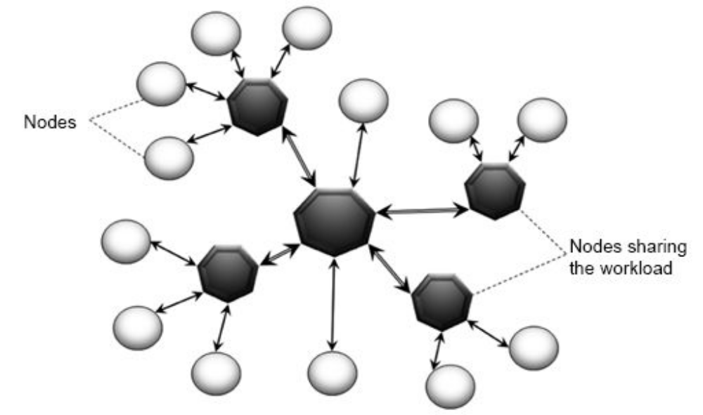
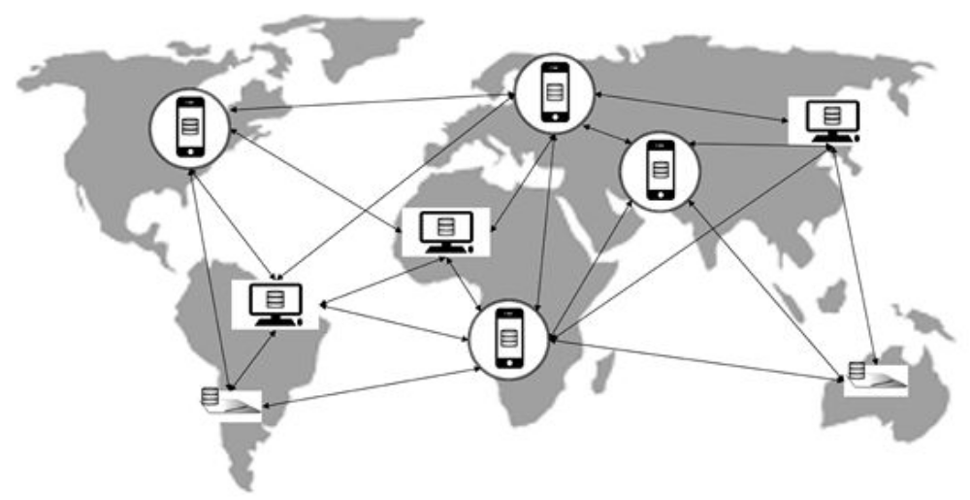
Distributed Ledger Technology
Decentralized network
Decentralized distributed network (Blockchain)

Slide 21
Distributed Ledger Technology
A distributed ledger technology or DLT is defined as a decentralized database that can securely record and share financial, physical, or electronic assets across a geography agnostic network through transparent updates of information.
However, it should be noted that a decentralized system does not necessarily mean a fully distributed one. Figure represents a decentralized network where the processing work or control is shared with sub-nodes.
In DLT of blockchain, a copy of the database is available on every computer or device of the users in the network. The database is independent of a central authority and any changes or entries to the ledger have to be “agreed” upon by all users/nodes/parties.
Once consensus is reached, the database is updated to all the nodes in the network. Thus, at any given time, information is synchronized across all the nodes. Hence, it is also referred to as distributed consensus.

Slide 22
Types of Blockchain - Private Blockchain, Public Blockchain
Section - 4

Slide 23
Public Blockchain
In a public blockchain, anyone in the world can access the blockchain, download a copy of the code, and run a node. It is a fully decentralized distributed network. One does not need any permission to read/access a transaction, initiate a transaction, or participate in the consensus process (PoW) to create a block.
Participants or nodes remain anonymous through high cryptographic protocols. Anonymity, transparency and immutability are valued over efficiency.
It is open to the public, as the name suggests. Anyone can join the network and be a participant/node.
No permissions are required for anyone to read/send transactions.
The standard consensus algorithm used is Proof-of-Work (PoW), where nodes (miners) solve the hash puzzle and submit their resultant block to the rest of the network participants for consensus.
There is no single point of failure (SPOF) as validation (consensus) is done by all the nodes.
High cryptographic methods are used to secure data.

Slide 24
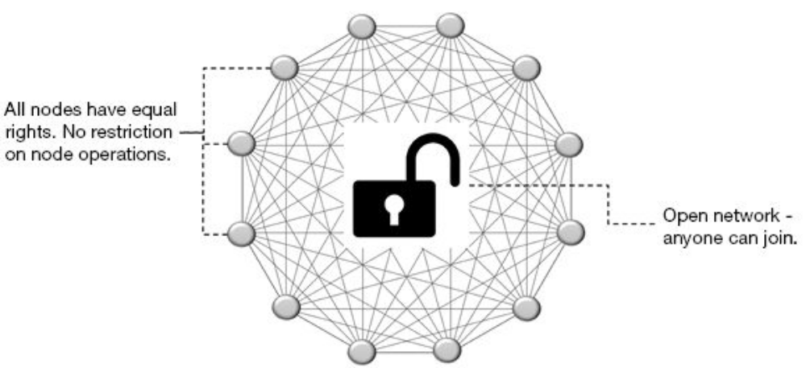
Public Blockchain
The downside of a public blockchain is its poor scalability:
It has low transaction processing speed – ten minutes to create a block.
Consensus mechanism requires an immense amount of energy and computational power.
Participants with supercomputers or more powerful ASICs have a better chance of mining than the others, hence the risk of decentralization with mining pools.
Bitcoin, Litecoin, Ethereum are the most common examples of a public blockchain.

Slide 25
Private Blockchain
The private permissioned blockchain, also known as the private blockchain, differs from the public blockchain in its accessibility and permission. The network is not open to everyone.
It leverages the blockchain features of distributed database, immutability and security. However, the innovative blockchain feature of decentralization and openness is lost as all the permissions are controlled by a few nodes in the organization.
Blockchain technology was invented to remove the power of central authority. So, in the case of a private blockchain network or organization where the owner has sole control over who can read, write, and validate data, it stands to reason why many may not consider it to be a real blockchain.
It is not open to the public. However, participants are known to each other and hence, trust is assured.
All participants are pre-approved by the organization. The ledger and access therein are distributed within the network of participants.
It has high transaction processing speed, taking only seconds to create a block.
Very low energy consumption as supercomputers are not required for processing.

Slide 26
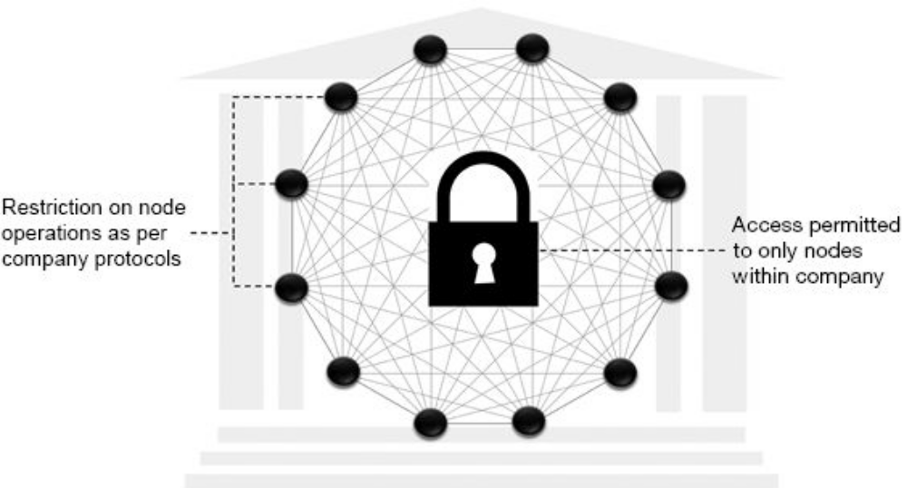
Private Blockchain
They are not decentralized. The trade-off is better scalability and security.
A central authority means a single point or point of failure, unlike the public blockchain, where there is zero downtime.
The organization must agree on who has the highest power to be the central authority.
The private blockchain is scalable and cryptographically secured from the organization’s point of view and hence more cost-effective.
Examples of private blockchain are Multichain and Monax.

Slide 27
Consensus Algorithm
Section - 5

Slide 28
Proof of Work
Several nodes of the distributed ledger called miners compete to solve a complicated mathematical problem based on a cryptographic hash algorithm.
The solution found is called Proof of Work or PoW. Without proof of work, adding blocks to the blockchain would be too easy and could make it vulnerable to hackers.
The mining node releases the proof of work to the other nodes for verification to reach consensus.
The solution to the problem is difficult to produce but easy for the network to verify. The process of mining is extremely computation-intensive. So the first miner who manages to produce the PoW will be rewarded either in the form of bitcoins or digital currency.
Disadvantages of the PoW consensus mechanism are :
  Time-consuming
  High energy consumption
  51% risk

Slide 29
Proof of Elapsed Time
PoET mechanism is based on the principle of a fair lottery system where every single node is equally likely to be a winner. Each miner node in the blockchain network is provided with a randomized timer object from a trusted code that generates a random wait time. This method of randomization aims to circumvent any attempt by a miner to get a timer with a shorter period.
The miner who completes the designated waiting time commits a new block to the blockchain and broadcasts the relevant information across the blockchain network. The process is then repeated for the discovery of the next block.
The PoET mechanism is similar to the PoW consensus mechanism except that instead of being resource-intensive, it allows a miner’s processor to sleep and switch to other tasks for the specified time, thereby increasing its efficiency and reducing power consumption. Also, in PoET, the identity of the miners is known unlike in PoW, where it remains anonymous.
Disadvantage attributed to PoET consensus mechanism is:
  Vulnerability

Slide 30
Proof of Stake
The more stake one has in the validating node, the less chance one will be tempted to corrupt the validating process. In other words, the users with the highest stake in a cryptocurrency will have the most interest in maintaining and securing the network because any attacks would diminish the reputation and price of the cryptocurrency that they hold.
In PoS, the mining nodes are called validators or forgers or delegates. A forger has to commit some of his/her stake (cryptocurrency) in the network as collateral to be in the running for a chance to validate the transaction.
An algorithm will randomly select a forger based on the percentage stake or collateral he or she has put forward. Validating nodes can forge or create new blocks proportional to the amount they have staked; i.e., a node with a 10% stake in the network can validate 10% of transactions.
Disadvantages of the PoS consensus mechanism are:
  Cheaper to attack
  Centralization risk

Slide 31
Delegated Proof of Stake
Delegated Proof of Stake (DPoS) is a variation of the PoS consensus mechanism. Here, the network participants or nodes use their cryptocurrency or tokens to vote for the delegates. Just as in PoS, the delegates are responsible for validating transactions and maintaining the blockchain ledger.
These elected delegates are called witnesses. The more the crypto-coins or tokens, the more the voting power.
In addition to the PoS benefits, DPoS enables better security and even distribution of wealth. Any fraudulent activity by the witnesses can be easily detected by the voters and penalized.
As it is a democratic system, it is not only the rich, but all users have a chance to be elected as witnesses and earn rewards. This makes DPoS more decentralized than either PoS or PoW.
Disadvantages of DPoS consensus mechanism are:
  51% risk
  Potential centralized power

Slide 32
Proof of Authority
It is similar to PoS and DPoS in the sense that only a group of pre-selected authorities called validators secure the blockchain and can produce new blocks. However, instead of staking coins or tokens, the validators stake their identity.
The identities of the validators are public and verifiable by a reliable third party, such as a public notary database. This incentivizes the validators to act in the best interest of the network, for otherwise, their reputation is ruined.
The validators are ideally limited to 25 or less to ensure the efficiency and security of the network. In addition to low energy consumption, PoA also benefits from zero node-to-node data transfer requirements. Once the nodes are verified and approved as validators, re-verification is not done unless required.
Some of the issues attributed to PoA are:
  Semi-centralized
  Reputational indifference

Slide 33
Practical Byzantine Fault Tolerance
It tolerates “Byzantine faults” based on the assumption that the number of malicious nodes in the network cannot simultaneously be equal to or exceed one-third of the overall nodes in the system in a given window of vulnerability.
It works on the format of the Byzantine Generals Problem, where all “generals” (nodes) are considered equal and take their work instruction from the leader node. The leader node is the primary node, and all other nodes are called secondary or backup nodes. The leader is selected at random in a round-robin fashion.
A node client sends a transaction request to the leader who then broadcasts it to all the backup nodes. The leader and backup nodes will use the message with their internal state to run computation and transmit the decision result to all the client nodes. The final decision is arrived at based on the agreement of the majority.
Disadvantages of the pBFT protocol are:
  Small group sizes
  Sybil Attacks

Slide 34
Proof of Stake Anonymous
A variation of PoS consensus mechanism, PoSA was first introduced in Cloakcoin in 2014. Here, nodes are incentivized for “cloaking” the transaction. There are no master nodes, making it a truly decentralized and secure network.
The cloaking nodes provide the transaction with inputs and outputs, rendering it close-to-impossible to establish the identity of the receiver or the sender of a transaction and ensuring anonymity.

Slide 35
Proof of Importance
First established with the NEM cryptocurrency platform, the PoI consensus mechanism works on the principle that users with the highest balance as also users who provide maximum value to the network should be incentivized. Thus, the chance of forging a block depends on many factors, including coin balance and authority.

Slide 36
Cryptocurrency
Section - 6

Slide 37
What is Cryptocurrency?
The concept of cryptocurrency first started as a simple peer-to-peer payment system focusing more on replacing the traditional cash system, it has now found unique user cases in almost every domain spanning finance, identity management, supply chain management, security, health management, ownership, records management and even powering Internet of Things.
Cryptocurrency has also given rise to a new form of raising capital for start-up ventures called Initial Coin Offering(ICO) that is much faster and simpler than the traditional fund-raising models.
This process of duplication from an existing blockchain is called forking. A fork creates an alternative version of a blockchain. It is typically done to apply upgrades or new governance rules to a network.
  Hard fork
  Soft fork
For the cryptocurrency to succeed and sustain in the market, it needs to foster a sturdy community of users, miners, merchants, and other players to build a strong blockchain ecosystem.

Slide 38
What is Cryptocurrency?
Cryptocurrency is a digital or virtual form of currency that uses cryptography for securing transactions, controlling the creation of new units, and verifying the transfer of assets.
Unlike traditional currencies issued by governments, cryptocurrencies operate on decentralized networks based on blockchain technology—a distributed public ledger that records all transactions transparently and immutably.

Slide 39
The birth of Bitcoin
Three key requirements that eventually brought about the birth of the Bitcoin was the need for a monetary system that could:
  Directly transact with another person without involving a third party, like a bank, to verify and validate the transaction and thus avoid the cost of mediation
  Operate without being backed and controlled by a central authority and assure the value of the money is maintained
  Preserve transparency in transactions, while still maintaining the users’ privacy
Bitcoin is the first and most widely recognized cryptocurrency, introduced in 2009 by an anonymous entity (or person) using the pseudonym Satoshi Nakamoto. It was designed as an alternative to centralized banking systems, enabling peer-to-peer transactions without intermediaries such as banks or payment processors.
Key milestones for Bitcoin:
  2008: Bitcoin whitepaper published – “Bitcoin: A Peer-to-Peer Electronic Cash System”.
  2009: Genesis block (first Bitcoin block) mined.
  2010: First real-world Bitcoin transaction – 10,000 BTC used to buy two pizzas.
  2017 onwards: Mainstream adoption and recognition as an investment asset.

Slide 40
The birth of Bitcoin
Hashing algorithm – SHA256
Digital currency, no physical form
Backed by Blockchain technology
Fixed limit – 21 million bitcoins
Released at decreasing rate
Transactions – chronological order and non reversible
Verification and validation by network
User anonymity is maintained
Forking – Bitcoin XT, Segwit, Bitcoin Cash, etc.
Initial value – 0.0001 USD, Jan2020 – 8000 USD

Slide 41
Characteristics of Cryptocurrency
Decentralized
Form of Existence
Limited Supply
Global Access
Transparency
Impossible to Duplicate
Irreversible

Slide 42
Types of Cryptocurrency & Usage
Section – 6.1

Slide 43
Altcoins
Some coins are not derived from Bitcoin but created as a native currency of an original blockchain and protocol, namely Monero, XRP (Ripple), and NxtCoin.
These cryptocurrency alternatives to the Bitcoin are referred to as ‘Alternative Cryptocurrency Coins,’ abbreviated as Altcoins or simply Coins. Many of the altcoins come from a fork of famous and durable cryptocurrencies like Bitcoin, Litecoin, and Ethereum.
While some altcoins are similar to their predecessors, most attempt to improve or set themselves apart by bringing in additional features or security like improved block times, different parameters, transaction management, scripting language, consensus mechanism, etc.
The main features that are common to all altcoins are:
  They are peer-to-peer digital currencies that involve a mining process.
  They possess their independent blockchain.
  They possess the characteristics of money, i.e., they are fungible, divisible and have limited supply, and typically meant to operate only as a means of payment.

Slide 44
Tokens
Tokens are another category of cryptocurrency that reside on top of an existing blockchain. It facilitates the creation of decentralized applications (DApps). Tokens and their underlying applications benefit from the technology and security of the native blockchain as they can leverage their existing mining strength and inherent resistance to attacks.
Though a token can be used as a method of payment within the project ecosystem, its primary purpose is its usage as a utility or asset to give the holder specific rights to participate in the blockchain network or even represent tangible objects like a house or painting.
For example, the WPR (WePower) token represents electricity and allows the public to buy and sell electricity on the blockchain using smart contracts.
Tokens differ from altcoins in following respects:
  They are digital assets that are built to perform a specific function(s) within the project ecosystem and not operational as a typical cryptocurrency.
  They do not have purchasing power.
  They are built to interact with decentralized applications (DApps) that sit on an existing blockchain network.

Slide 45
Altcoin v/s Tokens
Aspect | Altcoin | Token
Blockchain | Has its own blockchain | Built on an existing blockchain
Function | Acts as native currency for its blockchain | Represents assets, utility, or services
Creation | Requires building a new blockchain | Created using smart contracts on existing one
Examples | Ethereum (ETH), Litecoin (LTC), Cardano (ADA) | USDT, BAT, UNI, NFTs

Slide 46
Cryptocurrency Usage
Payments
  Peer-to-peer payments without intermediaries.
  Used in e-commerce, remittances, and cross-border transfers.
Investment and Trading
  Considered as a high-risk, high-return investment.
  Platforms like Binance, Coinbase, and Kraken allow cryptocurrency trading.
Decentralized Finance (DeFi)
  Financial services like lending, borrowing, and staking without banks.
  Powered by smart contracts on blockchains like Ethereum.
NFTs (Non-Fungible Tokens)
  Unique digital assets representing ownership of art, music, collectibles.
Supply Chain Management
  Blockchain-based tracking ensures transparency and authenticity.
Privacy and Security
  Enables secure transactions with encryption, though anonymity can attract misuse.

Slide 47
Cryptocurrency Usage
Ecosystem Players
Crypto mining
Airdrop
Token or Coin Burning
Investing and Trading
Cryptocurrency Safety
Regulations Around Cryptocurrency

Slide 48
Questions
Explain basic concepts of blockchain.
Explain different components of blockchain.
Give understanding of blockchain transaction step by step.
Briefly explain the concept of decentralization.
What is distributed ledger technology? Explain in brief.
Explain types of blockchain.
Give fundamental working of consensus algorithm (any one).
What is cryptocurrency? Explain types of forking.
Describe the characteristics of cryptocurrency.
Explain altcoins in brief.
Explain concept of tokens.
Describe the cryptocurrency usage.

Slide 49
Introduction to Advanced Technologies (2305CS302)
Prof. Vaseem Ghada
Master of Computer Application
vaseem.ghada@darshan.ac.in
9879531513

