Slide 1

Unit-1 | Part - II
Introduction to .NET
Web API
Building RESTful APIs with
ASP.NET Core
#2505CS311
Prof. Madhuresh R Fichadiya
Computer Science & Engineering Department
Madhuresh.fichadiya@darshan.ac.in
8866961282

Slide 2

Looping
Outline
  What is Web API?
  Understanding HTTP Protocol
    HTTP Request and Response Components
    HTTP Methods/Verbs
    HTTP Status Codes
  Problems Without Web APIs
  Key Characteristics of Web APIs
  JSON (JavaScript Object Notation)
  Middleware
  Dependency Injection (DI) & Service Lifetime

Slide 3
What is API?
(Application Programming Interface)
Section - 1

Slide 4

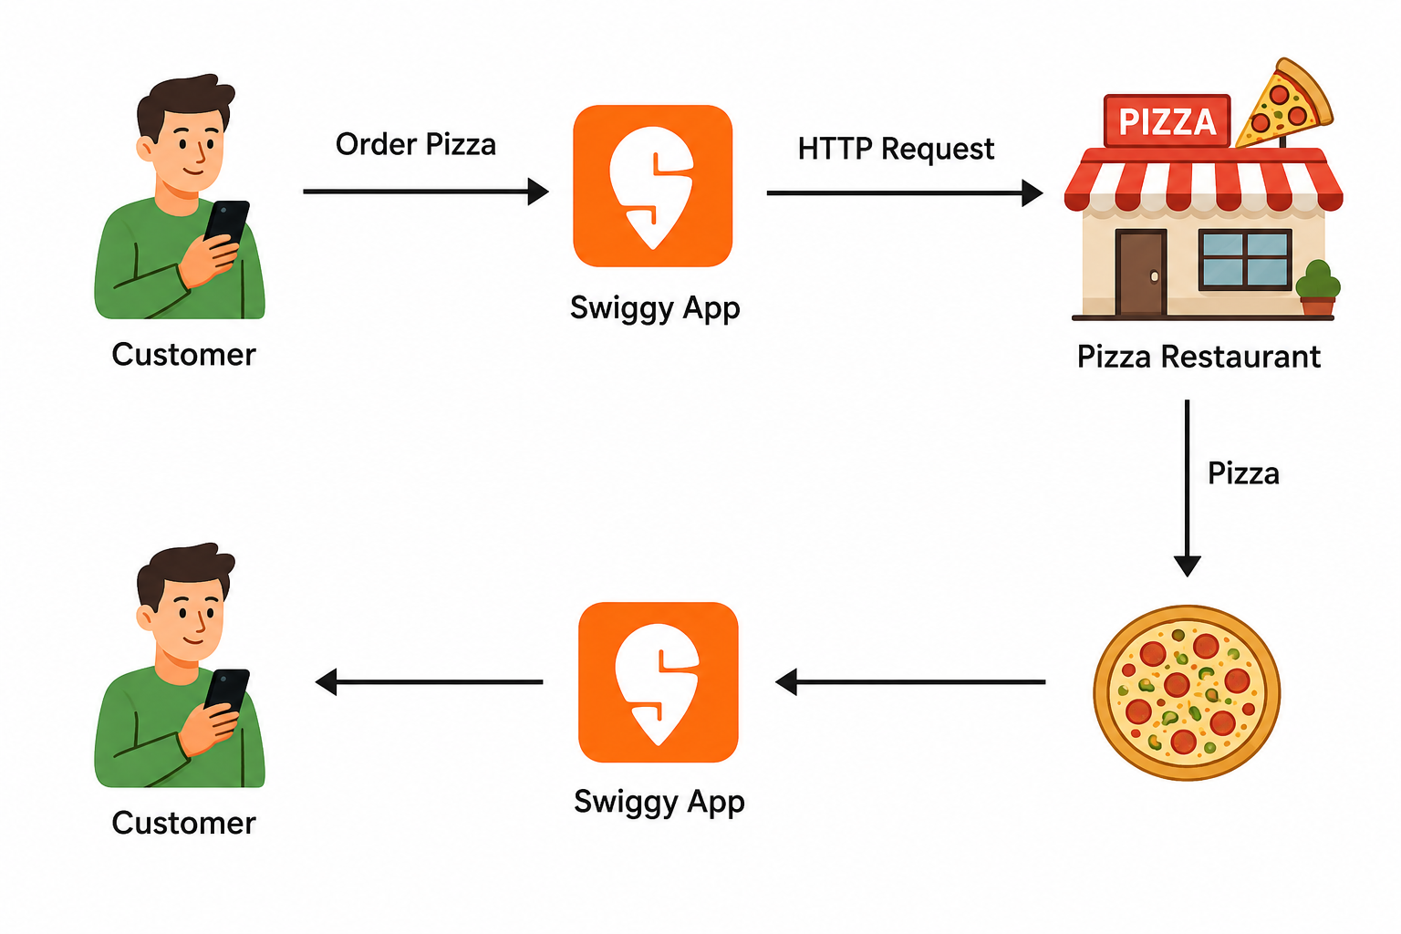
What is Web API?
A Web API (Application Programming Interface) is a software interface that allows one application to communicate with another over the internet using HTTP.
Simply, A Web API is a messenger between Client and Server.
Web API
Here Client can be Mobile Apps, Web Browsers, Smart Devices, Postman, Scalar. (For Request & Response Handling)
Client
Client

Slide 5
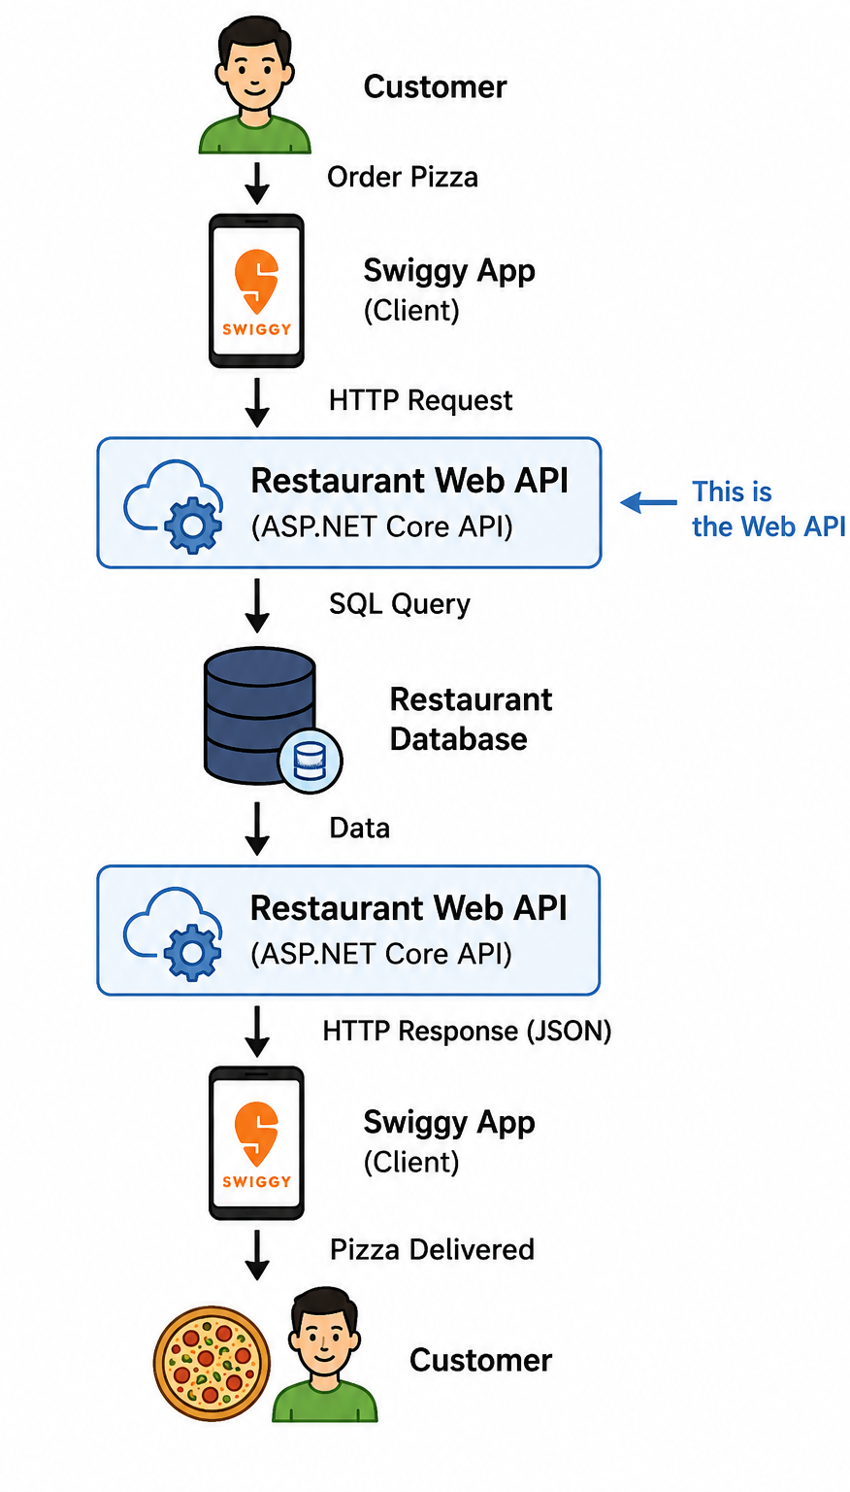
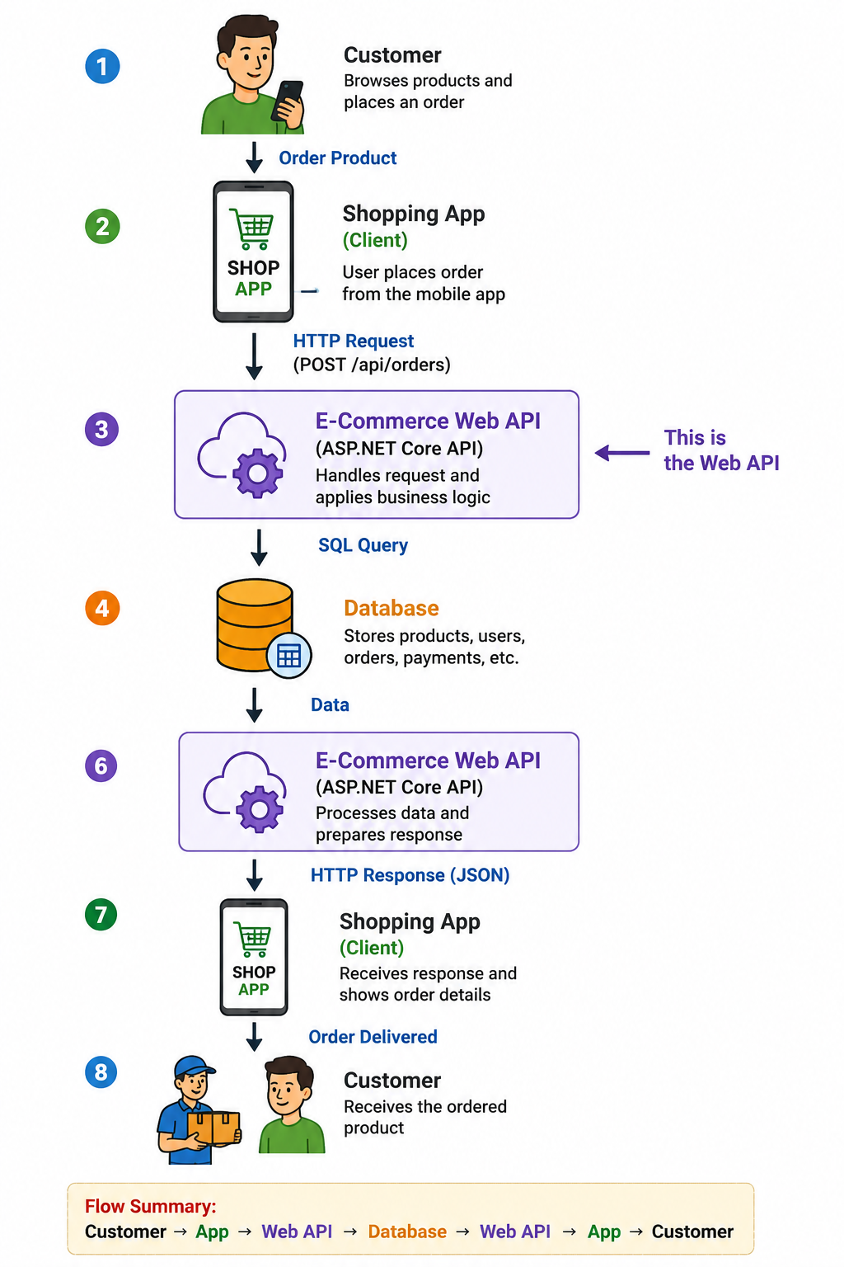
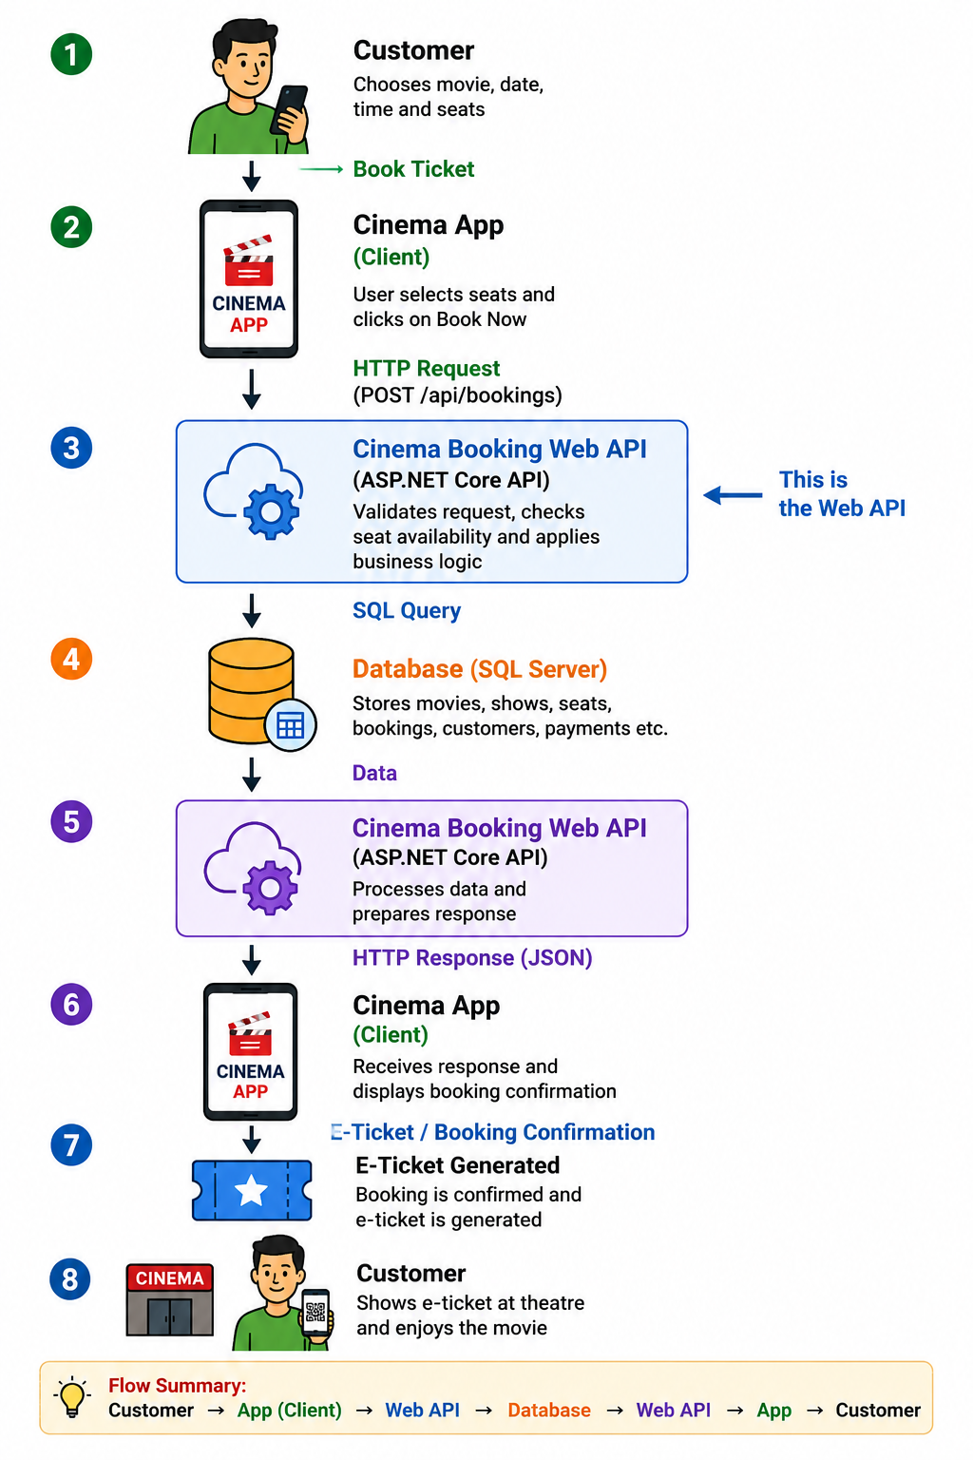
Web API Examples

Slide 6


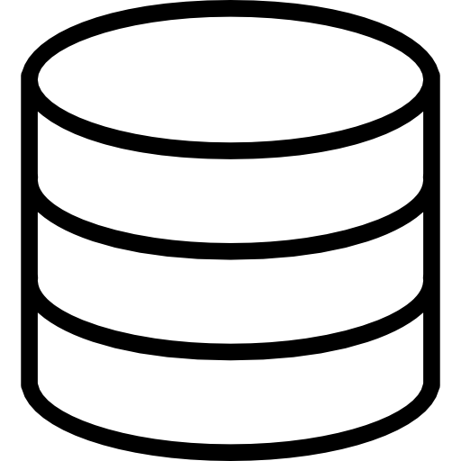



Need of API
We aim to establish communication between all these Android, iOS & web applications to the database.
So, what will we do? We will create a new separate project for all the platforms.
This individual application will interact with the database.
But this is totally wrong practice, because separate coding, separate logic & separate files.
So, what we have to do is to create an API Project and all these applications (frontend) will connect to it.
Database
Web API
Database

Slide 7
Need of API Cont..
So, these websites, Android and iOS applications, do not have direct access to the database.
They only need to communicate with the Web APIs, and it is the Web API project’s responsibility to interact with the database.
The entire business logic will be written in the Web API project only.
So, Web API acts as a mediator between the Front-End and Back-End.
Web API
Database

Slide 8
HTTP
(HyperText Transport Protocol)
Section - 2

Slide 9
HTTP (HyperText Transport Protocol)
How Browser and Server Communicate with Each Other?
What is HTTP?
HTTP Request/Response Components
HTTP Verbs or HTTP Methods
HTTP Status Codes

Slide 10
1. How Browser and Server Communicate with Each Other?
Suppose, we open the web browser, type the URL in the browser and press the enter button.
As soon as you press enter, a request is going to the server (called a web server).
Whatever data you are sending from the web browser to the web server is called a Request and whatever data you are receiving from the web server is called a Response & this type of communication is only possible by using HTTP Protocol.
So, the request can be termed an HTTP Request and the response can be called HTTP Response.
For example, if you are using a mobile application, then your mobile is a client.
https://darshan.ac.in/
HTTP Request
Server
HTTP Response
Web Browser
Web Server

Slide 11
2. What is HTTP?
HTTP stands for HyperText Transfer Protocol.
It is an application-layer protocol used for communication on the World Wide Web.
It is also called as communication protocol.
It is used to send and receive web pages and files on the internet.
It serves as a foundation for exchanging information between a web server and a client, typically a web browser.
HTTP enables the retrieval of resources such as HTML documents, images, videos, and other media files, allowing users to access websites and navigate the internet.
It follows a request-response model, where a client sends an HTTP request to a server, and the server responds with an HTTP response containing the requested information.

Slide 12
3. HTTP Request Components
An HTTP request is made by the client to request a resource from the server, and the server responds with an HTTP response containing the requested resource or an error message.
When we send something from the client (browser, mobile, postman etc.) to the server (webserver) is called a Request.
The request is formed with a couple of components, are as follows.
Component | Description
URL | Each Request must have a unique URL
Verb (Method) | Each Request must have an HTTP Verb (Majorly GET, POST, PUT & DELETE)
Header(s) | Each Request can contain one or more Headers
Body | Each request can have a body. The body contains the data that we want to send to the server.
Web Browser, Mobile App, Postman, Scalar
HTTP Request
Server
Clients
Web Server
URL, Verb, Header, Body

Slide 13
3. HTTP Response Components
Whatever we get from the webserver to the clients is called HTTP Response.
The HTTP response contains the following components.
Component | Description
HTTP Status Code | It must have a Status Code
Response Headers | It can have one or more response headers
Data | Response can have data i.e. return to the client
Web Browser, Mobile App, Postman, Scalar
HTTP Response
Server
Clients
Web Server
Http Status Code, Response Header(s), Data

Slide 14
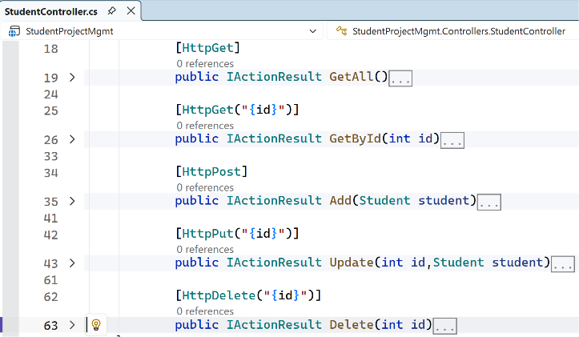
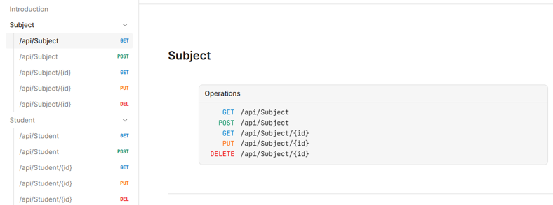
4. HTTP Verbs or HTTP Methods
HTTP verbs, also known as HTTP methods, are a set of standardized actions that can be performed on resources using the HTTP (Hypertext Transfer Protocol) protocol.
Each HTTP request typically includes a verb/method to indicate the desired action to be taken.
The primary or most-commonly-used HTTP verbs are POST, GET, PUT, and DELETE.

Slide 15
4. HTTP Verbs or Methods – Real-World Analogies
Remember
HTTP Method | Usage | Response | Idempotent
GET (Read) | Fetch data | 200 OK with data | ✅ Yes
POST (Create) | Submit new resource | 201 Created / 200 OK | ❌ No
PUT (Update) | Update full resource | 200 OK / 204 No Content | ✅ Yes
PATCH (Update[Partial]) | Update part of a resource | 200 OK / 204 No Content | ✅ Yes (ideally)
DELETE (Delete) | Remove resource | 204 No Content | ✅ Yes

Slide 16
4. HTTP Verbs or HTTP Methods (PUT v/s PATCH)
Method | Description
PUT | The PUT method is used to update all the properties of the current resource in the database. If we want to update all properties of a particular product (i.e. current resource) then we need to use PUT HTTP Request. So, whenever you want to update all the properties (column) of a resource (existing record in the database) It is idempotent.
PATCH | There are some situations where you don’t want to update all the properties of an existing resource instead you want to update a few of the properties, then you need to use the PATCH method. So, the PATCH method is similar to the PUT method, but it is used to update a few properties of the current resource in the database. For example, if you want to update a few properties (columns) of an existing product then you need to use the PATCH method. That means if your Product table contains 10 columns, and you want to update only four columns of an existing product, then you need to use the PATCH method. So, it applies partial modifications to a resource. It is used to update only specific parts of a resource, rather than replacing the entire resource.

Slide 17
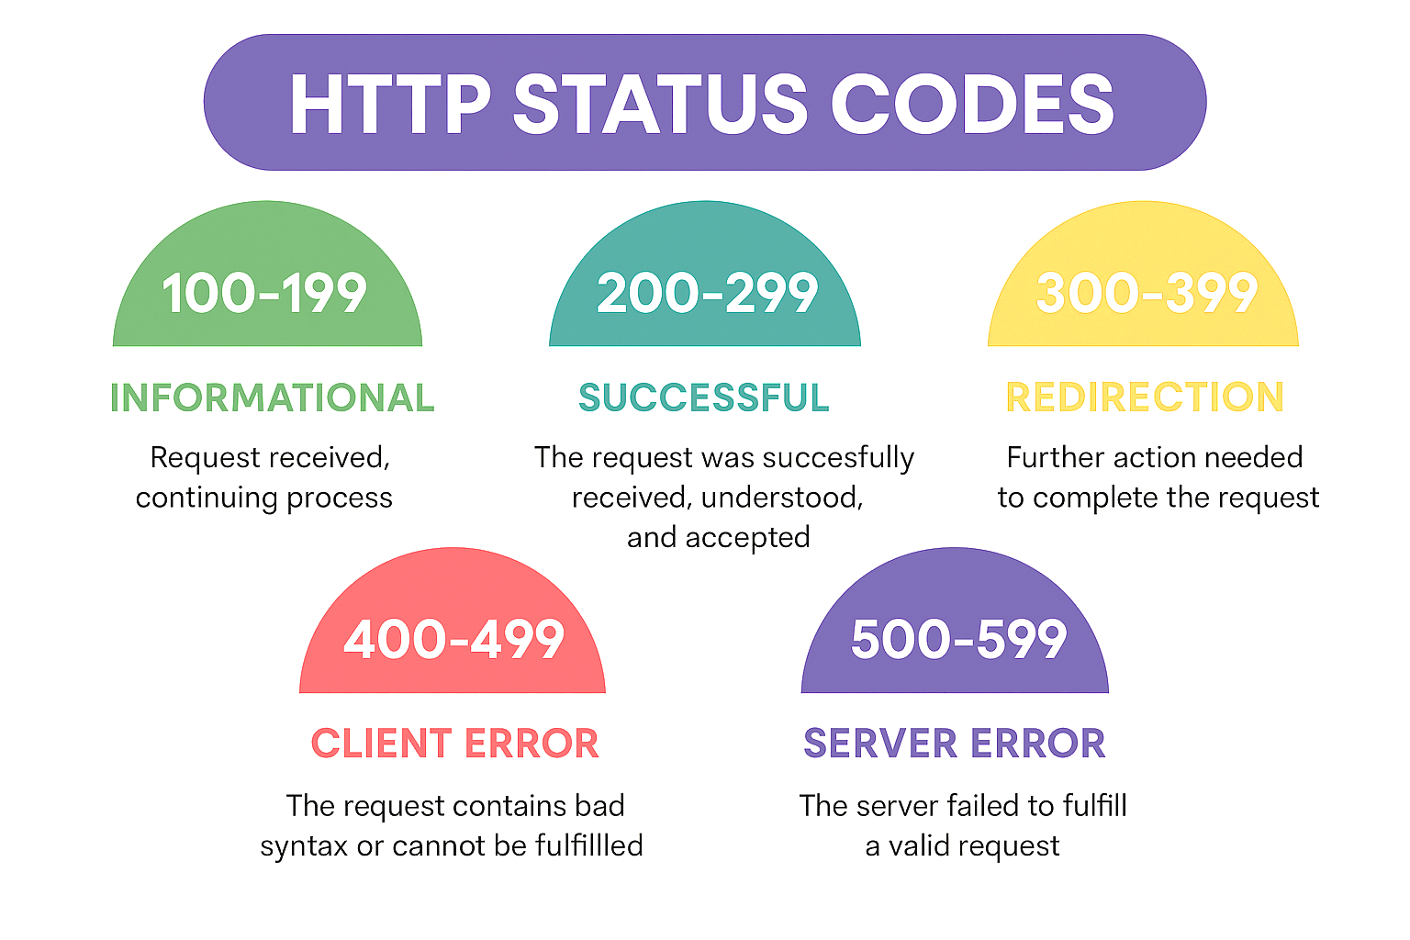
5. HTTP Status Codes

Slide 18
5. HTTP Status Codes Cont..
1XX: Informational Response (Example: 100, 101, 102, etc.)
  Status codes in the 1xx range indicate that the server has received the client’s request and is continuing the process.
  These codes are primarily used for informational purposes and do not typically require any action from the client.
2XX: Successful Response (Example. 200, 201, 203, 204, etc.)
  Whenever you get 2XX as the response code, it means the request is successful.
  Status codes in the 2xx range indicate that the client’s request was successfully received, understood, and accepted by the server.
  These codes typically indicate that the requested action was successfully completed.
3XX: Redirection Response (Example. 301, 302, 304, etc.)
  Whenever you get 3XX as the response code, it means it is re-directional i.e. some re-directional is happening on the server.
  Status codes in the 3xx range indicate that further action is needed by the client to complete the request.
  These codes are used when a resource has been moved or is temporarily unavailable, and the client needs to take additional steps to access the resource.

Slide 19
5. HTTP Status Codes Cont..
4XX: Client Error Response (Example: 400, 401, 404, 405, etc.)
  Whenever you get 4XX as the response code, it means there is some problem with your request.
  Status codes in the 4xx range indicate that the client’s request was not successful due to an error on the client’s side.
  These codes are often associated with issues such as invalid requests, unauthorized access, or missing resources.
5XX: Server Error Response (Example: 500, 502, 503, 504, etc.)
  Whenever you get 5XX as the response code, it means there is some problem in the server.
  Status codes in the 5xx range indicate that the server encountered an error while processing the client’s request.
  These codes are typically associated with issues on the server side, indicating that the requested action could not be completed due to server-related problems.

Slide 20
Problems Without Web APIs
Section - 2

Slide 21
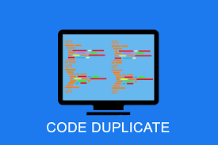

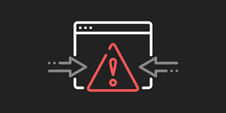

Problems Without Web APIs
1. Duplicate logic for each Application
The business should have some business logic. We will write the same logic for each application type, which means repeating the same logic for each type of application. This will duplicate our code.
3. Some Front-end frameworks cannot communicate directly with the Database
If you are developing the website (i.e., front-end) using the angular framework, then the angular framework cannot communicate with the database directly. Angular is a front-end framework.
2. Error-Prone Code
The business logic has been written in each type of application. We have to write the code in three different applications in our example. So, you might miss some code or logic in some applications. This will add more errors to your application.
4. Hard to Maintain
This type of structure is hard to maintain. This is because we have written the code in many places, and if we want to improve something in our application, we need to do the same thing in many places.

Slide 22
Key Characteristics of Web APIs
Section - 4

Slide 23
Key Characteristics of Web APIs
HTTP-based Communication:
  Most Web APIs are designed to work over HTTP, the same protocol used for web browsing.
  This means APIs can be accessed using standard HTTP methods like GET, POST, PUT, DELETE, etc.
  The API endpoints are typically represented as URLs (Uniform Resource Locators).
Data Exchange Formats:
  Web APIs use standardized data exchange formats such as JSON (JavaScript Object Notation) and XML (eXtensible Markup Language) to structure and transmit data between the client and server.
  JSON has become the most popular format due to its simplicity and ease of use.
RESTful Architecture:
  Many Web APIs are designed following Representational State Transfer (REST) principles.
  A RESTful API is stateless, uses standard HTTP methods, and organizes resources into a hierarchy with unique URLs for each resource.
Authentication and Authorization:
  Web APIs often implement security mechanisms for authentication and authorization to ensure that only authorized clients can access certain resources or perform specific actions.
  Common authentication methods include API Keys, OAuth, and JWT (JSON Web Tokens).

Slide 24
JSON
(JavaScript Object Notation)
Section - 5

Slide 25
What is JSON?
JSON (JavaScript Object Notation) is a lightweight data-interchange format that is easy for humans to read and write and for machines to parse and generate.
Many different programming languages use JSON which is a great way to ensure that different systems can work together and understand each other’s data.
It uses human-readable text to store and transmit data objects consisting of attribute–value pairs and arrays (or other serializable values).
JSON is a language-independent data format.
JSON is “name/value” assembly. Its structure is made up with {}, [], comma, colon and double quotation marks.
Valid data types in JSON are Object, Number, Boolean, String, Array, Null.
JSON filenames use the extension .json.
It is commonly used for transmitting data between a server and a web application as an alternative to XML, and has many business applications.

Slide 26
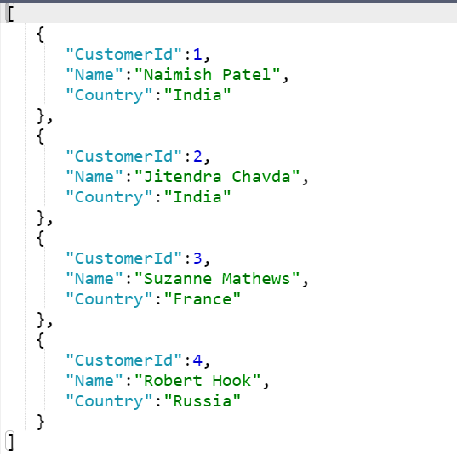
Example: JSON string returned from the API
Sample JSON
In .NET, we have two most common libraries to handle JSON:
Newtonsoft.Json
  Third-party powerful library with many features, including support for complex object graphs, custom converters, and more.
System.Text.Json
  High-performance JSON serialization and deserialization library introduced by Microsoft.
using System.Text.Json;
//To serialize
var jsonStr = JsonSerializer.Serialize(MyObject);
//To Deserialize
var weather = JsonSerializer.Deserialize<MyObject>(jsonStr);

Slide 27
Difference between JSON serialize and JSON deserialize?
Serialization
  Serialization means to convert an object into that string. (Object → String)
  Serialization is the process of converting the state of an object, that is, the values of its properties, into a form that can be stored or transmitted.
  The serialized form doesn't include any information about an object's associated methods.
  So, serialization converts the object into a shareable format.
Deserialization
  Deserialization is its inverse operation (String → Object).
  Deserialization is the process of converting the serialized stream of data into the original object state.
  This ensures that the original state is not altered and is recreated when we need it.

Slide 28
JSON Serialization Example
//Student.cs
namespace SerializeDemo
{
public class Student
{
    public int StudentID { get; set;} public string Name { get; set; }
        public string City { get; set; }
}
}
//Program.cs
using SerializeDemo;
using Newtonsoft.Json;
Student std = new Student()
{
StudentID = 101,
Name = "Naimish",
City = "Rajkot"
};
string jsonData = JsonConvert.SerializeObject(std);
Console.WriteLine(jsonData);
Output

Slide 29
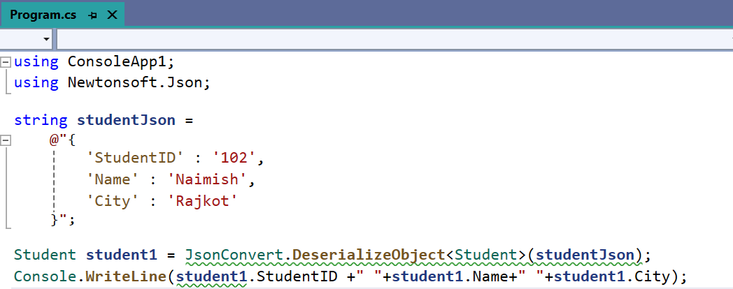
JSON Deserialization Example
Output

Slide 30
Different styles of JSON
Object
  An unordered “name/value” assembly.
  An object begins with “{“ and ends with “}”.
  Behind each “name”, there is a colon. And comma is used to separate much “name/value”.
Array (Multiple Objects)
  Value order sets, an array begins with “[“ and end with “]”.
  Values are separated with commas.
String
  Any quantity Unicode character assembly which is enclosed with quotation marks.
  It uses a backslash to escape.

Slide 31
Middleware
Section – 6

Slide 32
Middleware
Middleware is one of the core functionalities of any ASP.NET Core Web Application.
When we send a request from the client to the server, middleware comes into the picture.
HTTP Request Pipeline:
  Before understanding ASP.NET Core Middleware components, let us first understand what is HTTP Request Pipeline and how does it work.
  Please have a look at the following image for a better understanding of the HTTP Request Pipeline.
  As you can see in the below image, on the left-hand side, we have the client i.e. a browser and on the right-hand side, we have the server where our ASP.NET Core Web API application is hosted.
  Further, the Web API Application has three controllers.
  So, when the client sends a request to the server, we generally believe that it is the controller action method that is going to serve the request and then we get the response.
HTTP Request
Controller1
Controller2
Controller3
Client
HTTP Response
Web Browser
Web Server

Slide 33
Middleware Cont..
But in reality, before hitting the controller action method, the request has to pass through a pipeline.
Once the pipeline is completed, then only it navigates the request to the corresponding controller action method as shown in the below image.
Pipeline
HTTP Request
Client
Controller1
Controller2
Controller3
HTTP Response
Web Browser
Web Server

Slide 34
HTTP Request Pipeline
Now the confusion is what is Middleware?
Let us assume a middleware is a piece of code with some logic.
Middleware 1
Middleware 2
Middleware 3
HTTP
Request
Logic
Next();
Logic
Next();
Logic
Logic
Logic
HTTP
Response
Controller
BAL
DAL

Slide 35
HTTP Request Pipeline Cont..
Whenever a request comes from a client to the server, then the request comes to the first middleware which is registered in the request pipeline.
In our case it is Middleware1. The code or logic which is there in Middleware1 will be executed and then if it will call the next method, then the request goes to the next middleware which is registered in the request processing pipeline i.e. Middlware2.
The code or logic which is there in Middleware2 will be executed and if it calls the next method, then it navigates to the request to the next middleware i.e. Middleware3. Let us assume, in Middleware3, we don’t have the next method.
So, the code or logic which is there in Middleware3 will be executed and as there is no next method call, so the request will come back to the previous middleware i.e. Middleware2.
And if there is some code after the next method in Middleware2, then those codes will be executed and once the code executed the request again comes back to the previous middleware i.e. Middlwware1.
Similarly, if there is some code after the next method in Middleware1, then those codes will be executed and once the code gets executed the final response sends to the client who initially made the request.

Slide 36
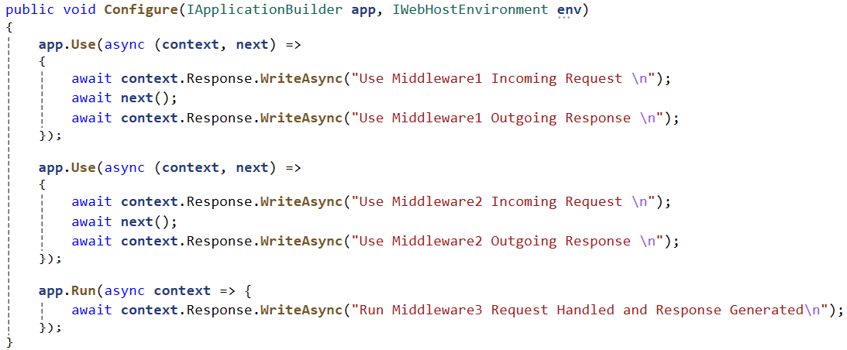
HTTP Request Pipeline in ASP.NET Core Example Cont..

Slide 37
Middleware Cont..
Middleware is a piece of code that is used in the HTTP Request Pipeline.
An ASP.NET Core Web API Application can have n number of middlewares.
So, depending upon the requirement, we can configure n number of middlewares in the application request processing pipeline.
The order of middleware matters a lot in the execution.
That means in the order they are configured into the request processing pipeline; in the same order, they are going to be executed when a request comes (response).
Each middleware in the ASP.NET Core Web API Application performs the following tasks.
  Chooses whether to pass the HTTP Request to the next component in the pipeline. This can be achieved by calling the next() method within the middleware.
  It can perform work before and after the next component in the pipeline.
ASP.NET Core provides some built-in middleware that is ready to be used, even if you want then you can also create your own custom middleware.

Slide 38
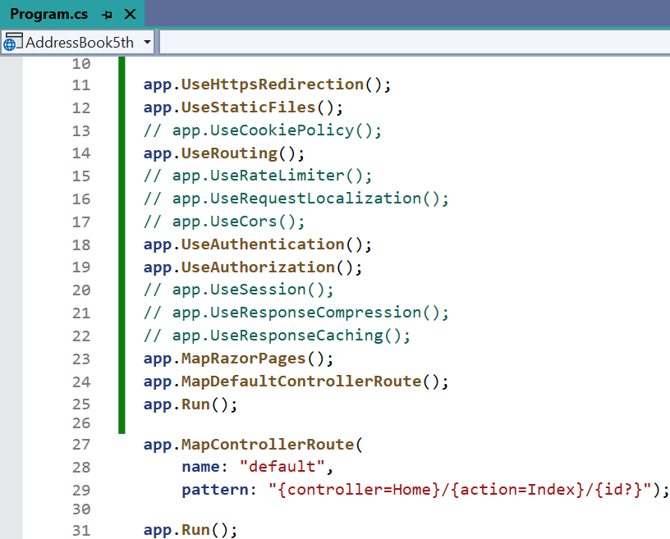
Middleware in Cont..
The most important point that you need to keep in mind is, in ASP.NET Core a given Middleware component should only have a specific purpose i.e. single responsibility.
Middleware Examples:
  Routing: If you want to implement Routing in your application, then you need to use Routing Middleware in the HTTP Request Processing pipeline.
  Authentication: If you want to authenticate the user then you need to use Authentication Middleware.
  Authorize: The Authorize Middleware is used to Authorize the users while accessing a specific resource.
  Log: If you want to log request and response while processing, then you need Middleware.
  Exception Middleware: You can also use Middleware to handle the exception globally.

Slide 39
Run, Use, Next, and Map Methods in Middleware
In order to work with ASP.NET Core Middleware Components, we need to learn about few methods are as follows:
Run() Method:
  The Run() Extension Method is used to complete the Middleware Execution.
  i.e. app.Run();
Use() Method:
  The Use() Extension Method is used to insert a new Middleware component to the Request Processing Pipeline.
  i.e. app.UseSwagger(); | app.UseSwaggerUI(); | app.UseAuthorization(); etc.
Next() Method:
  The Next() Extension Method is used to call the next middleware component in the request processing pipeline.
Map() Method:
  The Map() Extension Method is used to map the Middleware to a specific URL.
  i.e. app.MapControllers();

Slide 40
Dependency Injection (DI) & Service Lifetime
Section – 7

Slide 41
Introduction
In every application, one class often needs the help of another class to complete its work. The class that provides this help is called a dependency.
For example, imagine an application where users can register an account.
After successful registration, the application needs to send a notification to the user.
The notification can be sent through: Email, SMS, WhatsApp
The User Registration module depends on a Notification Service.
The important question is:
  Who should create the dependency?
  Should the User Registration class create it by itself, or should someone else provide it?
This is where Dependency Injection (DI) comes into the picture.

Slide 42
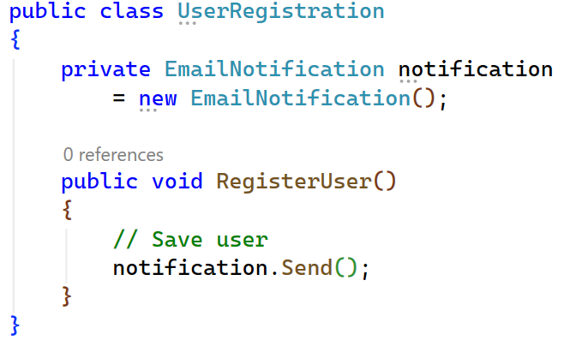
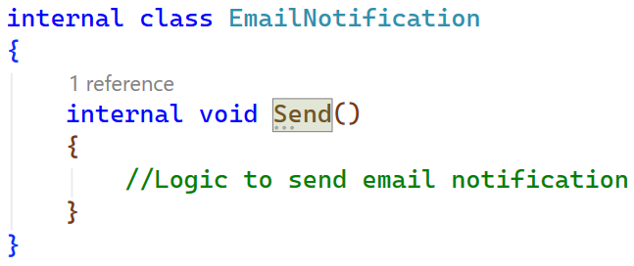
What Happens Without Dependency Injection?
Suppose the developer writes,
Here, the UserRegistration class creates the EmailNotification object using the new keyword.
The code works, but it creates several problems.

Slide 43
Problems Without Dependency Injection
Tight Coupling
  The UserRegistration class is directly connected to the EmailNotification class.
  Suppose the company decides to send SMS instead of Email, we must change class from EmailNotification to SMSNotification.
  Again, if the company decides to send WhatsApp messages, we must change the code again.
  Every business change requires modifying the UserRegistration class.
  This creates tight coupling.
Difficult to Test
  Suppose you are testing the registration process. You don't want to send real emails every time because:
    Users may receive unwanted emails.
    It increases testing time.
    It may require an internet connection.
    It may use a paid email service.
  During testing, you only want to check whether the notification method was called.
  Without DI, the class always creates a real EmailNotification object.
  Replacing it with a fake notification becomes difficult.

Slide 44
Problems Without Dependency Injection Cont..
Difficult to Replace Implementations
  Initially, the application uses Email notifications.
  Later, the business wants:
    SMS, WhatsApp, Push Notification
  Without DI, the developer must modify every place where EmailNotification is created.
  This increases development effort and introduces unnecessary risks.
Less Flexible
  The UserRegistration class only knows how to send emails.
  If tomorrow a new notification method is introduced, existing code must be modified.
  A good application should allow adding new features without changing existing business logic.
Difficult to Maintain
  In a real project, notifications may be sent from many different modules. Like Login, Forget Password, Orders, Payments etc.
  If every module creates its own EmailNotification object, changing the notification system later becomes a large task.
  Maintenance becomes difficult.

Slide 45
What is Dependency Injection?
Dependency Injection is a design pattern in which a class does not create its own dependency(objects or services).
Instead of creating dependencies (objects or services) directly within a class, dependencies are injected into the class from outside, typically through constructor parameters.
The class only uses the object.
It does not know:
  How the object is created.
  Which implementation is being used.
  When the object is created.
This responsibility is handled by the Dependency Injection Container.

Slide 46
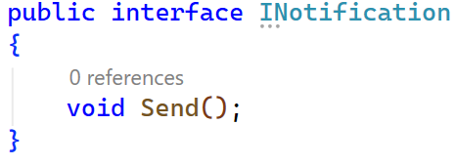
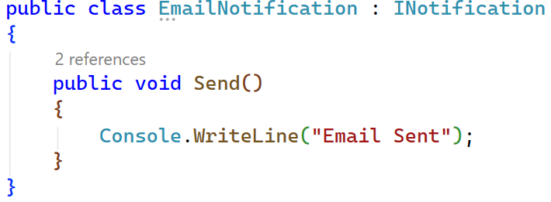
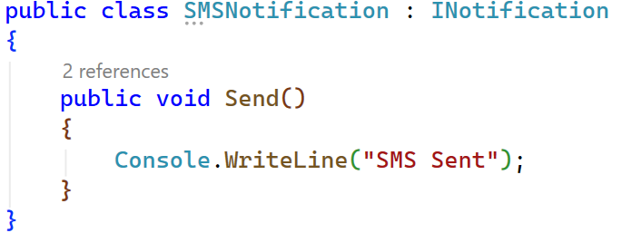
Using Dependency Injection
First, create an interface.
Now different notification classes implement the interface.

Slide 47
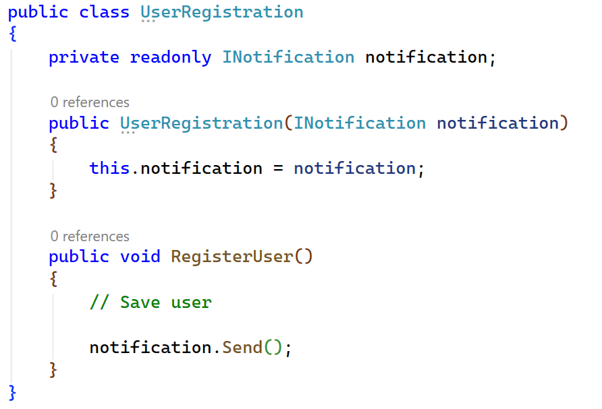
Using Dependency Injection Cont..
Now the UserRegistration class receives the dependency.
Here, UserRegistration no longer creates an EmailNotification.
It only depends on INotification.

Slide 48
How Dependency Injection is Performed?
In Program.cs, register the dependency.
This tells, Whenever a class requests an INotification, provide an instance of EmailNotification.
Now, when UserRegistration is created, .NET automatically creates the EmailNotification object and passes it to the constructor.
If the business later decides to use SMS instead of Email, only one line changes:
No changes are required in the UserRegistration class

Slide 49
Service Lifetimes in Dependency Injection
When we register a service in the Dependency Injection (DI) container, we also tell how long that service object should stay alive.
This is called the Service Lifetime.
There are three service lifetimes:
  Transient: New object every time
  Scoped: One object per HTTP request
  Singleton: One object for the entire application
The lifetime determines when a new object is created and how long it is reused.

Slide 50
Service Lifetimes in Dependency Injection Cont..
1. Transient Lifetime
A Transient service creates a new object every time it is requested from the DI container.
Even if the same service is requested multiple times during the same HTTP request, .NET creates a new instance each time.
Example:
  Suppose an application generates a PDF Invoice, Every invoice is different as it contains different customer details, products, and prices.
  Whenever someone requests an invoice, a new InvoiceGenerator object should be created.
    User A downloads Invoice 101 → New object is created.
    User A downloads Invoice 102 → Another new object is created.
    User B downloads Invoice 103 → Another new object is created.
Each request gets a completely new object.
Characteristics:
  A new object is created every time.
  Objects are not shared.
  Best for lightweight and stateless services.

Slide 51
Service Lifetimes in Dependency Injection Cont..
2. Scoped Lifetime
A Scoped service creates one object for each HTTP request.
If multiple classes use the same service during that request, they all receive the same object.
When the request is completed, the object is destroyed.
Example:
  Suppose a user places an order.
  During one request, multiple components like Order Service, Payment Service Invoice Service need notification details.
  All of them use the same Notification Service object during that request.
  When another user places a new order, .NET creates a new Notification Service object.
Characteristics:
  One object per HTTP request.
  Shared within the same request.
  New object for every new request.
This is the most commonly used lifetime in Web APIs.

Slide 52
Service Lifetimes in Dependency Injection Cont..
3. Singleton Lifetime
A Singleton service creates only one object for the entire application.
The same object is shared by every user and every request until the application stops.
Example:
  Suppose your application stores Application Configuration Settings.
  For Example, Company Name, Support Email, Website URL, Tax Percentage
  These values are the same for every user.
  Instead of creating the configuration object again and again, .NET creates it only once.
  Every request uses the same object.
Characteristics:
  Only one object is created.
  Shared across the entire application.
  Exists until the application stops.

Slide 53
Comparison of Service Lifetimes
Lifetime | Object Creation | Object Sharing | When to Use | Best Use Case
Transient | New object every time it is requested | Not shared | The service does not store data. Every operation should use a new object. The service is lightweight. | PDF Generator Email Formatter Validation Service
Scoped | One object per HTTP request | Shared within the same request | The object should remain the same throughout one HTTP request. Multiple services need to share the same instance during that request. | Business Services Database Context (DbContext), Repository Classes
Singleton | Only one object for the whole application | Shared by all users and requests | The object contains common data shared by everyone. The object is expensive to create. The data rarely changes. | Configuration Logging Service Memory Cache Application Settings

Slide 54

Building RESTful APIs with
ASP.NET Core
#2505CS311
Prof. Madhuresh R Fichadiya
Computer Science & Engineering Department
Madhuresh.fichadiya@darshan.ac.in
8866961282

