Slide 1

Unit-2
Entity Framework (EF) Core & Database Access
Building RESTful APIs with
ASP.NET Core
#2505CS311
Prof. Madhuresh R Fichadiya
Computer Science & Engineering Department
Madhuresh.fichadiya@darshan.ac.in
8866961282

Slide 2

Looping
Outline
  EF Core
  LINQ
  Dapper

Slide 3

Looping
Outline
  Introduction to EF Core & ORM
  EF Core CRUD Operations
  Code-First vs. Database-First
  DbContext & DbSet
  Migrations
  Tracking and No-Tracking Queries
  Async/Await
  DTOs (Data Transfer Objects)
  LINQ
  Dapper

Slide 4
EF Core
Section - 1

Slide 5
Introduction to EF Core & ORM
Section – 1.1

Slide 6
Intro: EF (Entity Framework) Core
What is EF Core?
  EF Core is an ORM (Object-Relational Mapper) that lets you interact with a database using C# classes instead of SQL queries directly.
  Install EF Core Packages:
    Microsoft.EntityFrameworkCore.SqlServer
    Microsoft.EntityFrameworkCore.Tools
What is ORM?
  An Object-Relational Mapper (ORM) is a software tool that helps you interact with a relational database (like SQL Server, MySQL) using objects in your programming language (like C# classes) — without writing raw SQL queries.
  ORM converts database tables into C# classes and rows into objects — and vice versa.
Without ORM (SQL)
1
SELECT * FROM Students WHERE StudentId = 1
It generates the SQL query in the background,
Fetch the data from the database,
Convert the row into a Student object.
With ORM (C#)
1
var student = _context.Students.Find(1);

Slide 7
Object-Relational Mapper (ORM)
📌 Benefits of Using an ORM:
  ✅ Less SQL Code
  ✅ Compile-time type checking
  ✅ Easy data access with LINQ
  ✅ Automatic table creation (via migrations)
  ✅ Better maintenance & readability
⚙ Popular ORMs
  EF Core – for .NET (C#)
  Hibernate – for Java
  Django ORM – for Python
  Active Record – for Ruby on Rails

Slide 8
EF Core Basic CRUD Operations
Section – 1.2

Slide 9
EF (Entity Framework) Core Basic CRUD - Steps
Steps
Install EF Core Packages
    Microsoft.EntityFrameworkCore.SqlServer
    Microsoft.EntityFrameworkCore.Tools
Define the Student Model (Entity)
  public class Student
  {
  public int StudentId { get; set; }
  public string FullName { get; set; }
  public string Email { get; set; }
  }
Create the DbContext Class
  public class AppDbContext : DbContext
  {
  public DbSet<Student> Students { get; set; }
  public AppDbContext(DbContextOptions<AppDbContext> options) : base(options)
  {
  }
  }

Slide 10
EF (Entity Framework) Core Basic CRUD – Steps Cont..
Steps
Add Connection String (appsettings.json)
  "ConnectionStrings": {
  "DefaultConnection": "server=Naimish; database=NRVDemo; trusted_connection=true; TrustServerCertificate=True;"
  }
Configure in Program.cs
  builder.Services.AddDbContext<NrvdemoContext>(options=>options.UseSqlServer(builder.Configuration.GetConnectionString("DefaultConnection")));
Migrations & Database Creation (Package Manager Console / Command)
  Add-Migration {MigrationName}
  Update-database

Slide 11
EF Core Basic CRUD Operations | Students Controller
Create
1
2
3
4
5
6
7
[HttpPost]
public IActionResult InsertStudent(StuStudent student)
{
_context.StuStudents.Add(student);
_context.SaveChanges();
return NoContent();
}
Read
1
2
3
4
5
6
[HttpGet("All")]
public IActionResult GetStudents()
{
var students = _context.StuStudents.ToList();
return Ok(students);
}

Slide 12
EF Core Basic CRUD Operations | Students Controller Cont..
Update
1
2
3
4
5
6
7
8
9
10
11
12
13
14
15
16
[HttpPut("{id}")]
public IActionResult UpdateStudent(int id, StuStudent student)
{
var existingStudent = _context.StuStudents.Find(id);
if (existingStudent == null)
{
return NotFound();
}
existingStudent.StudentName = student.StudentName;
existingStudent.Age = student.Age;
existingStudent.Email = student.Email;
_context.StuStudents.Update(existingStudent);
_context.SaveChanges();
return NoContent();
}

Slide 13
EF Core Basic CRUD Operations | Students Controller Cont..
Delete
1
2
3
4
5
6
7
8
9
10
11
12
[HttpDelete("{id}")]
public IActionResult DeleteStudentById(int id)
{
var students = _context.StuStudents.Find(id);
    if (students == null)
    {
    return NotFound();
    }
_context.StuStudents.Remove(students);
_context.SaveChanges();
return NoContent();
}

Slide 14
Code-First v/s Database-First Approach
Section – 1.3

Slide 15
Code-First vs. Database-First Approaches
Aspect | Code-First | Database-First
Starting Point | C# classes and code | Existing database schema
Model Definition | Defined in C# (manual or with annotations) | Auto-generated from database
Schema Generation | Migrations create/update database | Database schema is pre-defined
Tools | Add-Migration, Update-Database | Scaffold-DbContext
Flexibility | High (Fluent API, code-driven) | Limited (tied to database structure)
Maintenance | Easier to evolve with migrations | Re-scaffolding needed for schema changes
Use Case | New projects, code-driven teams | Legacy databases, DB-driven teams

Slide 16
DbContext & DbSet
Section – 1.4

Slide 17
DbContext & DbSet
In Entity Framework Core (EF Core), DbContext and DbSet are fundamental building blocks used to interact with a database using the Object-Relational Mapping (ORM) approach.
DbContext – The Bridge to the Database
  Think of DbContext as the primary class that coordinates EF Core functionality.
  It manages the connection to the database, tracks changes, and handles CRUD operations (Create, Read, Update, Delete).
  You define your own class that inherits from DbContext and specifies the entities (tables) it will manage.
Example
1
2
3
4
5
6
7
8
9
10
11
12
13
public class HMSContext : DbContext
{
public HMSContext()
{
}
public HMSContext(DbContextOptions<HMSContext> options)
: base(options)
{
}
public DbSet<Doctor> Doctors { get; set; }
public DbSet<Patient> Patients { get; set; }
public DbSet<Student> Students { get; set; }
}

Slide 18
DbContext & DbSet Cont..
DbSet<TEntity> – Represents a Table
  DbSet<TEntity> represents a table in the database.
  Each DbSet property allows querying and saving instances of that entity (T).
  EF Core uses it to perform LINQ queries and track entities.
  It allows querying and CRUD operations.
DoctorModel.cs
In the Context
1
2
3
4
5
6
7
8
9
public class Doctor
{
public int DoctorId { get; set; }
public string DoctorName { get; set; }
public string ContactNo { get; set; }
public int? Age { get; set; }
public DateTime? Dob { get; set; }
public string? BloodGroup { get; set; }
}
1
public DbSet<Doctor> Doctors { get; set; }
In the Controller
1
2
3
var allDoctors = _context.Doctors.ToList();
var doctor = _context.Doctors.Find(1);
_context.SaveChanges();

Slide 19
EF Core Migrations
Section – 1.5

Slide 20
EF Core Migrations
A Migration is a feature of Entity Framework Core (EF Core) that automatically creates or updates the database based on your C# model classes.
Migration is the bridge between your C# Model classes and the SQL Database.
Instead of manually writing SQL statements like CREATE TABLE or ALTER TABLE, EF Core generates them automatically.
Migration keeps your database schema synchronized with your C# model classes.
Prerequisites
  Make sure your project has:
    A DbContext class.
    A database provider package installed (e.g., Microsoft.EntityFrameworkCore.SqlServer)

Slide 21
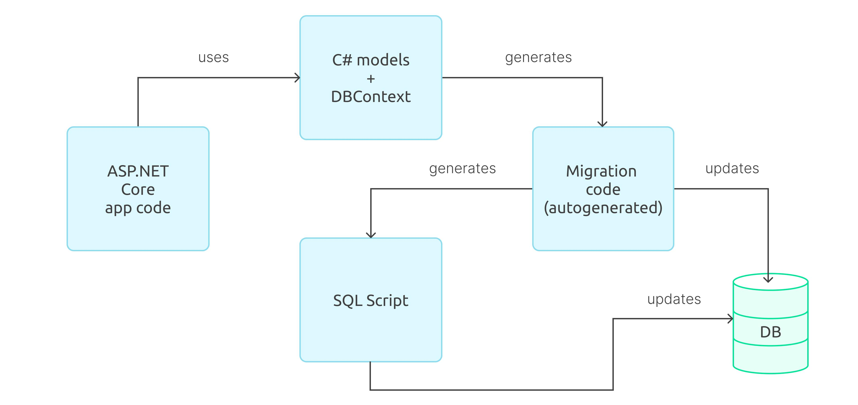
EF Core Migrations Cont..

Slide 22
EF Core Migrations Commands
Common Migration Commands (Use these in the Package Manager Console (or CLI) in Visual Studio)
Command | Purpose
add-migration [name] | Create a new migration with the specific migration name.
remove-migration | Remove the latest migration.
update-database | Update the database to the latest migration.
update-database [name] | Update the database to a specific migration name point.
get-migration(s) | Lists all available migrations.
script-migration | Generates a SQL script for all migrations.
drop-database | Drop the database.

Slide 23
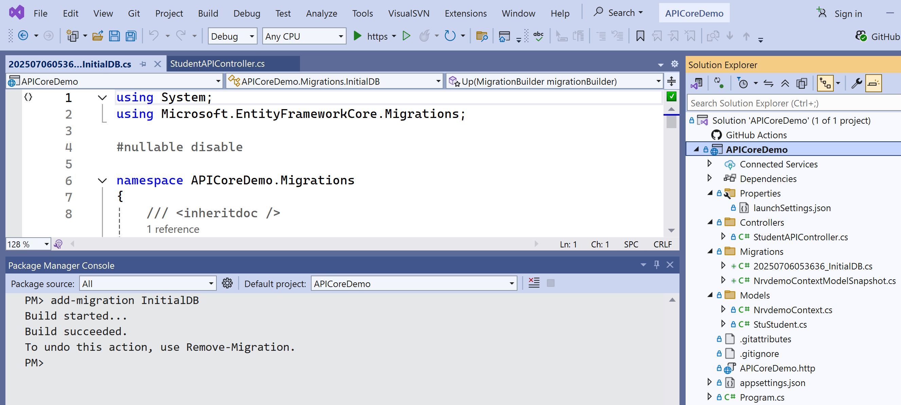
Add Migration | add-migration [name]

Slide 24
Add Migration | add-migration [name]
Add-Migration does not create the database. It only creates migration files inside the Migrations folder.
<timestamp>_<MigrationName>.cs – Contains the migration code.
  Up() → Applies database changes (Create/Modify objects).
  Down() → Reverts database changes (Undo/Remove objects).
<DbContextName>ModelSnapshot.cs – Stores a snapshot of the current model, which EF Core uses to detect changes when creating the next migration.

Slide 25
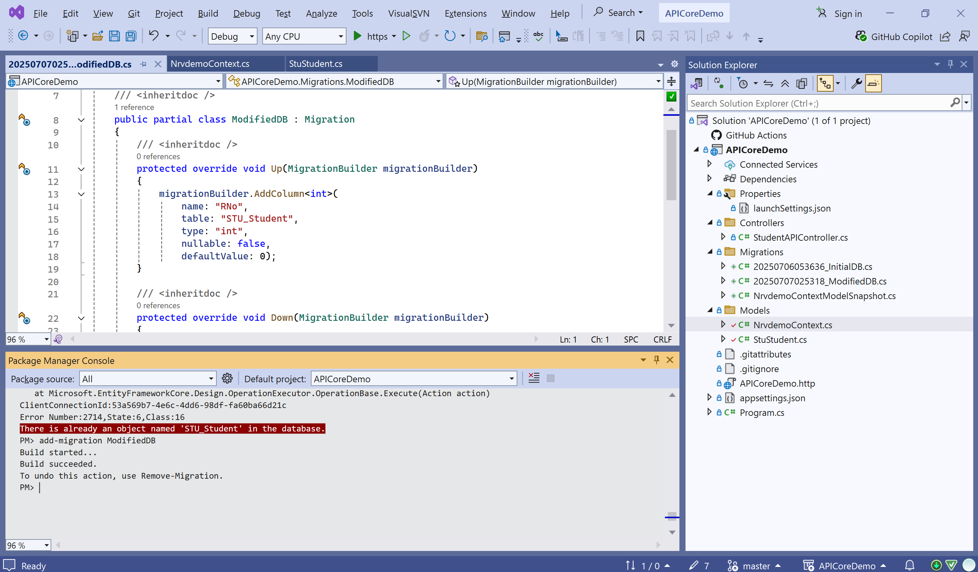
Adding Migrations after Initial Migration

Slide 26
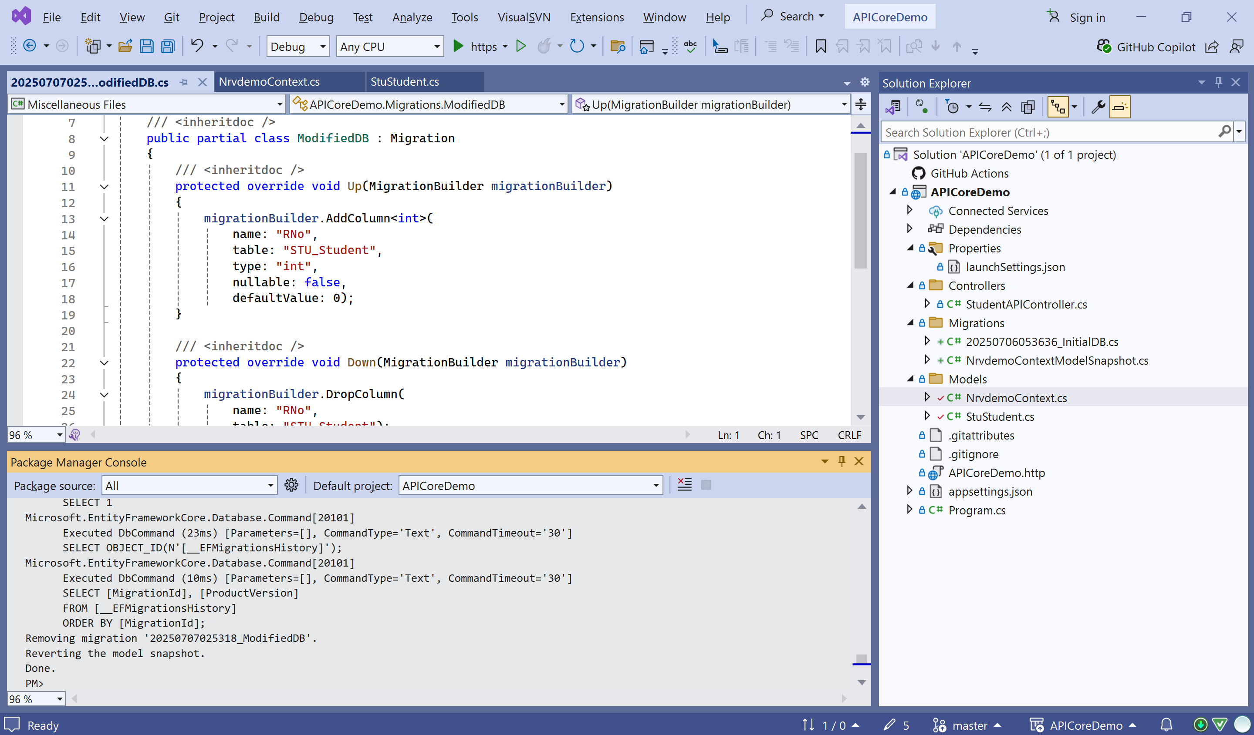
Removing Migration | remove-migration

Slide 27
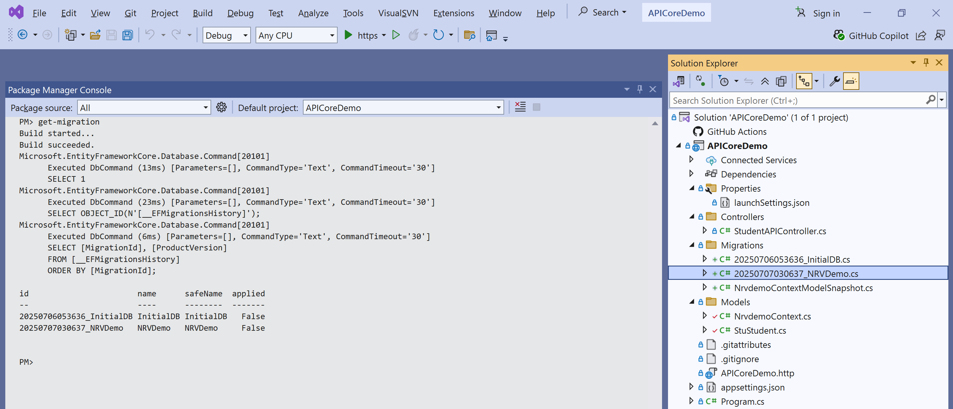
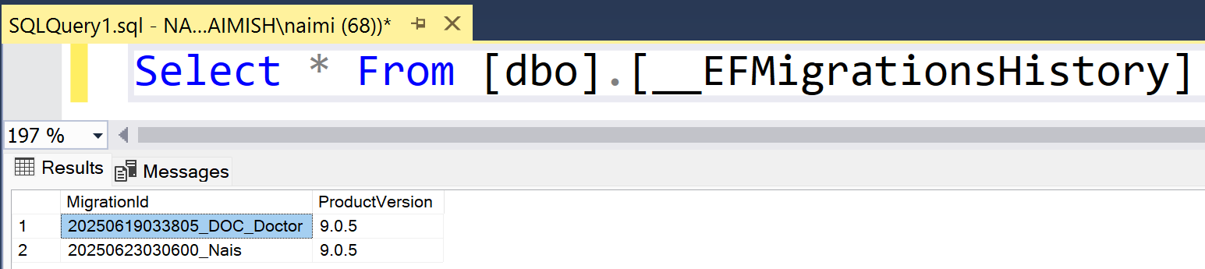
List All Migrations | get-migration

Slide 28

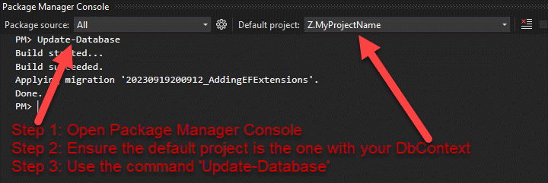
Update-Database
Updating a database using EF Core Migrations means applying or reverting database changes using migration files.
The Update-Database command checks which migrations have already been applied.
If a newer migration exists, EF Core runs the Up() method to apply changes.
If reverting to an older migration, EF Core runs the Down() method to undo changes.
EF Core automatically decides whether to apply or revert migrations based on the current database version.
Update-Database compares the database with migration files and executes Up() to apply changes or Down() to undo changes.

Slide 29
Tracking and No-Tracking Queries
Section – 1.6

Slide 30
What is Tracking?
By default, Entity Framework Core tracks all entities that it retrieves from the database.
This means EF Core remembers:
  Which objects were loaded.
  What changes are made to those objects.
  It can automatically update the database when SaveChanges() is called.
So in a simple way we can say that, tracking means EF Core keeps an eye on the retrieved data and detects any changes made to it.
When to Use Which?
  Tracking : Modify/update data (Insert/update/delete operations)
  No-Tracking : Read-only data (e.g., reports), High-performance querying, Long-running read contexts
Use Tracking when you need to modify and save data.
Use AsNoTracking() when you only need to read data for better performance.

Slide 31
Tracking/No-Tracking Queries
Tracking (Default Behavior)
EF Core tracks the returned entities in the DbContext's change tracker.
If you modify a tracked entity, EF Core will detect the changes and apply them on SaveChanges().
Best suited for read-write scenarios.
No-Tracking
Entities are not tracked by the DbContext.
Useful for read-only operations — faster and lightweight.
Suppose displaying data, reports, dashboards, read-only APIs, large datasets etc.
Cannot update entities unless you attach them manually.
var student = _context.Students.FirstOrDefault(s => s.Id == 1);
student.Name = "Naimish";
_context.SaveChanges(); // Changes are tracked and saved
var students = _context.Students
.AsNoTracking()
.ToList();

Slide 32
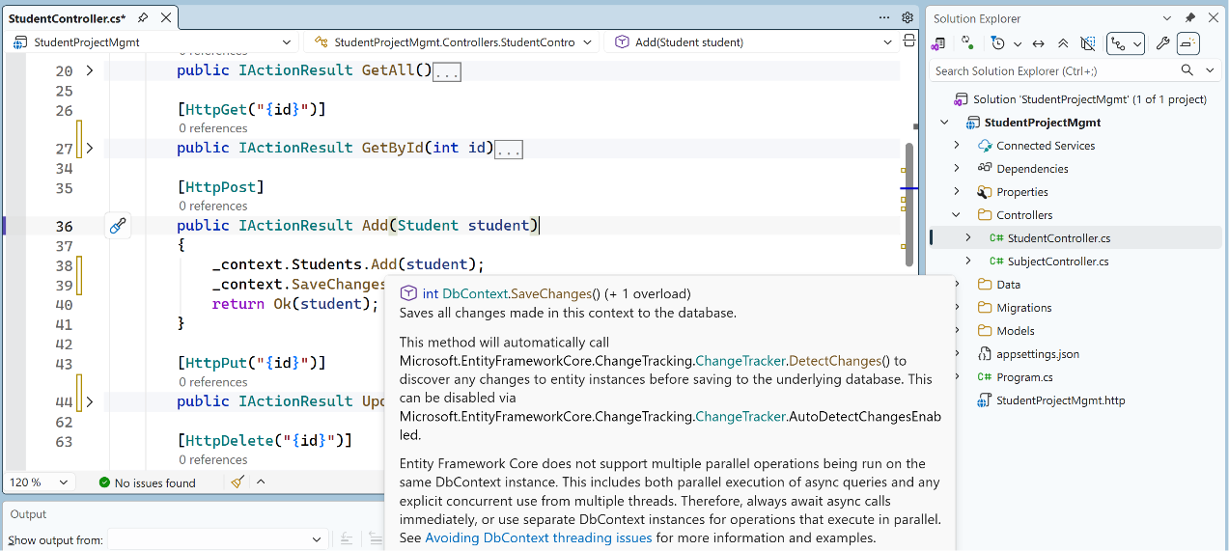
Tracking

Slide 33
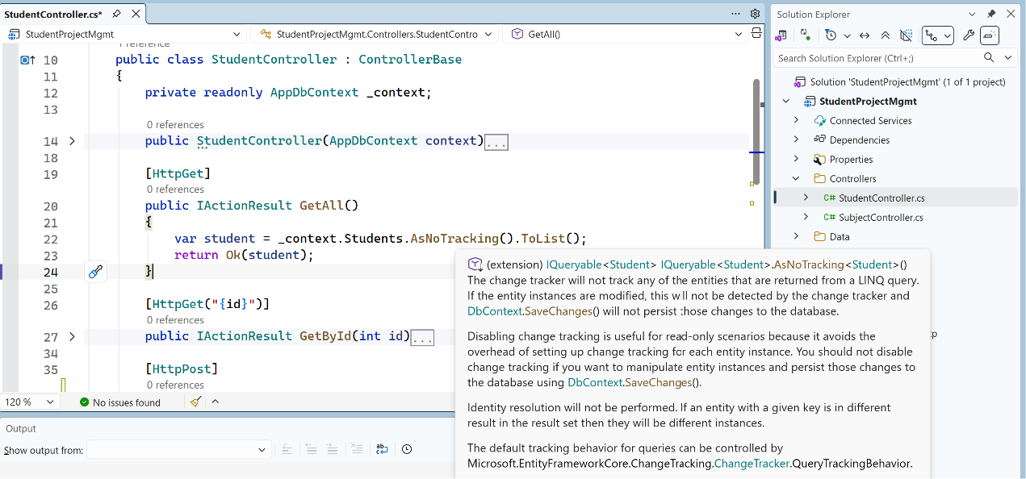
No-Tracking

Slide 34
Async/Await
Section – 1.7

Slide 35
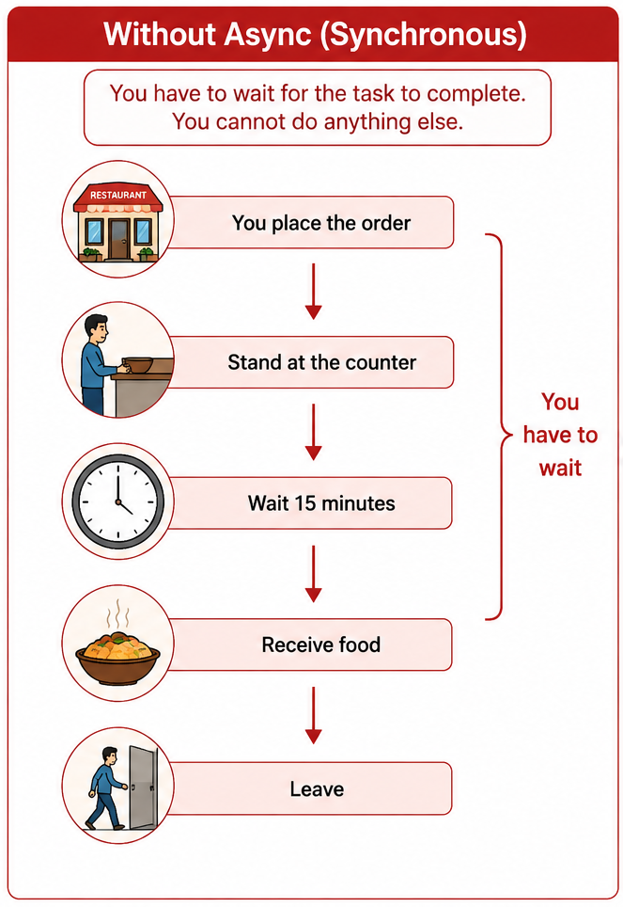
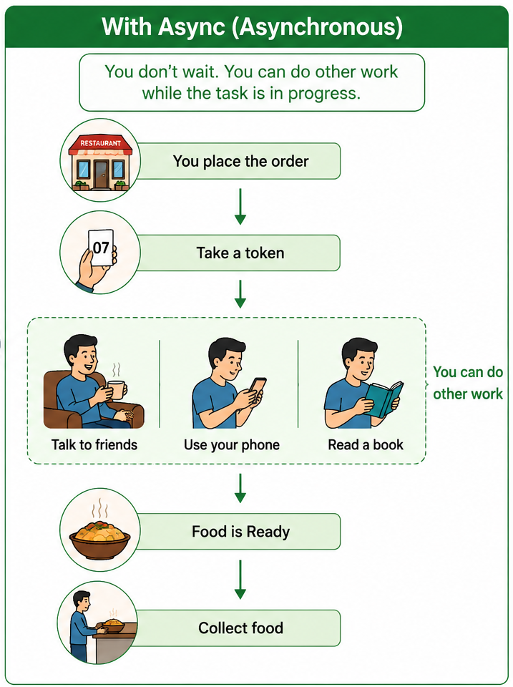
Async/Await: Intro | Example
async
This method can work asynchronously.
await
Wait for the result, but let the thread do other work.

Slide 36
Why Async/Await?
Suppose our API needs to:
  Read data from SQL Server
  Call another Web API
  Upload a file or Download an image
These operations take time.
Without Async
Client │ ▼ API │ Wait... Wait... Wait... │ Database
With Async
Client │ ▼ API │ Starts Database Work │ Thread is Free │ Database Responds │ Continue Execution
The server can handle other requests while waiting.
The thread remains blocked.

Slide 37
Async/Await Example in API
Example
1
2
3
4
5
6
[HttpGet]
public async Task<IActionResult> GetAllStudents()
{
var students = await _context.StuStudents.AsNoTracking().ToListAsync();
return Ok(students);
}
Code Part | Meaning
[HttpGet] | API method for GET request
async Task<IActionResult> | Asynchronous API method that returns HTTP response
Task | A Task represents an operation that will complete in the future. Think of it as a promise that the result will be available later.
_context.StuStudents | Accesses the database table
ToListAsync() | Fetch all records asynchronously
await | Wait for result (non-blocking)
return Ok(students) | Send data with 200 OK response

Slide 38
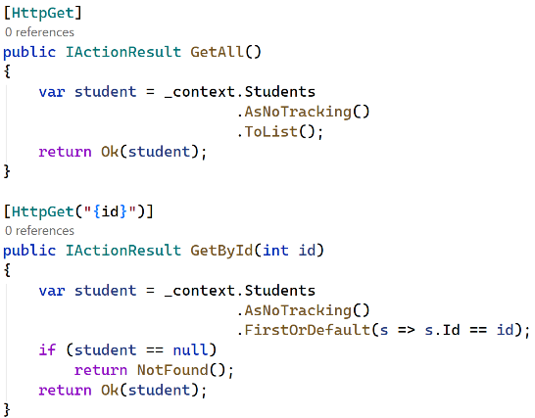
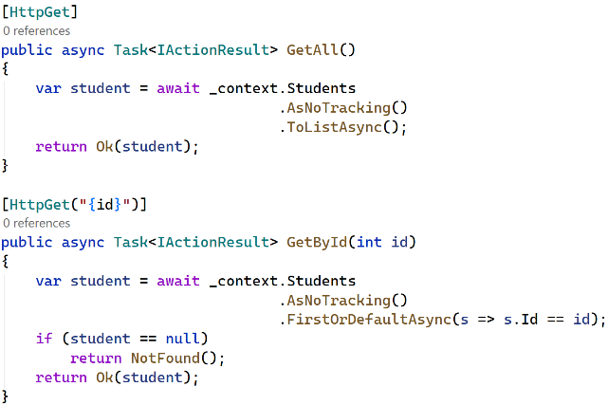
Async/Await Applied in Controller
Without Async/Await
With Async/Await

Slide 39
EF Core Sync/Async Methods
Synchronous | Asynchronous
ToList() | ToListAsync()
First() | FirstAsync()
FirstOrDefault() | FirstOrDefaultAsync()
Find() | FindAsync()
Add() | AddAsync()
SaveChanges() | SaveChangesAsync()
Any() | AnyAsync()
Count() | CountAsync()

Slide 40
DTOs
(Data Transfer Object)
Section – 2

Slide 41
DTOs: Intro
A DTO (Data Transfer Object) is an object used only to transfer data between the client and the server.
It is NOT your database table.
It contains only the information that should be sent or received.
A DTO is a simplified version of an Entity used for communication.
It has no business logic, just fields (and maybe basic validation).
Example
Bank
Account Number Password ATM PIN Balance Aadhaar PAN Address Phone Number Email
When you open the mobile banking app, does it show everything?
No
It only shows Name, Account Number & Balance
Why?
Because the remaining information is private.
That mobile app data is like a DTO.y?
BankDTO
Name Account Number Balance

Slide 42
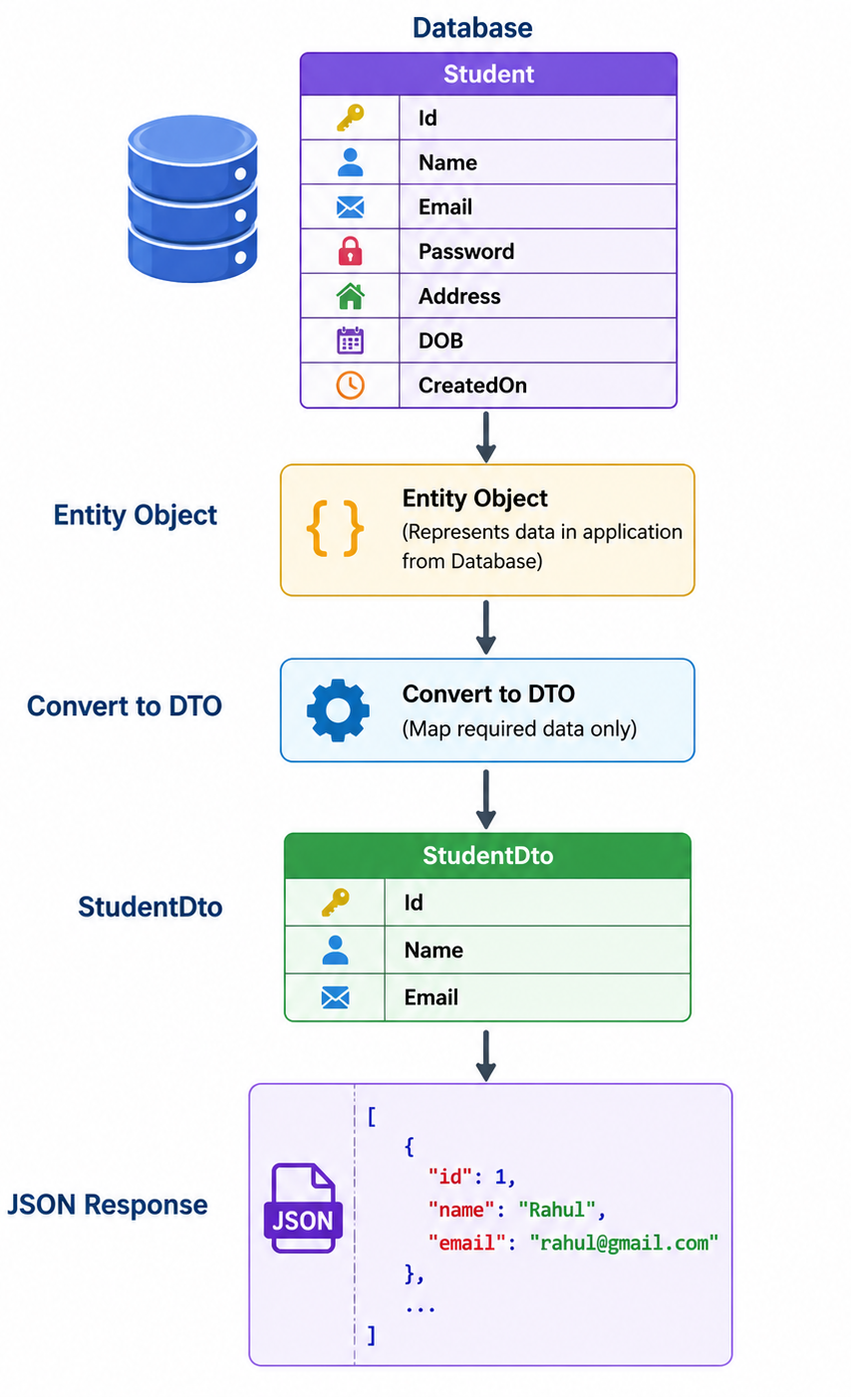
Why Do We Need DTOs?
Without DTO Database → API → Client, so everything goes to the client including confidential fields.
With DTO Database → Entity → DTO → Client (Response), so only require data goes outside.
Entity = Real Database Table
  Entity = Complete Patient File
DTO = Transfers data between client and server, Only required fields
  DTO = Patient Appointment Slip
Why Not Return the Entity Directly???????

Slide 43
Why Not Return the Entity Directly?
Suppose you later add new fields to the database:
Let Say I m having StudentModel.cs
  StudentID
  StudentName
  Age
  Email
Later on I have added 2-3 more fields like FatherName, City, ContactNumber.
So whenever I call api/student/getallstudents, I will get the response with all the columns as StudentID, StudentName, Age, Email, FatherName, City, ContactNumber.
But if I used DTOs for the same so newly added columns not comes to me. Only mentioned columns inside the DTOs will come in response.

Slide 44
Dapper
(Micro ORM)
Section – 3

Slide 45
Dapper: Intro
Dapper is a lightweight Object Relational Mapper (ORM) for .NET developed by Stack Overflow.
It helps us execute SQL queries directly and automatically converts the database records into C# objects.
We can say, Dapper is a micro ORM that allows us to write SQL queries ourselves while automatically mapping database data to C# objects.
Real Life Analogy
Imagine you order food in a restaurant.
Using ADO.NET, You
  Cook the food yourself
  Prepare the plate
  Serve yourself
  Wash the dishes
Everything is manual in this case.
Using Dapper
You tell the waiter:
  “Bring me Veg Biryani.”
The waiter understands your request and brings the food.
You still choose what to eat (SQL Query), but someone else handles the repetitive work.
?

Slide 46
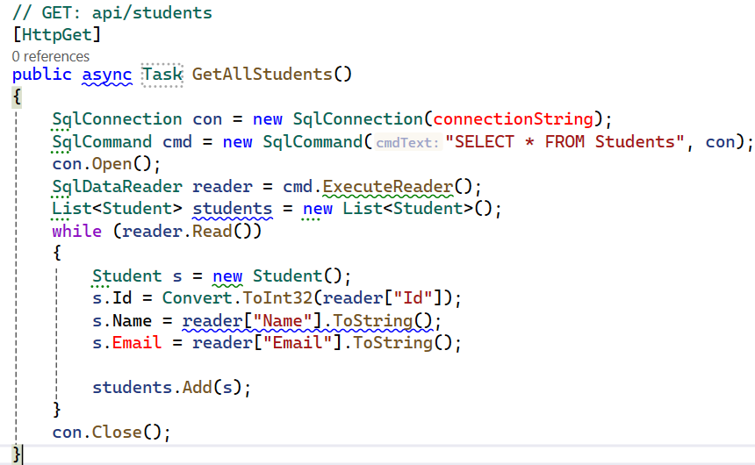
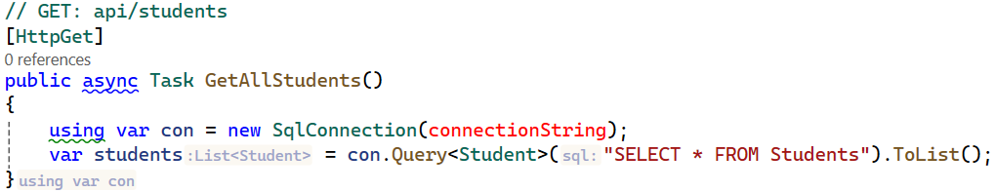
Why Dapper is Required?
Suppose you have a Students table in SQL Server.
Without Dapper, you need to:
  Open the database connection.
  Execute the SQL command.
  Read every row using SqlDataReader.
  Convert every column manually.
  Create objects one by one.
This requires a lot of code & repetitive coding.
With Dapper
Only one line retrieves all students and converts them into Student objects automatically.

Slide 47
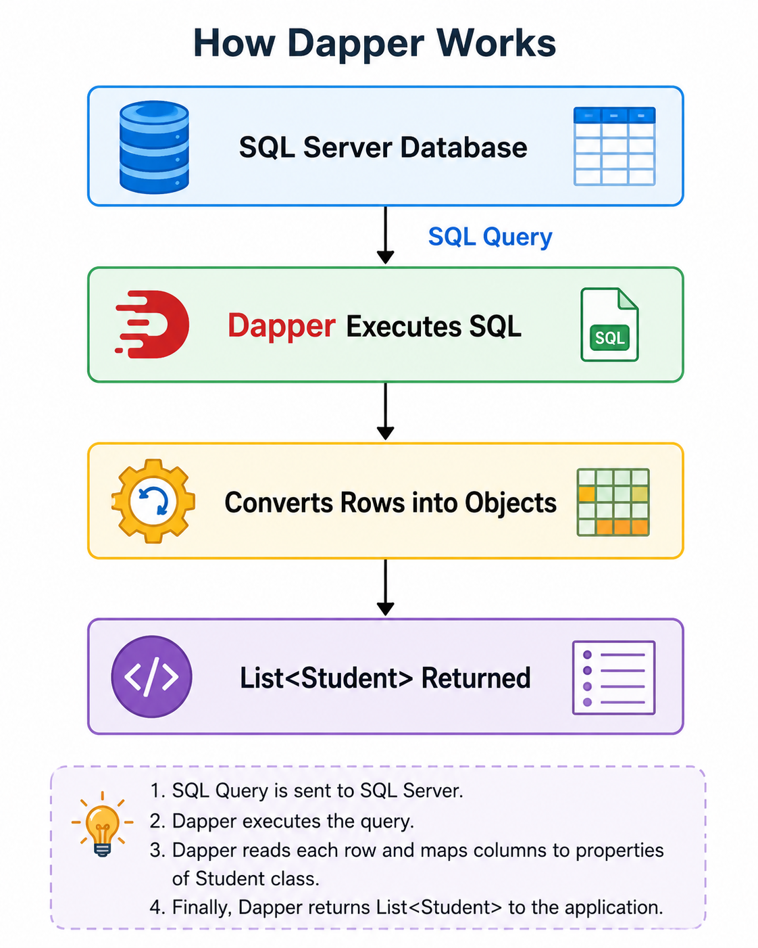
Why is it called Micro ORM & How it Works?
Large ORMs like Entity Framework manage many things automatically.
Dapper only performs object mapping.
That's why it is called a Micro ORM.
It is known for its speed and simplicity.
How Dapper Works? (Do install Dapper using Nuget Package Manager)

Slide 48
Different Dapper Methods
Method Name | Explanation | Code Snippet | UseCase
Query<T>() | Executes a SQL query and returns multiple records mapped to objects of type T. | var students = connection.Query<Student>("SELECT * FROM Students"); | Get all records, search results, lists
QueryAsync<T>() | Asynchronously executes a SQL query and returns multiple records mapped to T. | var students = await connection.QueryAsync<Student>("SELECT * FROM Students"); | Recommended for Web API GET operations
QueryFirst<T>() | Returns the first record from the result. Throws an exception if no record is found. | var student = connection.QueryFirst<Student>("SELECT * FROM Students ORDER BY Id"); | When you are certain that at least one record exists
QueryFirstAsync<T>() | Asynchronously returns the first record. Throws if no record exists. | var student = await connection.QueryFirstAsync<Student>(sql); | Async API operations where at least one result is expected
QueryFirstOrDefault<T>() | Returns the first record, or null/default value if no record exists. | var student = connection.QueryFirstOrDefault<Student>(sql, new { Id = 1 }); | Get a record by ID when the record may not exist
QueryFirstOrDefaultAsync<T>() | Asynchronously returns the first record, or null if no record exists. | var student = await connection.QueryFirstOrDefaultAsync<Student>(sql, new { Id = id }); | Very common in Web APIs for GET /api/students/{id}

Slide 49
Different Dapper Methods
MethodName | Explanation | Code Snippet | UseCase
QuerySingle<T>() | Expects exactly one record. Throws if zero or more than one record is returned. | var student = connection.QuerySingle<Student>(sql, new { Id = 1 }); | When the query must return exactly one record
QuerySingleAsync<T>() | Asynchronously returns exactly one record. Throws if zero or multiple records exist. | var student = await connection.QuerySingleAsync<Student>(sql, new { Id = 1 }); | Unique-record queries where exactly one result is guaranteed
QuerySingleOrDefault<T>() | Returns exactly one record or null. Throws if more than one record is returned. | var student = connection.QuerySingleOrDefault<Student>(sql, new { Id = 1 }); | Queries using a unique key where the record may not exist
QuerySingleOrDefaultAsync<T>() | Asynchronously returns one record or null, but throws if multiple records are returned. | var student = await connection.QuerySingleOrDefaultAsync<Student>(sql, new { Id = id }); | Async unique-record lookup

Slide 50
Different Dapper Methods
MethodName | Explanation | Code Snippet | UseCase
Execute() | Executes a command that does not return rows and returns the number of affected rows. | int rows = connection.Execute("DELETE FROM Students WHERE Id = @Id", new { Id = 1 }); | INSERT, UPDATE, DELETE
ExecuteAsync() | Asynchronously executes a command and returns the number of affected rows. | int rows = await connection.ExecuteAsync(sql, new { Id = id }); | Recommended for Web API INSERT, UPDATE, DELETE
ExecuteScalar<T>() | Executes a query and returns one single value. | int count = connection.ExecuteScalar<int>("SELECT COUNT(*) FROM Students"); | COUNT, MAX, MIN, generated ID, totals
ExecuteScalarAsync<T>() | Asynchronously executes a query and returns one single value. | int count = await connection.ExecuteScalarAsync<int>("SELECT COUNT(*) FROM Students"); | Async aggregate queries and retrieving generated IDs

Slide 51
Building RESTful APIs with
ASP.NET Core
#2401CS521
Prof. Madhuresh R Fichadiya
Computer Science & Engineering Department
Madhuresh.fichadiya@darshan.ac.in
8866961282

