Slide 1


Unit-3
Routing, Model Binding & Validation
Building RESTful APIs using .NET Core
#2505CS311
Prof. Madhuresh R Fichadiya
Computer Science & Engineering Department
Madhuresh.fichadiya@darshan.ac.in
8866961282

Slide 2

Looping
Outline
  Introduction to Routing
  Types of Routing
  Route Constraints
  Model Binding
  API Versioning
  Data Annotations
  Fluent Validation

Slide 3
Introduction to Routing
Section – 1.1

Slide 4
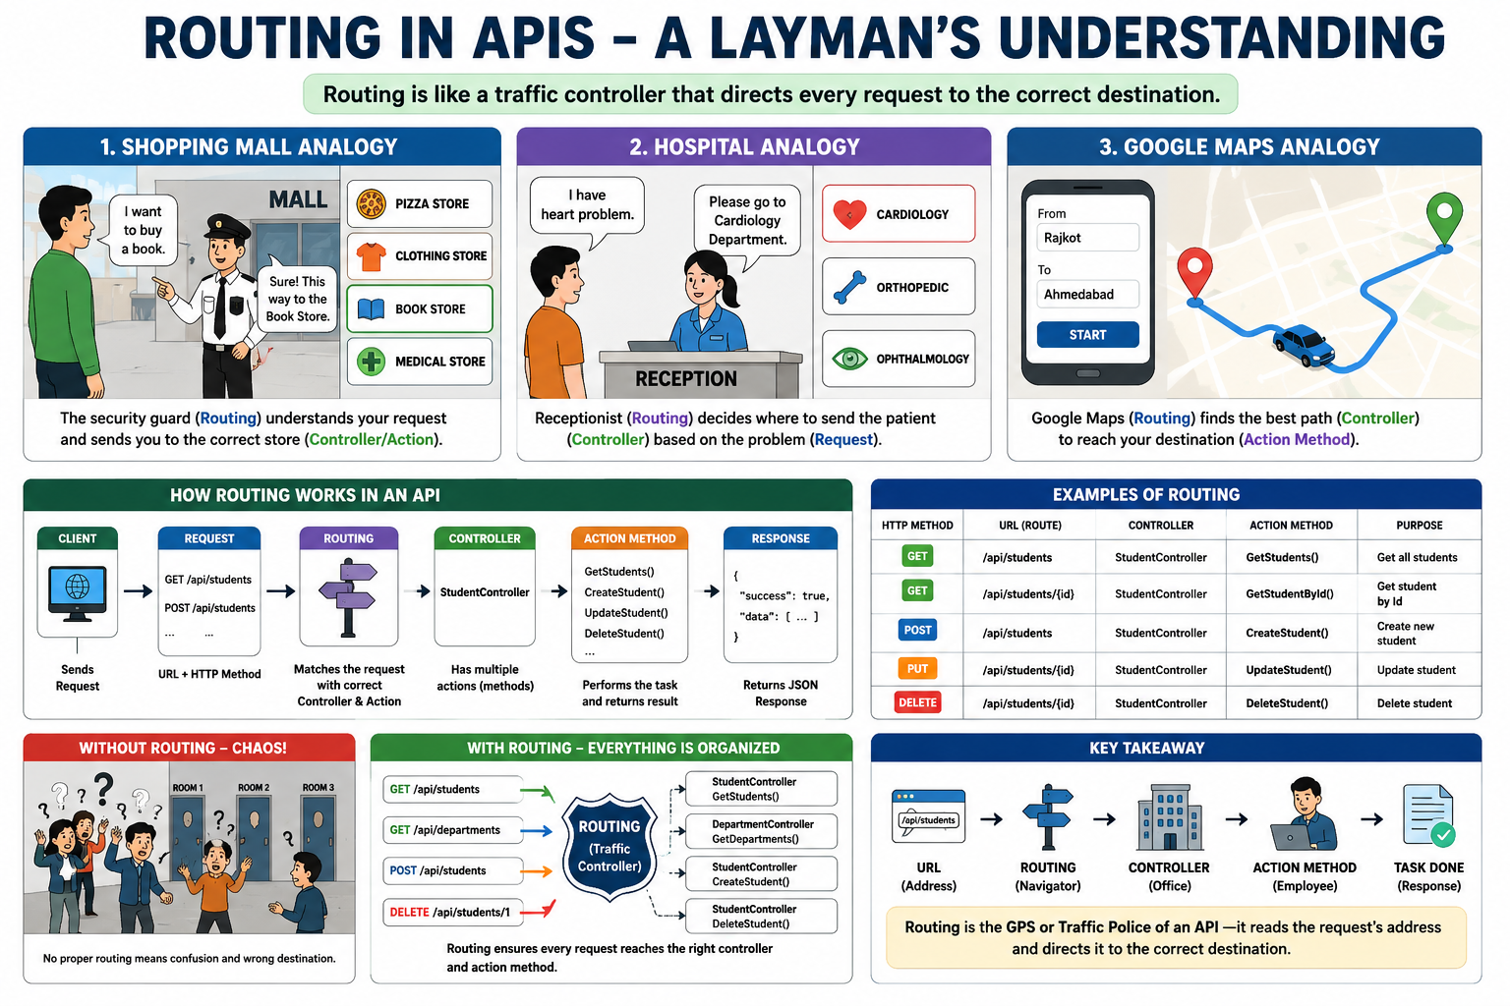
Introduction to Routing - [Example]

Slide 5
What is Routing?
Routing is the process of mapping an incoming HTTP request to the appropriate controller’s action.
The routing system relies on Endpoint Routing, processing requests in two distinct middleware phases:
  UseRouting(): Matches the URL path to an endpoint configuration.
  UseEndpoints() / MapControllers(): Executes the matched endpoint handler.
Best Practices
Use [ApiController]: It forces attribute routing and automates HTTP 400 responses for bad inputs.
Avoid Ambiguity: Never create two endpoints with identical HTTP verbs and URL patterns.
Use Tokens: Use [controller] tokens in your route templates to prevent broken links when renaming files.

Slide 6
Routing : Key Concepts
GET | https://localhost:5001/api/students/101
HTTP Request
  An incoming request from a client (e.g., browser, app) containing a URL, HTTP method, headers, and data.
Routing Middleware
  ASP.NET Core middleware that analyzes the request and matches it to a defined route. (Program.cs)
Route Templates
  Patterns defined with placeholders (e.g., {controller}, {action}, {id}) that match parts of the URL.
Route Values
  Extracted from the URL based on the route template (e.g., if the URL is /products/123, the id route value will be 123).
GET | api/student
PUT | api/student/{id}
GET | api/student/{id}
DELETE | api/student/{id}
app.UseRouting(); // Routing Middleware
app.MapControllers(); // Maps Controllers
api/students/101 | api/student/{id}
api/students/Computer/101 | api/student/{Course}/{id}
Id = 101
Department = Computer, Id = 101 (Multiple Values/Parameters)

Slide 7
Types of Routing
Section – 1.2

Slide 8
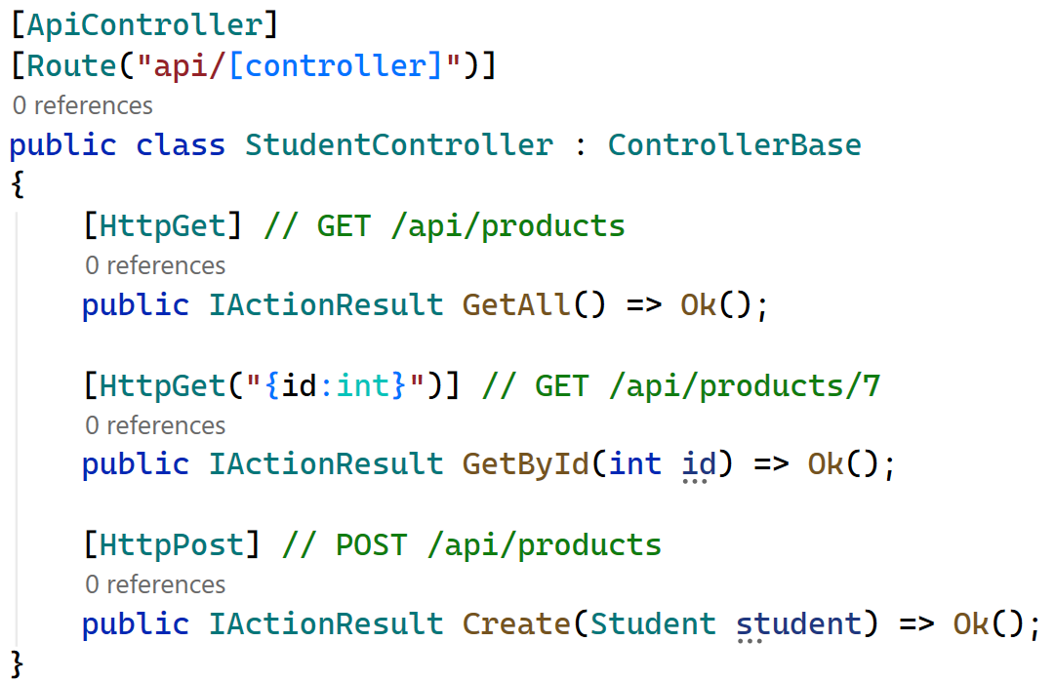
Types of Routing
Convention-Based/Conventional Routing
  Routes are defined once, centrally, using a URL pattern with placeholders.
  The framework matches any URL that fits the pattern and infers the controller/action from it.
  Defined centrally in Program.cs
  Good fit for MVC apps with predictable, uniform URLs.
  In Program.cs..
    app.MapControllerRoute
    (
    name: "default",
    pattern:"{controller=Home}/
    {action=Index}/{id?}"
    );
Attribute Routing (Majorly Used in APIs)
  Routes are declared directly above the controller or action using [Route], [HttpGet], etc.
  Each action owns its exact URL.
  Defined next to the code it routes to.
  Standard choice for Web APIs.
  Full control over each endpoint's URL shape.

Slide 9
Route/Routing Constraints
Section – 1.3

Slide 10
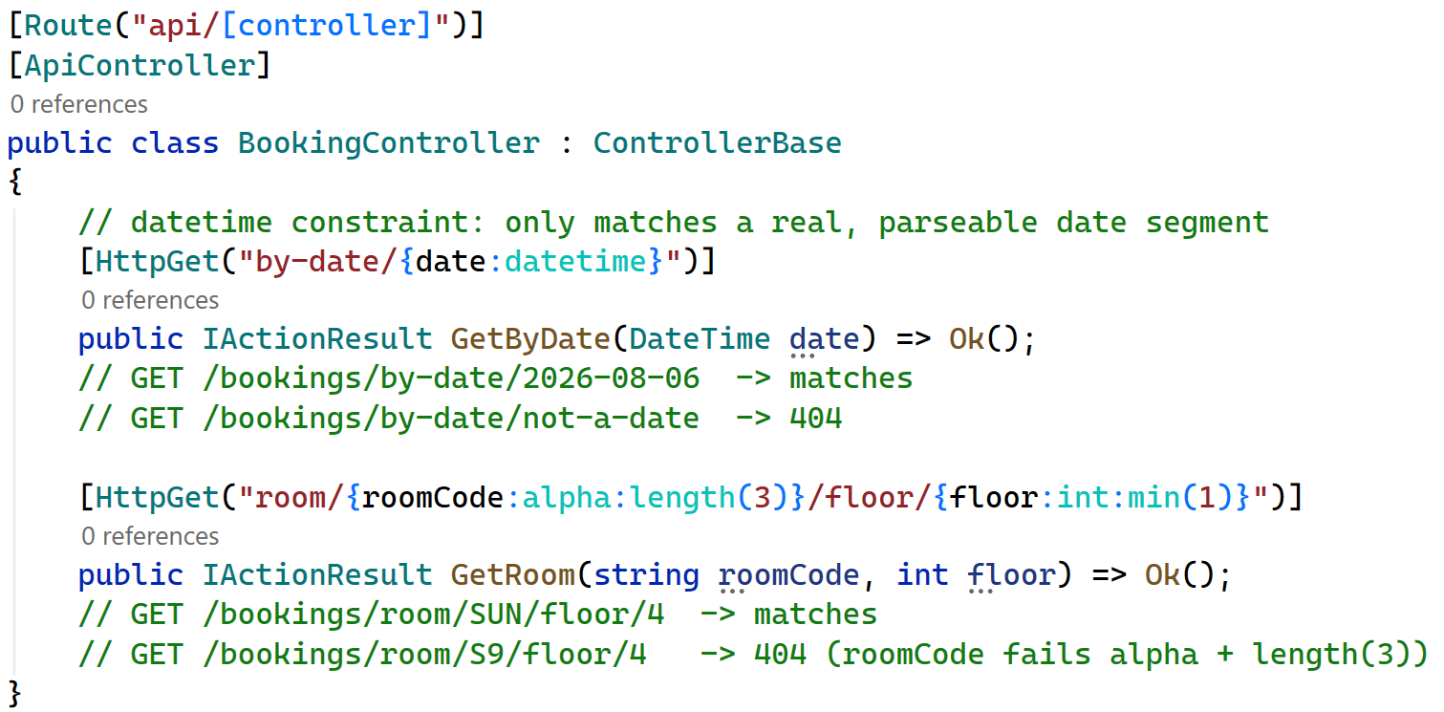
Route/Routing Constraints
A route constraint restricts what values a route parameter will accept, so that only URLs matching a certain shape or type reach an action.
If the constraint fails, routing simply treats the URL as not matching that route (usually resulting in a 404, or falling through to another matching route).
Constraints are written after the parameter name, separated by a colon: {id:int}.
  E.g [HttpGet("{id:int}")] , [HttpGet("product/{productId:int}")]

Slide 11
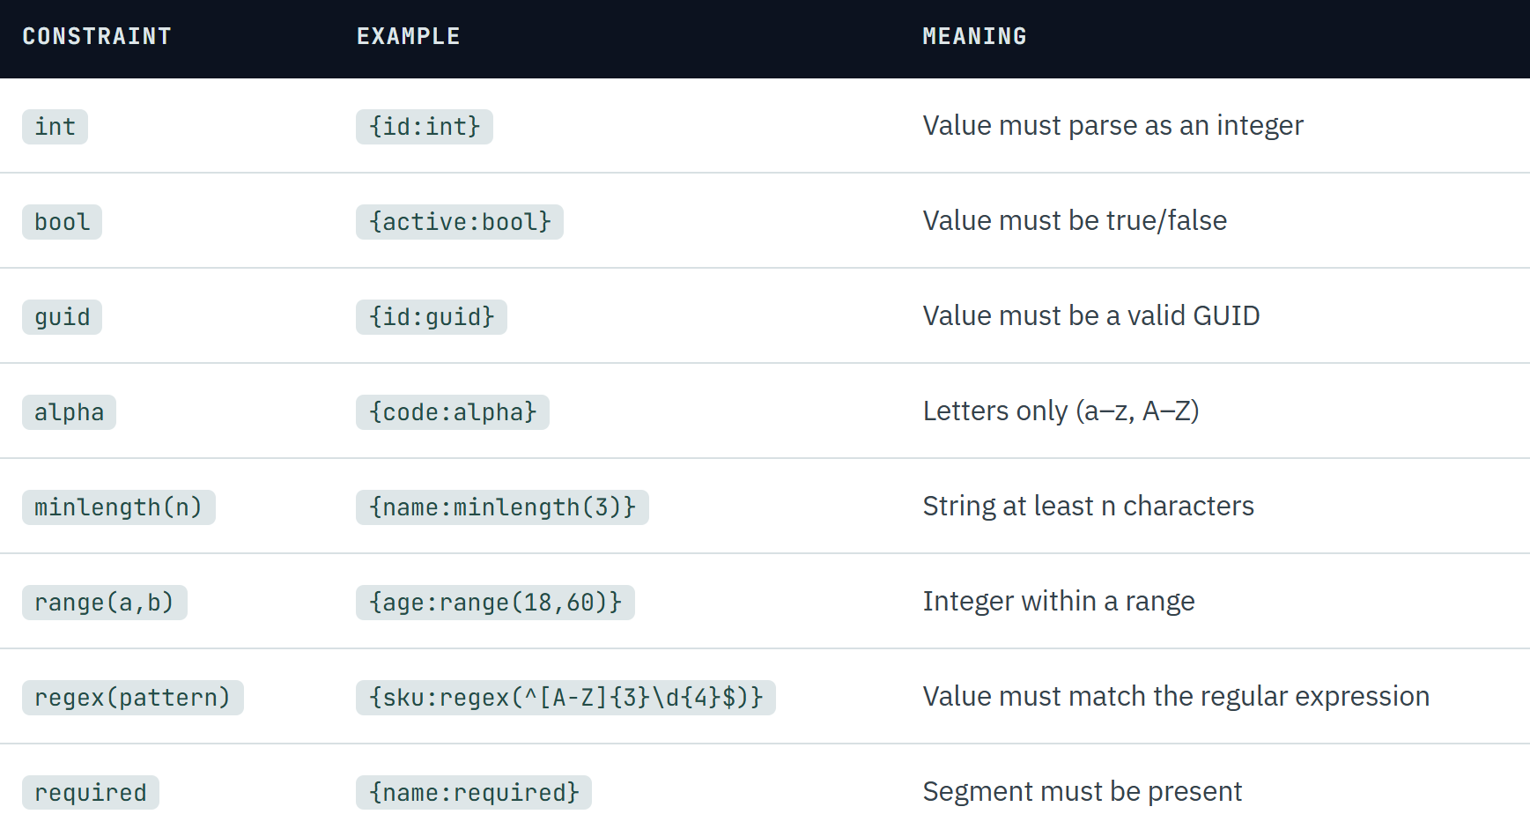
Route/Routing Constraints

Slide 12
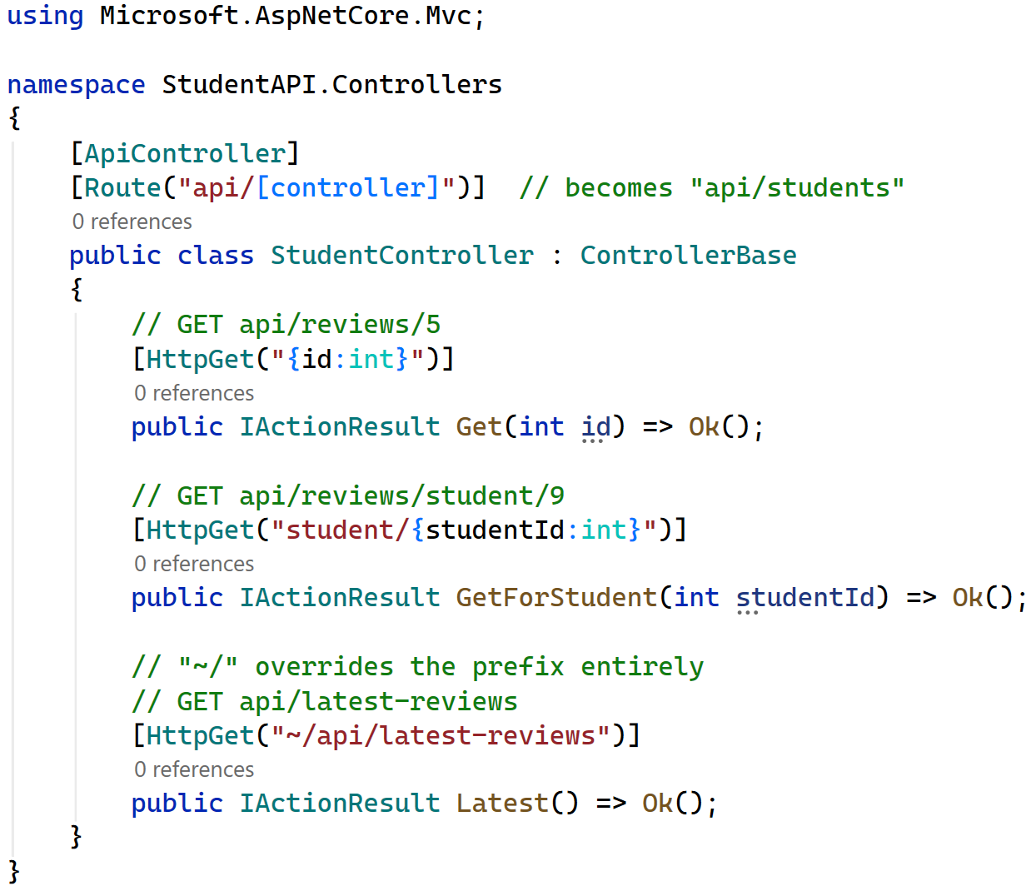
Routing Constraints - Token Replacement & Prefixes

Slide 13
Model Binding
Section - 2

Slide 14
Model Binding
Model Binding is the process by which ASP.NET Core automatically takes data from an HTTP request and converts it into C# objects or parameters used by a controller action.
For example, if a client sends:
ASP.NET Core Automatically bind this JSON data to a C# model.
POST /api/products
Content-Type: application/json
{
“name”: “Laptop”,
“price”: 50000
}
public class Product
{
public string Name {get; set;}
public decimal Price {get; set;}
}
public class ProductController : ControllerBase
{
[HttpPost]
public IActionResult Create(Product product)
{
return Ok(product);
}
}
Model
Controller

Slide 15
Common Model Binding Sources
ASP.NET Core can obtain values from several parts of an HTTP request:
Source | Attribute | Example
Route | [FromRoute] | /api/products/10
Query String | [FromQuery] | /api/products?id=10
Request Body | [FromBody] | JSON/XML body
HTTP Header | [FromHeader] | X-API-Key: abc
Form Data | [FromForm] | HTML form/ Multipart form
Services | [FromServices] | Dependency Injection

Slide 16
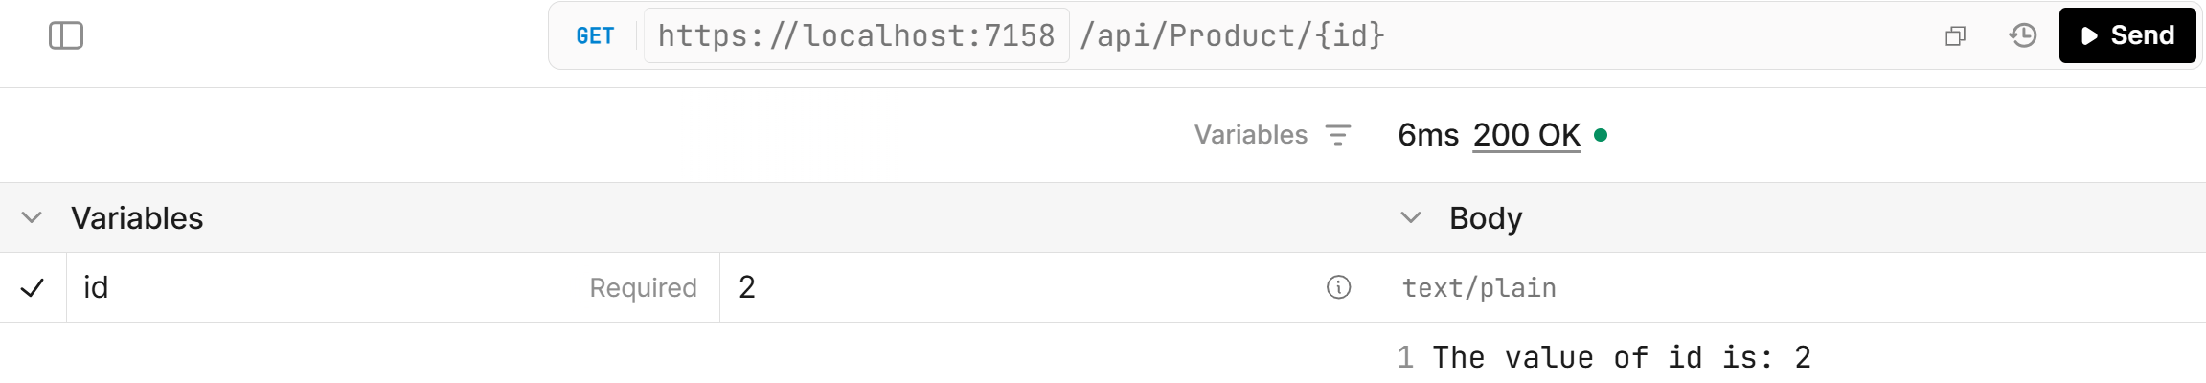
1. From Route
[FromRoute]
Request: GET /api/products/10
Controller:
  public class ProductController : ControllerBase
  {
  [HttpGet("{id}")]
  public IActionResult GetProductByID([FromRoute] int id)
  {
  return Ok($"The value of id is: {id}");
  }
  }
Output:

Slide 17
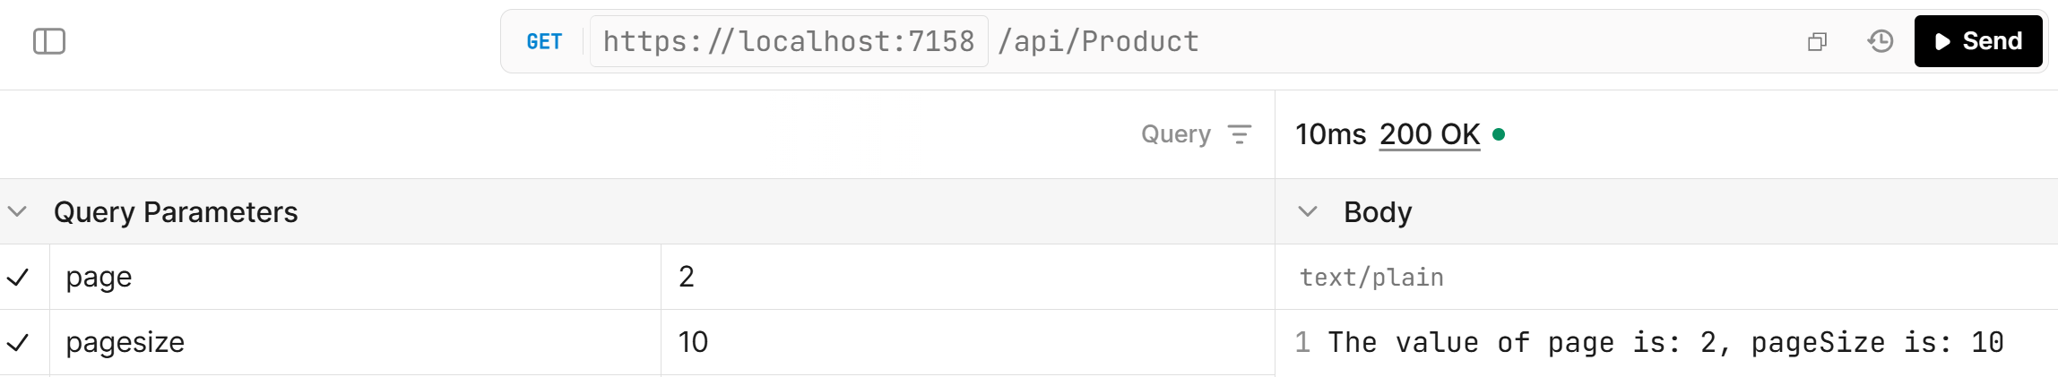
2. From Query String
[FromQuery]
Query Parameter(s)
Request: GET /api/products?page=2&pageSize=10
Controller:
  public class ProductController : ControllerBase
  {
  [HttpGet]
  public IActionResult GetProductByID([FromQuery] int page, [FromQuery] int pageSize)
  {
  return Ok($"The value of page is: {page}, pageSize is: {pageSize}");
  }
  }
Output:

Slide 18
3. From Body
[FromBody]
Request:
Model
POST /api/products
Content-Type: application/json
{
“name”: “Laptop”,
“price”: 50000
}
public class Product
{
public string Name { get; set; }
public decimal Price { get; set; }
}
Controller
public class ProductController : ControllerBase
{
[HttpPost]
public IActionResult Create([FromBody] Product product)
{
return Ok(product);
}
}

Slide 19
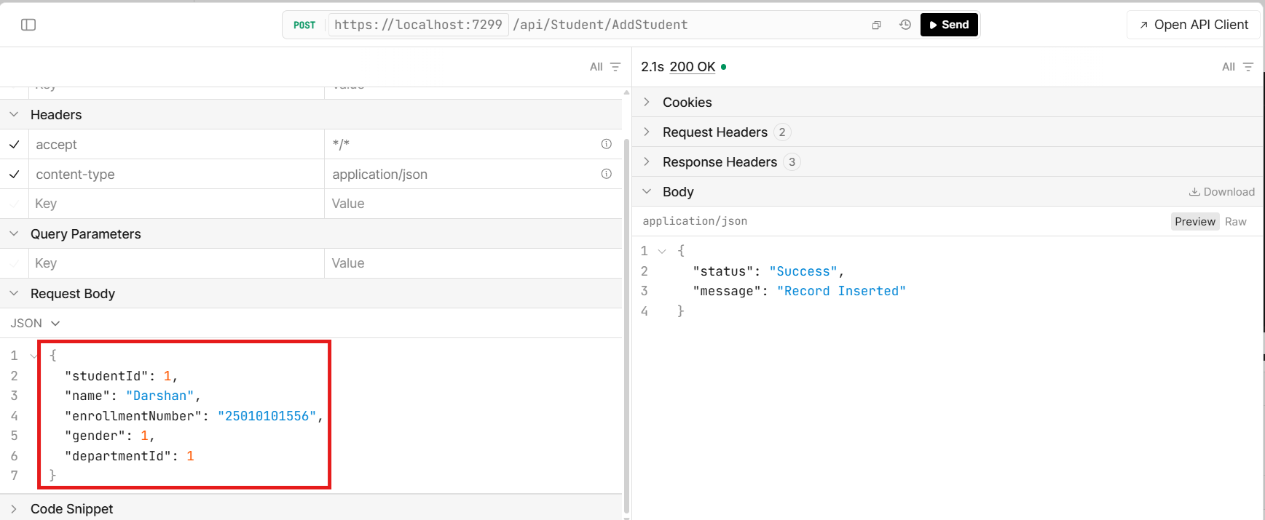
3. From Body Cont..

Slide 20
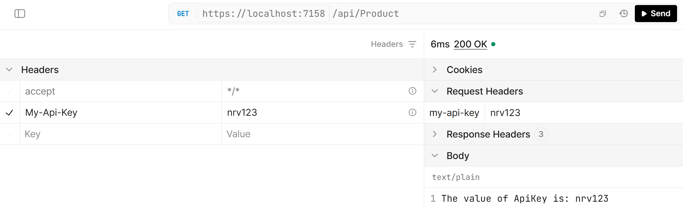
4. From Header
[FromHeader]
Request: GET /api/products
Controller:
  public class ProductController : ControllerBase
  {
  [HttpGet]
  public IActionResult GetProducts([FromHeader(Name = "My-Api-Key")] string ApiKey)
  {
  return Ok($"The value of ApiKey is: {ApiKey }");
  }
  }
Output:

Slide 21
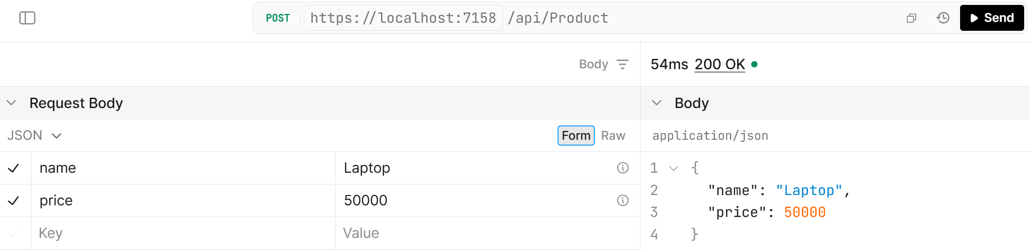
5. From Form Data
[FromForm]
It is widely used for form submissions or file uploads.
Controller:
  public class ProductController : ControllerBase
  {
  [HttpPost]
  public IActionResult Create([FromForm] Product product)
  {
  return Ok(product);
  }
  }
Output:

Slide 22
6. FromService
FromService is used for Method Injection. It is used when only single method requires any service.
Method Injection is a technique of Dependency Injection in which a dependency is provided directly to a method/action as a parameter instead of being injected through the class constructor.
Controller:
  [HttpGet]
  public async Task<IActionResult> GetAll([FromServices] AppDbContext contextDb)
  {
  var res = contextDb.Students.ToList();
  return Ok(res);
  }

Slide 23
API Versioning
Section - 3

Slide 24
What is API Versioning?
API Versioning = Managing API changes safely.
It tracks and communicates API changes to consumers/end-users.
Changes may include bug fixes, security updates, and new features releases.
Breaking changes can cause problems for existing clients.
Versioning maintains backward compatibility.
Multiple API versions allow old and new clients to work together.
It protects data availability and integrity.
It builds consumer trust while allowing the API to evolve.
Change API
Create Version
Protect Old Clients
Support New Clients

Slide 25
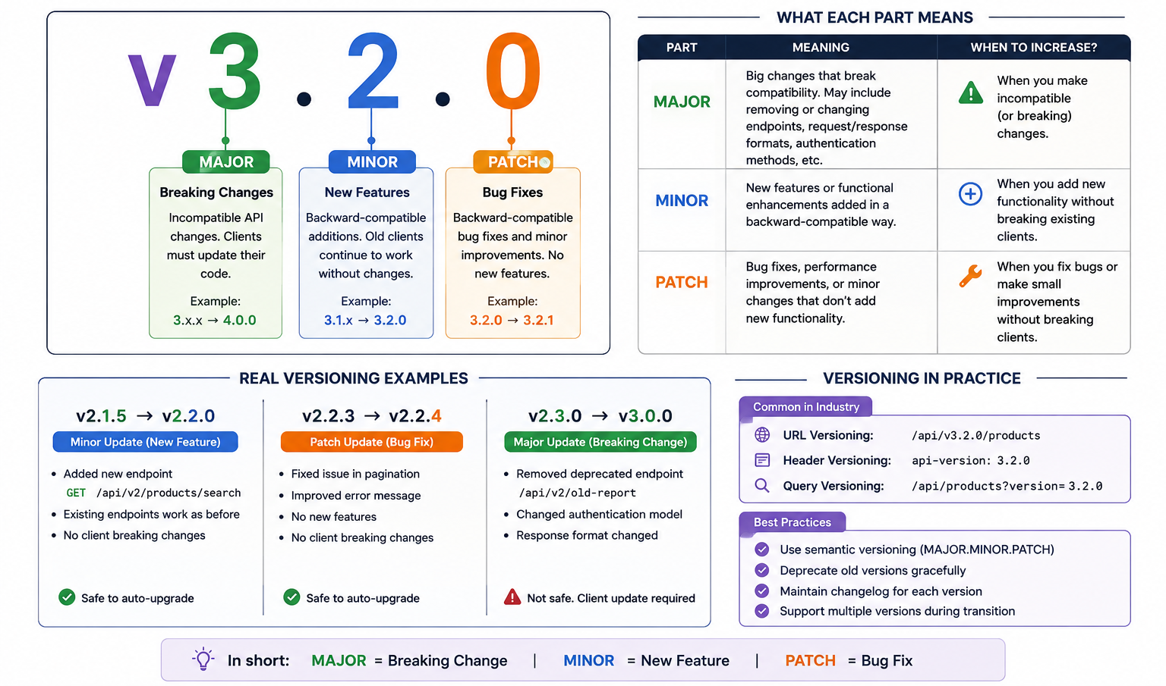
What is API Versioning? Cont..

Slide 26
Types of API Versioning
URL Versioning
Query Parameter Versioning
Header Versioning
Consumer-Based Versioning
Section - 2

Slide 27
Types of API Versioning
URL Versioning
  With this approach, the version number is included in the URL of the API endpoint.
  For instance, consumers who are interested in viewing all of the products in a database would send a request to the https://example-api.com/v1/products endpoint.
  This is the most popular type of API versioning.
  This is also called URL Segment Versioning.
Query Parameter Versioning
  This strategy requires users to include the version number as a query parameter in the API request.
  For instance, they might send a request to https://example-api.com/products?version=1.
GET | /api/v1/products GET | /api/v2/products
GET | https://localhost:7000/api/v1/products
GET | https://localhost:7000/api/v2/products
GET | /api/products?version=1.0
GET | /api/products?version=2.0

Slide 28
Types of API Versioning Cont..
Header Versioning
  This approach allows consumers to pass the version number as a header in the API request, which decouples the API version from the URL structure.
  This is particularly useful when you don't want the version visible in the URL.
Consumer-based Versioning
  It is not the same type of built-in version reader as URL, query-string, or header versioning.
  In URL/query/header versioning, the client explicitly tells the API which version it wants.
  In consumer-based versioning, server maintains the consumer & versions.
GET | /api/products
But the client sends(Header): api-version: 1.0 or api-version: 2.0
Consumer | API Version
Client-A | V1
Client-B | V2
Mobile App | V2
Client A → registered in 2025 → V1 Client B → registered in 2026 → V2
GET /api/products
Consumer-Id: Client-A
The server looks up:
Client-A → V1
GET /api/products
Consumer-Id: Client-B
The server looks up:
Client-B → V2

Slide 29
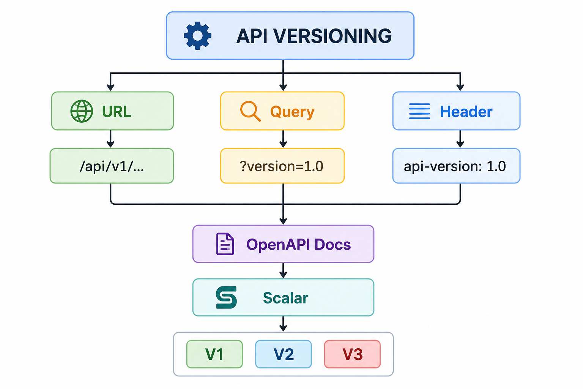
Types of API Versioning Cont..
Versioning | Request Example | Version Location
URL | /api/v1/products | URL
Query | /api/products?version=1.0 | Query String
Header | api-version: 1.0 | HTTP Header
Consumer | Consumer-Id: 1 | Consumer configuration

Slide 30
Fluent Validation
Section - 4

Slide 31
When to use Fluent Validation?
Conditional validation is required on multiple properties, when compared to data annotation, it’s much easier to use fluent validation with multiple properties.
View models must be separated from validation models.
Standard validation rules benefit from additional support. Fluent validation has much better client-side support than data annotation.
You need more control over validation rules.
Fluent Validation is a .NET library for building strongly-typed validation rules.
The fact is that both data annotation and fluent validation have their own unique strengths that make them viable under specific scenarios.
Both are superb validation tools for MVC, .NET, and ASP but fluent validation does provide more control over validation rules since it uses more advanced API to solve specific validations.

Slide 32
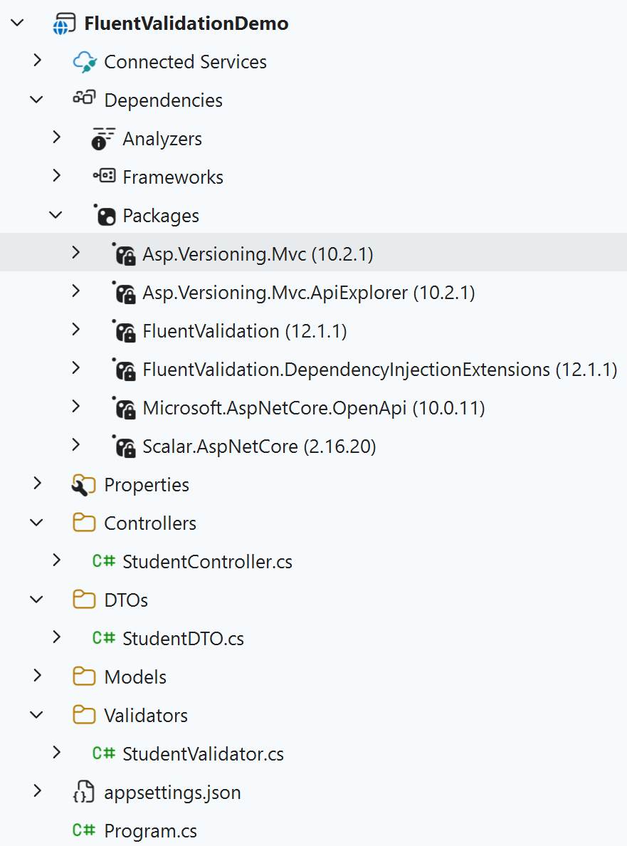

How to Use Fluent Validation in Our Project?
Steps
  First install packages from nuget
    FluentValidation
    FluentValidation.DependencyInjectionExtensions
  Create a new folder named Validators & Inside validators folder → create a validator classes for models or DTOs. (if you are using DTOs in your project so create validators for it because in request and response we using it.)
  Add your logic/validation rules in newly created class.
  Register validator in Program.cs
  Call Validator Manually in Controller
  After that run the project and check for validations.

Slide 33
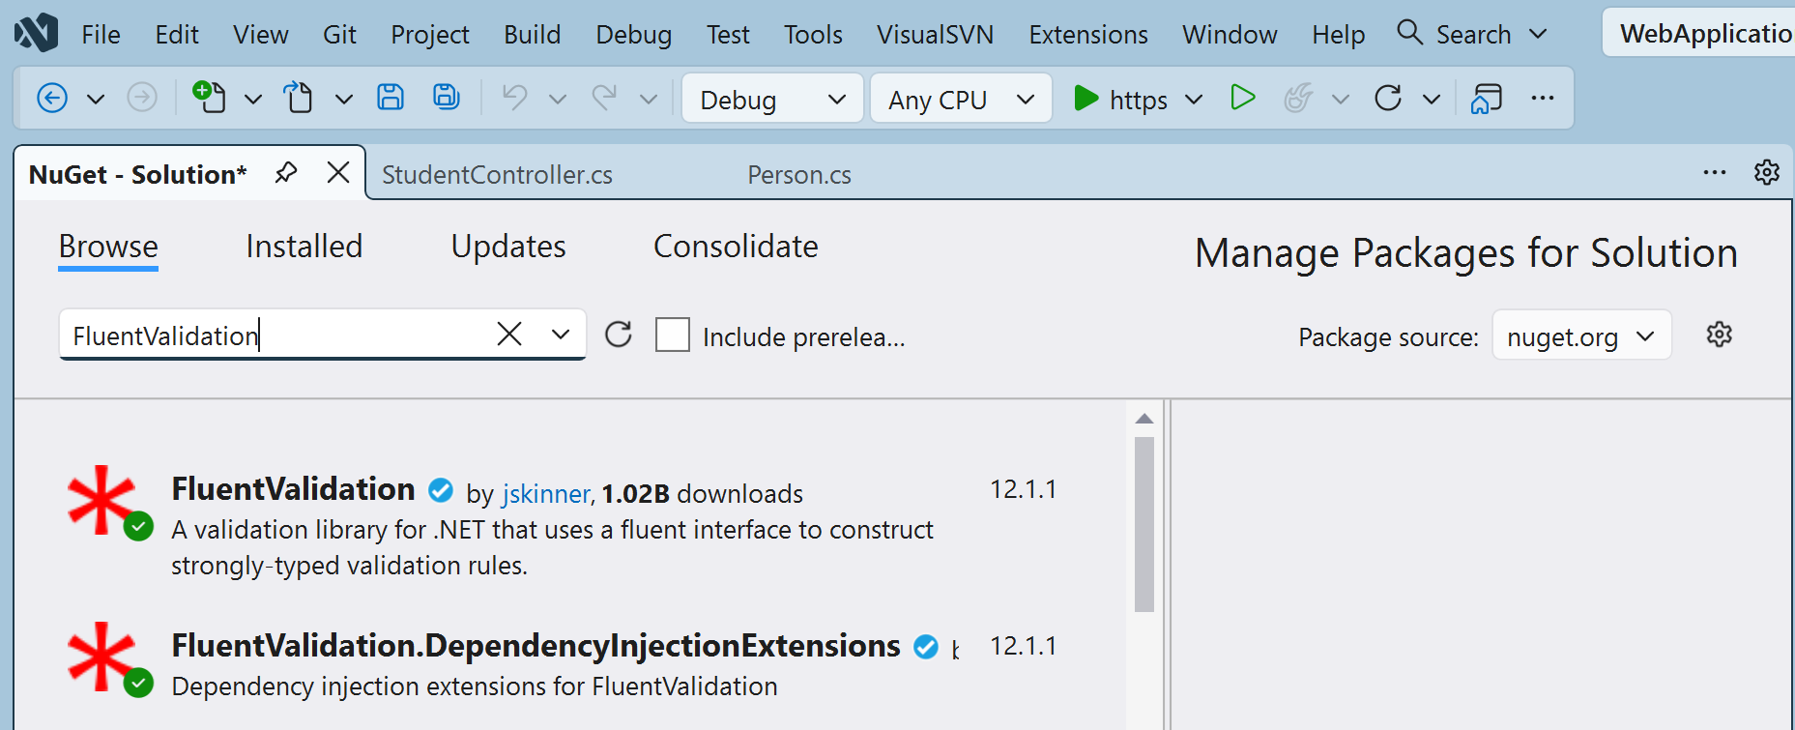
Step – 1 | Install Packages

Slide 34
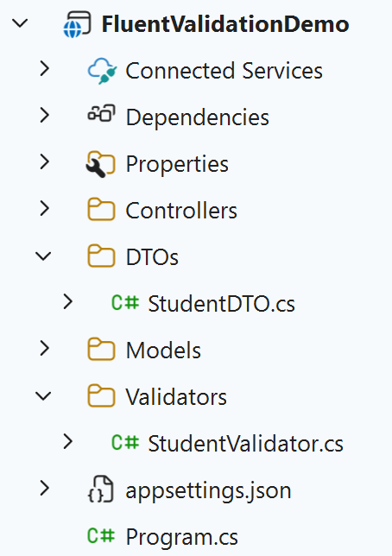
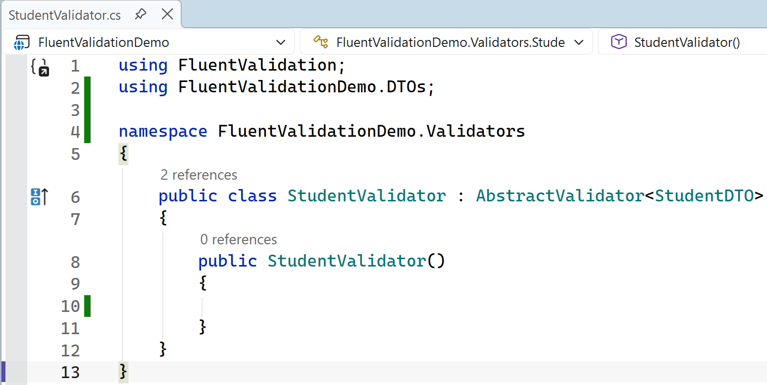
Step – 2 | Add a new validator class for separate validation rules of particular dtos/model

Slide 35
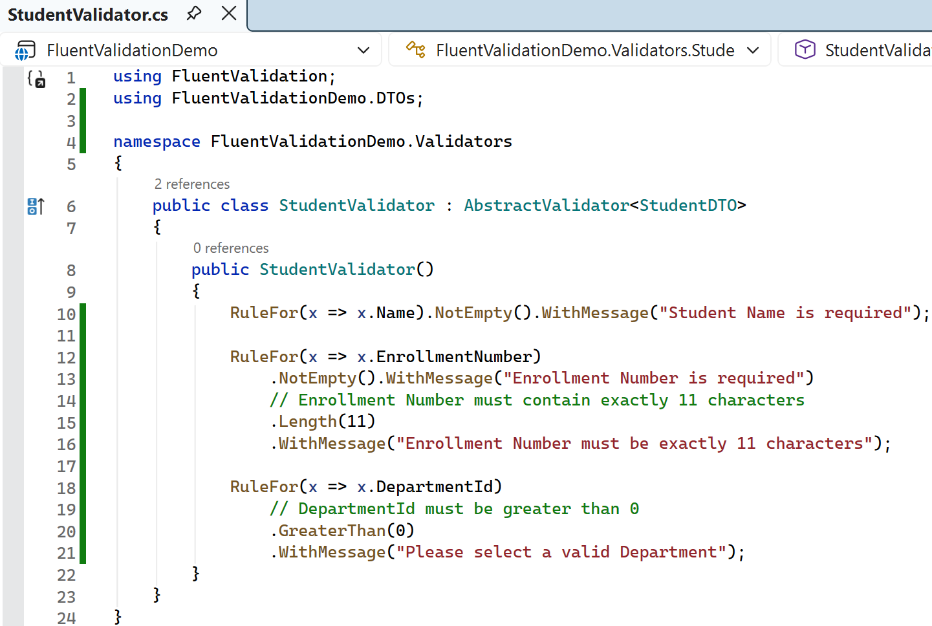
Step – 3 | Add validation rules in newly created class
AbstractValidator<T>:
This is a class provided by FluentValidation.
It is the base class that we need to extend to define our validation rules for a specific model.
In the example, PersonModel is the model being validated.
RuleFor(x => x.PropertyName):
This is the starting method to define a validation rule for a specific property on the model.
It sets the context for further chained methods determining how the property will be validated.

Slide 36
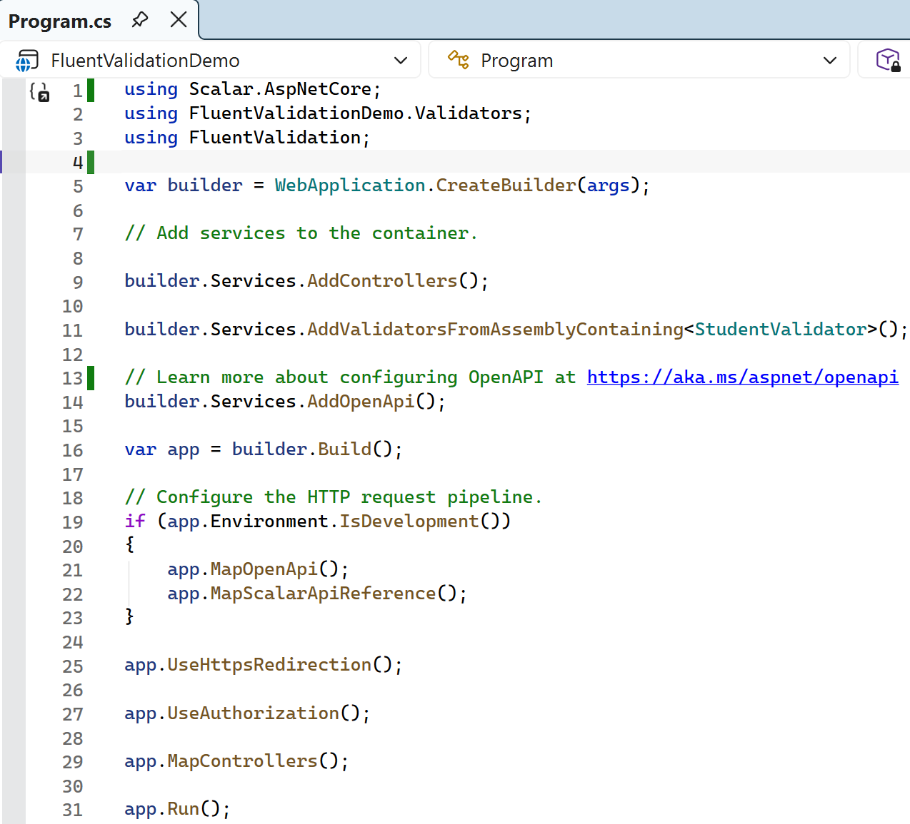
Step – 4 | Register services of fluent validation in program.cs
You can automatically register all FluentValidation validators in your application, you don't need to specify individually.
This already registers all validators in the same assembly as StudentValidator.
Validators
  │
  ├── StudentValidator.cs
  ├── DepartmentValidator.cs
  ├── CourseValidator.cs
  ├── TeacherValidator.cs
  └── ProductValidator.cs
If all of these are in the same project/assembly, this single line registers all of them

Slide 37
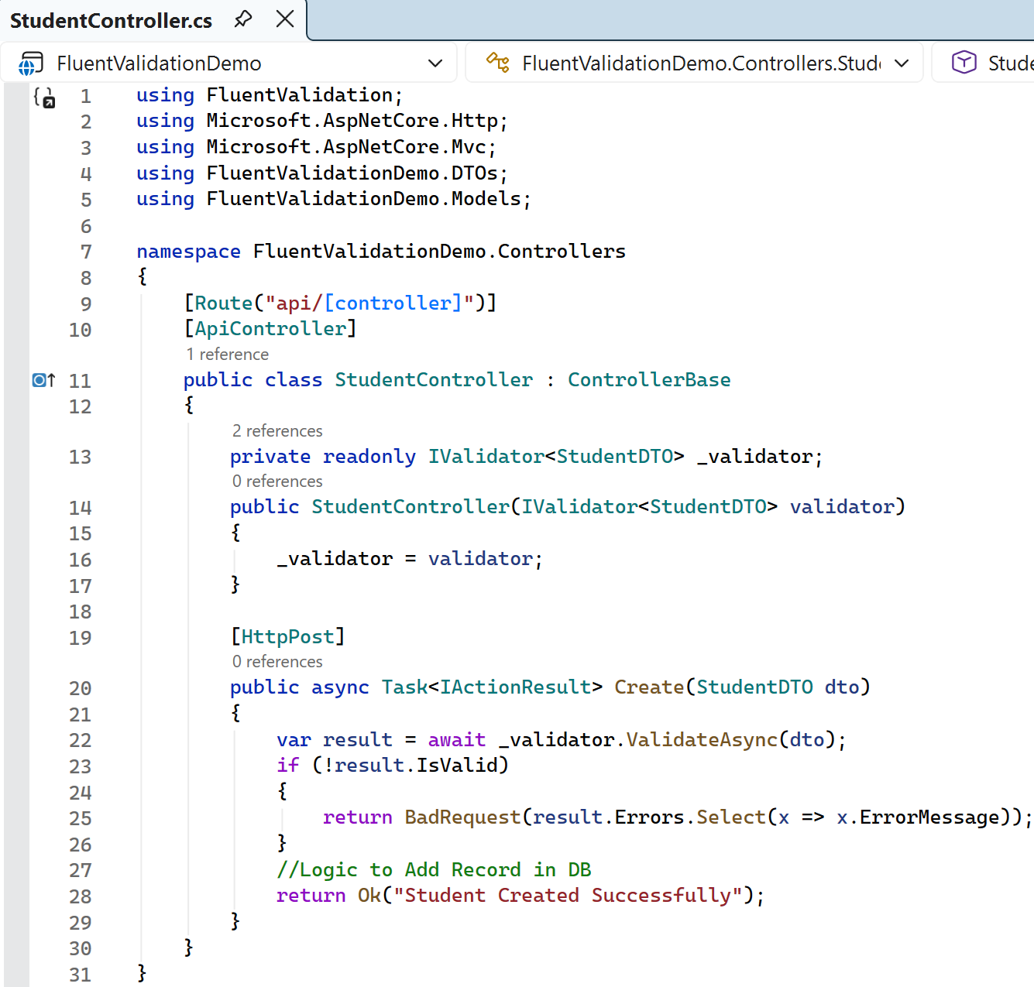
Step – 5 | Call Validator Manually in Controller
Understanding of code:
This is Dependency Injection + FluentValidation.
Create a private variable called _validator that can hold a validator for StudentDTO.
Here:
IValidator<StudentDTO> → FluentValidation interface for validating StudentDTO.
_validator → variable/reference to that validator.
readonly → it can be assigned only during declaration or inside the constructor.

Slide 38
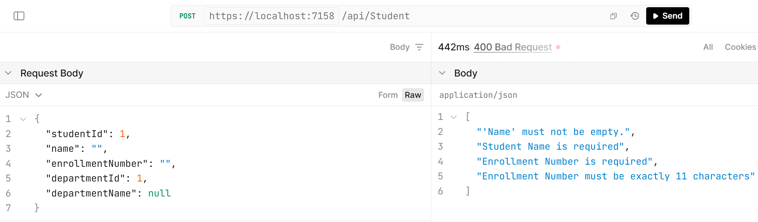
Step – 6 | After that run the project and check for validations

Slide 39
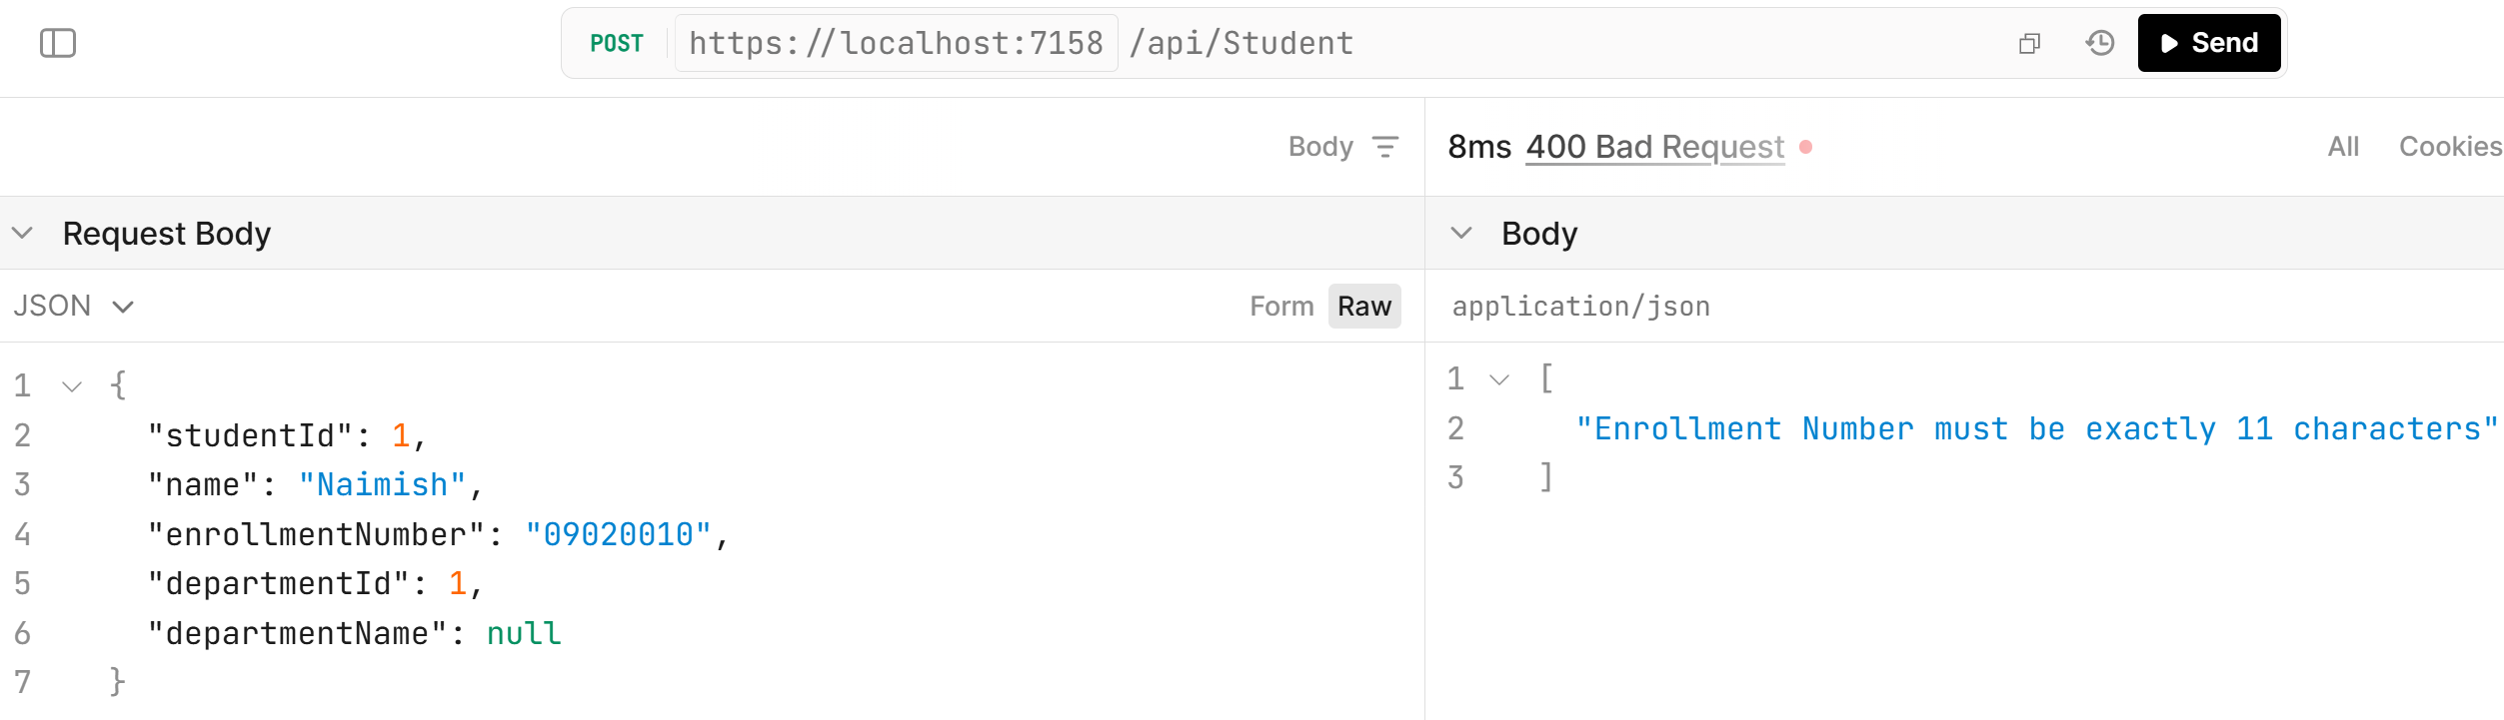
Step – 6 | After that run the project and check for validations

Slide 40
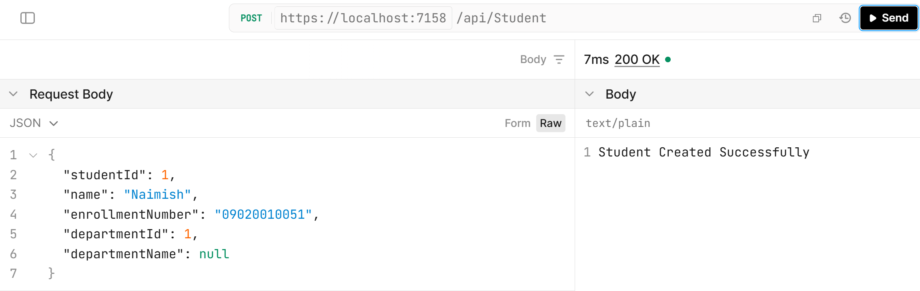
Step – 6 | After that run the project and check for validations

Slide 41
Fluent API Basic Validators
Validator | Description
NotNull() / NotEmpty() | Check the property is not null or empty
Equal() | Checks if the property equals another value or property
NotEqual() | Checks the property is not equal to another value or property
Length() | Checks the length of a string property that falls within the given min and max range
Matches() | Checks the property matches a given regex pattern

Slide 42
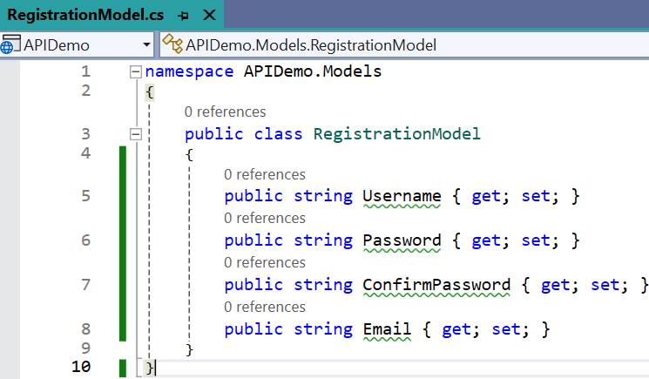
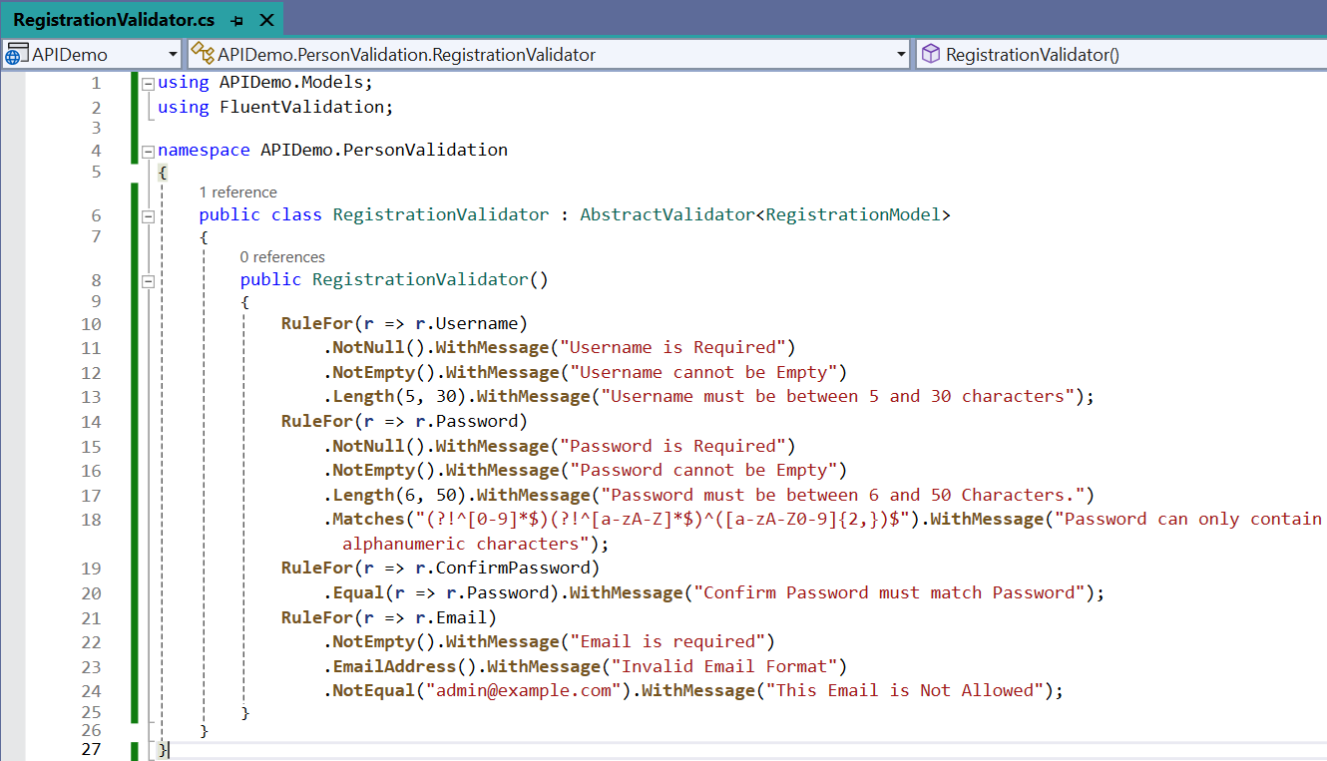
Fluent API Basic Validators Example
Basic Validators
NotNull() / NotEmpty()
Equal()
NotEqual()
Length()
Matches()

Slide 43
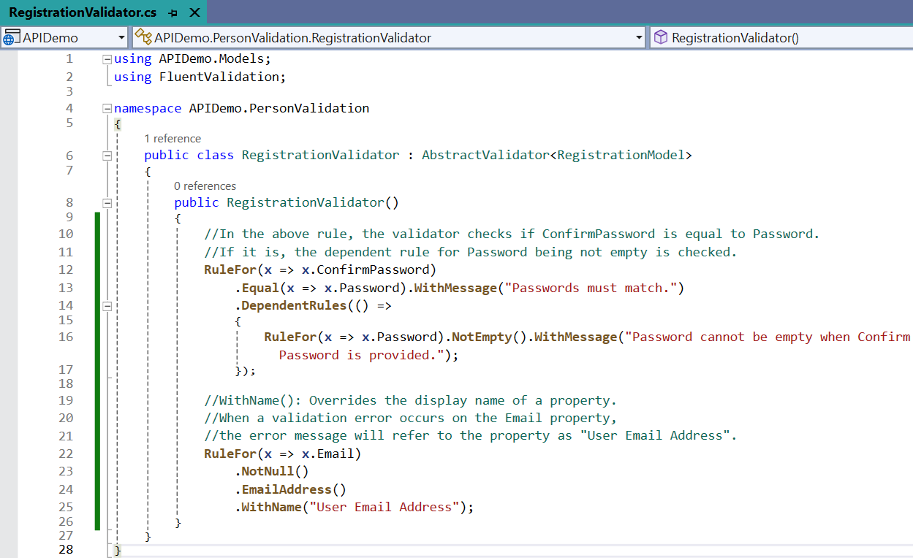
WithName() & Dependent Rules()
Validators
WithName() It is similar to display name in Data Annotations
Dependant Rules()

Slide 44
Fluent API Number Validators
Validator | Description
InclusiveBetween() | Checks the property value falls between or equals to the specified limits InclusiveBetween ensures the value lies within (and including) the provided range
ExclusiveBetween() | Checks the property value falls between but not equal to the specified limits ExclusiveBetween would ensure the value lies within the range but excluding the boundaries
GreaterThan, LessThan, GreaterThanOrEqualTo, and LessThanOrEqualTo set specific bounds on numeric values
LessThan() / LessThanOrEqualTo() | For comparison with another value
GreaterThan() / GreaterThanOrEqualTo() | Comparison with another value, but for greater values.

Slide 45
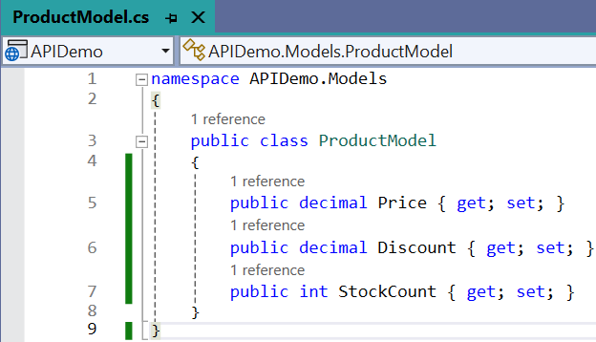
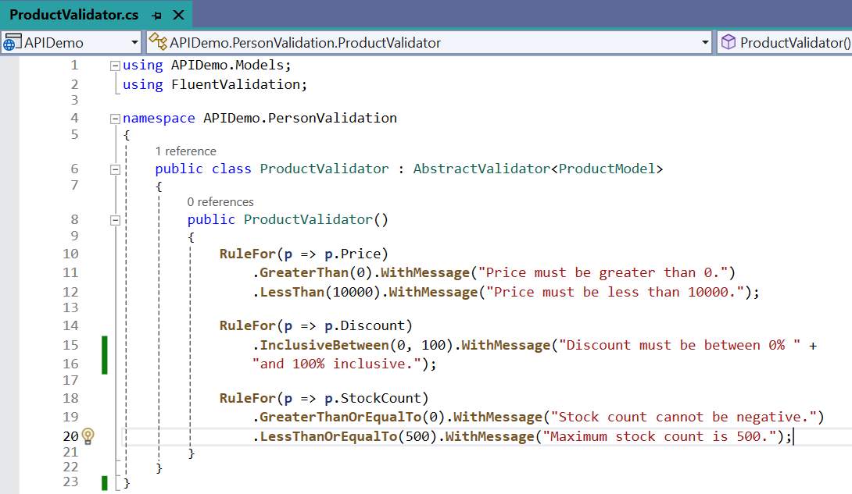
Fluent API Number Validators Example
Number Validators
LessThan() / LessThanOrEqualTo()
GreaterThan() / GreaterThanOrEqualTo()
InclusiveBetween()
ExclusiveBetween()

Slide 46
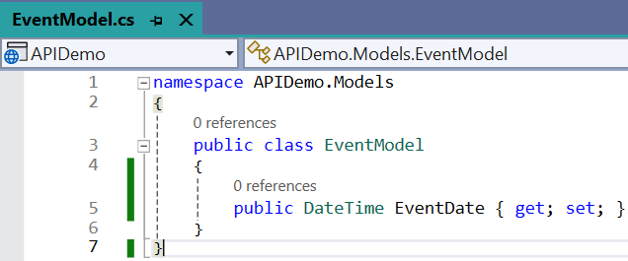
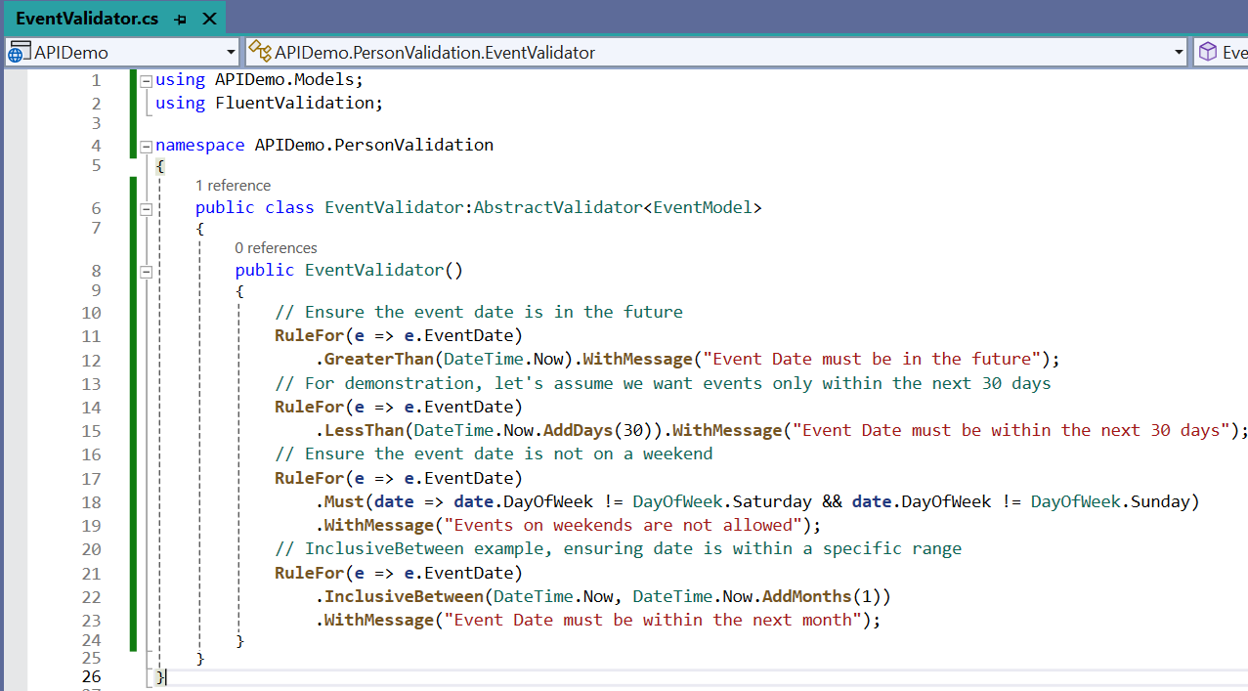
Date Time Validation Example
Rules
EventDate must be future date.
Event date only within the next 30 days.
Eventdate must not be on Saturday & Sunday.
Event Date Must be within the next month.

Slide 47
Conditional Validation using Fluent Validation
Conditional validation is one of the powerful features of Fluent Validation, allowing you to perform validation rules based on certain conditions.
This can be achieved using the following When() and Unless() methods.
They allow you to specify under which conditions a particular validation rule should be executed.
When():
  Apply rules conditionally based on properties.
  The When method takes an expression or a method which will return a Boolean value.
  If the returned value is true, then the immediately preceding validation is applied, otherwise the validation is skipped.
Unless():
  The opposite of When(), the rule is applied unless the condition is true.
  Similar to When, there is also an Unless method, which takes an expression or a method as input.
  That expression or method should return a Boolean Value. If the returned value is false, then the immediately preceding validation is applied, otherwise the validation is skipped.

Slide 48
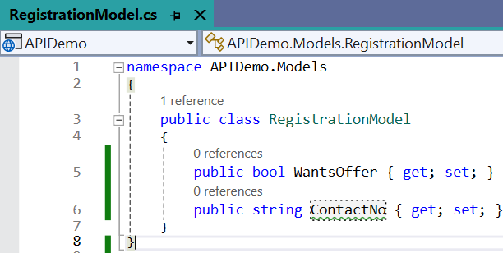
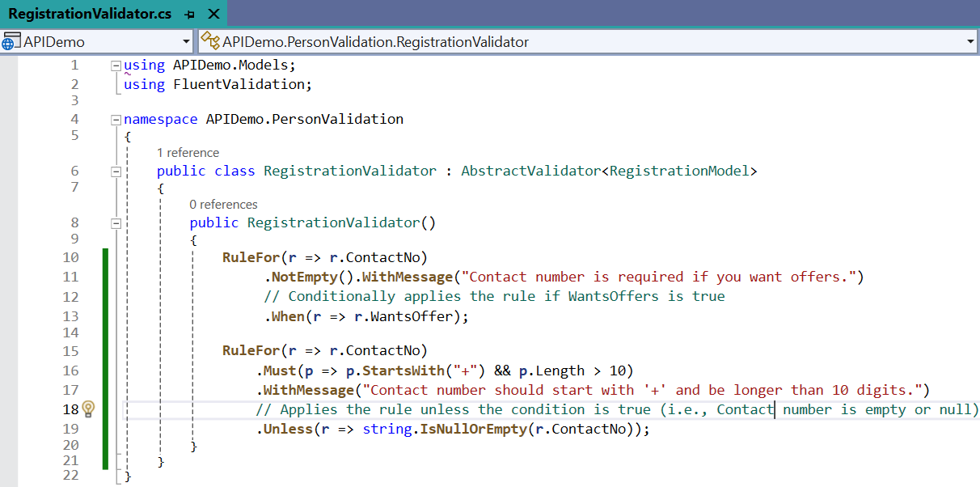
When() & Unless() Example

Slide 49
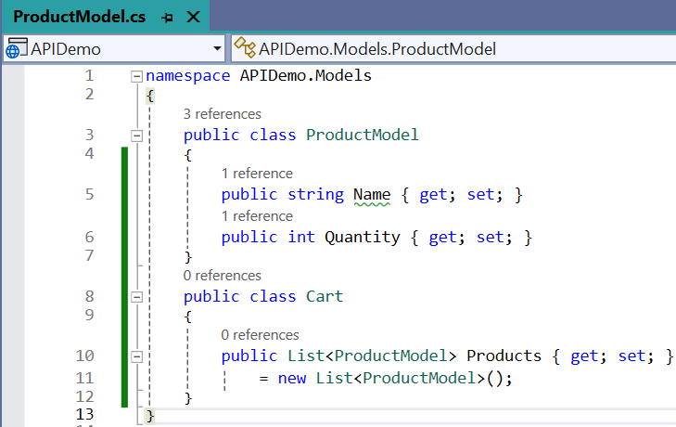
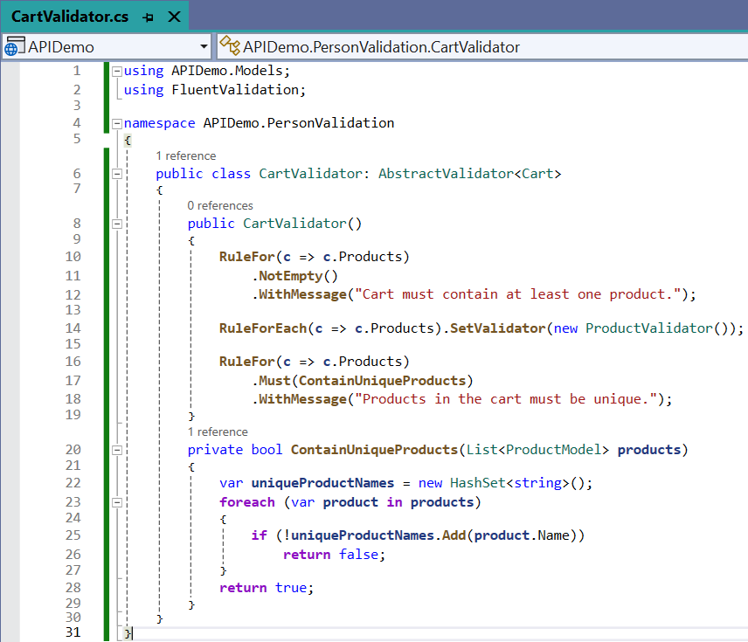
ForEach() = Apply a rule to each element in a collection
HashSet
HashSet is an unordered collection of unique elements
It is generally used when we want to prevent duplicate elements from being placed in the collection.
The performance of the HashSet is much better in comparison to the list.

Slide 50
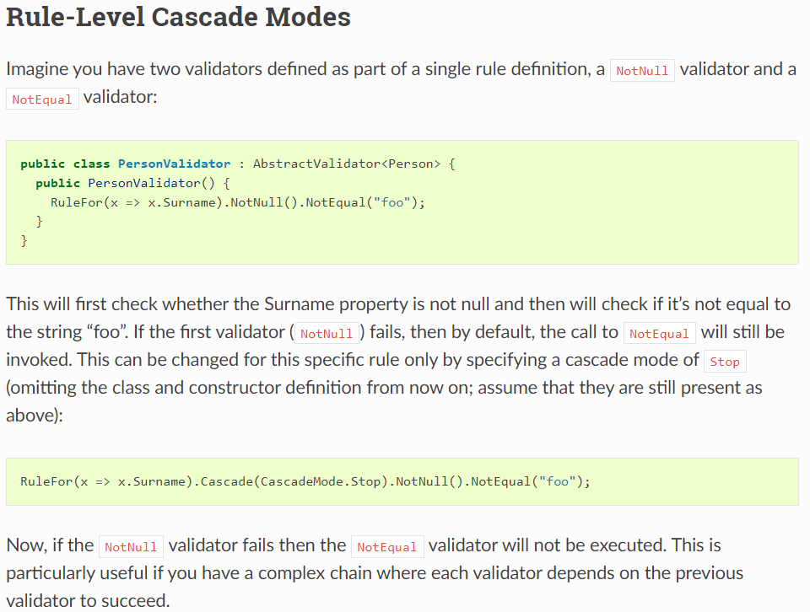
Cascade Modes
The two cascade modes are:
Continue (Default Mode)
Always invokes all rules in a validator class, or all validators in a rule, depending on where it is used.
Stop
Stops executing a validator class as soon as a rule fails, or stops executing a rule as soon as a validator fails, depending on where it is used.

Slide 51
Advantages of Fluent Validation
High Level of Flexibility
  Fluent Validation enables you to create any validation rule understandable.
  It’s overflowing with power and flexibility.
Testability
  Fluent Validation ensures that your code remains test-friendly.
  No more struggling unit tests!
Cleaner Code
  Say goodbye to cluttered data models.
  With Fluent Validation, your validation logic shifts to a separate class, hence code must be clean.
Easy to Maintain
  Fluent Validation’s pattern of separating validation rules from business objects makes maintenance a lot easier.
  If rules need to change, you know exactly where to look. Plus, it’s easier to reuse validation logic across projects.
Better User Experience:
  Fluent Validation allows for easily customizable and detailed error messages that assist users in correcting their data.

Slide 52
Building RESTful APIs using .NET Core
#2505CS311
Prof. Madhuresh R Fichadiya
Computer Science & Engineering Department
Madhuresh.fichadiya@darshan.ac.in
8866961282

