Slide 1

Unit-4
Authentication, Authorization & Security
Building RESTful APIs with ASP.NET Core
#2505CS311
Prof. Madhuresh R Fichadiya
Computer Science & Engineering Department
madhuresh.fichadiya@darshan.ac.in
8866961282

Slide 2

Looping
Outline
  Why API Security?
  Authentication v/s Authorization
  JWT Authentication
  Refresh Token Basics
  Role-Based Authorization
  Policy-Based Authorization
  CORS & HTTPs Configuration
  Secure API Practices

Slide 3
Why API Security?
Section – 1

Slide 4
Why API Security?
A REST API often handles sensitive information:
  Student information
  User accounts
  Financial data
  Employee information
  Admission data
  Academic records
  Administrative operations
  Patient Records
Without security: Anyone could potentially call
  GET /api/students
  DELETE /api/students/10
  POST /api/users
Client
Authentication
??
Authorization
??
API
Database

Slide 5
Authentication v/s Authorization
Feature | Authentication (Who are you?) | Authorization (What are you allowed to do?)
Definition | Process of verifying who the user is | Process of determining what the user can access
Purpose | Identity verification | Access control
When it happens | First step (Login) | After Authentication (once identity is confirmed)
Basis | Credentials (username, password, token, biometrics, etc.) | Roles, claims, policies, or permissions
Output | User is authenticated (logged in) or rejected | User is granted/denied access to the resources
Example | A student logs in with their University ID & password | After login, only students in "Admin" role can access exam results management
.NET Core Example | services.AddAuthentication() → Validates JWT / Cookie login | [Authorize(Roles = "Admin")] → Restricts access to certain actions

Slide 6
Example
Email: admin@college.com Password: ********
Login
Is this really Admin? = YES
Authentication
Can Admin delete students? = YES
Authorization
Student Can delete students? = NO 403 Forbidden
Another User

Slide 7
JWT (JSON Web Token) Authentication
Section – 2

Slide 8
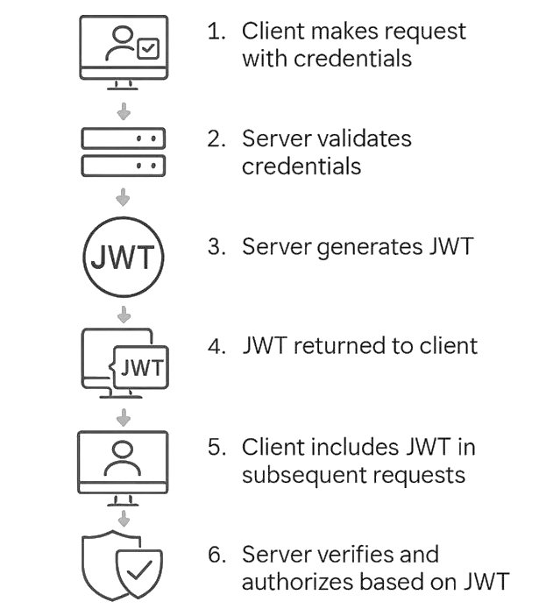
JSON Web Token (JWT)
JSON Web Token (JWT) authentication is a popular method for securing APIs in .NET Core.
It's a stateless mechanism, which means the server doesn't need to maintain a record of authenticated users.
Instead, a JWT is a self-contained token that holds all the necessary information about a user and their permissions.
How it Works?
  Authentication (Who are you?)
  Token Generation (Header, Payload, Signature)
  Token Delivery
  Subsequent Requests
  Authorization (What are you allowed to do?)

Slide 9
JSON Web Token (JWT) Cont..
Authentication
When a user logs in with their credentials (e.g., username and password), the server validates them.
Token Generation
Upon successful authentication, the server generates a JWT.
The token is a string consisting of three parts, separated by dots
Token Delivery
The server sends the JWT back to the client.
Subsequent Requests
The client stores the token and includes it in the HTTP headers of all subsequent requests to protect API endpoints, typically in the Authorization header with a "Bearer" scheme
Authorization
When the server receives a request with a JWT, it validates the token's signature using the same secret key. If the signature is valid, the server trusts the information in the payload and grants or denies access to the requested resource based on the user's claims. If the token is invalid (e.g., expired or tampered with), the server returns a 401 Unauthorized or 403 Forbidden response.

Slide 10
JSON Web Token (JWT) Cont..
Authentication Middleware
  In Program.cs
    app.UseAuthentication();
    app.UseAuthorization();
Order matters
  app.UseRouting();
  app.UseAuthentication();
  app.UseAuthorization();
  app.MapControllers();
Remember
  Authentication
  ↓
  Authorization

Slide 11
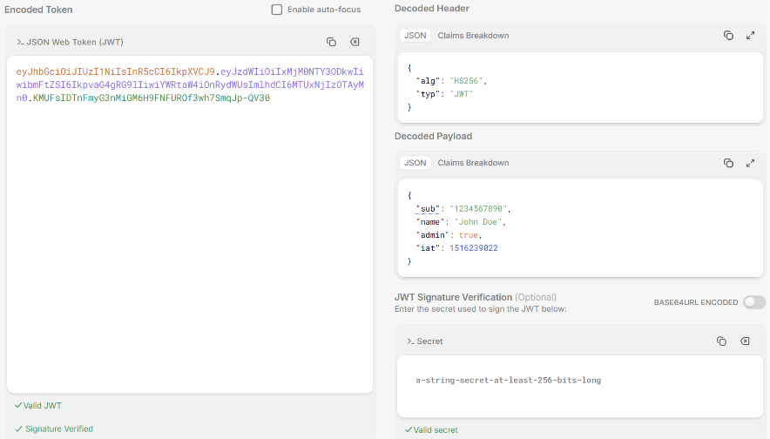
JSON Web Token (JWT) Format/Structure
Contains metadata about the token, such as the type of token and the hashing algorithm used
Contains the actual data being transmitted, such as user information or permissions. This data is referred to as "claims"
A JWT consists of three parts:
Header, Payload, and Signature, separated by dots (.).
The signature is created using the algorithm specified in the header.
Header.Payload.Signature

Slide 12
Role-Based Authorization
(Authorization based on the user's role. )
Admin
Teacher
Student
HOD
Principal
Section – 3
Librarian

Slide 13
Why Role is Required?
Suppose I m having 5000 users and I have to assign a permission to individuals for a specific screen or rights.
Instead of I create a role and then I give permission to that role.
Roles
  Admin (Suppose if you have 50 admins then you have to just assign the Admin role to them)
  Student (Suppose if you have 1000 students then you have to just assign the Student role to them)
  Staff (Suppose if you have 200 staff then you have to just assign the Staff role to them)
  Principal (Suppose if you have 10 principals then you have to just assign the Principal role to them)

Slide 14
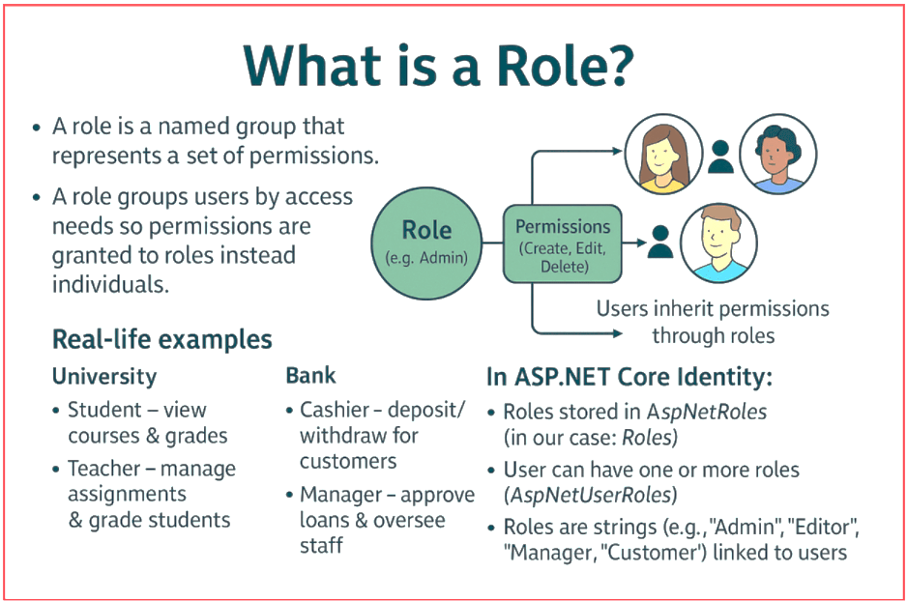
What is a Role?

Slide 15
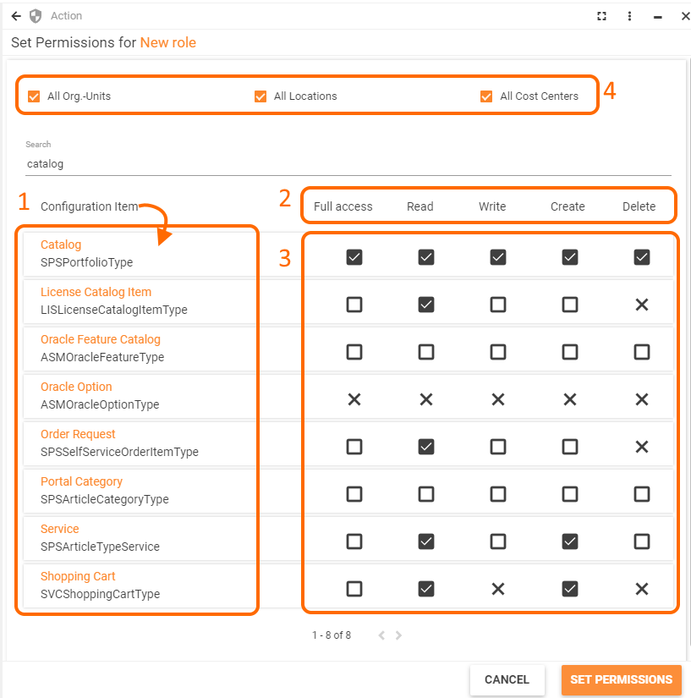
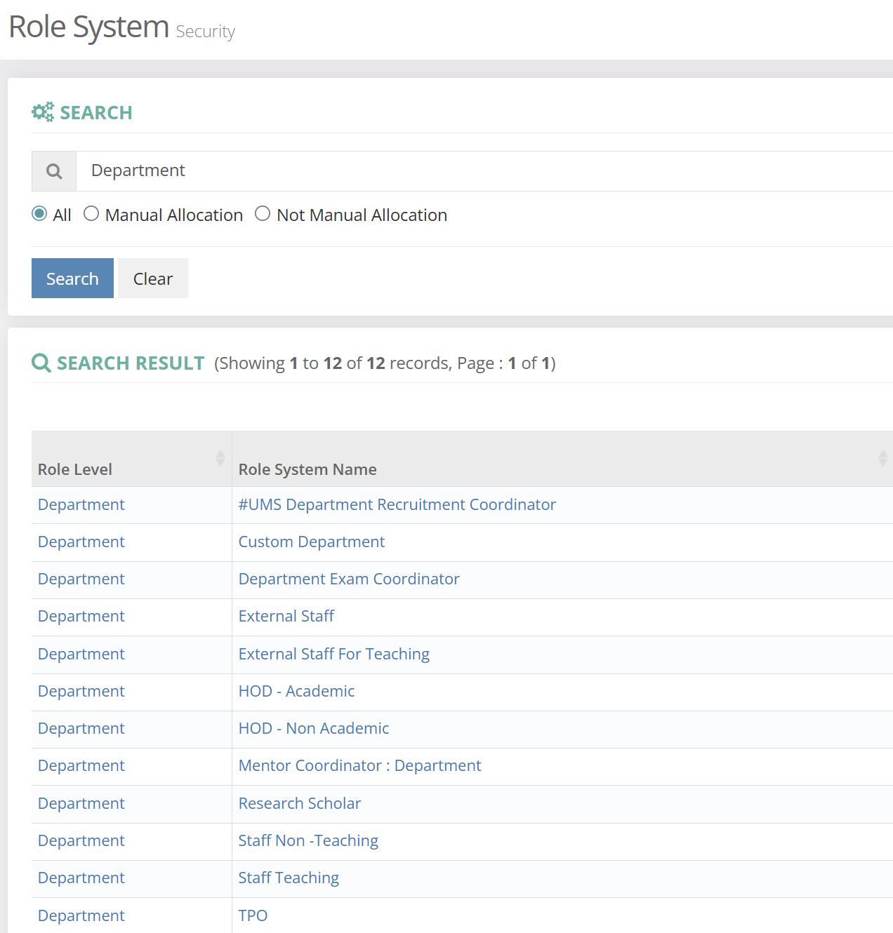
Example – Assigning Rights to Roles

Slide 16
Role-Based Access Control (RBAC)
Role-Based Access Control (RBAC) in .NET Core is a security model that governs what authenticated users can do within an application based on the roles assigned to them.
Instead of granting permissions directly to individual users, you grant permissions to roles, and then assign those roles to users.
This makes managing permissions simpler and more scalable, especially in large applications.
Key Concepts
  User:
    An individual who interacts with the application.
    A user has a unique identity, typically managed through a service like ASP.NET Core Identity.
  Role:
    A collection of permissions. Roles are abstractions that represent the responsibilities or job functions of users within the application (e.g., "Admin," "Editor," "Guest").
  Permission:
    A specific action a user is allowed to perform, like "CreateProduct," "EditPost," or "DeleteUser."

Slide 17
Role-Based Access Control (RBAC) Cont..
.NET Core provides a robust, built-in framework for implementing RBAC, primarily through the
  ASP.NET Core Identity
  Authorization
ASP.NET Core Identity
This is the foundational component for managing users, roles, and claims.
  User Management:
    Handles user registration, login, password management, and user data storage.
  Role Management:
    Allows you to create, update, and delete roles, and assign users to them.
  Claims: (Payload OR User Information)
    Claims are statements about the user.
    They are essentially key-value pairs that contain information about the user, such as their name, email, and—most importantly for RBAC—their roles.

Slide 18
Flow of RBAC in .NET Core
Authentication
Decision
The middleware uses the attributes (like [Authorize]) or policies defined for that resource to determine if the user's roles or claims meet the requirements
Access
If the requirements are met, the user is granted access. Otherwise, they are denied, and an HTTP 401 (Unauthorized) or 403 (forbidden) response is returned.
Claims Principal Creation
After successful authentication, a ClaimsPrincipal object is created. This object holds the user's identity and all their claims, including their assigned roles.
Authorization Check
When the user tries to access a protected resource (e.g., an API endpoint or a web page), the Authorization Middleware checks the ClaimsPrincipal object.
A user signs in, and ASP.NET Core Identity authenticates them.

Slide 19
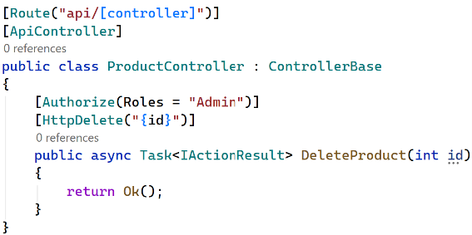
Role-Based Access Control (RBAC) Cont..
Authorization
  Once a user is authenticated (meaning their identity has been verified), authorization determines what they are allowed to do.
  In .NET Core, this is typically done using attributes and policies.
  [Authorize] Attribute: This is the most common way to enforce authorization. You can apply it to a controller or an action method to restrict access.
  Role-based Authorization:
    The attribute can specify one or more roles.
    A user must be in at least one of the specified roles to access the resource.

Slide 20
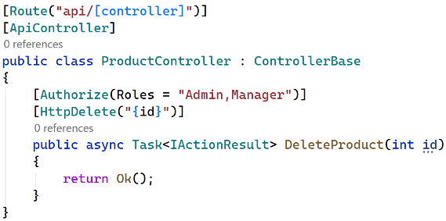
Role-Based Access Control (RBAC) Cont..
Multiple Roles can access this endpoint.

Slide 21
Role-Based Access Control (RBAC) Cont..
Policy-Based Authorization:
  Policies provide more flexible authorization rules.
  Instead of simply asking: Is user Admin?
  We can ask: (Must Have)
    Does user have Department = CSE?
    Does user have Permission = Student.Delete?
    Does user have Age >= 18?
    Does user have Claim = HR?

Slide 22
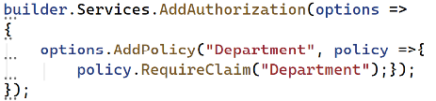
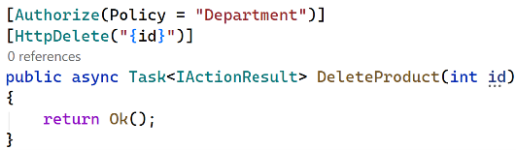
Role-Based Access Control (RBAC) Cont..
Policy-Based Authorization:
    A more flexible and recommended approach.
    You define a named policy that encapsulates one or more authorization requirements, then apply that policy with the [Authorize] attribute.
    This separates the authorization logic from the controller, making it cleaner and easier to manage.
  Steps
    Define the Policy: In Program.cs, configure a policy.
    Apply the Policy: Apply the policy to the controller or action method.

Slide 23
Summary | RBAC
Role
A label or group assigned to a user (such as Admin, Manager, or Customer).
Permission
A specific action a user is allowed to perform (such as Products.Delete or Users:Read).
Relationship
A role is a container that holds a set of permissions. Instead of giving 50 individual permissions to a single user, you assign them to a role, and assign that role to the user.
1. Role-Based Authorization (RBAC)
Checks if a user belongs to a specific role using attributes like [Authorize(Roles = "Admin")], [Authorize(Roles = "Admin, Teacher")] etc.
2. Permission-Based (Policy-Based) Authorization
Checks for specific capabilities or claims like Permissions.Products.Delete, which offers finer control without hardcoding titles into your source code

Slide 24
Refresh Tokens
Section – 4

Slide 25
Refresh Token Basics
Problem with JWT
  Suppose JWT expires after: 15 Minutes
  User must login again.
  This creates poor UX. (User Experience)
  The Solution is: Access Token + Refresh Token
Access Token | Refresh Token
Short-lived | Long-lived
Used for API requests | Used to obtain new access token
Sent frequently | Sent less frequently
Usually JWT | Random secure token
Example: 15 min | Example: days/weeks

Slide 26
Refresh Token Flow
Login
Example Login Response: JSON
{
"accessToken": "eyJhbGciOi...",
"refreshToken": "7f8a9b..."
}
Access Token + Refresh Token
Client
Client uses: Access Token for normal API requests.
When expired: Refresh Token is used to obtain a new access token.
Refresh Token Security
  Generate cryptographically secure random tokens.
  Set expiration.
  Store refresh tokens securely.
  Revoke tokens when necessary.
  Consider token rotation.
  Detect token reuse.
  Never make refresh tokens permanent.
API Request
API
Access Token Expired
Refresh Token
API
New Access Token
User doesn't need to enter the password again.

Slide 27
CORS & HTTPs Configuration
Section – 5

Slide 28
CORS (Cross-Origin Resource Sharing)
It controls which origins are allowed to access your API from browsers.
Different origins → CORS applies.
Same Origin v/s Cross Origin
Frontend
https://college-ui.com
API
https://api.college.com
Same
https://college.com
https://college.com/api
Cross
https://college.com
https://api.college.com

Slide 29
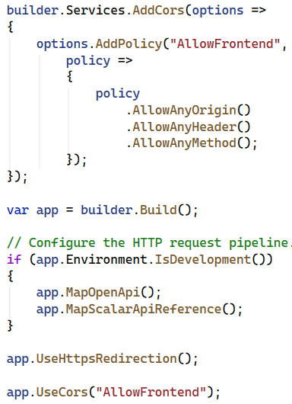
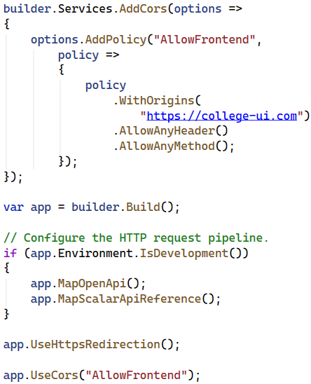
CORS (Cross-Origin Resource Sharing) Cont..
Configure CORS (Generic)
Configure CORS (Specific)

Slide 30
CORS (Cross-Origin Resource Sharing) Cont..
Configure CORS (Generic)
Who can access my API? → Everyone
Which headers can they send? → Any
Which HTTP methods can they use? → Any

Slide 31
Secure API Practices
Section – 6

Slide 32
Secure API Practices
Always use HTTPS
Validate input (Client Input → Validation → Business Logic)
Authenticate users ([Authorize])
Authorize access ([Authorize(Roles = "Admin")])
Use strong password policies
Protect secrets (E.g. Never hardcode: "SecretKey123" )
Never Store Secrets in Source Code (var secret = "MySecretKey";), Better to store in Configuration, Environment Variables or Secret Manager.
SQL Injection Protection
  Never build SQL like: var sql = "SELECT * FROM Students WHERE Name = '" + name + “’”;
  Use: Entity Framework Core or or parameterized queries.
Rate Limiting
  (Attackers may send: 1000 requests/sec to your api, Rate limiting controls request frequency, let say Client→100 requests/minute→API) | Excessive requests: 429 Too Many Requests

Slide 33
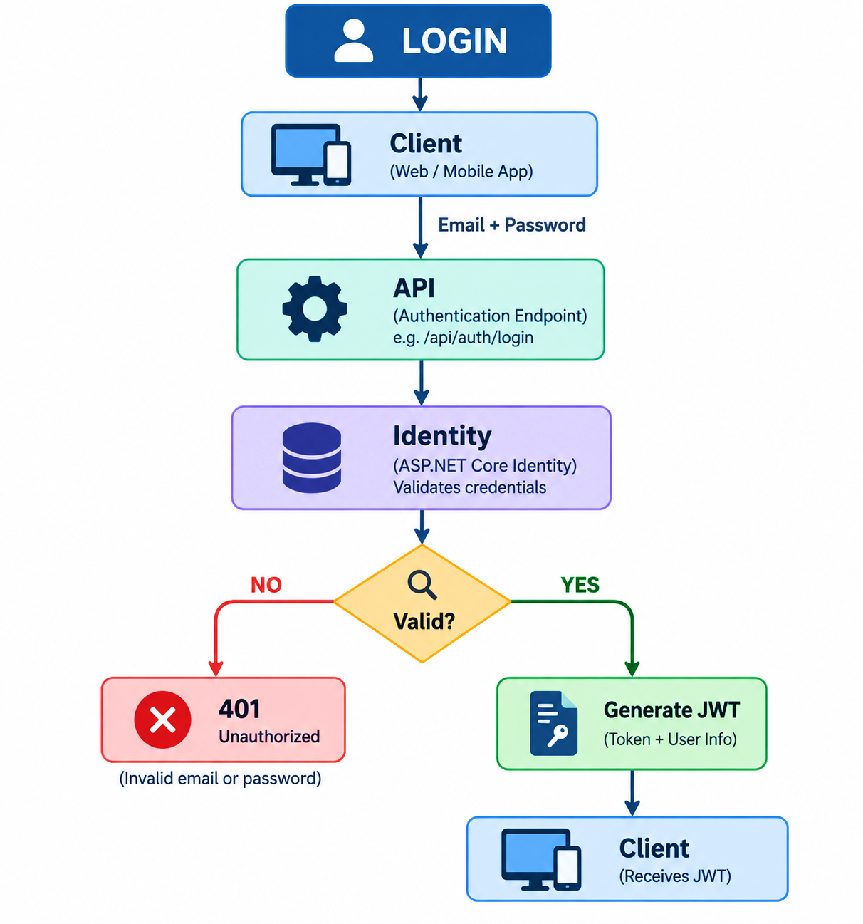
Proper HTTP Status Codes | Remember
Security-related responses:
Status | Meaning
200 | Success
201 | Created
400 | Bad Request
401 | Not Authenticated
403 | Not Authorized
404 | Not Found
429 | Too Many Requests
500 | Server Error
401 → Who are you?
401 Unauthorized: No valid authentication.
-----------------------------------------------------------------------
403 → I know who you are, but you can't do this.
403 Forbidden: User is authenticated but doesn't have permission.

Slide 34
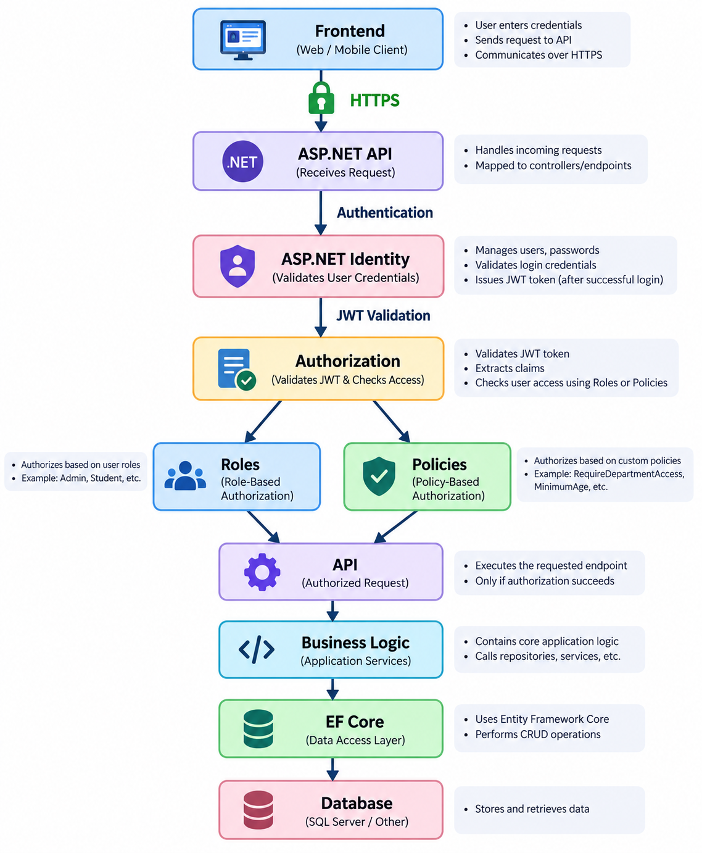
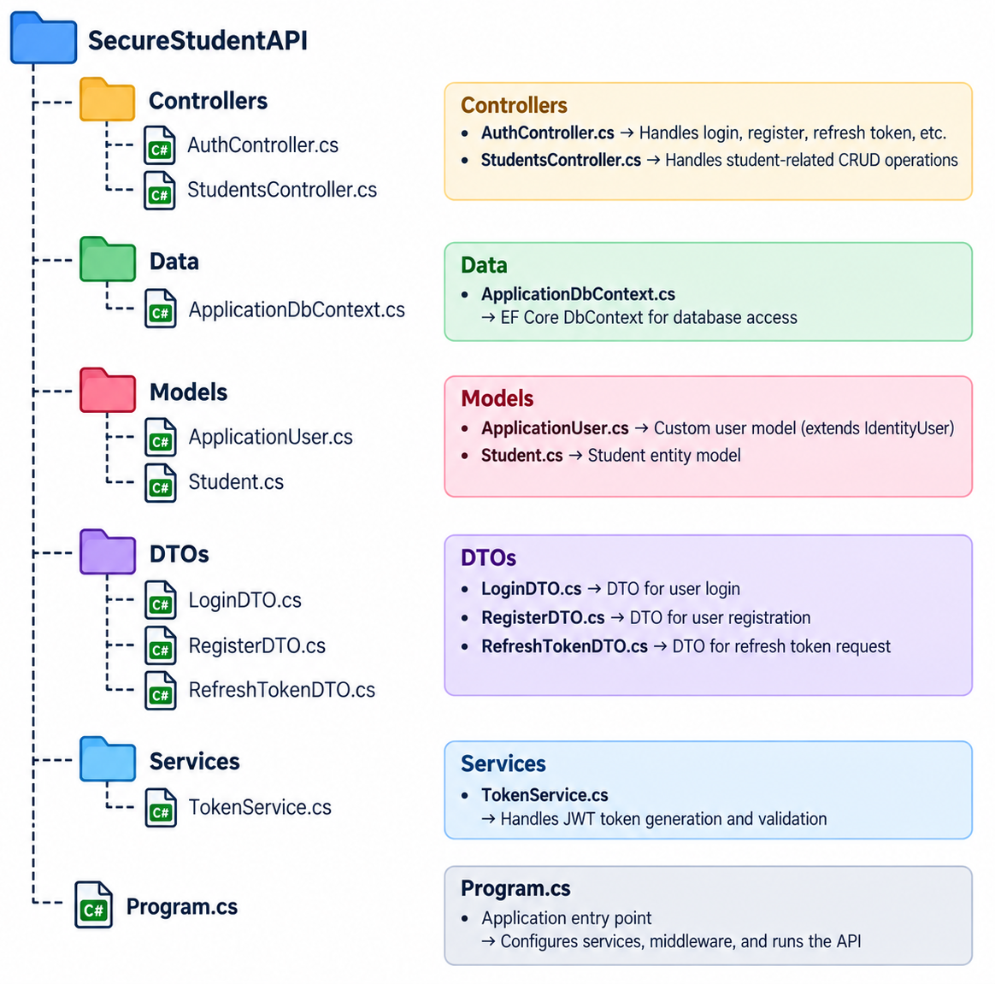
In a nutshell
Project Structure

Slide 35
Building RESTful APIs with ASP.NET Core
#2505CS311
Prof. Madhuresh R Fichadiya
Computer Science & Engineering Department
madhuresh.fichadiya@darshan.ac.in
8866961282

