Slide 1

Unit-5
API Testing & Architecture Basics
Building RESTful APIs with ASP.NET Core
#2505CS311
Prof. Madhuresh R Fichadiya
Computer Science & Engineering Department
madhuresh.fichadiya@darshan.ac.in
8866961282

Slide 2

Looping
Outline
  Why Testing Matters?
  Types of API Testing
  Test Pyramid
  Unit Testing Overview
  Repository Pattern for API
  Single Responsibility Principle
  Mocking Dependencies
  Dependency Injection

Slide 3
Why Testing Matters?
Section - 1

Slide 4
"Writing an API that works is only half the job. We also need to make sure it continues to work when the application grows."
Building Reliable, Maintainable and Testable ASP.NET Core Web APIs

Slide 5
Why Testing Matters?
Testing is the process of verifying that software behaves as expected.
Suppose the developer changes:
  student.Age = dto.Age; → student.Age = dto.Age + 1;
The application may still compile.
But the business logic is now wrong.
Testing helps us detect:
  Incorrect business logic
  Broken functionality
  Regression bugs
  Invalid input handling
  Database-related problems
  Unexpected changes
Student API
POST /api/students
Create Student
Database

Slide 6
What Happens Without Testing?
Imagine an e-commerce API.
Developer changes the discount calculation.
  Old → discount = total * 0.10;
  New → discount = total * 10;
  Suppose ₹1000 → 10% discount → Expected: ₹100 → Actual: ₹10,000
The application compiles successfully.
A test could catch this immediately.
Customer
POST /api/orders
Create Order
Calculate Total
Compilation tells us that the code is syntactically valid. Testing tells us whether the code behaves correctly.
Apply Discount
Save Order

Slide 7

Test Case
A car manufacturer doesn't build 10,000 cars and then test whether the brakes work.
They test components continuously: (Component Testing)
Brake
Engine
Airbag
Lights Transmission
↓
Individual Testing
↓
System Testing
↓
Complete Vehicle Testing
API development is similar.
Method
↓
Service
↓
API
↓
Complete Application

Slide 8
Types of API Testing
Section - 2

Slide 9
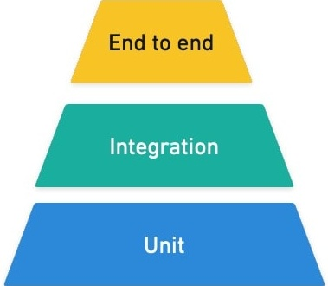
Types of API Testing
Unit Testing
Integration Testing
End-to-end Testing
Unit Testing .NET Library/Package
xUnit is a popular testing framework for .NET apps.
Its job is simple: Find test methods Run them Tell PASS / FAIL
One function, method, class, or component in isolation
Whether multiple components or services work together
A complete user journey through the running system
E.g. Verify that calculateTotal() applies a discount correctly
Verify that the application correctly saves an order to the database
Log in, add an item to a cart, pay, and receive confirmation
Fastest and cheapest
Moderate
Slowest and most expensive
Does this individual piece of logic work correctly?
Do these components interact correctly?
Can a real user successfully complete this important task?

Slide 10
Testing Pyramid
Section - 3

Slide 11
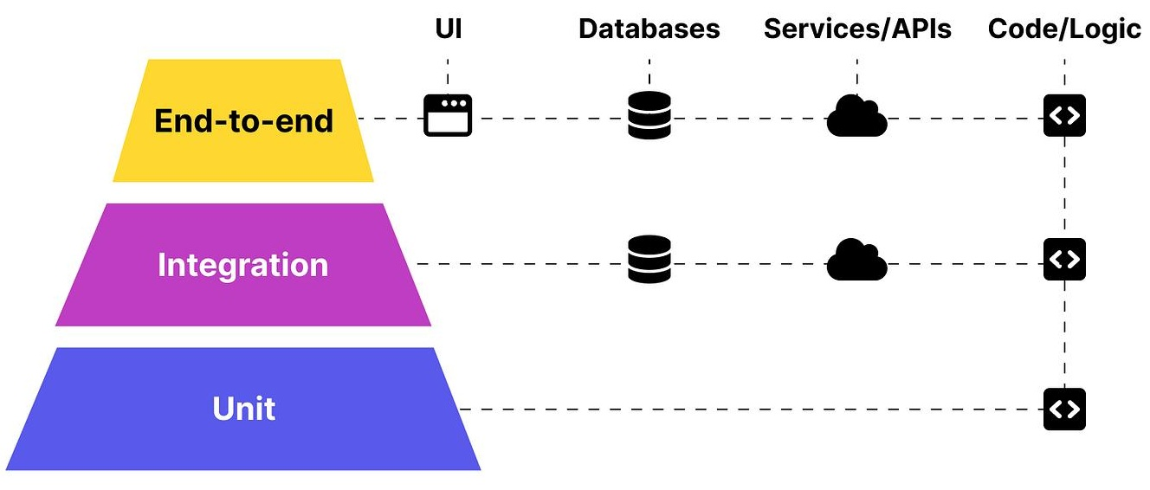
Testing Pyramid
Slow
Small Number of Critical E2E Tests
$$$
Execution Time
Fewer Integration Tests
Cost
Many Unit Tests
$
Fast

Slide 12
Testing Pyramid Cont..
Parameters | Unit | Integration | End-to-end
Scope | One class or method | API + real dependencies (test DB) | Whole deployed system
Speed | Milliseconds | Seconds | Seconds to minutes
Dependencies | Mocked / faked | Real, but isolated (test instance) | Real, live-like
Typical count | Hundreds to thousands | Dozens to hundreds | A handful
Typical tool | xUnit + Moq/NSubstitute | WebApplicationFactory | Playwright / Postman

Slide 13
Unit Testing
Section - 4

Slide 14
What is Unit Testing?
Unit testing is an essential part of software development, ensuring that individual components of an application function as expected.
A unit test tests one small unit of functionality in isolation.
In .NET, we can write unit tests using various testing frameworks, including MSTest, NUnit, and xUnit.
xUnit is generally considered the best overall choice for modern .NET applications due to its strong built-in test isolation, excellent parallel execution, and clean design.
Why Write Unit Tests?
  Ensure Correctness: Unit tests ensure that individual components of an application function correctly, reducing the likelihood of bugs and errors.
  Improve Code Quality: Writing unit tests encourages developers to write better, more modular code, improving overall code quality.
  Reduce Debugging Time: Unit tests help identify issues early, reducing debugging time and effort.

Slide 15
To write unit tests in .NET, you’ll need to:
Choose a Testing Framework:
  Select a testing framework, such as xUnit, MSTest or NUnit.
Create a Test Project:
  Create a new test project in Visual Studio, selecting the chosen testing framework.
Write Test Methods:
  Write test methods, using the [Fact] attribute (xUnit) or [TestMethod] attribute (MSTest).
Use Assert Statements:
  Use assert statements to verify the expected behaviour of the code under test.

Slide 16
Unit Testing Cont..
Example
  public int Add(int a, int b)
  {
  return a + b;
  }
Test case for the above method is:
  [Fact] // This is a test
  public void Add_TwoNumbers_ReturnsCorrectResult()
  {
  var result = Add(10, 20); // Perform operation
  Assert.Equal(30, result); // Verify expected result
  }
[Fact] is an attribute provided by xUnit, this attribute indicates that this is a test method. (It is for a test with fixed input/conditions.)
Assert is used to check whether the actual result matches what we expect.
Production Code
Unit Test Code

Slide 17
Unit Testing Cont..
If you want to test the same method with multiple sets of input, xUnit provides [Theory]
  [Theory]
  [InlineData(10, 20, 30)]
  [InlineData(5, 5, 10)]
  [InlineData(100, 50, 150)]
  public void Add_ReturnsCorrectResult(int a, int b, int expected)
  {
  var result = Add(a, b);
  Assert.Equal(expected, result);
  }
Name | Remarks
[Fact] | One fixed test scenario [A single, fixed scenario]
[Theory] + [InlineData] | Same test with different data or multiple data [the same test, many inputs]
Assert | Verify the result

Slide 18
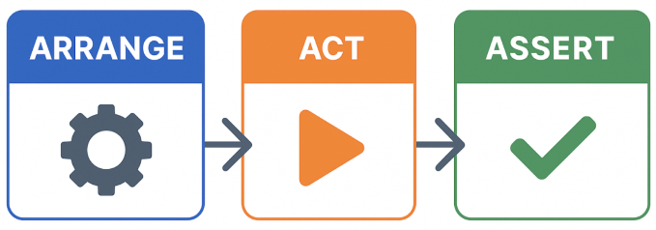
Pattern: Arrange → Act → Assert (AAA)
Arrange
Set up any objects and variables needed.
var calculator = new Calculator();
Act
Call the method you’re testing.
var result = calculator.Add(10, 20);
Assert
Verify the result is as expected.
Assert.Equal(30, result);
→
→

Slide 19
Common Assert Methods
Method | Example | Remarks
Assert.Equal(expected, actual) | Assert.Equal(30, result); | Checks equality
Assert.NotEqual(expected, actual) | Assert.NotEqual(50, result); | Checks that values are different
Assert.True(condition) | Assert.True(result > 0); | Checks whether something is true
Assert.False(condition) | Assert.False(result < 0); | Checks whether something is false
Assert.Null(object) | Assert.Null(student); | Checks whether a value is null
Assert.NotNull(object) | Assert.NotNull(student); | Checks that a value is not null
Assert.Contains(item, collection) | Assert.Contains("Rahul", students); | Checks whether something exists in a collection/string
Assert.Empty(collection) | Assert.Empty(students); | Checks whether collection has no elements
Assert.Throws<TEx>(action) | Assert.Throws<DivideByZeroException>(() => calculator.Divide(10, 0) ); | Action throws the given exception type

Slide 20
Single Responsibility Principle
Section - 5

Slide 21
Separation of Concerns & Single Responsibility Principle (SRP)
“Divide an application into different parts, where each part handles a specific type of responsibility.”
Instead of putting everything inside the Controller, we separate the application into layers.
Without Separation of Concerns (StudentsController)
  Receive HTTP Request
  Validate input
  Business logic
  SQL queries
  Database operations
  Error handling
  Return HTTP Response
The Controller is doing too many jobs.
SRP is one of the SOLID principles. (A class should have one primary responsibility and should have one reason to change)

Slide 22
Repository Pattern for API
Section - 6

Slide 23
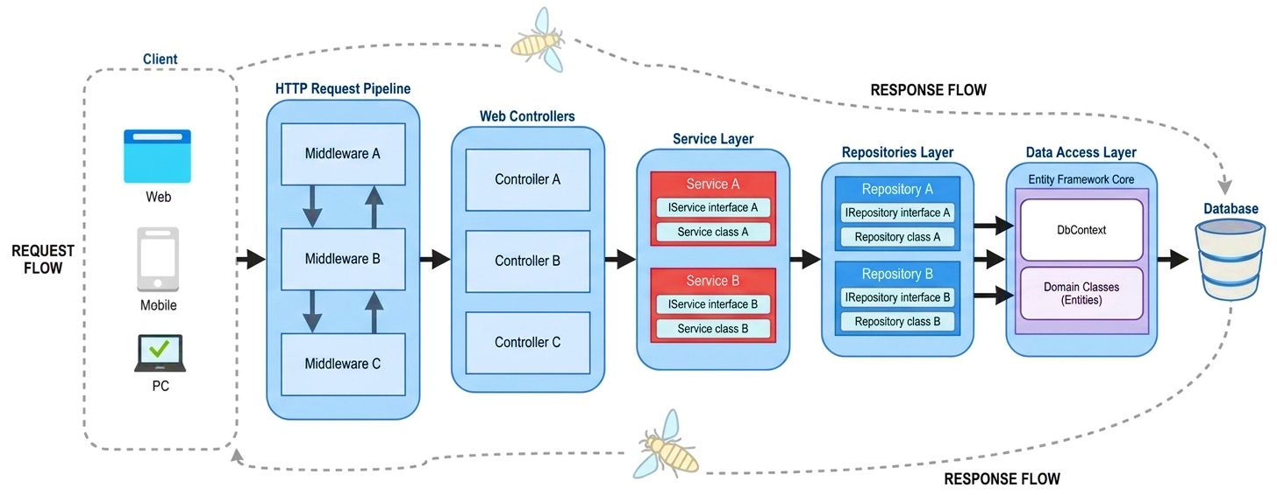
Repository Pattern - Design

Slide 24
Repository Pattern Cont..
The Repository pattern is a design pattern that abstracts data access behind a clean, domain-focused interface so your business logic doesn’t depend directly on databases, ORMs, or external APIs.
It’s commonly used in layered .NET applications (e.g., with Entity Framework Core) to improve testability, maintainability, and separation of concerns.
Without Repository:
  Controller → EF Core → Database (Current our project’s architecture)
  Calling DbContext or raw SQL directly.
  Mixing business rules with data-access details (queries, joins, includes, transactions).
  Being hard to unit test because they depend on a real database or EF Core.
With Repository:
  Controller → Service (Business Logic)→ Repository (DB Access) → EF Core → Database
  Repository responsibility: Handle data-access operations.

Slide 25
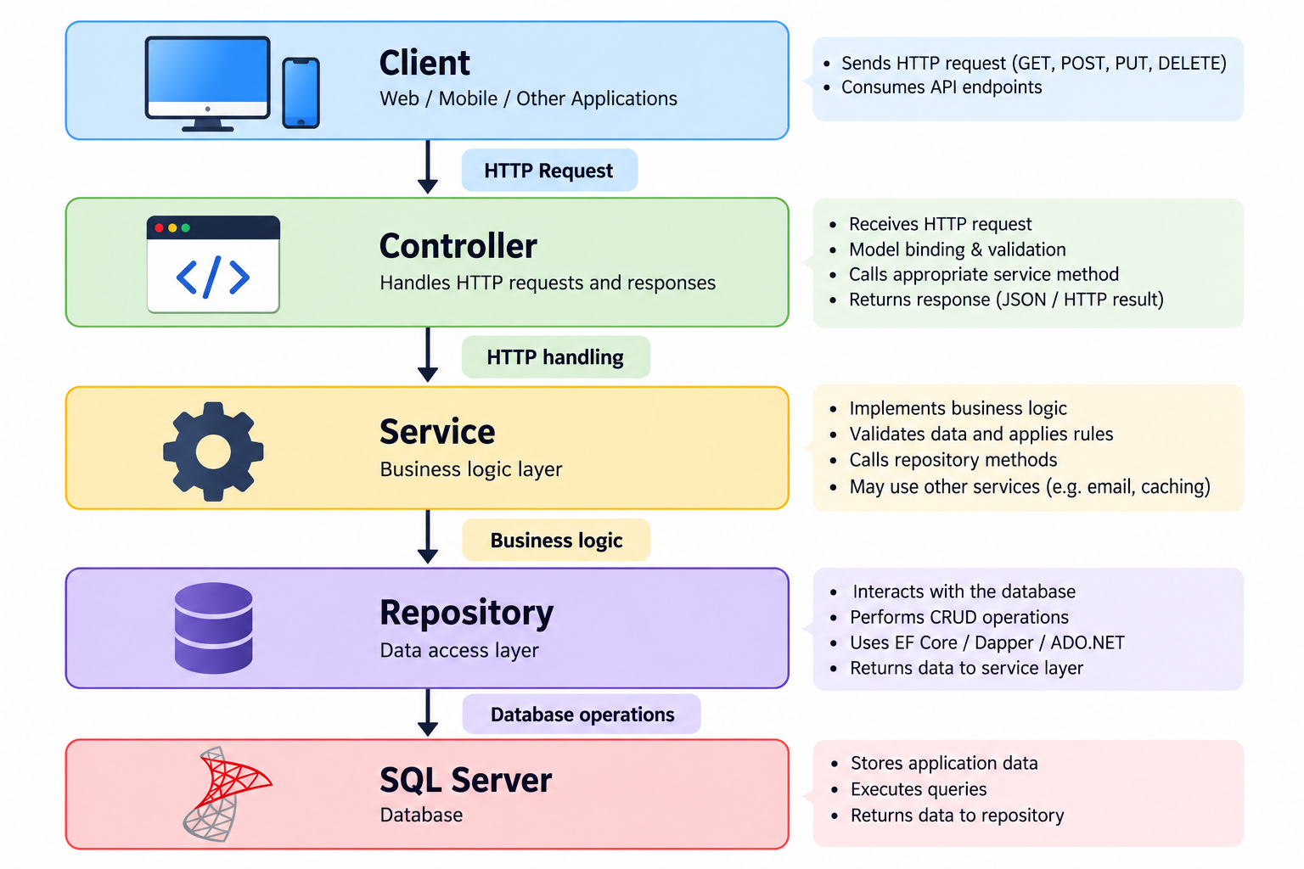
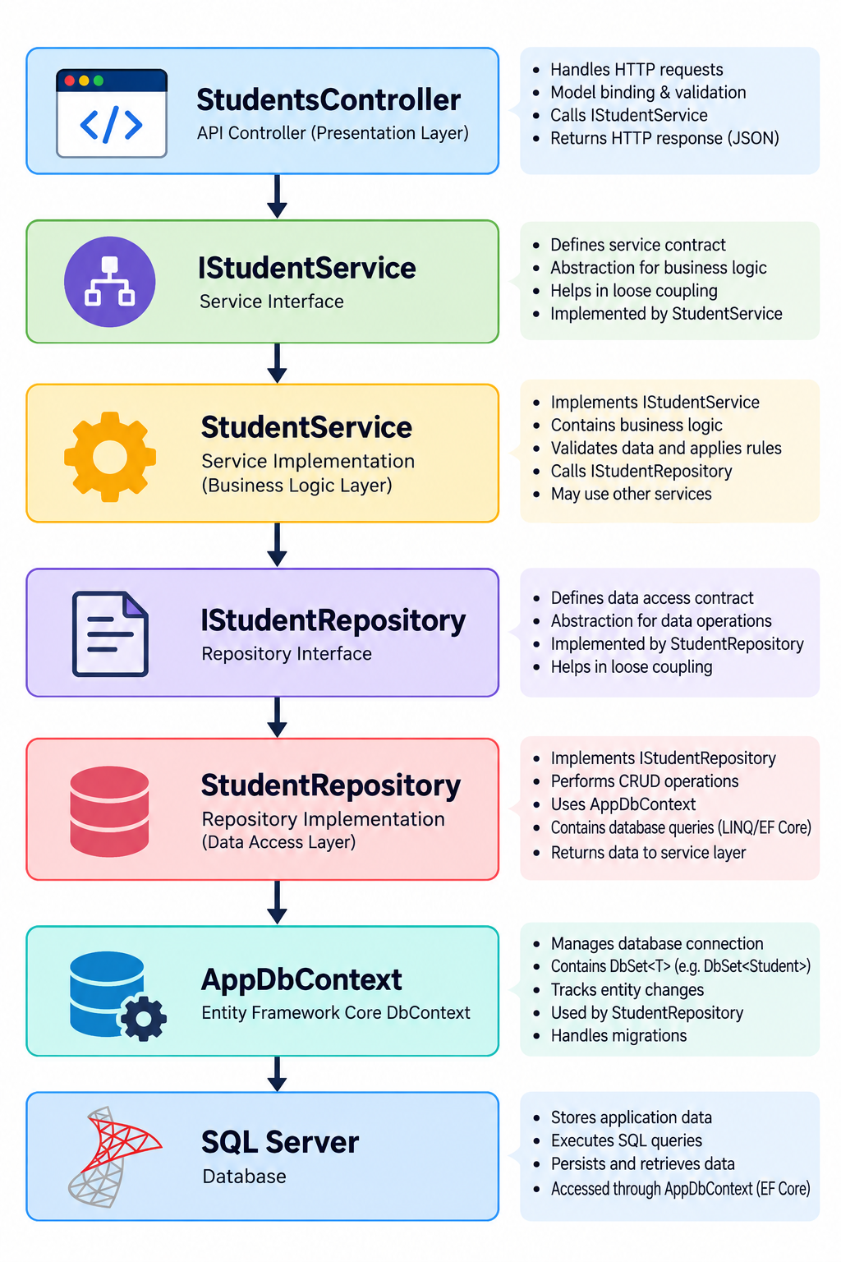
Repository Pattern Cont..

Slide 26
Repository Pattern Cont..
Without Repository Pattern
Difficult to test
Difficult to maintain
Large classes
Business logic mixed with SQL
Difficult to reuse logic
Changes can affect unrelated functionality
With Repository Pattern
Easier maintenance
Easier unit testing
Better code organization
Reusable business logic
Database logic is isolated
Controllers remain lightweight
Easier to change database implementation

Slide 27
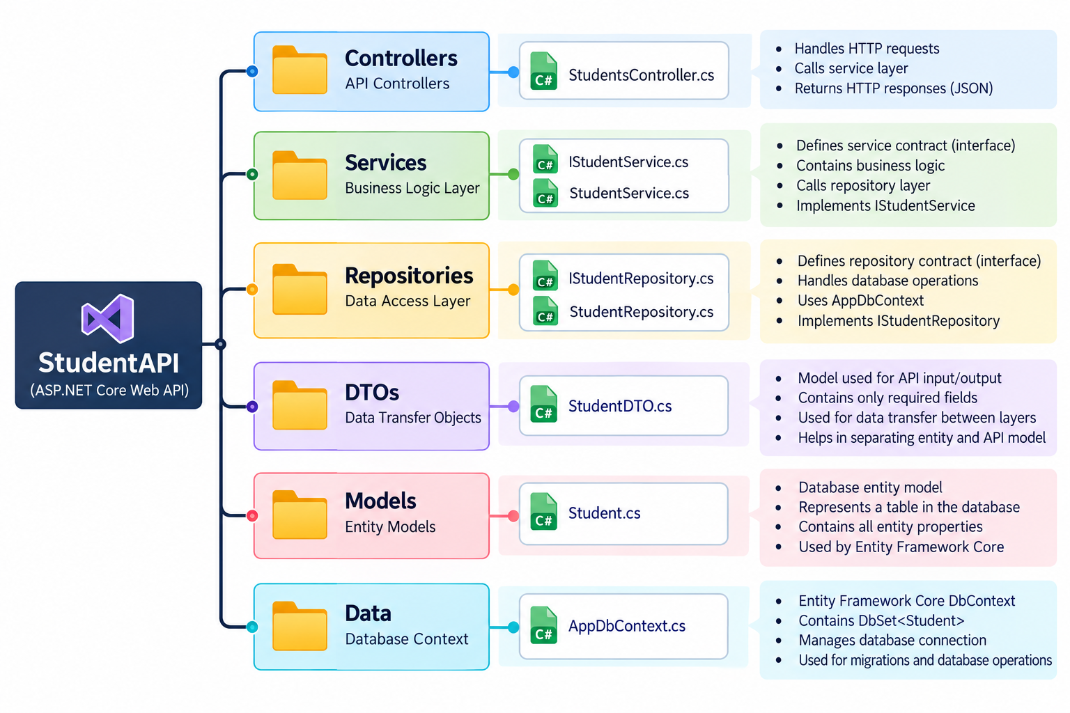
Repository Pattern Architecture

Slide 28
Mocking Dependencies with Moq
Section - 7

Slide 29
Why Mock?
Unit test should test one unit in isolation.
You're testing OrderService, but it depends on IOrderRepository (which talks to a DB).
You don't want a real DB in a unit test.
So you create a fake (mock) repository.
Real classes depend on databases, HTTP calls, email senders — a mock is a fake stand-in that pretends to be a dependency, so the real one never runs.
Your real application might have:
OrderServiceTests
IPaymentGateway
(Mock)
Real Payment API
(Never Called)
IPaymentGateway
↓
RazorpayPaymentGateway
↓
Real Payment API
IPaymentGateway
↓
Mock Object
↓
Fake Payment Gateway

Slide 30
Moq
Moq builds a fake implementation of an interface at runtime.
You tell it what to return with Setup, and can later check what was called with Verify.
How Moq Works?
new Mock<IService>()
Creates the fake object(service). | Fake implementation of an interface/class.
.Setup(...)
Defines behaviour for a method call. (Configure the fake)
It.IsAny<T>()
Accept any value of type T.
.Returns(value)
Tell the fake what to return.
.Object
The actual fake instance you inject into the class under test.
.Verify(...)
Check whether the fake was called correctly.
It.Is<T>(condition)
Check a specific condition on an argument.
Times.Once
Method must be called exactly once.

Slide 31
Moq Cont..
ARRANGE
ACT
ASSERT
Create fake payment gateway
↓
Configure payment gateway: any payment → true
↓
Create fake repository
↓
Create real OrderService using those fakes
Place an order for ₹99.99
↓
Payment mock returns true
↓
OrderService marks order as "Paid"
↓
OrderService calls repository.Save()
Check Save() was called
↓
Check the saved order has Status = "Paid"
↓
Check Save() was called exactly once

Slide 32
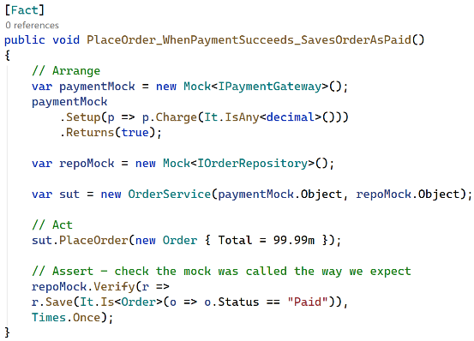
Moq Example
new Mock<T>()
.Setup(...) & It.IsAny()
.Returns(...)
.Object
.Verify(...)
It.Is<T>()
Times.Once

Slide 33
Building RESTful APIs with ASP.NET Core
#2505CS311
Prof. Madhuresh R Fichadiya
Computer Science & Engineering Department
madhuresh.fichadiya@darshan.ac.in
8866961282

