Slide 1

Unit-01
Introduction to Python
Python for Data Science (2305CS303)
Prof. Shruti Maniar
Computer Engineering Department
shruti.maniar@darshan.ac.in
(O) 9727747317

Slide 2

Outline
Introduction to Python
Advantages of Python
Installing Python
User interface and IDE
Indentation
Comments
Reading Input
Print Output
Variables
Datatypes
Tokens
Type Conversion
Operators
Conditional Statements
Looping Statements
break, continue & pass keywords
Magic Command
Looping

Slide 3
Syllabus
Reference Book:
Programming in Python 3 : A Complete Introduction to the Python Language
Introduction to Computation and Programming using Python
Core Python Programming
Python for Data Science for Dummies
Python for Data Analysis
Introduction to Machine Learning with Python
Sr. No. | Unit
1 | Introduction to Python, Object and Data Structure, Python Operators
2 | Conditional and Looping Statements, Functions in Python
3 | Numpy and Beautiful Soup
4 | Pandas
5 | Matplotlib

Slide 4
Introduction to Python

Slide 5

Introduction to Python
Python is a programming language developed by Guido van Rossum of Netherlands in 1991.
Python is an open source, interpreted, high-level and general-purpose programming language.
Python's design philosophy emphasizes code readability with its notable use of significant whitespace.
Python is dynamically typed and garbage-collected language.
Python was inspired by the ABC language that was developed in 1980s.
Python version gets updated time to time.
The latest version is Python 3.14 (as on June-2026).

Slide 6
Advantages of Python

Slide 7
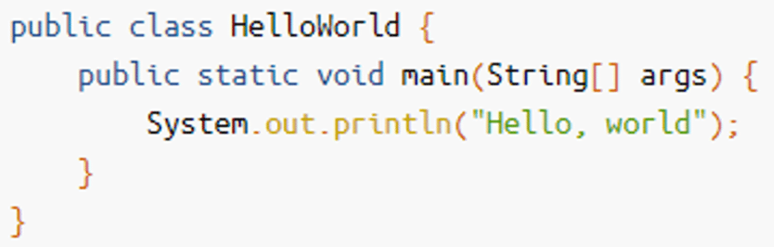
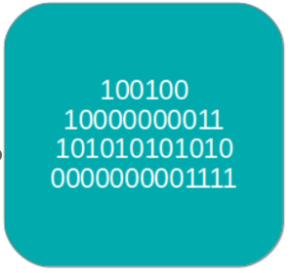
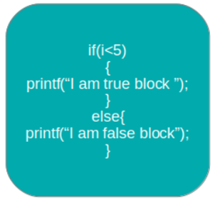
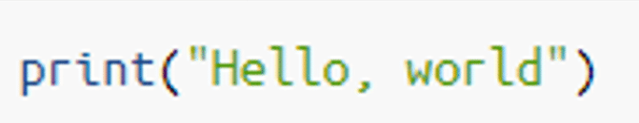
Advantages of Python
Easy to Read, Learn and Understand
  Code written in Python is simple and readable.
  Uses more English keywords.
  It has fewer syntax constructions than other languages.
High-Level Language
  Python is closer to human language than machine code (low-level language).
  We do not need to manually allocate/deallocate memory, as garbage collector takes care of unused memory automatically.
  This gives you the ability to program at a faster rate.
Java
Low-Level Language
Python
High-Level Language

Slide 8
How Garbage Collection is done? - Example
x = 10
  Python creates (or reuses) an integer object 10 in memory.
  The name x is bound to this object.
y = x
  Python does not copy the value It simply creates another name y pointing to the same object 10.
  Reference count of object 10 becomes 2.
x = 20
  Python creates (or reuses) an integer object 20, now the name x is rebound to this new object.
  y remains unchanged, still pointing to 10.
  Reference count of object 10 becomes 1 and Reference count of object 20 becomes 1.
  The object 10 is not deleted, because y still refers to it.
  Only when no name refers to 10, it becomes eligible for garbage collection.
y = 5
  Now 10 has zero references Python will clean it up.
  This is how Garbage Collection is done.
namespace
object
x
10
binding
20
y
5
a namespace is simply a container that maps names to objects
Reference Count
of object 5:
1
1
1
2
0
Reference Count
of object 10:
0
Reference Count
of object 20:
1

Slide 9
How Garbage Collection is done?
When we write x = 10 , Python performs following steps internally:
Python creates an object for the value
  Python stores all data as objects, not as raw values.
  So, Python first creates an integer object with value 10 in memory.
A name binding happens (x → object)
  In Python, x is not a box that stores data.
  x is just a name (reference) pointing to the object 10.
  Python stores this mapping in a namespace (dictionary) for that scope.
Reference counting is used to manage object lifetime
  Python uses Reference Counting to track how many names refer to an object.
  If all references to an object are removed then reference count becomes zero, so now Python automatically deallocates it.

Slide 10
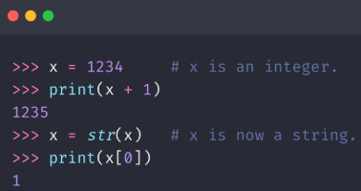
Advantages of Python
Easy to Read, Learn and Understand
  Code written in Python is simple and readable.
  Uses more English keywords.
  It has fewer syntax constructions than other languages.
High-Level Language
  Python is closer to human language than machine code (low-level language).
  We do not need to manually allocate/deallocate memory, as garbage collector takes care of unused memory automatically.
  This gives you the ability to program at a faster rate.
Dynamically Typed
  Python automatically assigns the data type during execution.
  The programmer doesn’t need to worry about declaring variables and their data types.
Automatic Data type Assignment

Slide 11
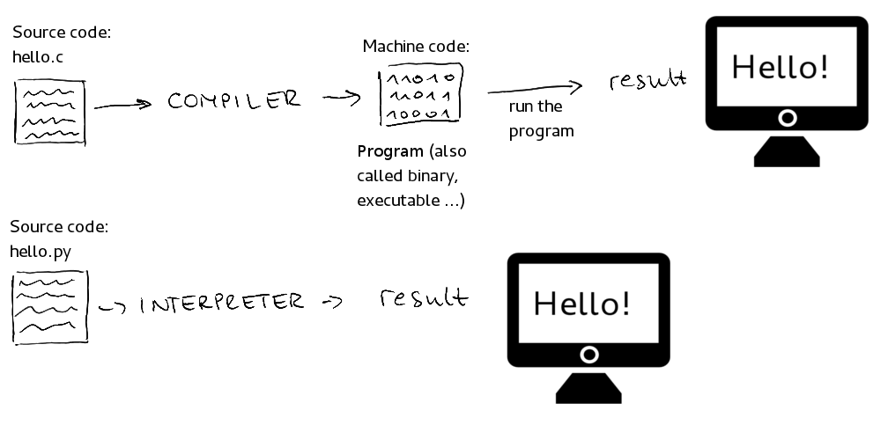
Advantages of Python (cont.)
Interpreted Language
  A program written in high-level language has to be either compiled or interpreted.
  Python is an interpreted language which means that Python directly executes the code line by line.
  In case of any error, it stops further execution and reports back the error which has occurred.
C : compiled language
Python : interpreted language

Slide 12
Advantages of Python (cont.)
Free and Open-Source
  Python is completely free to use and share because it is released under an OSI-approved open-source license.
  The Python Software Foundation (PSF) provides ready-to-install Python builds called CPython (C Implementation of Python) for all major operating systems.
  You can also download the CPython source code from the official Python website or its GitHub repository.
  If you want, you are allowed to modify the source code and redistribute it, as permitted by the CPython license.
Platform Independent and Portable
  In many languages like C/C++, you need to change your code to run the program on different platforms.
  That is not the same with Python. You only write once and run it anywhere.
  Python runs on all major operating systems like Microsoft Windows, Linux, and Mac OS X.
  The same Python source file can be executed across these platforms without modification.

Slide 13
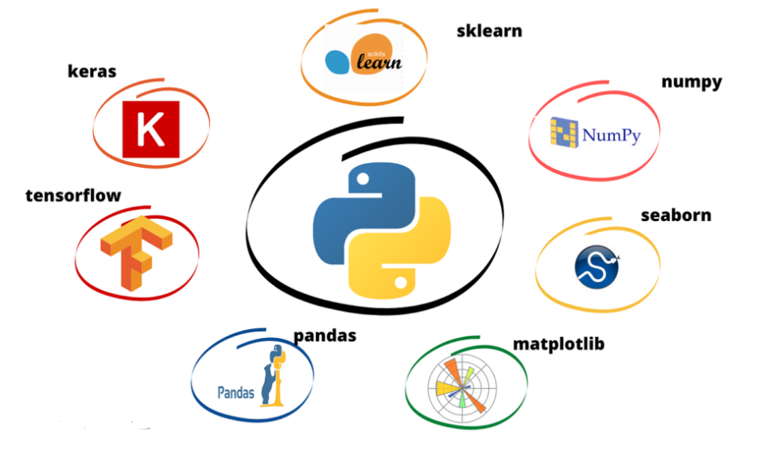
Advantages of Python(cont.)
Vast Libraries Support
  Python provides a huge standard library for common tasks like file handling, networking, and data processing.
  Thousands of external libraries (NumPy, Pandas, Django, etc.) are available for almost every domain.
  Library support helps in quick development without writing everything from scratch.
It’s Safe
  Python is considered safe because it doesn’t use pointers like C-based languages, which reduces many common programming errors.
  Also, Python never hides errors. If something goes wrong, it clearly shows an error message so you can understand what happened and fix it easily.

Slide 14
Installing Python

Slide 15
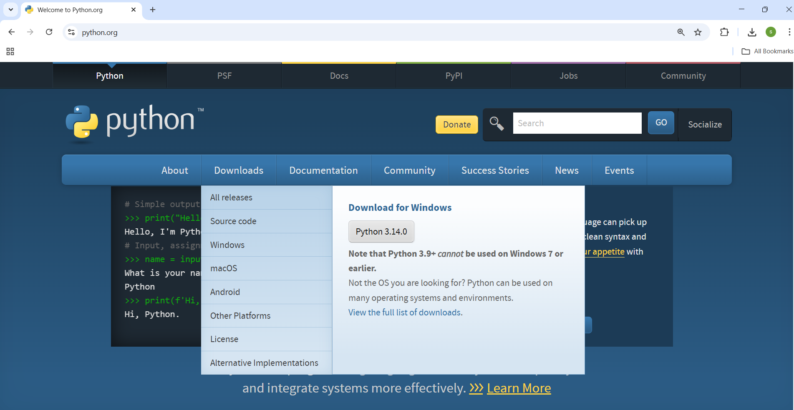
Installing Python for Windows
Download Python
Open your web browser.
Visit the official Python website: https://www.python.org
Hover on the 'Downloads' menu.
Click the latest version of python.(Python 3.14.0)

Slide 16
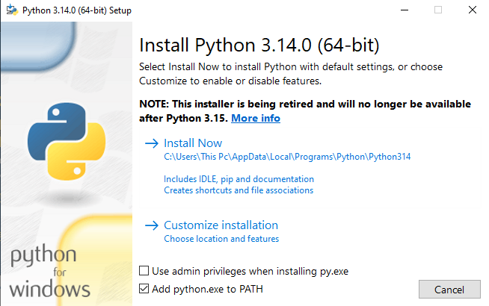
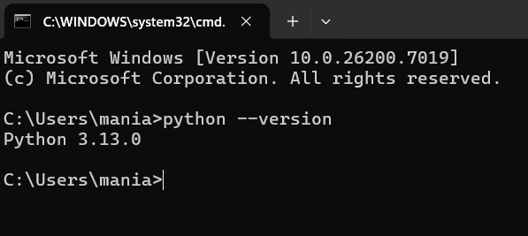
Installing Python for Windows
Run the Installer
After downloading, open the installer file.
Check the box that says 'Add python.exe to PATH’.
Click on 'Install Now’.
Verify Successful Installation
Open Command Prompt.
Type: python --version.
You should see the installed Python version displayed.

Slide 17
Installing Python for Linux
Update System Packages:
  Open the Terminal
  Run: sudo apt update
Install Python:
  Run: sudo apt install python3
Verify Python Installation:
  Check Python version:
  Run: python3 --version

Slide 18
User Interface and IDE

Slide 19
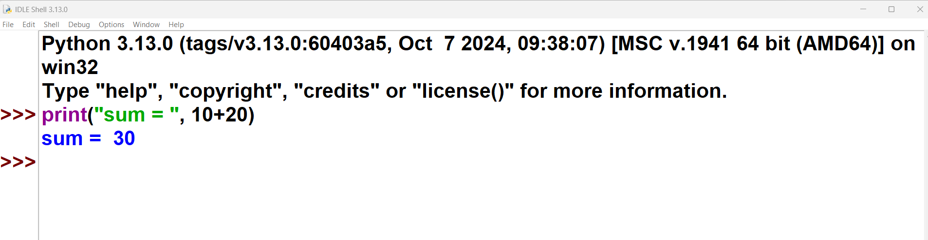
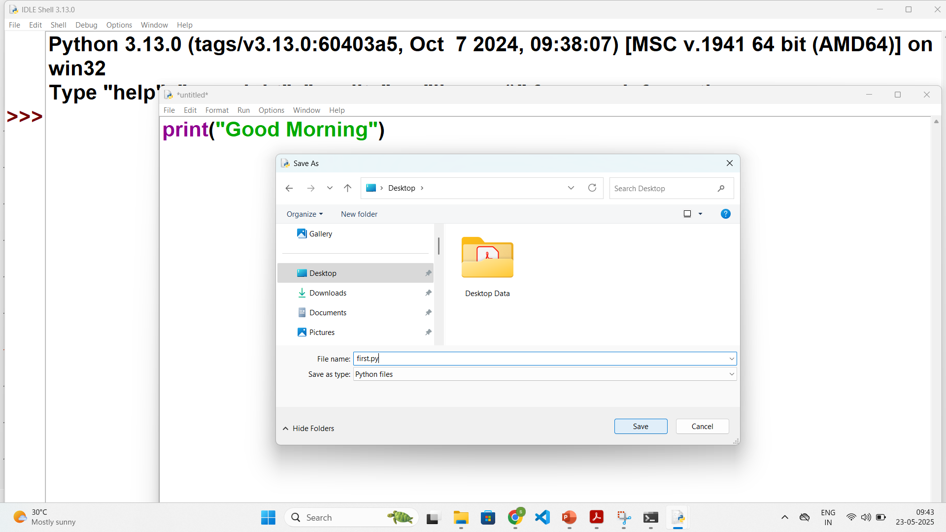
User Interface and IDE
Python supports two modes of programming:
Interactive Mode
  The code is written directly at the Python prompt (>>>).
  The output is displayed immediately.
  The code written in this mode is not saved, so it has to be written each time.
  Thus it is preferred for experimentation purposes.
Script Mode
  The code is written in the file and then the file is run.
  The advantage of script mode is that the file can be saved for later use.
  To Save : IDLE -> File -> New File -> write code -> Save As -> .py extension
  To Run : Run -> Run Module OR (F5)
Interactive Mode Programming
File
Run
Script Mode Programming

Slide 20
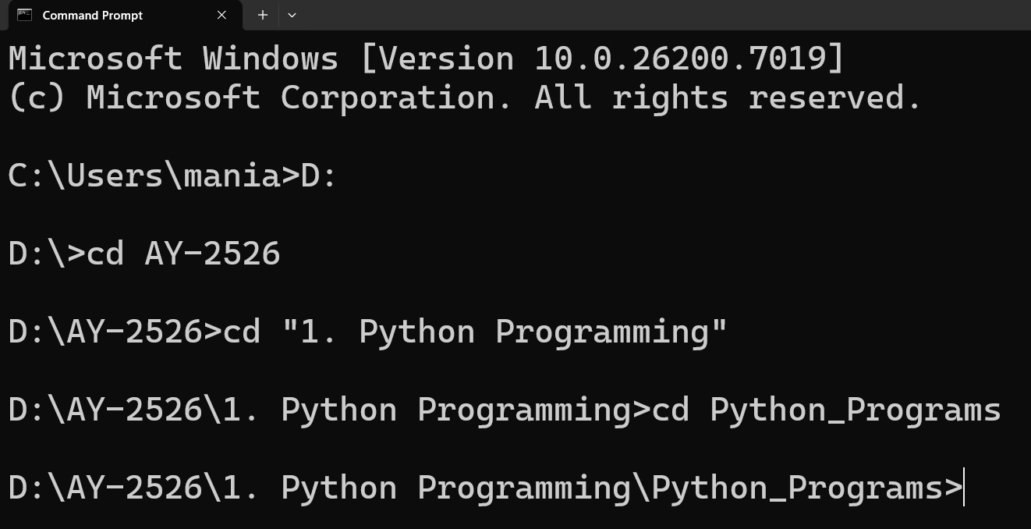
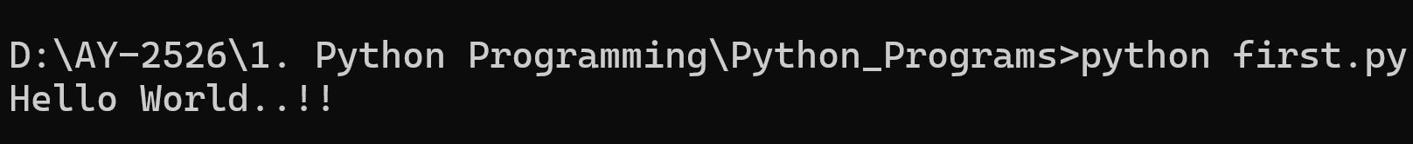
User Interface and IDE
To write python programs, we can use any text editor also.
Create a new file in editor, save it as first.py (.py – file extension)
To run the python file open command prompt and change directory to where your python file is.
Next, run python command (python filename.py)
first.py
Python line does not end with ;
1
print("Hello World..!!")

Slide 21
Installing Anaconda

Slide 22
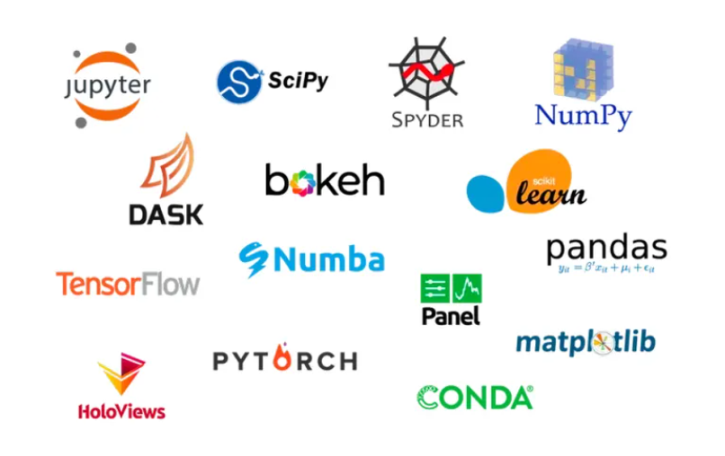
Anaconda for Python
Anaconda is a popular open-source distribution of the Python and R programming languages.
Anaconda comes packed with a suite of powerful tools designed to enhance your data science and machine learning workflow.
Following are some most useful ones:
  Jupyter Notebook
  Spyder
  Rstudio
  VS Code (Visual Studio Code)
  Anaconda Navigator
  TensorFlow, etc…
We will use Jupyter Notebook for doing interactive programming and getting immediate visualization.

Slide 23
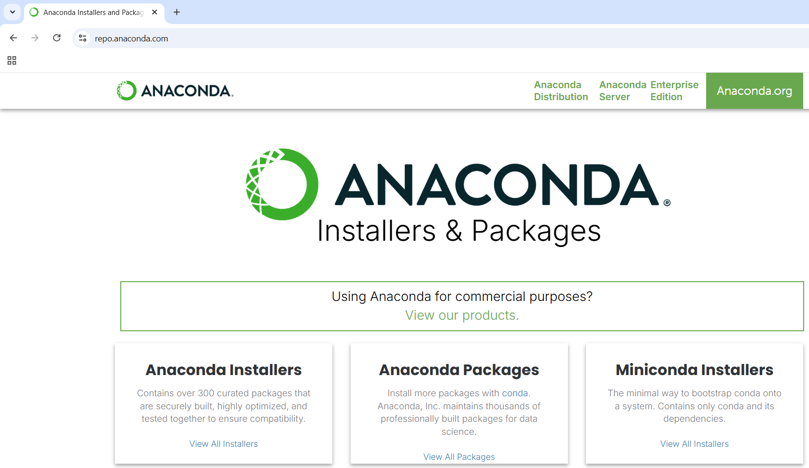
Installing Anaconda
Download Anaconda
Download Anaconda from Open official website: repo.anaconda.com

Slide 24
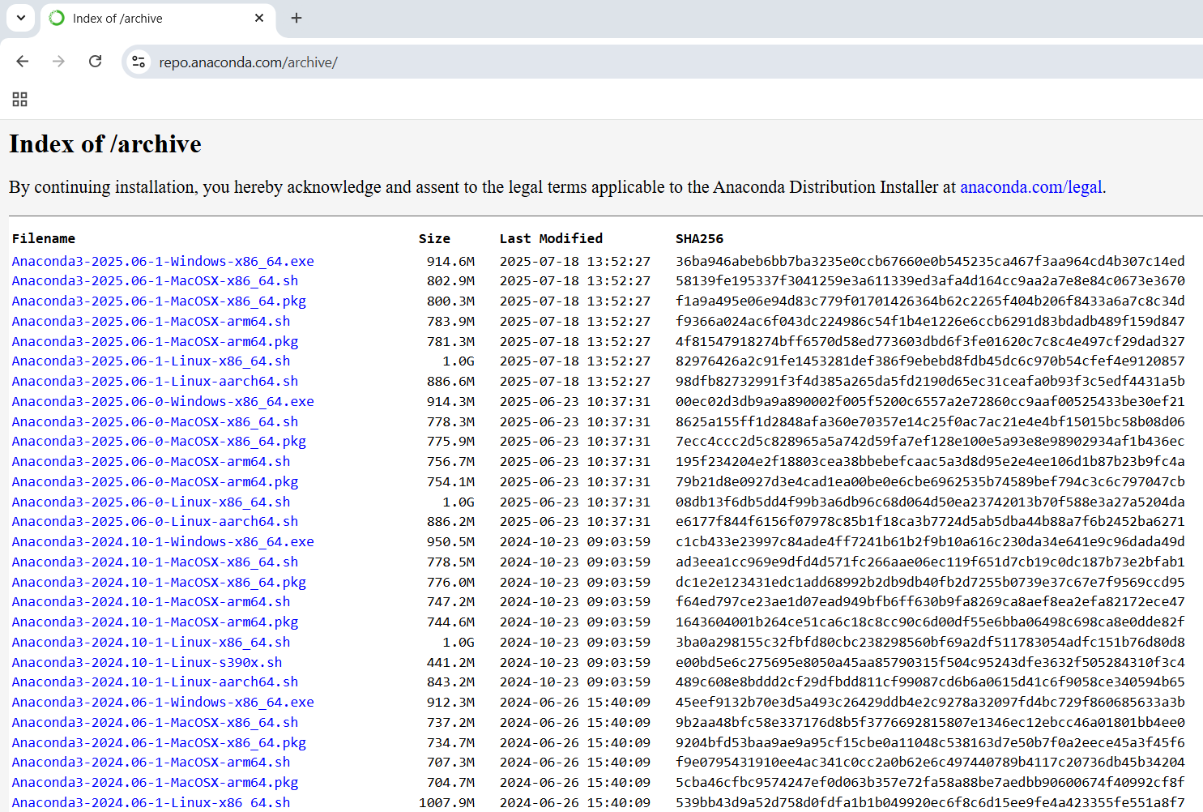
Installing Anaconda
Run the Installer
Download the suitable installer.
Open installer.
Click on Next.
Check Agree to License Agreement.
Select Installation Type:
  Just Me (recommended)
Choose installation location.
Select :
  Add to PATH environment variables.
Click on install.

Slide 25
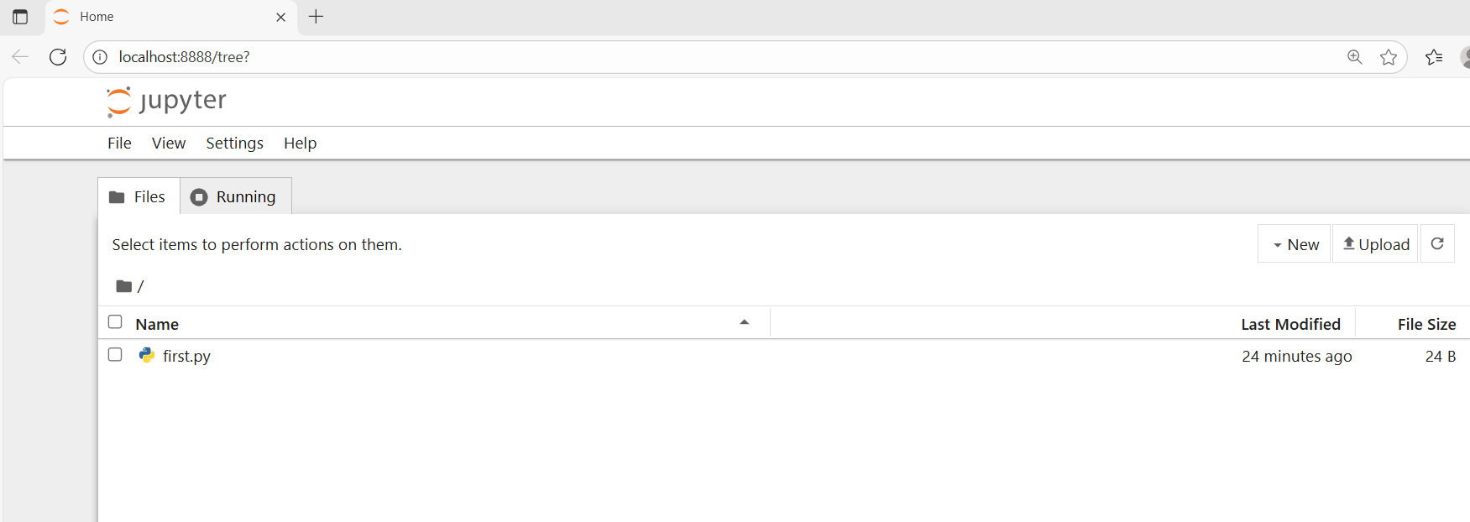
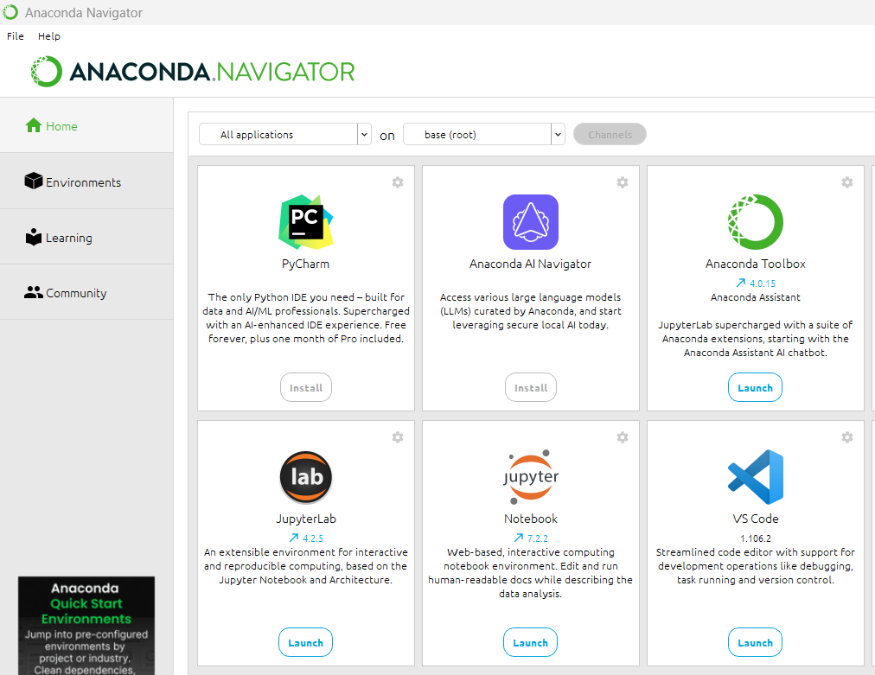
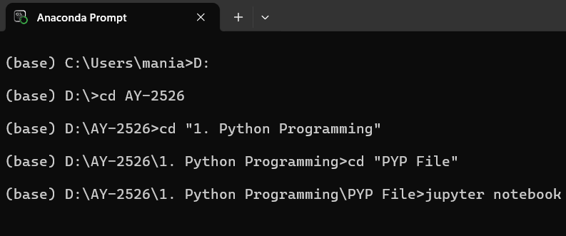
Installing Anaconda
Verify Successful Installation
Option 1: Using Anaconda Navigator
  Open Anaconda Navigator from the Start Menu
  Find Jupyter Notebook
  Click Launch.
  (It will open in your system’s default user folder)
Option 2: Using Anaconda Prompt
  Open Anaconda Prompt
  Navigate to the folder you want to use in Jupyter Notebook
  (Example: cd Desktop\Python)
  Type: jupyter notebook
  Press Enter to open Jupyter Notebook (By default, it opens in the default working directory).

Slide 26
Indentation

Slide 27
Indentation
Indentation in general means is, indenting words/spaces/lines in the document to follow the styling rule for documentation.
Indentation in Python refers to the (spaces and tabs) that are used at the beginning of a statement.
The statements with the same indentation belong to the same group called a suite.
Most programming languages like C, C++, Java, etc. use curly braces {} to define/identify a block of code in the program,
While in Python, it is done using the spaces or tabs, which is known as Indentation.
It is generally known as 4 space rule in Pep8 documentation of rules for styling and designing the code for Python.
Example.py
1
2
3
4
if Condition:
print("True")
else:
print("False")
IndentationError: unindent does not match any outer indentation level

Slide 28
Comments

Slide 29
Comments
In Python, comments are used to explain code and make it more readable.
They are ignored by the Python interpreter when the code is executed.
There are two main types of comments in Python:
Single-line Comments:
  These are created using the # symbol.
  Everything after the #, on that line is considered to be a comment.
Multi-line Comments:
  Python does not provide the option for multiline comments.
  However it can be achieved using multiple #.
  Or these can be done using string literals (‘ ‘ ’ or “ ” ”) as Python ignores those string literals that are not assigned to a variable.
''' This is Multiline Comment
that spans multiple lines
'''
print("Hello World..!!")
""" Another multiline comments
using triple quotes
"""
# This is Single-line Comment
print("Hello World..!!") #This comment is on the same line

Slide 30
Reading Input

Slide 31
Reding Input
For taking input from the user, input() is used.
The syntax of input function is as follows:
When input statement is executed, the prompt is displayed on the screen, and it waits for the user action.
Whatever you enter as input, the input() converts it into a string.
If you enter an integer value still input() function convert it into a string, that will need to be type casted.
Syntax
1
input([prompt])
Parameter Name | Description
prompt | A string to be displayed on the screen (optional)

Slide 32
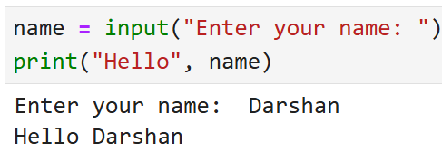
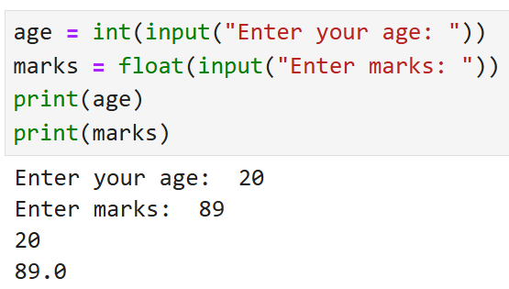
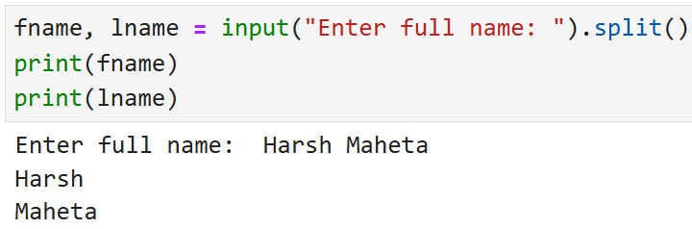
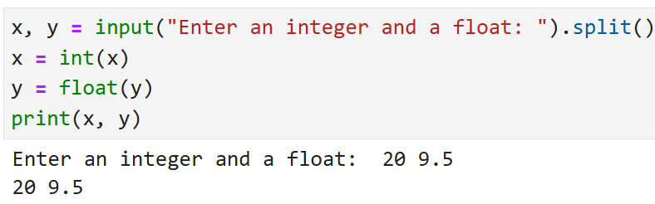
Reading Input
Basic usage
Converting input to a number
Taking two inputs in one line of same datatype
Taking two inputs in one line of different datatypes

Slide 33
Print Output

Slide 34
Print Output
The print() function prints the specified message to the screen, or other standard output device. The object will be converted into a string before written to the screen.
Syntax
1
print(object(s), sep=‘ ‘, end=‘\n’, file=sys.stdout, flush=False)
Parameter Name | Description
Object(s) | One or more items to print. Can be string, number, variable, etc. Will be converted into string before printing.
sep | A string inserted between the objects (optional), Default : one space (‘ ‘)
end | A string to print at the end (optional), Default : '\n'
file | Where to send the output, Default : sys.stdout (the screen) output can be redirected to the file as well
flush | Flush the buffer? (Trur / False), Default : False

Slide 35
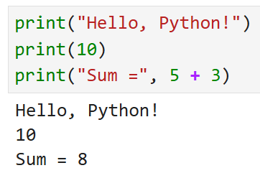

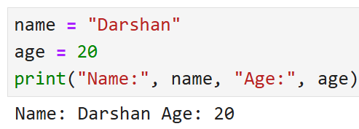
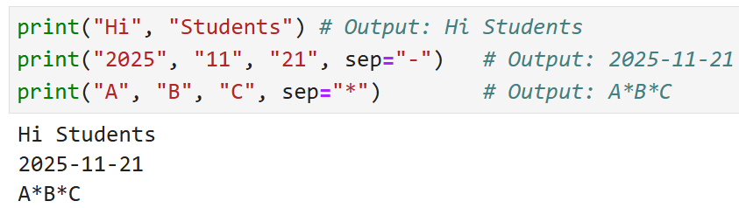
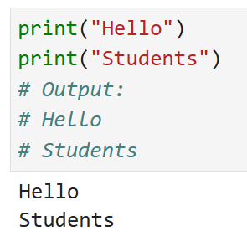
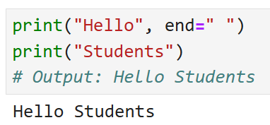
Print Output
Basic Printing
Printing Multiple Values
Printing Variables
Default sep is space
Using sep (separator)
Using end
Default end is \n

Slide 36
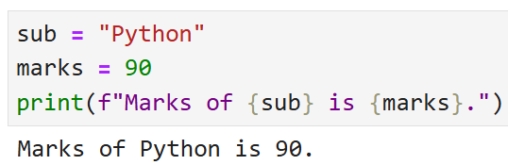
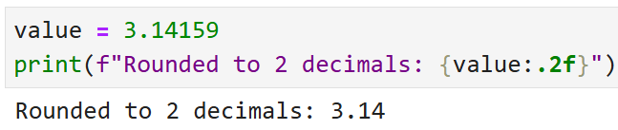
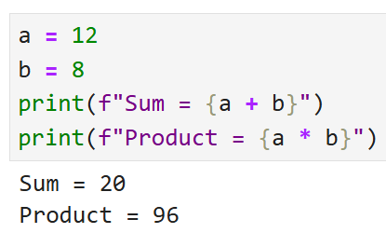
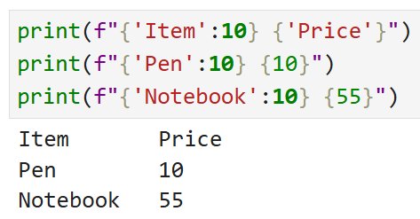
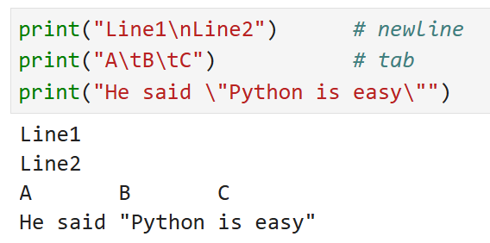
Print Output (f-string)
f-strings are formatted string literals in Python.
These allow embedding variables and expressions inside strings using {} for clearer, faster, and more readable string formatting.
f-String Formatting
Decimal Formatting
Expressions Inside f-strings
Alignment
Escape Characters

Slide 37
Example
Example.py
Output
1
2
3
4
5
6
7
9
10
11
12
13
14
a = 4
str = input("Enter your name = ")
num = int(input("Enter Number = "))
print(4,5)
print("Hello","World")
print("Hello","World",sep="-")
print("Hello","DU",sep="-",end=" ")
print("Hello " + "DU ")
print("a = ", a,end=", ")
print("num = ", num)
print("your Name ="+ str)
print("Your Name ",str,sep="=")
Enter your name = ABC
Enter Number = 10
4 5
Hello World
Hello-World
Hello-DU Hello DU
a = 4, num = 10
your Name =ABC
Your Name =ABC

Slide 38
Program 1
WAP to develop simple calculator in python
Example1.py
1
2
3
4
5
6
number1 = int(input("Enter first number: "))
number2 = int(input("Enter second number: "))
print(number1, "+", number2, "=", number1+number2)
print(number1, "*", number2, "=", number1*number2)
print(number1, "-", number2, "=", number1-number2)
print(number1, "/", number2, "=", number1/number2)
Output
Enter first number: 3
Enter second number: 3
3 + 3 = 6
3 * 3 = 9
3 - 3 = 0
3 / 3 = 1.0

Slide 39
Program 2
WAP to calculate simple interest
Example2.py
1
2
3
4
5
P = int(input("Enter P: "))
R = int(input("Enter R: "))
T = int(input("Enter N: "))
Simple_interest = (P * R * T) / 100
print("The simple interest is:", Simple_interest)
Output
Enter P: 10000
Enter R: 5
Enter N: 1
The simple interest is: 500.0

Slide 40
Program 3
WAP to calculate area of circle.
Example3.py
1
2
3
4
PI = 3.14
r = float(input("Enter the radius of a circle:"))
area = PI * r * r
print("Area of a circle = %.2f" %area)
Output
Enter the radius of a circle:100
Area of a circle = 31400.00

Slide 41
Variables

Slide 42

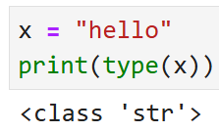
Variables
A Python variable is a named reference to a value stored in memory.
Unlike other programming languages, Python has no command for declaring a variable.
A variable is created the moment you first assign a value to it.
Python uses Dynamic Typing so,
  You do not need to specify the data type while creating a variable.
  Python automatically determines the data type based on the value assigned.
  You can reassign a new value of a different type:
We can check the current data type of the variable with type(variablename) in-built function.
Rules for Variable Name :
  Variable Name must begin with Letter or Underscore(_), it can not start with digit.
  Spaces and Special Characters(except underscore) are not allowed.
  Python Keywords are not allowed to be a Variable Name.
  Variable Names are case-sensitive.

Slide 43
Variables
Example :
demo.py
1
2
3
4
5
6
7
8
9
10
x = 10
print(x)
print(type(x))
y = 123.456
print(y)
x = "darshan insitute of engneering and technology"
print(x)
print(type(x))
Reassign same variable to hold different data type
Run in terminal
1
python demo.py
Output
1
2
3
4
5
10
int
123.456
Darshan institute of engineering and technology
str

Slide 44
Datatypes

Slide 45
Data Type | Class | Description
Data Types
Integer | int | Whole number such as 0,1,5, -5 etc..
Float | float | Numbers with decimal points such as 1.5, 7.9, -8.2 etc..
Complex Number | complex | Complex number (real_part)+(imaginary_part)j such as 2 + 3j
String | str | Sequence of character (Ordered) such as “darshan”, ‘college’, “રાજકોટ” etc..
Boolean | bool | Logical values indicating Ture or False (T and F here are capital in python)
Data Structures
List | list | Ordered Sequence of objects, will be represented with square brackets [ ] Example : [ 18, “darshan”, True, 102.3 ]
Tuple | Tup | Ordered immutable sequence of objects, will be represented with round brackets ( ) Example : ( 18, “darshan”, True, 102.3 )
Set | Set | Unordered collection of unique objects, will be represented with the curly brackets { } Example : { 18, “darshan”, True, 102.3 }
Dictionary | Dict | Ordered key : value pair of objects , will be represented with curly brackets { } Example : { “college”: “darshan”, “code”: “054” }

Slide 46
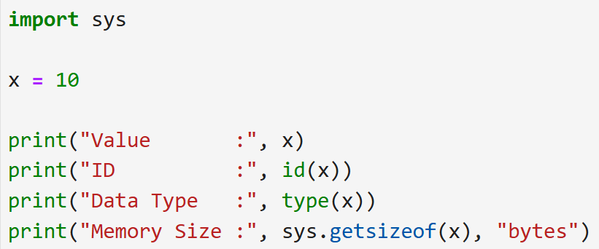
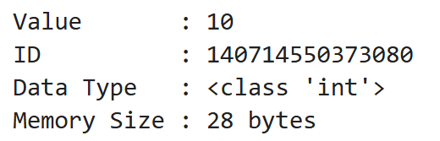
Datatypes
Input :
Output :
Find memory address (identity) of an object
Find a datatype of a variable
Find the memory occupied by an object

Slide 47
Tokens

Slide 48
Tokens
In Python, a Token is the smallest unit of a program.
Tokens are the building blocks of a Python program. Here are the main types of tokens in Python:
Keywords : Reserved words that have special meaning and cannot be used as identifiers. Example : if, else, for, while, try, except, etc.
Identifiers: Names given to variables, functions, classes, and other objects.
Literals: Constant values used in programs. They can be of various types (string, numeric, boolean, etc..)
Delimiters: Symbols used to separate code elements. Example : (),[],{},:,.,; and comma(,).
Comments: Text added to the code for documentation purposes, which is ignored by the Python interpreter. Example : #, ’ ’ ’ ,” ” ”
Operators: Symbols that perform operations on one or more operands. Example : +,-,*,/,==, !=,etc.

Slide 49
Tokens
# This is a comment
x = 42 # x is identifier , 42 is literal
if x > 0: # if is keyword, > is operator, 0 is literal
print("x is positive") # print is function, "x is positive" is string literal

Slide 50
Type Conversion

Slide 51
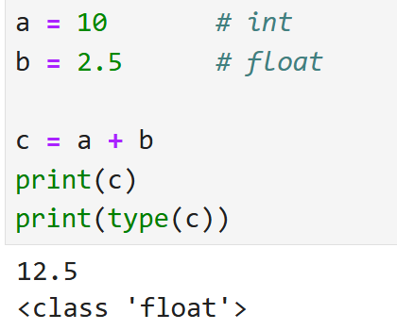
Type Conversion
Type conversion is the process of converting a value from one data type to another.
Types of Type Conversion:
Implicit Type Conversion (Automatic)
  Performed automatically by Python.
  No programmer intervention is required.
  Usually converts a smaller data type to a larger compatible type.
Explicit Type Conversion (Type Casting)
  Performed manually by the programmer.
  Uses built-in conversion functions.
Function | Converts to | Function | Converts to | Function | Converts to
int() | Integer | bool() | Boolean | tuple() | Tuple
float() | Floating Point | str() | String | set() | Set
complex() | Complex Number | list() | List | dict() | Dictionary
int(“100”) -> 100
int(“abc”) -> Error

Slide 52
Operators

Slide 53
Operators in Python
Operators are used for performing operations on variables and values.
We can segregate python operators in following groups,
  Arithmetic operators
  Assignment operators
  Comparison operators
  Logical operators
  Bitwise operators
  Identity operators
  Membership operators

Slide 54
Arithmetic Operators
Arithmetic Operators can be used with numeric values or variables to perform common mathematical operations.
Note : Consider A = 10 and B = 3
Imp. Point: Python does not support pre/post increment(++)/decrement(--) operators
Operator | Description | Example | Output
+ | Addition | A + B | 13
- | Subtraction | A - B | 7
/ | Division | A / B | 3.3333333333333335
* | Multiplication | A * B | 30
% | Modulus return the remainder | A % B | 1
// | Floor division returns the quotient | A // B | 3
** | Exponentiation | A ** B | 10 * 10 * 10 = 1000

Slide 55
Assignment Operators
Assignment Operators are used to assign values to variables.
Note : Consider A = 3, B = 5 and C = 0
Operator | Description | Example | Output
= | Assign | C = A + B | 8
+= | Add and Assign | A+=B | 8
-= | Subtract and Assign | A-=B | -2
*= | Multiply and Assign | A*=B | 15
/= | Divide and Assign | A/=B | 0.6
%= | Modulus and Assign | A%=B | 3
//= | Divide(floor) and Assign | A//=B | 0
**= | Power and Assign | A**=B | 243

Slide 56
Relational Operators
Relational Operators are used for comparing the values. It either returns True or False according to the condition.
Note : Consider A = 9, B = 5
Operator | Description | Example | Output
> | Greater than | A > B | True
< | Less than | A < B | False
== | Equal to | A == B | False
!= | Not Equal to | A != B | True
>= | Greater than or equal to | A >= B | True
<= | Less than or equal to | A <= B | False

Slide 57
Logical Operators
Logical Operators are used to perform logical operations on the values of variables. The value is either True or False. We can figure out the conditions by the result of the truth values.
Note : Consider A = 10 and B = 3
Operator | Description | Example | Output
and | Returns True if both statements are true | A > 5 and B < 5 | True
or | Returns True if one of the statements is true | A > 5 or B > 5 | True
not | Negate the result, returns True if the result is False | not ( A > 5 ) | False

Slide 58
Bitwise Operators
The Bitwise Operators are used to perform bitwise calculations on integers. The integers are first converted into binary and then operations are performed on bit by bit, hence the name Bitwise Operators. Then the result is returned in decimal format.
Note : Consider A = 10(binary - 1010) and B = 4(binary - 0100)
Operator | Description | Example | Output
& | Bitwise AND | A & B | 0
| | Bitwise OR | A | B | 14
~ | Bitwise NOT | ~A | -11
^ | Bitwise XOR | A ^ B | 14
>> | Bitwise right shift | A>>1 | 5
<< | Bitwise left shift | A<<1 | 20

Slide 59
Example
Example.py
1
2
3
4
5
6
7
9
10
11
12
13
14
15
16
17
18
19
20
21
22
23
24
25
x , y = 5,2
a,b = True,False
#Arithmetic operator
print('x // y =',x//y)
print('x ** y =',x**y)
#Assignemnt Operator
x+=5 # x = 10
y+=2 # y = 4
print('x y =',x,y)
#Comparison Operator
print('x >= y is',x>=y)
print('x <= y is',x<=y)
#Logical Operator
print('x and y is',a and b)
print('x or y is',a or b)
print('not x is',not a)
#Bitwise Operators
print('x & y is',x & y)
print('x | y is',x | y)
Output
x // y = 2
x ** y = 25
x y = 10 4
x >= y is True
x <= y is False
x and y is False
x or y is True
not x is False
x & y is 0
x | y is 14

Slide 60
Identity & Membership Operators
Identity Operator
  Note : consider A = [1,2], B = [1,2] and C=A
Membership Operator
  Note : consider A = 2 and B = [1,2,3]
Operator | Description | Example | Output
is | Returns True if both variables are the same object | A is B A is C | False True
is not | Returns True if both variables are different object | A is not B | True
Operator | Description | Example | Output
in | Returns True if a sequence with the specified value is present in the object | A in B | True
not in | Returns True if a sequence with the specified value is not present in the object | A not in B | False

Slide 61
Example
Example.py
1
2
3
4
5
6
7
9
10
11
12
13
14
15
16
17
18
19
20
x2 = 'Hello'
y2 = 'Hello'
x3 = [1,2,3]
y3 = x3
x = 'Hello world'
y = {1:'a',2:'b'}
z = [1,2,3,4,5]
# Identity Operator
print("x2 is y2 = ",x2 is y2)
print("x3 is y3 = ",x3 is y3)
print("x2 is not y2 =",x2 is not y2)
# Membership Operator
print("'H' in x = ", 'H' in x)
print("'hello' not in x = ",'hello' not in x)
print("5 in z = ", 5 in z)
print("1 in y = ",1 in y)
Output
x2 is y2 = True
x3 is y3 = True
x2 is not y2 = False
'H' in x = True
'hello' not in x = True
5 in z = True
1 in y = True

Slide 62
Conditional Statements

Slide 63
if statement
if statement is written using the if keyword followed by condition and colon(:) .
Code to execute when the condition is true will be ideally written in the next line with indentation (white space).
Python relies on indentation to define scope in the code (Other programming languages often use curly-brackets for this purpose).
Syntax
if statement ends with :
1
2
if some_condition :
# Code to execute when condition is true
Indentation (tab/whitespace) at the beginning
ifdemo.py
Output
1
2
3
4
x = 10
if x > 5 :
print("X is greater than 5")
1
X is greater than 5

Slide 64
if else statement
This is basically a “two-way” decision statement. This is used when we must choose between two alternatives.
Syntax
1
2
3
4
if some_condition :
# Code to execute when condition is true
else :
# Code to execute when condition is false
ifelsedemo.py
Output
1
2
3
4
5
6
x = 3
if x > 5 :
print("X is greater than 5")
else :
print("X is less than 5")
1
X is less than 5

Slide 65
Example
Example1.py
Output
1
2
3
4
5
6
# Program checks if the number is positive or negative
num = int(input("Enter Number="))
if num >= 0:
print("Positive number")
else:
print("Negative number")
Enter Number = 5
Positive number
Example2.py
Output
1
2
3
4
5
6
# Program checks if the number is Odd or Even
num = int(input("Enter Number="))
if num % 2 == 0:
print("Even number")
else:
print("Odd number")
Enter Number = 4
Positive number

Slide 66
Nested if statement
An if-else statement is written within another if-else statement is called nested if statement.
Syntax
1
2
3
4
5
if some_condition1 :
  if some_condition2 :
  # Code to execute when condition is true
  else :
  # Code to execute when condition is false
Output
Enter a Number = 4
Positive number
Example1.py
1
2
3
4
5
6
7
9
num = float(input("Enter a number: "))
if num >= 0:
if num == 0:
print("Zero")
else:
print("Positive number")
else:
print("Negative number")

Slide 67
Example
Example1.py
Output
1
2
3
4
5
6
7
8
9
10
11
12
13
14
15
16
17
# find maximum number from three number
a = int(input("Enter A="))
b = int(input("Enter B="))
c = int(input("Enter C="))
if a>b:
if a>c:
g=a
else:
g=c
else:
if b>c:
g=b
else:
g=c
print("Greater = ",g)
Enter A=10
Enter B=9
Enter C=2
Greater = 10

Slide 68
if, elif and else statement
The elif is short for else if. It allows us to check for multiple expressions.
If the condition for if is False, it checks the condition of the next elif block and so on.
If all the conditions are False, the body of else is executed.
Only one block among the several if...elif...else blocks is executed according to the condition.
The if a block can have only one else block, but it can have multiple elif blocks.
This statement is alternative for nested if statement to overcome the complexity problem involved in nested if statement.

Slide 69
if, elif and else statement
Syntax
1
2
3
4
5
6
if some_condition_1 :
# Code to execute when condition 1 is true
elif some_condition_2 :
# Code to execute when condition 2 is true
else :
# Code to execute when both conditions are false
ifelifdemo.py
Output
1
2
3
4
5
6
7
8
x = 10
if x > 12 :
print("X is greater than 12")
elif x > 5 :
print("X is greater than 5")
else :
print("X is less than 5")
1
X is greater than 5

Slide 70
Example
Example1.py
Output
1
2
3
4
5
6
7
8
9
10
11
12
13
14
15
16
17
18
19
20
21
22
23
24
25
# Python Program to find Student Grade
english = float(input(" Please enter English Marks: "))
math = float(input(" Please enter Math score: "))
computers = float(input(" Please enter Computer Marks: "))
physics = float(input(" Please enter Physics Marks: "))
chemistry = float(input(" Please enter Chemistry Marks: "))
total = english + math + computers + physics + chemistry
percentage = (total / 500) * 100
print("Total Marks = %.2f" %total)
print("Marks Percentage = %.2f" %percentage)
if(percentage >= 90):
print("A Grade")
elif(percentage >= 80):
print("B Grade")
elif(percentage >= 70):
print("C Grade")
elif(percentage >= 60):
print("D Grade")
elif(percentage >= 40):
print("E Grade")
else:
print("Fail")
Please enter English Marks: 50
Please enter Math score: 50
Please enter Computer Marks: 50
Please enter Physics Marks: 50
Please enter Chemistry Marks: 50
Total Marks = 250.00
Marks Percentage = 50.00
E Grade

Slide 71
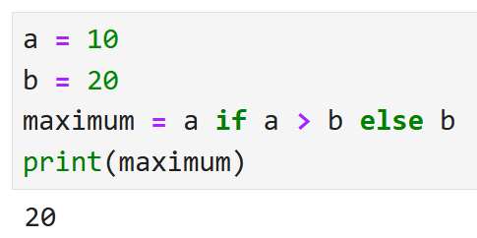
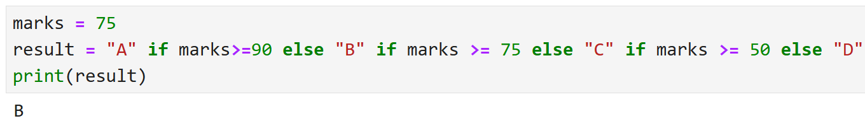
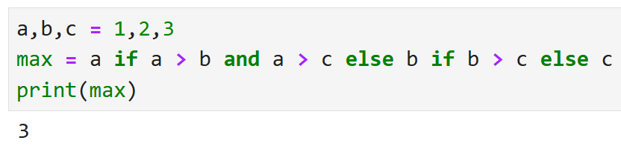
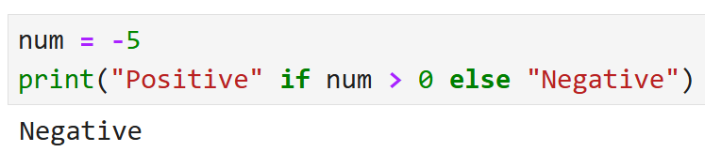
Ternary Operator
The ternary operator is a one-line shortcut to write a simple if-else statement.
Syntax:
value_if_true if condition else value_if_false
Example:
If the condition is True, value_if_true is returned.
If the condition is False, value_if_false is returned.

Slide 72
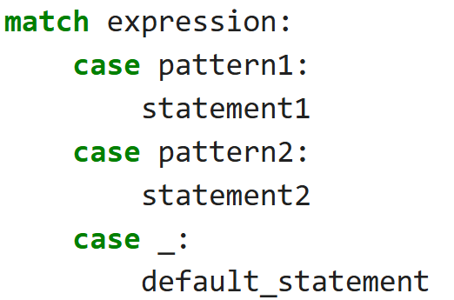
match case
match-case is a control flow statement.
It is similar to switch-case in C, C++, Java.
Used for pattern-based decision making.
match-case makes code: Cleaner, More readable and Structured.
  match → checks the expression
  case → checks pattern
  _ → default case (like else)
Python evaluates the expression after match.
It compares with each case.
First matching case executes.
No break statement required.
If no case matches → _ executes.
Syntax:

Slide 73
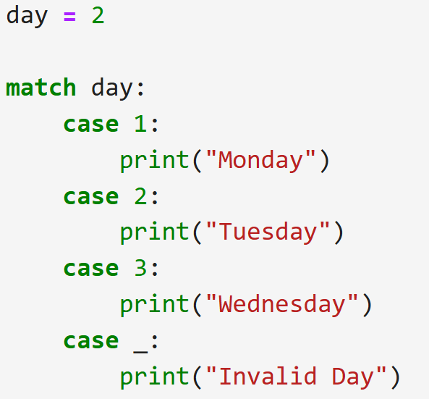
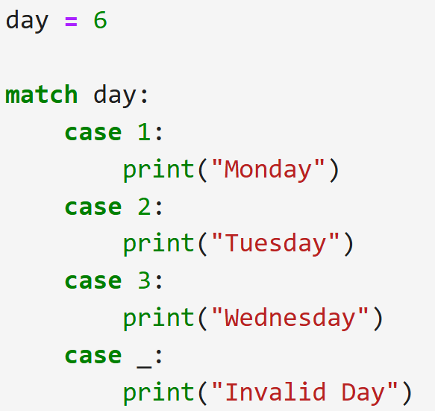
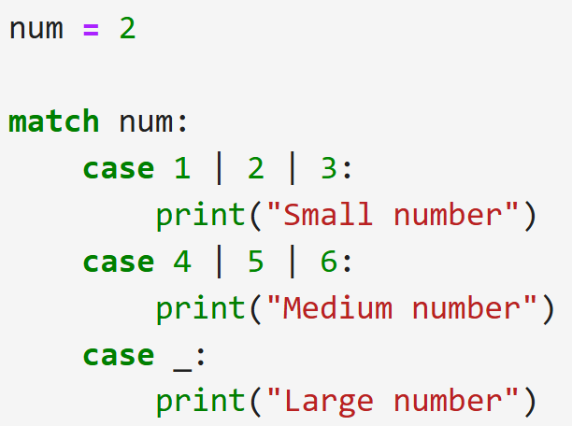



match case
input
input
input
output
output
output

Slide 74
Looping Statements

Slide 75
for loop
Many objects in python are iterable, meaning we can iterate over every element in the object.
  such as every elements from the List, every characters from the string etc..
We can use for loop to execute block of code for each element of iterable object.
Syntax
For loop ends with :
1
2
for temp_item in iterable_object :
# Code to execute for each object in iterable
Indentation (tab/whitespace) at the beginning
fordemo1.py
Output :
1
2
3
4
fordemo2.py
Output :
2
4
6
8
1
2
3
my_list = [1, 2, 3, 4]
for list_item in my_list :
print(list_item)
1
2
3
4
my_list = [1,2,3,4,5,6,7,8,9]
for list_item in my_list :
if list_item % 2 == 0 :
print(list_item)

Slide 76
range() function
The range() function returns a sequence of numbers, starting from 0 by default, and increments by 1 (by default), and stops before a specified number.
Syntax
1
range(start, stop, step)
Example1.py
Example2.py
Example3.py
Example4.py
1
2
3
x = range(3, 6)
for n in x:
print(n)
1
2
3
x = range(3, 20, 2)
for n in x:
print(n)
1
2
3
x = range(20)
for n in x:
print(n)
1
2
3
x = reversed(range(20))
for n in x:
print(n)
Output
Output
Output
Output
3
4
5
3
5
-
19
0
1
-
19
19
18
-
0

Slide 77
for loop (tuple unpacking)
Sometimes we have nested data structure like List of tuples, and if we want to iterate with such list we can use tuple unpacking.
withouttupleunapacking.py
withtupleunpacking.py
1
2
3
my_list = [(1,2,3), (4,5,6), (7,8,9)]
for list_item in my_list :
print(list_item[1])
1
2
3
my_list = [(1,2,3), (4,5,6), (7,8,9)]
for a,b,c in my_list :
print(b)
Output :
2
5
8
This technique is known as tuple unpacking
Output :
2
5
8

Slide 78
for loop with else
The else block just after for/while is executed only when the loop is NOT terminated by a break statement.
Example1.py
Example2.py
1
2
3
4
for i in range(1, 4):
print(i)
else:
print("No Break")
1
2
3
4
5
for i in range(1, 4):
print(i)
break
else: # Not executed as there is a break
print("No Break")
Output
Output
1
2
3
No Break
1

Slide 79
Example
Example1.py
Output
1
2
3
4
5
#odd numbers between 1 to n
num = int(input("Enter Number = "))
for i in range(1,num+1):
if i % 2 != 0:
print(i)
Enter Number = 5
1
3
5
Example2.py
Output
1
2
3
4
5
6
#series 1 + 4 + 9 + 16 + 25 + 36 + ...n
num = int(input("Enter Number = "))
sum = 0
for i in range(1,num+1):
sum = sum + i**2
print("Sum=",sum)
Enter Number = 10
Sum= 385

Slide 80
Example
Example3.py
Output
1
2
3
4
5
6
# Find factorial of the given number
num = int(input("Enter Number = "))
fact = 1
for i in range(1,num+1):
fact = fact * i
print("Factorial =", fact )
Enter Number = 5
Factorial = 120
Example4.py
Output
1
2
3
4
5
6
7
8
9
#series 1 – 2 + 3 – 4 + 5 – 6 + 7 ... n
num = int(input("Enter Number = "))
sum = 0
for i in range(1,num+1):
if i % 2 == 0:
sum = sum - i
else:
sum = sum + i
print("Sum=",sum)
Enter Number = 10
Sum= -5

Slide 81
while loop
While loop will continue to execute block of code until some condition remains True.
For example,
  while felling hungry, keep eating
  while have internet pack available, keep watching videos
Syntax
while loop ends with :
1
2
while some_condition :
# Code to execute in loop
Output :
X is greater than 3
Indentation (tab/whitespace) at the beginning
withelse.py
1
2
3
4
5
6
x = 5
while x < 3 :
print(x)
x += 1 # x++ is invalid in python
else :
print("X is greater than 3")
whiledemo.py
Output :
0
1
2
1
2
3
4
x = 0
while x < 3 :
print(x)
x += 1 # x++ is invalid in python

Slide 82
Example
Example1.py
Output
1
2
3
4
5
6
7
#odd numbers between 1 to n
num = int(input("Enter Number = "))
i=0
while(i<=num):
if i % 2 != 0:
print(i)
i+=1
Enter Number = 5
1
3
5
Example2.py
Output
1
2
3
4
5
6
7
#series 1 + 4 + 9 + 16 + 25 + 36 + ...n
num = int(input("Enter Number = "))
sum = i = 0
while(i<=num):
sum = sum + i**2
i+=1
print("Sum=",sum)
Enter Number = 10
Sum= 385

Slide 83
Exercise programs
Do Following programs using for and while loop.
  WAP to find out sum of first and last digit of a given number
  WAP to find whether the given number is prime or not.
  WAP to find out prime numbers between given two numbers
  WAP to print given number in reverse order.
  WAP to check whether the given number is Armstrong or not.
  WAP to find the sum of 1 + (1+2) + (1+2+3) + (1+2+3+4)+ …+(1+2+3+4+….+n).

Slide 84
break, continue & pass keywords

Slide 85
break keyword
Breaks out of the current closest enclosing loop.
Break Statement is a loop control statement that is used to terminate the loop.
As soon as the break statement is encountered from within a loop, the loop iterations stop there, and control returns from the loop immediately to the first statement after the loop.
Basically, break statements are used in situations when we are not sure about the actual number of iterations for the loop or we want to terminate the loop based on some condition.
Syntax
1
break
breakdemo.py
Output :
0
1
1
2
3
4
5
for temp in range(5) :
if temp == 2 :
break
print(temp)

Slide 86
continue keyword
Goes to the top of the current closest enclosing loop.
Continue statement is a loop control statement that forces to execute the next iteration of the loop while skipping the rest of the code inside the loop for the current iteration only i.e.
When the continue statement is executed in the loop, the code inside the loop following the continue statement will be skipped for the current iteration and the next iteration of the loop will begin.
Syntax
1
continue
continuedemo.py
Output :
0
1
3
4
1
2
3
4
5
for temp in range(5) :
if temp == 2 :
continue
print(temp)

Slide 87
pass keyword
Does nothing at all, will be used as a placeholder in conditions where you don’t want to write anything.
The pass statement is a null statement. But the difference between pass and comment is that comment is ignored by the interpreter whereas pass is not ignored.
Syntax
1
pass
passdemo.py
Output : (nothing)
1
2
for temp in range(5) :
pass

Slide 88
Magic Command

Slide 89
Magic Command
IPython’s special commands (which are not built into Python itself) are known as “magic” commands.
These are designed to facilitate common tasks and enable you to easily control the behavior of the IPython system.
magic command is any command prefixed by the percent symbol %
For example, you can check the execution time of any Python statement, such as a matrix multiplication, using the %timeit magic function (which will be discussed in more detail later):
Magic commands come in two type:
  line magics, which are denoted by a single % prefix and operate on a single line of input,
  cell magics, which are denoted by a double %% prefix and operate on multiple lines of input.

Slide 90
Magic Command
Command | Description
%quickref | Display the IPython Quick Reference Card
%magic | Display detailed documentation for all of the available magic commands
%who, %whos, %who_ls | Print all information related to interactive variables.
%hist | Print command input (and optionally output) history
%cd | Change the current working directory.
%paste | Execute preformatted Python code from clipboard
%cpaste | Open a special prompt for manually pasting Python code to be executed
%reset | Delete all variables/names defined in interactive namespace
%page OBJECT | Pretty-print the object and display it through a pager
%run script.py | Run a Python script inside IPython
%time statement | Report the execution time of a single statement
%timeit statement | Run a statement multiple times to compute an ensemble average execution time; useful for timing code with very short execution time

Slide 91
Introspection
Using a question mark (?) before or after a variable will display some general information about the object:
Then using ? shows us the docstring if defined.
Using ?? will also show the function’s source code if possible:
Introspection
Introspection
In[1]: In[2]:
b=[1,2,3]
b?
Type: list
String Form:[1, 2, 3]
Length: 3
Docstring:
list() -> new empty list
list(iterable) -> new list initialized from iterable's items
In[1]:
add_numbers??
Signature: add_numbers(a, b) Source:
def add_numbers(a, b):
  """
  Add two numbers together Returns
  -------
  the_sum : type of arguments
  """
  return a+b
File: <ipython-input-9-6a548a216e27> Type: function

Slide 92
The %run Command
You can run any file as a Python program inside the environment of your IPython session using the %run command.
All of the variables (imports, functions, and globals) defined in the file (up until an exception, if any, is raised) will then be accessible in the IPython shell:
lPython
In[1]:
In[2]:
Out[2]:
In[3]:
Out[3]:
%run demo.py
c
7.5
result
1.4666666666666666
demo.py
1
2
3
4
5
6
7
8
def f(x, y, z):
return(x+y)/z
a=5
b=6
c=7.5
result = f(a, b, c)

Slide 93
Thank You

