Slide 1

Unit-02
Data Structure and Function
Python for Data Science (2305CS303)
Prof. Shruti Maniar
Computer Engineering Department
shruti.maniar@darshan.ac.in
(O) 9727747317

Slide 2

Outline
Concept of mutability
Indexing & Slicing of a String
String Methods
String Formatting
List
Tuple
Set
Dictionary
Creating Function
DOCSTRING
Types of arguments
Calling Function
return statement
lambda expression
Recursion
Looping

Slide 3
String

Slide 4
Concept of mutability
String is Ordered Sequence of character such as “darshan”, ‘college’, “રાજકોટ” etc..
Strings are arrays of characters representing Unicode characters.
String can be represented as single, double or triple quotes.
String with triple Quotes allows multiple lines.
String in Python is immutable.
Square brackets can be used to access elements of the string, Ex. “Darshan”[1] = a, characters can also be accessed with reverse index like “Darshan”[-1] = n.
String index
x = " D a r s h a n "
index = 0 1 2 3 4 5 6
Reverse index = -7 -6 -5 -4 -3 -2 -1

Slide 5
Indexing & Slicing
We can get the substring in python using string slicing, we can specify start index, end index and steps (colon separated) to slice the string.
syntax
x = 'darshan institute of engineering and technology, rajkot, gujarat, INDIA'
subx = x[startindex:endindex:steps]
endindex will not be included in the substring
strslicedemo.py
1
2
3
4
5
6
7
8
9
10
11
x = 'darshan institute of engineering and technology, rajkot, gujarat, INDIA'
subx1 = x[0:7]
subx2 = x[49:55]
subx3 = x[66:]
subx4 = x[::2]
subx5 = x[::-1]
print(subx1)
print(subx2)
print(subx3)
print(subx4)
print(subx5)
Output : darshan
Output : rajkot
Output : INDIA
Output : drhnisiueo niern n ehooy akt uaa,IDA
Output : AIDNI ,tarajug ,tokjar ,ygolonhcet dna gnireenigne fo etutitsni nahsrad

Slide 6
String Methods
Python has lots of built-in methods that you can use on strings, we are going to cover some frequently used methods for string like
  len()
  count()
  title(), lower(), upper(), casefold(), swapcase()
  istitle(), islower(), isupper()
  find(), rfind(), replace()
  index(), rindex()
  Methods for validations like
    isalpha(), isalnum(), isdigit()
  strip(), lstrip(), rstrip()
  split()
  Etc..
Note : len() is not the method of the string but can be used to get the length of the string
lendemo.py
Output : 7 (length of “Darshan”)
1
2
x = "Darshan"
print(len(x))

Slide 7
String Methods (cont.)
count() method will returns the number of times a specified value occurs in a string.
  title(), lower(), upper() will returns capitalized, lower case and upper case string respectively.
countdemo.py
1
2
3
x = "Darshan"
ca = x.count('a')
print(ca)
Output : 2 (occurrence of ‘a’ in “Darshan”)
changecase.py
1
2
3
4
5
6
7
x = "darshan Institute, rajkot"
c = x.title()
l = x.lower()
u = x.upper()
print(c)
print(l)
print(u)
Output : Darshan Institute, Rajkot
Output : darshan institute, rajkot
Output : DARSHAN INSTITUTE, RAJKOT

Slide 8
String Methods (cont.)
  istitle(), islower(), isupper() will returns True if the given string is capitalized, lower case and upper case respectively.
  strip() method will remove whitespaces from both side of the string and returns the string.
  rstrip() and lstrip() will remove whitespaces from right and left side respectively.
checkcase.py
1
2
3
4
5
6
7
x = 'darshan institute, rajkot'
c = x.istitle()
l = x.islower()
u = x.isupper()
print(c)
print(l)
print(u)
Output : False
Output : True
Output : False
stripdemo.py
1
2
3
x = ' Darshan '
f = x.strip()
print(f)
Output : Darshan (without space)

Slide 9
String Methods (cont.)
find() method will search the string and returns the index at which they find the specified value
rfind() will search the string and returns the last index at which they find the specified value
  Note : find() and rfind() will return -1 if they are unable to find the given string.
  replace() will replace str1 with str2 from our string and return the updated string
finddemo.py
1
2
3
x = 'darshan institute, rajkot, india'
f = x.find('in')
print(f)
Output : 8 (occurrence of ‘in’ in x)
rfinddemo.py
1
2
3
x = 'darshan institute, rajkot, india'
r = x.rfind('in')
print(r)
Output : 27 (last occurrence of ‘in’ in x)
replacedemo.py
1
2
3
x = 'darshan institute, rajkot, india'
r = x.replace('india','INDIA')
print(r)
Output :
“darshan institute, rajkot, INDIA”

Slide 10
String Methods (cont.)
index() method will search the string and returns the index at which they find the specified value, but if they are unable to find the string it will raise an exception.
rindex() will search the string and returns the last index at which they find the specified value , but if they are unable to find the string it will raise an exception.
Note : find() and index() are almost same, the only difference is if find() is unable to find the string it will return -1 and if index() is unable to find the string it will raise an exception.
indexdemo.py
1
2
3
x = 'darshan institute, rajkot, india'
f = x.index('in')
print(f)
Output : 8 (occurrence of ‘in’ in x)
rindexdemo.py
1
2
3
x = 'darshan institute, rajkot, india'
r = x.rindex('in')
print(r)
Output : 27 (last occurrence of ‘in’ in x)

Slide 11
String Methods (cont.)
isalnum() method will return true if all the characters in the string are alphanumeric (i.e either alphabets or numeric).
isalpha() and isnumeric() will return true if all the characters in the string are only alphabets and numeric respectively.
isdecimal() will return true is all the characters in the string are decimal.
Note : isnumeric() and isdigit() are almost same, you suppose to find the difference as Home work assignment for the string methods.
isalnumdemo.py
1
2
3
x = 'darshan123'
f = x.isalnum()
print(f)
Output : True
isdecimaldemo.py
1
2
3
x = '123.5'
r = x.isdecimal()
print(r)
Output : False

Slide 12
String Formatting
str.format() is one of the string formatting methods in Python3, which allows multiple substitutions and value formatting.
This method lets us concatenate elements within a string through positional formatting.
We can specify multiple parameters to the function
strformat.py
1
2
3
4
x = '{} institute, rajkot'
y = x.format('darshan')
print(y)
print(x.format('ABCD'))
Output : darshan institute, rajkot
Inline function call
Output : ABCD institute, rajkot
strformat.py
1
2
3
4
x = '{} institute, {}'
y = x.format('darshan','rajkot')
print(y)
print(x.format('ABCD','XYZ'))
Output : darshan institute, rajkot
Inline function call
Output : ABCD institute, XYZ

Slide 13
String Formatting (cont.)
We can specify the order of parameters in the string
We can also specify alias within the string to specify the order
We can format the decimal values using format method
strformat.py
1
2
3
4
x = '{1} institute, {0}'
y = x.format('darshan','rajkot')
print(y)
print(x.format('ABCD','XYZ'))
Output : rajkot institute, darshan
Inline function call
Output : XYZ institute, ABCD
strformat.py
1
2
x = '{collegename} institute, {cityname}'
print(x.format(collegename='darshan',cityname='rajkot'))
Output : darshan institute, rajkot
strformat.py
1
2
3
per = (438 / 500) * 100
x = 'result = {r:3.2f} %'.format(r=per)
print(x)
Output : result = 87.60 %
width
precision

Slide 14
String Formatting (cont.)
Python feature f-string (formatted string literal) provides easier way for string formatting and interpolation (the process of substituting values of variables into placeholders in a string).
We can use fstring to print the values of variables.
We can use f-string to evaluate expressions.
fstring.py
1
2
3
x = ‘Darshan’
y = ‘Rajkot’
print(f"{x} Institute , {y}.")
Output : Darshan Institute , Rajkot.
fstring.py
1
2
3
4
x = 25
y = 5
z = 1
print(f"{x} * {y} - {z} = {x*y-z}")
Output : 25 * 5 - 1 = 124

Slide 15
Data Structures in Python

Slide 16
Data Structures in Python
There are four built-in data structures in Python - list, dictionary, tuple and set.
Lets explore all the data structures in detail…
Name | Type | Description
List | list | Ordered Sequence of objects, will be represented with square brackets [ ] Example : [ 18, “darshan”, True, 102.3 ]
Dictionary | dict | Ordered key : value pair of objects , will be represented with curly brackets { } Example : { “college”: “darshan”, “code”: “054” }
Tuple | tup | Ordered immutable sequence of objects, will be represented with round brackets ( ) Example : ( 18, “darshan”, True, 102.3 )
Set | set | Unordered collection of unique objects, will be represented with the curly brackets { } Example : { 18, “darshan”, True, 102.3 }

Slide 17
List

Slide 18
List
List is a mutable ordered sequence of objects, duplicate values are allowed inside list.
List will be represented by square brackets [ ].
Python does not have array, List can be used similar to Array.
We can use slicing similar to string in order to get the sub list from the list.
list.py
Output : institute (List index starts with 0)
1
2
3
4
5
6
my_list = ['darshan', 'institute', 'rkot']
print(my_list[1])
print(len(my_list))
my_list[2] = "rajkot"
print(my_list)
print(my_list[-1])
Output : 3 (length of the List)
Output : ['darshan', 'institute', 'rajkot']
Note : spelling of rajkot is updated
Output : rajkot (-1 represent last element)
list.py
1
2
my_list = ['darshan', 'institute', 'rajkot','gujarat','INDIA']
print(my_list[1:3])
Output : ['institute', 'rajkot']
Note : end index not included

Slide 19
List Methods
append() method will add element at the end of the list.
insert() method will add element at the specified index in the list
extend() method will add one data structure (List or any) to current List
appendlistdemo.py
1
2
3
my_list = ['darshan', 'institute', 'rajkot']
my_list.append('gujarat')
print(my_list)
Output : ['darshan', 'institute', 'rajkot', 'gujarat']
insertlistdemo.py
1
2
3
4
my_list = ['darshan', 'institute', 'rajkot']
my_list.insert(2,'of')
my_list.insert(3,'engineering')
print(my_list)
Output : ['darshan', 'institute', 'of', 'engineering', 'rajkot']
extendlistdemo.py
1
2
3
4
my_list1 = ['darshan', 'institute']
my_list2 = ['rajkot','gujarat']
my_list1.extend(my_list2)
print(my_list1)
Output : ['darshan', 'institute', ‘rajkot', ‘gujarat']

Slide 20
List Methods (cont.)
pop() method will remove the last element from the list and return it.
remove() method will remove first occurrence of specified element
clear() method will remove all the elements from the List
index() method will return first index of the specified element.
poplistdemo.py
1
2
3
4
my_list = ['darshan', 'institute','rajkot']
temp = my_list.pop()
print(temp)
print(my_list)
Output : rajkot
Output : ['darshan', 'institute‘]
removelistdemo.py
1
2
3
my_list = ['darshan', 'institute', 'darshan','rajkot']
my_list.remove('darshan')
print(my_list)
Output : ['institute', 'darshan', 'rajkot']
clearlistdemo.py
1
2
3
my_list = ['darshan', 'institute', 'darshan','rajkot']
my_list.clear()
print(my_list)
Output : []

Slide 21
List Methods (cont.)
count() method will return the number of occurrence of the specified element.
reverse() method will reverse the elements of the List
sort() method will sort the elements in the List
countlistdemo.py
1
2
3
my_list = ['darshan', 'institute', 'darshan','rajkot']
c = my_list.count('darshan')
print(c)
Output : 2
reverselistdemo.py
1
2
3
my_list = ['darshan', 'institute','rajkot']
my_list.reverse()
print(my_list)
Output : ['rajkot', ‘institute','darshan']
sortlistdemo.py
1
2
3
4
5
my_list = ['darshan', 'college','of','enginnering','rajkot']
my_list.sort()
print(my_list)
my_list.sort(reverse=True)
print(my_list)
Output : ['college', 'darshan', 'enginnering', 'of', 'rajkot']
Output : ['rajkot', 'of', 'enginnering', 'darshan', 'college']

Slide 22
List Comprehension
List comprehensions offer a way to create lists based on existing iterable. When using list comprehensions, lists can be built by using any iterable, including strings, list, tuples.
For example, if we want to create a list of characters from the string, we can use for loop like below example,
Syntax
ForLoop.py
[ expression for item in iterable ]
OR
[ expression for item in iterable if condition ]
1
2
3
4
5
mystr = 'darshan'
mylist = []
for c in mystr:
mylist.append(c)
print(mylist)
Example1.py
1
2
mylist = [c for c in 'darshan']
print(mylist)
Output
['d', 'a', 'r', 's', 'h', 'a', 'n']

Slide 23
List Comprehension (cont.)
Similarly, we can use list comprehensions in many cases where we want to create a list out of other iterable, let’s see another example of the use of List Comprehension.
Example (Using for loop):
ForLoop1.py
Example2.py
1
2
3
4
5
#list of square from 1 to 10
mylist = []
for i in range(1,11):
mylist.append(i**2)
print(mylist)
1
2
3
# list of square from 1 to 10
mylist = [ i**2 for i in range(1,11) ]
print(mylist)
Output
[1, 4, 9, 16, 25, 36, 49, 64, 81, 100]

Slide 24
Tuple
Tuple is a immutable ordered sequence of objects, duplicate values are allowed inside list.
Tuple will be represented by round brackets ( ).
Tuple is similar to List but List is mutable whereas Tuple is immutable.
tupledemo.py
1
2
3
4
5
Output : ('darshan', 'institute', 'of', 'engineering', 'of', 'rajkot')
my_tuple = ('darshan','institute','of','engineering','of','rajkot')
print(my_tuple)
print(my_tuple.index('engineering'))
print(my_tuple.count('of'))
print(my_tuple[-1])
Output : 3 (index of ‘engineering’)
Output : 2
Output : rajkot

Slide 25
Set
Set is a unordered collection of unique objects.
Set will be represented by curly brackets { }.
Set has many in-built methods such as add(), clear(), copy(), pop(), remove() etc.. which are similar to methods we have previously seen.
Only difference between Set and List is that Set will have only unique elements and List can have duplicate elements.
setdemo.py
1
2
my_set = {1,1,1,2,2,5,3,9}
print(my_set)
Output : {1, 2, 3, 5, 9}

Slide 26
Dictionary
Dictionary was unordered collection of key-value pair before Python 3.7 but after 3.7 it is ordered.
Dictionary will be represented by curly brackets { }. Dictionary is mutable.
syntax
my_dict = { 'key1':'value1', 'key2':'value2' }
Key value is seperated by :
Key value pairs is separated by ,
dictdemo.py
1
2
3
my_dict = {'college':"darshan", 'city':"rajkot",'type':"engineering"}
print(my_dict['college'])
print(my_dict.get('city'))
values can be accessed using key inside square brackets as well as using get() method
Output : darshan
rajkot

Slide 27
Dictionary Methods
keys() method will return list of all the keys associated with the Dictionary.
values() method will return list of all the values associated with the Dictionary.
items() method will return list of tuples for each key value pair associated with the Dictionary.
keydemo.py
1
2
my_dict = {'college':"darshan", 'city':"rajkot",'type':"engineering"}
print(my_dict.keys())
Output : ['college', 'city', 'type']
valuedemo.py
1
2
my_dict = {'college':"darshan", 'city':"rajkot",'type':"engineering"}
print(my_dict.values())
Output : ['darshan', 'rajkot', 'engineering']
itemsdemo.py
1
2
my_dict = {'college':"darshan", 'city':"rajkot",'type':"engineering"}
print(my_dict.items())
Output : [('college', 'darshan'), ('city', 'rajkot'), ('type', 'engineering')]

Slide 28
List vs. Tuple vs. Set vs. Dictionary
List | Tuple | Sets | Dictionaries
Ordered Data | Ordered Data | Unordered Data | Ordered Data
Mutable | immutable | mutable | mutable
Square braces.[] | Parenthesis () | Curly brackets {} | Curly brackets {key : value}
Duplicate elements allowed | Duplicate elements allowed | No Duplicate elements | No Duplicate key
append() | Element cannot be added | add() | update()
We can create a list using the list() function. | We can create a tuple using the tuple() function. | We can create a set using the set()function. | We can create a dictionary using the dict() function.
my_list = [5,6,7,8] | my_tuple = (5,6,7,8) | my_sets = {3,4,5,6} | my_dictionaries = {"name" : "XYZ", "rollno." : "101"}

Slide 29
Functions
Creating clean repeatable code is a key part of becoming an effective programmer.
A function is a block of code which only runs when it is called.
In Python a function is defined using the def keyword:
Syntax
ends with :
def function_name() :
#code to execute when function is called
Indentation (tab/whitespace) at the beginning
Output :
hello world
==============================
from darshan college
==============================
rajkot
Functiondemo.py
1
2
3
4
5
6
7
8
def seperator() :
print('==============================')
print("hello world")
seperator()
print("from darshan college")
seperator()
print("rajkot")

Slide 30
Function
There are two kinds of functions in Python.
Built-in Functions : Functions that are provided as part of Python - input(), print()...
User Defined Functions : Functions that we define ourselves and then use.
Then we treat the built-in function names as "new" reserved words (i.e. we avoid them as variable names)
In Python a function is some reusable code that takes arguments(s) as input, does some computation and then returns a result(s)
We call/invoke the function by using the function name, parenthesis and arguments in an expression
Function name
Functiondemo.py
Arguments
1
2
a = max(2,90)
print(a)

Slide 31
Function Name
Use a naming scheme, and use it consistently (camel case syntax).
For all names, avoid abbreviations, unless they are both standardized and widely used.
The name should describe the data’s meaning rather than its type (e.g., amount_due rather than money),
Functions and methods should have names that say what they do or what they return (depending on their emphasis), but never how they do it—since that might change.
All three functions below return the index position of the first occurrence of a name in a list of names, starting from the given starting index and using an algorithm that assumes the list is already sorted.
Functiondemo.py
1
2
3
def find(l, s, i=0): # BAD
def linear_search(l, s, i=0): # BAD
def first_index_of(sorted_name_list, name, start=0): # GOOD

Slide 32
DOCSTRING
Doc string helps us to define the documentation about the function within the function itself.
Unlike conventional source code comments, the docstring should describe what the function does, not how.
The docstrings can be accessed using the __doc__ method of the object or using the help function.
Syntax
Enclosed within triple quotes
def function_name() :
'''
DOCSTRING: explains the function
INPUT: explains input
OUTPUT: explains output
'''
#code to execute when function is called
Help.py
1
2
Function_name. __doc__
help(Function_name)

Slide 33
Function Types
Four kinds of functions can be created in Python: global functions, local functions, lambda functions, and methods.
Global functions
  Global objects (including functions) are accessible to any code in the same module (i.e., the same .py file) in which the object is created.
Local functions
  (also called nested functions) are functions that are defined inside other functions. These functions are visible only to the function where they are defined;
  They are especially useful for creating small helper functions that have no use elsewhere.
Lambda functions
  Lambda functions are expressions, so they can be created at their point of use;
  however, they are much more limited than normal functions.
Methods
  Methods are functions that are associated with a particular data type and can be used only in conjunction with the data type (when we cover object-oriented programming.)

Slide 34
Exercise
WAP to count simple interest using function.
WAP to find maximum number from given two numbers using function.
WAP that defines a function exchange to interchange the values of two variables, say x and y.

Slide 35
Function Arguments
Positional Arguments
Keyword Arguments
Default Arguments
Variable Length Arguments
  Variable Length Positional Arguments
  Variable Length Keyword Arguments
Positional Only Arguments
Keyword Only Arguments

Slide 36
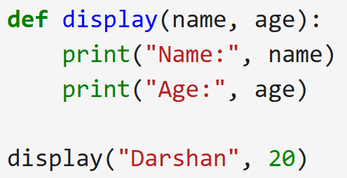
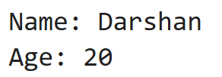
Positional Arguments
Positional arguments are the arguments passed to a function in correct positional order.
During a function call, values passed through arguments should be in the order of parameters in the function definition.
Order must match.
Number of arguments must match number of parameters,
Otherwise generates TypeError.
input.py
Demo.py
Output
1
2
3
4
5
def add_number(n1,n2):
print("Sum = ", n1+n2)
add_number(2,3)
add_number(3,5)
Sum = 5
Sum = 8
Output

Slide 37
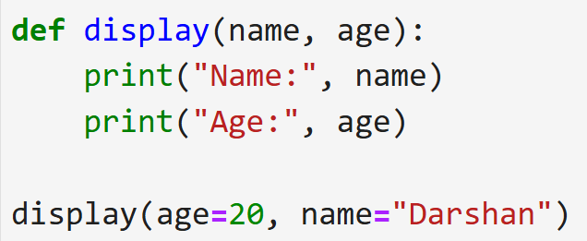
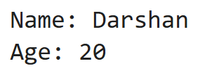
Keyword arguments
Arguments passed using parameter name = value format.
Order does not matter.
Parameter names must match exactly.
Cannot repeat same argument.
Demo.py
Demo.py
1
2
3
4
5
def subtract_number(n1,n2):
print("Subtraction = ", n1-n2)
subtract_number(20,10)
subtract_number(n2=20,n1=10) Keyword Arguments
Output
Output
Subtraction = 10
Subtraction = -10

Slide 38
Default arguments
A default argument is an argument that assumes a default value if a value is not provided in the function call for that argument.
Default arguments are values that are provided while defining functions.
The assignment operator = is used to assign a default value to the argument.
Default arguments become optional during the function calls.
If we provide a value to the default arguments during function calls, it overrides the default value.
Default parameters must come after non-default parameters.
Demo.py
Output
1
2
3
4
5
def add_number(n1,n2 = 10):
print("Sum = ", n1+n2)
add_number(2,3)
add_number(3)
Sum = 5
Sum = 13

Slide 39
Variable-length arguments
Variable-length arguments are also known as arbitrary arguments.
If we don’t know the number of arguments needed for the function in advance, we can use arbitrary arguments.
There are two types of variable length arguments:
Variable length positional arguments (*args)
  You may need to process a function for more arguments than you specified while defining the function.
  These arguments are called variable-length arguments and are not named in the function definition, unlike required and default arguments.
  An asterisk (*) is placed before the variable name that will hold the values of all non keyword variable arguments.
  This tuple remains empty if no additional arguments are specified during the function call.
Tuple representing variable length arguments
Syntax
def functionname([formal_args,] *args):
#code to execute when function is called

Slide 40
Variable-length arguments
Variable length positional arguments example
Demo.py
Output
1
2
3
4
5
6
7
8
def add_number(n1,*n):
  sum = n1
  for i in n:
  sum = sum + i
  print("Sum = ", sum)
add_number(2)
add_number(10,10,10,10)
Sum = 2
Sum = 40

Slide 41
Variable-length arguments
Variable-length keyword arguments (**kwargs)
  For Variable-length keyword argument, a double asterisk (**) is placed before a parameter in a function which can hold keyword variable-length arguments.
  Stored as dictionary.
  Must be written at last in parameter list.
Demo.py
Output
1
2
3
4
5
6
7
8
9
def add_Number(**a):
  sum = 0
  sum = a['a'] + a['b']
  print("Sum=",sum)
  for i in a.items():
  print(i)
  print(a)
add_Number(a=4,b=3,c=4)
Sum= 7
('a', 4)
('b', 3)
('c', 4)
{'a': 4, 'b': 3, 'c': 4}

Slide 42
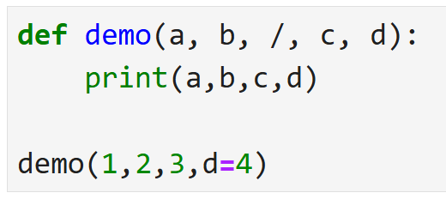
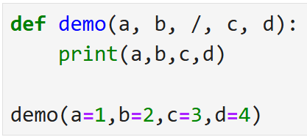
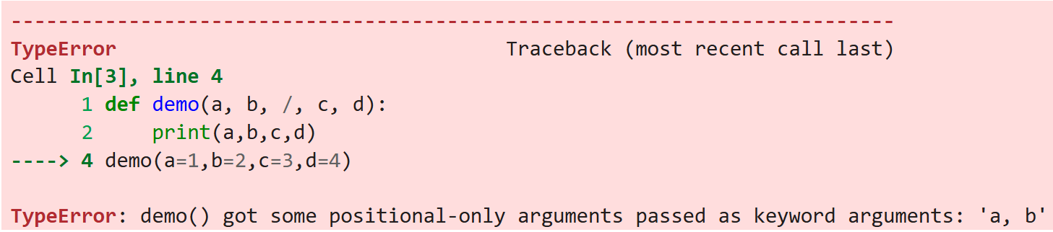

Positional Only arguments
A positional-only argument is a function parameter that must be passed by position, not by keyword.
A positional-only argument is defined using a / (forward slash) in the function definition.
Demo.py
Demo.py
Output
Output

Slide 43
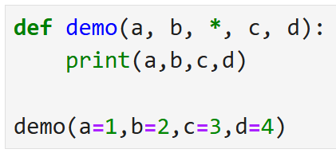
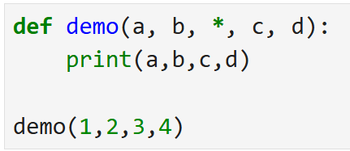
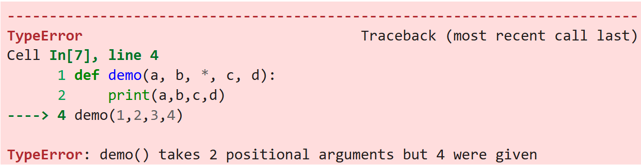
Keyword Only arguments
A keyword-only argument is a function parameter that must be passed using its parameter name and cannot be passed by position.
A keyword-only argument Is defined using * in the function definition.
Demo.py
Demo.py
Output
Output

Slide 44
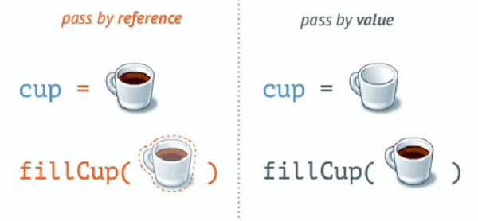
Pass by reference vs value
In call by value method, the value of the actual parameters is copied into the formal parameters.
In call by reference, the address of the variable is passed into the function call as the actual parameter.
In python value is passed as “Call by Object Reference” or “Call by assignment”.
When we pass whole numbers, strings or tuples to a function, the passing is like call-by-value because you can not change the value of the immutable objects being passed to the function.
Whereas passing mutable objects can be considered as call by reference because when their values are changed inside the function, then it will also be reflected outside the function.

Slide 45
Pass by reference vs value
CallByValue.py
CallByReference.py
1
2
3
4
5
6
7
8
9
# Call by Value
def modifiy_String(s):
  s = "Darshan University"
  print("Inside Function:", s)
str = "Darshan"
modifiy_String(str)
print("Outside Function:",str)
1
2
3
4
5
6
7
8
9
# Call by Reference
def add_more(list):
  list.append(50)
  print("Inside Function:", list)
list = [1,2,3,4,5]
add_more(list)
print("Outside Function:",list)
Output
Output
Inside Function: Darshan University
Outside Function: Darshan
Inside Function: [1, 2, 3, 4, 5, 50]
Outside Function: [1, 2, 3, 4, 5, 50]

Slide 46
Pass by reference vs value
def printA(a):
a = 3
def printList(a):
a.append(3)
x=2
printA(x)
print("A = ",x)
x= [1,2]
printList(x)
print("List",x)
Call by Value
Call by Reference
X
a
X
a
2
2
[1,2]

Slide 47
return Statement
return statement : return allows us to assign the output of the function to a new variable, return is use to send back the result of the function, instead of just printing it out.
A return statement is used to end the execution of the function call. The statements after the return statements are not executed.
If the return statement is without any expression, then the special value None is returned.
In python we can return multiple values from function using object, tuple, list, Dictionary.
returnDemo.py
1
2
3
4
5
6
7
def add_number(n1,n2) :
return n1 + n2
sum1 = add_number(5,3)
sum2 = add_number(6,1)
print(sum1)
print(sum2)
Output :
8
7

Slide 48
return Multiple values
returndemo.py
Output
1
2
3
4
5
6
7
8
9
10
11
def test():
  a=1
  b=2
  c=3
return a,b,c # return multiple values
x = test()
a,b,c = test()
print(x)
print(x[1])
print("a, b, c=",a,b,c)
(1, 2, 3)
2
a, b, c= 1 2 3

Slide 49
Scope of Variables
All variables in a program may not be accessible at all locations in that program. This depends on where you have declared a variable.
The scope of a variable determines the portion of the program where you can access a particular identifier. There are two basic scopes of variables in Python:
  Global variables
  Local variables
Variables that are defined inside a function body have a local scope, and those defined outside have a global scope.
This means that local variables can be accessed only inside the function in which they are declared.
whereas global variables can be accessed throughout the program body by all functions.
When we call a function, the variables declared inside it are brought into scope.

Slide 50
Scope of Variables (cont.)
Local.py
Output
1
2
3
4
5
6
7
8
total = 0
def sum( arg1, arg2 ):
  total = arg1 + arg2
  print ("Inside the function local total : ", total)
return total;
# Now you can call sum function
sum( 10, 20 );
print ("Outside the function global total : ", total)
Inside the function local total : 30
Outside the function global total : 0
Global.py
Output
1
2
3
4
5
6
7
8
9
total = 0
def sum( arg1, arg2 ):
  global total
  total = arg1 + arg2
  print ("Inside the function local total : ", total)
return total;
# Now you can call sum function
sum( 10, 20 );
print ("Outside the function global total : ", total)
Inside the function local total : 30
Outside the function global total : 30

Slide 51
lambda Function
We can use the lambda keyword to create small anonymous functions.
These functions are called anonymous because they are not declared in the standard manner by using the def keyword.
lambda forms can take any number of arguments but return just one value in the form of an expression. They cannot contain multiple expressions.
An anonymous function cannot be a direct call to print because lambda requires an expression.
lambda functions have their own local namespace and cannot access variables other than those in their parameter list and those in the global namespace.
Although it appears that lambda's are a one-line version of a function, they are not equivalent to inline statements in C or C++.

Slide 52
lambda Function (cont.)
Syntax
1
lambda arg1,arg2..argN: expression
The parameters are optional, and if supplied they are normally just comma- separated variable names, that is, positional arguments.
Lambda functions accept all kinds of arguments, just like normal def function
The expression can not contain branches or loops (although conditional expressions are allowed), and cannot have a return statement. The result of a lambda expression is an anonymous function.
When a lambda function is called it returns the result of computing the expression as its result.
Example.py
1
2
sum = lambda arg1,arg2: arg1 + arg2
print("Total",sum(5,5))
Output
Total 10

Slide 53
lambda Function (cont.)
Cube.py
Output
1
2
3
4
5
6
7
8
def cube(y):
  return y*y*y
lambda_cube = lambda y: y*y*y
# using the normally defined function
print(cube(5))
# using the lambda function
print(lambda_cube(5))
125
125
WithIfElse.py
Output
1
2
3
# Example of lambda function using if-else
Max = lambda a, b : a if(a > b) else b
print(Max(1, 2))
2
call.py
Output
1
2
# Lambda functions can be Immediately Invoked
print((lambda x: x*x)(3))
9

Slide 54
map
map() function returns a map object(which is an iterator) of the results after applying the given function to each item of a given iterable (list, tuple etc.)
Syntax
1
map(fun, iterable)
demo1.py
Output
1
2
3
4
5
6
7
def addition(n):
return n * n
numbers = [1, 2, 3, 4]
result = list(map(addition, numbers))
# result = list(map(lambda n:n*n,numbers))
print(result)
[1, 4, 9, 16]
demo2.py
Output
1
2
3
strdata = ["Darshan","University"]
lengthdata = list(map(len,strdata))
print(lengthdata)
[7, 10]

Slide 55
filter
To find out items based on a test function we can use a Filter.
For example, the following filter call picks out items in a sequence that are divide by 2:
demo1.py
Output
1
2
3
lista = [1,2,3,4,5,6,7,8,9,10]
ans = list(filter(lambda x: x % 2 == 0 ,lista))
print(ans)
[2, 4, 6, 8, 10]

Slide 56
Recursion
Any function which calls itself is called recursive function and such function calls are called recursive calls.
Recursion cannot be applied to all problems, but it is more useful for the tasks that can be defined in terms of a similar subtask.
It is idea of representing problem a with smaller problems.
Any problem that can be solved recursively can be solved iteratively.
When recursive function call itself, the memory for called function allocated and different copy of the local variable is created for each function call.
Some of the problem best suitable for recursion are
  Factorial
  Fibonacci
  Tower of Hanoi

Slide 57
Properties of Recursion
A recursive function can go infinite like a loop. To avoid infinite running of recursive function, there are two properties that a recursive function must have.
Base Case or Base criteria
  It allows the recursion algorithm to stop.
  A base case is typically a problem that is small enough to solve directly.
Progressive approach
  A recursive algorithm must change its state in such a way that it moves forward to the base case.

Slide 58
Recursion - factorial example
The factorial of a integer n, is product of
  n * (n-1) * (n-2) * …. * 1
Recursive definition of factorial
  n! = n * (n-1)!
  Example
    3! = 3 * 2 * 1
    3! = 3 * (2 * 1)
    3! = 3 * (2!)
Recursive trace
Final Ans 5 *24 = 120
Fact(5)
return 4 * 6 = 24
call
Fact(4)
return 3 * 2 = 6
call
Fact(3)
return 2 * 1 = 2
call
Fact(2)
call
return 1
Fact(1)

Slide 59
Examples
Factorial.py
Output
1
2
3
4
5
6
7
8
9
10
def recursive_factorial(n):
  if n == 1:
  return n
  else:
  return n * recursive_factorial(n-1)
# recursive function call
# user input
num = int(input("Enter the number="))
print("Factorial of number", num, "=", recursive_factorial(num))
Enter the number=5
Factorial of number 5 = 120
fibonacci.py
Output
1
2
3
4
5
6
7
8
9
def r_fibonacci(n):
  if n <= 1:
  return n
  else:
  return(r_fibonacci(n-1) + r_fibonacci(n-2))
n = 8
print("Fibonacci series:")
for i in range(n):
print(r_fibonacci(i))
Fibonacci series:
0
1
1
-
-
13

