Slide 1







OEE
OVERALL EQUIPMENT EFFECTIVENESS
KPIs ANALYSIS
# PRODUCED
# EXPECTED
# REJECTED
PRODUCTIVE HOURS
OUTAGED HOURS
OEE
PRODUCTIVITY
QUALITY
KPIs
HOURS
PRODUCTIVITY
AVAILABILITY

Slide 2

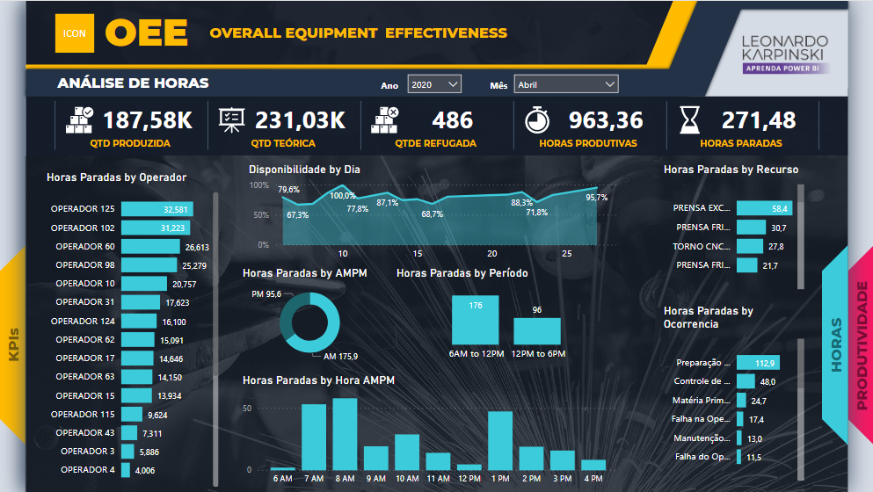
OEE
OVERALL EQUIPMENT EFFECTIVENESS
ANÁLISE DE HORAS
HOURS ANALYSIS
# PRODUCED
# EXPECTED
# REJECTED
PRODUCTIVE HOURS
OUTAGED HOURS
KPIs
HOURS
PRODUCTIVITY

Slide 3
OEE
OVERALL EQUIPMENT EFFECTIVENESS
PRODUCTIVITY ANALYSIS
# PRODUCED
# EXPECTED
# REJECTED
PRODUCTIVE HOURS
OUTAGED HOURS
HOURS
KPIs
PRODUCTIVITY

Slide 4
OEE
AVAILABILITY
PRODUCTIVITY
PRODUCTIVE HOURS
QUALITY
OUTAGED HOURS
AVAILABILITY
PRODUCTIVTY

