Slide 1
Investment Prediction

Slide 2
Objective:
In the era of big data for predicting stock market prices and trends has become even more popular than before. I collected 11 years of GOOGLE’s stock data and proposed a comprehensive customization of feature engineering and machine learning-based model for predicting price trend of stock markets. The proposed solution is comprehensive as it includes pre-processing of the stock market dataset, utilization of multiple feature engineering techniques, combined with a customized machine learning based system for stock market price trend prediction. We conducted comprehensive evaluations on frequently used machine learning models and conclude that our proposed solution outperforms due to the comprehensive feature engineering that we built. The system achieves overall high accuracy for stock market trend prediction. With the detailed design and evaluation of prediction term lengths, feature engineering, and data pre-processing methods, this work contributes to the stock analysis research community both in the financial and technical domains.
Benefits:
Predict Stocks Price.
Gives better insight of companies results.
Helps in easy flow for managing resources.

Slide 3
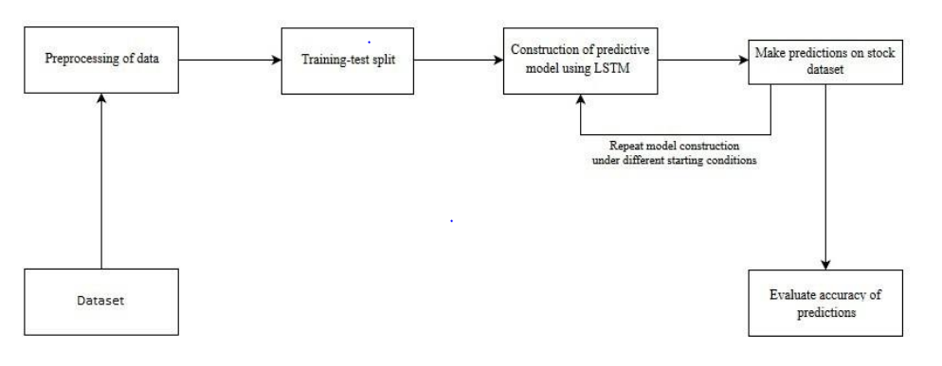
Architecture

Slide 4
Model Training:
Data Export from Db :
The accumulated data from db is exported in csv format for model training
Data Preprocessing
Performing EDA to get insight of data like identifying distribution , outliers ,trend
among data etc.
Check for null values in the columns. If present impute the null values.
Encode the categorical values with numeric values.
Perform Standard Scalar to scale down the values.

Slide 5
Prediction:
The testing files are shared in the batches and we perform the same Validation operations ,data transformation and data insertion on them.
The accumulated data from db is exported in csv format for prediction
We perform data pre-processing techniques on it.
Logistic Regression model created during training is loaded and clusters for the preprocessed data is predicted
Once the prediction is done. The predictions are saved in csv format and shared.

Slide 6
Q & A:
Q1) What’s the source of data?
The data for training is provided by the client in multiple batches and each batch contain multiple files
Q 2) What was the type of data?
The data was the combination of numerical and Categorical values.
Q 3) What’s the complete flow you followed in this Project?
Refer slide 3rd for better Understanding
Q 4) After the File validation what you do with incompatible file or files which didn’t pass the validation?
Files like these are moved to the Achieve Folder and a list of these files has been
shared with the client and we removed the bad data folder.

Slide 7
Q 5) How logs are managed?
We are using different logs as per the steps that we follow in validation and
modeling like File validation log , Data Insertion ,Model Training log , prediction log
etc.
Q 6) What techniques were you using for data pre-processing?
Removing unwanted attributes
Visualizing relation of independent variables with each other and output variables
Checking and changing Distribution of continuous values
Removing outliers
Cleaning data and imputing if null values are present.
Converting categorical data into numeric values.
Scaling the data

Slide 8
Q 7) How training was done or what models were used?
Before diving the data in training and validation set we performed clustering over fit to divide the data into clusters.
As per cluster the training and validation data were divided.
The scaling was performed over training and validation data
Algorithms like SVM , XGBoost were used based on the recall final model was used for each cluster and we saved that model .
Q 8) How Prediction was done?
The testing files are shared by the client .We Perform the same life cycle till the data is clustered .Then on the basis of cluster number model is loaded and perform prediction. In the end we get the accumulated data of predictions.

Slide 9
Q 9) What are the different stages of deployment?
When the model is ready we deploy it in Fire environment .Where SIT and UAT is performed over it.
Once We get Sign off from Fire we deploy in Earth and UAT is performed over it.
After getting the sign off from Earth we deploy in production

