Slide 1
CONVERSION INTELLIGENCE
Why Are 84.5% of Sessions
Not Converting?
A data-driven case study on purchase intent prediction
for an Indian e-commerce platform
Statalytical Showdown | Mohit | MNNIT Allahabad

Slide 2
THE BUSINESS PROBLEM
An Indian e-commerce platform sees only 15.5% of website sessions result in a purchase. The business needs to understand: who are the high-intent visitors, what drives their behaviour, and how can we identify them in real time to act?
01
02
03
Who converts?
What signals intent?
Can we predict it?
When & which visitors are most likely to buy?
Which behaviours predict a purchase session?
Build a real-time conversion predictor
DATASET AT A GLANCE
12,330
18
84.5%
15.5%
0
Sessions
Features
Non-Buyers
Buyers
Missing Values

Slide 3
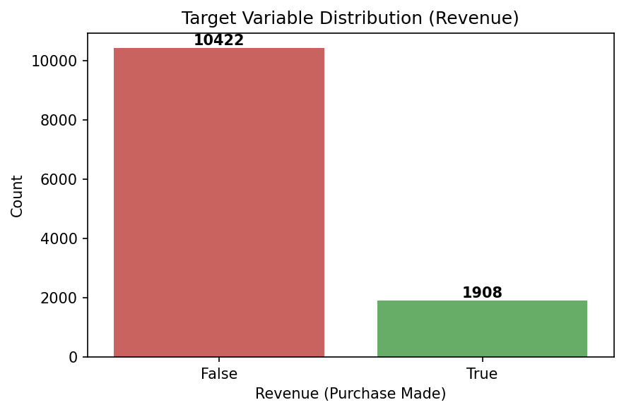
THE CORE CHALLENGE: CLASS IMBALANCE
The Problem
A naive model predicting 'No Purchase' every time achieves 84.5% accuracy — but catches zero buyers. Accuracy is completely misleading here.
Our Metric: F1 Score
Balances precision (avoiding false alarms) and recall (catching real buyers). We apply SMOTE to balance training data.
Imbalance Ratio: 5.5 : 1
Non-buyers vs Buyers
Requires SMOTE oversampling before model training to prevent bias
10,422 non-buyers vs 1,908 buyers — standard classifiers will ignore the minority class

Slide 4
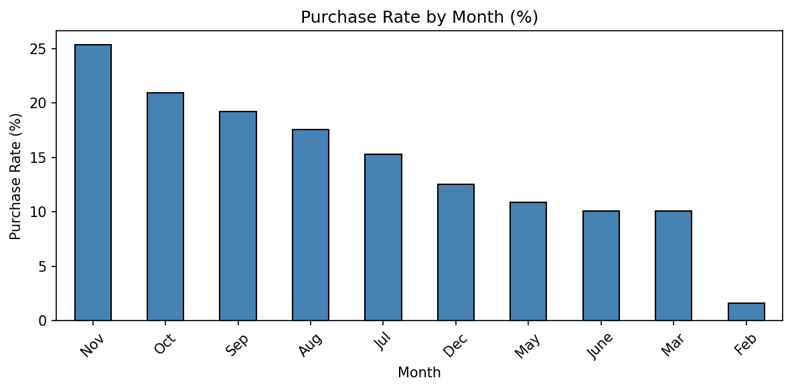
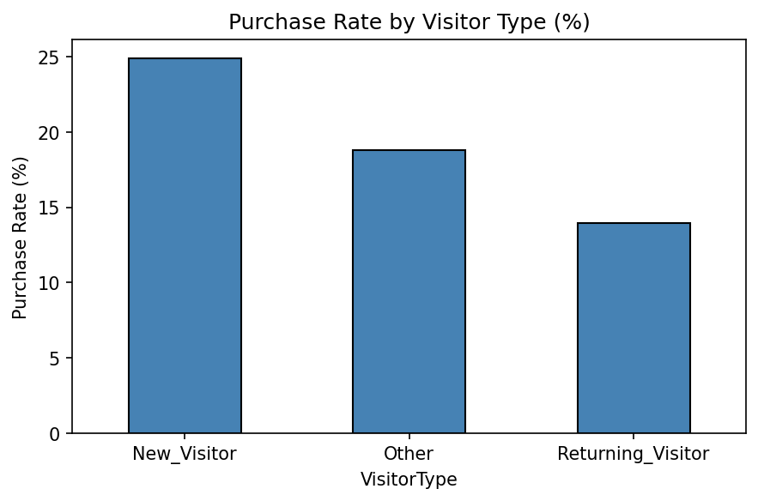
KEY INSIGHTS FROM THE DATA
Conversion Rate by Month
Conversion Rate by Visitor Type
Nov & Oct convert at 25% and 21% — 2.5x the platform average. Feb almost dead at 1.6%.
New visitors convert at 25% vs returning at 14%. Returning visitors browse casually — need re-engagement strategy.

Slide 5
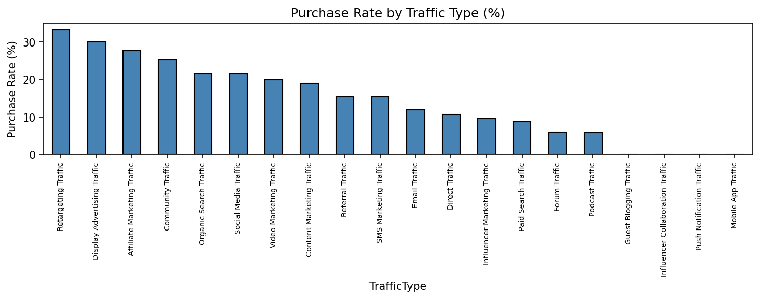
TRAFFIC SOURCE ANALYSIS
33%
0%
30%
Retargeting Traffic
Mobile App / Influencer
Display Advertising
Highest converting — 2x platform average
Near-zero — channel mismatch or insufficient data
Strong paid channel — users arrive with intent

Slide 6
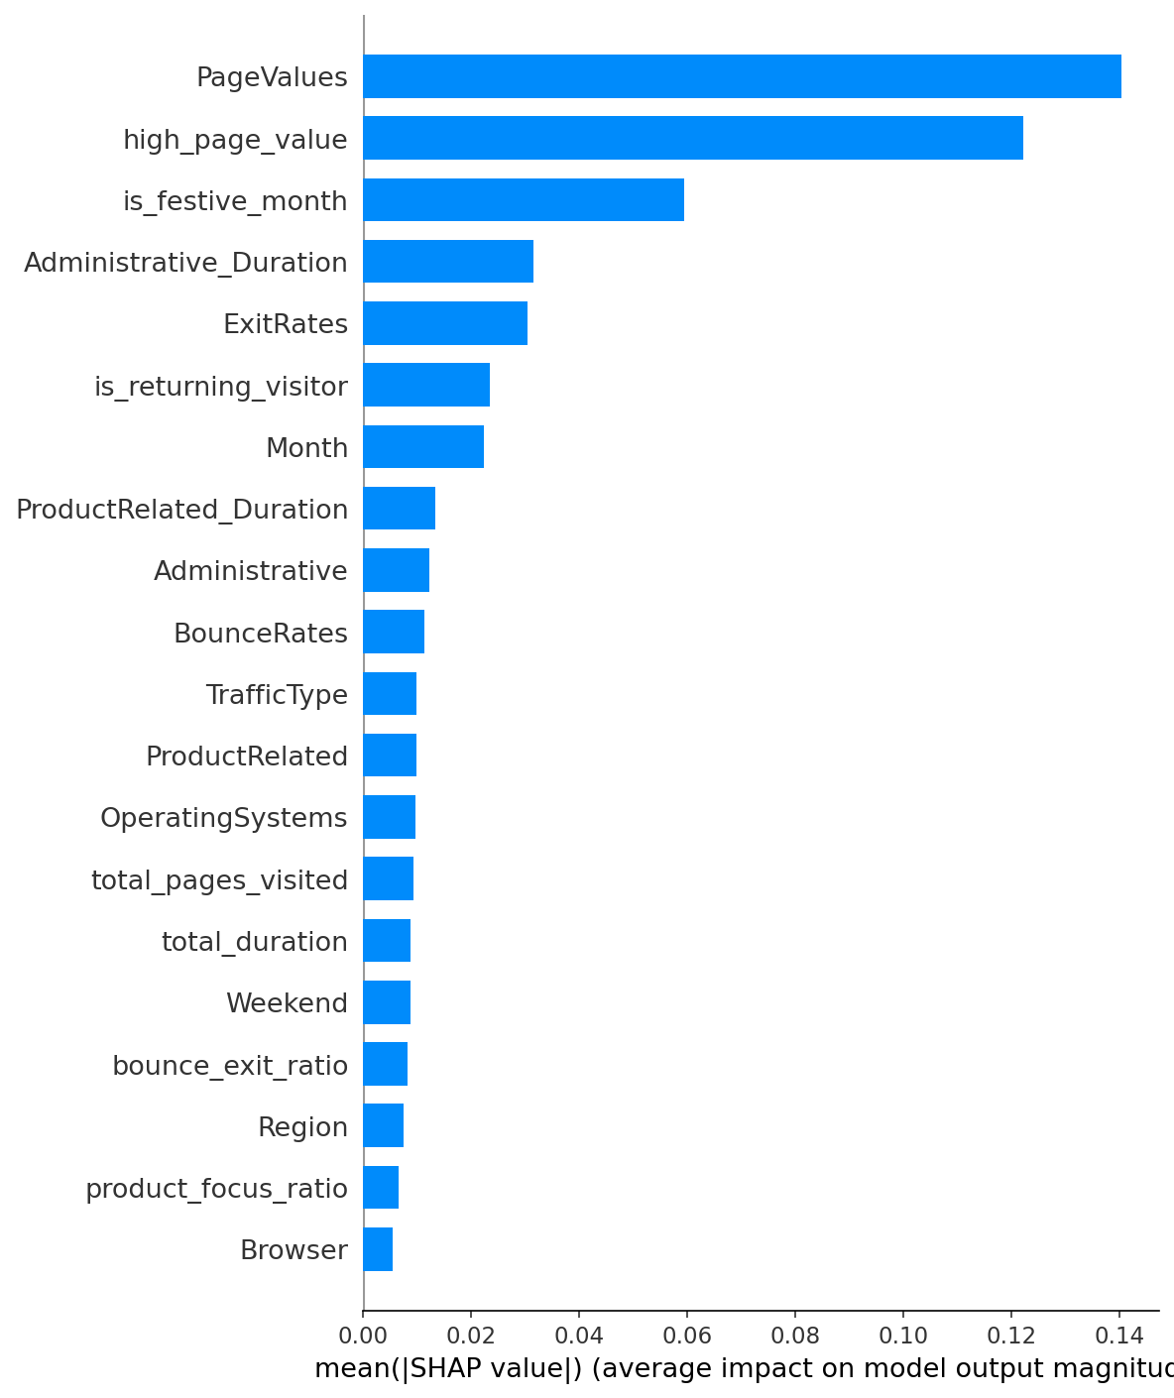
WHAT DRIVES PURCHASE INTENT? (SHAP Analysis)
TOP PREDICTORS
#1
PageValues
Sessions with PageValues > 0 are overwhelmingly buyers
#2
high_page_value
Engineered binary flag — stronger than raw PageValues (0.60 vs 0.49)
#3
is_festive_month
Engineered — Oct/Nov significantly boost conversion probability
#4
ExitRates
High exit rate = strong negative signal, user leaving without buying
2 of top 3 predictors are engineered features — feature engineering validated by SHAP.

Slide 7
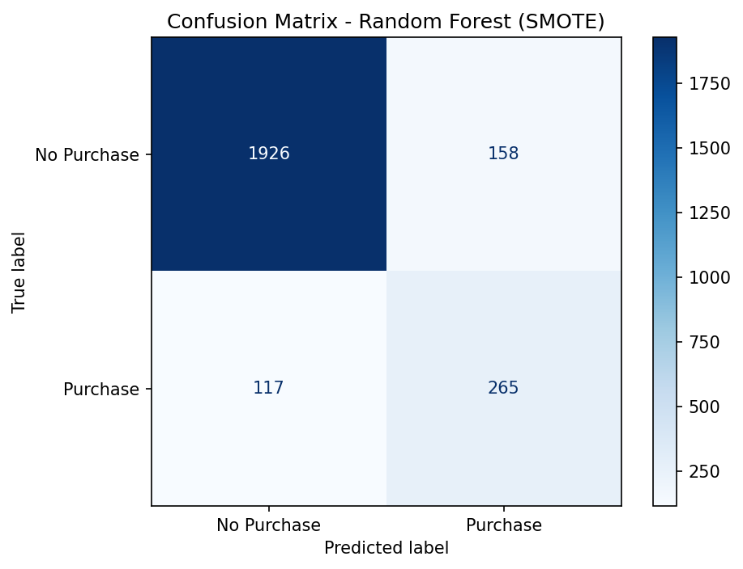
MODEL PERFORMANCE
Model Comparison — Minority Class F1
Confusion Matrix — Final Model
Model | F1 | Precision | Recall
RF (SMOTE) - SELECTED | 0.658 | 0.626 | 0.694
LR (Class Weight) | 0.639 | 0.531 | 0.801
LR (SMOTE) | 0.633 | 0.521 | 0.806
XGBoost (Class Weight) | 0.632 | 0.598 | 0.670
XGBoost (SMOTE) | 0.629 | 0.662 | 0.599
RF (Class Weight) | 0.625 | 0.748 | 0.537
Business Interpretation: Of 382 real buyers, we correctly flagged 265 (69.4%). Only 7.6% of non-buyers were incorrectly flagged. The cost of offering a discount to 8 casual browsers is far lower than missing 3 genuine buyers.

Slide 8
BUSINESS RECOMMENDATIONS
01
Front-load marketing spend in Oct & Nov
Nov: 25.4% | Oct: 21.0% | Feb: 1.6%
Festive months convert at 2.5x average. Increase ad budget, launch promotions in Q4.
02
Prioritise retargeting traffic channel
Retargeting: 33% vs Avg: 15.5%
Retargeting converts at 33% — double the platform average. Reallocate from low-converting channels.
03
Use PageValues as a real-time intent trigger
PageValues = #1 SHAP predictor
When a session's PageValue crosses zero, fire an intervention — discount popup or live chat.
04
Re-engage returning visitors differently
New: 25% | Returning: 14%
86% of sessions are returning visitors but convert at only 14%. Target with personalised wishlists.
05
Reduce exit rates on product pages
ExitRates = #4 SHAP predictor
High exit rates strongly predict non-conversion. Improve UX — better images, clear CTAs.

Slide 9
EXPECTED IMPACT
If We Improve Conversion
Rate by Just 3%...
+370
2x
69.4%
Additional purchases
per 10,000 sessions
ROI on retargeting
vs other channels
Real buyers correctly
identified by model
Model: Random Forest + SMOTE | F1: 0.658 | Dataset: 12,330 sessions | Statalytical Showdown
Thank You

