Slide 1
01
VENDOR SALES
PERFORMANCE ANALYTICS
End-to-End Data Analytics Portfolio Project
Python
PostgreSQL
Power BI
matplotlib / seaborn
Mohith · Senior Test Analyst | Transitioning to Data Analytics · Cognizant
Notes:
Introduce yourself and the project. This is an end-to-end analytics pipeline project covering 2.6M+ rows of beverage retail data — from raw CSV ingestion to a Power BI dashboard.

Slide 2
Project Overview
What this project covers
01
02
03
04
05
Data Engineering
SQL Transformation
EDA & Cleaning
Analysis & Stats
Power BI Dashboard
CSV → PostgreSQL pipeline with Python logging
3-CTE query to build vendor_sales_summary table
Outlier detection, distributions, correlation heatmap
Pareto, segmentation, CI, hypothesis testing
Live PostgreSQL connection — interactive KPIs
Notes:
Walk through the 5 major phases: ingestion, SQL transform, EDA, analysis, dashboarding.

Slide 3
Dataset at a Glance
5 raw CSVs · 2.6M+ rows · PostgreSQL inventory database
2.6M+
5
119
18
4
Total rows ingested
Source CSV files
Unique vendors
Columns in summary
Engineered KPIs
File | Rows | Key Columns
purchases.csv | 2,372,474 | VendorNumber, Brand, PurchasePrice, Quantity, Dollars
purchase_prices.csv | 12,261 | Brand, Description, Price, Volume, PurchasePrice
vendor_invoice.csv | 5,543 | VendorNumber, Quantity, Dollars, Freight
end_inventory.csv | 224,489 | InventoryId, Store, City, Brand, onHand, Price
begin_inventory.csv | ~224K+ | Opening stock positions — same schema as end_inventory
Notes:
The biggest table is purchases at 2.37M rows — this drives most of the analysis. The pipeline ingested all 5 files in ~210 minutes.

Slide 4
01
Exploratory Data Analysis
Understanding distributions, outliers, and data quality

Slide 5
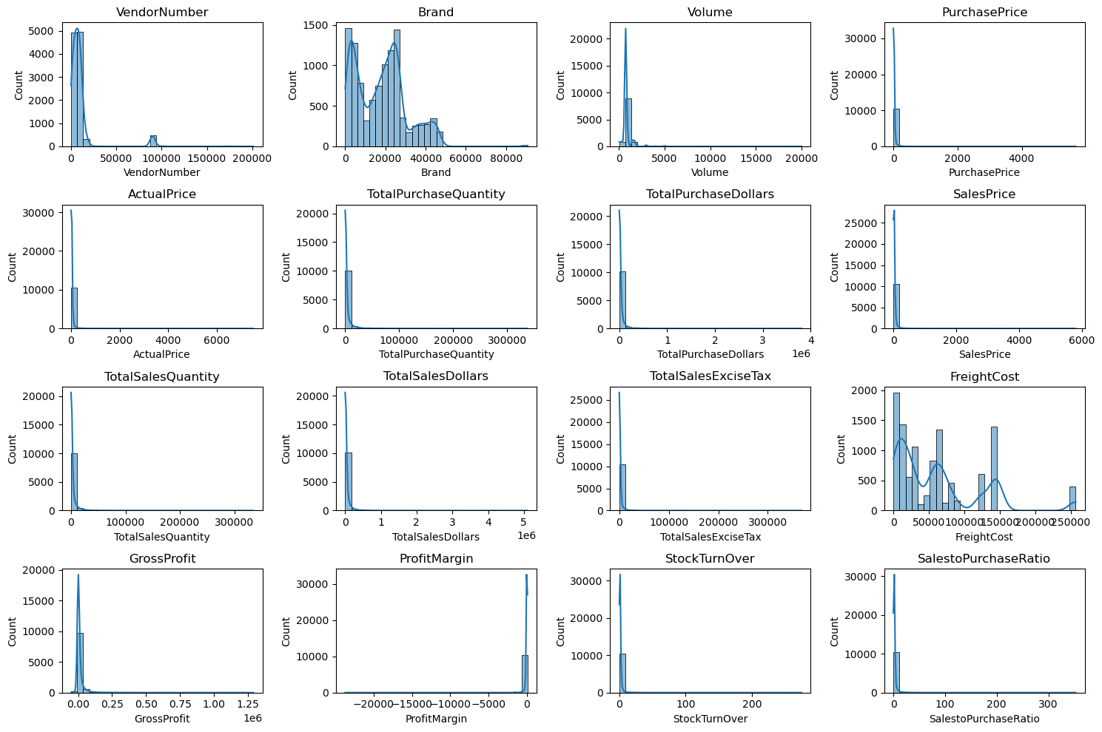
Distribution of All Numerical Columns
Histograms with KDE — raw data before filtering
Notes:
16 numerical columns plotted. Key observations: highly skewed distributions for purchase/sales dollars, freight cost, and profit margin (has -inf values). This guided the filtering step.

Slide 6
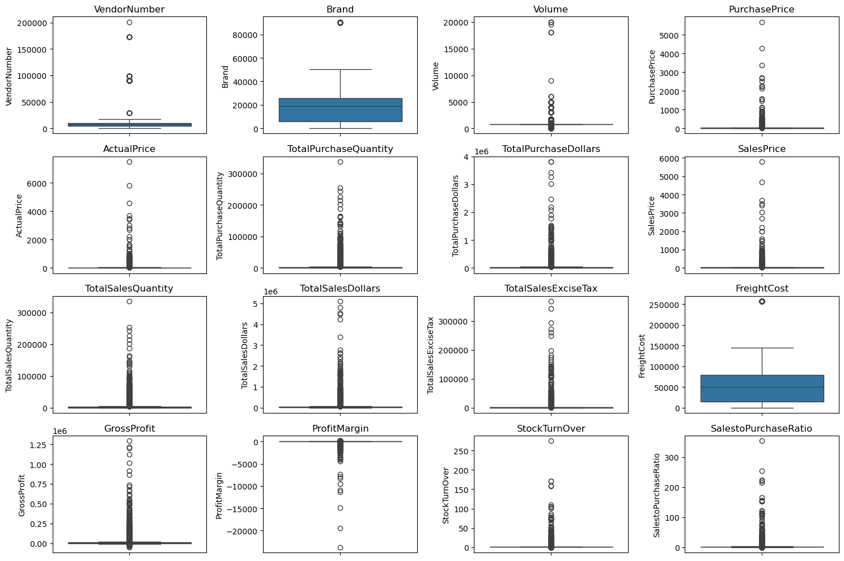
Outlier Detection — Box Plots
Identifying anomalies before analysis
GrossProfit min
−$52,003
Some products sell at a loss
FreightCost range
$0.09 → $257K
Massive logistics variance
StockTurnover max
274.5×
Values >1 = drawing from old stock
PurchasePrice max
$5,682
Premium/specialty products exist
Notes:
Outliers in freight, purchase price, and stock turnover are real business phenomena — not data errors. These were kept in the dataset; only loss-making records were filtered.

Slide 7
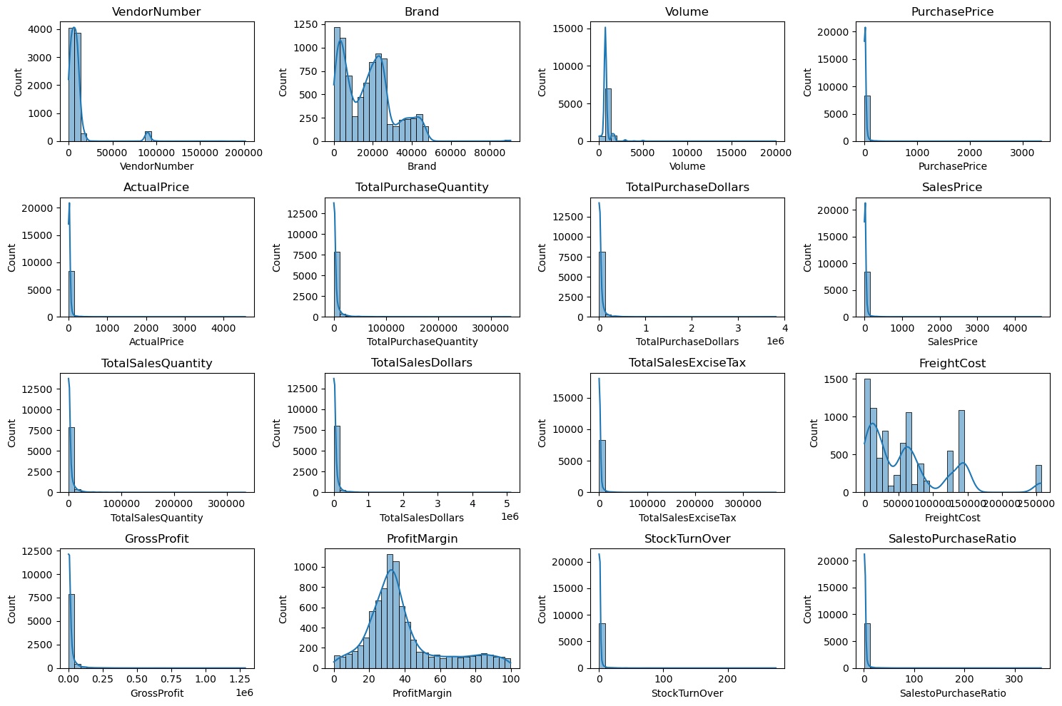
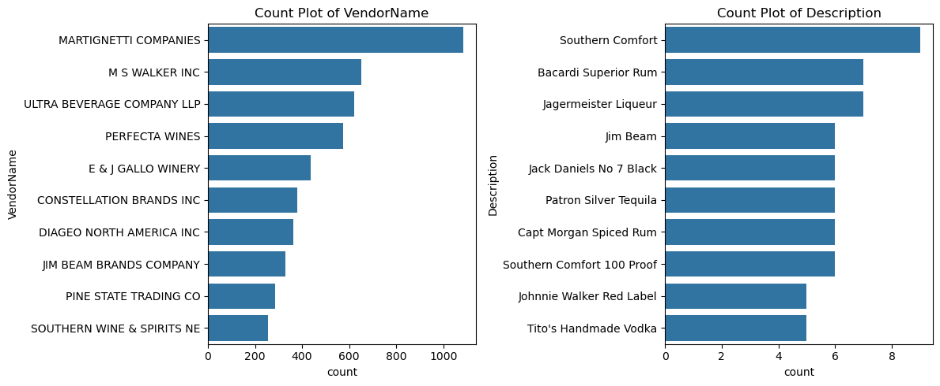
EDA Summary — After Filtering
Filtered: GrossProfit > 0 · ProfitMargin > 0 · SalesQuantity > 0
After removing loss-making & unsold records, distributions become cleaner. The count plots confirm heavy concentration in a small set of vendors and products.
Notes:
The filtering step removed records with zero or negative margins. This cleaned dataset (8,564 rows) is what powers all subsequent analysis.

Slide 8
02
Correlation Analysis
How do purchase, sales, and profit metrics relate?

Slide 9
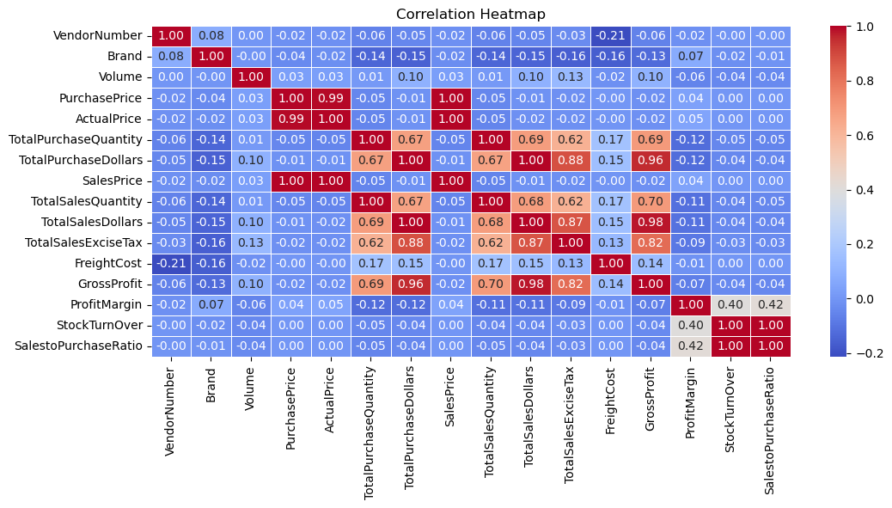
Correlation Heatmap
Pearson correlations across all numerical columns
PurchaseQty ↔ SalesQty
0.999
Near-perfect — almost all purchased stock is sold
PurchasePrice ↔ Sales $
−0.012
Price doesn't drive revenue — volume does
StockTurnover ↔ Margin
−0.055
Faster turnover ≠ higher profitability
PurchasePrice ↔ Profit
−0.016
Higher unit price doesn't mean more gross profit
Notes:
The 0.999 correlation between purchase and sales quantity is the standout — it confirms very efficient inventory management. The weak correlations with price are counter-intuitive but real.

Slide 10
03
Vendor & Brand Performance
Who drives the most revenue?

Slide 11
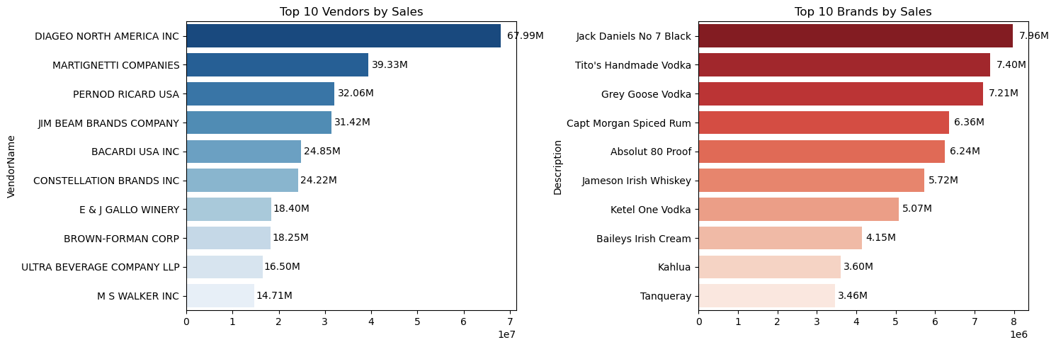
Top 10 Vendors & Brands by Sales
Ranked by Total Sales Dollars
Notes:
DIAGEO dominates at $68M. The top brand Jack Daniels No.7 does $7.96M alone. Note the concentration — just 10 brands account for a huge share of total sales.

Slide 12
Top 10 Vendor Leaderboard
By Total Sales $ — with Purchase Contribution %
# | Vendor Name | Total Sales $ | Purchase Contribution | Total Purchase $
1 | DIAGEO NORTH AMERICA INC | $67.99M | 16.30% | $50.10M
2 | MARTIGNETTI COMPANIES | $39.33M | 8.30% | $25.50M
3 | PERNOD RICARD USA | $32.06M | 7.76% | $23.85M
4 | JIM BEAM BRANDS COMPANY | $31.42M | 7.64% | $23.49M
5 | BACARDI USA INC | $24.85M | 5.67% | $17.43M
6 | CONSTELLATION BRANDS INC | $24.22M | 4.97% | $15.27M
7 | E & J GALLO WINERY | $18.40M | 3.93% | $12.07M
8 | BROWN-FORMAN CORP | $18.25M | 4.31% | $13.24M
9 | ULTRA BEVERAGE COMPANY LLP | $16.50M | 3.63% | $11.17M
10 | M S WALKER INC | $14.71M | 3.18% | $9.76M
Notes:
DIAGEO is nearly double the #2 vendor in total sales. The purchase contribution column shows procurement concentration — top 2 alone = 24.6%.

Slide 13
04
Vendor Purchase Concentration
Pareto analysis across 119 vendors

Slide 14
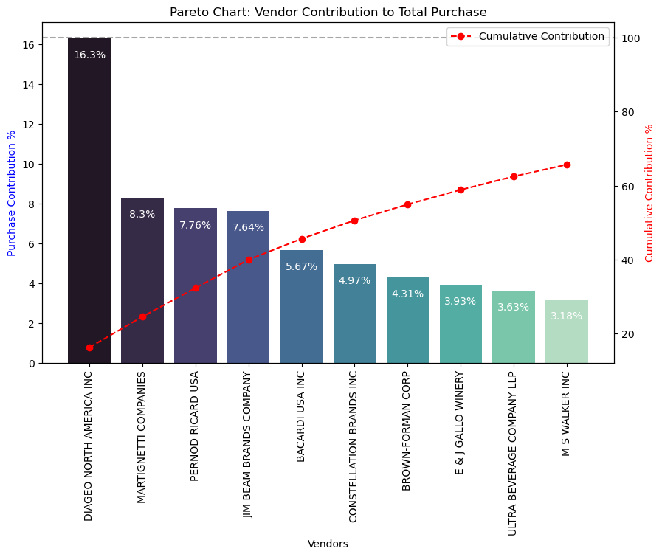
Pareto Chart — Vendor Purchase Contribution
Top 10 vendors account for 65.69% of total procurement spend
65.69%
of total procurement
from top 10 of 119 vendors
Supply Chain Risk
DIAGEO alone
accounts for 16.3%
of all purchasing.
Notes:
This is the classic 80/20 Pareto principle. Concentration at this level creates procurement risk — if DIAGEO supply is disrupted, 16% of revenue is at immediate risk.

Slide 15
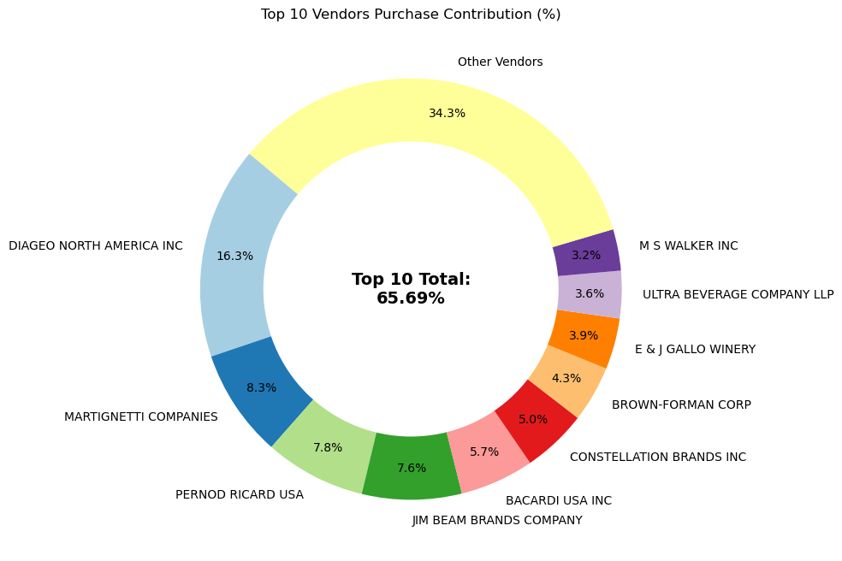
Purchase Concentration — Donut View
Visual breakdown of top 10 vs all other vendors
Notes:
The donut chart makes the concentration visually clear — the 'Other Vendors' slice (34.31%) is spread across 109 vendors, while the top 10 take the rest.

Slide 16
05
Promotional Opportunity
Low sales · High margin brands need attention

Slide 17
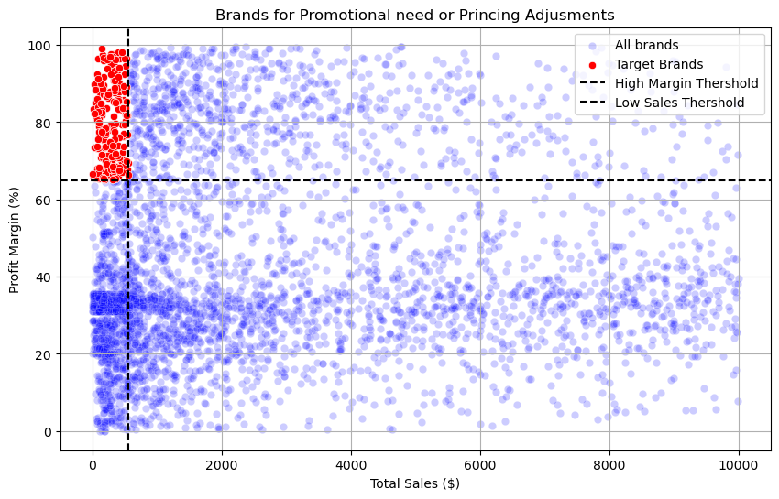
Brands Needing Promotions or Pricing Adjustment
Low-sales / high-margin quadrant — 198 target brands identified
Methodology
Low Sales: ≤ 15th pct. ($560.30) High Margin: ≥ 85th pct. (64.97%)
Sample Target Brands
Crown Royal Apple
Sales: $27.86
Margin: 89.81%
Sauza Sprklg Wild Berry
Sales: $27.96
Margin: 82.15%
Dad's Hat Rye
Sales: $538.89
Margin: 81.85%
Concannon Glen Ellen
Sales: $15.95
Margin: 83.45%
Notes:
198 brands are in this quadrant. Crown Royal Apple has an 89.81% margin but only $27.86 in sales — it just needs visibility. Even a small sales increase generates outsized profit given the margin.

Slide 18
06
Bulk Pricing Impact
Does order size affect unit cost?

Slide 19
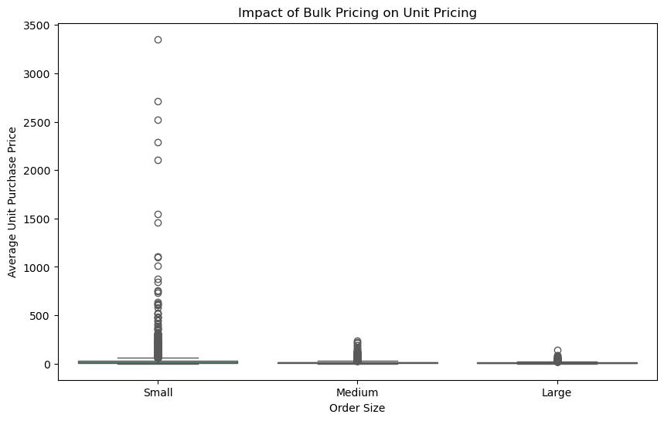
Unit Cost by Order Size
Quantile-based segmentation: Small / Medium / Large
Small Orders
$39.07
avg. unit cost —
Medium Orders
$15.49
avg. unit cost ↓ 60%
Large Orders
$10.78
avg. unit cost ↓ 72%
Notes:
The 72% price reduction from Small to Large orders is enormous. Vendors placing Large orders pay $10.78/unit vs $39.07 for Small. This is a strong incentive to consolidate orders.

Slide 20
07
Unsold Inventory Risk
Capital tied up in slow-moving stock

Slide 21
Unsold Inventory by Vendor
UnsoldValue = (PurchaseQty − SalesQty) × PurchasePrice
$2.71M
Vendor Name | Unsold Value
DIAGEO NORTH AMERICA INC | $722.21K
JIM BEAM BRANDS COMPANY | $554.67K
PERNOD RICARD USA | $470.63K
WILLIAM GRANT & SONS INC | $401.96K
E & J GALLO WINERY | $228.28K
SAZERAC CO INC | $198.44K
BROWN-FORMAN CORP | $177.73K
CONSTELLATION BRANDS INC | $133.62K
MOET HENNESSY USA INC | $126.48K
REMY COINTREAU USA INC | $118.60K
Total unsold inventory
across all vendors
Notes:
DIAGEO has $722K of unsold inventory — the same vendor that has the highest procurement spend. This suggests their supply planning needs tighter alignment with actual demand.

Slide 22
08
Statistical Analysis
Confidence intervals · Hypothesis testing

Slide 23
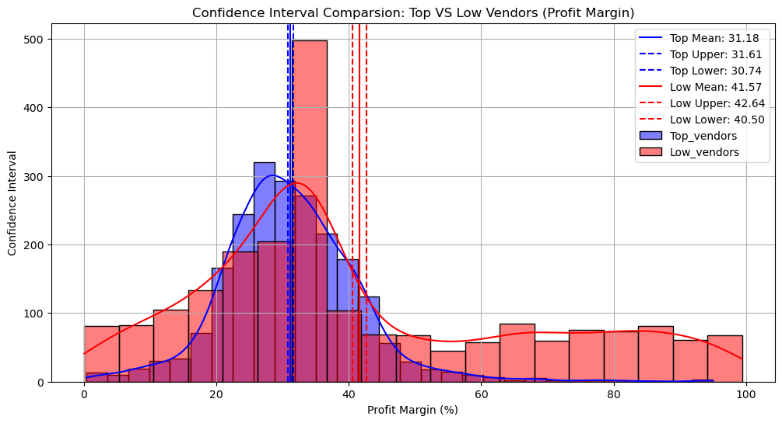
Profit Margin: Top vs Low-Performing Vendors
95% Confidence Intervals — t-distribution (Welch's two-sample t-test)
Top-Performing Vendors
Mean: ~31.2%
95% CI: 30.74% – 31.61%
Low-Performing Vendors
Mean: ~41.6%
95% CI: 40.48% – 42.62%
Notes:
Counter-intuitive result: low-volume vendors have significantly higher profit margins. This is real and statistically confirmed — they likely operate niche/premium segments with less price competition.

Slide 24
Hypothesis Test — Is the Margin Difference Real?
Two-Sample t-Test (Welch's, equal_var=False) · scipy.stats.ttest_ind
H₀ (Null Hypothesis)
Test Results
No significant difference in mean profit margins between top-performing and low-performing vendors.
T-Statistic:
−17.6695
P-Value:
0.0000
H₁ (Alternative Hypothesis)
α = 0.05 significance level
A significant difference exists in profit margins between the two groups.
✓ Reject H₀
Low-performing vendors have statistically significantly higher profit margins (40–43%) than top-performing vendors (30–32%). p-value of 0.0000 means this result would occur by chance less than 1 in 10,000 times.
Notes:
p = 0.0000 is highly significant. The t-stat of -17.67 is enormous — this is one of the strongest findings in the project. Low-volume vendors consistently price at a premium.

Slide 25
09
Conclusions & Recommendations
What the data tells us to do

Slide 26
5 Key Business Recommendations
Derived from analysis of 2.6M+ rows of vendor sales data
1. Reduce Vendor Concentration Risk
4. Encourage Bulk Order Consolidation
Top 10 of 119 vendors = 65.69% of procurement. Develop backup suppliers; negotiate multi-year contracts with top 3.
Large orders cost 72% less per unit ($10.78) vs Small ($39.07). Communicate bulk pricing tiers to medium-tier vendors.
2. Audit Pricing for Top Vendors
5. Clear $2.71M Unsold Inventory
Top vendors earn only 31% margin vs 41% for low-volume vendors (p=0.0000). Selective price adjustments could recover millions.
DIAGEO ($722K), JIM BEAM ($555K), PERNOD ($471K) carry highest risk. Run clearance campaigns; revise reorder quantities.
3. Invest in Promotional Opportunity
198 brands with 65–90% margins but minimal sales. Crown Royal Apple (89.81% margin) is the highest-priority target.
Notes:
These 5 recommendations are all directly backed by data from the analysis. Each has a clear action and a quantifiable impact.

Slide 27
Thank You
Questions? Let's discuss the data.
End-to-End Pipeline: CSV → PostgreSQL → Python → Power BI
2.6M+ rows processed · 119 vendors · 4 engineered KPIs
Statistical testing confirms key findings (p = 0.0000)
All charts and tables built from real notebook outputs
Mohith · Data Analytics Portfolio · Cognizant
Notes:
Wrap up. Offer to walk through any specific slide in more detail. Mention that all code is available on GitHub.

