Slide 1
Efficient Blockchain Transaction Indexing using B-Trees

Slide 2

2
Problem Statement
Blockchain networks generate millions of transactions daily
Need fast and scalable methods for:
Insertion of new transactions
Searching by transaction ID
Range queries (e.g., between two dates)
The Core Problem: Speed vs. Trust
Blockchain faces a trade-off between speed and trust.
Traditional databases are fast but less secure, while blockchain is highly secure but slower.
The core challenge is to build a system that is both fast and secure for real-world use.
The Goal
Build a system that is both fast AND secure, overcoming this trade-off.

Slide 3
3
Introduction
Blockchain is a decentralized and secure digital ledger technology that records transactions in a transparent and immutable manner. This case study focuses on implementing a blockchain system to manage and verify transactions efficiently. It explores the underlying structure, consensus mechanisms, and practical applications, demonstrating how blockchain ensures trust, security, and scalability in modern digital systems.

Slide 4
4
Objectives
1.To design and implement a B-Tree index for blockchain transactions.
2.To demonstrate four fundamental operations: insertion, search, range queries, and display in sorted order.
3.To extend functionality with transaction statistics and chain validation.
4.To justify why B-Trees are the most optimized structure for blockchain indexing compared to other data structures.
5.To present a menu-driven demo for real-world applications like blockchain explorers and auditing tools

Slide 5
5
Why B-Trees Are the Most Optimized Solution
Balanced structure → Keeps height = O(log n), unlike BSTs which can degrade to O(n).
Multiple keys per node → Shallower than AVL/Red-Black trees → fewer comparisons.
Disk-friendly → Each node matches disk blocks → fewer I/O operations (real blockchain data > memory).
Supports both exact search and range queries (unlike hash tables).
Proven in real systems → Databases (MySQL, PostgreSQL, MongoDB) and file systems use B-Trees.
Thus, B-Trees are the optimal choice for blockchain transaction indexing.

Slide 6
6
Methods Implemented
1.insertTransaction(tx) – Inserts a new transaction.
2.splitBlock(node) – Handles overflow when a node exceeds max keys.
3.searchTransaction(tx_id) – Efficient search using B-Tree property.
4.displayTransactions() – Inorder traversal → sorted order.
5.rangeQuery(startID, endID) – Fetch transactions in ID range.
6.get_total_transactions() – Counts all transactions.
7.get_average_value() – Returns average transaction value.
8.get_max_transaction() – Finds highest transaction value.
9.get_min_transaction() – Finds lowest transaction value.
10.get_range_sum(startID, endID) – Sum of values in a range.
11.validateChain() – Ensures blockchain order by checking prev_hash links.

Slide 7
7
Method name | Function | Time Complexity | Space Complexity
insertTransaction(txn) | Inserts a new transaction into the B-Tree (into the current block/node). | O(log n) | O(1) per insert
splitBlock(node) | Splits a node when it becomes full to maintain B-Tree balance. | O(1) per split | O(1)
searchTransaction(tx_id) | Searches for a transaction by ID using B-Tree property. | O(log n) | O(1)
7

Slide 8
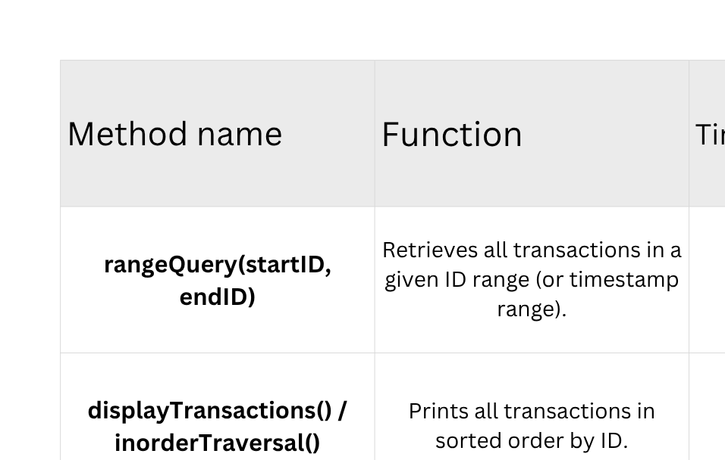
8

Slide 9
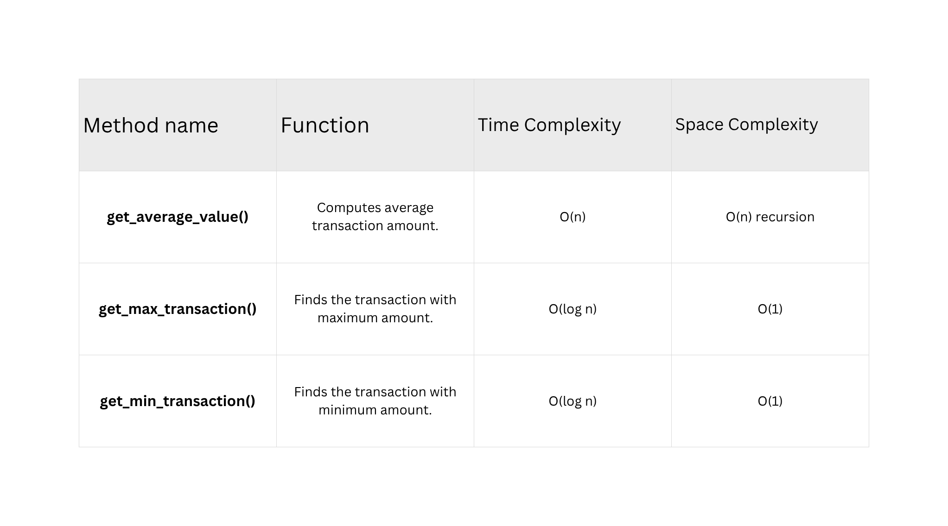
9
1

Slide 10
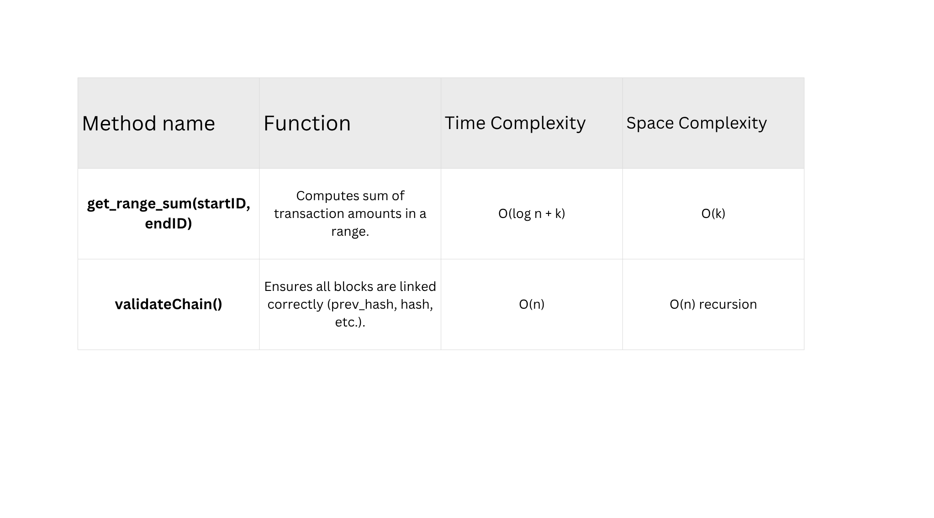
10

Slide 11
11
Time & Space Complexity Summary
O(log n): searchTransaction, insertTransaction, get_min_transaction, get_max_transaction
O(log n + k): rangeQuery, get_range_sum (k = # of results)
O(n): displayTransactions, get_total_transactions, get_average_value, validateChain
Space Complexity: Mostly O(1) for per-method operations, O(n) for recursion/results.
1

Slide 12
12
Why B-Trees Are Optimal for All 11 Methods
Balanced Tree: Keeps height low → insert, search, max/min all O(log n).
Multi-Key Nodes: Reduces disk accesses → practical for millions of transactions.
Supports Range Queries: Essential for rangeSum, rangeQuery, and statistics.
Dynamic Updates: Insertion & deletion handled efficiently, unlike hash tables.
Real-World Proven: Used in databases, file systems, and blockchain explorers.

Slide 13
13
Team Members
1.Amal U - CB.SC.U4CSE24204
2.Gopi Krishna P - CB.SC.U4CSE24221
3.Nishitha Kamalapathi - CB.SC.U4CSE24238
4.Golla Mohith - CB.SC.U4CSE24263
1

Slide 14
14
Thank you

