Slide 1
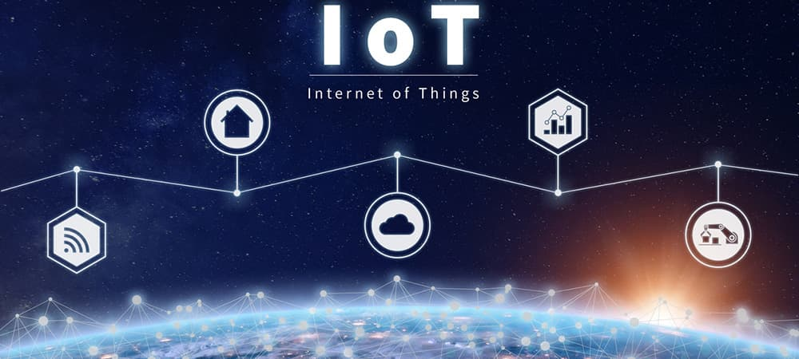
MaRS Open Project
Iot Based Water Pollution Monitoring System
Team-
Vishwa E.
Sanchit Singh
Mohith Reddy
Madhu Singh

Slide 2
Problem Statement-
To design a boat, embedded with sensors to get water quality parameters.
The sensor data is uploaded to an IoT platform facilitating easy monitoring of data from anywhere.

Slide 3
The first step towards controlling or checking water pollution is to determine the actual level of pollution. For this, we have designed a water pollution monitoring system embedded with temperature and turbidity sensors to provide us with data of water quality level. This is facilitated using an IoT platform online over which data is recorded and transmitted. The speed of servo motor is also controlled using IoT platform rather than using a RC system.
The data collected by sensors is sent to the cloud by using IoT based Blynk platform. The model is developed for testing water samples and the data sent over the internet is analyzed. This helps to alert the user when there is a certain deviation of water quality parameters from the pre-defined set of standard values.
As the variation in values of the parameter points towards the presence of pollutants, this system can be used to keep a check on pollution of water resources and provide an environment for safe drinking water.

Slide 4
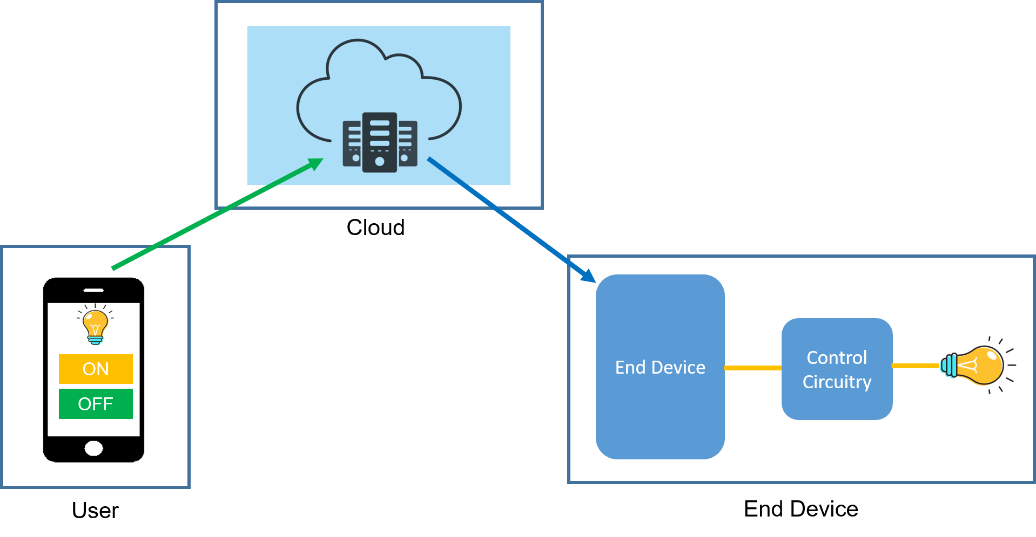
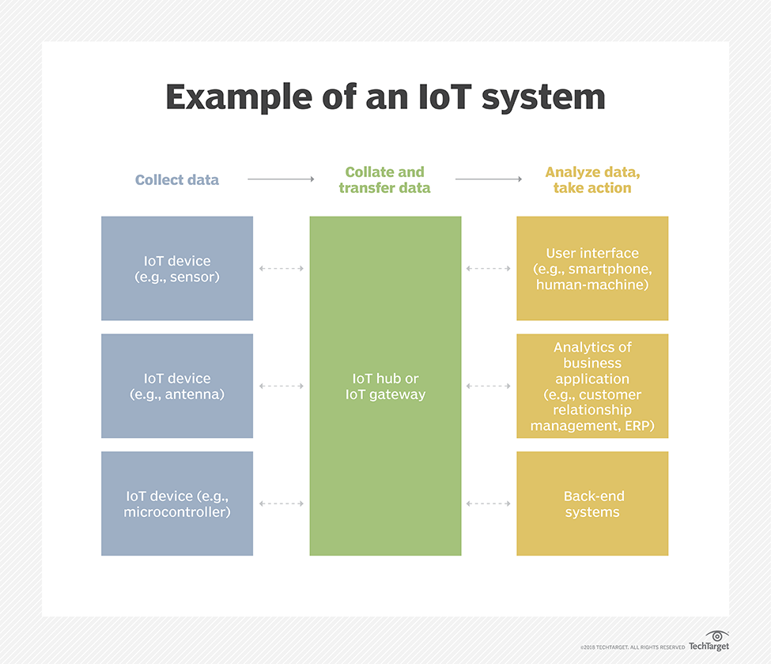
IoT
IoT i.e. Internet of Things refers to the interconnection of physical devices, such as appliances and vehicles, that are embedded with software and sensors enabling them to connect and exchange data. This technology allows for the collection and sharing of data from a vast network of devices, creating opportunities for more efficient and automated systems.

Slide 5
Components of the project model
DS18B20 Temperature sensor
Turbidity sensor
NodeMCU ESP32 board
BLDC motor
MG90S Servo Motor
Drive shaft and propellor
ESC
Rudder

Slide 6
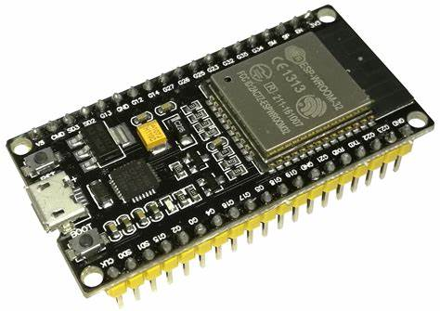
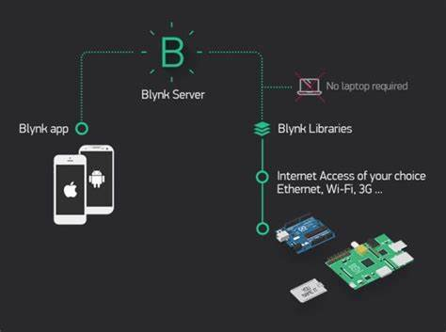
NodeMCU ESP32
NodeMCU stands for Node Microcontroller Unit. It is an open-source Lua-based firmware that is designed for IoT(Internet of Things) applications.
It comes with a microUSB interface that you can use to connect the board to your computer to upload code or apply power.
It uses the CP2102 chip (USB to UART) to communicate with your computer via a COM port using a serial interface.
Low cost
Supports Bluetooth and WiFi
Dual core
Blynk IoT Platform
Blynk is an IoT platform that allows the user to quickly build interfaces for remotely controlling and monitoring hardware projects using android device.

Slide 7
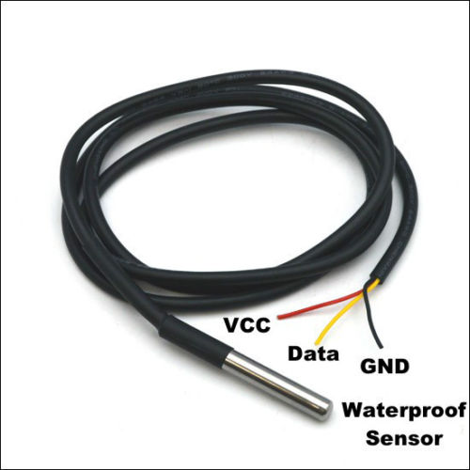
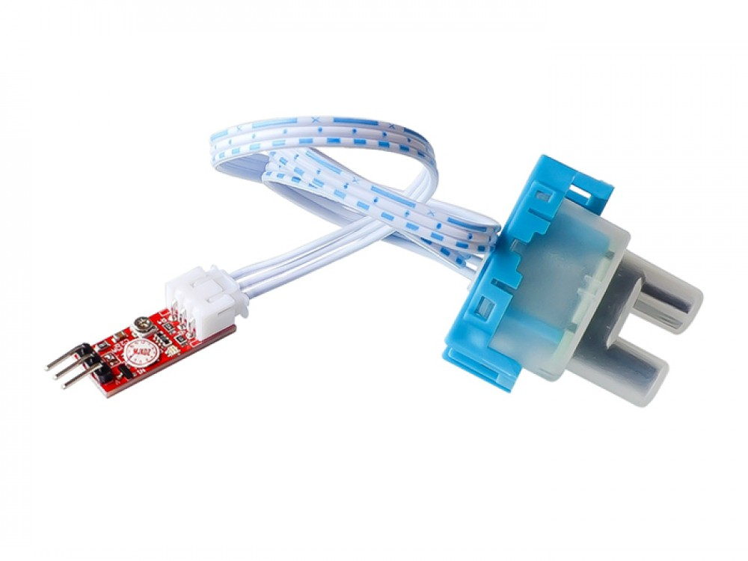
DS18B20 temperature sensor-
This is a long waterproof, sealed and pre-wired digital temperature sensor probe based on the DS18B20 sensor.
Usable temperature range: -55 °C to 125°C (-67°F to +257°F)
Uses 1-Wire interface- requires only one digital pin for communication
±0.5°C Accuracy from -10°C to +85°C
Usable with 3.0V to 5.5V power/data
Turbidity Sensor-
Turbidity is caused by suspended substances such as silt, clay, organic matter, plankton and microorganisms contained in the water.
The sensor uses optical principles to comprehensively judge the turbidity through the light transmittance and scattering rate in the solution.
Higher the suspended particles, higher the turbidity.
Digital and Analog output
Operating voltage: 5VDC
Current- 30mA
Operating Temperature: -30 °C to 80 °C

Slide 8
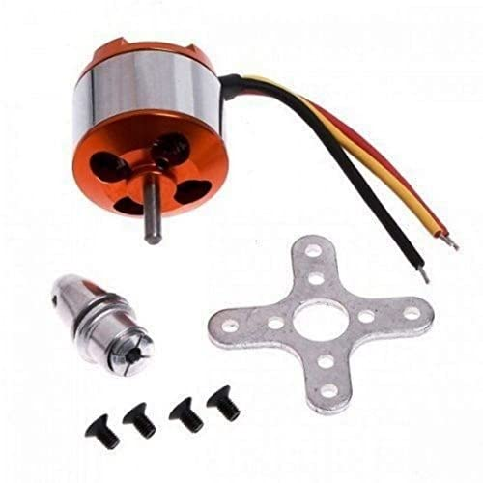
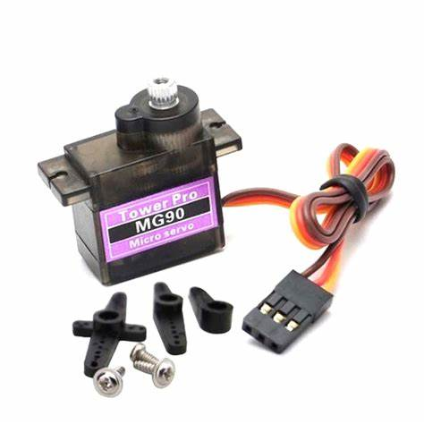
BLDC motor
Operating Voltage: 12volts
Dimensions: 7*5*5cm
Speed: 1000 RPM
MG90S Digital Servo Motor
Operating Voltage: 4.5V to 6V
Stall torque: 1.8kg/cm
Operating Speed: 0.1s/60 °
Rotation: 0 ° to 180 °
Drive shaft and propeller
Shaft length: 250mm
Shaft sleeve length: 200mm

Slide 9
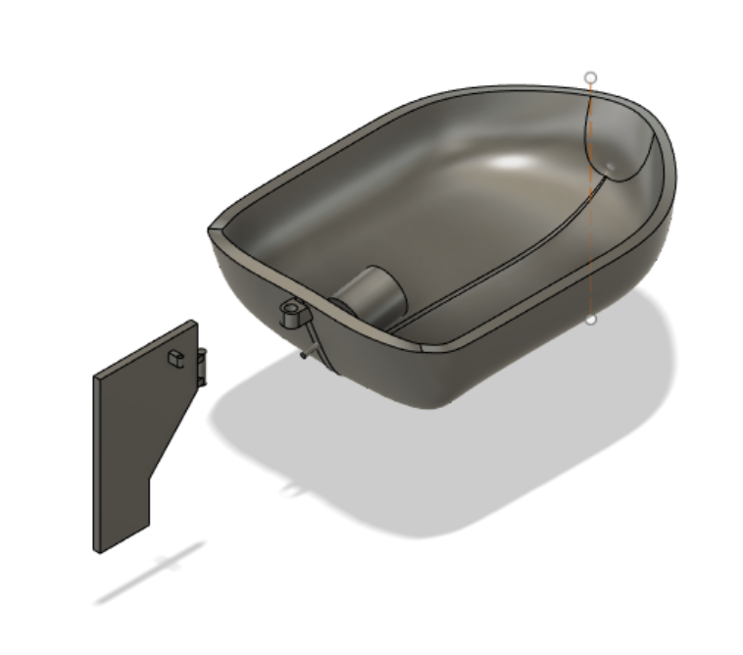
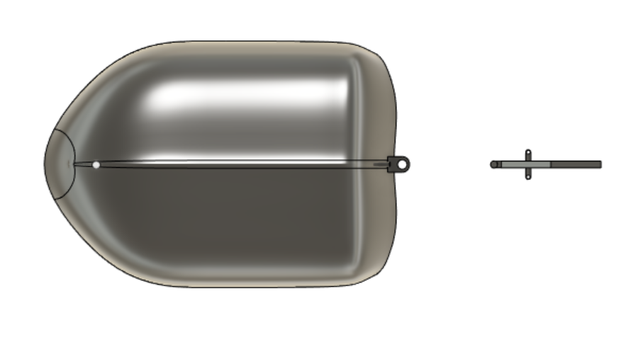
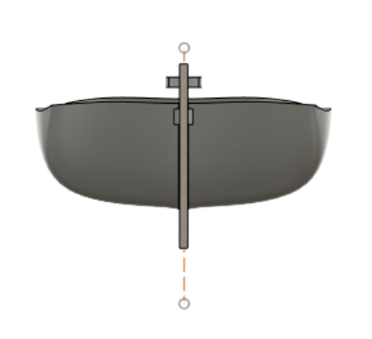

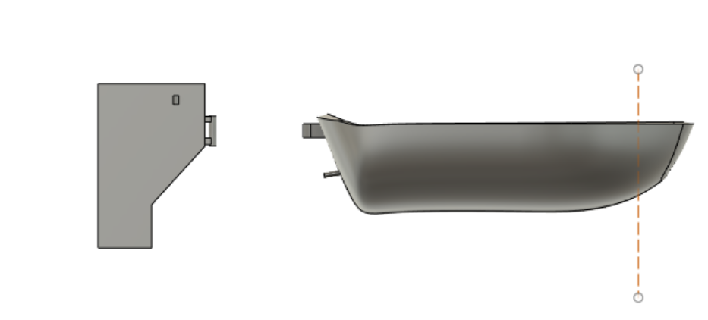
CAD Model
For designing the CAD model of our boat we have used Fusion 360 which is a cloud-based 3D modelling, CAD, CAM, CAE and PCB software platform for product design and manufacturing.
Here are some pictures of our CAD model designed using the software-
Final CAD Model
Top View
Back View
Front View
Side View

Slide 10
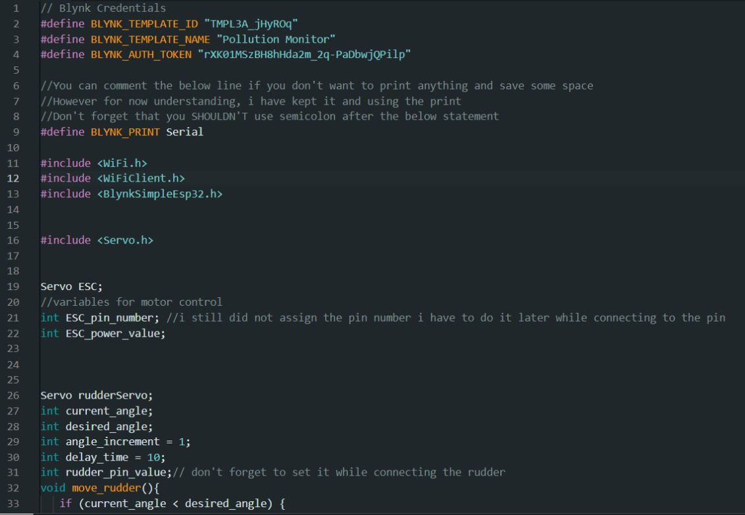
Code Snippets

Slide 11
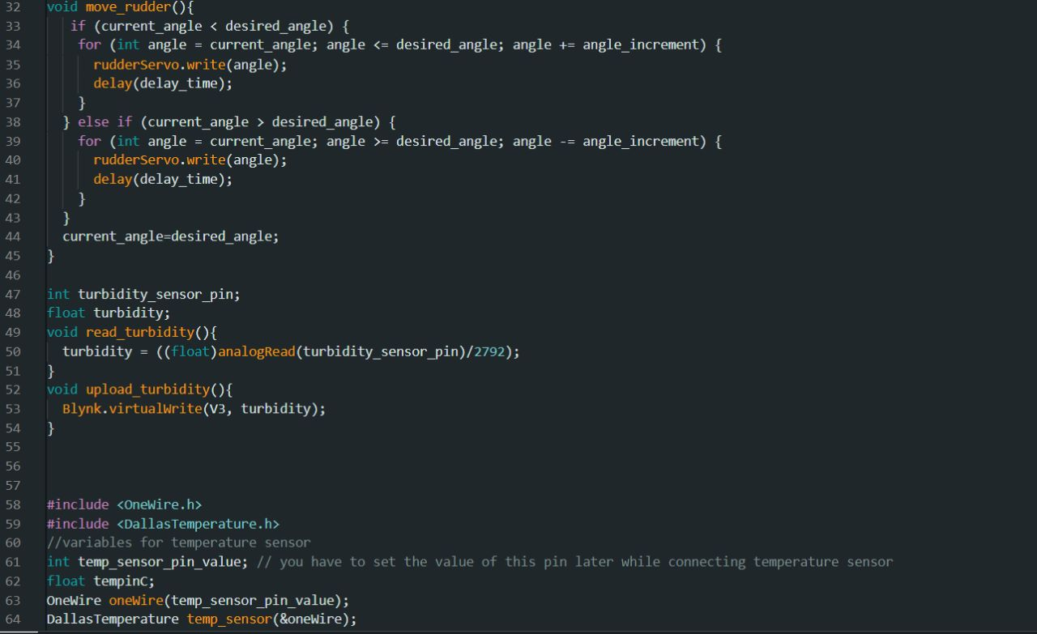
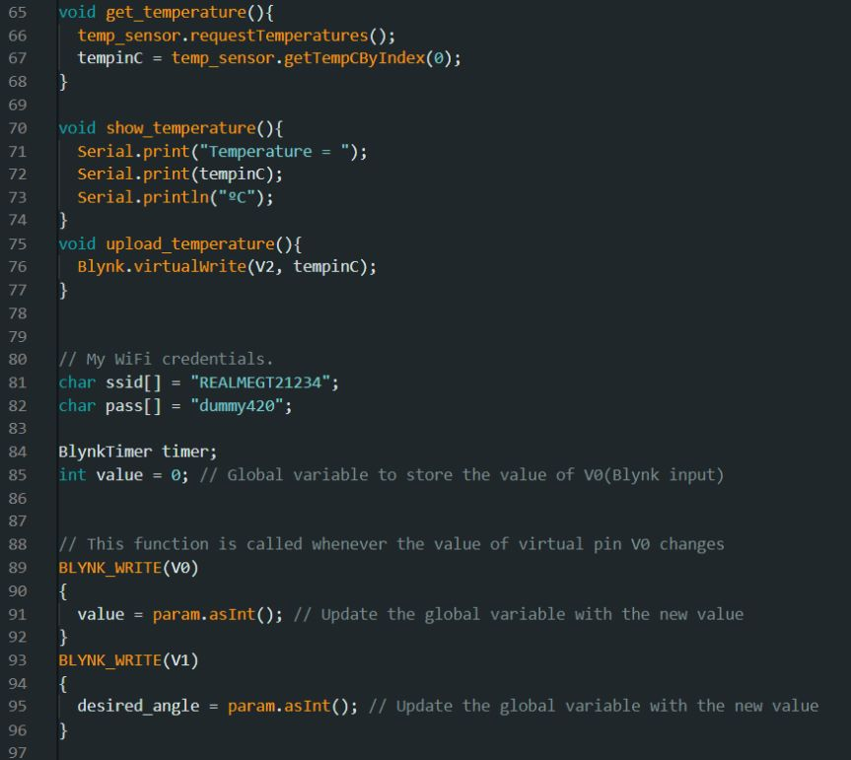

Slide 12
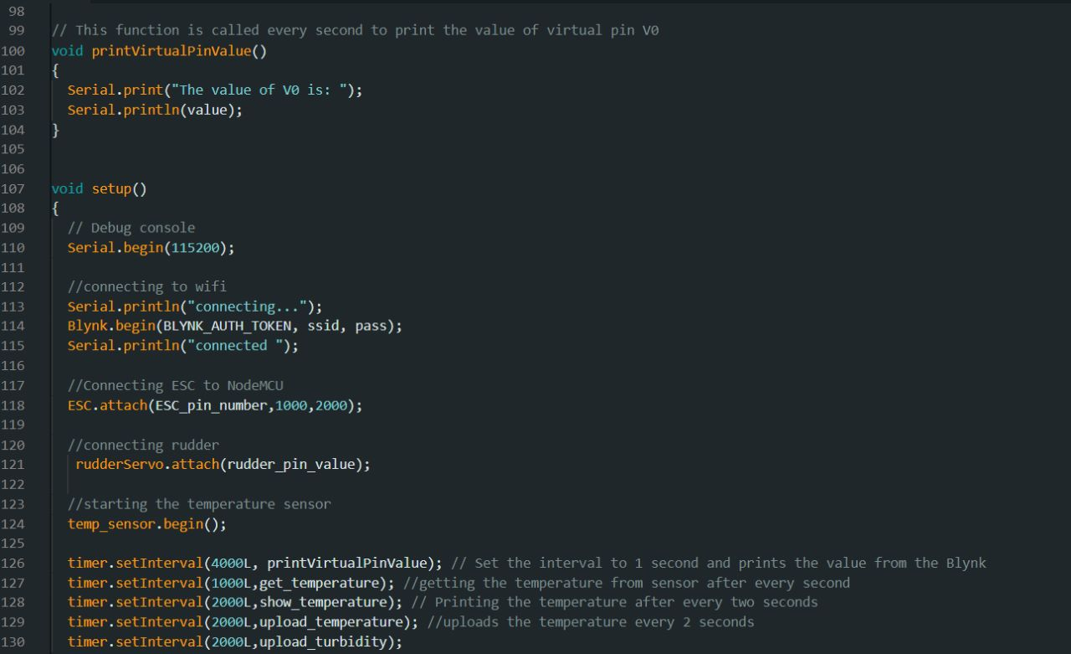
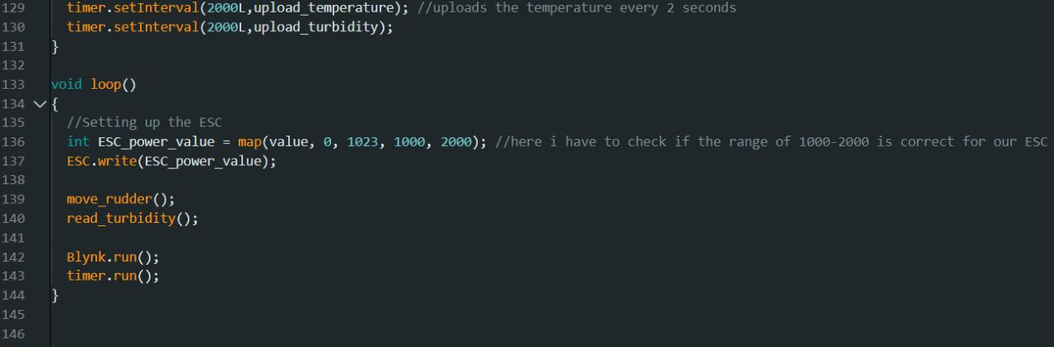

Slide 13
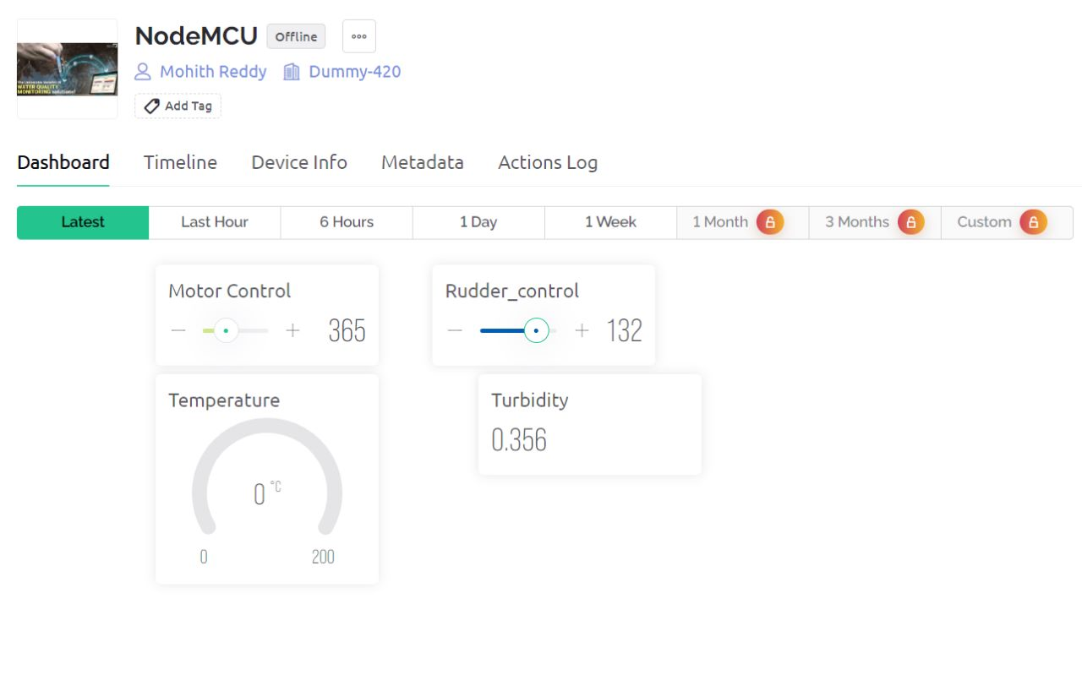
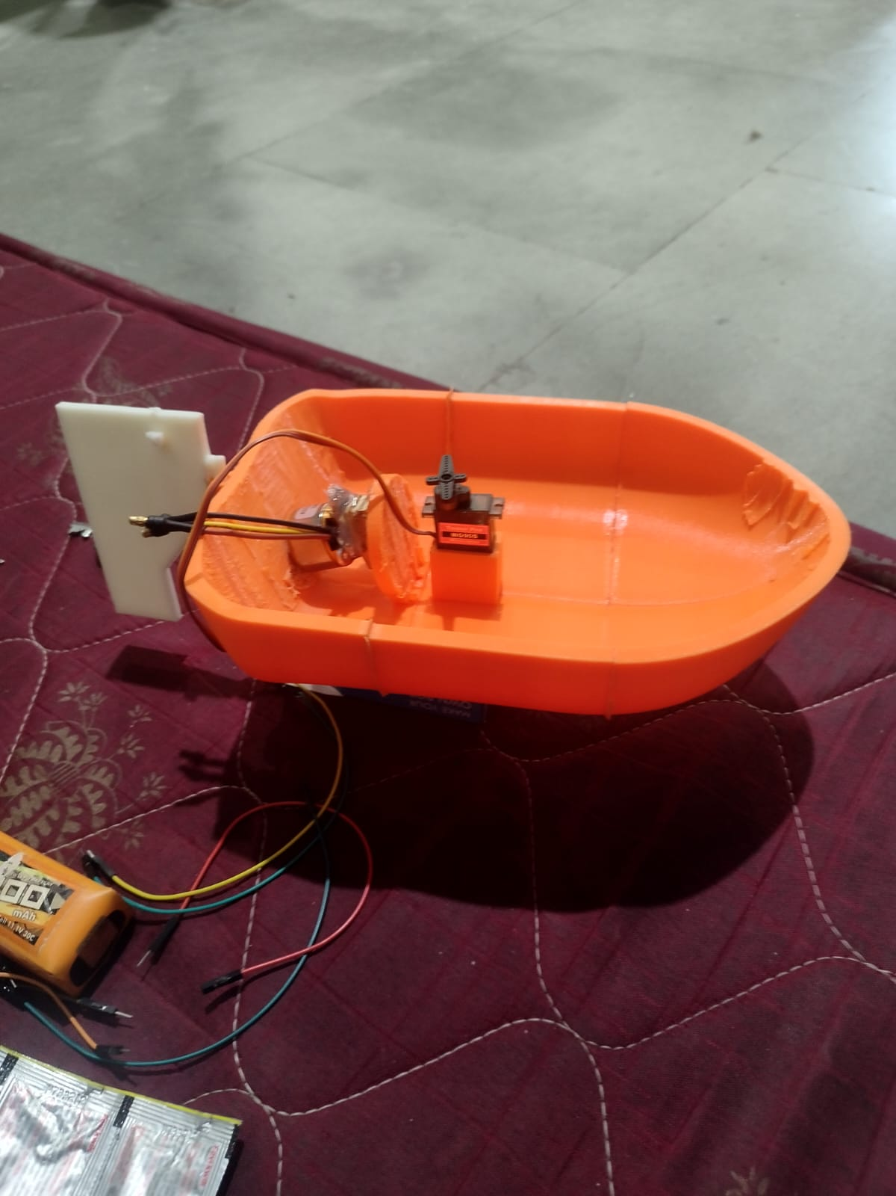
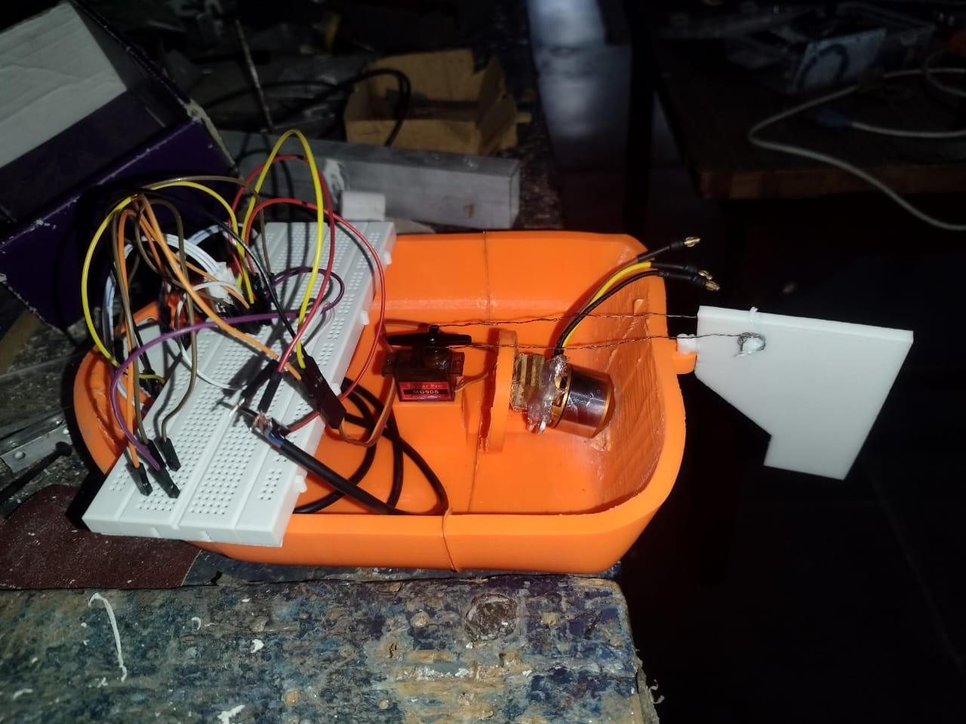
Final Model and Result

Slide 14
Individual contributions in the project-
Vishwa E. - Designing the CAD model of the boat, arranging the mechanical components and uploading sensor data to server
Sanchit Singh- Designing the hull of the boat, code for servo control and uploading sensor data to server
Mohith Reddy- Code for controlling the motor , to get input from Blynk, connections part and uploading sensor data to server
Madhu Singh- Determining and arranging the sensors to be used, connection of sensors to NodeMCU and uploading sensor data to server

Slide 15
Things we learnt from the project
Introduction to IoT and its use in day-to-day life.
We learnt how to create and work on CAD models.
We learnt that how can we upload and receive data over IoT platform using Arduino IDE, NodeMCU ESP32 and Blynk server.
We also got to know how we can control the servo by giving inputs over IoT.
This project really helped us to learn more about IoT, 3D modelling and introduced us to the use of different sensors.
Moreover, the most important thing that this open project taught us is teamwork. We got to work in a team where we could learn new things from our teammates and helped each other at different steps.

Slide 16
Problems we faced during the project-
We had problem interpreting the actual problem statement and that project was turning into a simple RC boat. So we got the problem statement modified later on.
We tried to use Blynk and ThingSpeak servers simultaneously but there was some problem in it so we continued with Blynk server only.
The first 3D model could not be printed properly so we had to go with our another model.

Slide 17
Further changes or developments that we would like to do in this project-
We would like to add some more sensors like pH sensor and dissolved oxygen sensor so that we can get a better set of values to correctly evaluate the pollution level in water source or body.
We would also like to add a GPS module which would provide us with the location of boat when used in big lakes or water bodies.
If we could manually connect NodeMCU to WiFi by introducing a new function in the code

Slide 18
THANK YOU

