Slide 1
CNN-LSTM based Image Captioning
Mohith Damarapati
md4289@nyu.edu

Slide 2
Introduction
Describing an image is an easy and obvious task for humans
But, is it so for machines?
No! Because they lack commonsense and intelligence
They cannot understand the meaning of context and content in the image
The problem of making machines to automatically describe an image in a natural language is referred as “Image Captioning”
It is an interesting problem because making machines understand the visual scene is an important sub goal of True AI

Slide 3
Artificial Intelligence
Computer Vision
Aims to make machines understand the visual scenes
Like an ‘eye’ to AI machine
Natural Language Processing
Aims to make machines understand and generate natural language
To converse with humans
Image Captioning Problem
Connects CV and NLP, two sub fields of AI
A baseball player swinging a bat at a ball
Generated by my model

Slide 4
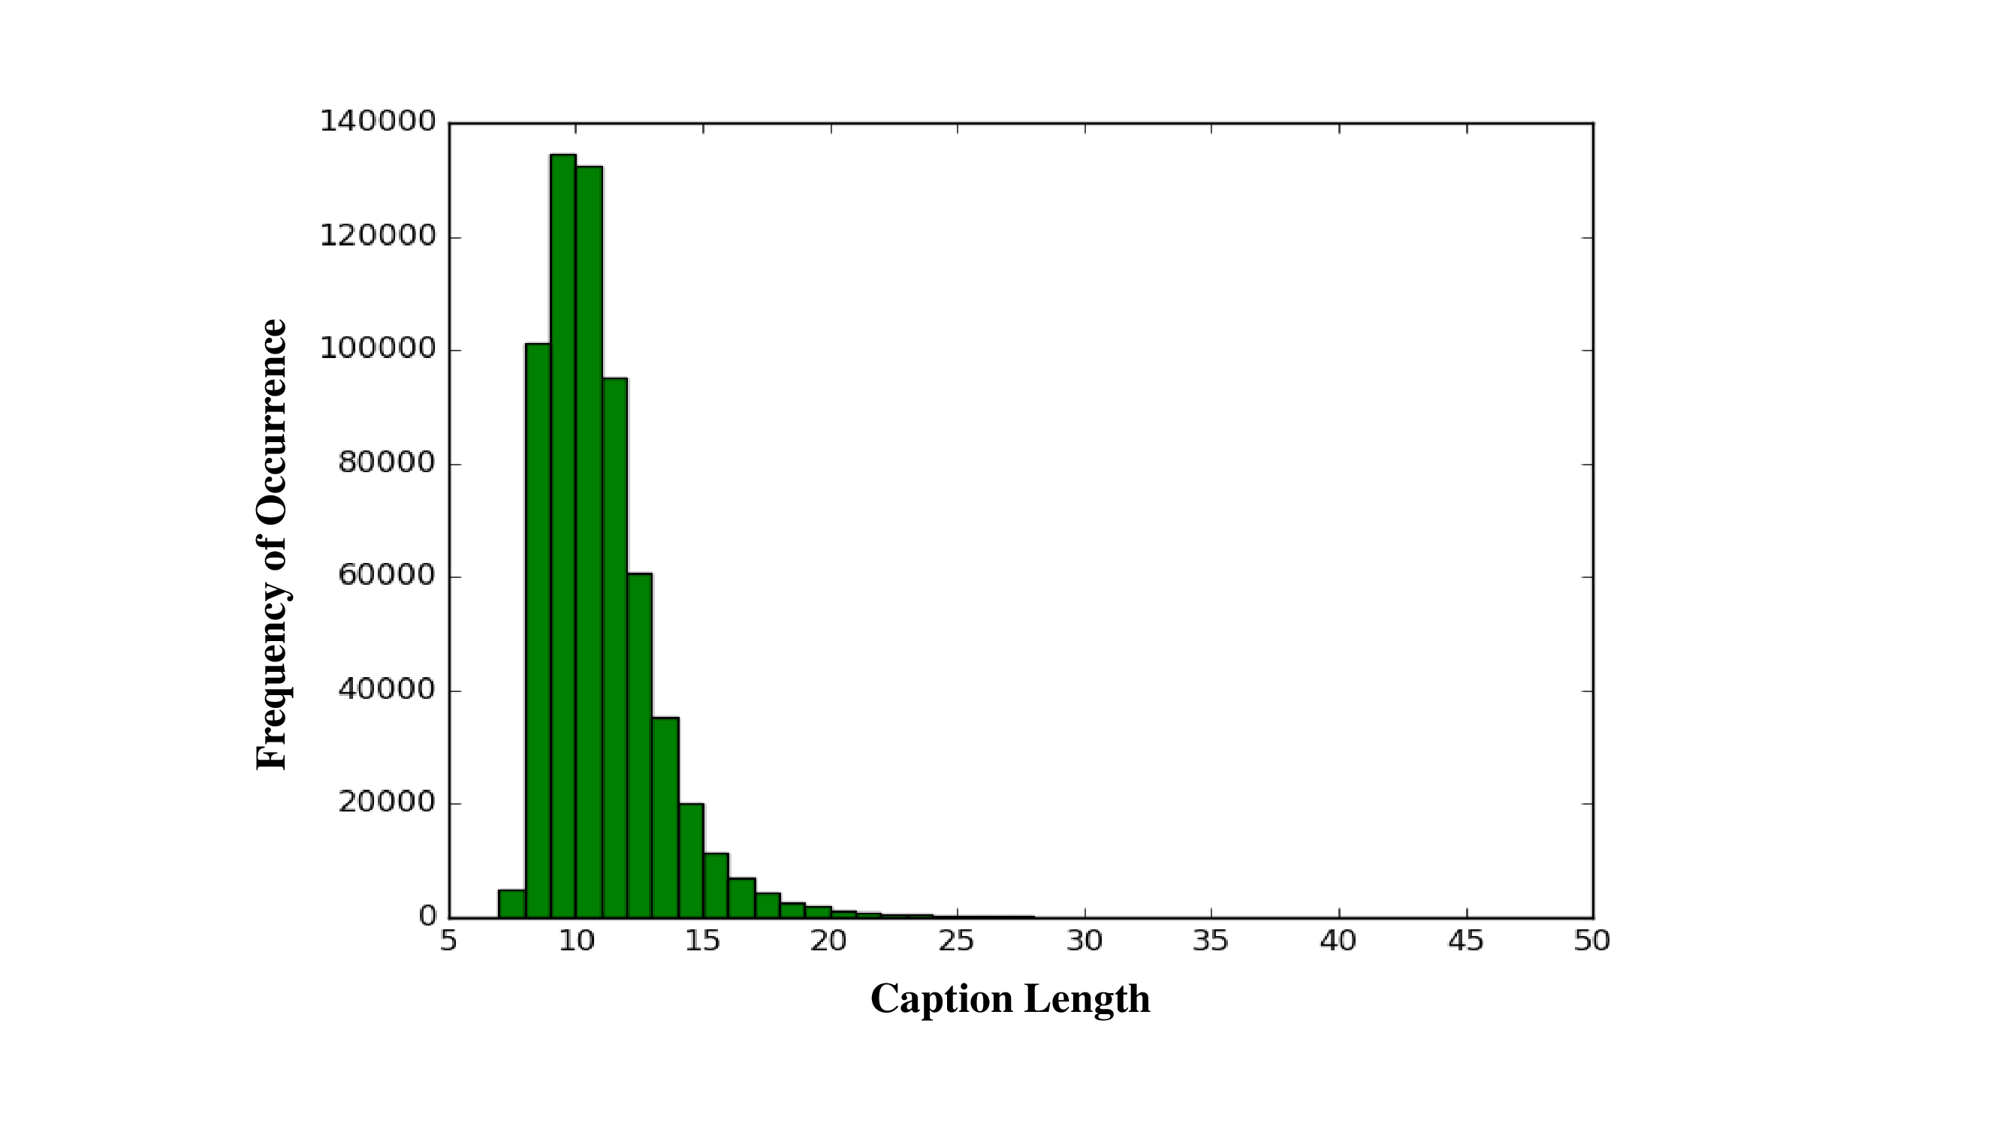

Dataset (MSCOCO)
MSCOCO dataset has a total of 82783 train images and 40592 test images
Each image has 5 captions on an average
Caption lengths vary from 7 to 57
REFERENCE CAPTIONS
Candles, pumpkins and skull decorations on table
A table topped with Halloween decorations and food
A table decorated with skulls, apples and oranges

Slide 5

CNN – LSTM Framework
CNNs provide a rich representation of the features which can be used for various vision tasks like classification, localization and detection
We also call the process of extraction of rich image features as learning disentangled representations
These disentangled representations are given as input to sequence models like RNN
In this project, I used the ResNet-101, which is pre-trained on the ImageNet data to capture image features
Features in the last layer of ResNet-101 after removing the fully connected layer are given as inputs to an LSTM, which is a modified version of an RNN
LSTM architecture is similar to the architecture used in NIC

Slide 6
Experiments
LSTM architecture is similar to NIC. Dimension of LSTM hidden states is 512 and word embedding is 256
Trained the model for LSTM layers ranging from 1 to 4
LSTM layers above 2 gave almost similar results, but there is a comparable difference in the results when compared to 1 layer
Batch size and learning rate are set as 64 and 0.001 respectively
Also, investigated the effect of minimum word frequencies of vocabulary set on the model
Minimum word frequency of 4 in the vocabulary set gave better results than 2 and 8

Slide 7

Results
MODEL | BLEU1 | BLEU2 | BLEU3 | BLEU4
LSTM - 4 | 74.22 | 57.28 | 36.18 | 20.61
LSTM - 3 | 74.3 | 57.32 | 36.42 | 20.98
LSTM - 2 | 74.14 | 57.24 | 36.26 | 20.7
LSTM - 1 | 72.82 | 55.43 | 34.12 | 19.99
Baseline Results
Model | BLEU4
Random Forest | 4.6
Nearest Neighbor | 9.9
Human | 21.7
NIC | 27.7
Deep Visual-Semantic | 23
Hard Attention | 25.0
Soft Attention | 24.3
My best model | 20.98
BEST BLEU4 = 20.98

Slide 8
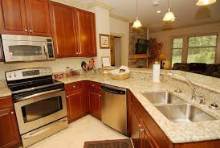
Results – Sample Captions generated by my model
A kitchen with a sink and a microwave
BLEU4: 0.397
Successful example
A couple of cows standing next to each other
BLEU4: 7.8Xe^-15
Failed example

Slide 9
Problems in the current captioning models
Lack distinctiveness: Images with similar kind of objects but different interactions between them are not captured accurately
Cannot do basic arithmetic: If model is trained with 2 cats playing, and if we test an image with 4 cats playing, current captioning models still caption it as 2 cats as they cannot understand arithmetic
Cannot capture deep meaning: Humans can infer deep meanings, but current captioning models cannot. For instance, if an image consists of a man petting a cat, humans can infer the love shown towards the cat, but machine can only describe that a man is rubbing cat’s fur

Slide 10
ResNet152
Pretrained on ImageNet
A baseball player swinging a bat at a ball
LSTM
LSTM
LSTM
LSTM
LSTM
LSTM
LSTM
LSTM
LSTM
Embedding
Caption

