Slide 1
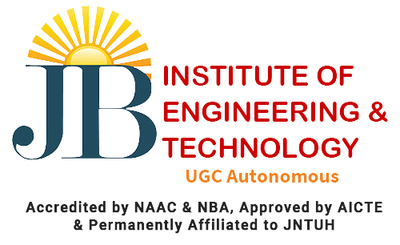


ROBOTIC DEVICE FOR BOREWELL RESCUE
OPERATION
Team Members:
K.Naga Mohith
G.Vasanth
V.Rahul
Ch.Deepthi
B.Nimisha
T.Rithika

Slide 2
CONTENTS
Introduction
Necessity
Existing system
Proposed System
System architecture
Future scope
Conclusion

Slide 3
INTRODUCTION
Borewell rescue robots are specialized devices designed for the critical task of rescuing individuals, especially children, trapped in borewells. These robots are equipped with features such as robotic arms for comfort and safety during rescue operations, pulley and rope mechanisms for accessing the child and providing visual surveillance , and Lab view software for manual control . They often incorporate metallic wire(with measurements) and cameras to monitor the child's depth and condition, allowing for precise rescue methods . These robotic systems play a critical role in saving lives when children fall into uncovered borewells, making rescue operations more efficient and safe .

Slide 4
NECESSITY
The necessity for borewell rescue robots is driven by the urgent need to save lives in critical situations where individuals, particularly children, become trapped in open borewells unknowingly. These robots are designed to access narrow and deep borewells, which are often challenging for manual rescue operations. Key factors include:
Safety
Efficiency
Precision
Minimization of Human Error
Versatility
Remote and continuous operation

Slide 5
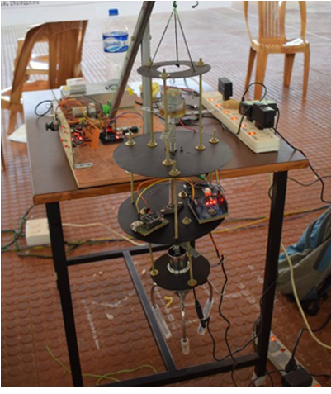
EXISTING SYSTEM
It is widely using but the rescue rate is low rate.
Due to the mechanical arms some times the arms are entering in to the body .
Some times it may cause Damage to the body parts or the human and sometimes it leads to death.
And due to improper development of the product it losses it holding capacity

Slide 6
PROPOSED SYSTEM
Initial Assessment: A camera is sent into the borewell to assess its dimensions and condition of a child.
Robotic Deployment: Once we know the borewell's size and condition, specialized robotic arms and an inflatable object are dispatched via a strong metallic cable.
Manipulation Capability: These robotic arms are designed for precise object handling and retrieval tasks.
Inflatable Utility: The inflatable object, often resembling a football, serves multiple purposes, such as risk mitigation or structural support within the borewell.
Life Support: An oxygen cylinder is provided to ensure the trapped individual's safety by sustaining their respiratory needs.

Slide 7
ADVANTAGES
Swift Response: The system allows for rapid deployment, reducing rescue time and increasing the chances of saving lives.
Remote Assessment: It enables remote visual assessment of the borewell's conditions, ensuring informed decision-making.
Precise Measurement: The camera accurately measures the width of the borewell, ensuring that rescue equipment fits without issues.
Versatile Robotic Arms: The robotic arms can perform delicate maneuvers, providing greater control during rescue operations.
Inflatable Football: The use of an inflatable football minimizes the risk of injury to the trapped individual and aids in creating space for rescue.

Slide 8
Oxygen Supply: The provision of an oxygen cylinder ensures that the trapped person has access to a crucial life support element.
Minimized Human Risk: By reducing the need for human entry into the borewell, the system minimizes the risk to rescue personnel.
Cost-Effective: The system offers a cost-effective solution compared to traditional rescue methods.
Enhanced Safety: It enhances the safety of both the trapped individual and the rescuers, reducing potential hazards.
Scalability: The system can be adapted for various borewell sizes and conditions, making it versatile and applicable in different scenarios.

Slide 9
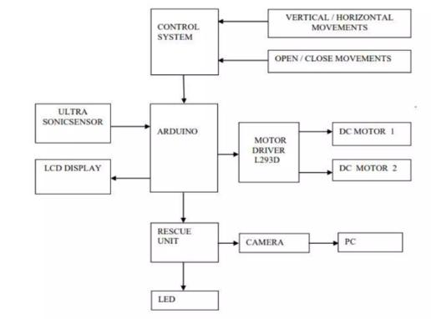
SYSTEM ARCHITECTURE

Slide 10
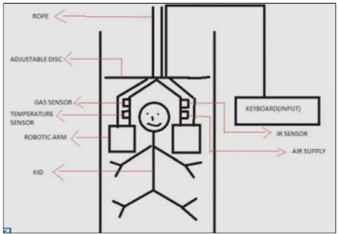
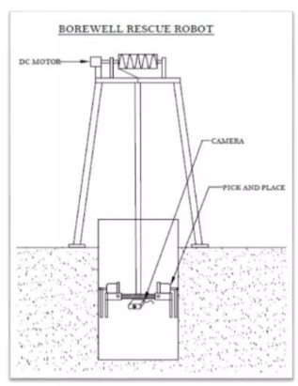
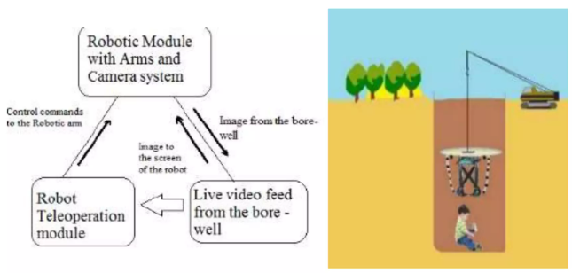
REFERENCE IMAGES

Slide 11
FUTURE SCOPE
AI-Driven Decision Support by using Advanced AI algorithms will provide real-time decision support, suggesting optimal rescue strategies based on the specific borewell conditions. Environmental Monitoring by Nano-sensors can detect changes in the borewell environment, including toxic gases, which can provide early warnings and protect both the trapped individual and the rescue team. Cost Reduction Work on cost-effective designs and manufacturing processes to make these robots more accessible to rescue organizations, especially in regions where borewell accidents are common.

Slide 12
CONCLUSION
These robots are getting smarter and tougher, which means they can help save more lives during disasters. They can go to dangerous places where humans might be at risk, like collapsed buildings. Using fancy technology like artificial intelligence and drones, they can find people who need help faster. And they can even give basic medical assistance. This means rescue missions will be quicker and safer for everyone involved. So, in the future, these robots will be like superheroes, helping us when we need it most

Slide 13
Thank You

