Slide 1
Incentives based Design for onboarding Legal Service Providers such as Advocates, Arbitrators, Mediators, Notaries, Document Writers, etc on eMarket Place for extending Legal Services to Citizens in India
CSE7101- Capstone Project
Review-1
Batch Number: CSE_166
Roll Number | Student Name
20221CSE0363 | YASHAVNTH K S
20221CSE0325 | LANCHAN J
20221CSE0328 | MOHITH GOWDA J P
Under the Supervision of,
Dr.B Chandrashekar
Assistant Professor
School of Computer Science and Engineering
Presidency University
Name of the Program: Computer Science and Engineering
Name of the HoD: Dr. Asif Mohammed , Dr. Blessed Prince
Name of the Program Project Coordinator: Dr. Jayavadivel Ravi, Mr.Muthuraju V
Name of the School Project Coordinators: Dr. Sampath A K , Dr. Geetha A

Slide 2
PS
Organization: Ministry of Law and Justice
Category (Hardware / Software / Both) : Software
Problem Description:
India’s legal service sector is fragmented, with advocates, mediators, notaries, and others operating independently without a centralized platform. This creates challenges in transparency, accessibility, quality assurance, and affordability for citizens. The objective is to design an incentivized eMarketplace that onboards legal service providers, motivates them through rewards and gamification, ensures quality and accountability, and enables citizens from all socio-economic backgrounds to easily find and access suitable legal services. Integration with legal institutions such as courts, bar associations, and legal aid clinics will further enhance trust and service reach.

Slide 3
Problem Statement
The legal service sector in India, despite its crucial role in upholding justice, remains largely unorganized. Citizens often face multiple barriers in accessing legal assistance, such as:
Lack of visibility of service providers (advocates, arbitrators, mediators, notaries, document writers, etc.).
Geographical constraints, particularly in rural or semi-urban regions.
Unclear pricing structures, leading to trust issues.
Limited transparency in service quality and provider credibility.

Slide 4
Objectives
The primary goal is to design and develop an incentivized eMarketplace that:
Onboards verified legal service providers from across India.
Incentivizes participation using financial, reputational, and gamification-based rewards.
Ensures transparency and accountability in service delivery.
Improves accessibility for citizens from all socio-economic backgrounds.
Facilitates efficient client-provider matching based on needs, expertise, and availability.

Slide 5
Background and Related work for title Selection
India’s legal services remain largely unorganized, creating barriers in transparency, quality, and accessibility.
Existing platforms (LawRato, VakilSearch) focus on limited segments, lacking performance-based incentivization and wider inclusivity.
Government efforts like NALSA and Tele-Law provide significant outreach but are not integrated into a single eMarketplace.
Research highlights that verified profiles, transparent ratings, and gamified rewards can attract, retain, and motivate legal service providers effectively.

Slide 6
Analysis of Problem Statement
The unorganized sector accounts for about 90% of India’s workforce, highlighting the scale of informality across sectors including legal services.
India’s legal profession is the world’s second largest, with over 600,000 lawyers practicing nationwide.
Online legal marketplaces like LawRato and Vakilsearch currently serve urban and niche clientele but lack comprehensive incentivization models for providers and broader accessibility.
In 2022, about 25 million cases were filed and approximately 23 million cases disposed of by district judiciary courts across India, showing the huge volume of legal service demand.

Slide 7
Innovation & Novel Contribution
Integrated Workflow – Combines student application, approval, attendance, fee management, and online classes in one seamless platform.
Automated Credentials & Notifications – Generates student login credentials automatically upon approval and sends them via email, reducing admin effort.
Batch-wise & Mode-specific Scheduling – Handles online/offline scheduling dynamically, ensuring personalized timetables.
Incentive-driven Service Model (for Legal Services Project) – Uses gamified rewards and reputation scores to encourage legal service providers to maintain high service quality.
Transparent Fee Tracking – Provides a dual-view fee system for admins (batch-wise, student-wise) and students (payment history, dues).
Cross-platform Accessibility – Responsive frontend ensures smooth use across desktop and mobile without separate apps.

Slide 8
Analysis of Problem Statement
Solutions
Centralized eMarketplace to connect citizens with verified legal service providers (advocates, arbitrators, mediators, notaries, document writers, etc.).
Incentive Mechanisms:
Monetary rewards for case completions.
Badges, ratings, and leaderboards via gamification.
Discounts on platform fees for consistent service quality.
Institutional Verification with Bar Councils, arbitration bodies, and notary authorities for trust and credibility.
Intelligent Matching algorithm to pair clients with the most suitable providers.
Inclusive Design to ensure affordability and accessibility for citizens from all socio-economic backgrounds.

Slide 9



Analysis of Problem Statement
Technology Stack Components:
1. Frontend (User Interface): React.js
2. Backend (Server-side Logic): Java
3. Database (Data Storage): MySQL
4. Security & Authentication: JWT
5. Integration Services
APIs: Integration with court systems, legal aid clinics, bar associations.
6. Deployment:
Frontend: Vercel /Netlify (React.js)
Backend: Render (Java)
Database: RemoteMySQL.com

Slide 10
Analysis of Problem Statement (contd...)
Software and Hardware Requirements:
Software Requirements | Hardware Requirements
Operating System: Windows 10 | Processor: Intel Core i5 or higher
Backend: Java Spring Boot (v3.x) | RAM: 8 GB or more
Frontend: React.js (v18+) | Storage: 256 GB SSD or higher
Database: MySQL (v8.0+) | Display: 1080p Full HD monitor
Authentication: JWT / Firebase Auth | Network: Stable broadband internet (10 Mbps+)
Web Server: Apache Tomcat 10+ | Peripherals: Keyboard, mouse
Build Tools: Maven | Optional: UPS for power backup
Payment Integration: Razorpay | —

Slide 11
Github Link
The Github link provided should have public access permission.
GitHub Link:
https://github.com/Mohith4488/Capstone-project-legal-service-adviser

Slide 12
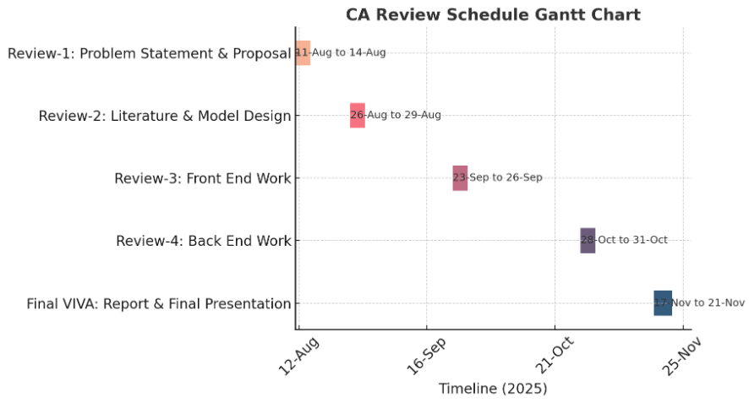
Timeline of the Project (Gantt Chart)

Slide 13
References (IEEE Paper format)
  [1] S. K. Tripathi and P. K. Jain, "Digital transformation of legal services in India: Opportunities and challenges," International Journal of Law and Technology, vol. 12, no. 3, pp. 45-58, Sep. 2022.
  [2] M. R. Gupta and A. Singh, "Incentive mechanisms for online marketplace service provider onboarding," IEEE Transactions on Engineering Management, vol. 67, no. 1, pp. 112-123, Feb. 2020.
  3] A. Das and R. Kumar, "Designing reputation systems for multi-sided digital marketplaces," Proceedings of the 18th ACM Conference on Electronic Commerce, pp. 189-198, June 2017.

Slide 14


