Slide 1
Incentives based Design for onboarding Legal Service Providers on eMarket Place
CSE7101- Capstone Project
Review-2
Batch Number: CSE_166
Roll Number | Name
20221CSE0363 | YASHAVANTH K S
20221CSE0325 | LANCHAN J
20221CSE0328 | MOHITH GOWDA J P
Under the Supervision of,
Dr.B Chandrashekar
Assistant Professor
School of Computer Science and Engineering
Presidency University
Name of the Program: B.Tech Computer Science and Engineering
Name of the HoD: Dr. Asif Mohammed , Dr. Blessed Prince
Name of the Program Project Coordinator: Dr. Jayavadivel Ravi, Mr. Muthuraju V
Name of the School Project Coordinators: Dr. Sampath A K , Dr. Geetha A

Slide 2
Content
Problem Statement
Abstract
Literature Survey
Objectives
Existing Methods and Drawbacks
Proposed Methods and Feasibility Study
Architecture Diaagram
Modules
Hardware and Software Details
Timeline of the Project
References

Slide 3
Problem Statement
Organization: Ministry of Law and Justice
Category : Software
Problem Description:
India’s legal service sector is fragmented, with advocates, mediators, notaries, and others operating independently without a centralized platform. This creates challenges in transparency, accessibility, quality assurance, and affordability for citizens. The objective is to design an incentivized eMarketplace that onboards legal service providers, motivates them through rewards and gamification, ensures quality and accountability, and enables citizens from all socio-economic backgrounds to easily find and access suitable legal services. Integration with legal institutions such as courts, bar associations, and legal aid clinics will further enhance trust and service reach.

Slide 4
Abstract
Access to legal services is challenged in India as a result of lack of transparency, affordability, and difficulty in finding the right professionals available to citizens. This project displays a way to centralize a new type of e-Marketplace that connects citizens to legal service providers that are verified. Legal professionals could include advocates, arbitrators, mediators, notaries, and document writers situated in any city in India. The platform also developed pricing structures for aggregated services that include an incentive program for participation including financial rewards if completed on time, gamified features like badges and leaderboards, discounted platform time for multi-year use and verified services. Providers participate most in an institutional manner through Bar Councils, arbitration boards, and notary authorities. Our system uses an intelligent algorithm that can match all clients with the best legal professional based on case type, area of expertise, and availability. This system is intended to be inclusive, affordable, and available to all citizens, regardless of socio-economic background. This will provide transparency, efficiency, and accountability in the legal profession.

Slide 5
Literature Survey

Slide 6
Objectives
The primary goal is to design and develop an incentivized eMarketplace that:
Onboards verified legal service providers from across India.
Incentivizes participation using financial, reputational, and gamification-based rewards.
Ensures transparency and accountability in service delivery.
Improves accessibility for citizens from all socio-economic backgrounds.
Facilitates efficient client-provider matching based on needs, expertise, and availability.

Slide 7
Existing Methods and Drawbacks
E-Governance & Legal Aid Platforms (eCourts, Nyaya Bandhu, NALSA)
Only voluntary/pro-bono incentives → very low uptake.
Awareness gap among advocates.
Poor UI/UX, not mobile-friendly.
Professional Networking & Legal Startups (LawRato, VakilSearch, LegalKart)
Biased rankings—big firms dominate, new lawyers invisible.
Clients can’t judge quality until after service.
Data privacy concerns (sensitive case data).
Freelance & Gig Platforms (Upwork, Fiverr, UrbanCompany-style)
Anyone can register → unverified/low-quality providers.
Legal services become “commoditized” like gigs → not suitable for serious cases
Legal Tech Startups in India
Legal Tech Startups in India

Slide 8
Proposed Methods and Feasibility Study
Verified Digital Onboarding → Bar Council ID, Aadhaar/DigiLocker, License checks.
AI-Powered Matching → Clients matched with lawyers by specialization, location, language.
Gamified Incentives → Badges, leaderboards, tiers (Bronze → Gold → Platinum).
Financial-Based Rewards → Providers will be eligible for financial bonuses for timely completion of services based on feedback and badges.
Participation of all legal service providers →All the legal service providers like advocates, lawyers, arbitrators, mediators, notaries and document writers.
Accessibility for all citizens →All the citizens can assess this easily without and need of other just like other apps.

Slide 9
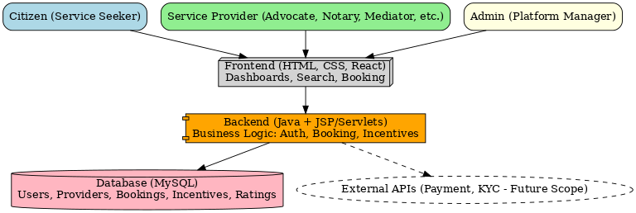
Architecture Diagram

Slide 10
System architecture diagram
The above diagram represent the system architecture of the e-Marketplace for legal services. It demonstrates the interaction of the three primary users:
Citizens, who use the system as Service Seekers.
Service Providers who provides the services.
Admin Users, interact with the core system components.
Citizens (Service Seekers) use the Frontend (HTML, CSS, React) component to access the e-Marketplace system to search for a provider, make a booking, or submit feedback.
Service Providers (Advocates, Notaries, Mediators, Arbitrators, Document Writers, etc.) use the same Frontend component to manage their profile, accept/reject a booking, or view their incentive dashboard.
Admin (Platform Manager) will use the relatively small Admin component of the e-Marketplace system to verify providers, or resolve disputes, or configure incentives.

Slide 11
System architecture diagram
All user requests will be served from the Backend (Java with JSP/Servlets), where business logic for authentication, management of bookings for service seekers, and incentives for service providers will all reside.
MySQL Database will serve as the repository for the all user details, provider credentials, bookings, incentives, ratings, and transactions reporting.
Further, the high-level architecture accommodates for External APIs such as Payment Gateways for secure online transactions, and KYC Verification APIs to verify legal service providers in a convenient manner. These components are noted in the diagram as optional elements for future enhancement.
In total, the e-Marketplace system architecture provides for a modular and scalable, safe and efficient interaction of users, and responsible management of data.

Slide 12
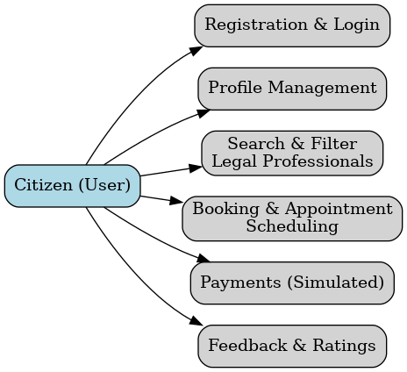
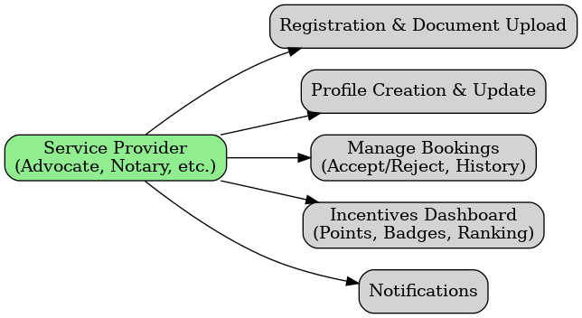
Modules
Citizen Module
Service Provider Module

Slide 13
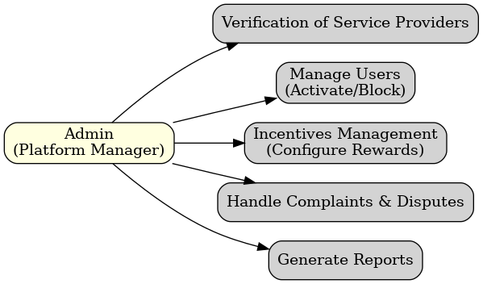
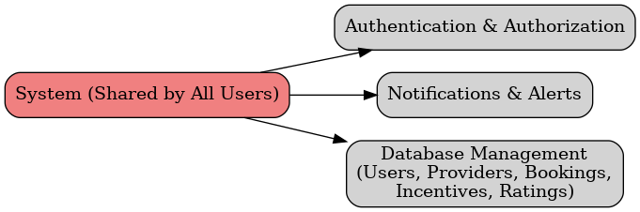
Modules
Admin Module
Common/Shared Modules

Slide 14



Technology Stack Components
1. Frontend (User Interface): HTML, CSS, Reactjs
2. Backend (Server-side Logic): Java
3. Database (Data Storage): MySQL/MongoDB
4. Security & Authentication: JWT
5. Integration Services
APIs: Integration with court systems, legal aid clinics, bar associations.
6. Deployment:
Frontend: Vercel /Netlify (React/Next.js)
Backend: Render or Railway (Java)
Database: MongoDB Atlas

Slide 15
Software and Hardware Requirements
Software Requirements | Hardware Requirements
Operating System: Windows 10 | Processor: Intel Core i5 or higher
Backend: Java Spring Boot (v3.x) | RAM: 8 GB or more
Frontend: React.js (v18+) | Storage: 256 GB SSD or higher
Database: MySQL (v8.0+) | Display: 1080p Full HD monitor
Authentication: JWT / Firebase Auth | Network: Stable broadband internet (10 Mbps+)
Web Server: Apache Tomcat 10+ | Peripherals: Keyboard, mouse
Build Tools: Maven / Gradle | Optional: UPS for power backup
Payment Integration: Razorpay | —

Slide 16
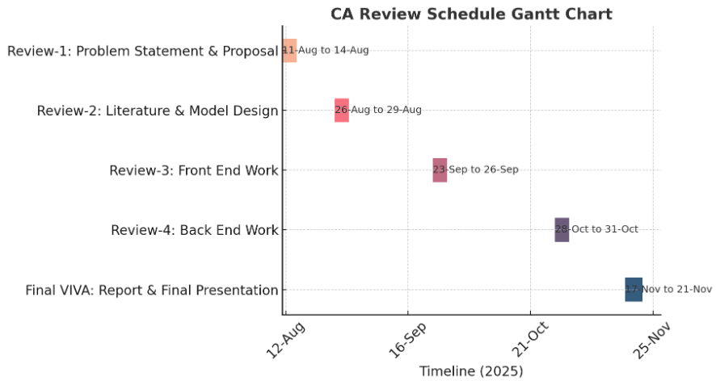
Timeline of the Project (Gantt Chart)

Slide 17
References (IEEE Paper format)
  [1] S. K. Tripathi and P. K. Jain, "Digital transformation of legal services in India: Opportunities and challenges," International Journal of Law and Technology, vol. 12, no. 3, pp. 45-58, Sep. 2022.
  [2] M. R. Gupta and A. Singh, "Incentive mechanisms for online marketplace service provider onboarding," IEEE Transactions on Engineering Management, vol. 67, no. 1, pp. 112-123, Feb. 2020.
  3] A. Das and R. Kumar, "Designing reputation systems for multi-sided digital marketplaces," Proceedings of the 18th ACM Conference on Electronic Commerce, pp. 189-198, June 2017.

Slide 18


