Slide 1
Incentives based Design for onboarding Legal Service Providers on eMarket Place
CSE7101- Capstone Project
Review-5
Batch Number: CSE_166
Roll Number | Name
20221CSE0363 | YASHAVANTH K S
20221CSE0325 | LANCHAN J
20221CSE0328 | MOHITH GOWDA J P
Under the Supervision of,
Dr.B Chandrashekar
Assistant Professor
School of Computer Science and Engineering
Presidency University
Name of the Program: B.Tech Computer Science and Engineering
Name of the HoD: Dr. Asif Mohammed
Name of the Program Project Coordinator: Dr. Jayavadivel Ravi
Name of the School Project Coordinators: Dr. Sampath A K , Dr. Geetha A

Slide 2
Content
Problem Statement
Abstract
Literature Survey
Objectives
Existing Methods and Drawbacks
Proposed Methods and Feasibility Study
Architecture Diaagram
Modules
Timeline of the Project
Results
References

Slide 3
Problem Statement
Organization: Ministry of Law and Justice
Category : Software
Problem Description:
India’s legal service sector is fragmented, with advocates, mediators, notaries, and others operating independently without a centralized platform. This creates challenges in transparency, accessibility, quality assurance, and affordability for citizens. The objective is to design an incentivized eMarketplace that onboards legal service providers, motivates them through rewards and gamification, ensures quality and accountability, and enables citizens from all socio-economic backgrounds to easily find and access suitable legal services. Integration with legal institutions such as courts, bar associations, and legal aid clinics will further enhance trust and service reach.

Slide 4
Abstract
Access to legal services is challenged in India as a result of lack of transparency, affordability, and difficulty in finding the right professionals available to citizens. This project displays a way to centralize a new type of e-Marketplace that connects citizens to legal service providers that are verified. Legal professionals could include advocates, arbitrators, mediators, notaries, and document writers situated in any city in India. The platform also developed pricing structures for aggregated services that include an incentive program for participation including financial rewards if completed on time, gamified features like badges and leaderboards, discounted platform time for multi-year use and verified services. Providers participate most in an institutional manner through Bar Councils, arbitration boards, and notary authorities. Our system uses an intelligent algorithm that can match all clients with the best legal professional based on case type, area of expertise, and availability. This system is intended to be inclusive, affordable, and available to all citizens, regardless of socio-economic background. This will provide transparency, efficiency, and accountability in the legal profession.

Slide 5
Literature Survey
The literature review highlights that access to legal services in India remains limited due to economic, geographical, informational, and cultural barriers, causing a significant portion of the population—especially rural and marginalized groups—to remain disconnected from justice systems. Although government-led digital initiatives such as e-Courts, Tele-Law, and ODR frameworks represent progress, they lack comprehensive integration, incentive structures, and widespread adoption. Global platforms like LegalZoom and Rocket Lawyer demonstrate useful models, yet require major contextual adaptations to suit India’s diverse socio-legal landscape. Research on digital marketplaces shows that incentive mechanisms—such as badges, ratings, leaderboards, and structured rewards—improve participation and accountability, though they must be carefully designed to protect legal ethics and service quality. Overall, the literature reveals clear gaps, including lack of verified legal networks, limited pricing transparency, insufficient incentive frameworks, and inadequate coverage for underserved communities. These gaps indicate the necessity for a unified, incentivized digital legal marketplace tailored to Indian needs, ensuring trust, accessibility, transparency, and improved justice delivery.

Slide 6
Literature Survey
S# | Article Title, Published Year, Journal Name | Methods | Methods | Merits | Demerits
1 | Designing Digital Marketplaces for Legal Services: Incentive Mechanisms and Governance Models” (2020, Journal of Legal Technology and Research) | Mixed-method approach (survey + game theory) | Proposes an incentive-driven governance model for digital legal marketplaces using reward-based participation. | Enhances participation of diverse legal professionals through structured incentive policies. | Limited to developed countries’ market models; lacks adaptation for Indian regulatory setup.
2 | “Blockchain-based Smart Contracts for Legal Service Marketplaces” (2021, IEEE Access) | Blockchain integration & smart contract automation | Introduces blockchain to ensure transparency, authentication, and fair remuneration via automated smart contracts. | Improves trust, reduces fraud, and ensures transparency in fee distribution. | Implementation cost and technical literacy among legal practitioners remain barriers.
3 | “Crowdsourcing Legal Expertise through Incentive Design in Online Platforms” (2019, International Journal of Information Management) | Econometric modelling & incentive analysis | Studies reward mechanisms and peer reputation systems for motivating experts to participate in online legal platforms. | Shows that non-monetary incentives (ratings, visibility) significantly increase engagement. | Focuses more on generic expert platforms, not specific to legal practitioners.
4 | “E-Governance and Legal Aid Platforms: Policy Design and Incentivization in Developing Countries” (2022, Government Information Quarterly) | Policy analysis & stakeholder mapping | Explores incentive policies in government-run e-governance portals for onboarding public legal officers and mediators. | Demonstrates how tiered incentives improve service delivery and citizen access. | Limited longitudinal evaluation; lacks insights into private sector adoption.
5 | “Adoption of Online Legal Service Platforms: Motivation and Barriers for Legal Practitioners in India” (2023, Indian Journal of Law and Technology) | Empirical study – survey of 250 practitioners | Investigates motivation factors, trust barriers, and expected benefits influencing adoption of legal e-marketplaces. | Provides localized insights into incentive and training needs in Indian context. | Study limited to urban regions; excludes rural and semi-urban practitioners.

Slide 7
Objectives
The primary goal is to design and develop an incentivized eMarketplace that:
Onboards verified legal service providers from across India.
Incentivizes participation using financial, reputational, and gamification-based rewards.
Ensures transparency and accountability in service delivery.
Improves accessibility for citizens from all socio-economic backgrounds.
Facilitates efficient client-provider matching based on needs, expertise, and availability.

Slide 8
Existing Methods and Drawbacks
E-Governance & Legal Aid Platforms (eCourts, Nyaya Bandhu, NALSA)
Only voluntary/pro-bono incentives → very low uptake.
Awareness gap among advocates.
Poor UI/UX, not mobile-friendly.
Professional Networking & Legal Startups (LawRato, VakilSearch, LegalKart)
Biased rankings—big firms dominate, new lawyers invisible.
Clients can’t judge quality until after service.
Data privacy concerns (sensitive case data).
Freelance & Gig Platforms (Upwork, Fiverr, UrbanCompany-style)
Anyone can register → unverified/low-quality providers.
Legal services become “commoditized” like gigs → not suitable for serious cases
Legal Tech Startups in India
Legal Tech Startups in India

Slide 9
Proposed Methods and Feasibility Study
Verified Digital Onboarding → Bar Council ID, Aadhaar/DigiLocker, License checks.
AI-Powered Matching → Clients matched with lawyers by specialization, location, language.
Gamified Incentives → Badges, leaderboards, tiers (Bronze → Gold → Platinum).
Financial-Based Rewards → Providers will be eligible for financial bonuses for timely completion of services based on feedback and badges.
Participation of all legal service providers →All the legal service providers like advocates, lawyers, arbitrators, mediators, notaries and document writers.
Accessibility for all citizens →All the citizens can assess this easily without and need of other just like other apps.

Slide 10
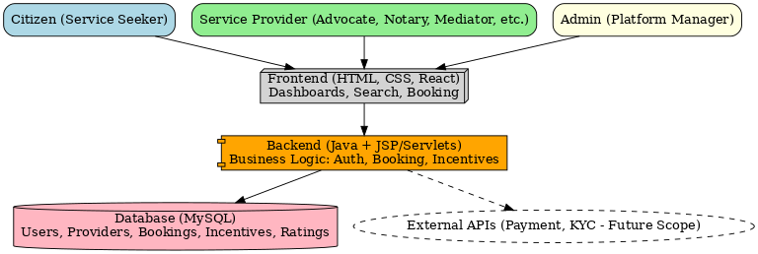
Architecture Diagram

Slide 11
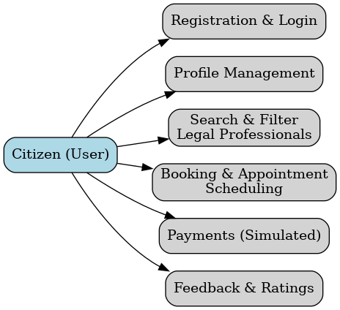
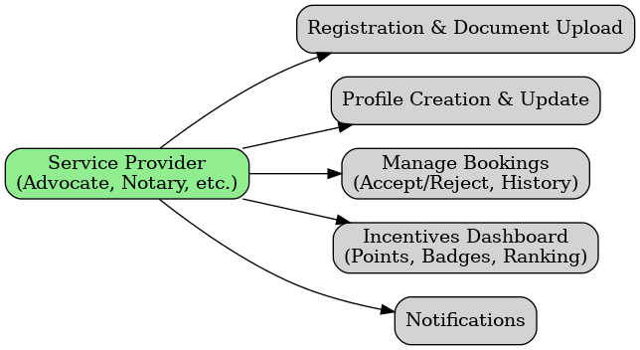
Modules
Citizen Module
Service Provider Module

Slide 12
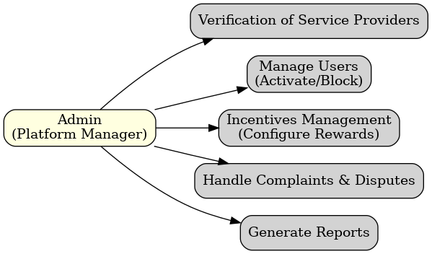
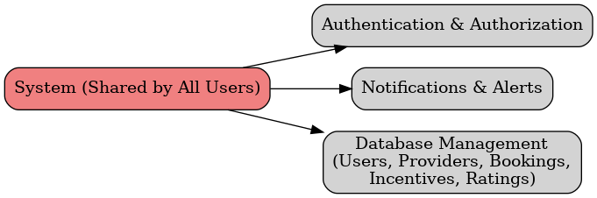
Modules
Admin Module
Common/Shared Modules

Slide 13

Technology Stack Components
1. Frontend (User Interface): Reactjs
2. Backend (Server-side Logic): NodeJS, ExpressJS
3. Database (Data Storage): MySQL
4. Security & Authentication: JWT
5. Integration Services
APIs: GeminiAPI key

Slide 14
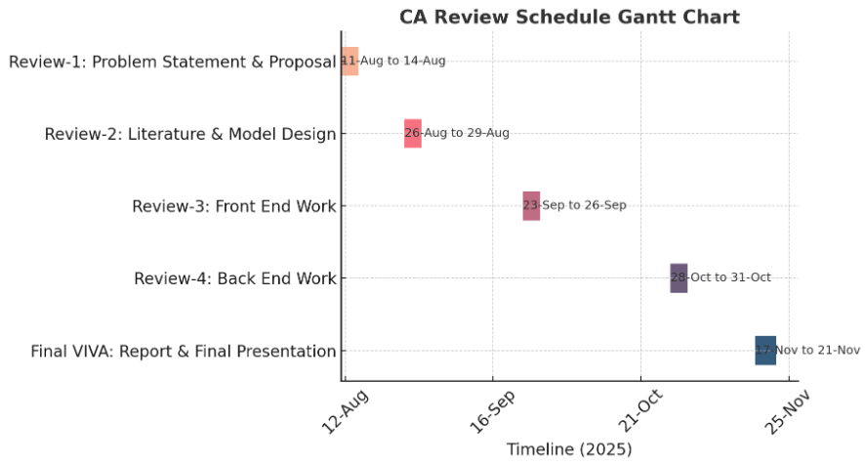
Timeline of the Project (Gantt Chart)

Slide 15
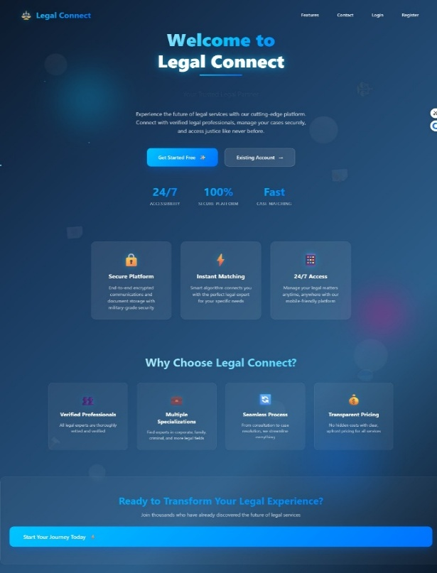
Results
Landing Page

Slide 16
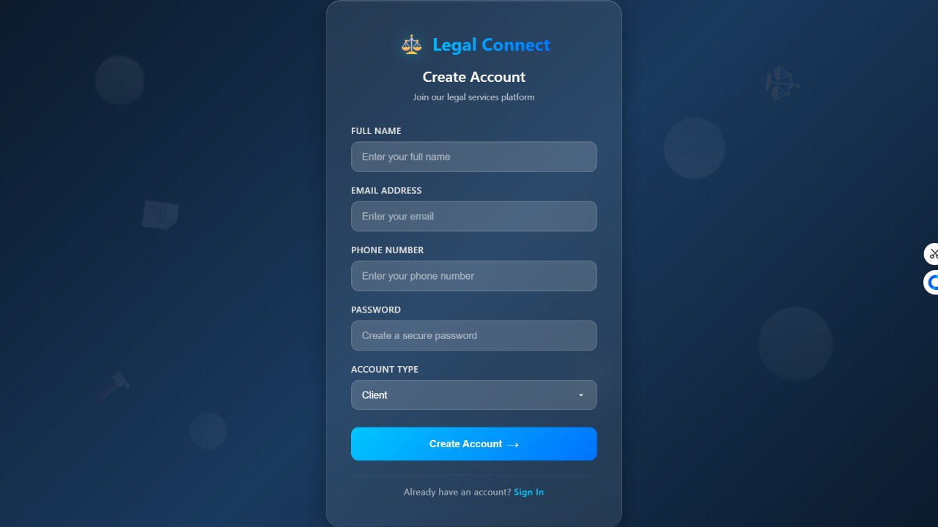
Result
Registration Page

Slide 17
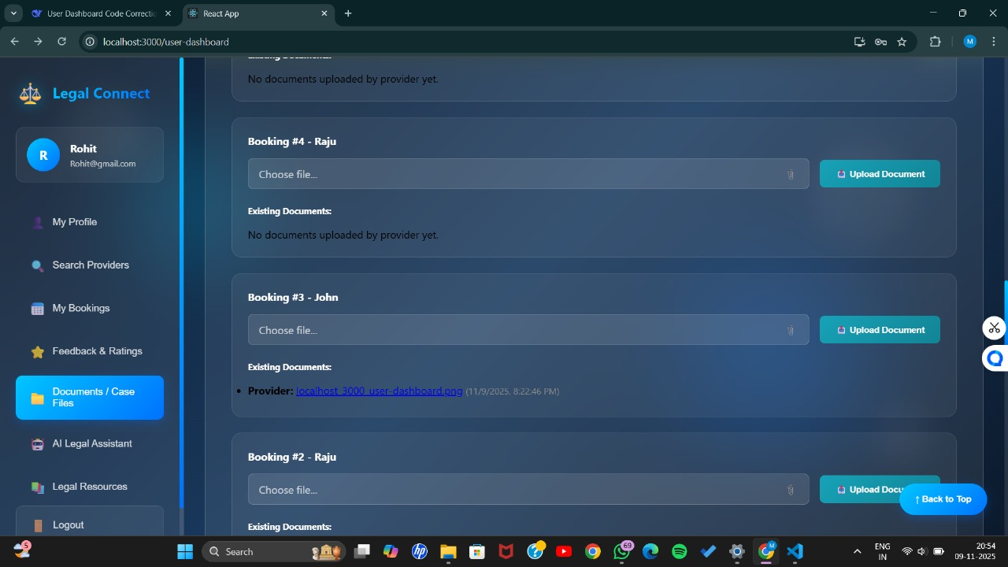
Client Page

Slide 18
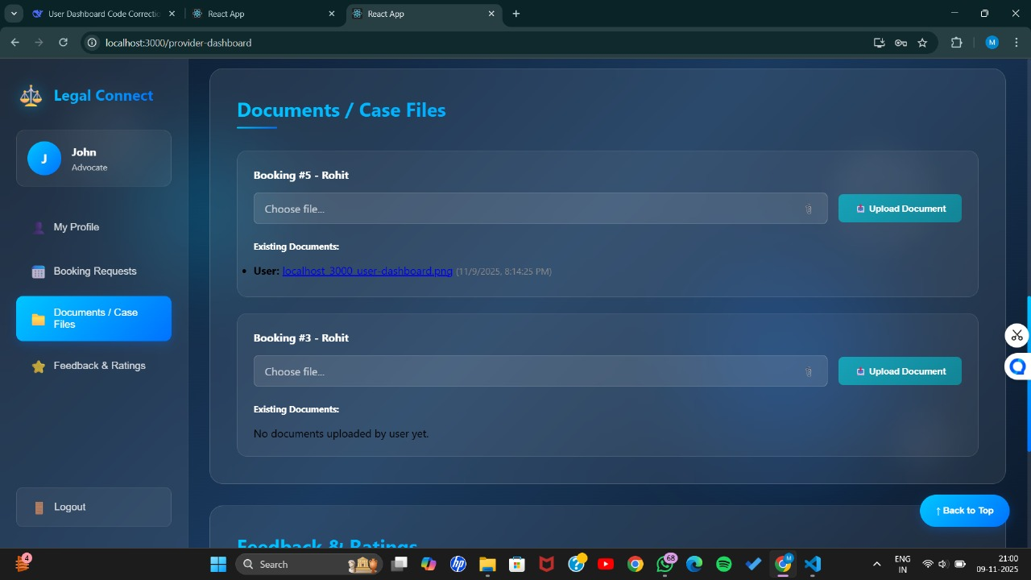
Results
Service Provider Page

Slide 19
Github Link
The Github link provided should have public access permission.
GitHub Link:
https://github.com/Mohith4488/Capstone-project-legal-service-adviser

Slide 20
References (IEEE Paper format)
Incentives based Design for onboarding Legal Service Providers for Extending Legal Services to Citizens in India by Piyush Karnale, Srishti Chavan, Amulya Chougale, and Ansh Patil .
Barriers to Adoption of B2B E-marketplaces: An Empirical Study of Indian Manufacturing MSMEs by Pallavi Upadhyaya, Manjunatha Prasad Karantha, and Mohan P. Thayyil .
India Legal Aid Clinics: Creating Service Learning Research Projects to Study Social Justice by David W. Tushaus, Shailendra Kr. Gupta, and Sumit Kapoor .
Improving Legal Service Delivery: the approving role of legal technologies by Krishna Chaitanya Balthu, Iain Reid, and Ben Clegg .
Artificial intelligence (AI) applications for marketing: A literature-based study by Abid Haleem, Mohd Javaid, Mohd Asim Qadri, Ravi Pratap Singh, and Rajiv Suman .

Slide 21
References (IEEE Paper format)
Integrating AI-Based Information Services in Legal Systems: Opportunities and Challenges by Odiljon Nematillaev, Khayitjon Turdiev, Timur Kenjayev, Karamat Kilicheva, I.B. Sapaev, Xosiyatposhsho Axmadaliyeva, Jaloliddin Yusubov, and Umid Menglikulovs .
Blockchain Technology and Legal Framework in India: A Systematic Review by Neha Kukrety, Pitresh Kaushik, and Shashank Shekhar Pandey .
Legal Sahyog Hub: An Incentives Based Design For Onboarding Legal Service Providers On E-Market Place For Extending Legal Services To Citizens In India by Dr. Yakuta Tayyebi, Anuj Banke, Anshita Balodiya, Gourav choudhary, and Ananya Dey .
Multi-sided Platforms and Markets: A Literature Review by Juan Manuel Sánchez-Cartas and Gonzalo León.
Online Legal Service: The Present and Future by Md Aminur Islam, Jannatul Ferdaus, Md. Abbas Ali Khan, and Md. Tarek Habib

Slide 22


