Slide 1


Team Details
Team name: SamanvAI
Team lead: [Add team lead name]
Problem: citizens navigate fragmented services while officials lack a unified, jurisdiction-scoped operating view.

Slide 2
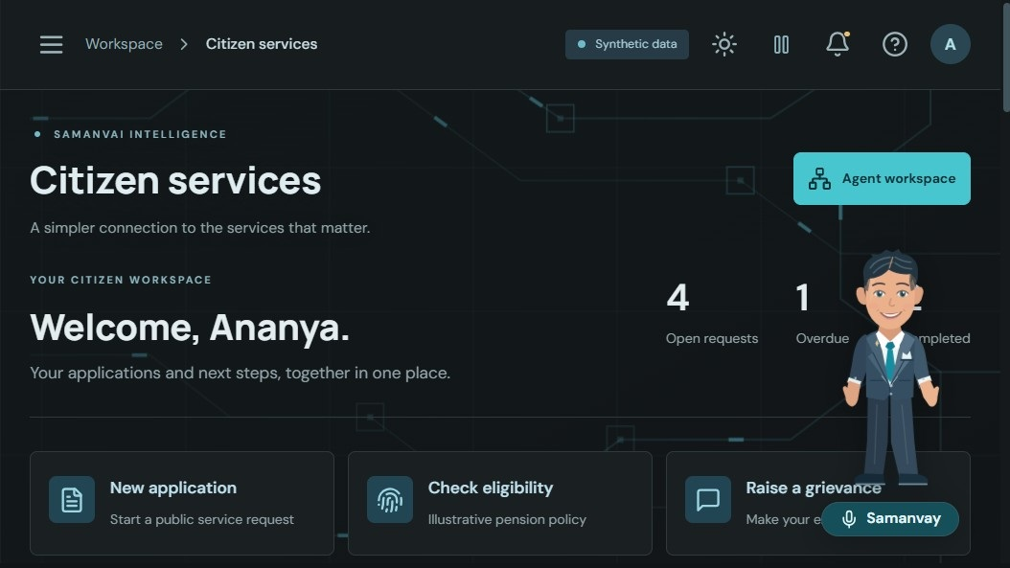

One connected civic service loop
CITIZENS
Discover a service, create a demo request, and track its next step.
OFFICIALS
Review jurisdiction-scoped cases, trends, overdue work and department performance.
SAMANVAY
Multilingual guidance leads to real forms; people review and submit themselves.
SYNTHETIC PILOT | NO OFFICIAL DEPARTMENT SYSTEMS CONNECTED

Slide 3
Brief about the idea
SamanvAI joins citizen service discovery and government case review in one role-aware workflow.
Fragmented journey
Limited operational view
One accountable pilot
Citizens need to find the right service, understand next steps and follow an application across stages.
Officials need comparable service, aging and SLA signals scoped to their verified state, district, taluk or department role.
A citizen workspace, governance review and constrained Samanvay guide share the same case store and authorization boundaries.
Pilot scope: synthetic Karnataka records and illustrative service rules; no external government portals are connected.

Slide 4
Opportunity and differentiators
Service continuity
Role-aware operations
Constrained assistance
Service catalog -> application intake -> status tracking -> explicit grievance or escalation action.
Server-enforced scopes keep Chief Secretary, DC, Tahsildar and department views within assigned boundaries.
Six sequential workflow nodes use deterministic rules and authorized evidence. Gemini is optional phrasing, not an action authority.
USP
A traceable service workflow where guidance, scope checks and human confirmation are explicit.

Slide 5
Services and capabilities
Pension assistance
Birth certificate
Property registration
Social Welfare | 30-day demo SLA
Civil Registration | 14-day demo SLA
Revenue | 30-day demo SLA
Driving licence renewal
Water supply
Transport | 21-day demo SLA
Public Works | 7-day demo SLA
All deadlines shown are illustrative demo rules, not official processing-time commitments.

Slide 6
Use case: guidance to reviewed request
CITIZEN
REACT UI
FASTAPI
LANGGRAPH
SQLALCHEMY
REVIEW
Chooses a service and shares a question
Typed forms and Samanvay guide
Validates inputs and identity
Six sequential evidence steps
Reads or writes the case store
Response, status and audit view
CHAT PATH: Citizen Service -> Policy Reasoning -> Case Resolution -> Escalation -> Sentiment/Grievance -> Governance Intelligence
Mutation guard
No silent submission
Escalations require explicit consent or an explicit user action.
Assistant navigation opens a form; the citizen reviews and submits.

Slide 7
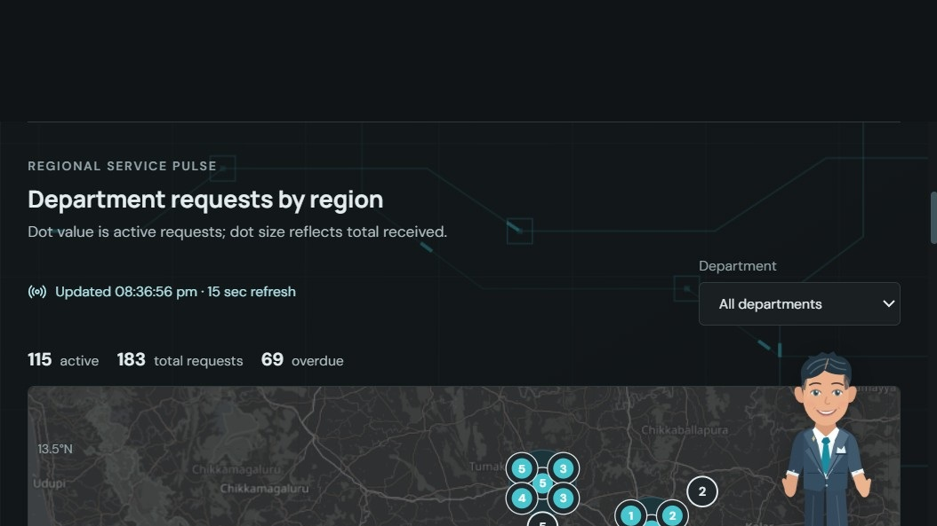
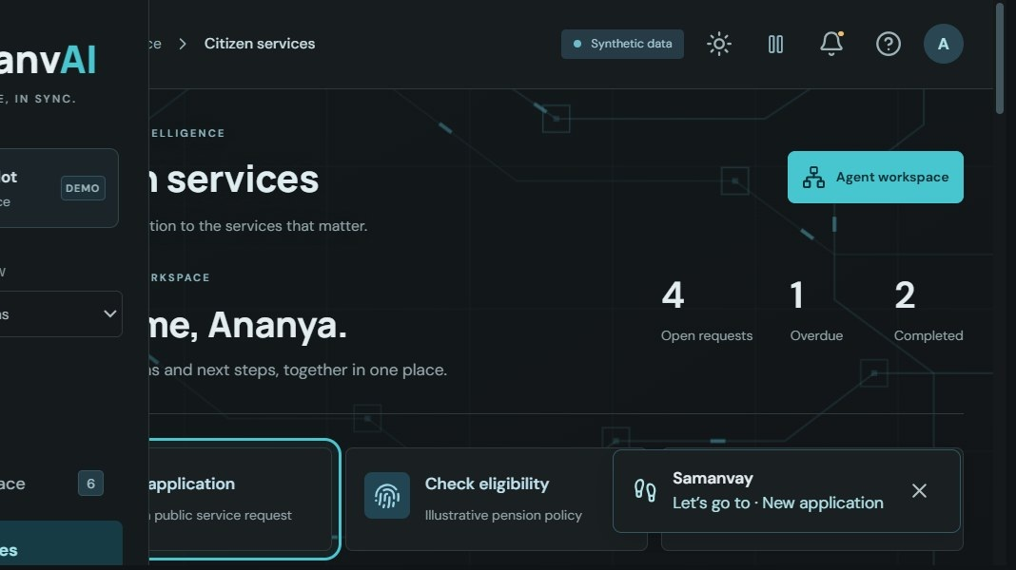
Prototype screens: citizen and official workspaces
Screens captured from the running local pilot. Values are synthetic and may change as the demo database changes.
Citizen workspace
Regional service pulse
Samanvay guidance
Applications first; service request options below.
Department dots over approximate pilot regions.
Guided movement opens a real reviewable form.
Samanvay currently supports English, Hindi and Kannada text guidance; spoken voice availability depends on browser/device or configured Google Cloud TTS.

Slide 8
Architecture: current pilot and deployment target
IMPLEMENTED PILOT
React + TypeScript
FastAPI
LangGraph
SQLAlchemy
SQLite
Vite SPA; citizen and official UI
Routes, validation and identity boundary
Six sequential workflow nodes
Repository and transaction logic
Synthetic local demo database
Optional integrations: Firebase Auth (verified tokens), Gemini/Vertex text synthesis, PostgreSQL-compatible DATABASE_URL.
CONFIGURED DEPLOYMENT PATH
GitLab CI
OIDC / WIF
Cloud Build
Artifact Registry
Cloud Run
Tests and build
Keyless Google identity
Builds root-context image
Commit-tagged container
One combined app service
Cloud Run deployment requires GCP setup; no live cloud deployment is claimed. Microservice/microfrontend boxes are a future migration target.

Slide 9
Technology stack
Experience
Services and workflow
Data and deployment
React 19 + TypeScript
Vite build
Recharts + Lucide
Responsive citizen and governance views
FastAPI + Pydantic
LangGraph: six sequential nodes
Deterministic policy/SLA checks
Optional Gemini/Vertex synthesis
SQLAlchemy + SQLite in local demo
PostgreSQL-compatible connection
Firebase token verification optional
Docker + GitLab CI + Cloud Run target
No Firestore, BigQuery, Vertex RAG, external department API or notification provider is currently connected.

Slide 10
Cost status and Google Cloud cost drivers
No Google Cloud project is provisioned, so there is no measured bill or defensible monthly estimate yet.
Cloud Run
Cloud SQL
Optional services
Request volume, CPU/memory, concurrency and minimum instances determine compute spend. Scale-to-zero is possible.
Instance tier, storage, backups and connectivity are the main persistent baseline cost drivers.
Artifact Registry, logs, network egress, Vertex/Gemini and Cloud TTS depend on use and retention.
Before deployment, price the chosen region, Cloud SQL tier, request profile and model usage in Google Cloud Pricing Calculator. No cost values are invented here.

Slide 11
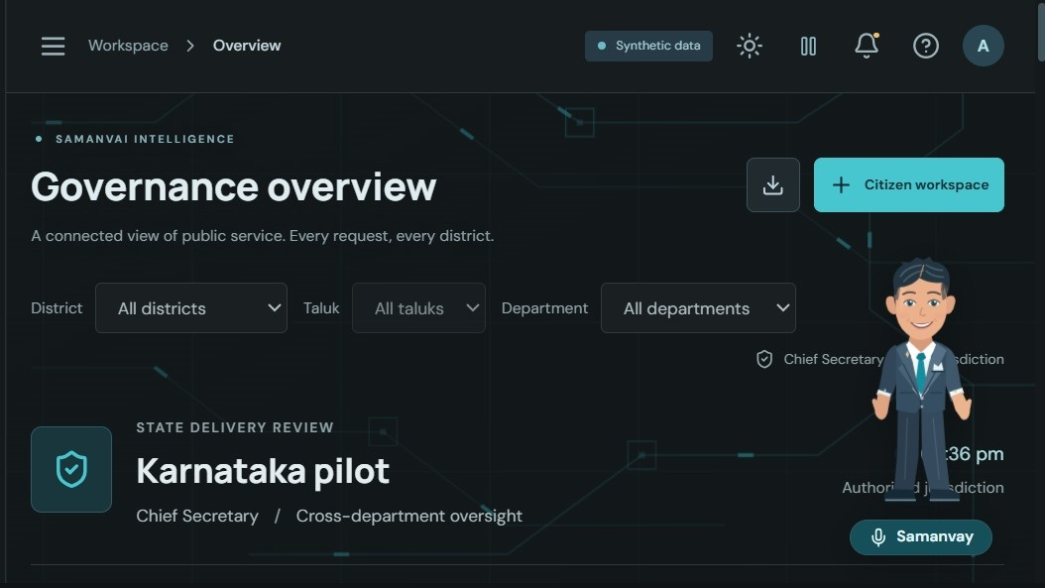
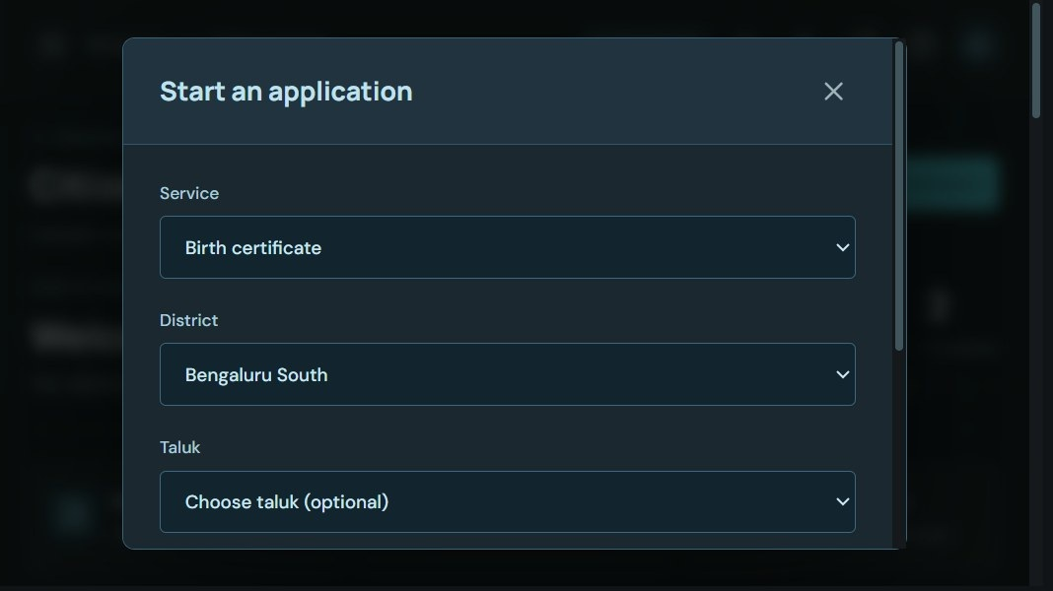
Prototype snapshots
Scoped governance KPIs
Department and region counts
Citizen intake review form
Current prototype: role selector is explicitly synthetic. In production, Firebase custom claims and trusted assignments must define official scopes.

Slide 12
Prototype validation: measured checks
32 backend tests
Production build
Scope verification
Domain, jurisdiction, retrieval, memory, API and mocked speech paths pass.
TypeScript check and Vite production build pass.
State, district, taluk and department filters are asserted at the API layer.
Refresh behavior
Map pilot
Not benchmarked
Overview refreshes on a 15-second client interval.
Six named districts; approximate centroids; aggregates reconcile to scoped cases.
No load test, p95 latency, production SLO or cloud scale test is claimed.

Slide 13
Roadmap: from pilot to trusted deployment
01 / TRUST
02 / DATA
03 / OPERATE
04 / EXTRACT
Provision Firebase claims; validate official roles; approve canonical policy and geography sources.
Deploy Cloud SQL with migrations, backups, private connectivity and retention controls.
Add request tracing, load tests, dashboards, alerts and incident/runbook ownership.
Split service APIs and microfrontends only after data ownership and API contracts are defined.
The attached Cloud Run diagram is a target architecture; current source remains one React SPA and one FastAPI runtime.

Slide 14
Repository, demo and product access
Repository
Demo video
Product
GitLab migration is planned. This workspace is not currently connected to a public Git remote.
media/demo-video/samanvai-overview.mp4
139 seconds
English voice-over
Local demo: http://127.0.0.1:8000
No public Cloud Run URL or custom DNS is provisioned.
Architecture reference: architecture/cloud-run-target.html. The service split shown there is proposed, not deployed.

Slide 15
Trust boundaries and demo limitations
Synthetic records
Seeded citizen, request, feedback and SLA data are illustrative; do not enter real personal information.
No department integration
Requests stay in the local pilot store; no external portal, email, SMS or officer notification is connected.
Human-confirmed actions
Samanvay explains and navigates. Citizens review forms; escalations require explicit action or consent.
Verified production roles
Firebase claims must be assigned through a trusted admin process; the demo role selector is not authentication.
Illustrative geography and policy
Approximate pilot coordinates and demo rules are not authoritative boundaries, policies or processing-time commitments.

Slide 16


