Slide 1

SMART INDIA HACKATHON 2026
TITLE PAGE
Problem Statement ID: [TO BE FILLED]
Problem Statement Title: [TO BE FILLED - Smart Assistive Mobility Device]
Theme: MedTech / Assistive Hardware & Robotics
PS Category: Hardware
Team ID: [TO BE FILLED]
Team Name: [TO BE FILLED]
College: R.V. College of Engineering, Bengaluru
Project Name: SMART INTELLIGENT CANE
Tagline: "Asymmetric Dual-Processor Assistive Mobility Platform with Fail-Safe Reflex Safety"
⚡50ms Safety Loop | 📷 Dual AI Cameras | 🦴 Ears-Free Audio | 🔋 36h+ Battery | 🚨 Autonomous SOS | 🦿 Motorized Quad-Pod

Slide 2
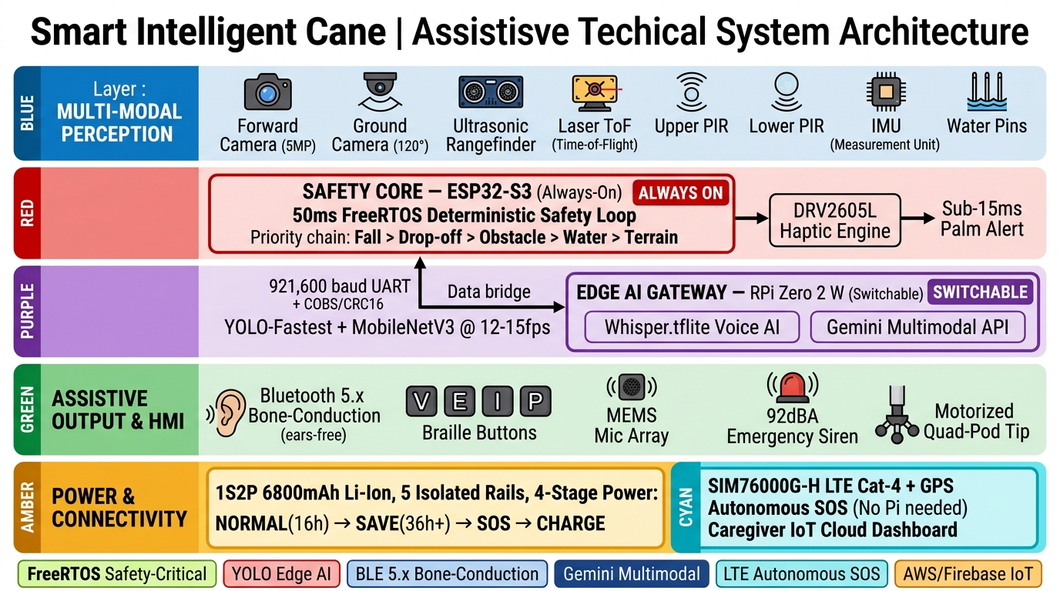
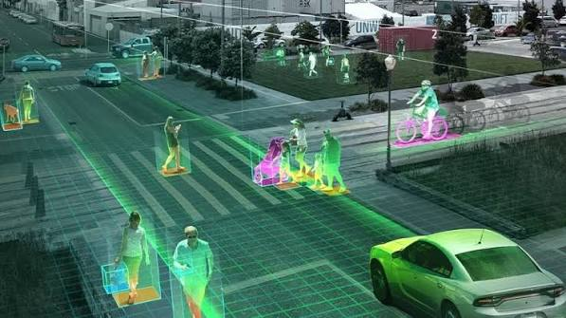
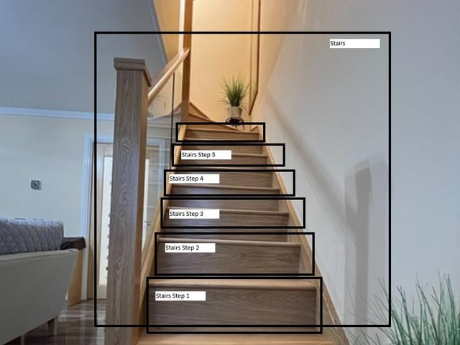
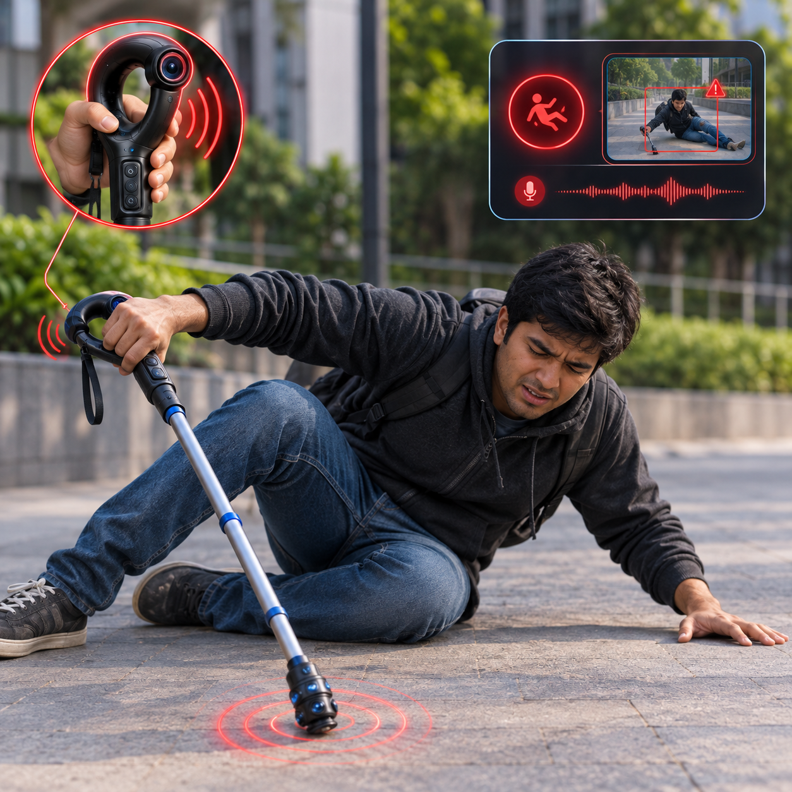
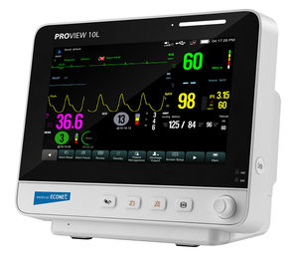
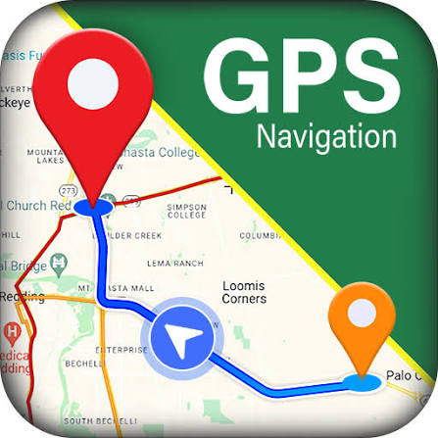
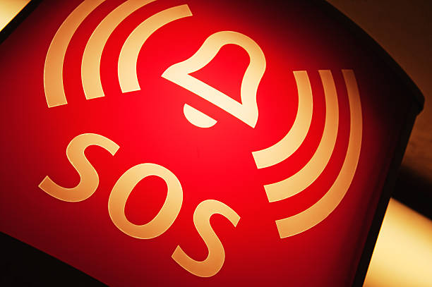
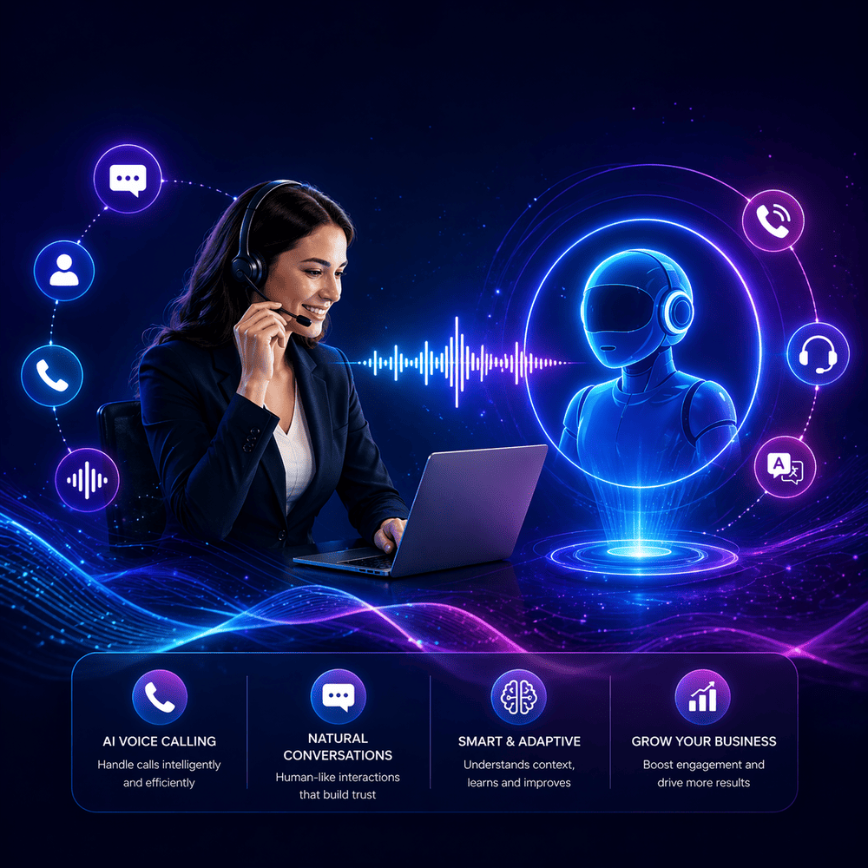
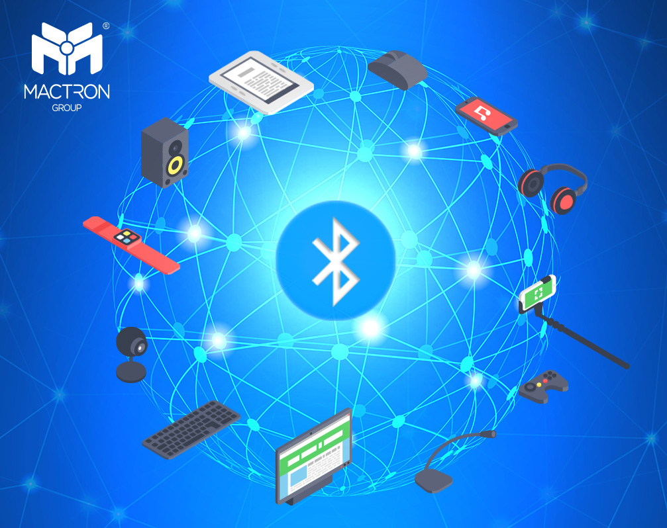
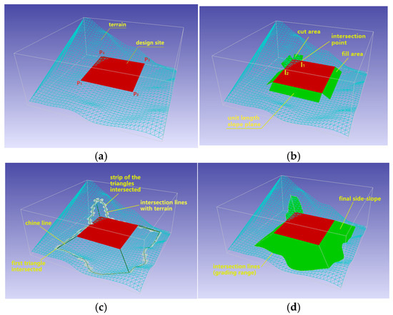
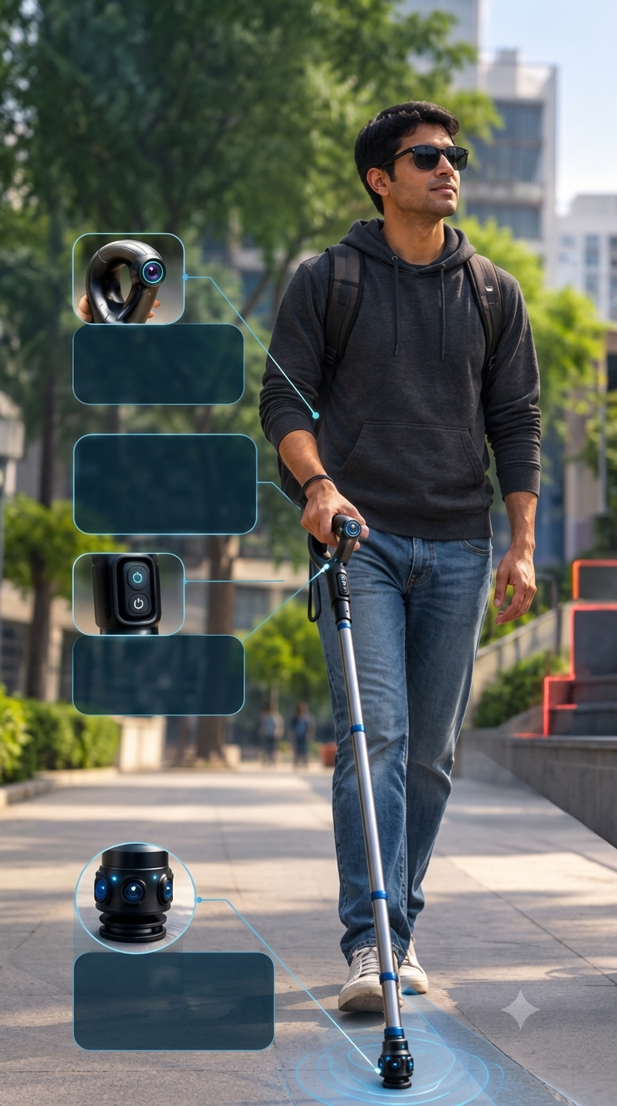
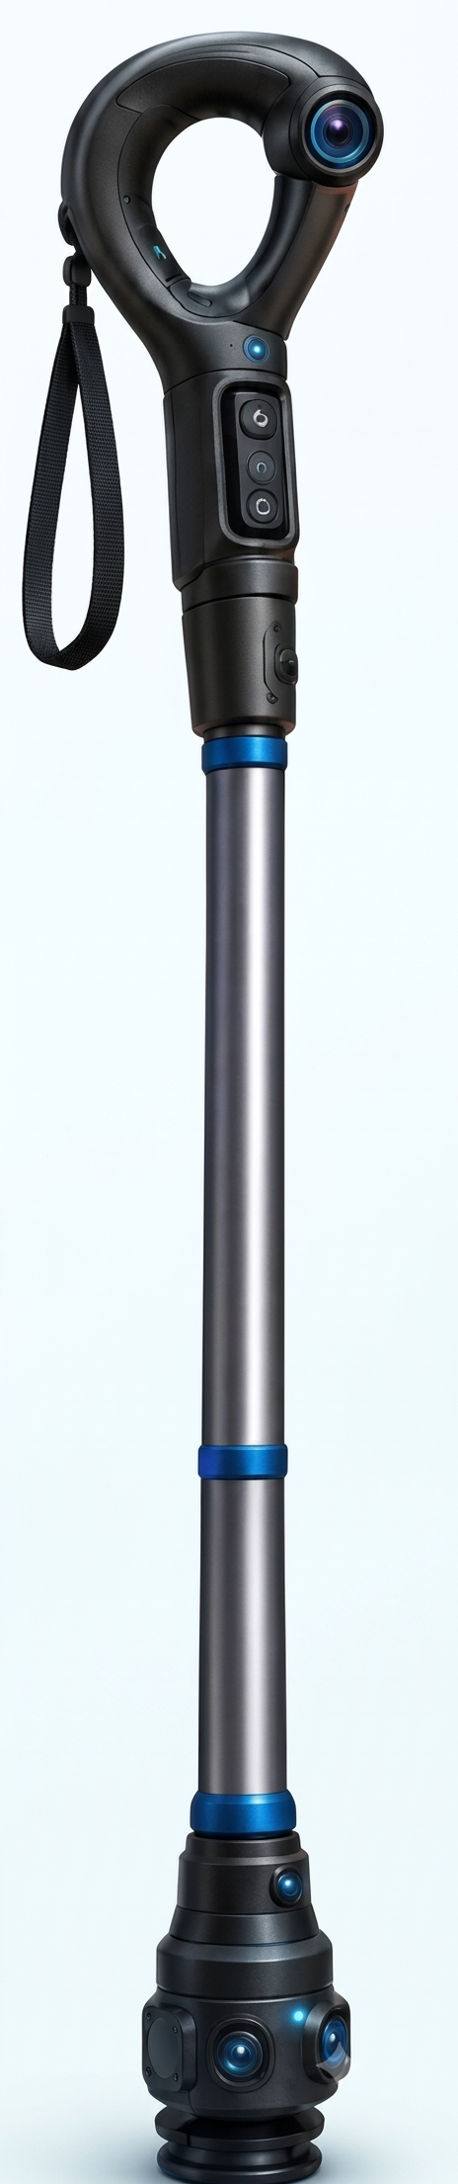
IDEA TITLE — Problem, Solution & Architecture
Your Team Name
PROBLEM:
1. "I can feel the ground with my cane, but I can't detect the low branch at head height."
2. "I never hear the electric scooter until it's too late."
3. "My smart cane uses earbuds, so I can't hear traffic anymore."
4. "The app crashed and I had no warning at the curb."
5. Short 3-4 hour battery, no autonomous SOS if user falls unconscious.
SOLUTION — 6 Pillars:
1. ⚡ Asymmetric Dual-Processor Fail-Safe
2. 📷 Dual-Tier 8-Sensor 360° Perception
3. 🦴 Ears-Free Bone-Conduction
4. ✋ Sub-15ms Haptic Palm Reflex
5. 🚨 Autonomous Cellular SOS
6. 🦿 Motorized Quad-Pod Tip
UVP: "World's first assistive cane with hardware-guaranteed safety reflex independent of any OS, with autonomous cellular SOS and ears-free guidance."

Slide 3
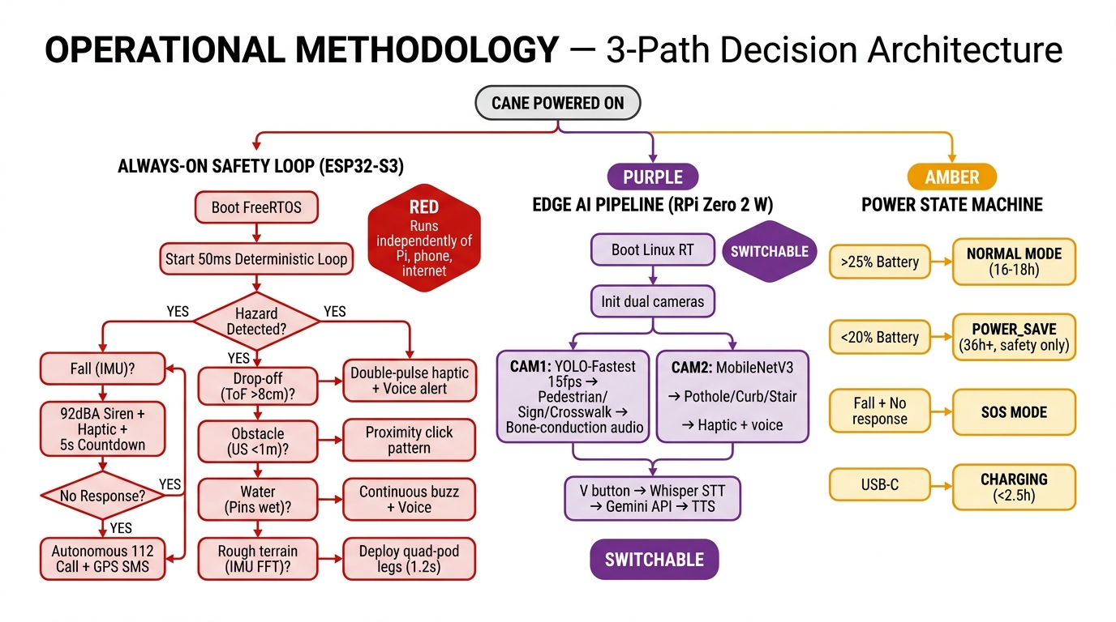
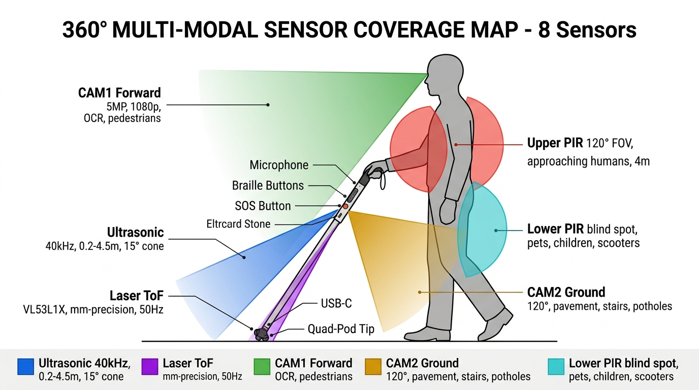
TECHNICAL APPROACH
Your Team Name
Tech Stack Grid:
• ESP32-S3 + FreeRTOS: Always-on safety, 50ms loop, C/C++
• RPi Zero 2 W + Linux RT: Edge AI, YOLO-Fastest, MobileNetV3, Python
• Computer Vision: YOLO-Fastest + MobileNetV3-SSD Int8 @ 12-15fps
• Audio & HMI: BLE 5.x bone-conduction, Knowles MEMS mic array, Whisper STT
• Power: TPS63020 Buck-Boost, BQ25895 charger, 5 isolated rails, 6800mAh Li-Ion
• Cloud: SIM7600G-H LTE Cat-4 + GPS, MQTT/TLS, AWS/Firebase IoT
• 3D CAD: Blender 5.2, 63K+ face mesh, CNC aluminum linkages
• Mechanical: DRV8830 motor driver, quad-pod linkage, over-current protection
Inter-Processor Bridge:
ESP32-S3 ↔ RPi: 4-wire UART + RTS/CTS @ 921,600 baud (COBS + CRC16)
PCA9615 Differential I²C for 1.1m shaft sensors

Slide 4
FEASIBILITY & VIABILITY
Your Team Name
Technical Feasibility
• ESP32-S3 FreeRTOS: Industry-proven for safety-critical IoT
• YOLO-Fastest + MobileNetV3 validated on RPi Zero 2 W at 12-15 fps
• PCA9615 differential I²C validated up to 3m (shaft = 1.1m)
• Complete 3D CAD (63K+ face mesh) manufacturing-ready
Economic Viability
• BOM: ₹8,000-12,000 (vs ₹50,000-2,00,000 for competitors)
• Market: 12M+ VI in India (WHO), ~2% with smart aids. TAM: ₹9,600 Cr
• Revenue: B2G (ADIP scheme), B2B, D2C, SaaS cloud dashboard
• Aligned with: Accessible India Campaign, RPwD Act 2016
Operational Feasibility
• Zero smartphone dependency for safety
• Offline-first: All safety + edge AI local
• 4 Braille buttons: No screen needed
• 36+ hours in Power-Save mode
Challenges & Risk Mitigation
1. AI accuracy in Indian conditions → Multi-modal redundancy (8 sensors)
2. RPi crash during use → Asymmetric architecture; ESP32 safety continues
3. Mechanical tip failure → IP54 enclosure, over-current shutoff, spring fallback
4. LTE unavailable rural → Multi-band fallback, all safety offline, GPS cache
5. User adoption resistance → <400g weight, Braille buttons, ears-free

Slide 5
IMPACT & BENEFITS
Your Team Name
THREE NATIONAL IMPACT PILLARS
🏥 SOCIAL & ACCESSIBILITY
• 12M+ visually impaired beneficiaries (WHO 2023)
• Only ~2% have access to any smart mobility aid
• 60% projected fall injury reduction via sub-15ms haptics
• Autonomous SOS saves lives — no smartphone needed
• Ears-free design preserves full independence
• Voice AI enables independent navigation & sign reading
💰 ECONOMIC IMPACT
• ₹9,600 Cr addressable market in India
• 70-90% cost reduction vs commercial alternatives
• Make in India: 100% COTS, domestic SMT assembly
• 5,000+ manufacturing & support jobs
• ₹2-5K Cr healthcare savings over 5 years
🇮🇳 GOVERNMENT MISSION ALIGNMENT
• Accessible India Campaign (Sugamya Bharat Abhiyan)
• RPwD Act 2016 — Sec 42 (accessibility), Sec 25 (assistive tech)
• ADIP Scheme — BPL subsidy eligible (MoSJE)
• Digital India — IoT caregiver cloud dashboard
• Ayushman Bharat — PPG vitals health records integration
COMPETITIVE COMPARISON
Feature | WeWALK | Sunu | Ours
Dual-Processor | ✗ | ✗ | ✓
Sub-15ms Haptic | ✗ | ~ | ✓
Dual AI Cameras | ✗ | ✗ | ✓
Bone-Conduction | ✗ | ✗ | ✓
Autonomous SOS | ✗ | ✗ | ✓
8-Sensor 360° | 1 | 1 | 8
Motorized Tip | ✗ | ✗ | ✓
Fall + Auto SOS | ✗ | ✗ | ✓
PPG Health | ✗ | ✗ | ✓
Voice AI (Gemini) | ~ | ✗ | ✓
36h+ Battery | 4-5h | 6-8h | 36h+
Price (India) | ₹50K+ | ₹30K+| ₹8-12K
12M+ Beneficiaries | 90% Cost Reduction | <5s SOS | 36h+ Battery | 50ms Reflex | 8 Sensors

Slide 6
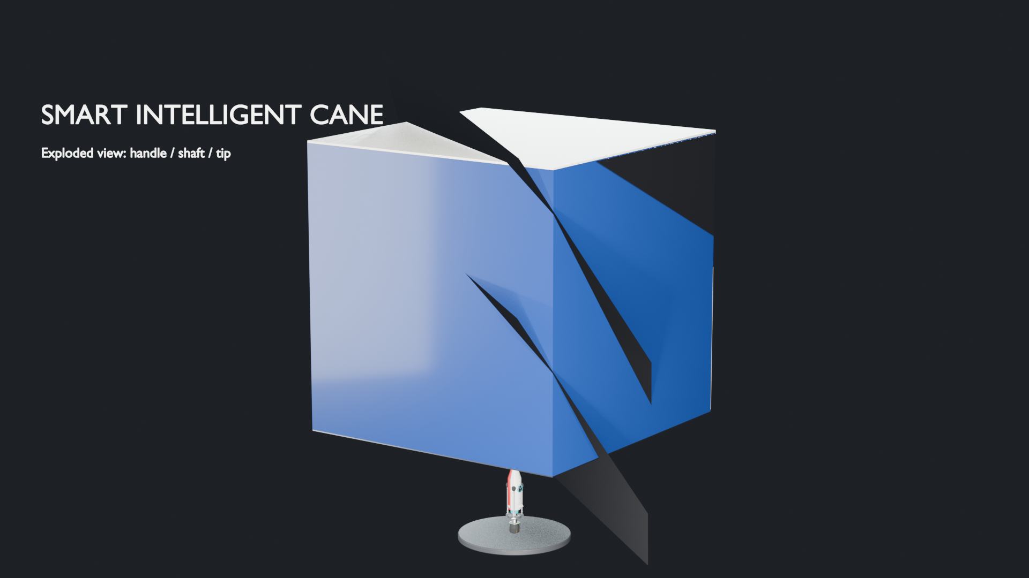
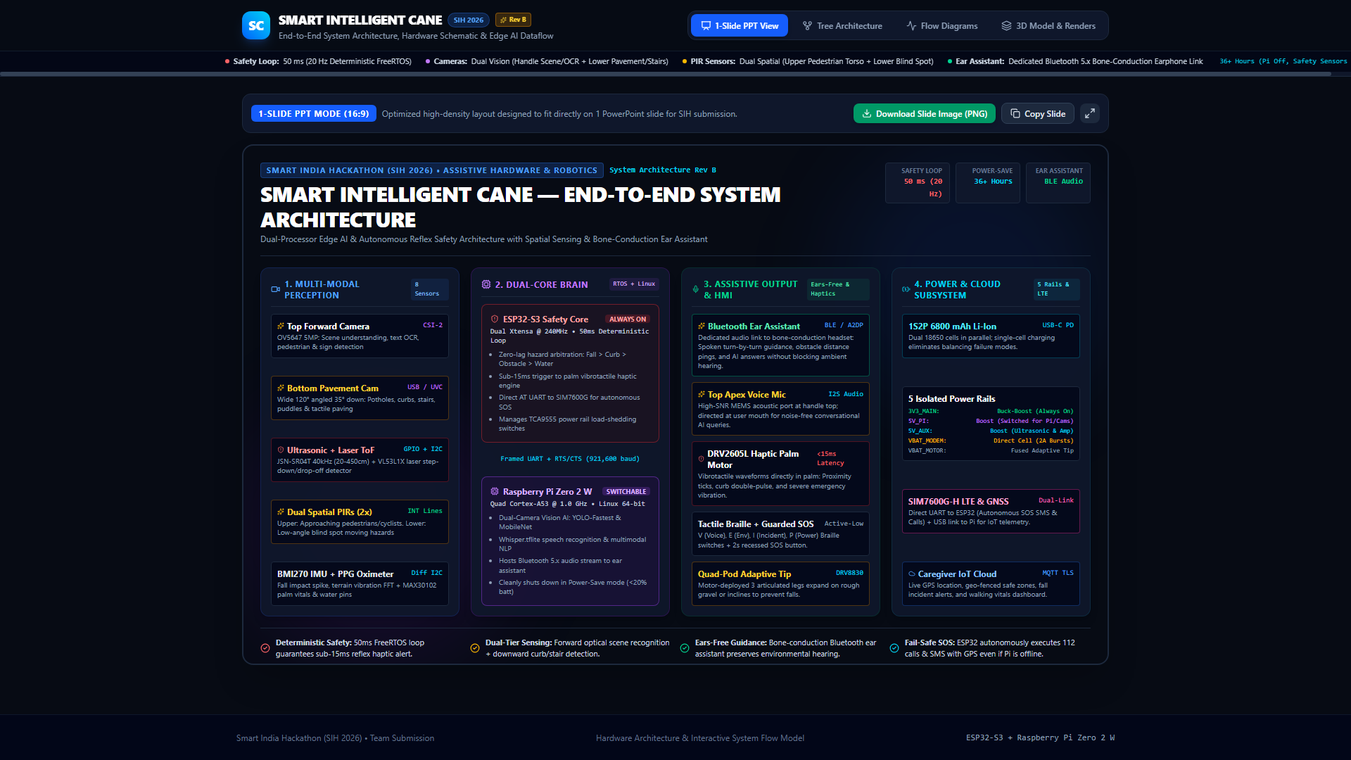


RESEARCH & REFERENCES
Your Team Name
STANDARDS & RESEARCH CITATIONS
Standards & Regulatory:
• WHO Global Report on Assistive Technology (2022)
• RPwD Act 2016 (India) — Sec 42 & 25
• Accessible India Campaign (Sugamya Bharat Abhiyan)
• IEC 62366-1:2015 — Medical device usability
• ISO 11334-1 — Walking aids standard
Key Research Papers:
• Bai et al. (2019) IEEE Trans. Consumer Electronics — Dual-camera + ultrasonic validation
• Elmannai & Elleithy (2017) MDPI Sensors — Assistive sensing modalities
• Saaid et al. (2016) IEEE ICEEI — Baseline smart cane architecture
• Lin et al. (2020) YOLO-Fastest — Sub-100ms edge inference
• Radford et al. (2022) Whisper — Robust speech recognition
• NSO (2021) MoSPI — 12M+ visually impaired stats
3D CAD Model (Blender 5.2, 63K+ faces)
Interactive Architecture Web App
Quad-Pod Adaptive Tip Detail
Handle Assembly Detail
23-page Engineering Specification (Rev A) + Engineering Diagrams Package + Full 3D CAD Model + Interactive Architecture Web App

