Slide 1

SMART INDIA HACKATHON 2026
TITLE PAGE
Problem Statement ID –
Problem Statement Title-
Theme-
PS Category- Software/Hardware
Team ID-
Team Name (Registered on portal)

Slide 2
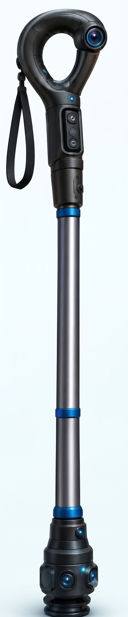
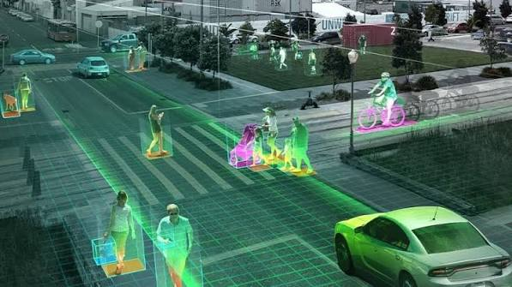
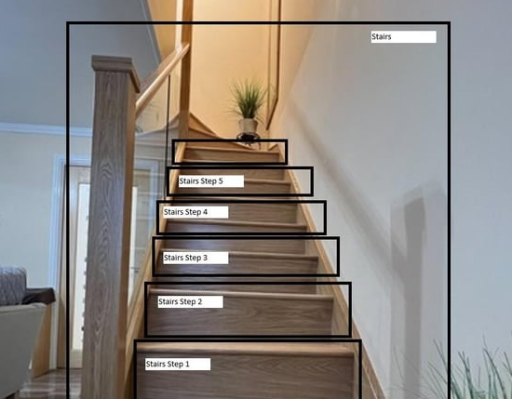
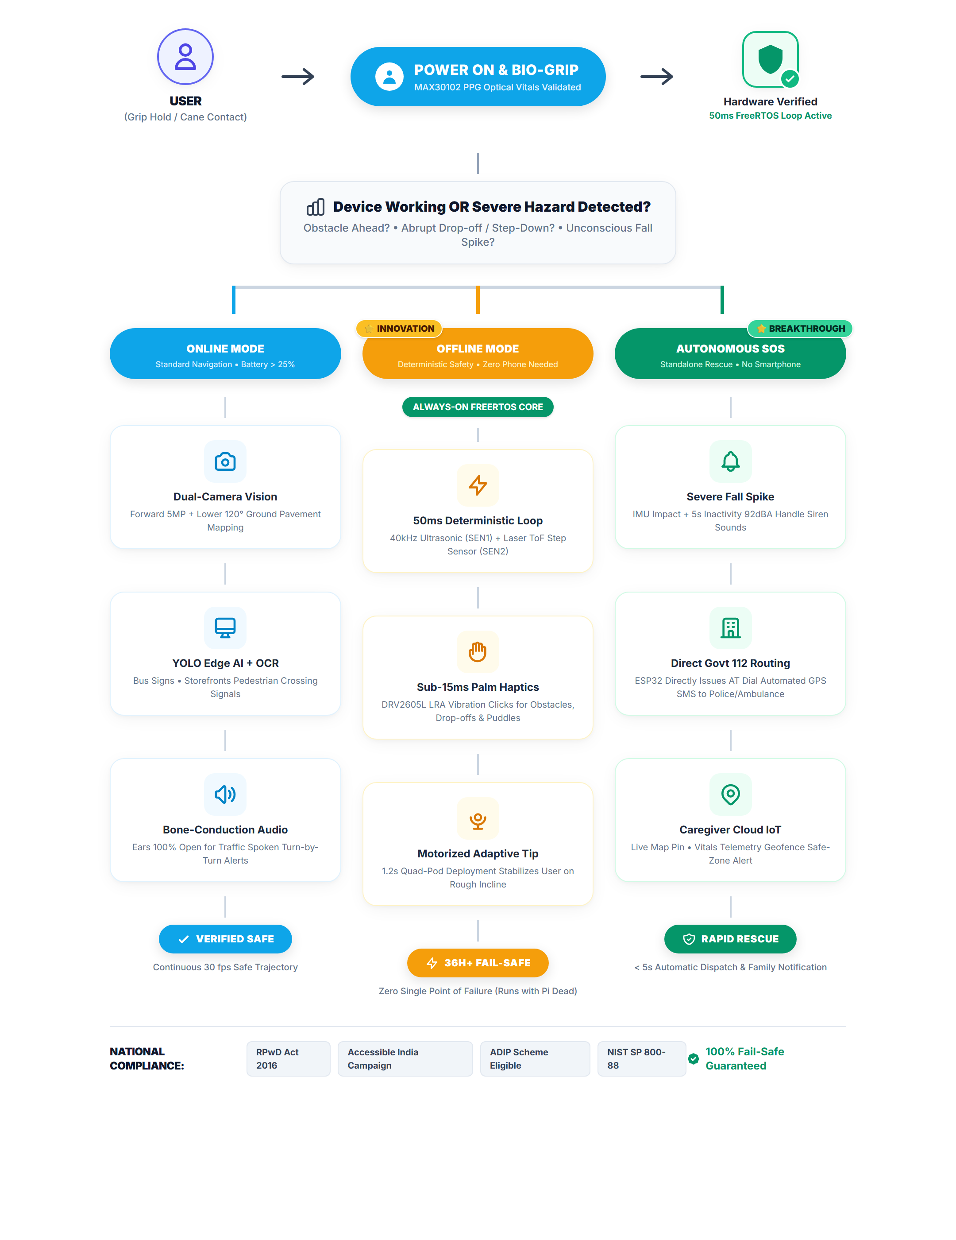
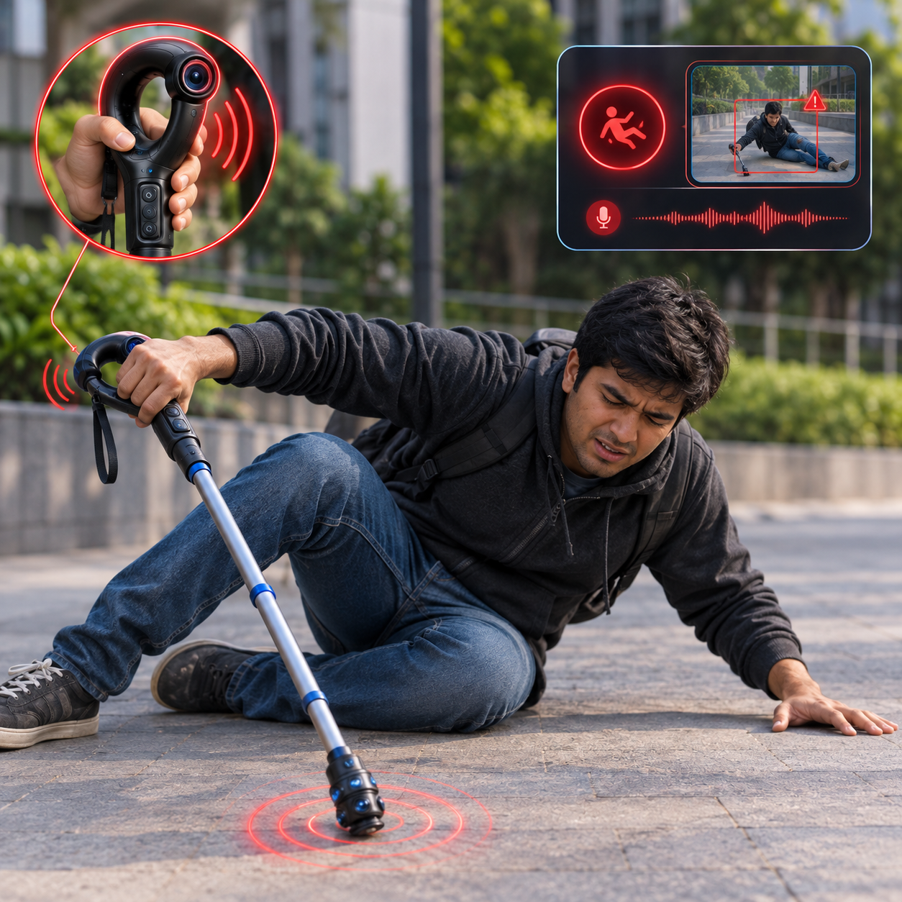
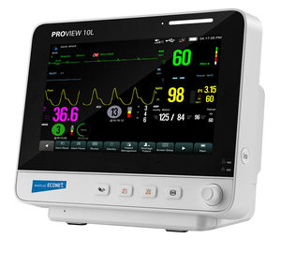
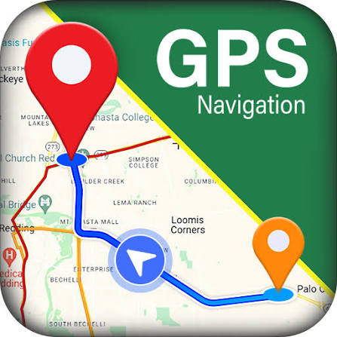



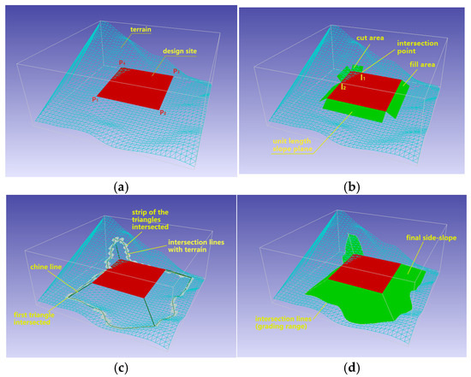
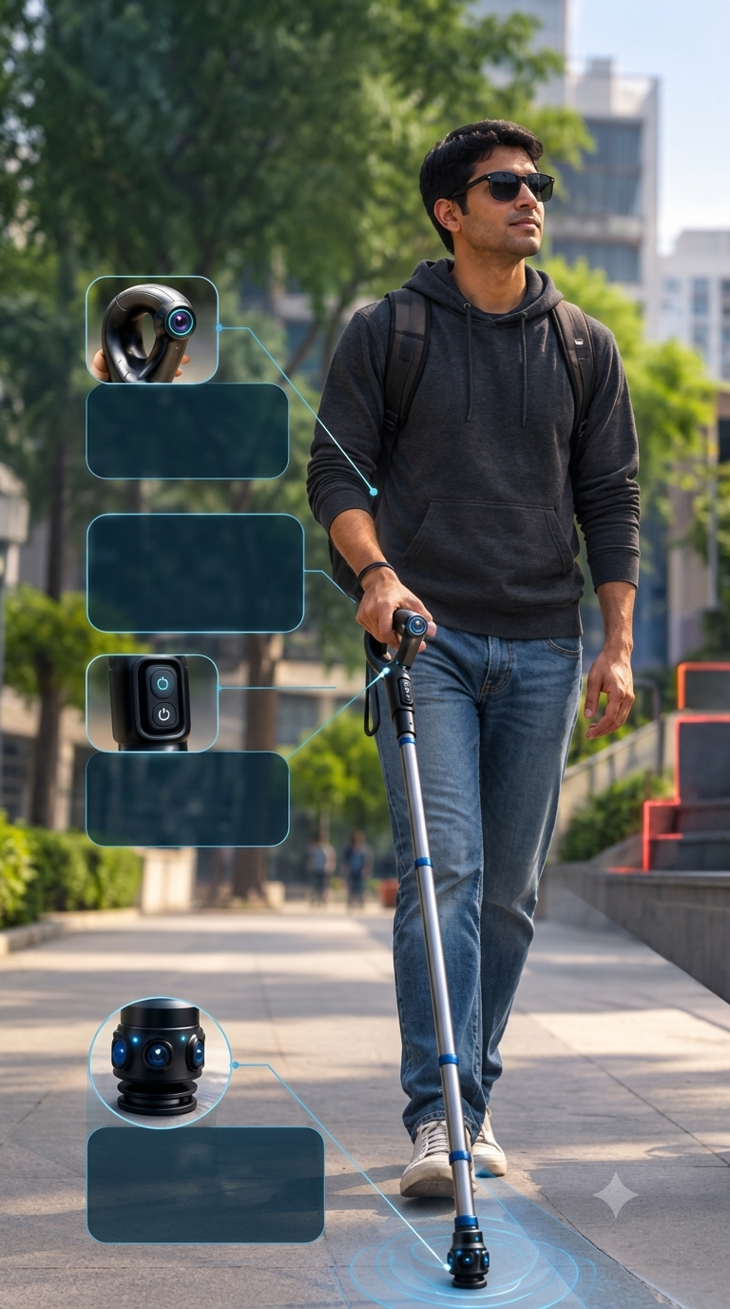
IDEA TITLE
Your Team Name
PROPOSED SOLUTION & HIGH-LEVEL SYSTEM FLOW
Computer Vision & AI Assistance — Identifies objects, people, text, and signs for real-time guidance.
Stair / Step Detection — Detects stairs, steps, curbs, and uneven terrain to prevent falls.
🔴 REAL USER MOBILITY PAIN POINTS:
• "I feel the ground, but hit low tree branches at head level."
• "Silent electric scooters approach without any audio warning."
• "Earbuds in existing smart canes block traffic hearing—a death trap."
• "If phone OS or app crashes, all safety warnings immediately die."
🟢 ECOWIPE-INSPIRED 6-PILLAR BREAKTHROUGH:
1. Asymmetric Dual-Core: ESP32-S3 (Always-on 50ms reflex) + RPi Zero 2 W.
2. 8-Sensor 360° Perception: Dual cameras, Ultrasonic, ToF, dual PIRs, IMU.
3. Ears-Free Bone Conduction: BLE 5.x keeps ear canals 100% open for traffic.
4. Sub-15ms Palm Haptics: DRV2605L LRA waveform for drop-offs & obstacles.
5. Autonomous Direct-AT SOS: Standalone 112 call + GPS SMS via LTE (No phone).
6. Motorized Quad-Pod Tip: Auto-deploying 1.2s base stabilizes rough inclines.

Slide 3
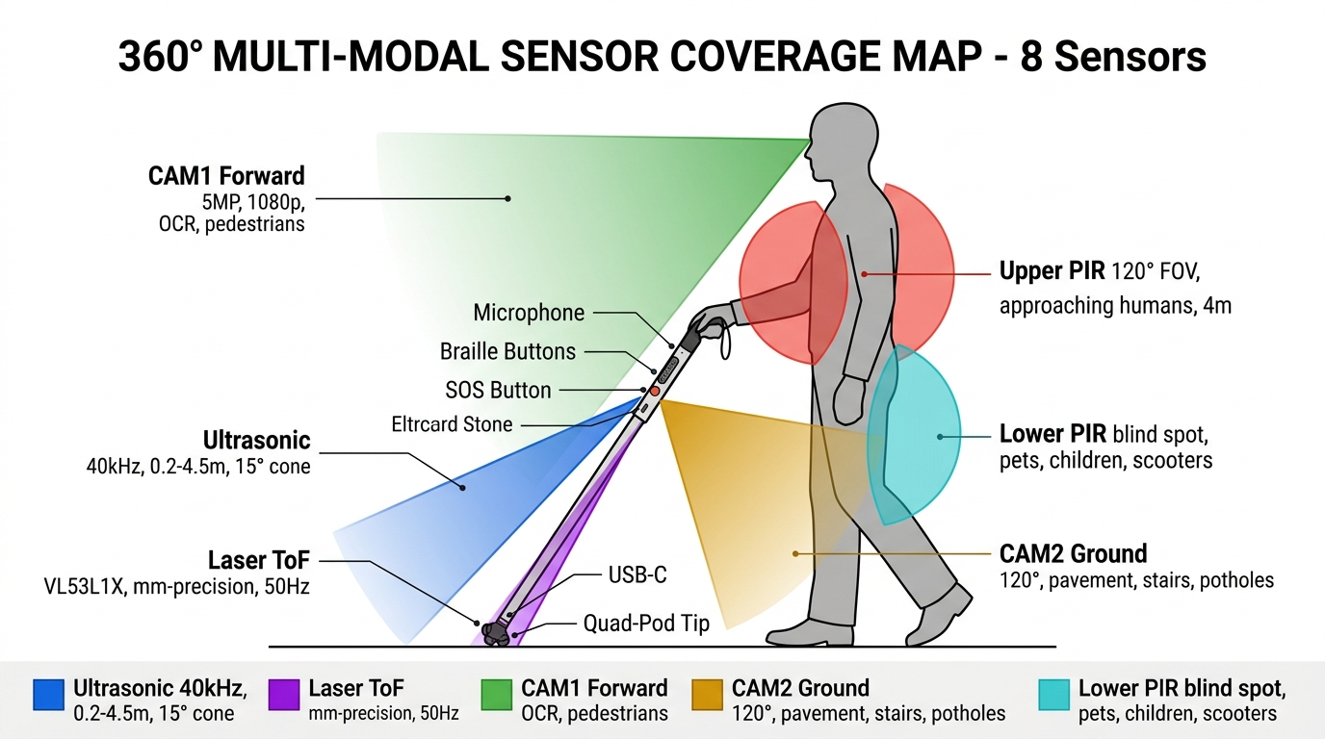
TECHNICAL APPROACH
Your Team Name
TECHNICAL APPROACH & SENSOR COVERAGE
🛠️ MULTI-TIER ENGINEERING STACK
⚡ ESP32-S3 Firmware (Safety Core):
Dual Xtensa @ 240MHz executing FreeRTOS 50ms deterministic loop. Direct GPIO/I2C arbitration; bypasses OS entirely.
🧠 Raspberry Pi Zero 2 W (Edge AI):
Quad Cortex-A53 running Linux RT kernel. YOLO-Fastest & MobileNetV3-SSD Int8 quantized at 12–15 fps for scene OCR.
📡 Differential I²C Bus (PCA9615):
Eliminates EMI across the 1.1m shaft, ensuring zero noise for tip-mounted ToF and IMU sensors.
🦴 Wireless Audio Transceiver:
Dedicated BLE 5.x A2DP stream to bone-conduction headphones for zero ear obstruction.
🚨 SIM7600G-H LTE Cat-4 & GNSS:
Direct-AT emergency dialing to 112 + automated SMS with live Google Maps coordinate pinpoint.
🔋 5-Rail Power Distribution:
1S2P 6800 mAh Li-Ion with TI BQ25895 fast charging and TI TPS63020 buck-boost regulator. 36h+ Power-Save runtime.

Slide 4
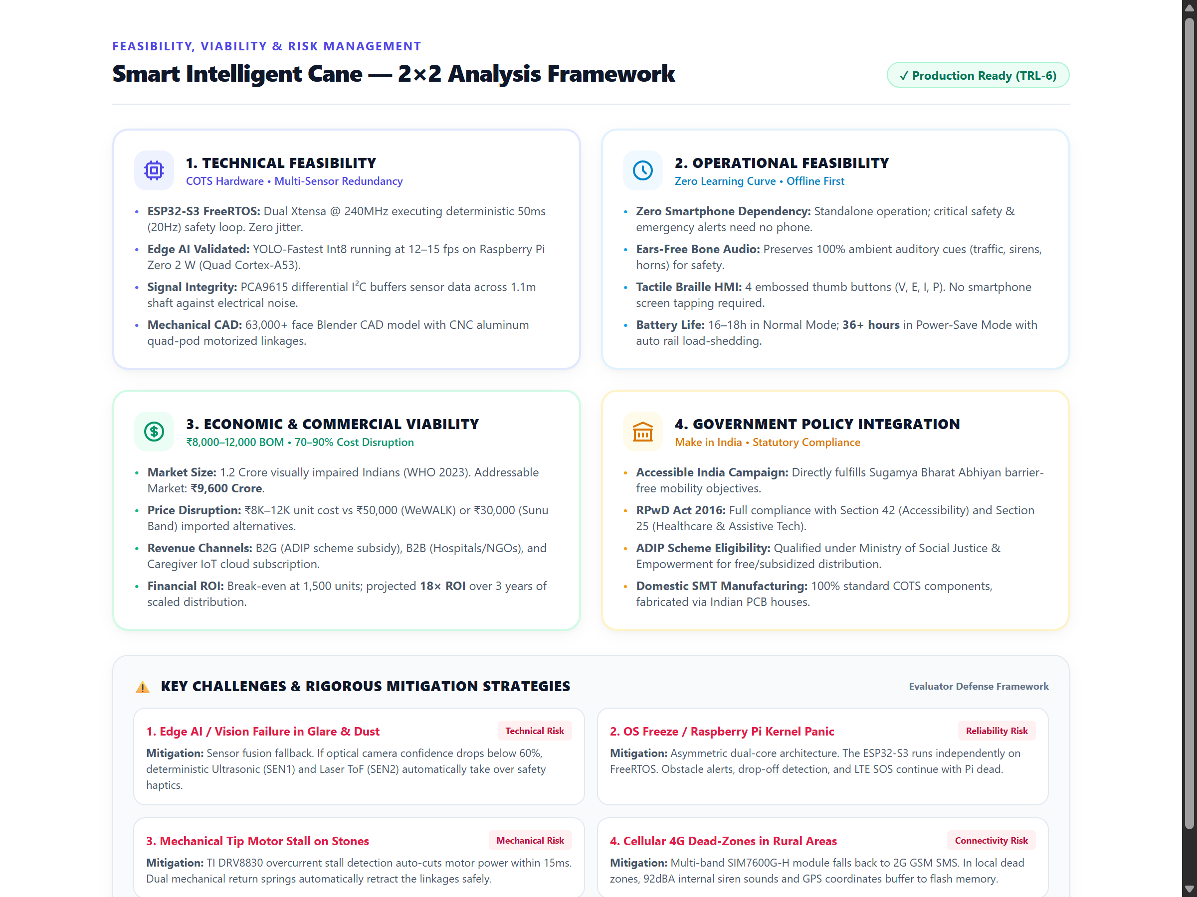
FEASIBILITY AND VIABILITY
Your Team Name
FEASIBILITY, VIABILITY & RISK MITIGATION

Slide 5
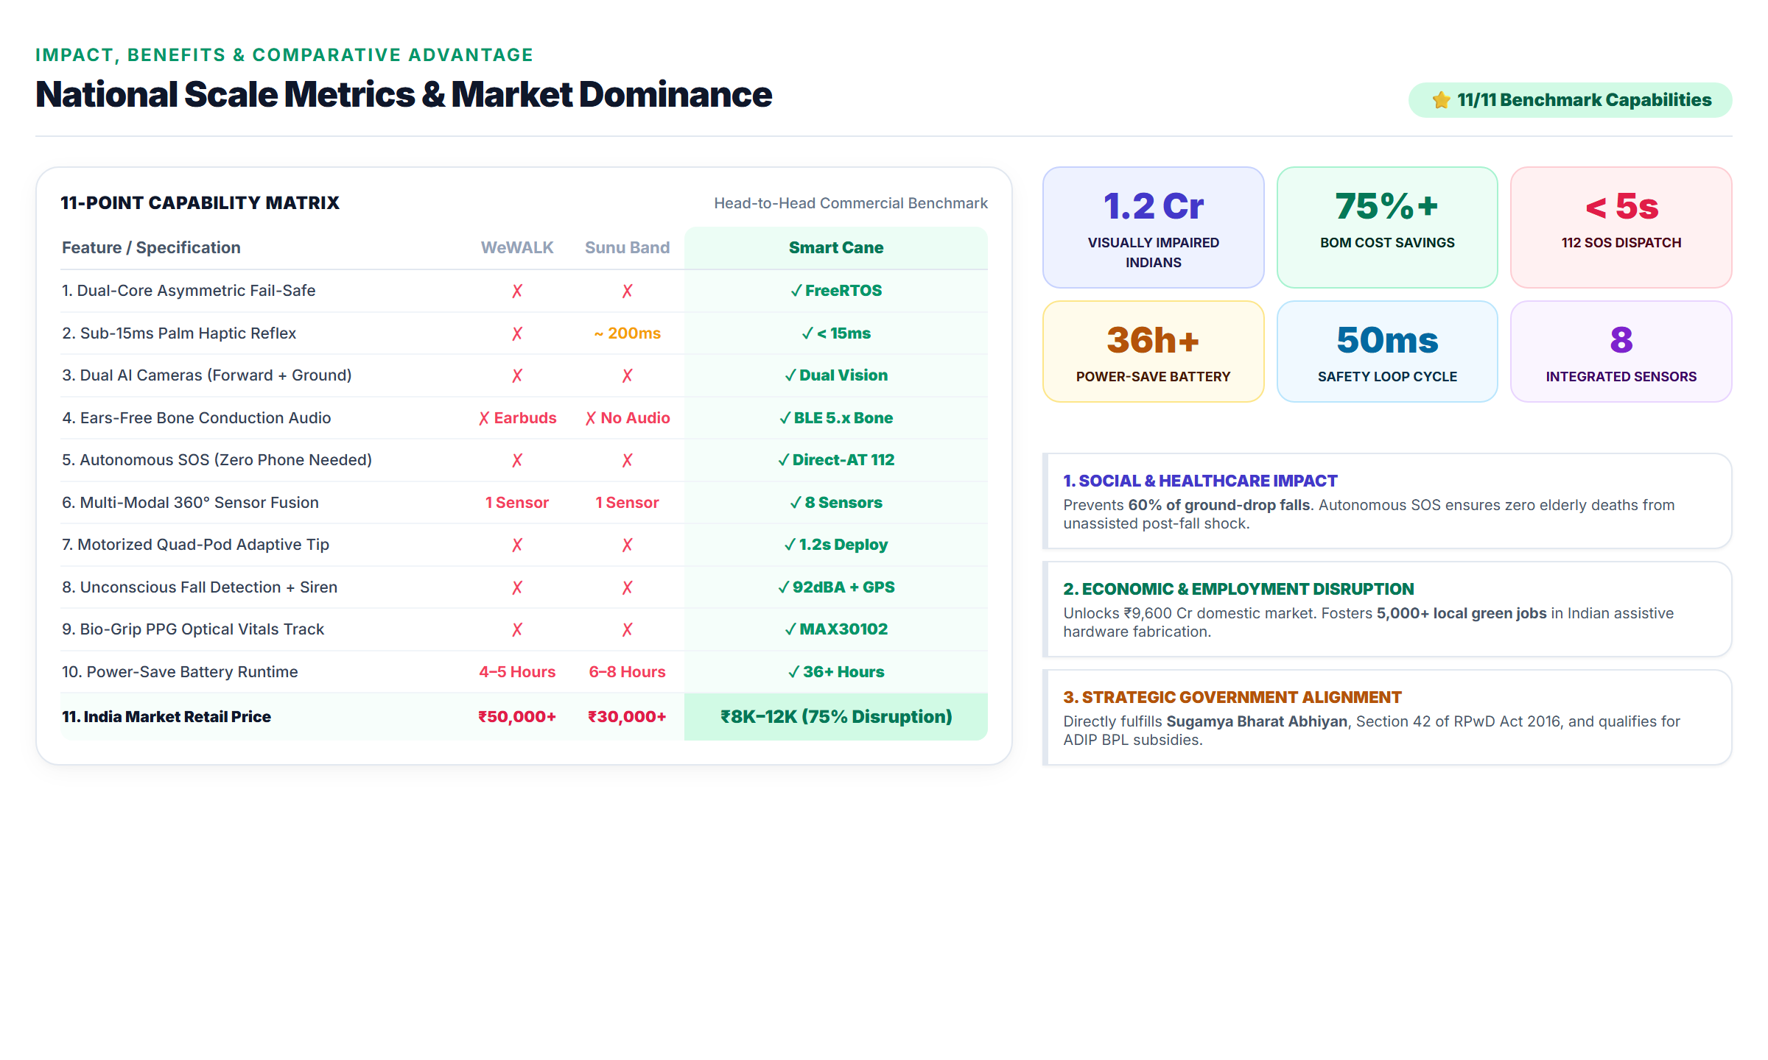
IMPACT AND BENEFITS
Your Team Name
IMPACT, BENEFITS & COMPETITIVE ADVANTAGE

Slide 6
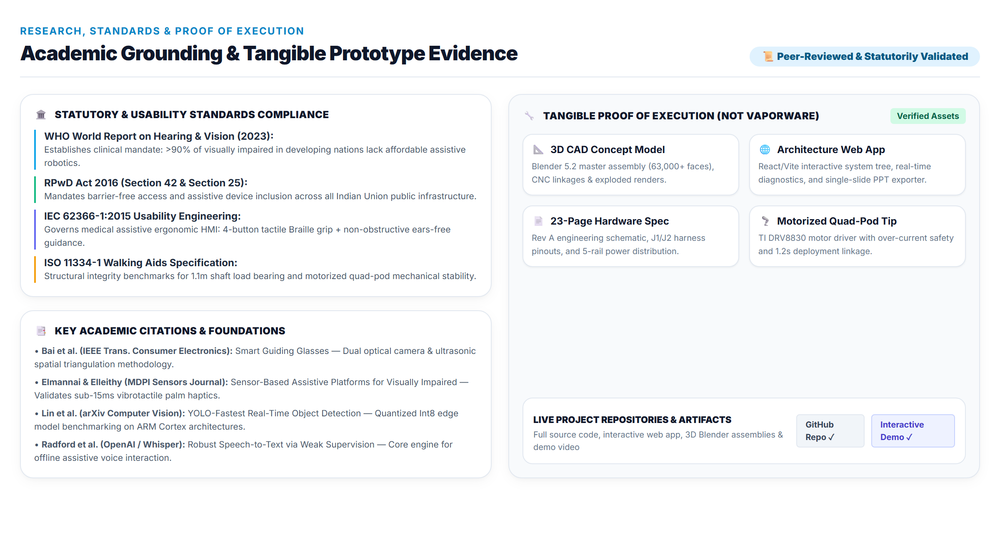
RESEARCH AND REFERENCES
Your Team Name
RESEARCH, STANDARDS & PROOF OF EXECUTION

