Slide 1
Mini Project - II
Modelling on Multivariate Time Series Classification & Data Analysis

Slide 2
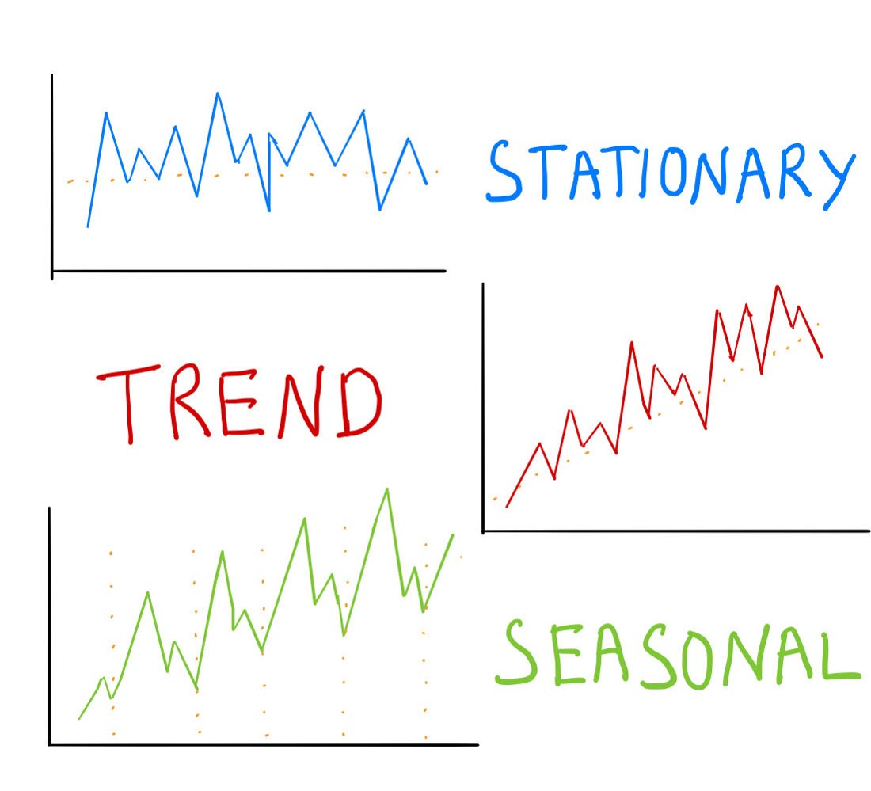
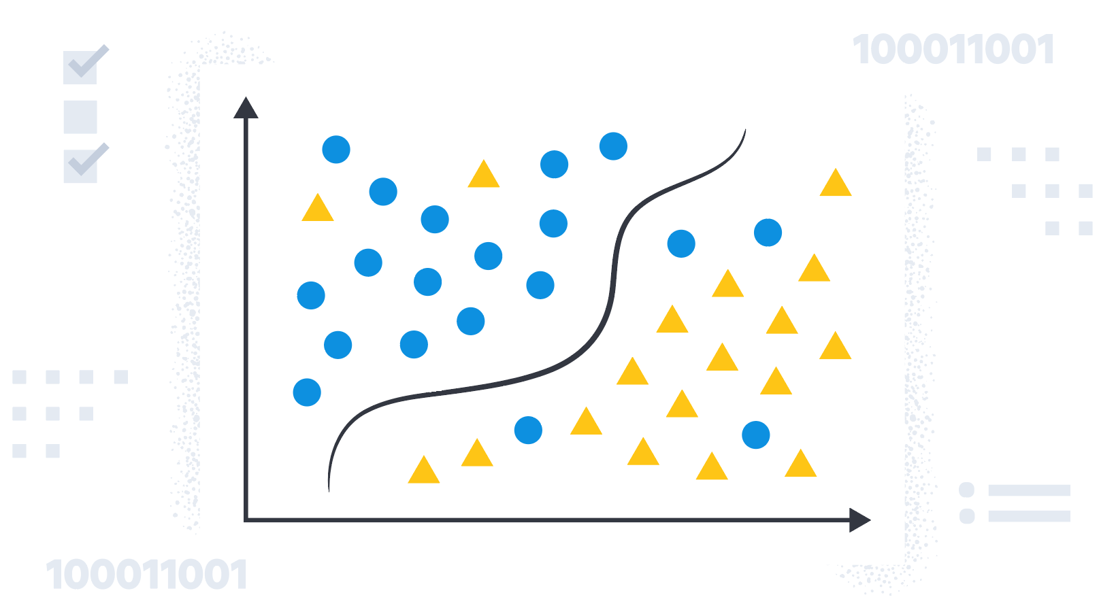
Introduction
Time Series
Time-series analysis is a statistical method of analyzing data from repeated observations on a single unit or individual at regular intervals over a large number of observations.
Machine Learning
Machine learning (ML) is a field of inquiry devoted to understanding and building methods that 'learn', that is, methods that leverage data to improve performance on some set of tasks.

Slide 3
DATA COLLECTION
Human Activity Recognition from Continuous Ambient Sensor-Data
This dataset represents ambient data collected in homes with volunteer residents.
Data is collected continuously while residents perform their normal routines.
This dataset has 37 attributes and has around 14 million data points.
The classification task is to predict the activity that is occurring in the smart home and being observed by the ambient sensors.

Slide 4
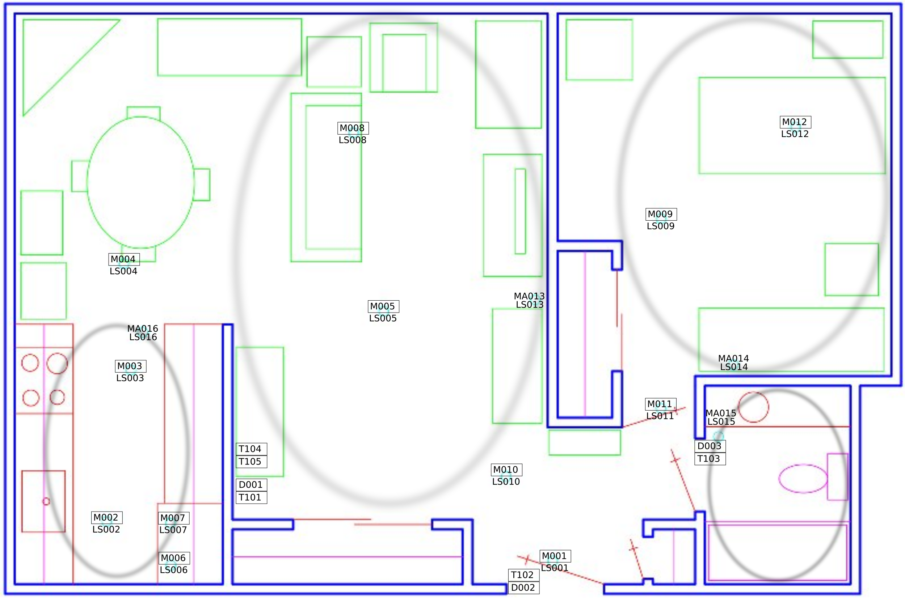
DATA COLLECTION

Slide 5
Machine Learning models used
Random Forest
Logistic Regression
Linear Support Vector Classifier
K – Nearest Neighbor Classifier
Gaussian Naïve Bayes
Multinomial Naïve Bayes
X Gradient Boost
LSTM-RNN Model

Slide 6
Machine Learning models used
Random Forest
Random forests or random decision forests is an ensemble learning method for classification, regression and other tasks that operates by constructing a multitude of decision trees at training time.
Logistic Regression
Logistic Regression is a type of statistical model which is often used for classification and predictive analytics.
A logistic regression model predicts a dependent data variable by analyzing the relationship between one or more existing independent variables.

Slide 7
Machine Learning models used
Linear Support Vector Classifier
Linear Support Vector Classifier is an algorithm that attempts to find a hyperplane to maximize the distance between classified samples linearly.
Linear SVC doesn’t support multi-class classification natively. It supports binary classification and separating data points into two classes.
K – Nearest Neighbor Classifier
K-nearest-neighbor classification was developed from the need to perform discriminant analysis when reliable parametric estimates of probability densities are unknown or difficult to determine.
It is used for classification and regression. In both cases, the input consists of the k closest training examples in a data set.

Slide 8
Machine Learning models used
Gaussian Naïve Bayes
Gaussian Naive Bayes supports continuous valued features and models each as conforming to a Gaussian (normal) distribution.
An approach to create a simple model is to assume that the data is described by a Gaussian distribution with no co-variance (independent dimensions) between dimensions.
Multinomial Naïve Bayes
Feature vectors represent the frequencies with which certain events have been generated by a multinomial distribution.
This is the event model typically used for document classification.
X Gradient Boost
In this algorithm, decision trees are created in sequential form. Weights play an important role in XGBoost.
Weights are assigned to all the independent variables which are then fed into the decision tree which predicts results.

Slide 9
LSTM-RNN
Recurrent Neural Network is a generalization of feedforward neural network that has an internal memory.
RNN is recurrent in nature as it performs the same function for every input of data while the output of the current input depends on the past one computation.
Long Short-Term Memory (LSTM) networks are a modified version of recurrent neural networks, which makes it easier to remember past data in memory.
The vanishing gradient problem of RNN is resolved here.

Slide 10
OUR PROJECT PHASES
Stage-1
Stage-2
Stage-3
Stage-4

Slide 11
STAGE ONE
No.
Model
Accuracy
No.
Target
Start Date
1
Random Forest Classifier
99.898%
2
Logistic Regression
30.521%
3
Linear Support Vector Classifier
31.72%
4
K-Nearest Neighbor Classifier
88.08%
5
Gaussian Naïve Bayes
83.4%

Slide 12
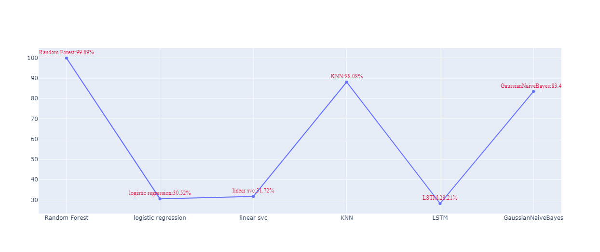
STAGE ONE

Slide 13
STAGE TWO
No.
Model
Accuracy
No.
Target
Start Date
1
Random Forest Classifier
99.2%
2
X Gradient Boost
99.66%
3
LSTM-RNN
37.3%
4
K-Nearest Neighbor Classifier
96.07%
5
Gaussian Naïve Bayes
90.07%

Slide 14
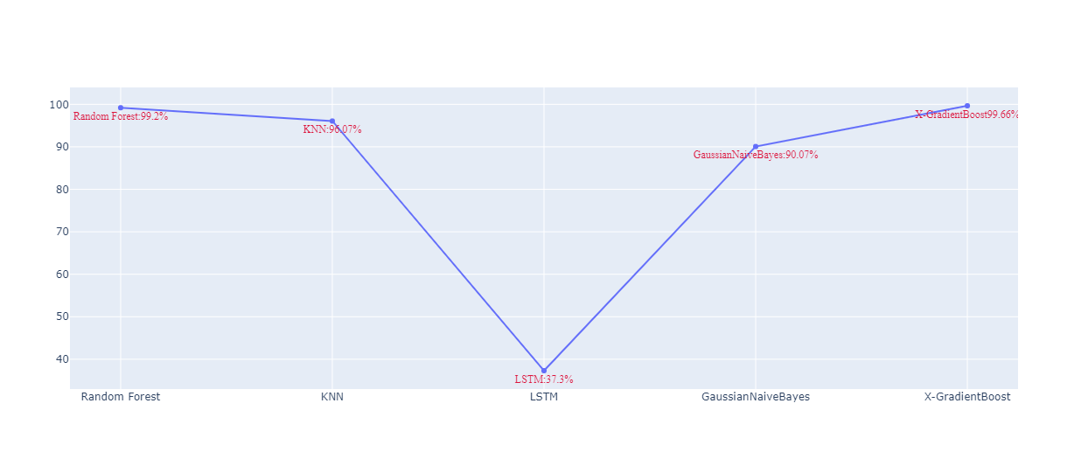
STAGE TWO

Slide 15
STAGE THREE
No.
Model
Accuracy
No.
Target
Start Date
1
Random Forest Classifier
74.72
2
X Gradient Boost
72.9%
3
LSTM-RNN
3.56%
4
K-Nearest Neighbor Classifier
50.82%
5
Gaussian Naïve Bayes
69.15%
6
Multinomial Naïve Bayes
44.52

Slide 16
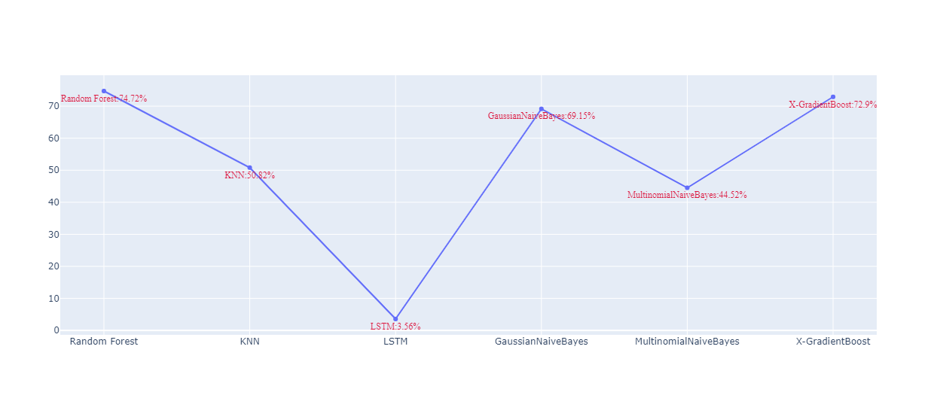
STAGE THREE

Slide 17
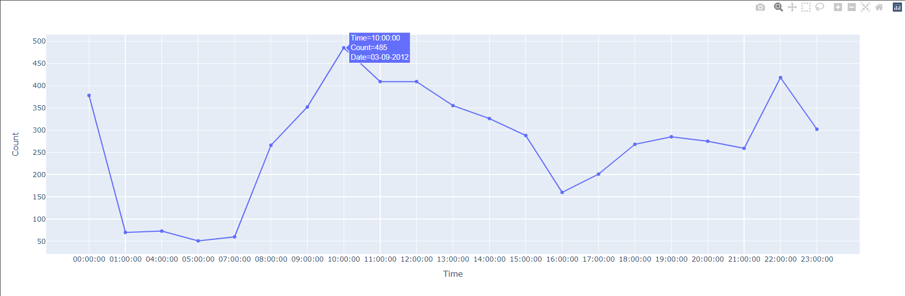
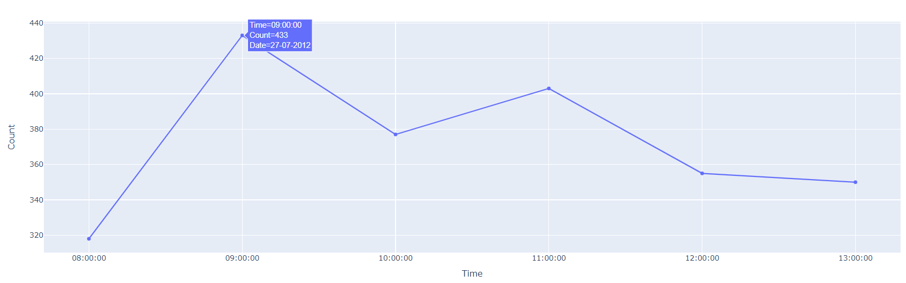
STAGE FOUR
Watching TV
Bathe

Slide 18
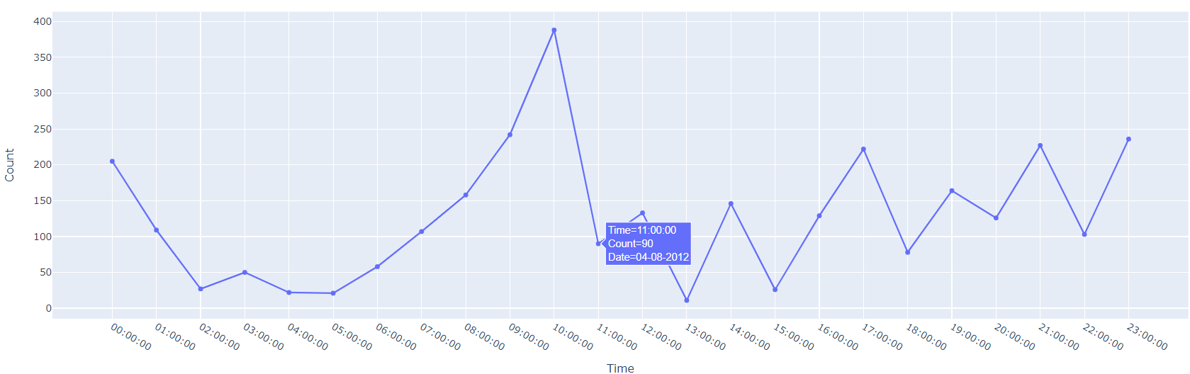
STAGE FOUR
Personal Hygiene

Slide 19
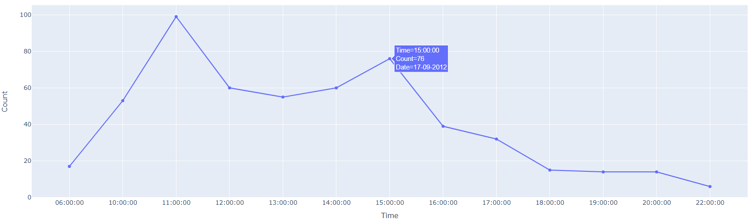
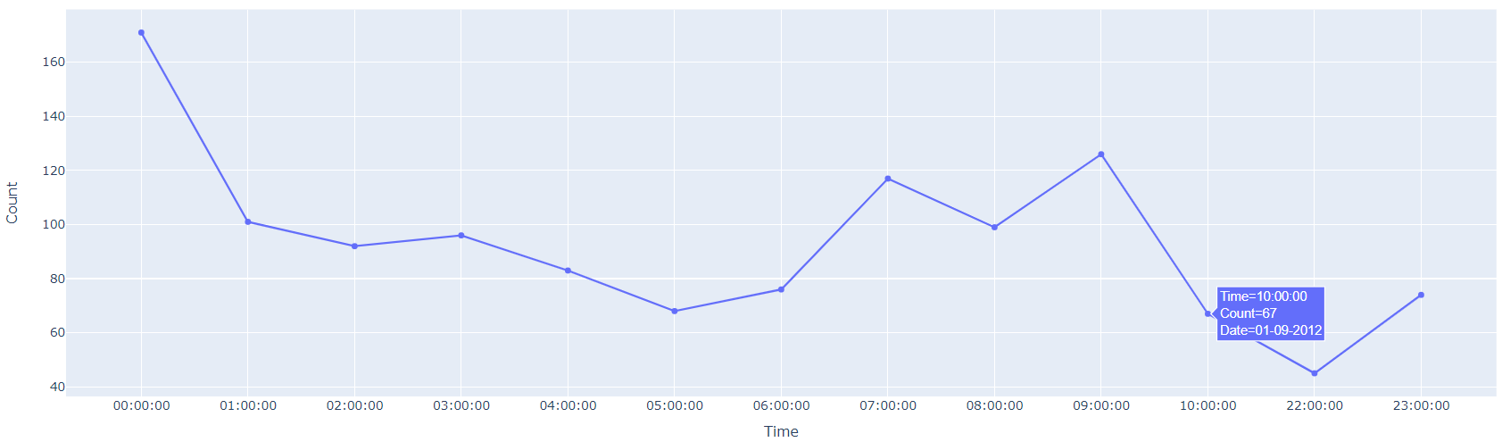
STAGE FOUR
Phone
Sleep

Slide 20
THANK YOU
Presented by:
19BCS015 B S Sathwik Goud
19BCS043 G Mohith Krishna
19BCS056 Kola Lokesh
19BCS085 P Goutam

