Slide 1

Exploratory Data Analysis and Visualization of Diabetes Prediction Dataset
DSA0613- Data Handling and Data Visualization for Data Analytics
Submitted By: Guided By:
C. Jasvina(192324026) Dr. Kumaragurubaran T
P. Mohitha(192324025) Dr. Senthilvadivu S

Slide 2


ABSTRACT
Diabetes is a major health problem, and analyzing medical data helps in identifying important risk factors associated with the disease.
This project performs Exploratory Data Analysis (EDA) on a diabetes dataset using preprocessing and visualization techniques.
Visualizations such as histograms, boxplots, scatter plots, correlation heatmaps, and PCA are used to study distributions and relationships among features.
The analysis identifies glucose as the most influential factor, with BMI and age also contributing to diabetes risk.

Slide 3
PROBLEM STATEMENT
Diabetes datasets contain multiple medical attributes, but raw data often includes missing values, zero entries, and outliers that affect analysis accuracy.
Without proper exploratory data analysis, understanding data distributions and key patterns related to diabetes becomes difficult.
Identifying relationships between health parameters such as glucose, BMI, age, and diabetes outcome is challenging using only numerical data.
There is a need for effective data preprocessing and visualization techniques to extract meaningful insights from diabetes prediction datasets.

Slide 4
OBJECTIVES
To clean and preprocess the diabetes dataset by handling missing values and outliers.
To analyze the distribution of key health parameters such as Glucose, BMI, Age, Insulin, and Blood Pressure.
To visualize relationships between medical attributes and diabetes outcome using suitable plots.
To identify influential factors associated with diabetes through exploratory data analysis and visualization techniques.

Slide 5
SIGNIFICANCE OF THE STUDY
Helps in understanding important health factors associated with diabetes through data analysis.
Provides clear visual insights into complex medical data, making interpretation easier.
Highlights the importance of exploratory data analysis before applying predictive models.
Supports data-driven decision making in healthcare analytics and research.

Slide 6
SCOPE OF THE PROJECT
The project focuses on exploratory data analysis and visualization of a diabetes prediction dataset.
Analysis is limited to key attributes such as Glucose, BMI, Age, Insulin, Blood Pressure, and Outcome.
Both univariate and multivariate visualization techniques are applied to study data patterns and relationships.
The study is performed using R programming and does not include predictive or machine learning models.

Slide 7
OVERALL METHODOLOGY
The project follows a two-module approach.
Module 1: Exploratory Data Analysis and distribution visualization of diabetes data.
Module 2: Relationship analysis and multivariate visualization of diabetes outcome.
Data cleaning, preprocessing, statistical analysis, and visualization are performed entirely in R.
Results from both modules are combined to identify key factors associated with diabetes.

Slide 8
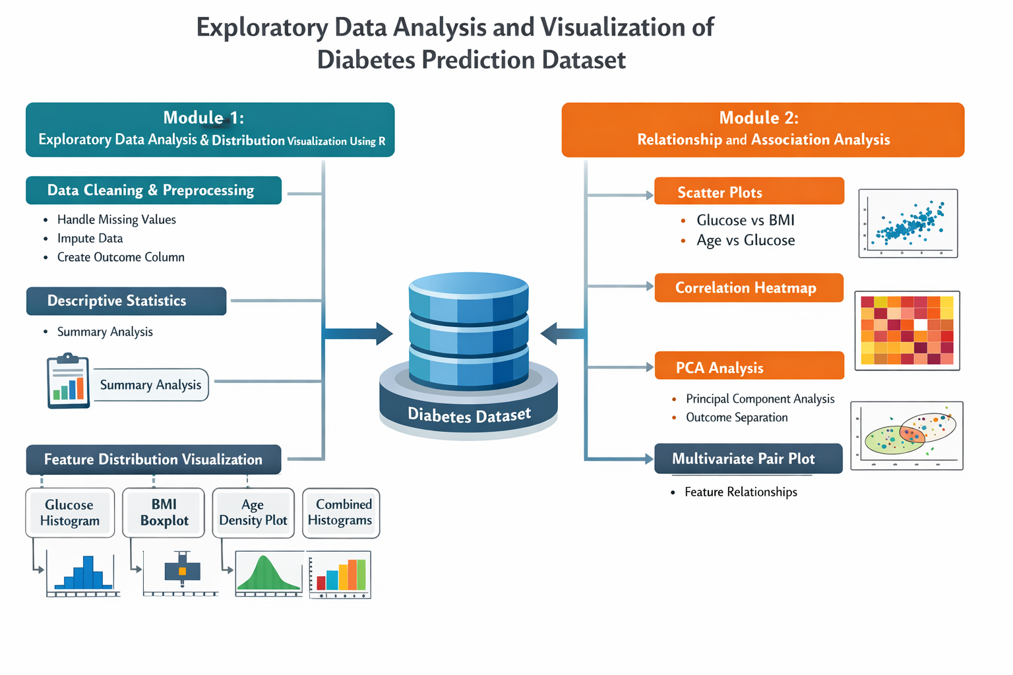
SYSTEM ARCHITECTURE

Slide 9
TOOLS AND TECHNOLOGIES
Programming Language: R
IDE: RStudio
Libraries:
Ggplot2
Dpylr
tidyverse
Corrplot

Slide 10
MODULE-1
Loads and explores the diabetes dataset to understand its structure and features.
Cleans the data by handling missing values and invalid entries.
Computes descriptive statistics for key health attributes.
Uses histograms, boxplots, and density plots to visualize feature distributions and detect outliers.
Identifies skewness and variability in medical attributes.
Prepares a clean and reliable dataset for further relationship analysis in Module 2.

Slide 11
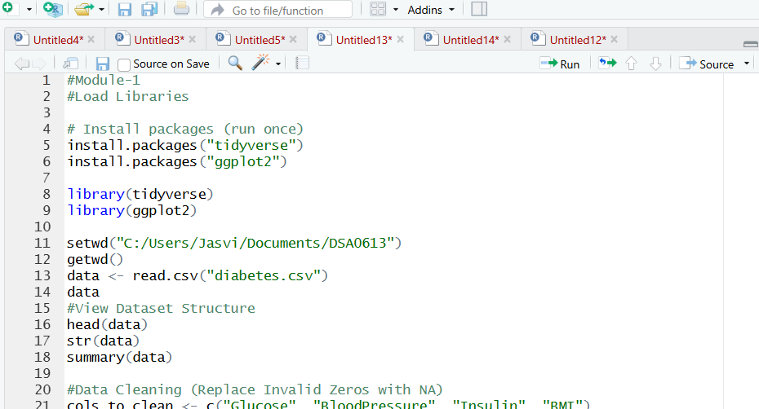
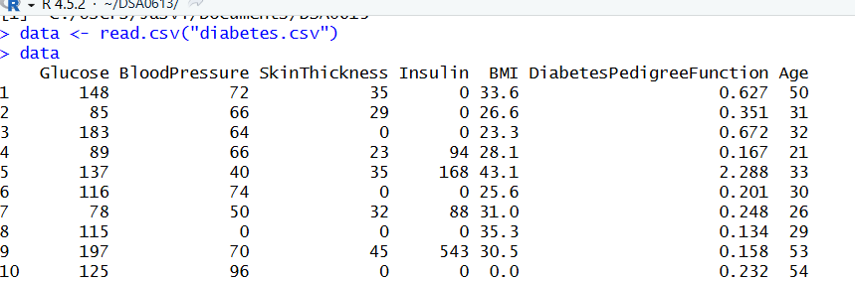
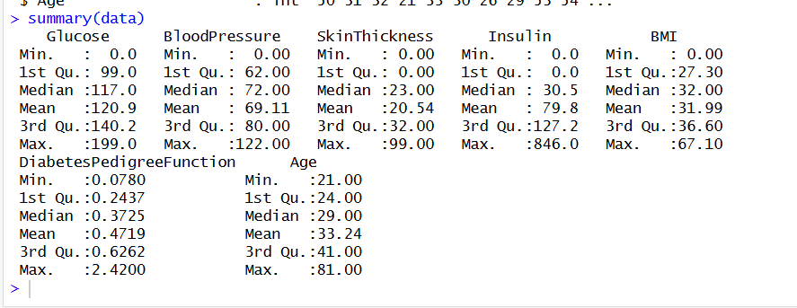
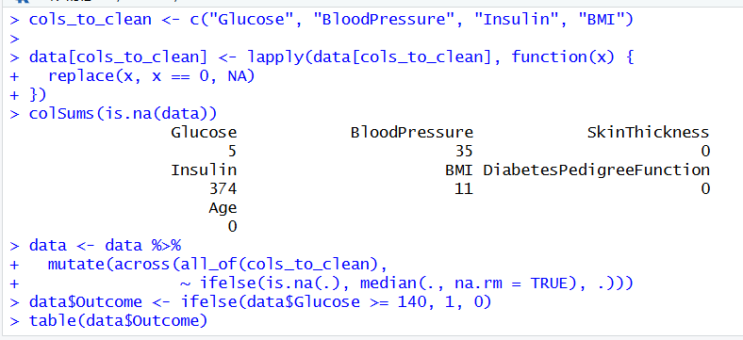
MODULE-1

Slide 12
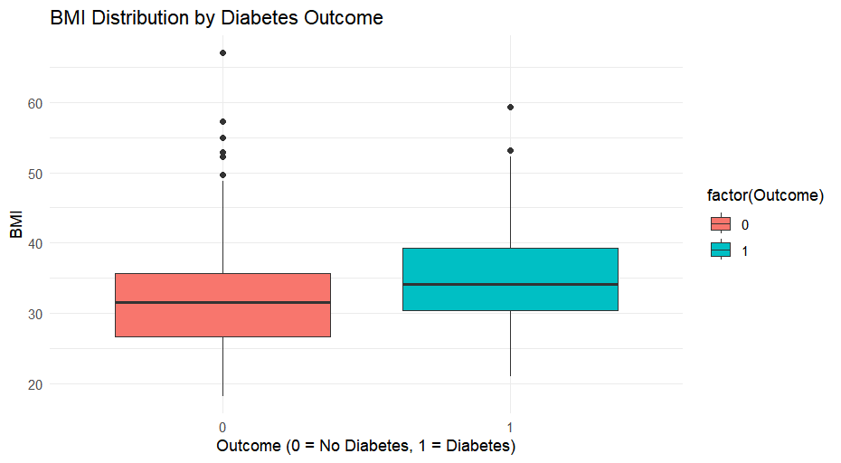
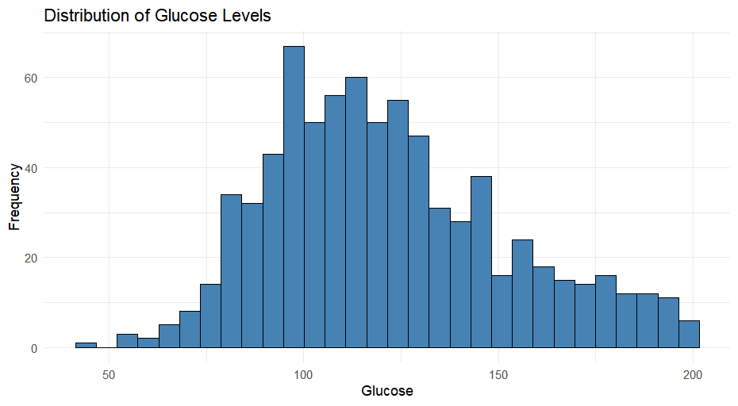
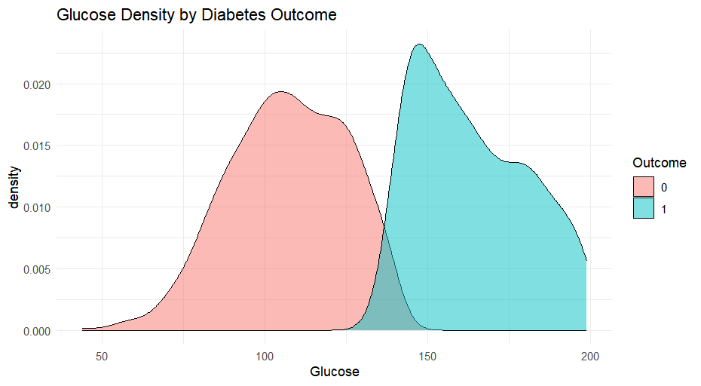
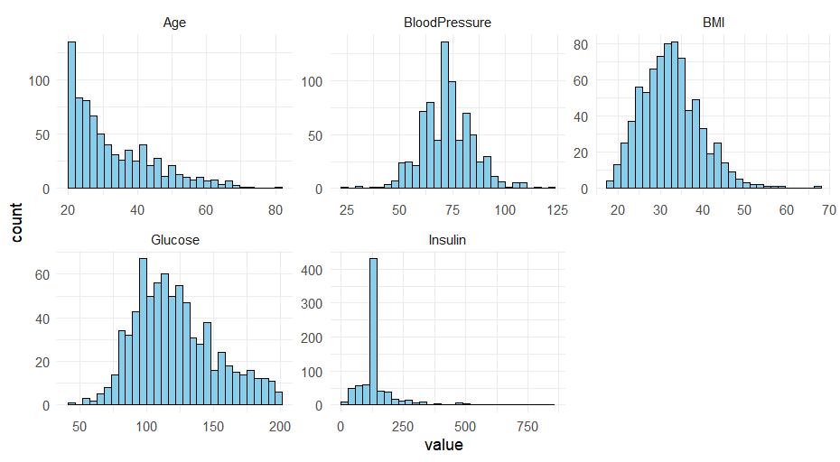
MODULE-1 OUTPUT

Slide 13
MODULE-2
Focuses on analyzing relationships between health attributes and diabetes outcome.
Uses scatter plots to study interactions between Glucose, BMI, Age, and Outcome.
Examines associations between variables to identify influential factors related to diabetes.
Applies correlation analysis and multivariate visualization to understand feature interdependencies.
Helps distinguish patterns between diabetic and non-diabetic cases.
Supports deeper insight beyond individual feature analysis.

Slide 14
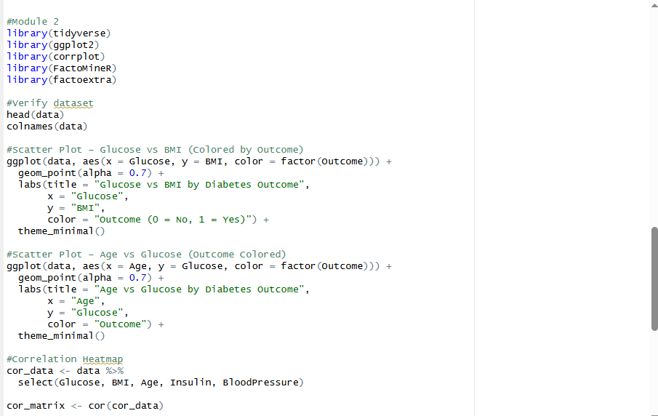
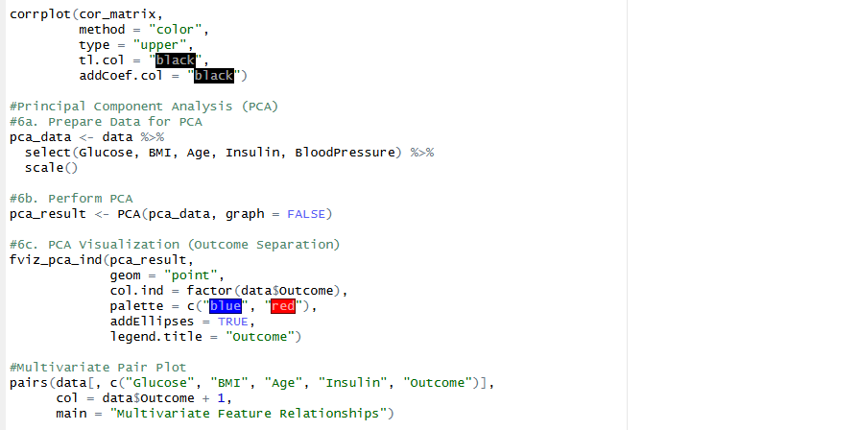
MODULE-2

Slide 15
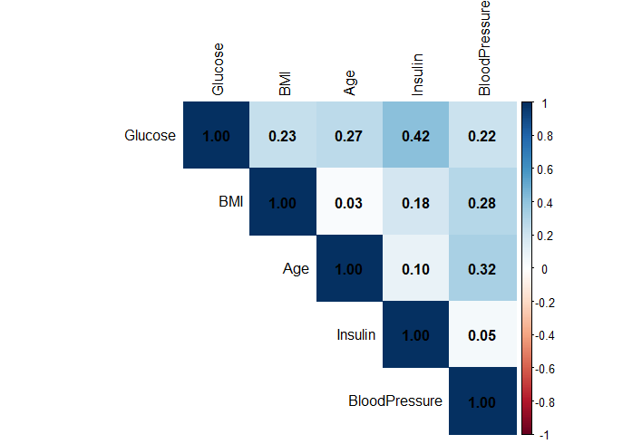
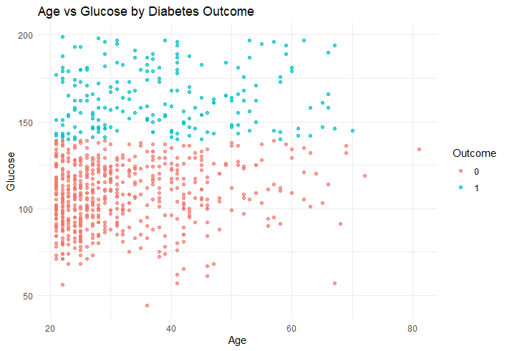
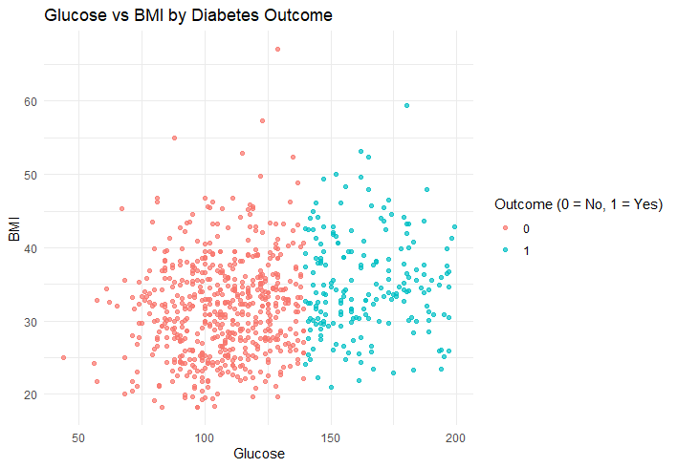
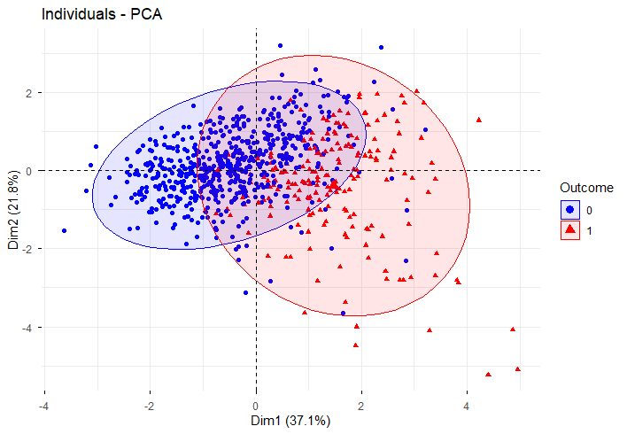
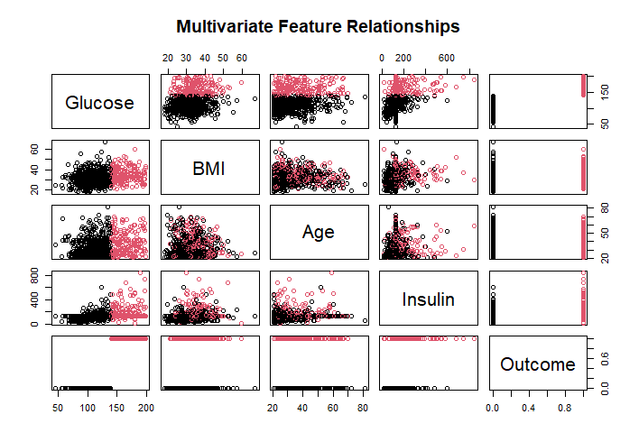
MODULE-2 OUTPUT

Slide 16
LEARNING OUTCOMES
Gained hands-on experience in data cleaning, preprocessing, and exploratory data analysis using R.
Learned to visualize data distributions and relationships using appropriate plots and charts.
Developed the ability to interpret medical data and identify key factors associated with diabetes.
Improved analytical thinking and understanding of visualization-driven data analysis in healthcare.

Slide 17
CONCLUSION
The project successfully explored and visualized the diabetes prediction dataset using exploratory data analysis techniques.
Data preprocessing and visualization helped in understanding feature distributions, patterns, and outliers.
Relationship analysis highlighted glucose as the most influential factor associated with diabetes.
Overall, the study demonstrates the importance of EDA and visualization in healthcare data analysis.

Slide 18
REFERENCE
Kumar, R., & Verma, S. (2023). Exploratory Data Analysis Techniques for Healthcare Datasets. International Journal of Data Science and Analytics, 16(2), 95–104.
Patel, A., & Shah, N. (2024). Statistical Analysis and Visualization of Diabetes Prediction Data. International Journal of Medical Informatics, 19(1), 48–56.
Singh, D., & Kaur, H. (2023). Visualization of Diabetes Risk Factors Using R Programming. International Journal of Healthcare Information Systems, 10(1), 41–48.
Joshi, M., & Kulkarni, P. (2024). Data Wrangling and Descriptive Statistical Analysis for Clinical Datasets. International Journal of Advanced Computer Science and Applications, 15(5), 198–205.
Mehta, A., & Rao, S. (2025). Histogram, Boxplot, and Density Plot Techniques for Healthcare Data Exploration. Journal of Medical Data Analytics, 4(1), 12–20.

Slide 19


