Slide 1

Design and Verification of AHB2APB Bridge using UVM
ECE593 – Fundamentals of Pre-Silicon Validation
Team Members
Daniel Jacobsen
Balaji Ginkal Harisha
Mohith Kumar Bennahatti Chikkegowda
Akshaya Kudumalakunte Ravi Kumar

Slide 2
Table of Contents:
Introduction
AHB2APB Bridge Overview
AHB Bus Protocol
APB Bus Protocol
AHB2APB Bridge
AHB2APB Bridge Functionality
Read and Write Transfer
Verification Plan
UVM Testbench Architecture
Test Cases
Simulation Results
Coverage report
Conclusion
References

Slide 3
AHB2APB Bridge Overview
Purpose:
Acts as an interface between AHB (Advanced High-Performance Bus) and APB (Advanced Peripheral Bus).
Converts AHB transactions to APB transactions.
Key Features:
Handles synchronization, protocol adaptation, and control signals.
Supports pipelined AHB and non-pipelined APB protocols.

Slide 4
AHB Bus Protocol
Features:
High-performance, pipelined bus.
Supports burst transfers, split transactions, and single-cycle handover.
Key Signals:
HCLK(Bus clock)
HRESETn
HADDR[31:0]
HWRITE[1:0]
HBURST[2:0]
HWDATA[31:0]
HRDATA[31:0]
HREADY
HRESP

Slide 5
APB Bus Protocol
Features:
Low-power, simple bus for peripherals.
Supports single-cycle read/write transactions.
Key Signals:
PCLK
PRESETn
PENABLE
PWRITE
PADDR
PWDATA
PRDATA
PREADY

Slide 6
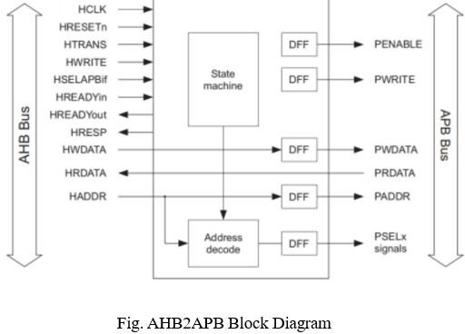
AHB2APB Bridge

Slide 7
AHB2APB Bridge Functionality
Key Functions:
Latches and decodes AHB addresses.
Generates PSEL signals for APB peripherals.
Converts AHB transactions to APB transactions.
Handles wait states for synchronization.
Write Transfer:
Converts HRDATA to PWDATA.
Read Transfer:
Converts PRDATA to HRDATA.

Slide 8
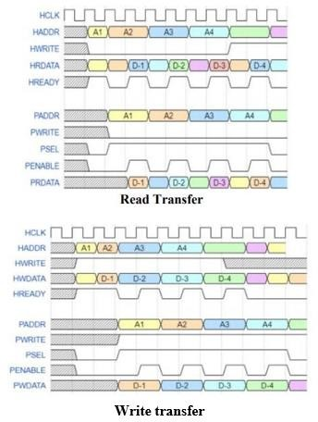
Read and Write Transfer

Slide 9
Verification Plan
Verification Objectives:
Ensure correct data transfer between AHB and APB.
Verify protocol compliance (AHB and APB).
Handle error conditions, and corner cases.
Verification Levels:
Top-level module verification for end-to-end functionality.

Slide 10
UVM Testbench Architecture
UVM Components:
AHB Agent: Driver, Sequencer, Monitor.
APB Agent: Driver, Sequencer, Monitor.
Scoreboard: Compares expected vs. actual transactions.
Verification Flow:
Build → Connect → Run → Check → Report.

Slide 11
Test Cases
Test Types:
Single Read/Write: Basic read/write operations.
Burst Read/Write: Burst mode transactions.
Corner Cases: Address boundary testing, error injection.

Slide 12
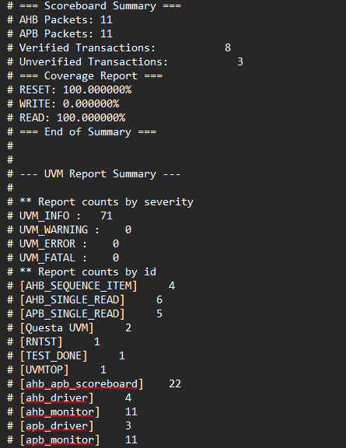
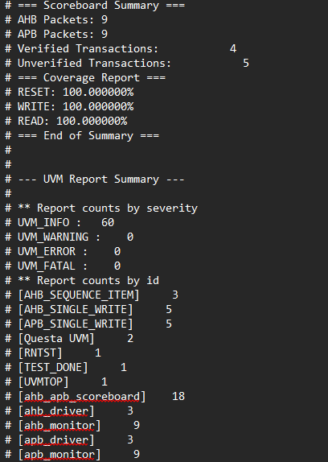
Simulation Results
Single Read/Write: Basic read/write operations.

Slide 13
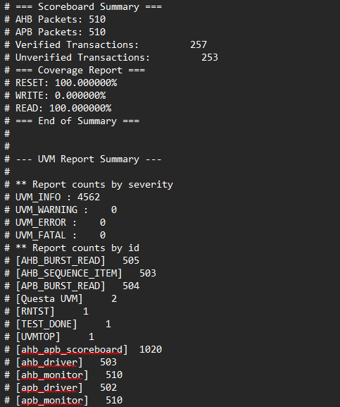
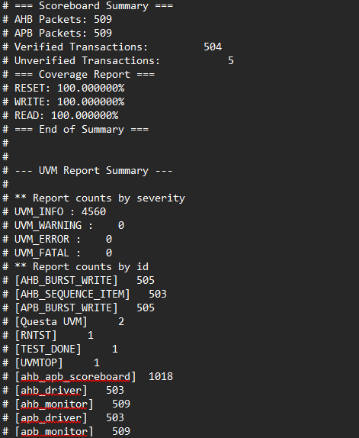
Simulation Results
Burst Read/Write: Burst mode transactions.

Slide 14
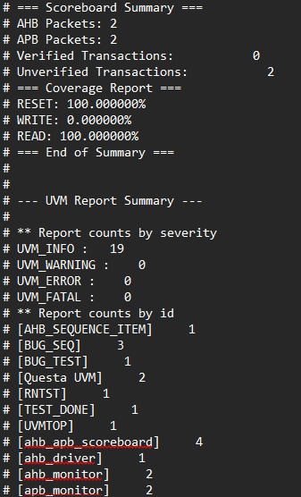
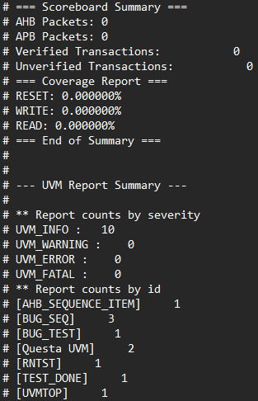
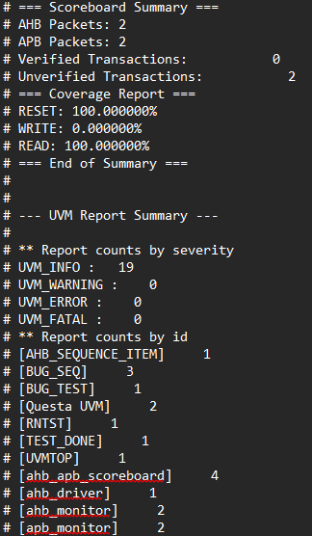
Simulation Results
Corner Cases: Address boundary testing, error injection.
Address Mismatch
Dropped Transaction
Write Corruption
-Added +4
- Scoreboard confirms 0 verified transactions and 2 unverified
- Printed transactions shows h85006177 and h8500617b
-No finish items leaving the transaction “open”
-Driver never picks it up for execution.
-Verified with 0 packets and 0 verified transactions.
-Shows no false packets
-Modifies HWDATA by XORing with 32’F
-Test values changes from h57b7e1b0 to ha8481e4f
-Verification vails because of corruption

Slide 15
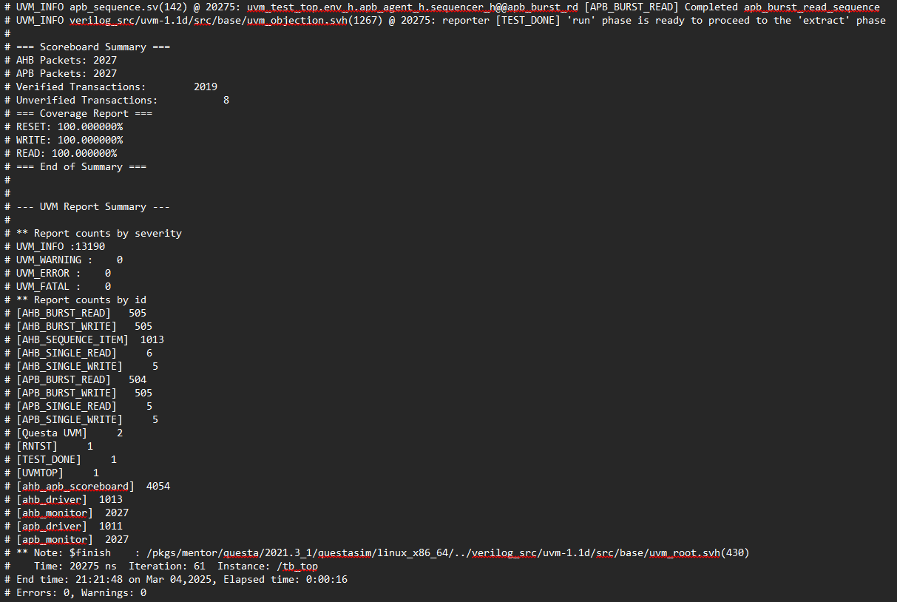
Simulation Results
Combined Cases: Combined read/write and burst read/write.

Slide 16
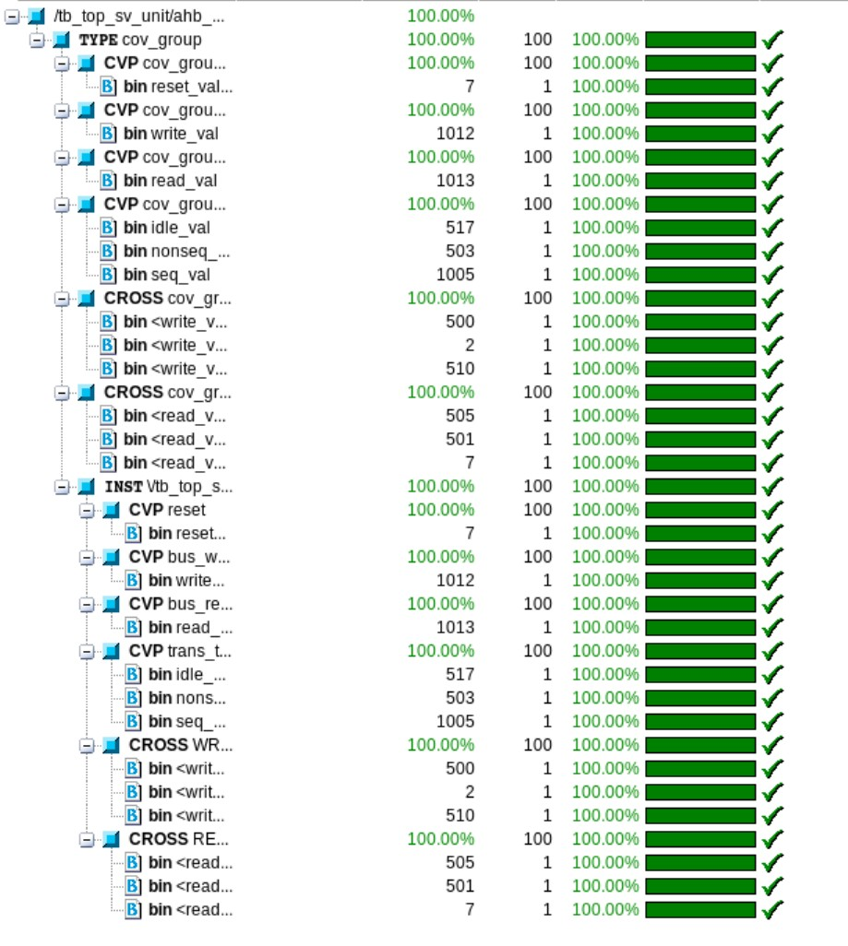
Coverage report:

Slide 17
Conclusion
Successfully designed and verified the AHB2APB bridge.
Achieved high functional and code coverage.

Slide 18
References
GitHub Repositories:
AHB-to-APB-Bridge
Pre_Silicon-AHB-to_APB-Verification
Tools:
QuestaSim, EDA Playground.

