Slide 1
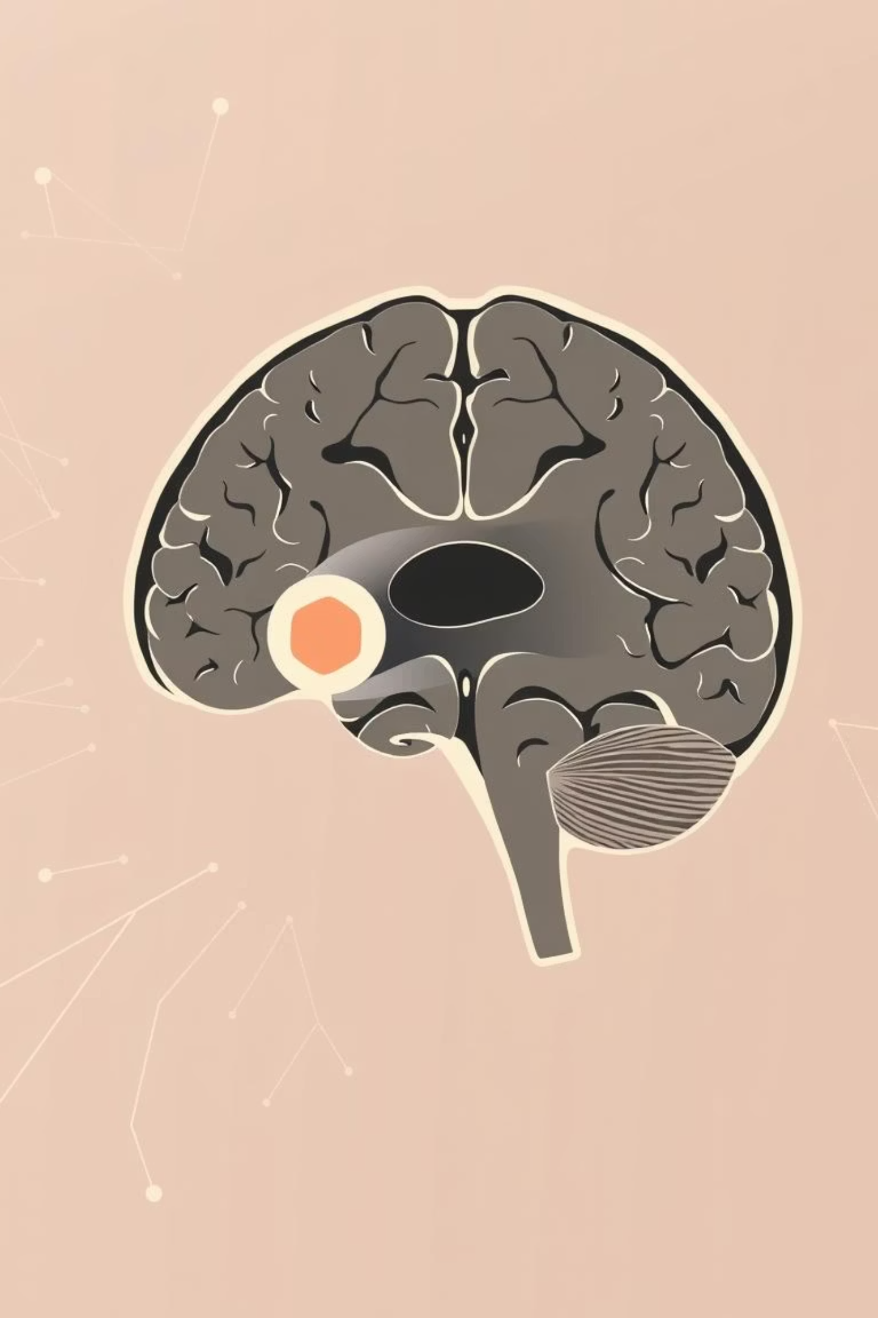
Automated Brain Tumor Segmentation: An Advanced Approach
Presented by our dedicated team of researchers and engineers, this presentation delves into cutting-edge deep learning methodologies for precise brain tumor segmentation.

Slide 2
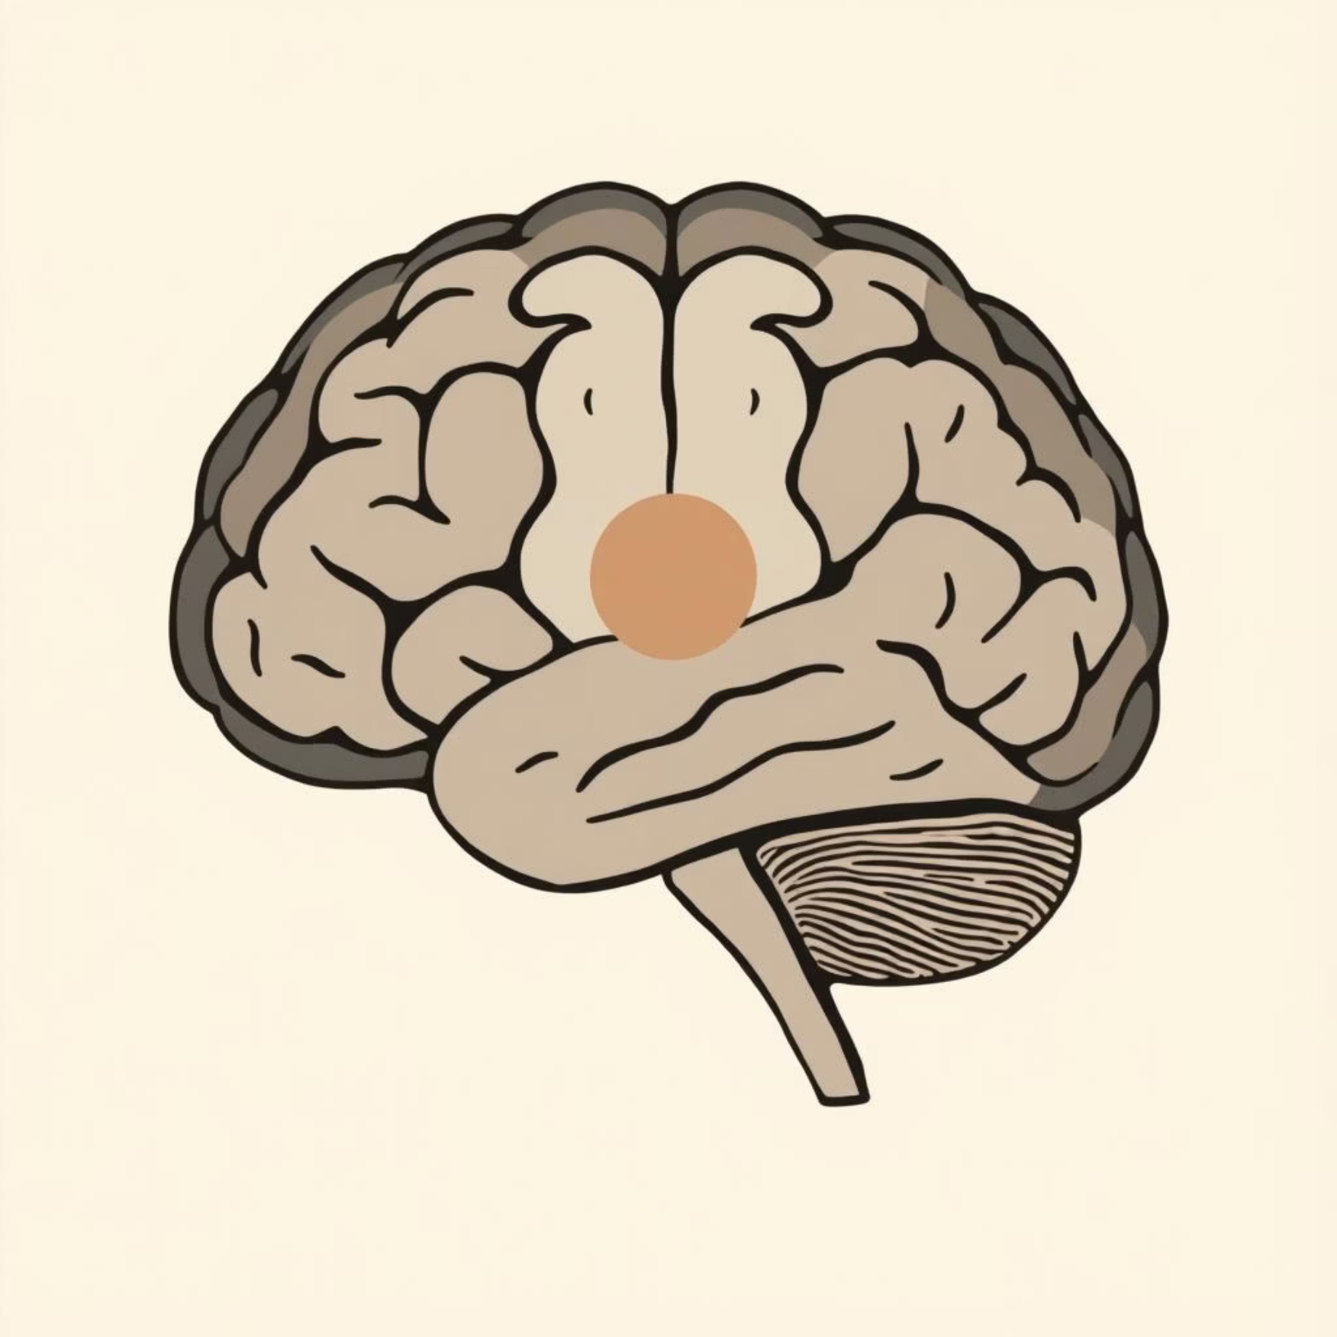
Section 1
The Imperative of Image Segmentation
Brain Tumor Overview
Major cause of cancer-related morbidity & mortality worldwide.
Common types: Gliomas (incl. Glioblastoma Multiforme – GBM) and Meningiomas.
GBM facts: Most aggressive malignant brain tumor, rapid progression, poor prognosis, 5-year survival rate <10%.
Symptoms depend on tumor location: Persistent headaches, seizures, cognitive decline, motor impairments.
Diagnosis Challenges
Early signs mimic benign neurological conditions.
MRI is the primary detection tool (superior to CT).
Tumors show irregular borders, necrosis, or edema.
Risk of confusion with abscesses or demyelination.

Slide 3





Section 2
Deep Learning in Brain Tumor Segmentation
Deep Learning Role
MRI-based Segmentation
Clinical Importance
Automates feature extraction & segmentation using CNNs & U-Net variants.
Crucial for radiotherapy planning, surgical navigation, & treatment evaluation.
Delineates enhancing tumor, core, & edema, enhancing sensitivity.
Key Challenges
Need for Automation
Tumor heterogeneity, overlapping intensities, & annotation variability.
Reduces human bias, improves reproducibility, & speeds up diagnosis.

Slide 4
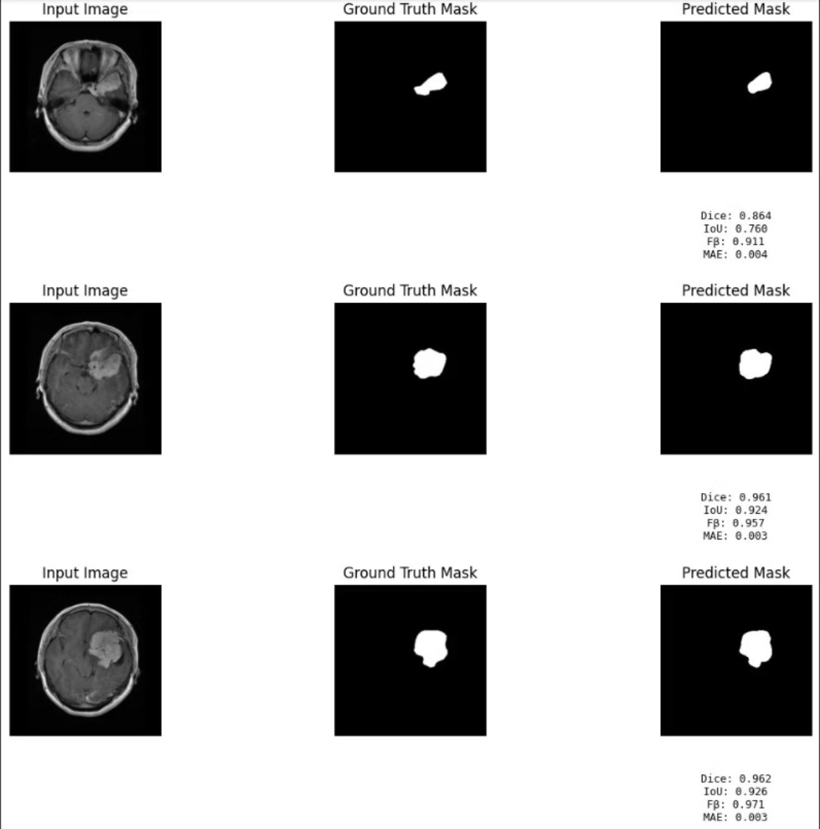
Model Architectures
MINet: A Multi-Scale Information Network
MINet, or Multi-Scale Information Network, is designed to capture both local and global contextual information effectively. Its architecture leverages multiple receptive fields to enhance feature representation, crucial for segmenting highly heterogeneous brain tumors.
This approach helps in distinguishing subtle boundaries and intricate structures, leading to more accurate segmentation results.

Slide 5
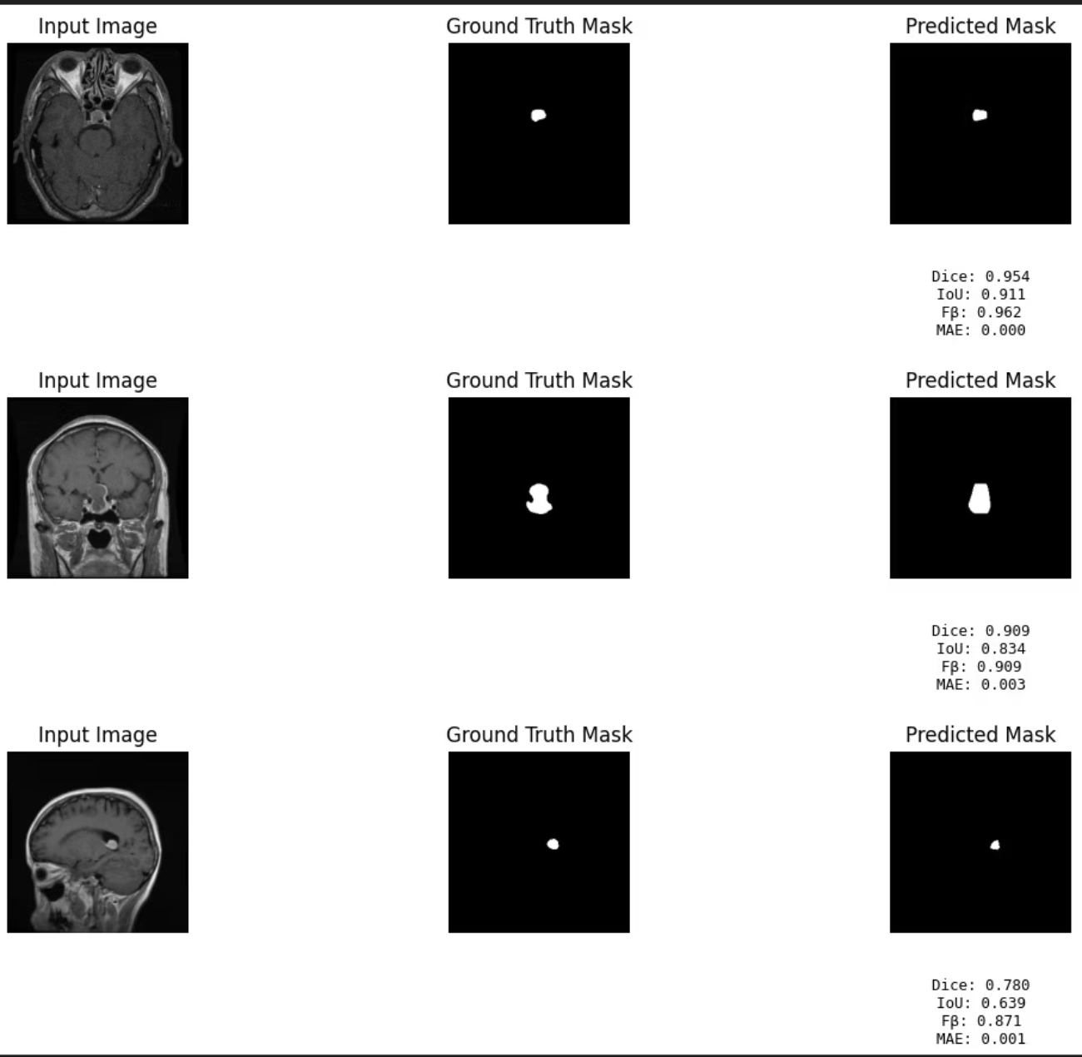
Model Architectures
F3Net: Feature Fusion and Feedback Network
F3Net excels in integrating features from various levels and scales through a robust feedback mechanism. This allows the network to refine its segmentation predictions iteratively, leading to improved accuracy.
The feedback loops ensure that finer details are not lost, which is particularly beneficial for handling the complex morphology of brain tumors.

Slide 6

Model Architectures
ALMNet: Attention-Guided Location-Aware Module Network
ALMNet integrates attention mechanisms to focus on relevant regions of the MRI scans, enhancing the network's ability to precisely locate and segment tumor boundaries.
Its location-aware modules are crucial for distinguishing tumor tissue from surrounding healthy brain structures, improving overall specificity in segmentation.

Slide 7
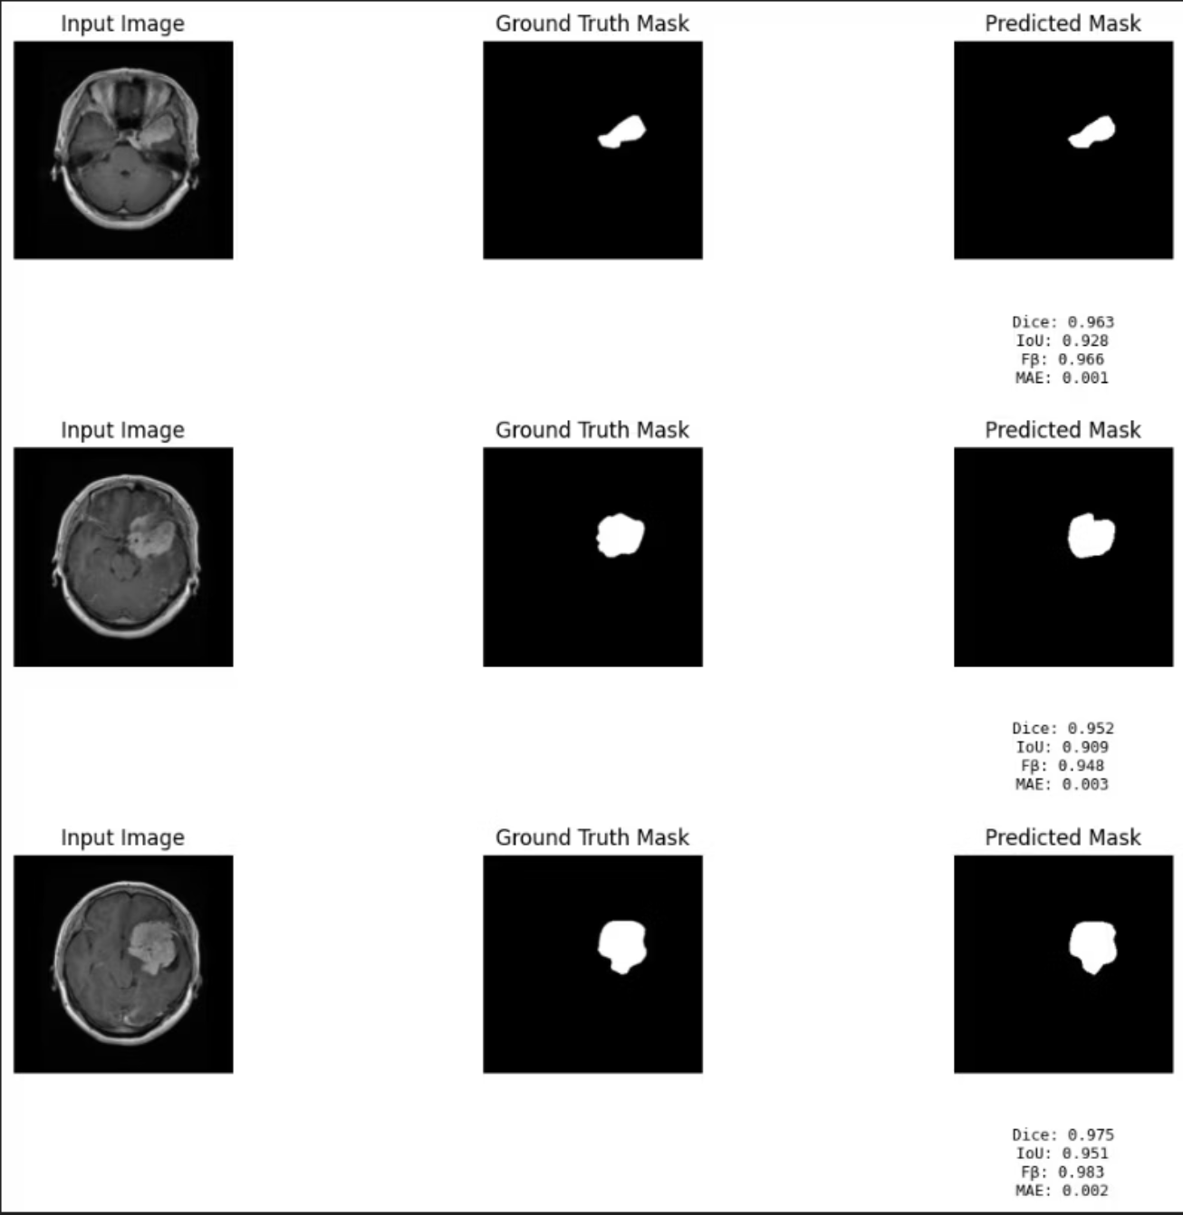
Model Architectures
DeepLabV3: Atrous Convolution for Semantic Segmentation
DeepLabV3 employs atrous convolution (also known as dilated convolution) to capture multi-scale context without increasing the number of parameters or losing resolution.
This technique is highly effective for semantic segmentation tasks, allowing the model to analyze images at various scales and integrate information to delineate complex tumor shapes.

Slide 8
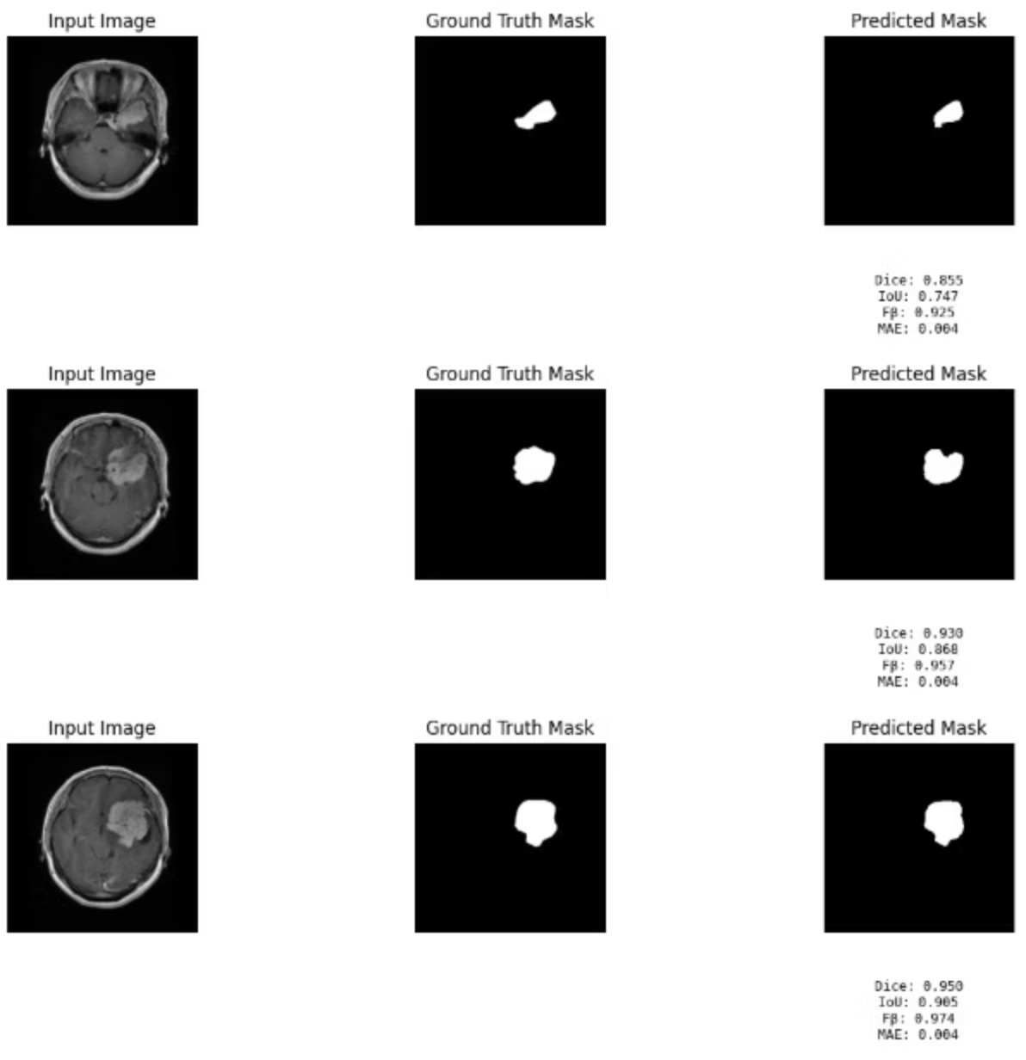
Model Architectures
WDUNet: Weighted Deep U-Net
WDUNet introduces a weighted mechanism into the classic U-Net architecture, allowing it to emphasize more critical features during segmentation.
This weighting is particularly useful for handling class imbalance issues, where tumor regions are significantly smaller than healthy tissue, leading to more balanced and accurate predictions.

Slide 9
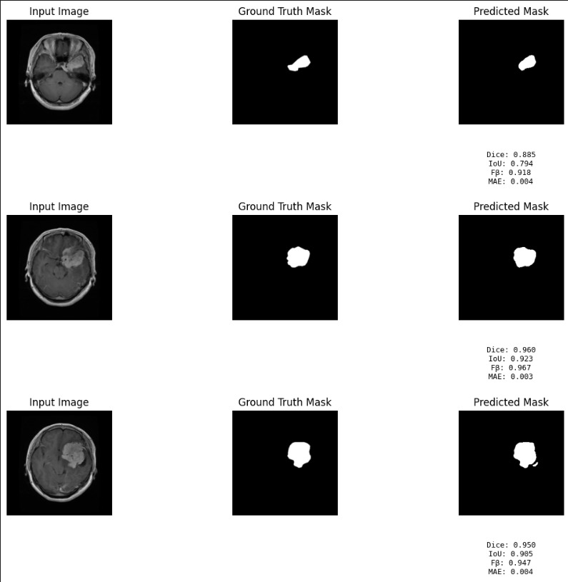
Our Contribution
FusionNet: Our Model's Results
FusionNet combines the strengths of various architectures, achieving robust and
highly accurate segmentation results. Our model demonstrates superior performance
In delineating tumor boundaries and identifying intricate structures within MRI images.

Slide 10
Performance Metrics
Comparative Analysis of Segmentation Models
Model
MSE
MAE
F-beta
UNet
0.012
0.0183
0.5571
DeepLabV3
0.0016
0.022
0.9152
F3Net
0.0053
0.003
0.8495
ALMNet
0.0016
0.017
0.9364
WDUNet
0.0056
0.0281
0.7683
MINet
0.0051
0.4977
0.7844
FusionNetX
0.0055
0.0062
0.8145
This table compares the performance of various deep learning models, highlighting key metrics such as Mean Squared Error (MSE), Mean Absolute Error (MAE), and F-beta score. Our FusionNet model demonstrates competitive performance, particularly in achieving a balanced F-beta score, indicating strong precision and recall in segmentation.

