Slide 1

CINEMATCH AI
SMART MOVIE RECOMMENDATION SYSTEM
Final Project Review | Department of Computer Science and Engineering | KLH Deemed to be University
TEAM MEMBERS
2420030723 – T. Mohith Sai
2420030146 – K.Akshitha
2420030711 – K.Sree Vardhan
Guide: Dr.N.Sunanda
Associate Professor
Department of CSE
Academic Year: 2026–27
Notes:
Title slide. Replace all bracketed text. Use the full project title, list every team member with registration number, and name your guide. Insert the institution logo in the dashed box.

Slide 2
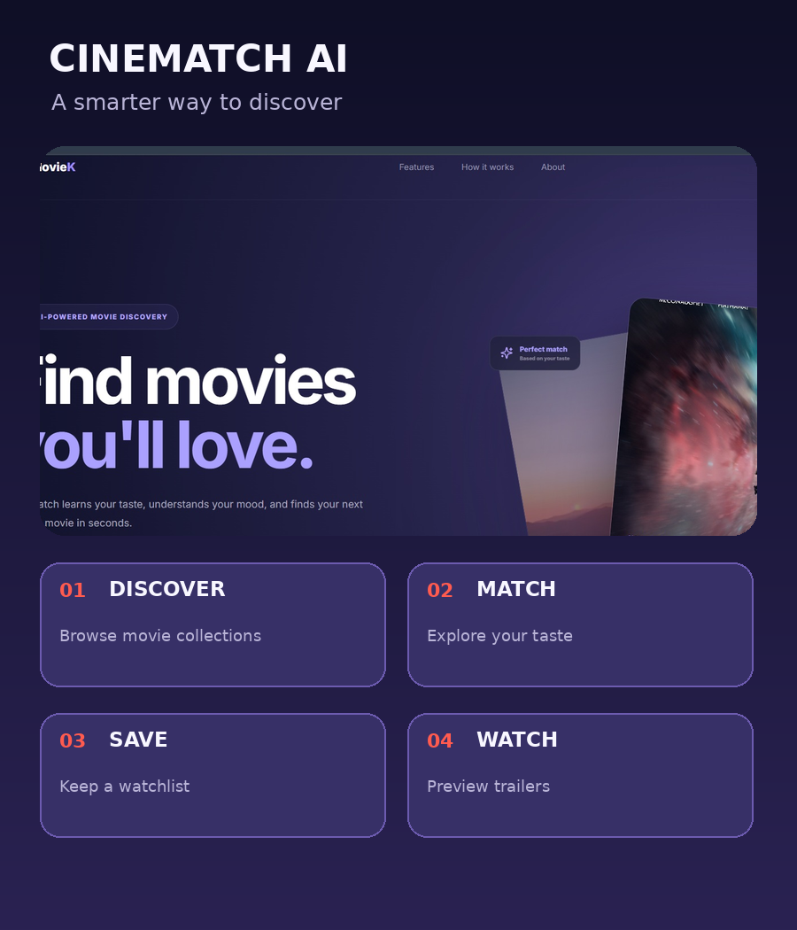



Introduction & Problem Statement
Background
Online platforms contain large movie and series catalogues. Users can spend significant time browsing titles before finding something that fits their interests.
Problem Statement
Movie discovery can feel overwhelming when users rely on broad categories or popularity alone. Users need a simple way to search, explore genres, understand a title and save items for later.
Motivation / Need
CineMatch AI brings discovery, title descriptions, favorites and trailer previews into one interface for movie and series fans.
Notes:
State the domain, the exact problem and why it matters. Keep it to about 2 minutes. Add one real-world statistic if you can, with a citation.

Slide 3


Objectives & Scope
Objectives
1
Develop a responsive movie and series discovery interface.
2
Provide search, genre filters and media-category navigation.
3
Enable account registration and sign-in through a FastAPI backend.
4
Support movie details, favorites/watchlist and trailer previews.
Notes:
Objectives should be measurable and start with action verbs. The scope slide tells the panel what you did and did not attempt.

Slide 4

Literature Survey
Author(s) / Year | Approach | Key Idea | Relevance / Gap | Limitation / Gap
Resnick et al., 1994 | Collaborative filtering (GroupLens) | Recommendations can use preferences of similar users. | Requires user ratings/interactions; not implemented in current prototype. | [Gap or limitation]
Sarwar et al., 2001 | Item-based collaborative filtering | Item similarity can support scalable recommendations. | Needs interaction/rating data and model evaluation. | [Gap or limitation]
Burke, 2002 | Hybrid recommender systems | Combines multiple recommendation techniques. | A future enhancement for CineMatch AI. | [Gap or limitation]
Ricci et al., 2015 | Recommender Systems Handbook | Reviews recommendation methods and evaluation. | Provides a foundation for future recommendation engine work. | [Gap or limitation]
Research Gap
Research gap: recommendation literature describes sophisticated personalization methods, but the current CineMatch AI prototype focuses on the user-facing discovery experience—search, genre browsing, descriptions, favorites and trailers. A trained content-based or collaborative recommendation engine and its evaluation remain future work.
Notes:
Summarise four to six relevant papers or existing systems. End with the research gap, because that gap justifies your project.

Slide 5





Proposed System & Methodology
STEP 1
STEP 2
STEP 3
STEP 4
STEP 5
Define Problem
Collect Data
Design
Implement
Test & Evaluate
Identify movie-discovery friction and define core user journeys.
Use a small curated catalogue of 8 sample titles embedded in the frontend; no external training dataset is included.
Build a React/Vite interface, FastAPI authentication API and SQLite user/session database.
Implement landing page, login/signup, dashboard, search, genre filters, favorites, settings, help and trailer modal.
Validate sign-up/sign-in, search, filters, watchlist actions, movie details and trailer opening.
Key Novelty / Contribution
The contribution is an integrated, cinematic movie-discovery prototype that combines a curated catalogue, account access, saved favorites, rich title details and trailer previews in one application.
Notes:
Walk through the five steps left to right. Rename the steps to match your project (for example, Requirement Analysis, Design, Coding, Testing, Deployment). End with your novelty.

Slide 6
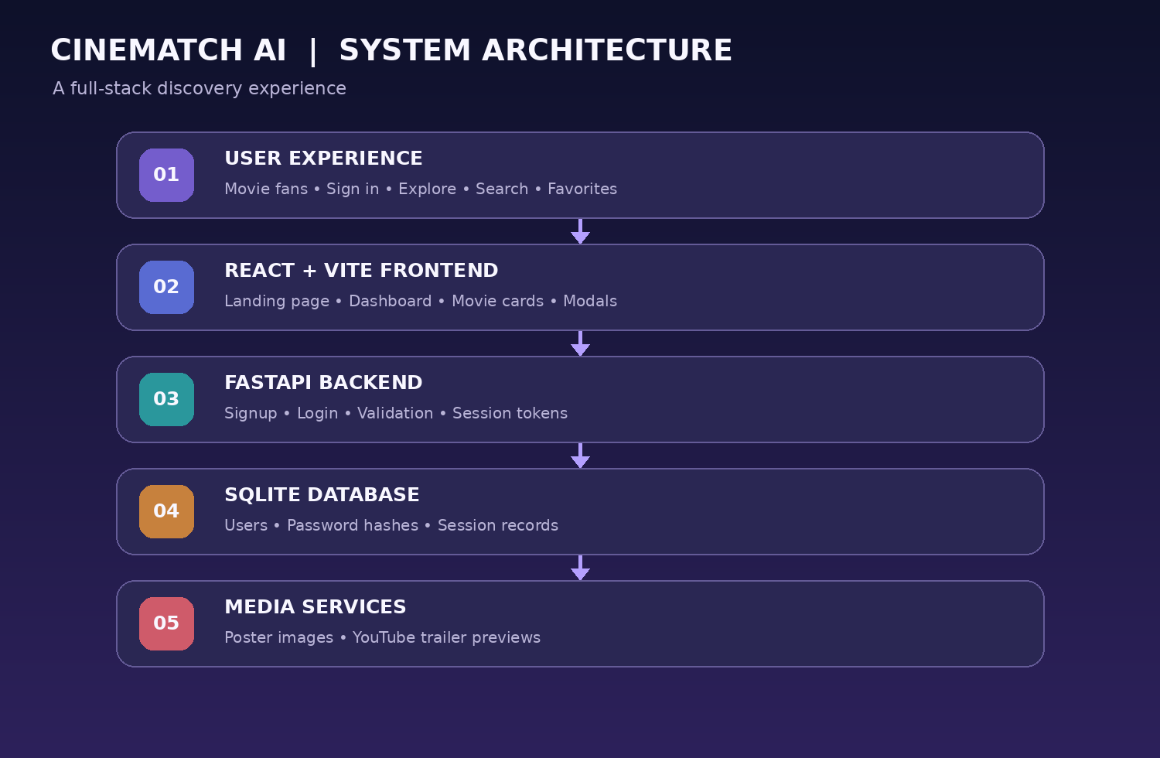
System Architecture
Components
1
React + Vite UI
Renders the landing page, dashboard, movie cards and navigation.
2
FastAPI API
Provides health, signup and login endpoints.
3
SQLite database
Stores user accounts, password hashes and server-side sessions.
4
Browser + YouTube
Stores client-side preferences/watchlist and displays trailer previews.
Notes:
Insert a clear block diagram: input, processing, storage, output. Number each block and explain them on the right. Redraw the figure yourself rather than copying it.

Slide 7


Hardware & Software Requirements
Hardware
Software & Tools
Libraries / Frameworks
• Windows 10/11 or Linux
• 4 GB RAM minimum; 8 GB recommended
• Internet connection for remote poster images and YouTube trailers
• Local disk for project and SQLite database
• Windows / Linux
• JavaScript (ES modules)
• Python 3.x
• VS Code and Git
• React 19
• Vite 7
• FastAPI + Uvicorn
• SQLite
• lucide-react icons
Deployment / Platform: Local development using Vite on port 5173 and FastAPI on port 8000; cloud deployment is a future option.
Notes:
List only what you actually used, with versions. For a pure software project, shorten the hardware list and add cloud or deployment resources.

Slide 8
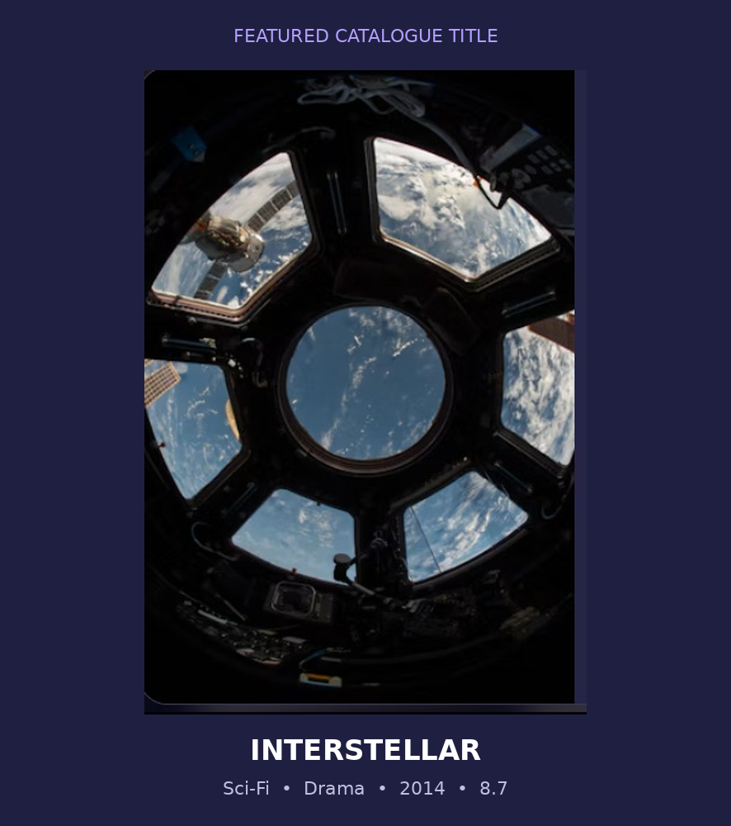
Dataset / Data Understanding
8
8 core
Records (rows)
Features (columns)
N/A
N/A
Missing values
Target classes
Source: Curated sample catalogue embedded in src/main.jsx; no external Kaggle/UCI dataset is used.
Catalogue fields: id, title, genre, rating, year, duration, poster URL, description and trailer ID; selected titles also include director, cast and storyline.
Authentication data is stored in SQLite: user name, email, password hash and created time; sessions store token, user ID and timestamp.
Notes:
Explain where the data came from and what it contains. Show a screenshot of the first rows or the info summary. For non-data projects, replace this slide with “Requirement Analysis” or “Input Specification”.

Slide 9
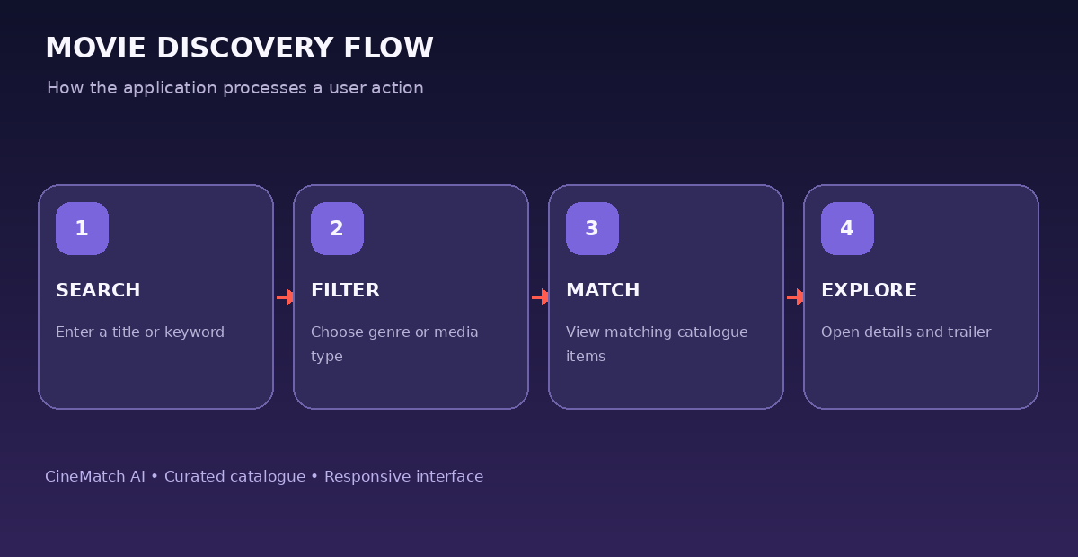
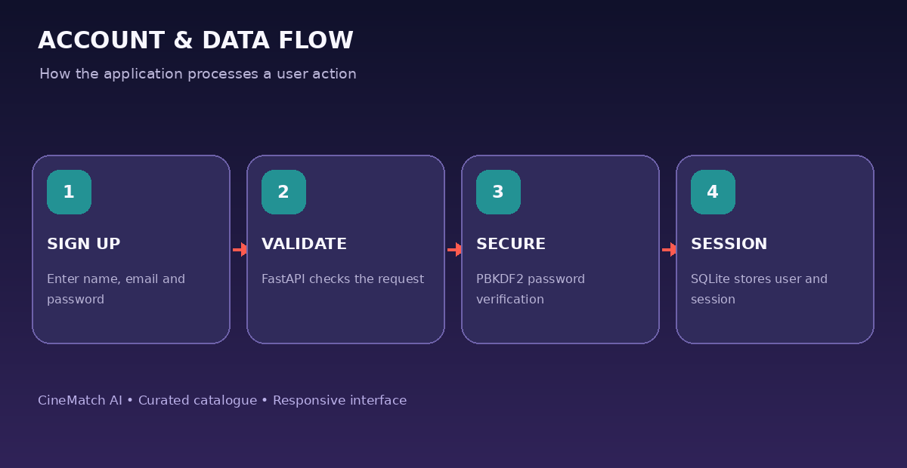



Data Preprocessing & Exploratory Analysis
Cleaning
Transformation
Feature Selection
Catalogue entries are maintained as static JavaScript objects; optional fields are handled with fallbacks in the UI.
Genre and media categories use consistent text labels; favorites are represented by movie IDs in browser storage.
No statistical feature selection or ML preprocessing is implemented. Search and genre filters operate on catalogue title and genre fields.
Notes:
Show two or three plots that tell a story: distributions, correlations, outliers. Explain what each plot told you and what you did about it.

Slide 10
Module-wise Description
1
Authentication
2
Movie Discovery
Purpose: Account registration and sign-in.
Input → Output: Credentials → authenticated user session.
Purpose: Search titles and browse genre/media categories.
Input → Output: Query/filter → matching catalogue cards.
3
Favorites / Watchlist
4
Details & Trailers
Purpose: Save and revisit selected titles.
Input → Output: Bookmark action → saved movie IDs in browser storage.
Purpose: Show synopsis, metadata and trailer preview.
Input → Output: Selected title → detail modal / YouTube player.
Notes:
Divide the project into three to five modules. For each, state its purpose, inputs, outputs and who built it. Duplicate a card if you have more modules.

Slide 11

Algorithms & Technologies Used
Catalogue Filtering & Search
PBKDF2-HMAC-SHA256
REST API + SQLite
Why chosen
Simple, transparent filtering over the current sample catalogue.
Key parameters
Search query, selected genre and media category.
Why chosen
Password hashing with a per-user salt in the backend.
Key parameters
SHA-256, 310,000 iterations and random 16-byte salt.
Why chosen
Lightweight backend and relational persistence for demo accounts.
Key parameters
FastAPI routes, JSON requests, SQLite users and sessions.
Selection criteria: simple local setup, open-source stack, clear user flow, maintainable code and suitability for a hackathon prototype. No trained recommendation algorithm is currently included.
Notes:
Name each model, algorithm or technology, say why you chose it, and list the key settings. Then explain how you picked the final one.

Slide 12
Implementation / Model Building
Feature Selection
Code snippet / pseudocode
Signup: name, email and password. Login: email and password. Discovery: search query, genre and media category. Favorites: selected title IDs.
POST /auth/login
{
"email": "user@example.com",
"password": "your-password"
}
FastAPI verifies the stored PBKDF2 hash,
creates a server-side session token,
and returns the user profile + token.
Preprocessing Pipeline
User submits form → React calls FastAPI → backend validates credentials → hashes/verifies password → stores or checks SQLite record → creates session token → frontend stores user/session data.
Data Splitting
Not applicable: the uploaded project does not train or load a machine-learning model. The current discovery view uses a curated static catalogue.
Configuration
Backend password hashing: PBKDF2-HMAC-SHA256 with 310,000 iterations and a random 16-byte salt. API runs locally on port 8000; Vite frontend on port 5173.
Notes:
Describe the build in the order you did it. Paste only the most important code or pseudocode, not entire files. For hardware projects, show the circuit or wiring summary instead.

Slide 13
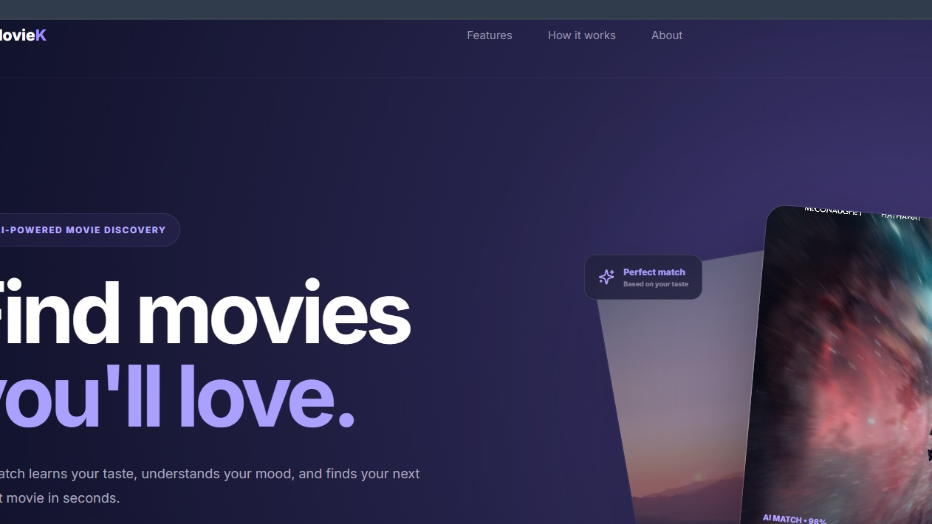
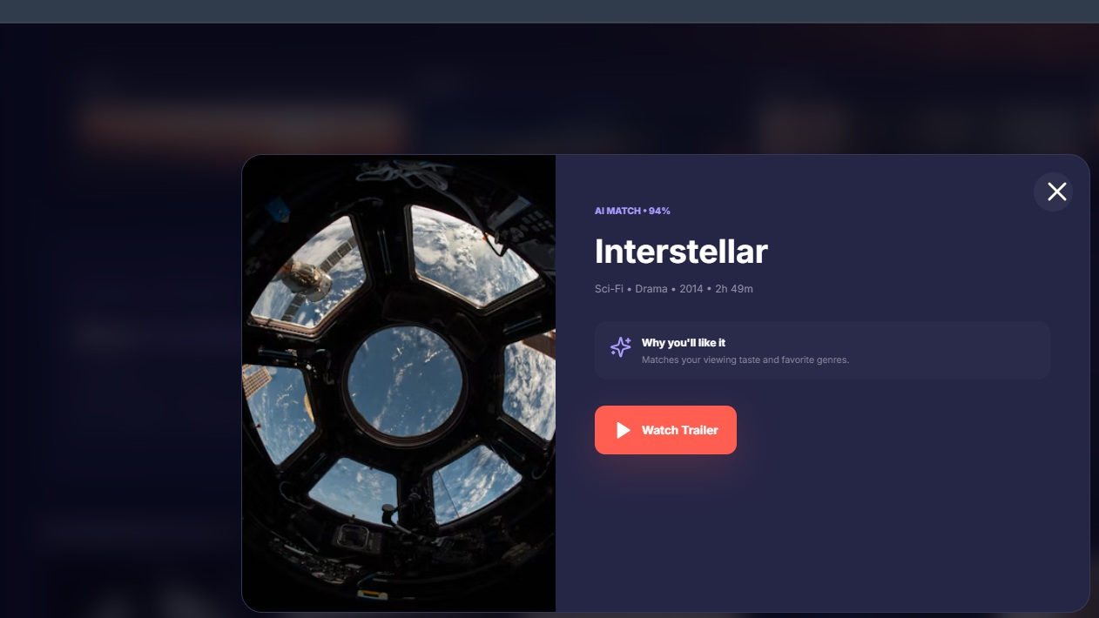
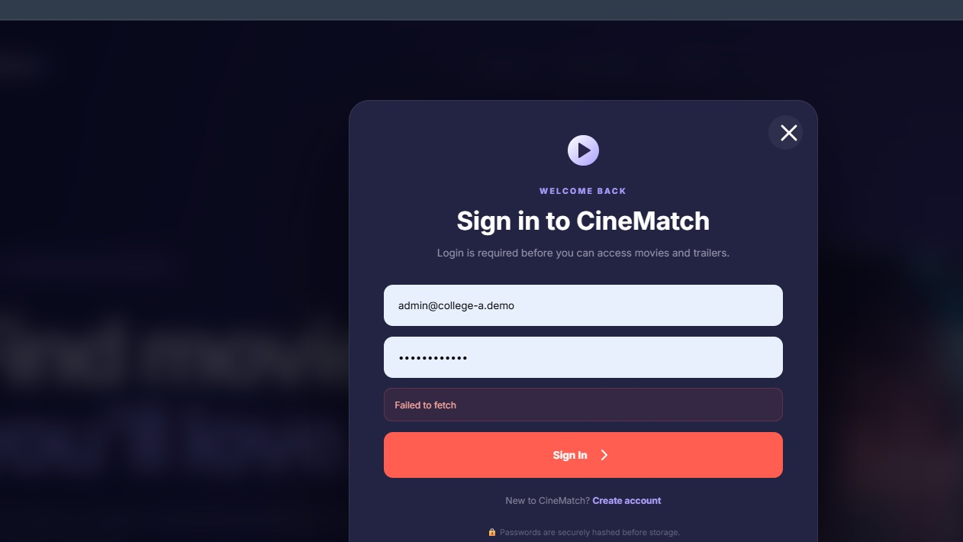
Working Prototype / Output Screens
Landing Page
Hero section introduces CineMatch AI and entry points for sign-in/sign-up.
Movie Details
Interstellar detail modal shows genre, year, duration, match label and trailer action.
Authentication
Sign-in interface; screenshot captured during a backend-unavailable test, so it shows a fetch error.
Notes:
Show real screenshots, photos of the hardware or a short demo video link. Caption each one with what the viewer should notice.

Slide 14
Results & Performance Comparison
Metric | Model A | Model B | Model C
Accuracy | 0.00 | 0.00 | 0.00
Precision | 0.00 | 0.00 | 0.00
Recall | 0.00 | 0.00 | 0.00
F1-score | 0.00 | 0.00 | 0.00
ROC-AUC | 0.00 | 0.00 | 0.00
Current result: working UI prototype; recommendation accuracy not measured.
The uploaded source contains a curated 8-title catalogue and rule-based search/filter interactions. The visible “AI MATCH” percentages in the interface are currently static presentation labels, not scores produced by a trained model. No trained recommender, test dataset or measured Precision@K, Recall@K, NDCG, RMSE or MAE is included. These metrics should be collected after implementing and evaluating a recommendation model.
Notes:
Right-click the chart and choose Edit Data to enter your real numbers. Replace the metrics with the ones that fit your project (accuracy, latency, power, throughput, user rating). State clearly which option performed best.

Slide 15
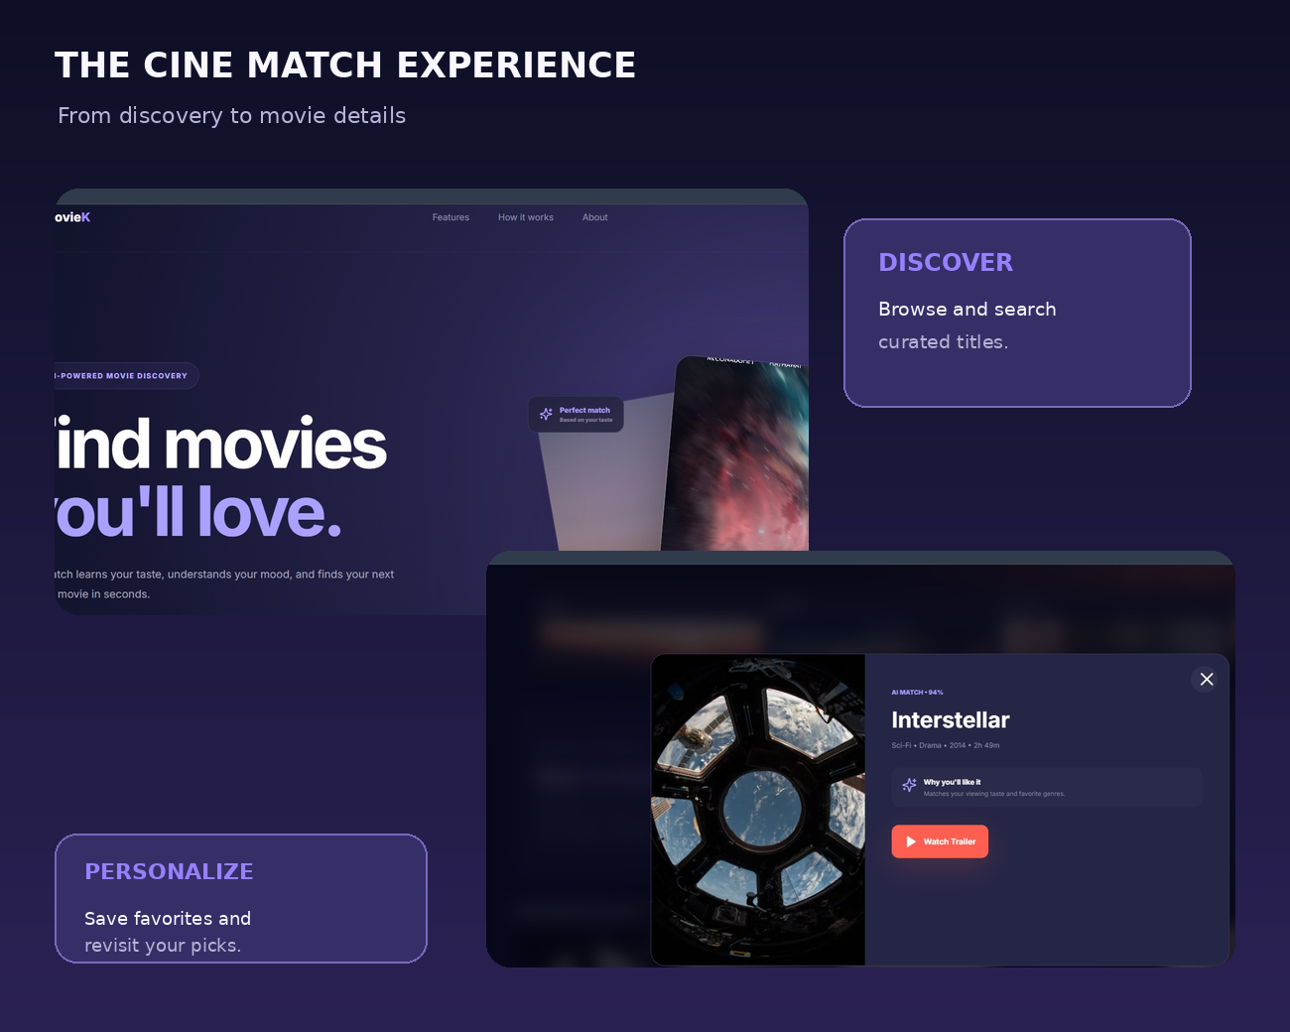
Analysis & Key Findings
N/A
Recommendation accuracy not yet evaluated.
Interpretation: The prototype demonstrates the main discovery journey from account access to browsing, saving a title and opening a trailer.
Important clarification: “AI MATCH” percentages shown in the UI are illustrative static labels; they are not calculated by a trained recommendation algorithm.
Error analysis: Authentication depends on FastAPI being available; remote posters and YouTube previews require internet access.
Key finding: The application layer is implemented, while algorithmic personalization and quantitative evaluation remain future work.
Notes:
Explain what the numbers mean. Use a confusion matrix, ROC curve, feature-importance chart or output comparison. Be honest about weak results; panels value that.

Slide 16

Testing & Validation
Test ID | Test Description | Expected Result | Actual Result | Status
TC-01 | Sign up with valid details | User created and session returned | Verify during demo | Pending
TC-02 | Sign in with valid credentials | User authenticated | Verify during demo | Pending
TC-03 | Search for a movie title | Matching title appears | Verify during demo | Pending
TC-04 | Filter by genre | Only matching titles appear | Verify during demo | Pending
Functional Testing
Validation Method
Performance Testing
Check FastAPI health, signup/login endpoints, UI forms, search, genre filters, favorites and trailer modal.
No ML cross-validation is applicable. Use manual functional tests and API checks for the current application.
Measure page load, API response time, concurrent sign-ins and stability after deployment; measurements are not yet supplied.
Notes:
List representative test cases with expected and actual outcomes. Name the validation methods you used. Delete rows you do not need.

Slide 17


Challenges & Limitations
Challenges Faced
Limitations
Remote image URLs may fail → provide fallback artwork and test network access.
Backend unavailable causes “Failed to fetch” → start FastAPI before sign-in.
Large catalogue browsing can be slow → add pagination and server-side search as the catalogue grows.
The catalogue is a small static sample of 8 titles.
No trained ML recommendation engine or real-time personalization is implemented.
Favorites/profile preferences are stored in browser localStorage; production deployment needs stronger persistence and security controls.
Remote posters and YouTube trailers require internet access.
Notes:
Be candid. Pair every challenge with how you solved it, and list limitations that the panel would otherwise spot themselves.

Slide 18

Conclusion
CineMatch AI is a React/Vite movie-discovery prototype connected to a FastAPI backend and SQLite authentication database.
1
Final Outcome
The source implements account access, a curated catalogue, search, genre/media filters, favorites, movie details and YouTube trailer previews. Model accuracy has not been measured.
N/A
2
Delivered: full-stack discovery prototype
Quantitative recommendation metrics: not yet evaluated.
The prototype addresses the discovery user journey and provides a base for future content-based, collaborative and mood-aware recommendation methods.
3
Notes:
Revisit each objective and say whether you met it. Quote your headline result with numbers. Do not introduce new material here.

Slide 19



Future Scope & Applications
Improve Performance
Optimize catalogue loading, image handling and search responsiveness.
Applications
• Personal movie discovery
• Streaming-platform discovery interface
• Student recommender-system prototype
• Entertainment catalogue exploration
Expand Data / Features
Add a larger licensed movie dataset, user ratings, viewing history and mood preferences.
Deploy & Build an Interface
Add a production API deployment, responsive testing and optional mobile experience.
Scale & Secure
Use PostgreSQL, HTTPS, secure HttpOnly cookies, rate limiting, password reset and secrets management.
Notes:
Give concrete next steps, ideally tied to the limitations. Then name two or three real-world uses.

Slide 20
Team Contribution
Registration No. | Team Member | Contribution
2420030146 | K.Akshitha | Frontend UI and movie discovery screens
2420030146 | K.Sree Vardhan | FastAPI backend, authentication and database
2420030711 | T.Mohith Sai | Testing, documentation and presentation
— | Team effort | Integration, validation and final demonstration
Notes:
Show that work was planned and shared. Every member should be able to explain their own module.

Slide 21

References
[1] Resnick, P. et al., “GroupLens: An Open Architecture for Collaborative Filtering of Netnews,” CSCW, 1994.
[2] Sarwar, B. et al., “Item-Based Collaborative Filtering Recommendation Algorithms,” WWW, 2001.
[3] Burke, R., “Hybrid Recommender Systems: Survey and Experiments,” User Modeling and User-Adapted Interaction, 2002.
[4] Ricci, F., Rokach, L. and Shapira, B. (eds.), Recommender Systems Handbook, 2nd ed., Springer, 2015.
[5] FastAPI documentation; React documentation; Vite documentation; SQLite documentation.
Project Links
GitHub repository: Not supplied
Dataset: Curated sample catalogue embedded in the project source
Demo: Local application at http://localhost:5173 (when running)
Notes:
Use IEEE style, numbered in order of first citation in the deck. Include datasets, documentation and code repositories.

Slide 22
THANK YOU
Questions & Discussion
Team members:
Guide: Dr.N.Sunanda
Associate Professor
Department of CSE
Department of Computer Science and Engineering
KLH Deemed to be University
Notes:
Leave this slide up during questions. Make sure every team member can answer questions about their own module.

