Slide 1
PRESENTATION ON IPL AUCTION STRATEGY
NAME-MOHIT KUMAR
COURSE-DATA SCIENCE
INTERNSHALA TRAININGS

Slide 2
Create Table
create table matches (
id int,
city varchar(255),
date date,
player_of_match varchar(255),
venue varchar(255),
neutral_venue int,
team1 varchar(255),
team2 varchar(255),
toss_winner varchar(255),
toss_decision varchar(255),
winner varchar(255),
result varchar(255),
result_margin int,
eliminator varchar(255),
method varchar(255),
umpire1 varchar(255),
umpire2 varchar(255));
create table deliveries (
id int,
inning varchar(255),
over int,
ball int,
batsman varchar(255),
non_striker varchar(255),
bowler varchar(255),
batsman_runs int,
extra_runs int,
total_runs int,
is_wicket int,
dismissal_kind varchar(255),
player_dismissed varchar(255),
fielder varchar(255),
extras_type varchar(255),
batting_team varchar(255),
bowling_team varchar(255));

Slide 3
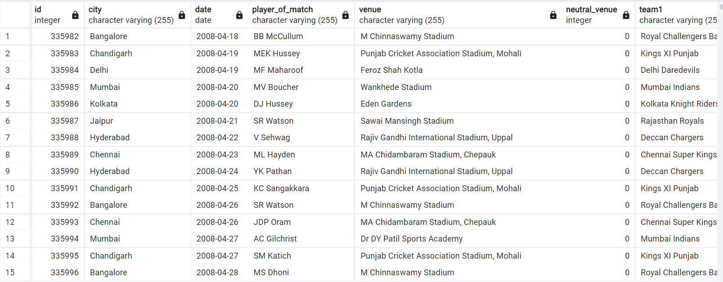
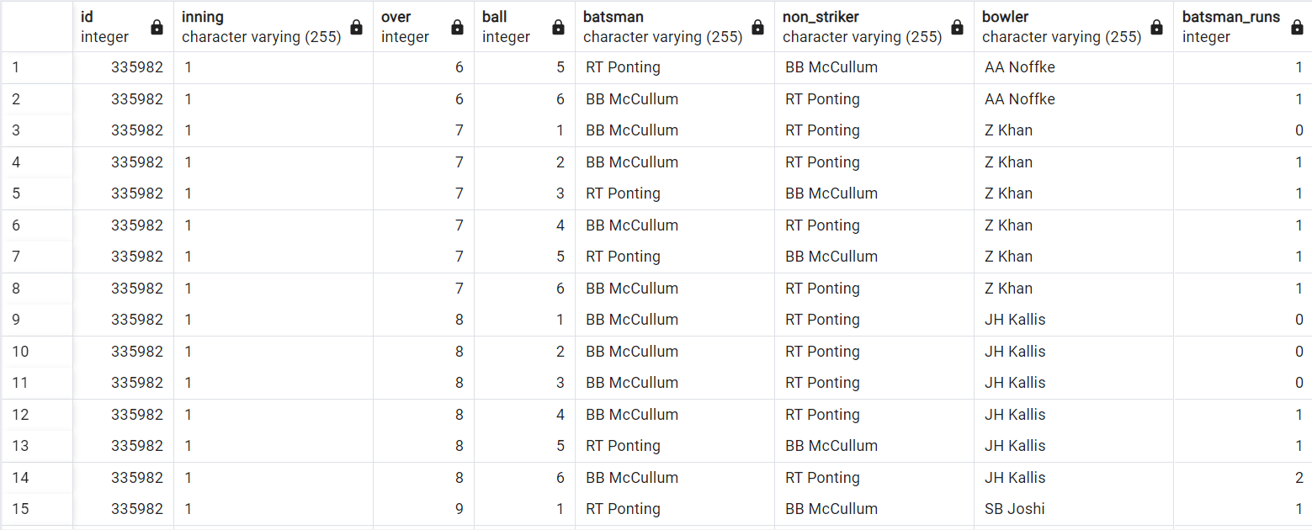
Copy & Retrieve
Copy matches from'c:\program files\postgresql\data\ipl_matches.Csv' delimiter ',' csv header;
select * from matches
Copy deliveries from'c:\program files\postgresql\data\ipl_ball.Csv' delimiter ',' csv header;
select * from deliveries

Slide 4
TASK - 1
Your first priority is to get 2-3 players with high S.R who have faced at least 500 balls. And to do that you have to make a list of 10 players you want to bid in the auction so that when you try to grab them in auction you should not pay the amount greater than you have in the purse for a particular player.

Slide 5
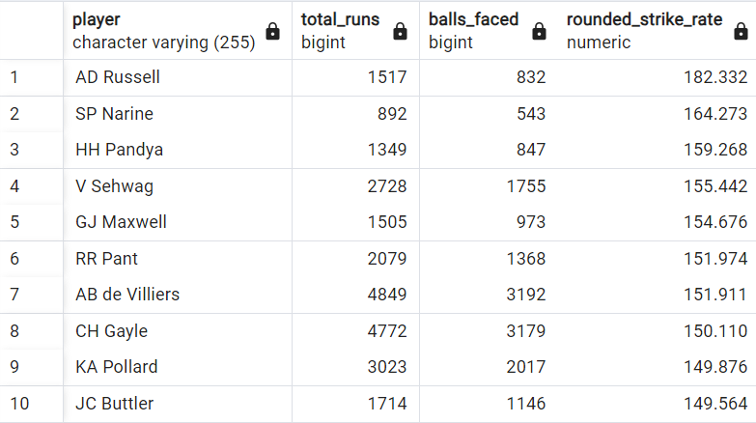
AGGRESSIVE BASTMEN
select player, total_runs, balls_faced, round(cast(strike_rate as numeric),3) as rounded_strike_rate from (select batsman as player,sum(batsman_runs) as total_runs,count(ball) as balls_faced,(cast(sum(batsman_runs) as float) / count(ball))*100 as strike_rate from deliveries where extras_type != 'wides'group by batsman) as player_stats where balls_faced >= 500 order by strike_rate desc limit 10;

Slide 6
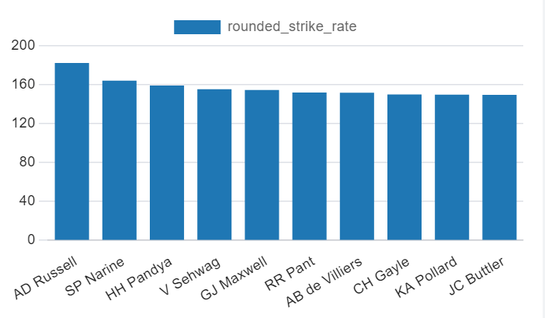
BAR CHART OF STRIKE RATE OF PLAYERS

Slide 7
TASK - 2
Now you need to get 2-3 players with good Average who have played more than 2 ipl seasons. And to do that you have to make a list of 10 players you want to bid in the auction so that when you try to grab them in auction you should not pay the amount greater than you have in the purse for a particular player.

Slide 8
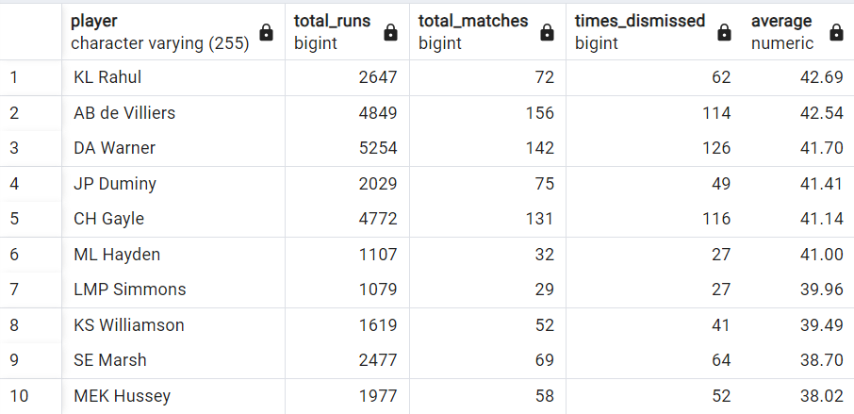
ANCHOR BASTMEN
with playerstats as (select batsman as player,sum(batsman_runs) as total_runs,count(distinct id) as total_matches,count(is_wicket) filter (where is_wicket = 1) as times_dismissed from deliveries group by batsman having count(distinct id) > 28 and count(is_wicket) filter (where is_wicket = 1) > 0)select player, total_runs, total_matches, times_dismissed,round(cast(cast(total_runs as float) / times_dismissed as numeric),2)as average from playerstats order by average desc limit 10;

Slide 9
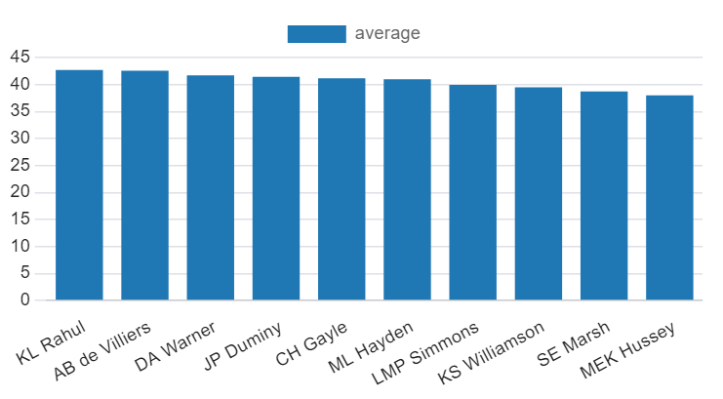
BAR CHART OF AVERAGE OF PLAYERS

Slide 10
TASK - 3
Now you need to get 2-3 Hard-hitting players who have scored most runs in boundaries and have played more the 2 ipl season. To do that you have to make a list of 10 players you want to bid in the auction so that when you try to grab them in auction you should not pay the amount greater than you have in the purse for a particular player.

Slide 11
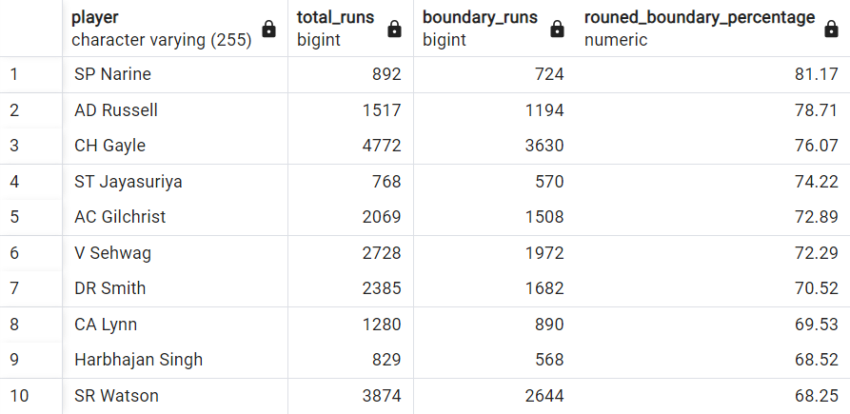
HARD HITTERS
select player,total_runs, boundary_runs,round(cast(boundary_percentage as numeric), 2) as rouned_boundary_percentage from (select batsman as player,sum(batsman_runs) as total_runs,count(distinct id) as total_matches,sum(case when batsman_runs = 4 or batsman_runs = 6 then batsman_runs else 0 end) as boundary_runs,cast(sum(case when batsman_runs = 4 or batsman_runs = 6 then batsman_runs else 0 end) as float) / nullif(sum(batsman_runs),0)*100 as boundary_percentage from deliveries group by batsman having count(distinct id)>28) as player_stats where boundary_percentage>0order by boundary_percentage desc limit 10;

Slide 12
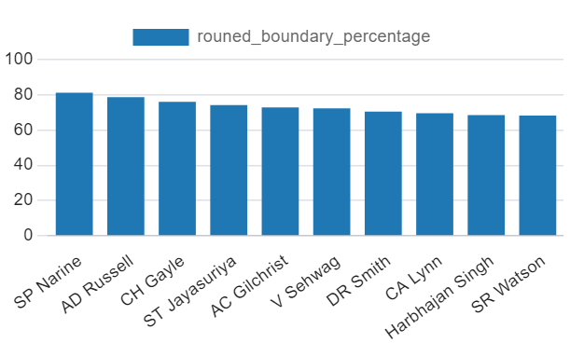
BAR CHART OF BOUNDARY PERCENTAGE

Slide 13
TASK - 4
Your first priority is to get 2-3 bowlers with good economy who have bowled at least 500 balls in IPL so far.To do that you have to make a list of 10 players you want to bid in the auction so that when you try to grab them in auction you should not pay the amount greater than you have in the purse for a particular player.

Slide 14
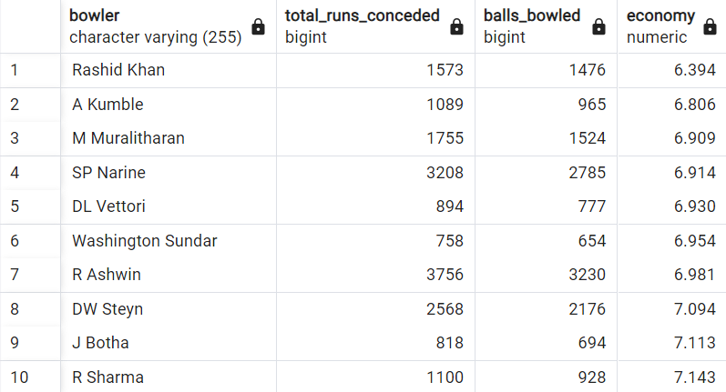
ECONOMICAL BOWLERS
select bowler,sum(total_runs) as total_runs_conceded,sum(case when extras_type != 'wides' and extras_type != 'noballs' then 1 else 0 end) as balls_bowled,round(cast(cast(sum(total_runs) as float) / (sum(case when extras_type != 'wides' and extras_type != 'noballs' then 1 else 0 end)/6) as numeric),3) as economy from deliveries group by bowler having sum(case when extras_type != 'wides' and extras_type != 'noballs' then 1 else 0 end) >= 500 order by economy asc limit 10;

Slide 15
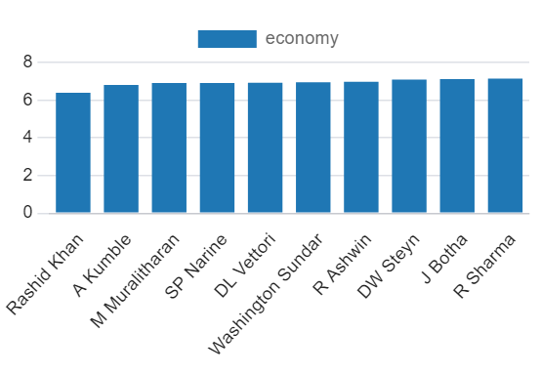
BAR CHART OF ECONOMY OF BOWLERS

Slide 16
TASK - 5
Now you need to get 2-3 bowlers with the best strike rate and who have bowled at least 500 balls in IPL so far.To do that you have to make a list of 10 players you want to bid in the auction so that when you try to grab them in auction you should not pay the amount greater than you have in the purse for a particular player.

Slide 17
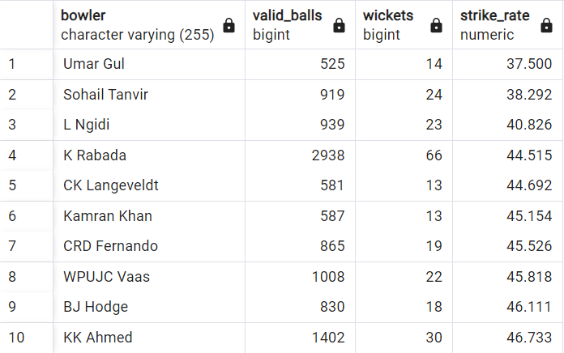
WICKET-TAKING BOWLERS
with bowlerstats as (select bowler,sum(case when is_wicket = 1 then 1 else 0 end) as wickets,sum(case when extras_type != 'wides' and extras_type != 'noballs' then ball else 0 end) as valid_balls from deliveries group by bowler having sum(case when extras_type != 'wides' and extras_type != 'noballs' then ball else 0 end) >= 500)select bowler,valid_balls,wickets,round(cast((cast(valid_balls as float) / wickets) as numeric),3) as strike_rate from bowlerstats where wickets > 0 order by strike_rate asc limit 10;

Slide 18
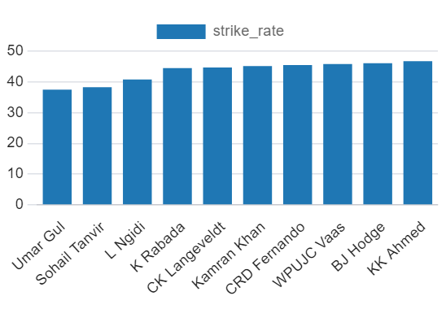
BAR CHART OF STRIKE RATE OF BOWLERS

Slide 19
TASK - 6
Now you need to get 2-3 All_rounders with the best batting as well as bowling strike rate and who have faced at least 500 balls in IPL so far and have bowled minimum 300 balls.To do that you have to make a list of 10 players you want to bid in the auction so that when you try to grab them in auction you should not pay the amount greater than you have in the purse for a particular player.

Slide 20
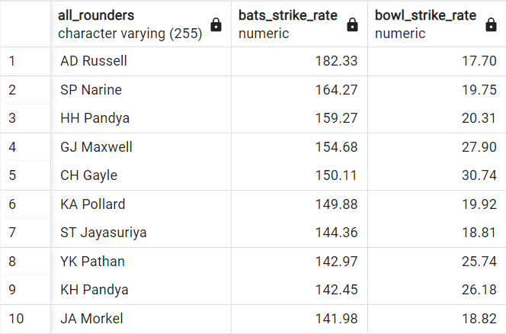
ALL-ROUNDERS
select batsman as all_rounders,round((sum (batsman_runs)*1.0/ count (ball)*100), 2) as bats_strike_rate, bowl_strike_rate from deliveries as d inner join(select bowler, count (bowler) as balls,sum (is_wicket) as total_wicket,round(((count (bowler)*1.0/ sum (is_wicket))), 2) as bowl_strike_rate from deliveries group by bowler having count (bowler)>300 order by bowl_strike_rate asc) as b on d.batsman = b.bowler where not extras_type= 'wides' group by batsman, bowl_strike_rate having count (ball)>=500 order by bats_strike_rate desc, bowl_strike_rate desc limit 10;

Slide 21
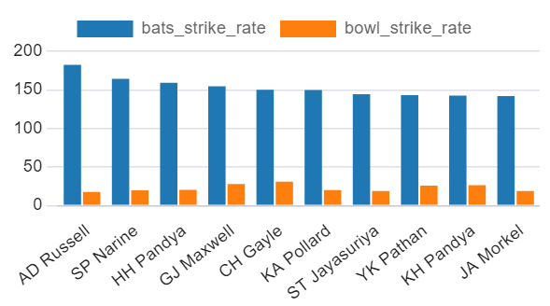
BAR CHART OF ALL-ROUNDER PLAYERS

Slide 22
WICKETKEEPER
﻿1.Wicketkeeping Skills: The primary criterion is the wicketkeeper's ability toper form well behind the stumps. This includes excellent catching, stumping, and general wicket keeping techniques. A wicket keeper who can take sharp catches and effect quick stumpings can create crucial break throughs for the team.
2.Batting Ability: In T20 cricket, every player's contribution with the bat is essential. A wicket keeper who can also contribute significantly with the bat adds depth to the team's batting lineup. Look for wicket keepers with a good strike rate, ability to score quick runs, and adaptability to different match situations.
3.Bowling Ability: T20 wicketkeeper should have a reliable bowling arm, offering varied deliveries, good economy, and wicket-taking ability. Their experience, adaptability, and fielding skills are crucial, along with maintaining fitness for a dual role efficiently.
4.Decision-Making Expertise: A wicket keeper in cricket is expected to have the ability to make decisions on LBW (Leg Before Wicket), wides, and reviews behind the stumps These decisions are crucial in the field and contribute significantly to the matches.

Slide 23
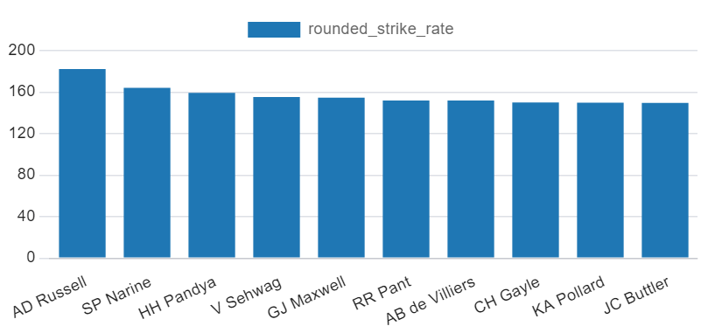






VISUAL REPRESENTATION IN THE FORM OF CHARTS

Slide 24
VISUAL REPRESENTATION IN THE FORM OF TABLES

Slide 25
ADDITIONAL QUESTIONS FOR FINAL ASSESMENT

Slide 26

1. Get the count of cities that have hosted an IPL match
select count(distinct city) as city_count
from matches;

Slide 27
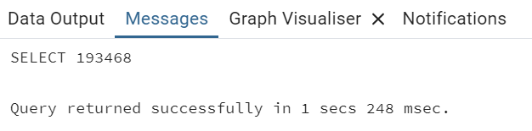
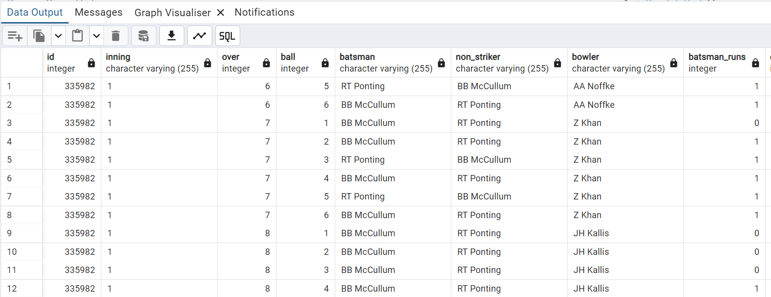
2. Create table deliveries_v02 with all the columns of the table ‘deliveries’ and an additional column ball_result containing values boundary, dot or other depending on the total_run (boundary for >= 4, dot for 0 and other for any other number)
create table deliveries_v02 as select *,case when total_runs >= 4 then 'boundary’ when total_runs = 0 then 'dot'else 'other'end as ball_result from Deliveries;

Slide 28
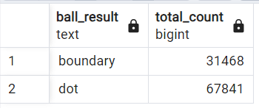
3. Write a query to fetch the total number of boundaries and dot balls from the deliveries_v02 table.
select ball_result, count(*) as total_count from deliveries_v02 where ball_result in ('boundary', 'dot') group by ball_result;

Slide 29
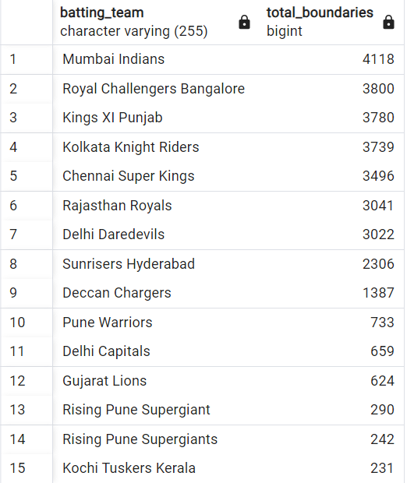
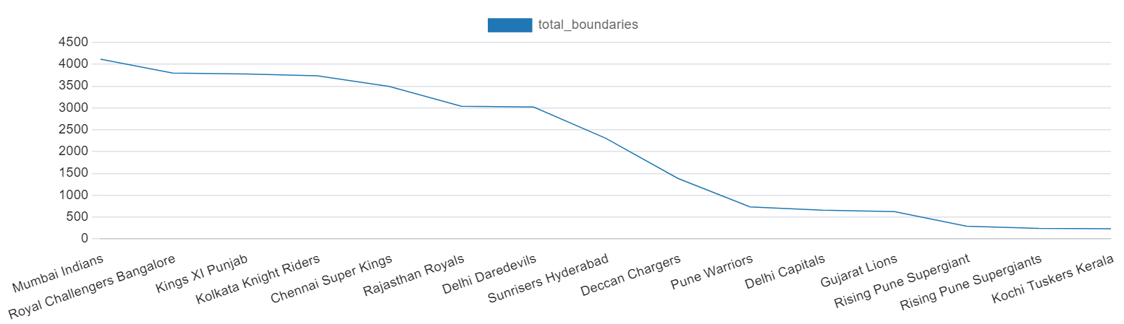
4. Write a query to fetch the total number of boundaries scored by each team from the deliveries_v02 table and order it in descending order of the number of boundaries scored.
Select batting_team,count(*) as total_boundaries from deliveries_v02 where ball_result = 'boundary’ group by batting_team order by total_boundaries desc;

Slide 30
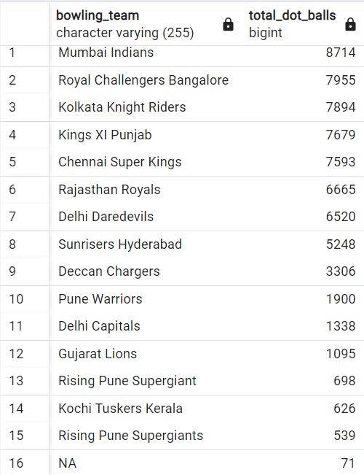
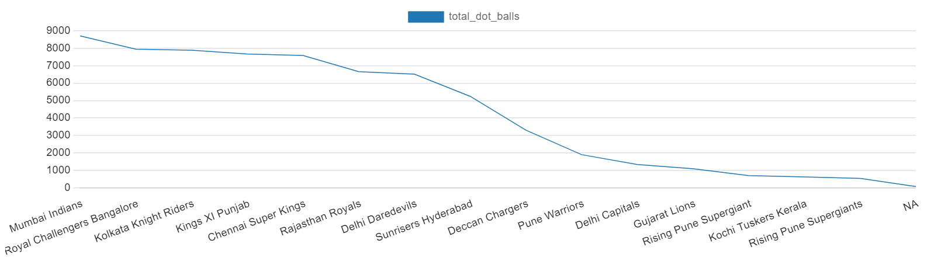
5. Write a query to fetch the total number of dot balls bowled by each team and order it in descending order of the total number of dot balls bowled.
Select bowling_team,count(*) as total_dot_balls from deliveries_v02 where ball_result = 'dot’ group by bowling_team order by total_dot_balls desc;

Slide 31
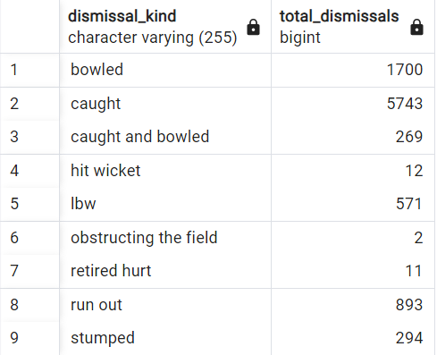
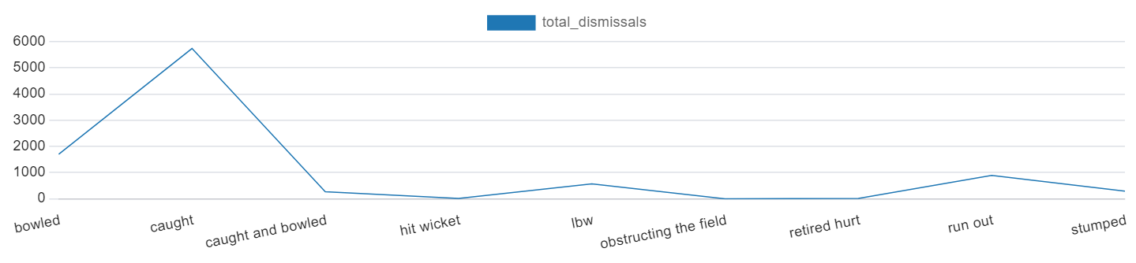
6. Write a query to fetch the total number of dismissals by dismissal kinds where dismissal kind is not NA
Select dismissal_kind,count(*) as total_dismissals from deliveries_v02 where dismissal_kind <> 'NA'group by dismissal_kind;

Slide 32
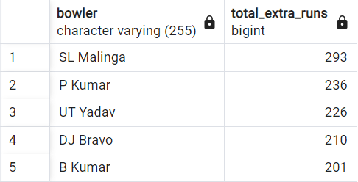
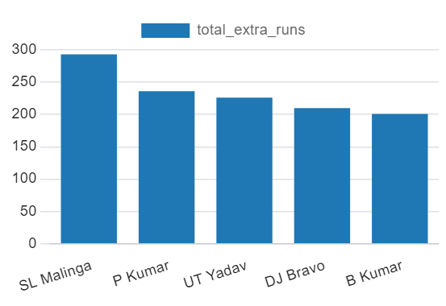
7. Write a query to get the top 5 bowlers who conceded maximum extra runs from the deliveries table
Select bowler,sum(extra_runs) as total_extra_runs from deliveries group by bowler order by total_extra_runs desc limit 5;

Slide 33
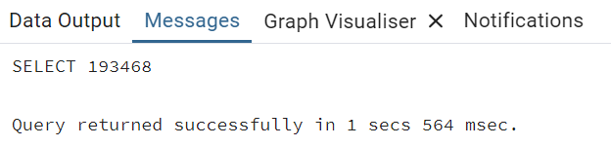
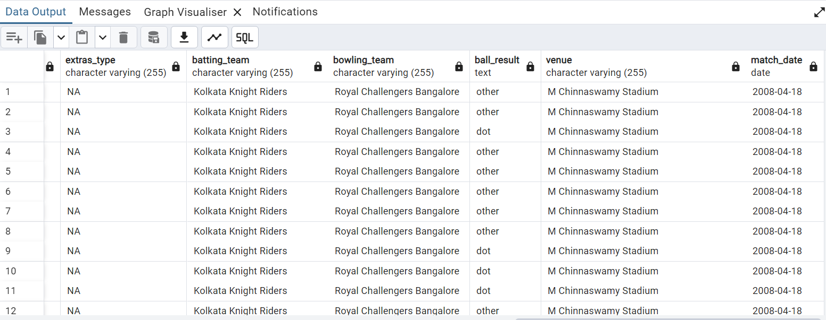
8. Write a query to create a table named deliveries_v03 with all the columns of deliveries_v02 table and two additional column (named venue and match_date) of venue and date from table matches
create table deliveries_v03 as select dv2.*,m.venue,m.date as match_date from deliveries_v02 dv2 join matches m on dv2.id = m.id;

Slide 34
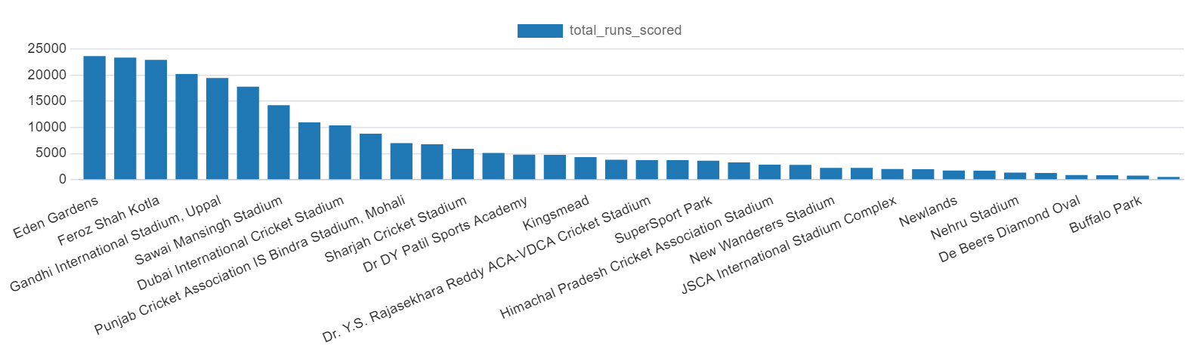
9. Write a query to fetch the total runs scored for each venue and order it in the descending order of total runs scored.
Select venue,sum(total_runs) as total_runs_scored from deliveries_v03 group by venue order by total_runs_scored desc;

Slide 35
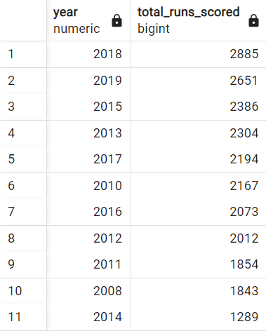
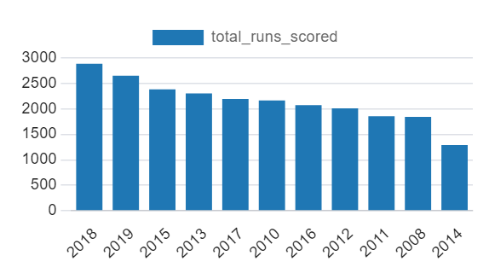
10. Write a query to fetch the year-wise total runs scored at Eden Gardens and order it in the descending order of total runs scored.
Select extract(year from match_date) as year,sum(total_runs) as total_runs_scored from deliveries_v03 where venue = 'Eden Gardens’ group by year order by total_runs_scored desc;

Slide 36
THE END

