Slide 3

Review:
3rd Sprint(22/10/2019)
-Collaboration for Transaction Table -Minor Validations(Card Pin)
2nd Sprint (09/10/2019)
-Card ”Block” & functions -Tracking Query Status -Multiple Confirmations
1st Sprint(27/09/2019)
-Service Request Table -Naming Conventions -Back Function

Slide 4
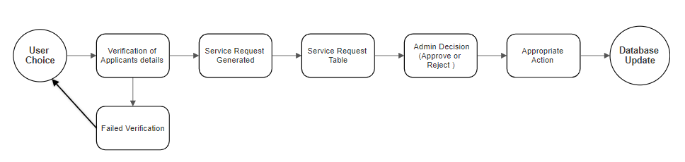
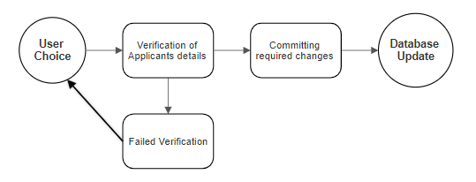

Slide 6
