Slide 1

Terasate :- AI-Based Satellite Image Land Use & Terrain Classification System
Team name :- CodeSib
Domain : AIML

Slide 2
Problem Statement
Our Solution
  Manual analysis of satellite imagery is slow and error-prone at scale
  No real-time tool to classify terrain types (Urban, Forest, Water, Agricultural, Barren)
  Lack of change-detection to track urban expansion or deforestation over time
  Researchers lack a unified platform for model comparison and augmentation preview
  AI-powered ResNet50 model trained on ISRO satellite patch dataset - 94.7% accuracy
  Instant terrain classification from any uploaded satellite image in milliseconds
  Change-detection engine compares two time-period images and computes area shift (km²)
  Model leaderboard + augmentation preview for scientific reproducibility

Slide 3
Features Implementation
  Single Image Classification - Upload a satellite patch → get terrain label + confidence score + per-class probability breakdown
  Batch Processing - Upload multiple patches at once; receive aggregated terrain distribution stats
  Change Detection - Upload Year-1 & Year-2 images → calculates area shift in km² and % change per terrain class
  Augmentation Preview - Preview 3 data-augmentation variants: 90° Rotation, Horizontal Flip, Brightness boost
  PDF Reporting - Users can export processed results and visualizations as PDF reports for offline access and documentation.
  Analytics Dashboard - Training loss curve, confusion matrix (5 classes), model reliability (96.7%), system performance metrics

Slide 4
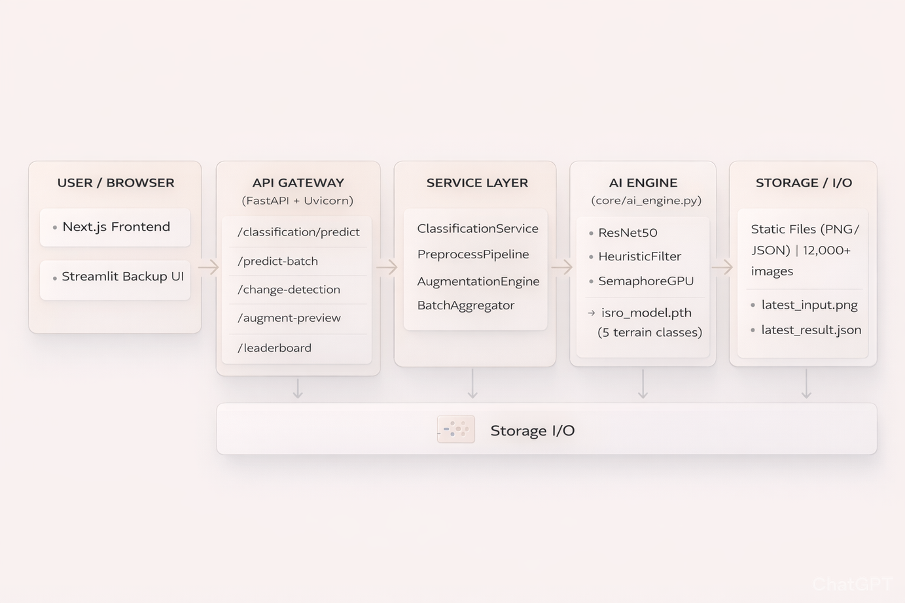
System Architecture

Slide 5
Technology Stack
Backend Layer
  FastAPI — High-performance async REST API
  Python 3.x — Core backend language
  PyTorch + TorchVision — Deep learning model inference
  Pillow / NumPy — Image preprocessing & array operations
  Uvicorn — ASGI production web server
Frontend layer
  Next.js 14 — React framework with App Router
  TypeScript — Typed component development
  Tailwind CSS — Utility-first styling
  Framer Motion — Animations & transitions
  Recharts — Data visualization (loss curve, dashboards)
  Lucide Icons — Consistent iconography
AI / ML Engine
  ResNet50 — Base classification model architecture
  isro_model.pth (~94 MB) — Trained ISRO terrain classifier
  Heuristic Filter — Pixel-math override for shadow/water edge cases
  GPU Semaphore — Parallel inference throttle (max 2 concurrent)
  Softmax output — Per-class confidence probabilities
  Data Augmentation — Rotation, flip, brightness pipeline

