Slide 1


MediSage
Decode. Understand. Heal.

Slide 2

Challenge In Hand..
In India, patients often struggle with handwritten prescriptions due to illegible handwriting, lack of awareness, and unavailable medicines.
Misinterpretation can lead to dosage errors or health risks, while pharmacists may be too busy to assist. There’s also no automated system to suggest real-time medicine alternatives, leaving patients without proper solutions.

Slide 3

Our Plan..
Medisage simplifies prescriptions by providing clear details on medicine use, dosage, and side effects.
It suggests safe alternatives if a drug is unavailable, enhancing medication safety and empowering patients with informed health choices.

Slide 4

Upload Prescription
Users take a photo or upload an image of their prescription.
How It Works..
Extract & Display
Medisage decodes the prescription and presents medicine details in a clear format.
Suggest Alternatives
If a medicine is unavailable, safe substitutes are provided.
Empower Users
Patients gain accurate insights, reducing errors and improving medication safety.

Slide 5


Traditional Prescription Understanding
Medisage AI-Powered Solution
Handwritten prescriptions are hard to read
Patients rely on pharmacists for explanations
No instant access to medicine substitutes
High risk of misinterpretation and dosage errors
Limited accessibility in rural areas
Convert prescription into clear , readable text.
Provide instant medicine details.
Suggest safe alternatives when medicines are unavailable.
Reduce medical errors with accurate data
24/7 accessible and user-friendly platform

Slide 6






Frontend:
React.js
Tailwind CSS
Backend:
FastAPI
Uvicorn
Data Processing:
NumPy
Pandas
Tech Stack
NLP
Hugging Face
Transformers
OCR & Image Processing:
OpenCV
PyTesseract
EasyOCR
Pillow
Deployment:
Vercel
Render / RailwayNLP
Model → Hugging Face Inference API

Slide 7
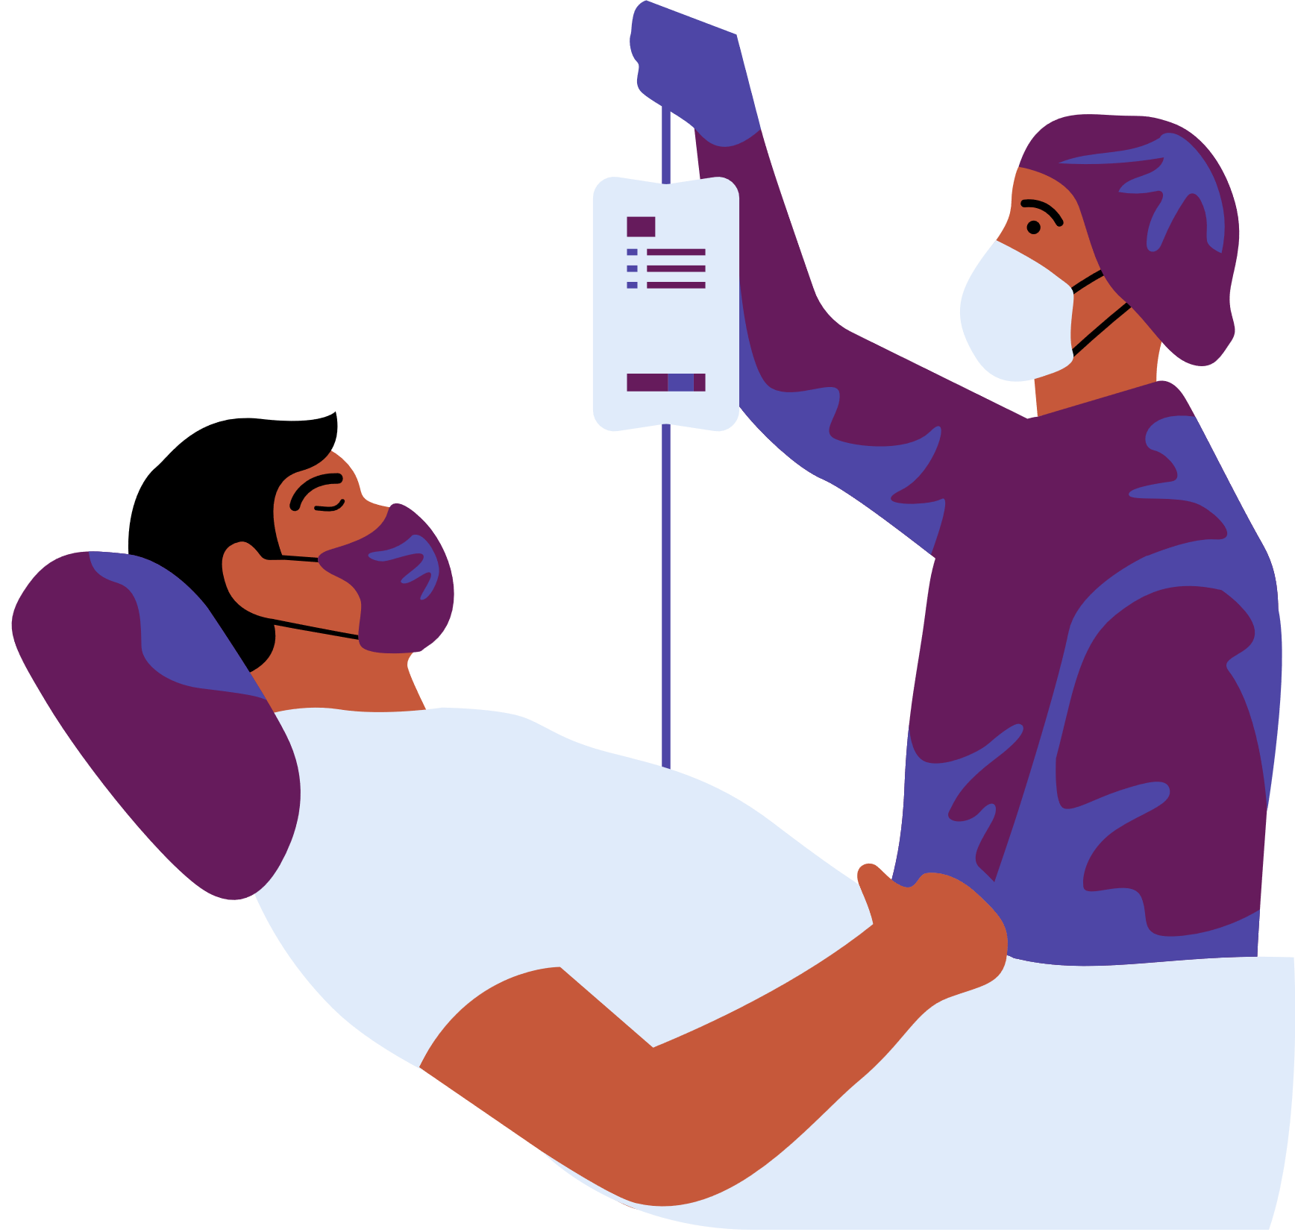

Future Aspects..
1. Mobile Application (iOS & Android)- CrosDevelop a mobile app using “React Native” or “Flutter” for seamless accessibility on both iOS and Android.
2. Prescription Reminders & Alerts- Medication Schedule: Based on the decoded prescription, generate a personalized medication schedule for users.
Example : Push Notifications & SMS Alerts:

Slide 8
Medisage Revenue Model…
1. Subscription-Based Model
2.B2B Model
3. API Licensing for Healthcare Apps
Premium plan with alternative suggestions & dosage reminders.
B2B Partnerships with Pharmacies & Hospitals
Medisage API for telemedicine & health tech platforms.
Revenue from API usage & enterprise licensing.

Slide 9

Thank You!

