Slide 1



Anti-theft System for Motorbike
Md. Mohitul haque
Golam kibria papel
March 19th, 2017
IoT Army of 300:
Resource Development to Enable our Brightest Minds in Technology

Slide 2
Problem statement
No available option for remote operation of stolen bikes.
Available services are either Smartphone based tracking or offline alert.
Services are remote agent dependent.

Slide 3
OUR solution
Secure SMS and web based anti theft notification and tracking system for motorbike.

Slide 4
Product features
Provides SMS notification of every bike operation.
Configurable from any simple web browser.
Remote control of motor bike.
Location tracking of motor bike.
Easy to operate and low cost theft notification and prevention.
Phone platform independent online and offline service.
Secure log of information.

Slide 5
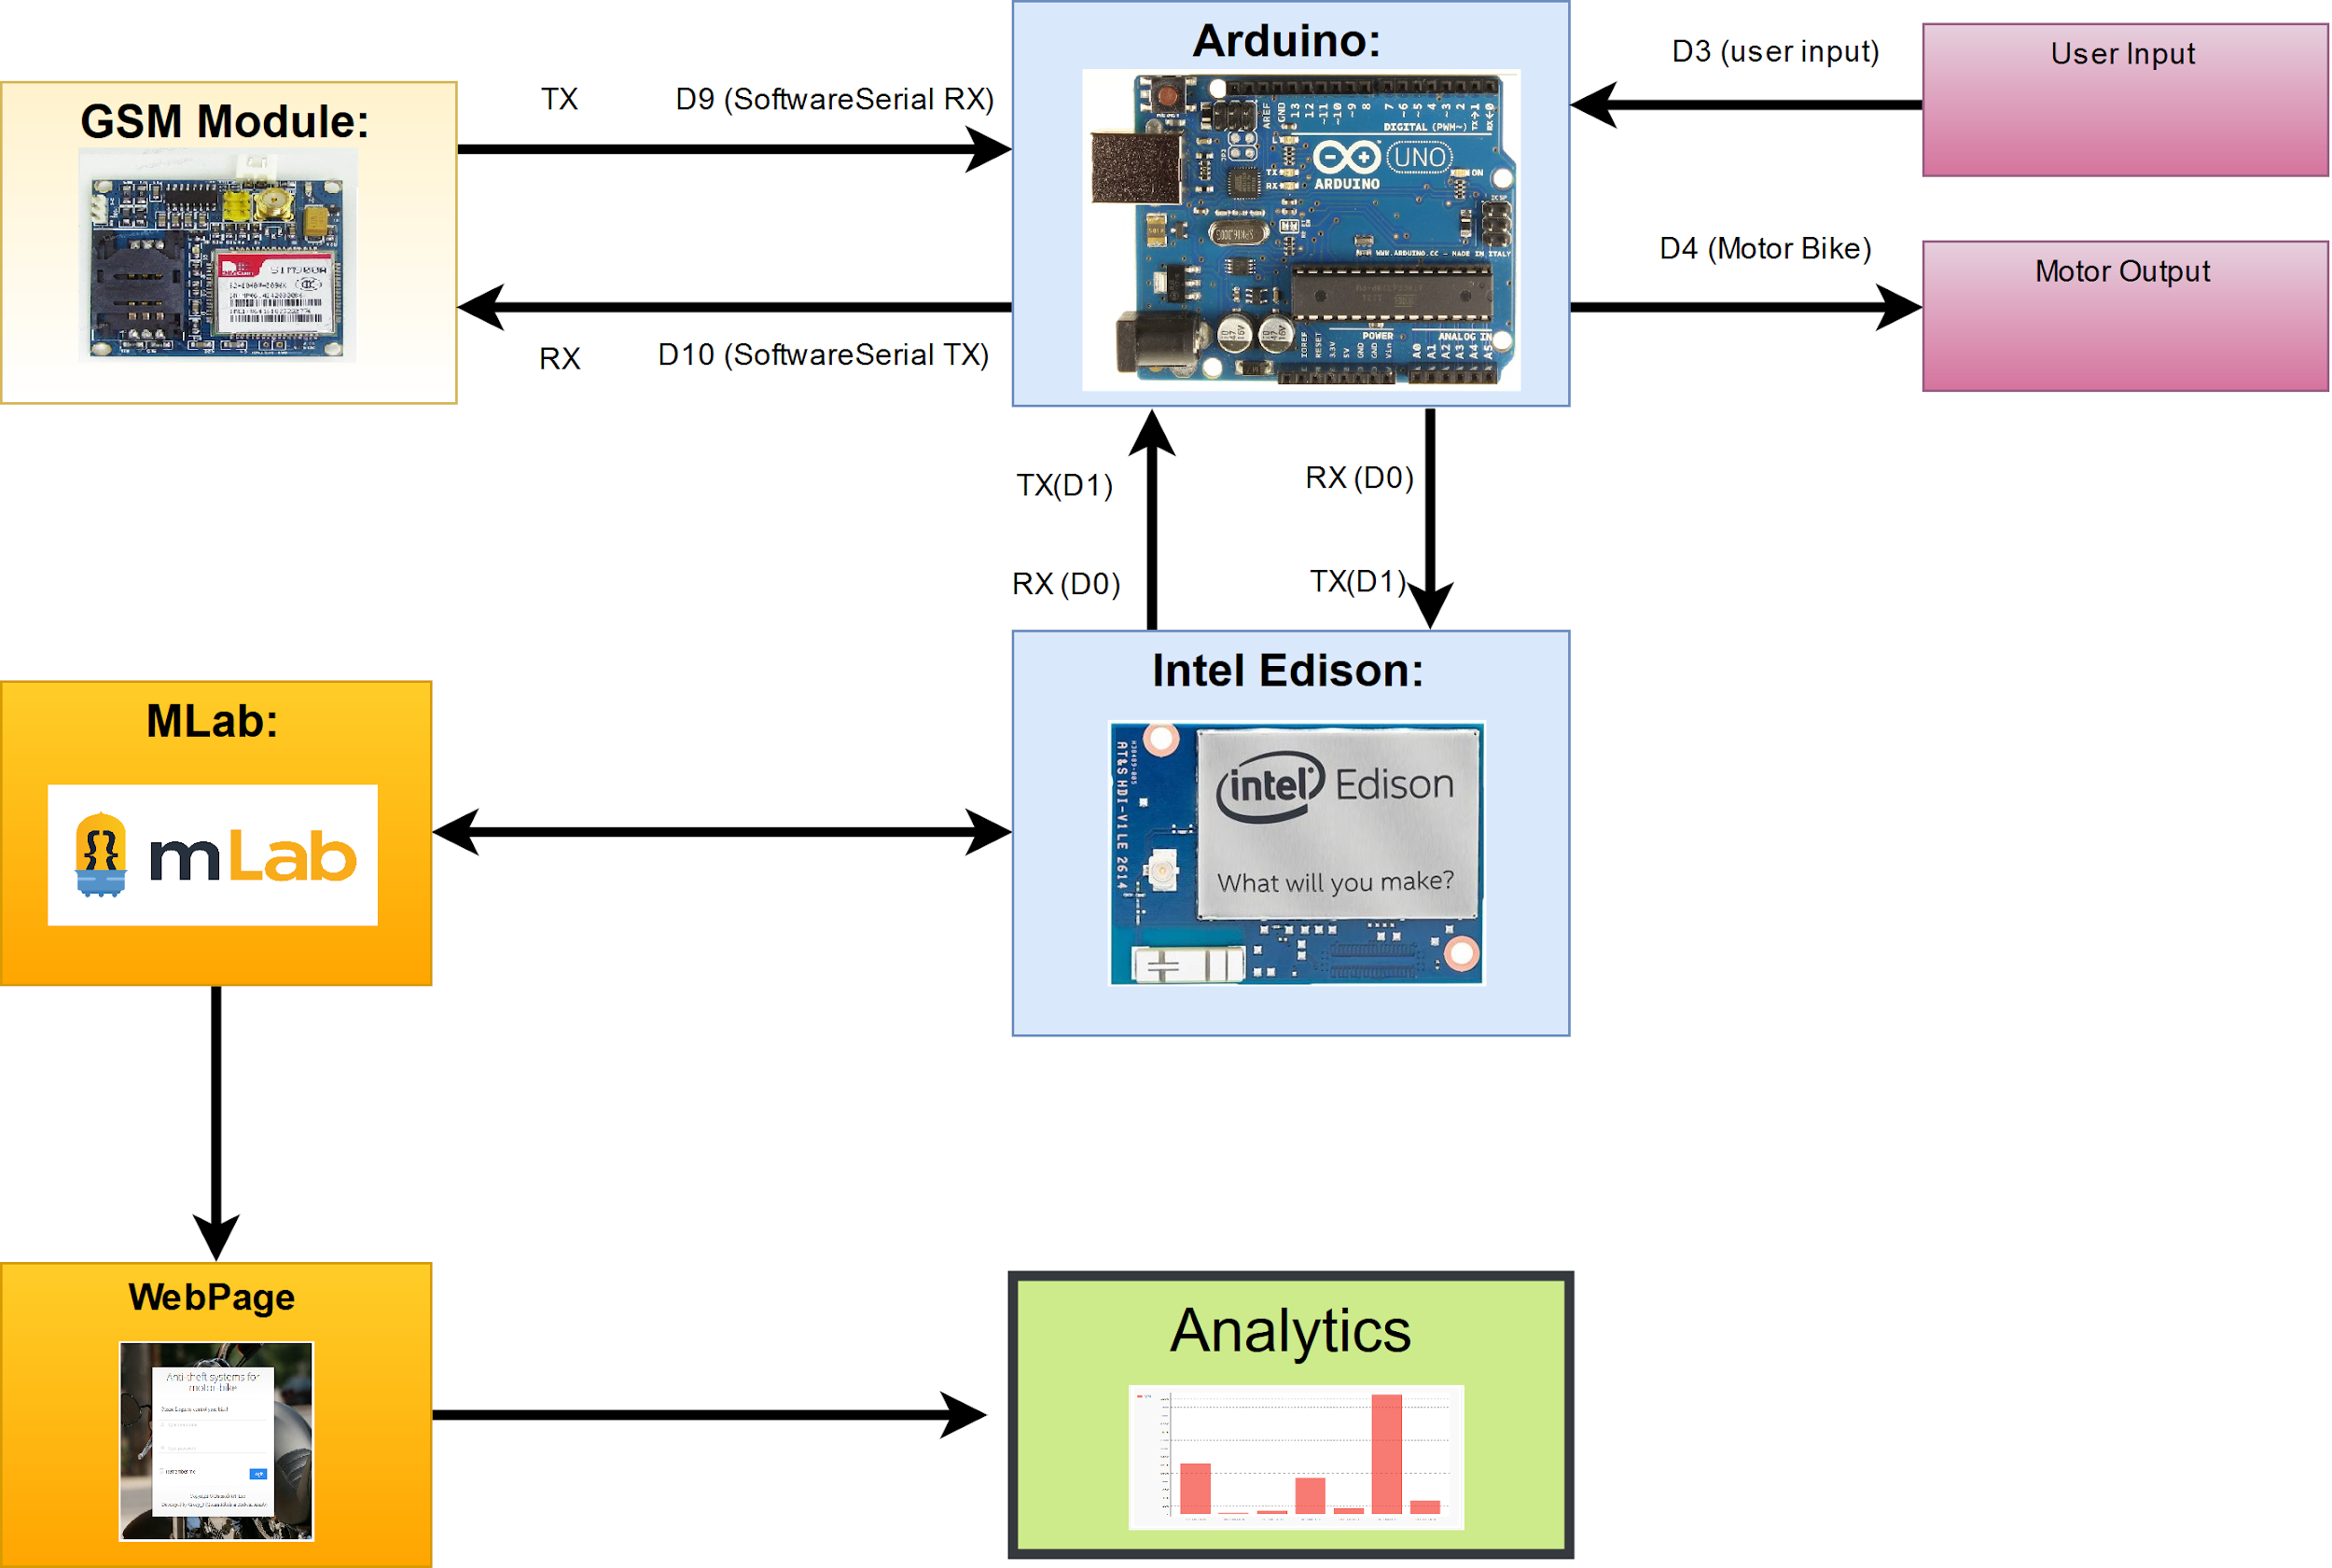
System architecture

Slide 6
Comparative advantages
Existing Company Name | Limitations | Our product
Grameenphone | Smartphone based service | Phone independent service
Pi-Labs | Offline Panic alert | Both offline and online
Banglalink Ntrack | Smartphone based GPS tracking | Phone platform independent tracking and control

Slide 7
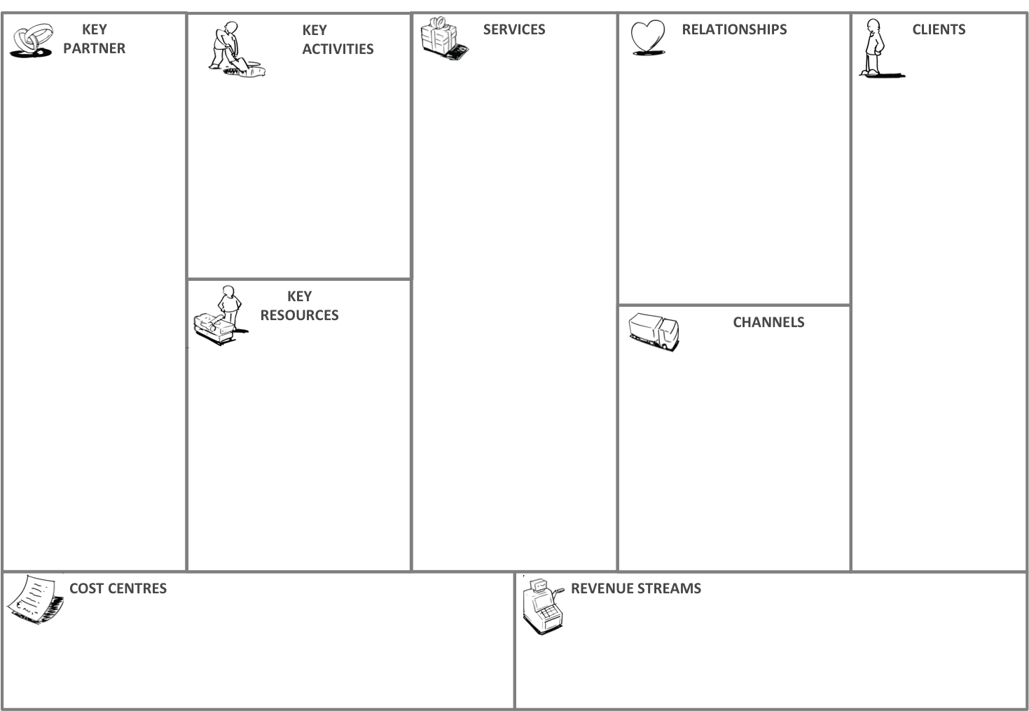
Business Model
Motor Bike R&D
Develop our IoT product and provide operation and maintenance service of the product
Phone number and secret encrypted key to identify user module
One time purchase
motorbike owners
Emergency maintenance
Security agencies
Security agencies
Gsm to connect to bike and stop it
Embedded system tools dealers
Operation would be possible both online and offline
MCU, GSM Module and other embedded electronic devices
Online stores
Bike show rooms
System development and maintenance
Per user purchase and maintenance

Slide 8
Tools used for prototyping
Hardware:
SIM900A GSM Module
Arduino Uno
Intel Edison
IDE and Software:
Arduino IDE
Putty
Visual Studio
Cloud Platforms:
MLab
Languages:
Processing
Python
Special Libraries:
Arduino:
SoftwareSeiral
StringSplitter
Python
Flask
PyMongo
PyCrypto
PyGal

Slide 9
Initial Challenges
Response from GSM and GPS sensor.
Interfacing with bike.
Power & Bandwidth consumption.

Slide 10
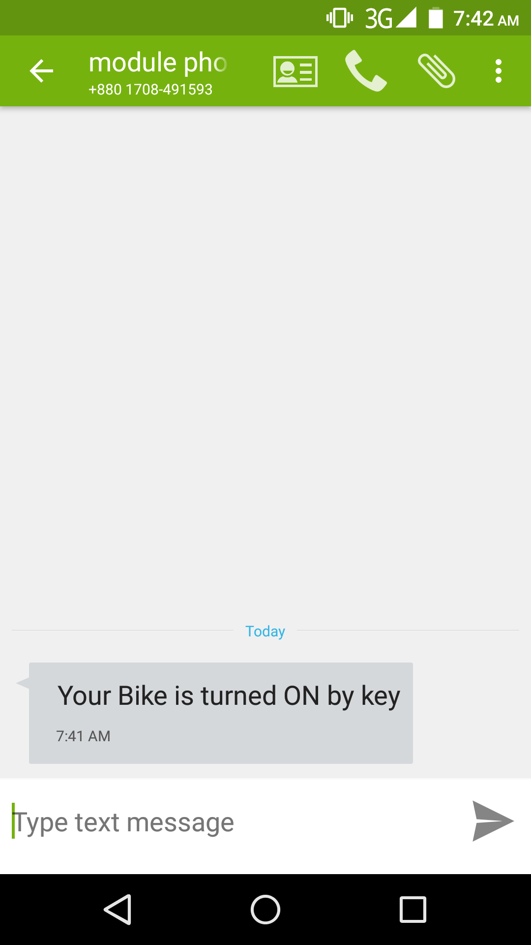
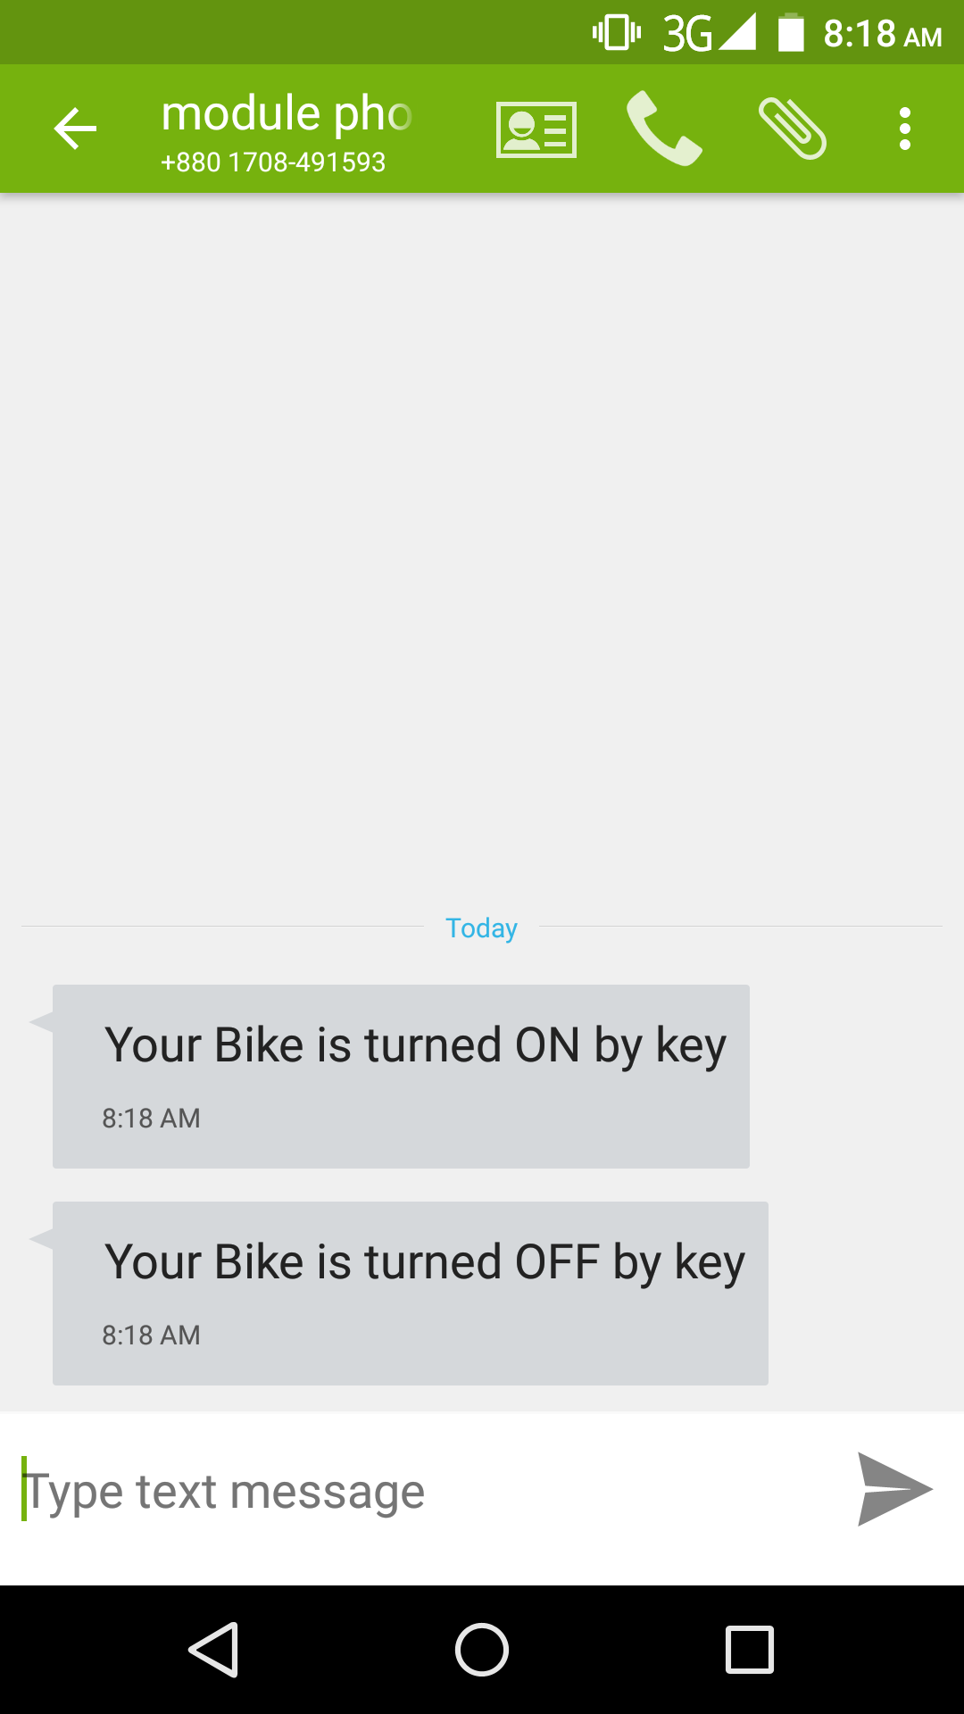
Screenshots from Prototype

Slide 11
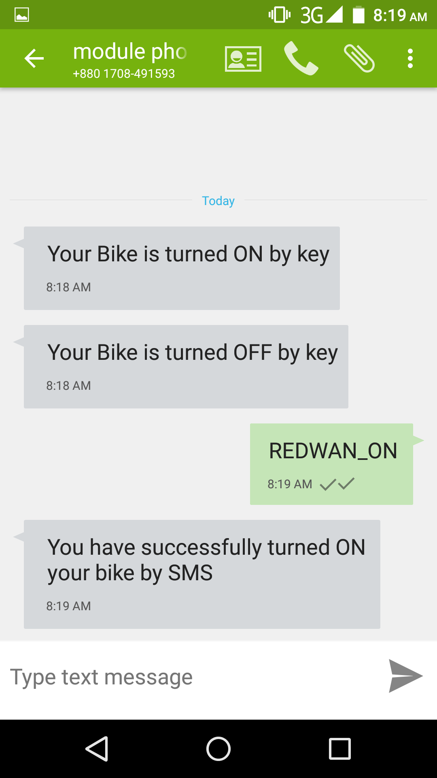
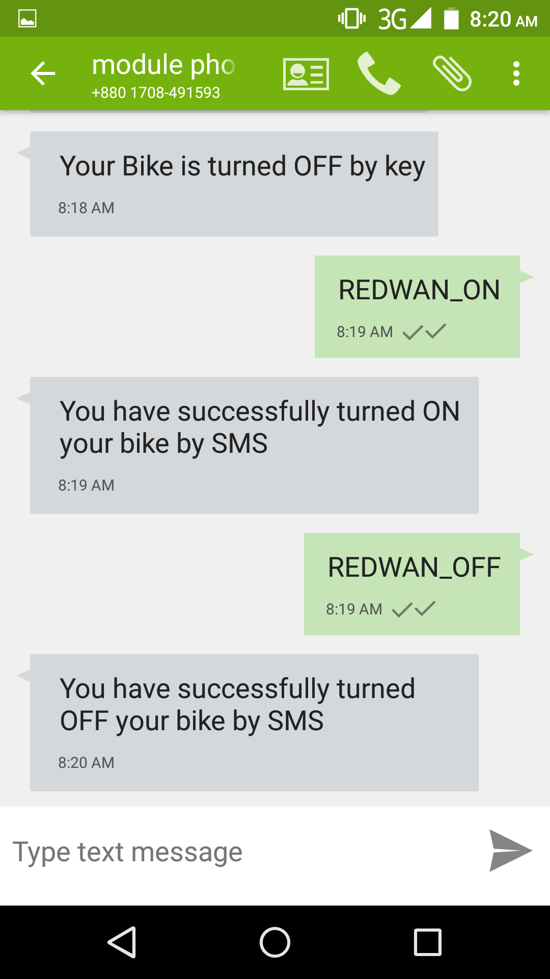
Screenshots from Prototype

Slide 12
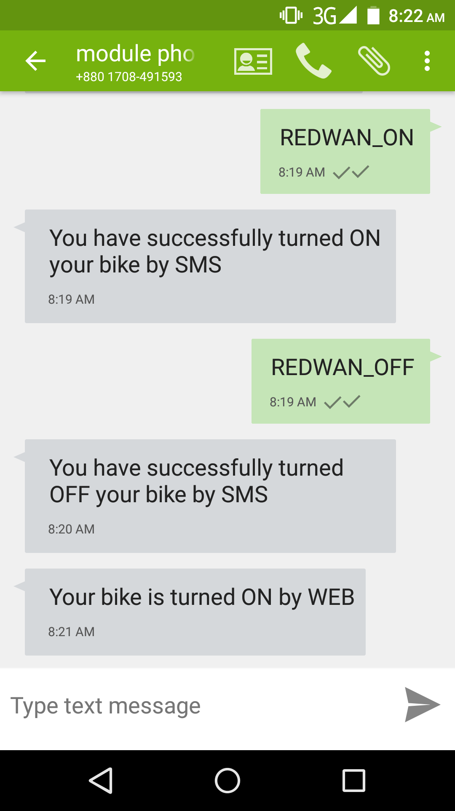
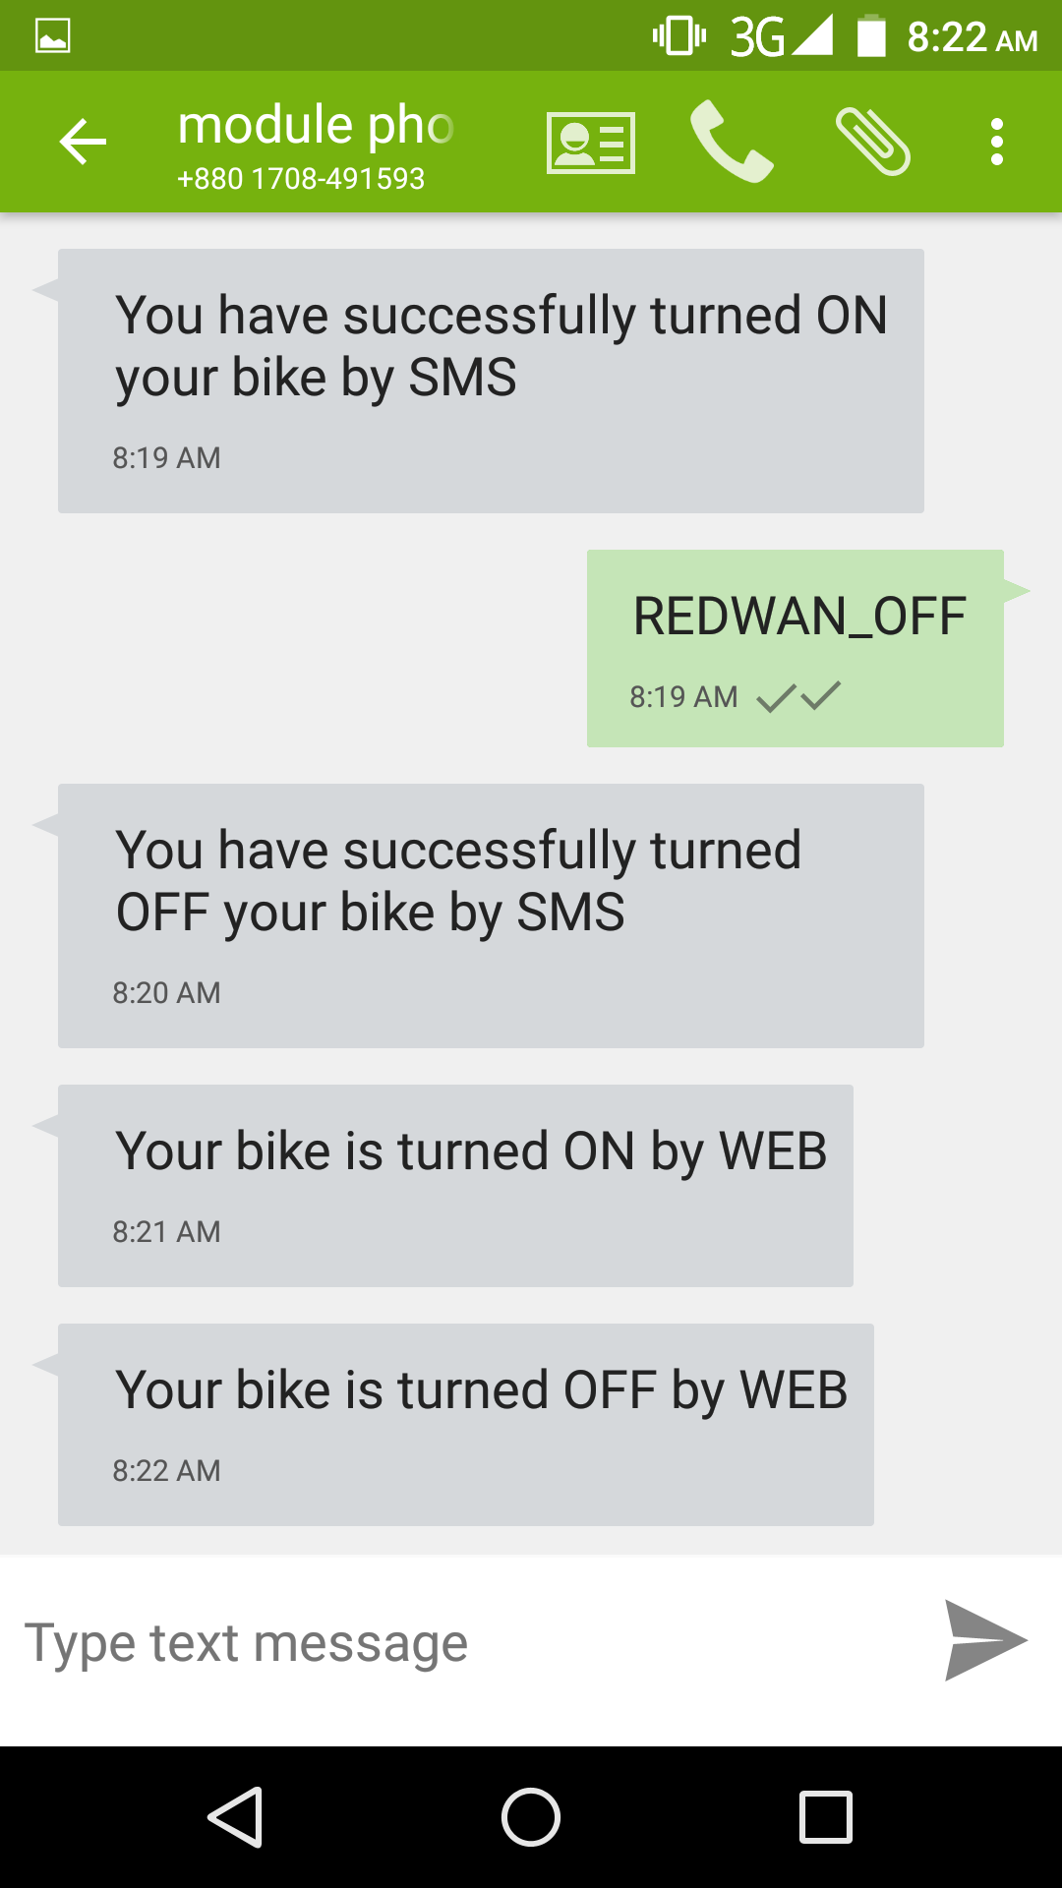
Screenshots from Prototype

Slide 13
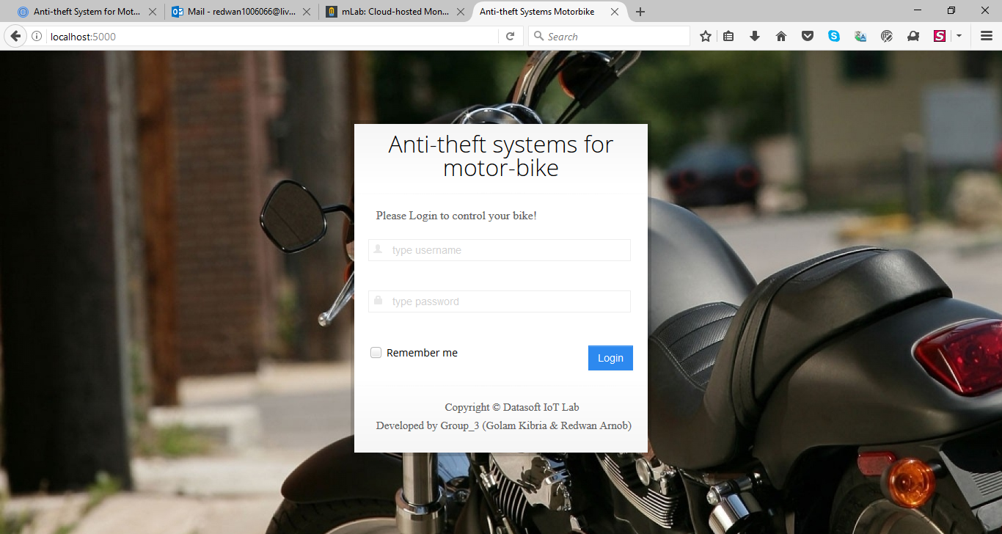
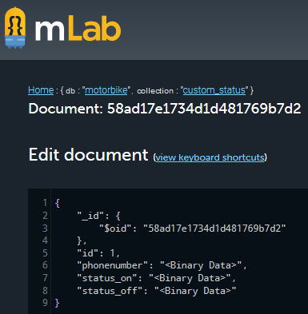
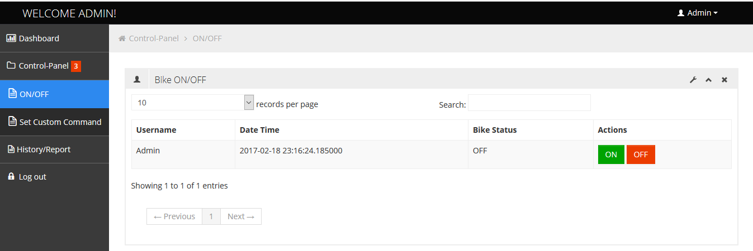
Screenshots from Prototype

Slide 14
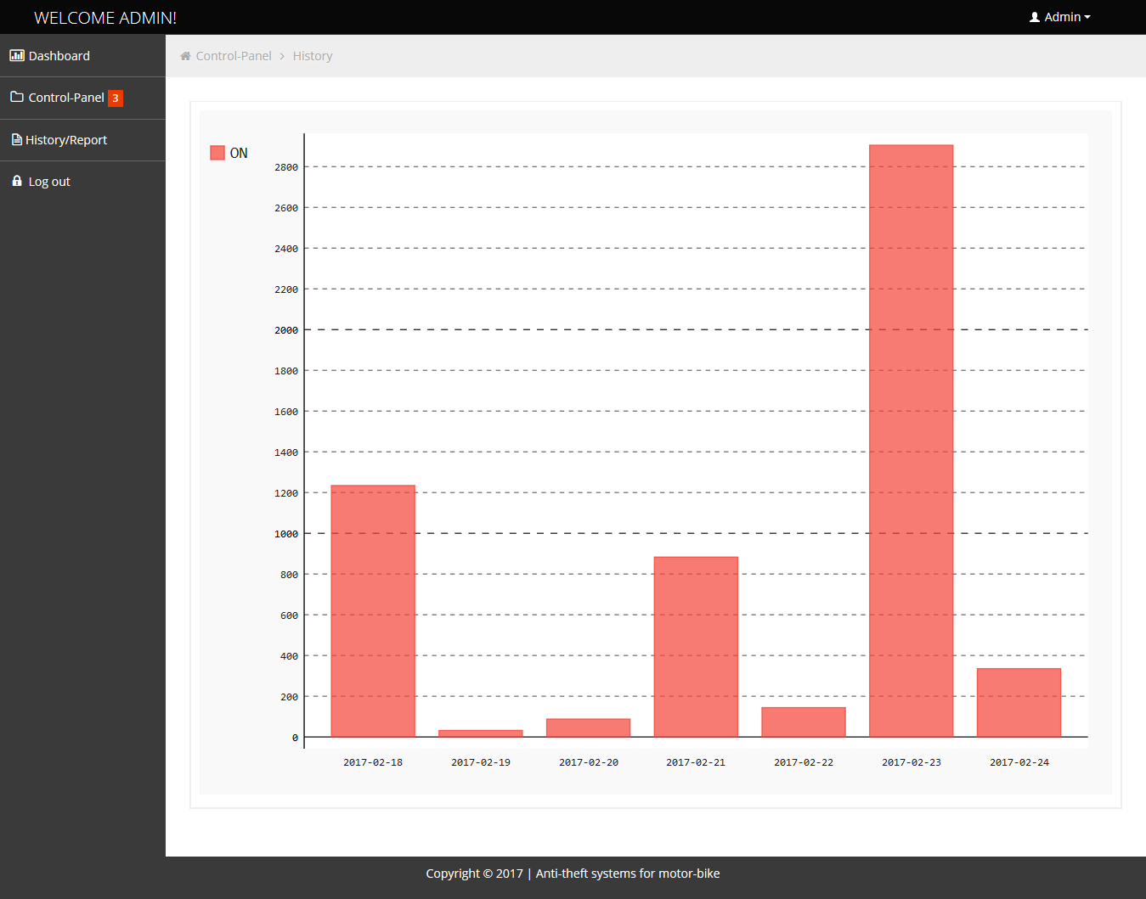
Screenshots from Prototype

Slide 15
Future considerations
Development for non electronic vehicles like bicycle or rickshaw.
More complex analytics like traffic jam prediction in specific roads.
Complete unmanned operation.

Slide 16
Video demo
https://www.youtube.com/watch?v=vs-7tPLHmMI

Slide 17
Thank you so much

