Slide 1

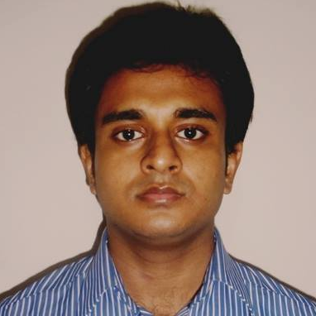
Smart Wake-up Alarm
Md. Mohitul Haque
November 3rd, 2016
IoT Army of 300:
Resource Development to Enable our Brightest Minds in Technology

Slide 2
Stages Of Sleep
Sleep stages:
Light Sleep or REM sleep
Deep Sleep
Brief awakenings
Light Sleep Light sleep occurs in cycles of about 90-120 minutes throughout the night, and it accounts for up to 20-25% of total sleep time in adult humans
Non REM Sleep
Theta stage
Delta Stage

Slide 3
Characteristics of REM or light sleep → Low-amplitude mixed-frequency brain waves → Similar to those experienced during the waking state - theta waves, alpha waves and even the high frequency of beta waves. → The brain’s oxygen consumption, reflecting its energy consumption, is also very high during this period. → Heart rate and blood pressure also increase to near waking levels. → Dreams happen mostly in this phase.
Stages Of Sleep

Slide 4
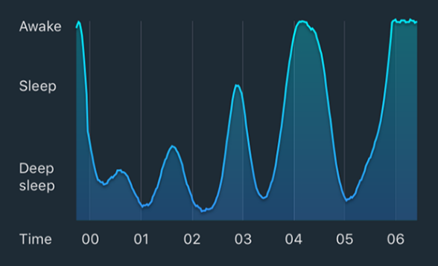
A graph of sleep between midnight and 6 am

Slide 5
●Unhealthy sleep is root to many health problems and also decreased productivity at work. ●Many students cannot have a regular sleep, which makes them feel uncomfortable and tired. ●People can hardly know their sleepiness status when they fall in sleep. ●It’s meaningful for users to manage their sleeping quality, so that they can adapt to have a better sleep. ● Very important to get a sound sleep while getting up on time.
Motivation

Slide 6
Problems I Want to Solve and Human Benefits
Problems | Deliverables
Oversleeping | Impedes from oversleeping
Unrestful/Unrefreshed awakenings | Can help people wake up refreshed and healthy
Insomnia | Detect and may help treat insomnia
Snoring | Detection of snoring
Anxiety Disorder | May prevent anxiety disorder
Table: 01
Added benefits:
Can monitor one’s sleep quality and get information about his sleep
Can improve one’s sleep quality

Slide 7
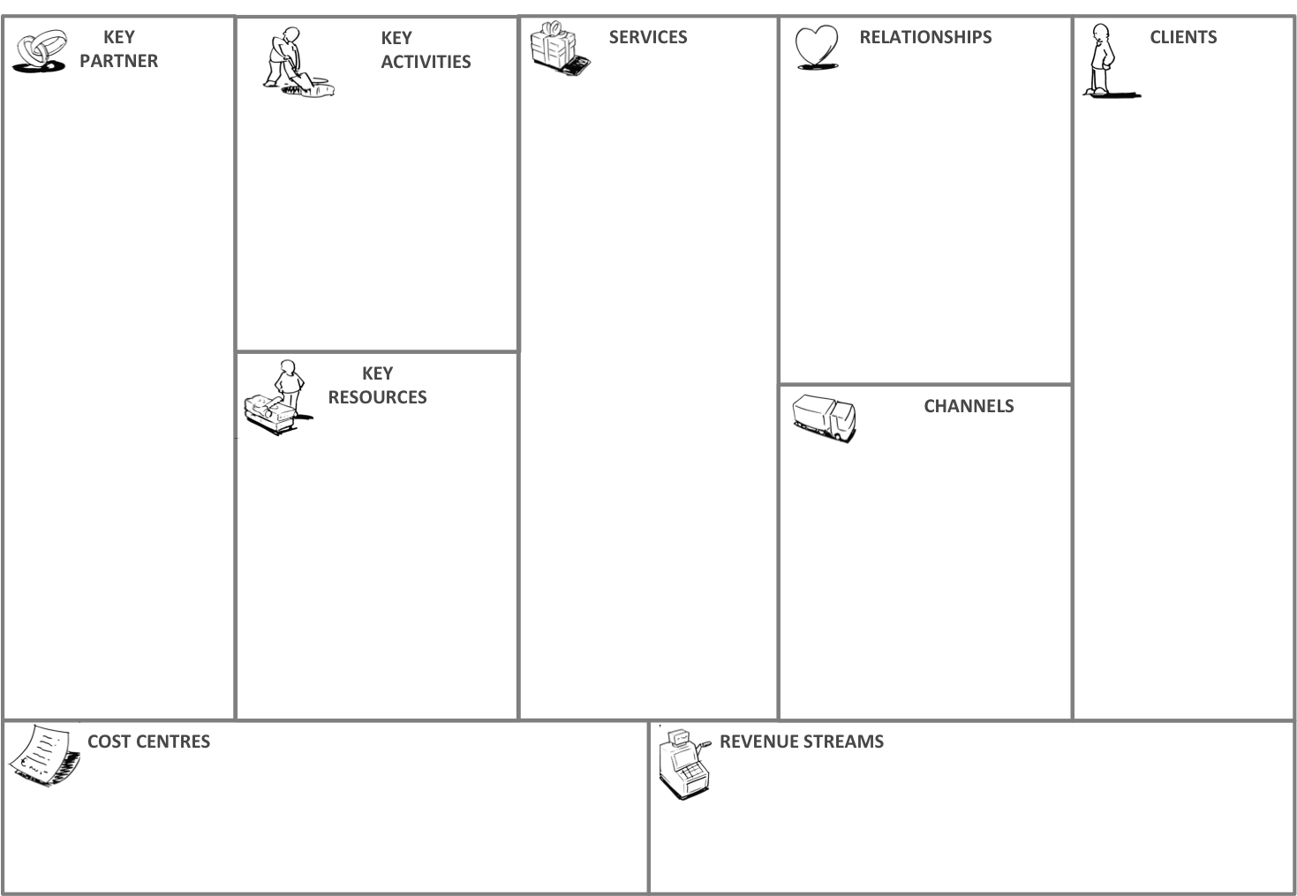
Tuesday, February 28, 2017
Digital marketing agencies
Integrating Sensors with MCU
Smart wake-up alarm
Personal Contact
Techy/ trendy
Sleep quality monitoring
Data analytics on gained data
Interaction over the web
Advertising agencies
Database export
Anyone who wants his/her sleep info
Nightly sleep graph
Anyone who wants improve their sleep quality
Sensors, buzzer etc
Regular alarm and Snooze
MCU
Online backup with a subscription
Anyone with sleep issue
Mobile App or stand alone device
Cloud Service
Alarm melodies and Apple health integration
R & D
Subscription fee

Slide 8
Existing Companies & Comparison
Comparison with my device
Sleep tracker/monitoring | Sleep tracking + alarm+non-wearability | Sleep tracker/monitoring
Zeo | Sleep Cycle Alarm Clock | UP3
ActiGraph | Smart wake-up alarm | Garmin VivoSmart
Fatigue Science RediBand | Withings Aura | Fitbit Blaze
Fatigue Science RediBand |  | Beddit 3 Sleep Tracker
Sproutling Baby Monitor |  | Sense
S+ |  | Sleepace Reston
Table:04

Slide 9
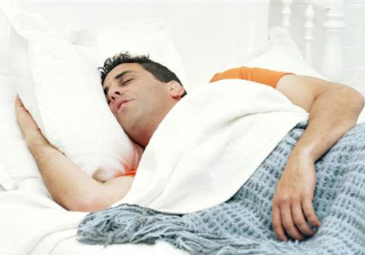
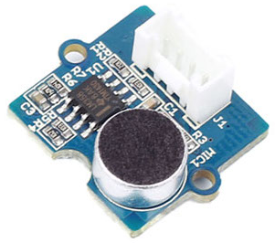
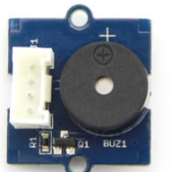
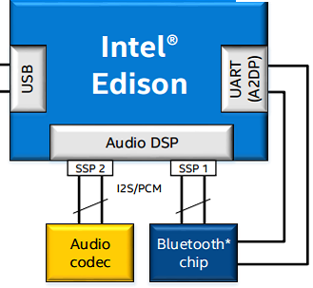
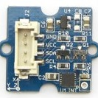
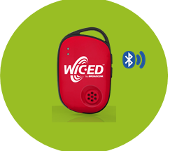

System Architecture
Sense movement by sound sensor
After data processing trigger a smart alarm
WebApp
(Sleep Quality)
Over ADC
Sense movement by accelerometer
After data analyzing and processing using relevant tool
Gained data storing to cloud by rest api
Over I2C
Through Wi-Fi

Slide 10
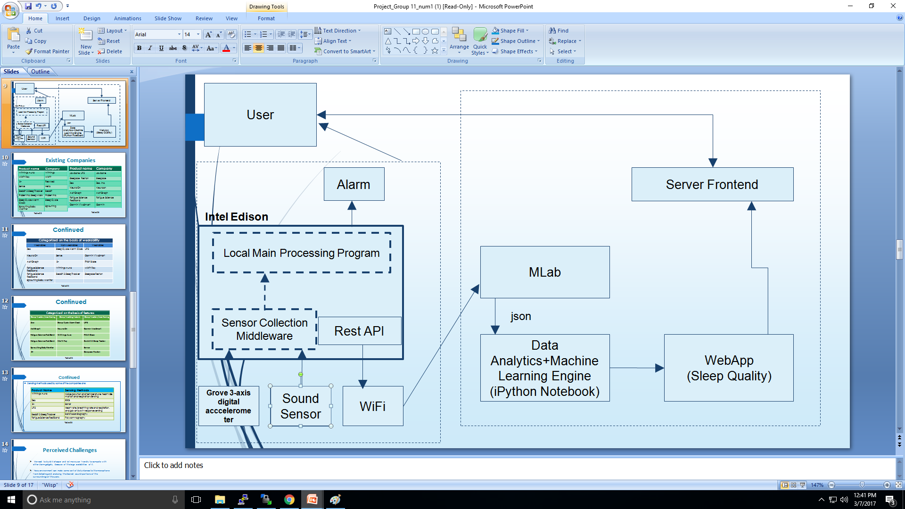
Technical Architecture

Slide 11
Perceived Challenges
Noisy environment can make some sort of disturbances to the microphone to detect and analyze for the desired sound portions of the surroundings of the users.
Little time consuming and hassling to collect data every night of sleep.
Data analytics and logic implementation.

Slide 12
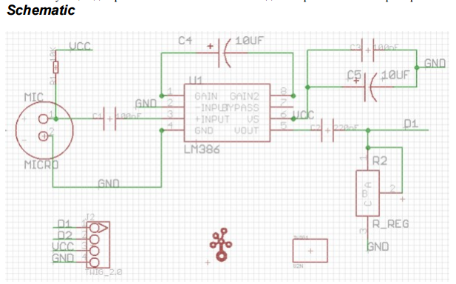
Sensor Basics
Sound Sensor:
The Sound sensor module is a simple microphone. Based on the power amplifier LM386 and the electret microphone, it can be used to detect the sound strength of the environment
Working Principle
Sound sensors work by detecting differences in air pressure and transforming them into electrical signals. Sound sensors such as microphones usually have built-in amplifiers that increase the strength of the incoming signal.

Slide 13
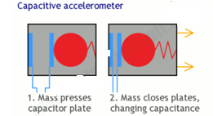
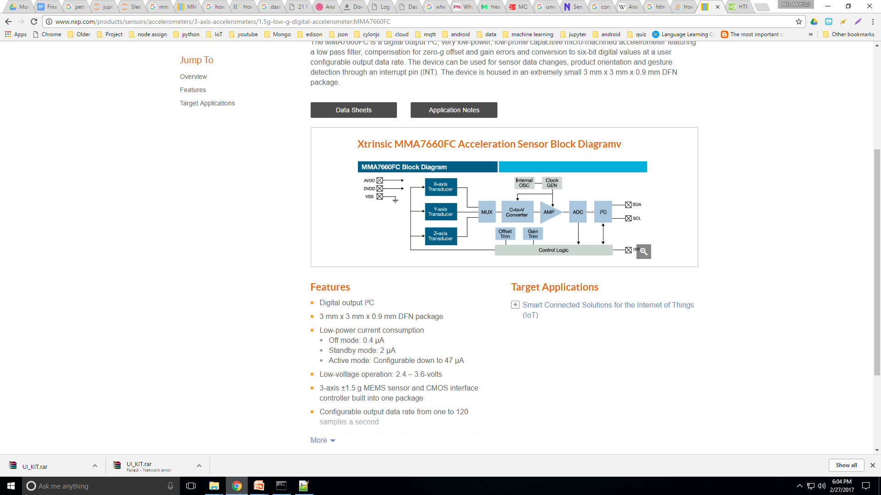
Continued
Accelerometer:
The MMA7660FC is a ±1.5 g 3-Axis Accelerometer with Digital Output (I2C).
Working Principle
Moving mass alters the distance between two metal plates, measuring the change in their capacitance gives a measurement of the force that's acting.

Slide 14
Sensor Data Collection
Data format:
Analog input- Integer, I2C- up to two floating points
Data acquisition interface- ADC, I2C
ADC bit resolution- max 12 bit
ADC sampling rate- 1MHz
Operational frequency of I2C - 100Khz
For i2C data is transferred in sequences of 8 bits
Using Aio, I2C, GPIO connections
Data sampling rate/5 seconds
Data sent to cloud server(Heroku) and stored to cloud database(mlab) in json format
Used Protocol: Rest API

Slide 15
Sensor Characterization & Calibration
Sound sensor: Not very accurate due to low sensitivity and low quality
Reference: Android sound recorder
Noise origin: Environmental noise
Filtering: Took a observed region of mean and standard deviation for filtering
Accelerometer: Fairly accurate
Reference: Manual observation

Slide 16
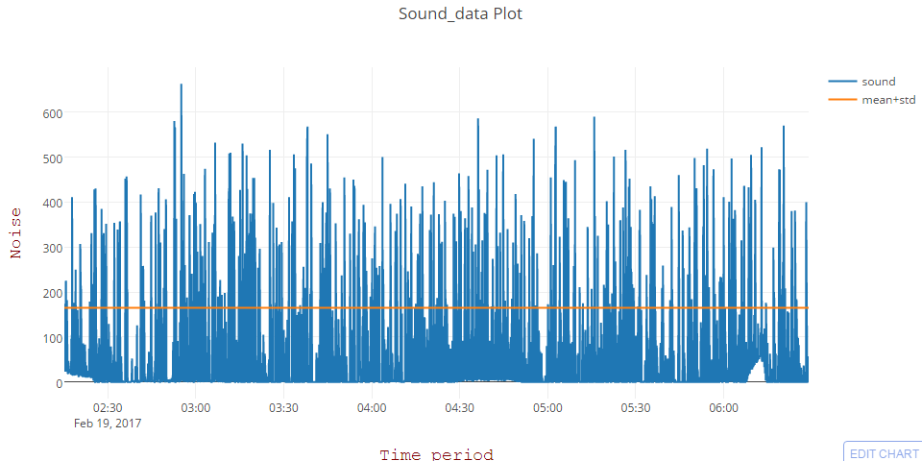
Continued
 | Sound data
count | 3005.00
mean | 54.0146
std | 110.808
min | 0.00
25% | 0.00
50% | 0.00
75% | 50.0
max | 663.0

Slide 17
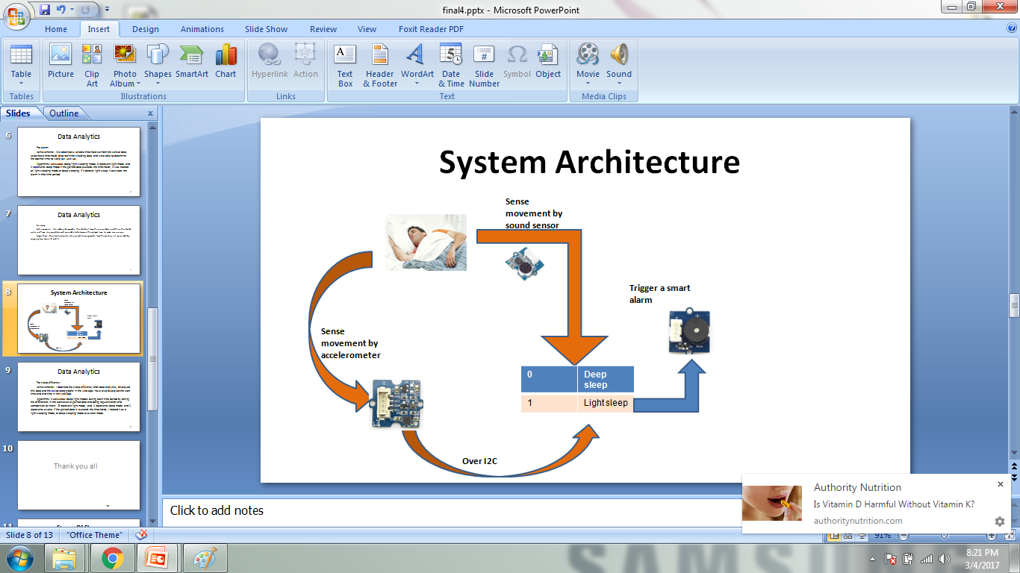
Data Analytics
For alarm:
Achievements: We obtained a variable threshold set from the sensor data, used these thresholds onto real-time sleeping data, and were able to determine the optimal time to wake our user up.
Algorithms: Constantly calculates deep/light sleeping mode from the variation of sensor data by assigning two values 0 and 1.
Within the time period of 30m of set time

Slide 18


Continued
For sleep efficiency:
Achievements: I obtained the sleep efficiency after data analytics, displayed this data and the associated graphs in the web app I have also displayed the start time and end time in the web app.
Algorithms: It calculates deep/light modes data by assigning three values 0.1 and 0.5 and 1 during each time period by taking the differences in the consecutive gained data and doing regularization and comparison on them.
Assigned values from data analytics | Sleep stages
0.1 | Deep sleep
0.5 | Light sleep
1.00 | Awake

Slide 19
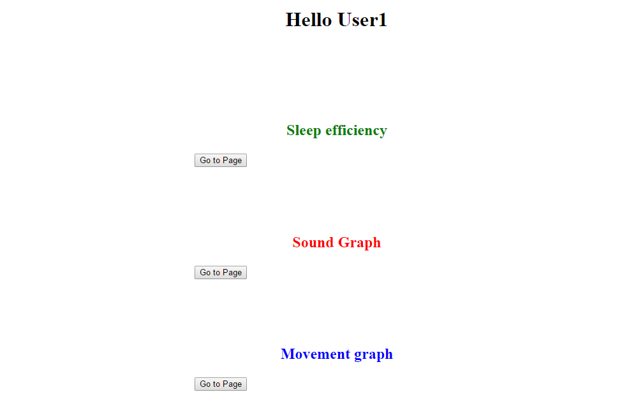
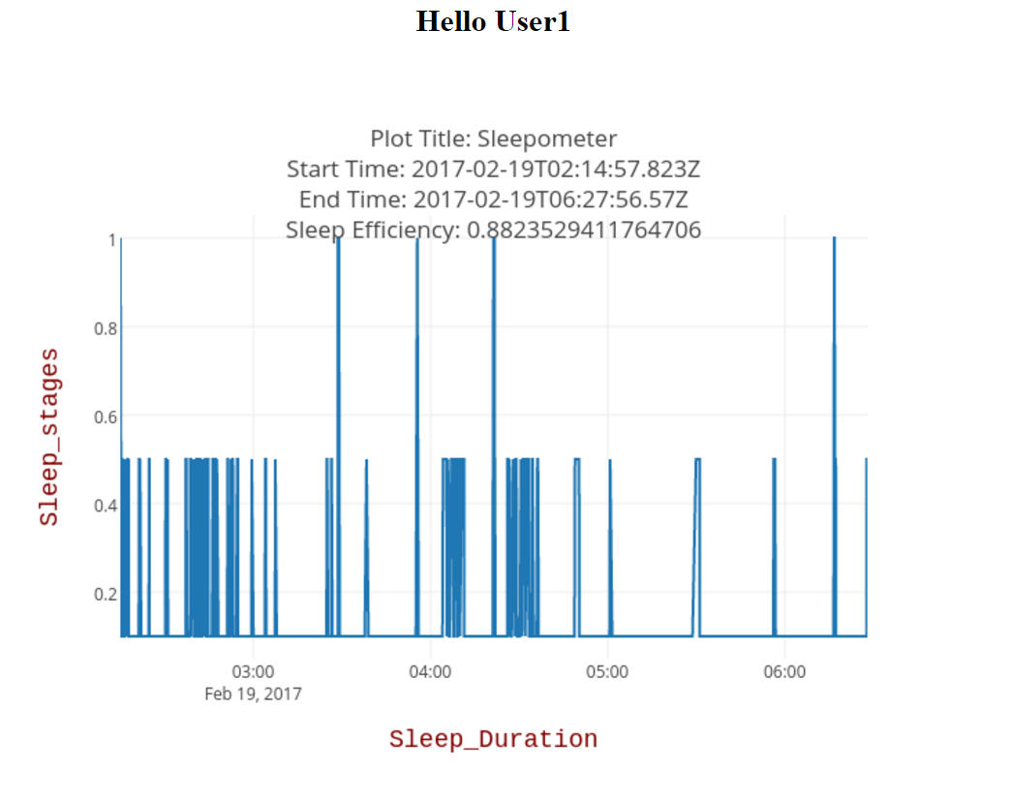
Demo Screenshots

Slide 20
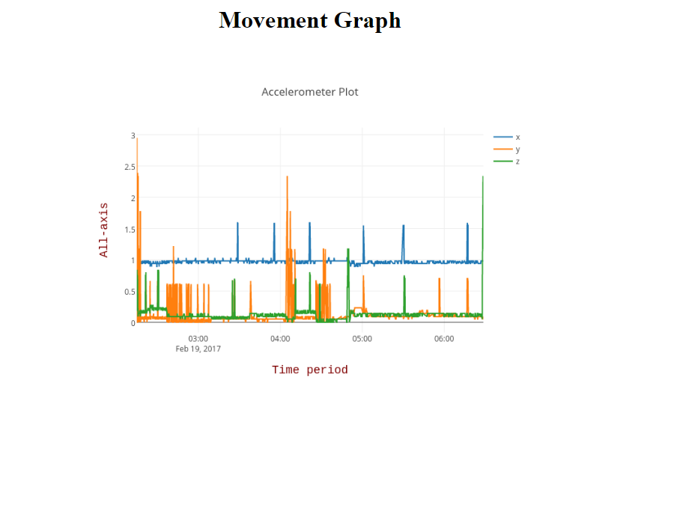
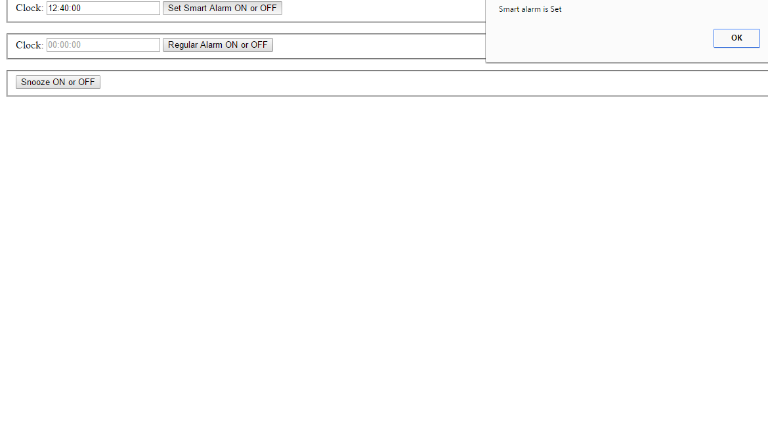
continued

Slide 21
Thanks To All

