Slide 1
Name: Mohiuddin
Trainee ID: 1282547
Batch: WDPF/TCLK-M/60/01

Slide 2
Project Name:
Car Rental Management System

Slide 3
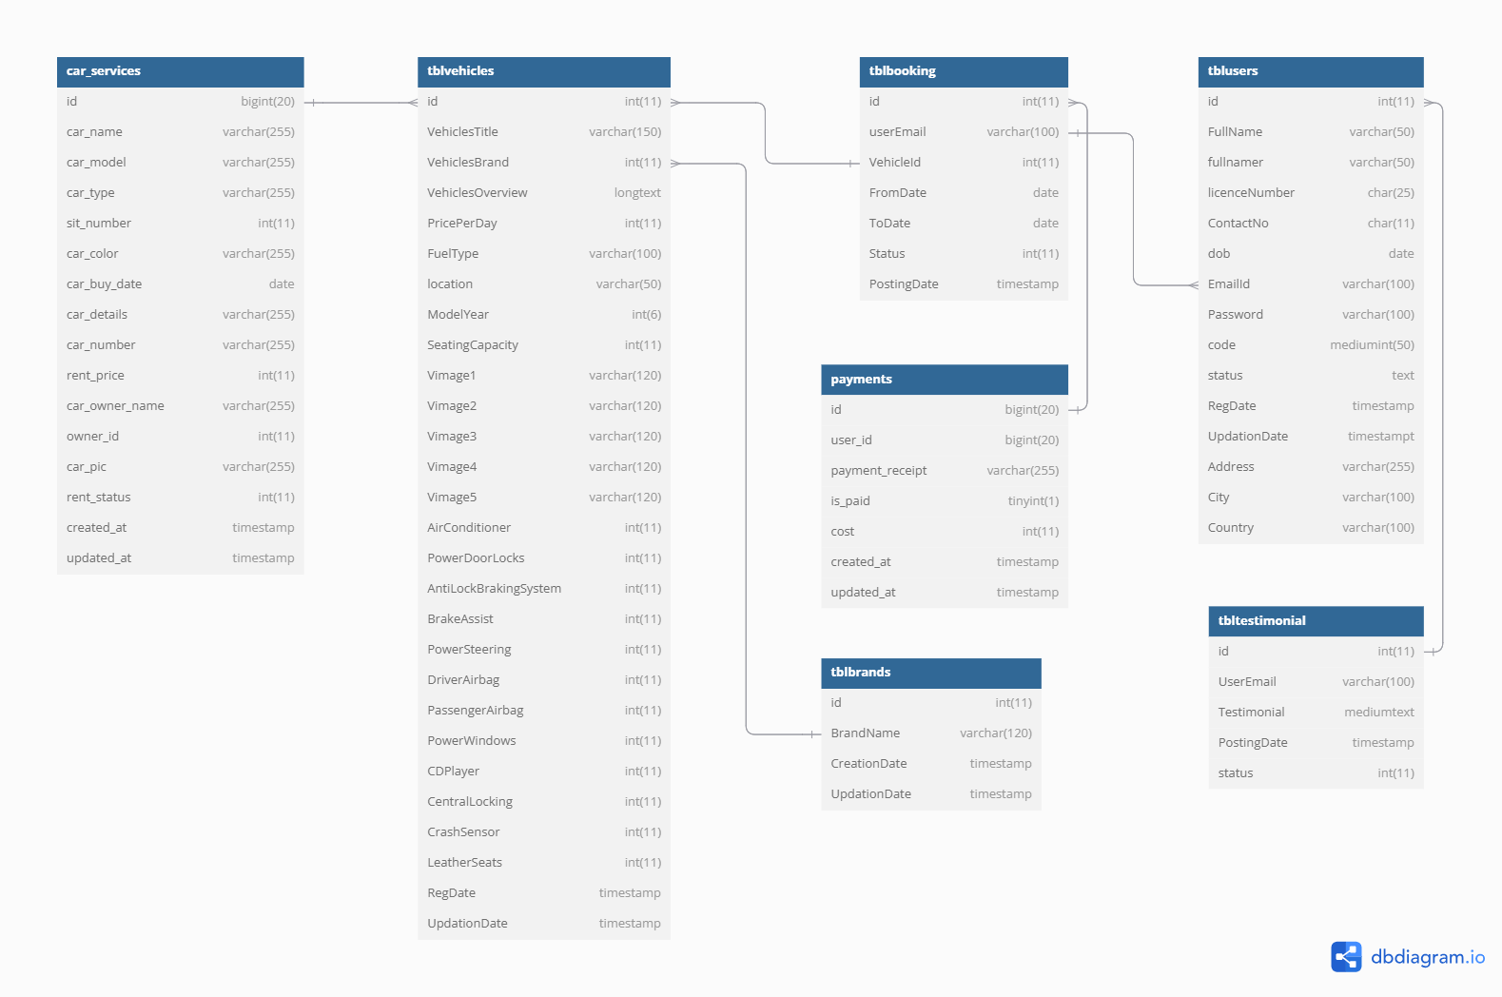

Slide 4
Project Features

Slide 5
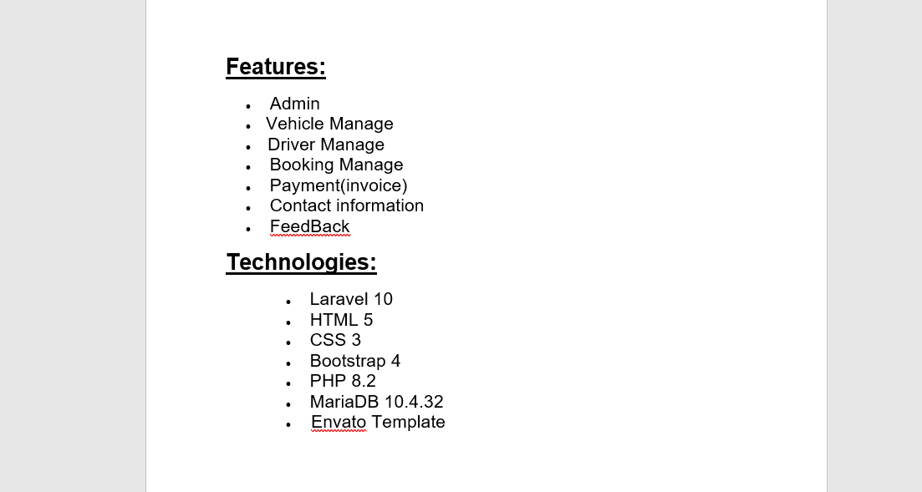

Slide 6
Project Frontend

Slide 7
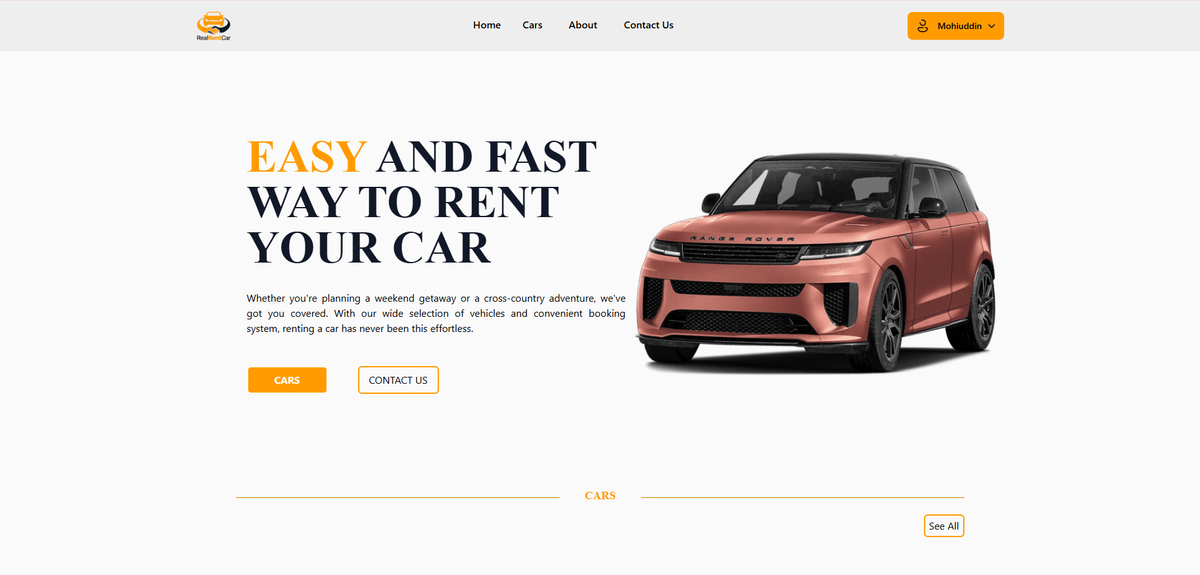

Slide 8
User Registration Form

Slide 9
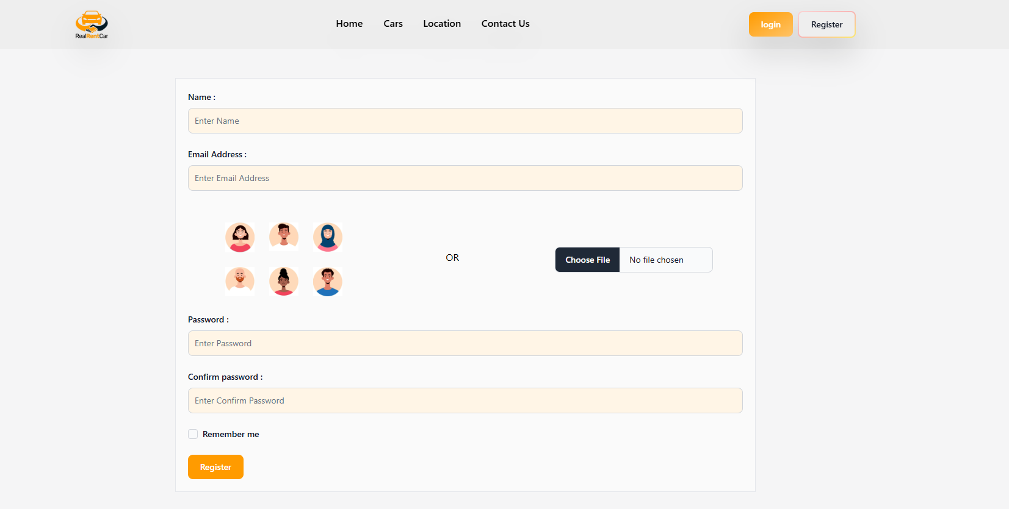

Slide 10
User Login Form

Slide 11
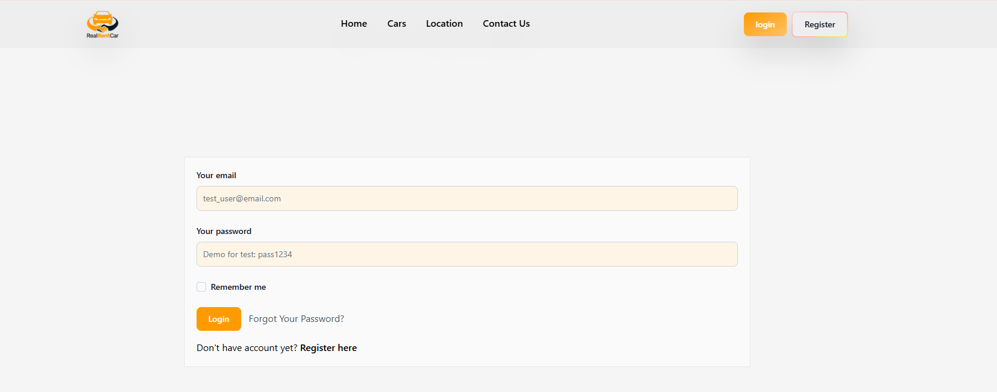

Slide 12
User Profile

Slide 13
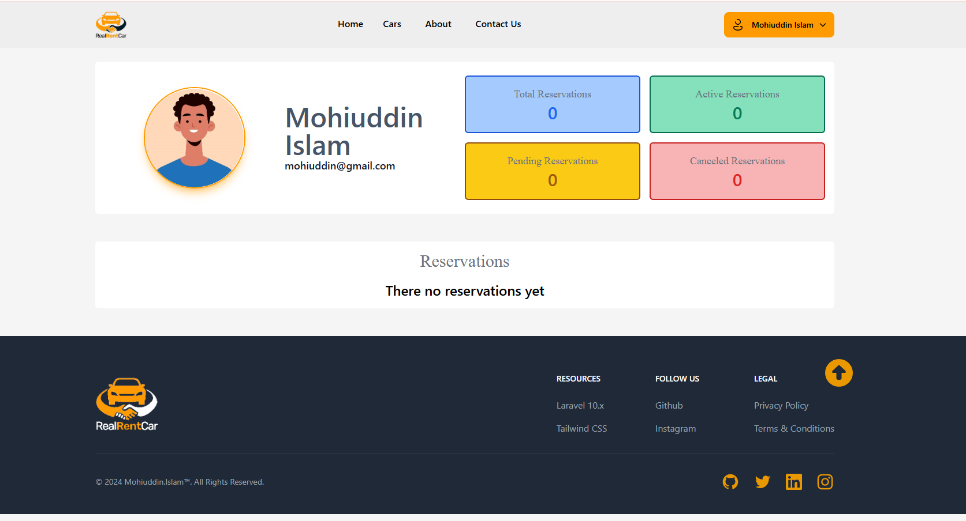

Slide 14
User Car Booking

Slide 15
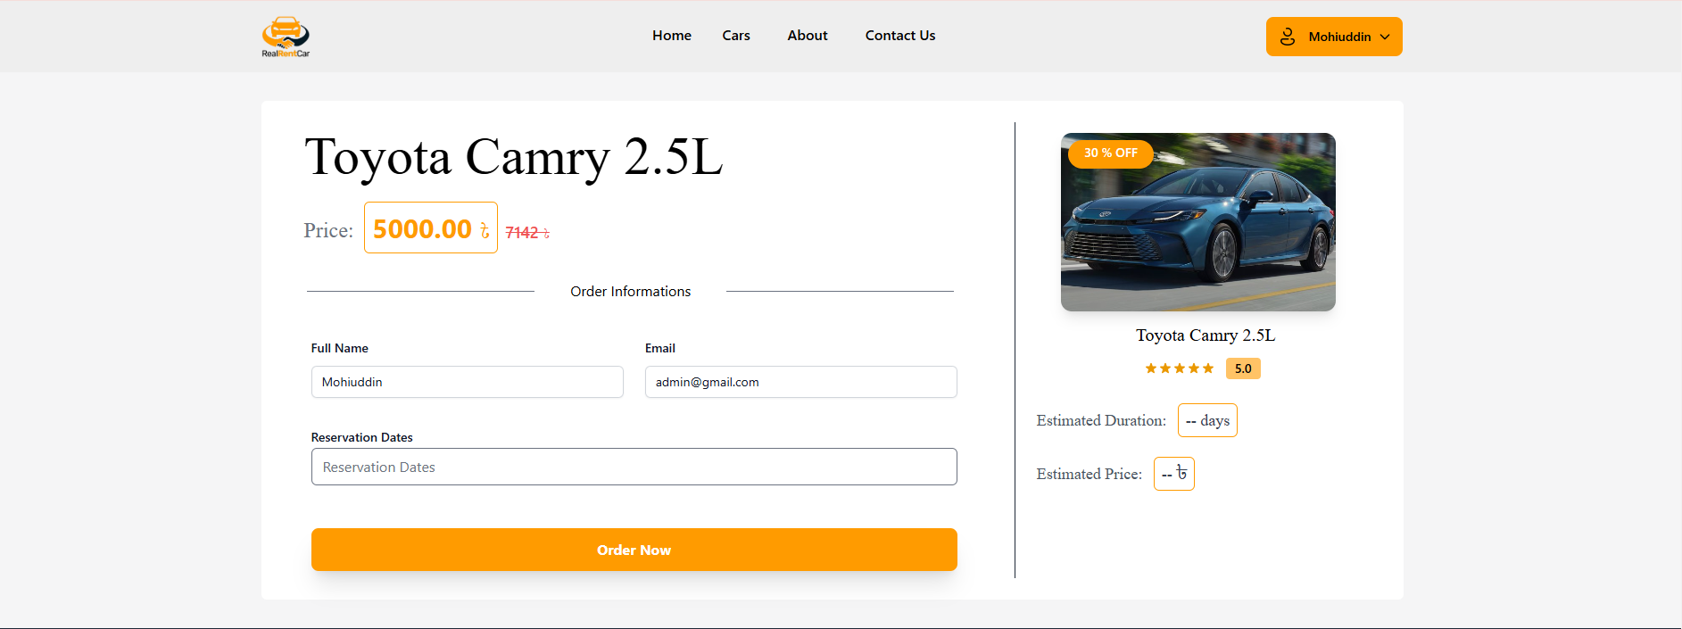

Slide 16
Car List

Slide 17
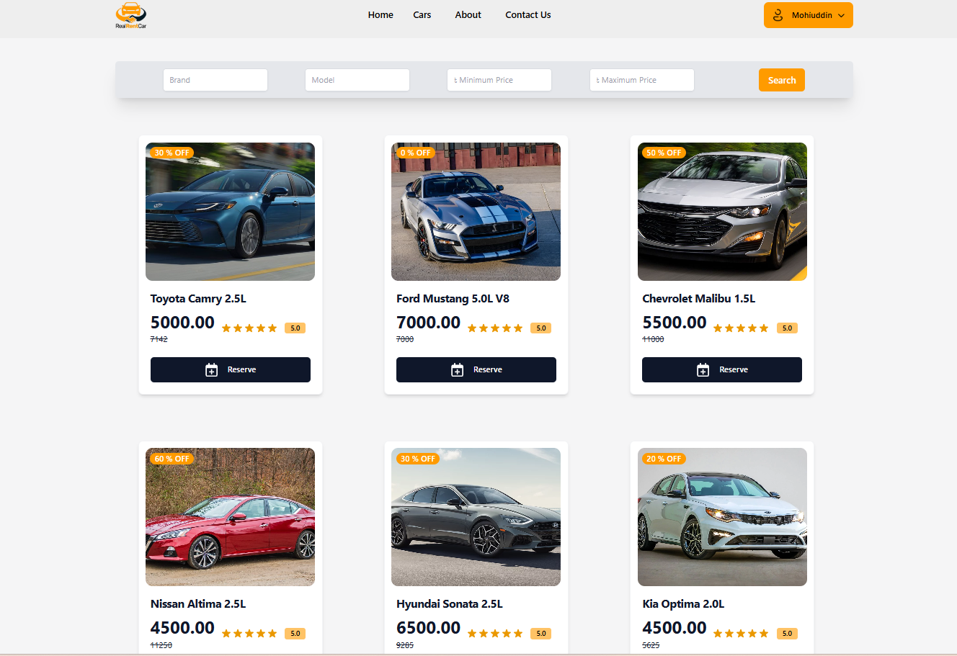

Slide 18
Admin Dashboard

Slide 19
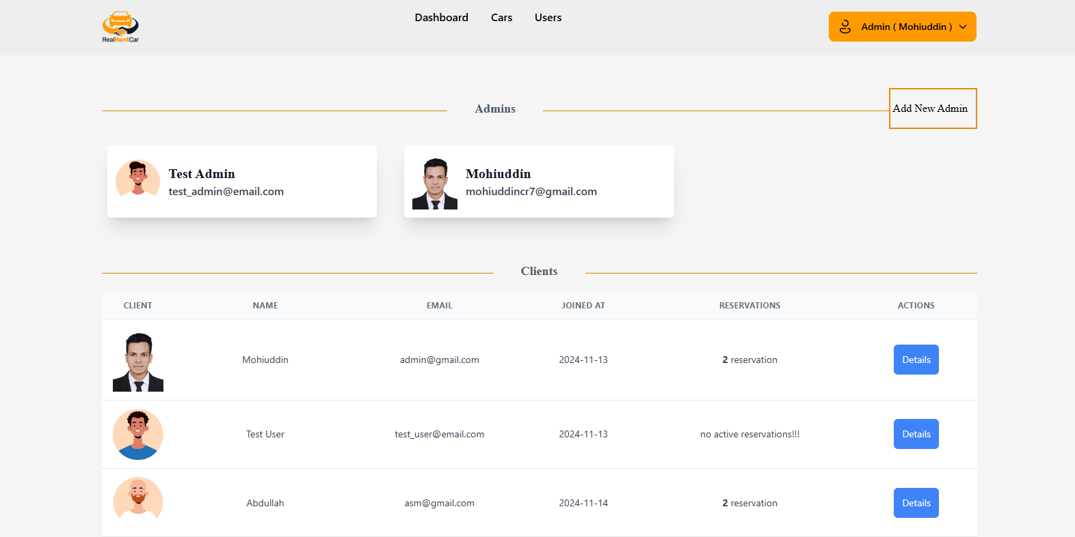

Slide 20
Admin Car Manage

Slide 21
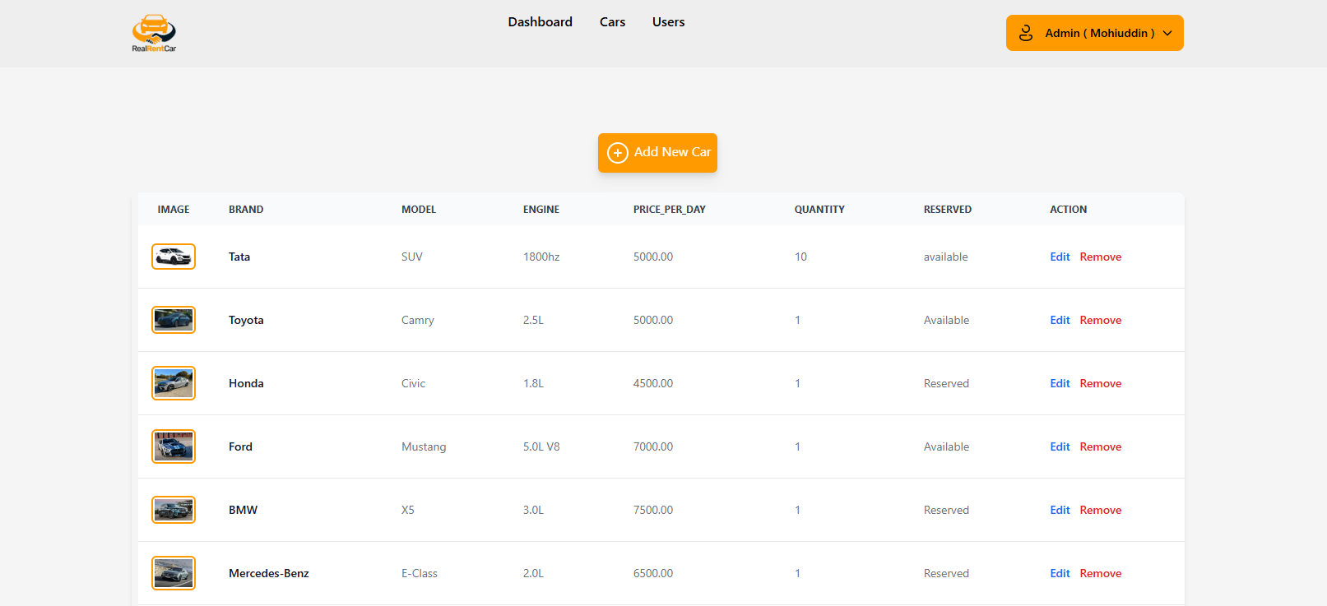

Slide 22
