Slide 1



1
SCAHunter: Scalable Threat Hunting through Decentralized Hierarchical Monitoring Agent Architecture
Mohiuddin Ahmed
Ph.D. Candidate Department of Software and Information System
University of North Carolina at Charlotte
Charlotte, NC, USA
Jinpeng Wei
Associate Professor
Department of Software and Information System
University of North Carolina at Charlotte
Charlotte, NC, USA
Ehab Al-Shaer
Distinguished Career Professor
Software and Societal Systems Department
Carnegie Mellon University
Pittsburgh, PA, USA
Notes:
Hi, I am Mohiuddin from UNC Charlotte.
Today I am going to present our paper- SCAHunter: Scalable Threat Hunting through Decentralized Hierarchical Monitoring Agent Architecture

Slide 2
Outline
2
Introduction
Challenges and Solutions
Problem Statement
Approach Overview and Implementation
Evaluation
Conclusions and Future Works
Notes:
1. In this presentation, I am going to cover – current state of the attack detection,
2. Next , I am going to cover what are the challenges in attack detections, what problem we solved
3. Then I will cover distributed threat hunting approach and implementation
4. I am also going to cover evaluation result on both simulated attack scenarios and real attack data set
5. I will end the presentation, by summarizing our approach and future work

Slide 3
Introduction: Cyber Attacks are on the Rise
3
Advanced persistent threat (APT) and ransomware attacks increased from 37% in 2020 to 78% in 2021 [1].
The global average dwell time of the adversary is 24 days [2].
The data breach damage from ransomware attacks increased from $3.86 million in 2020 to $4.24 million in 2021.
The time to identify and contain the data breach is, on average, 287 days.
A typical APT is sending spear phishing emails to get initial access on the target host, performing drive by download attack to exploit a vulnerability in the target, and later exfiltrating confidential data from the compromised host.
Events are low-level logs generated in the end-host and networking devices based on the corresponding user activities (benign and adversary).
Event Monitoring tools can be centralized or distributed.
Notes:
In recent years, there has been an increase in the attack, including APT, ransomware, and the techniques used by the attacker in these attacks have reached an unprecedented sophistication
2. These attacks evade signature-based intrusion detection systems by exploiting the zero-day vulnerability, whitelisted applications and threat emulation tools
3. Due to the diverse and sprawling nature of organizational network, attackers can dwell in the system for extended periods
4. The damage incurred by the adversary on an organization increases exponentially with increasing dwell time
5. To detect attack, the organization deploys EDR and SIEM to record, monitor continuously, and analyze events in end-host devices.
6. Those solutions detect threats by matching single events against a knowledge base of adversarial techniques
7. It collects events through agent installed in the end-host devices and aggregates in the central server.

Slide 4
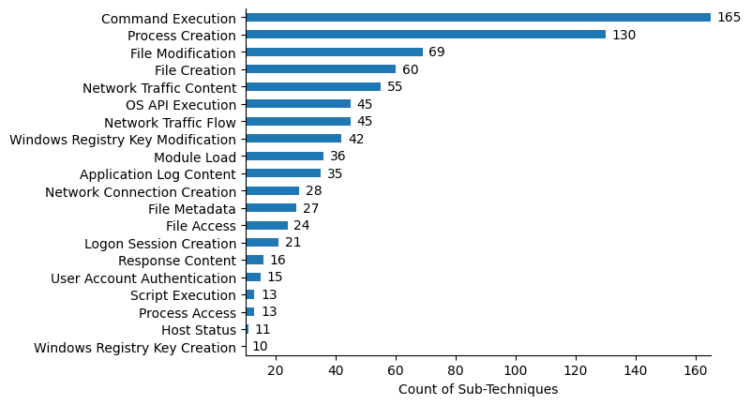
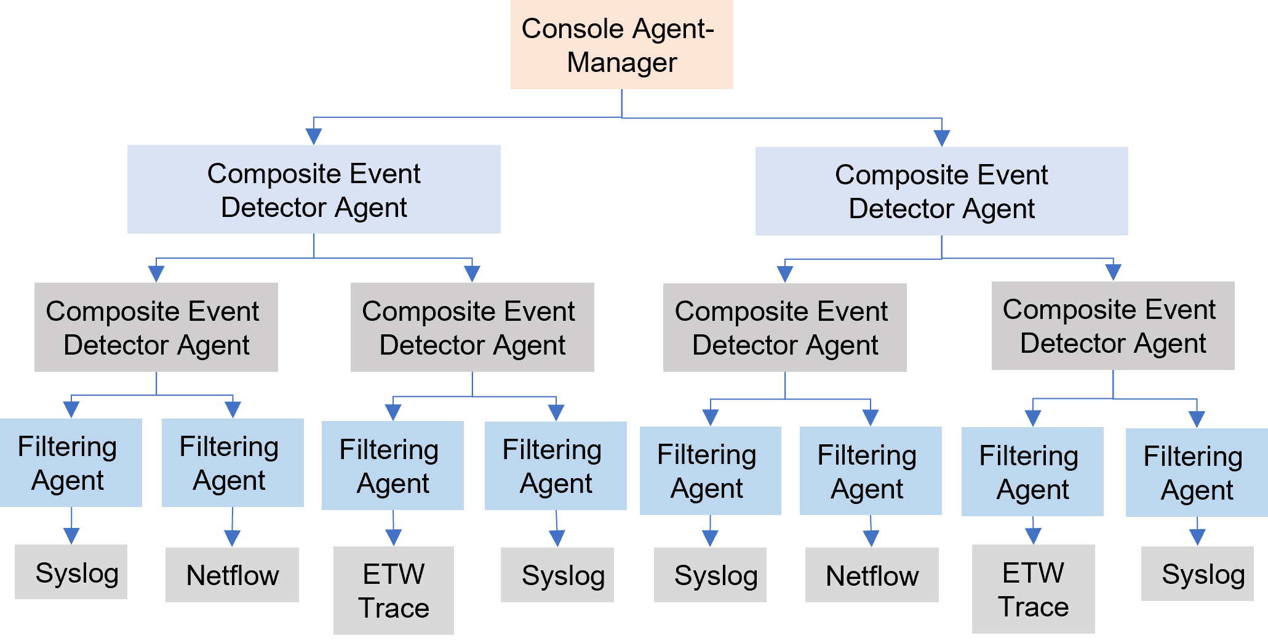
Challenges and Solutions
4
High event storage and communication overhead
Hierarchical monitoring and distributed event correlation
Alert fatigue problem
Monitoring everything
Agent Hierarchy Generation
On-demand monitoring
Approximation Algorithm
Fig 1: Hierarchical Event Filtering
Fig 2: Data Source to Attack Technique Correlation
Notes:
A threat hunter uses SIEM to analyze and correlate collected event to detect adversary activities during the threat hunting process proactively.
While such centralized event correlation facilitates causality analysis of attacker activities, it has some limitation as indicated by the high detection time of average 287 days
The first limitation is that Existing researches try to monitor everything to give data visibility as much as possible, which ignores precedence on attacker activities.
For example- without logging in to an user machine, an adversary will not be able to exfiltrate data from the machine.
By considering the attacker technique precedence, we provide on-demand monitoring by instrumenting windows API
Secondly, The centralized threat hunting process continuously collects monitored logs to the central server, which incurs high memory usage and communication overhead to transfer events to the central server.
This approach introduces scalability issues on the monitored network.
We solve this limitation by providing hierarchical monitoring and distributed event correlation
Lastly, To detect attack, existing solutions and researches use single event matching on the end-host devices and generate alerts.
Unfortunately, such a single event matching approach generates many false alerts, causing the alert fatigue problem.
For example, adversary and benign users can use windows command shell execution TTP to execute an executable on the system. Detection based on the single event matching will generate many false alerts.
Again, We solve this limitation by providing hierarchical monitoring and distributed event correlation

Slide 5
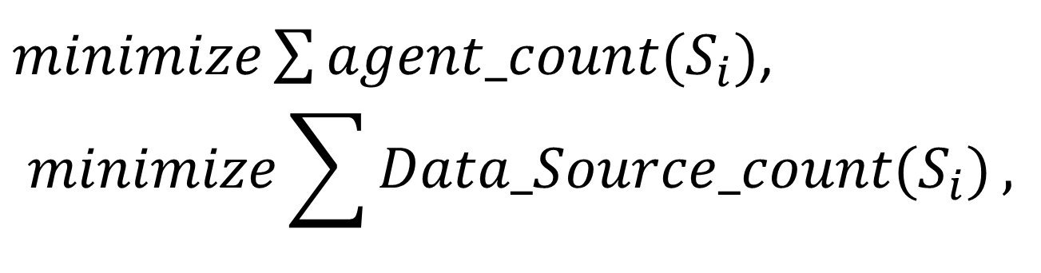
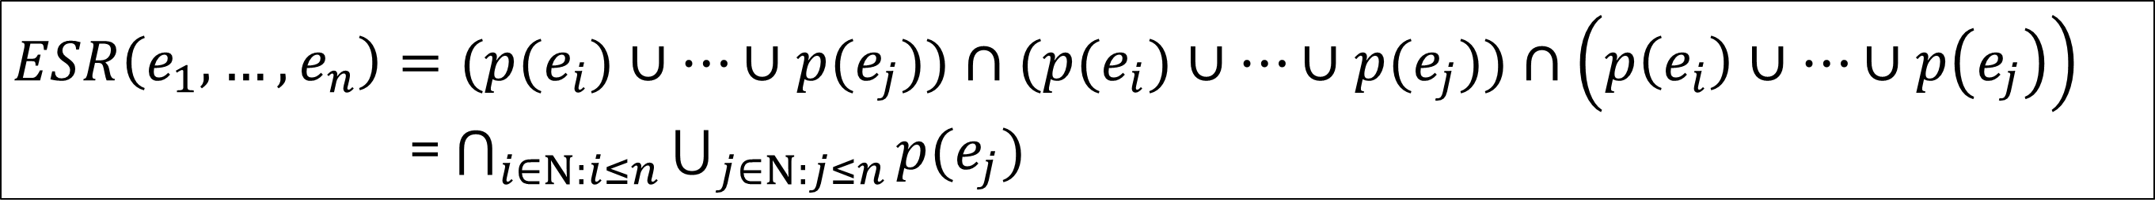
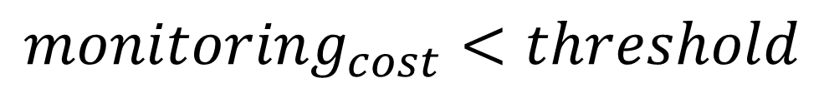
Problem Statement
5
Given the attack signature or event subscription request Si as ESR and a network topology, the goal of the hierarchical monitoring architecture is to generate optimal agent hierarchy such that communication cost and memory usage is reduced, and task is distributed among the agents.
$minimize\sum{agent_count(S_{i})}$,
$$minimize\sum{Data_Source_count(S_{i})},$$
Subject to
$$monitoring_{cost}<threshold$$
Event subscription request Si as ESR: Logical Boolean expression of a conjunctive normal form (CNF) using multiple predicates to match an attack signature (subscription) occurrence.
$ESR\left(e_{1}, …,e_{n}\right)=(p(e_{i})∪…∪p(e_{j}))∩(p(e_{i})∪…∪p(e_{j}))$ $∩\left(p\left(e_{i}\right)∪…∪p\left(e_{j}\right)\right)$
= $\bigcap_{i∈Ν:i≤n}{\bigcup_{j∈Ν:j≤n}{p(e_{j})}}$
Notes:
To develop the hierarchical monitoring architecture, we have to address three problems-
First, Given the event subscription request in CNF format and network topology, generate the optimal number of middle-level agents, while maintaining monitoring capacity constraints of each agent
Second, Given the event subscription request in CNF format, determine the optimal number of data sources to monitor
Third, develop monitoring agent for the specific data source

Slide 6
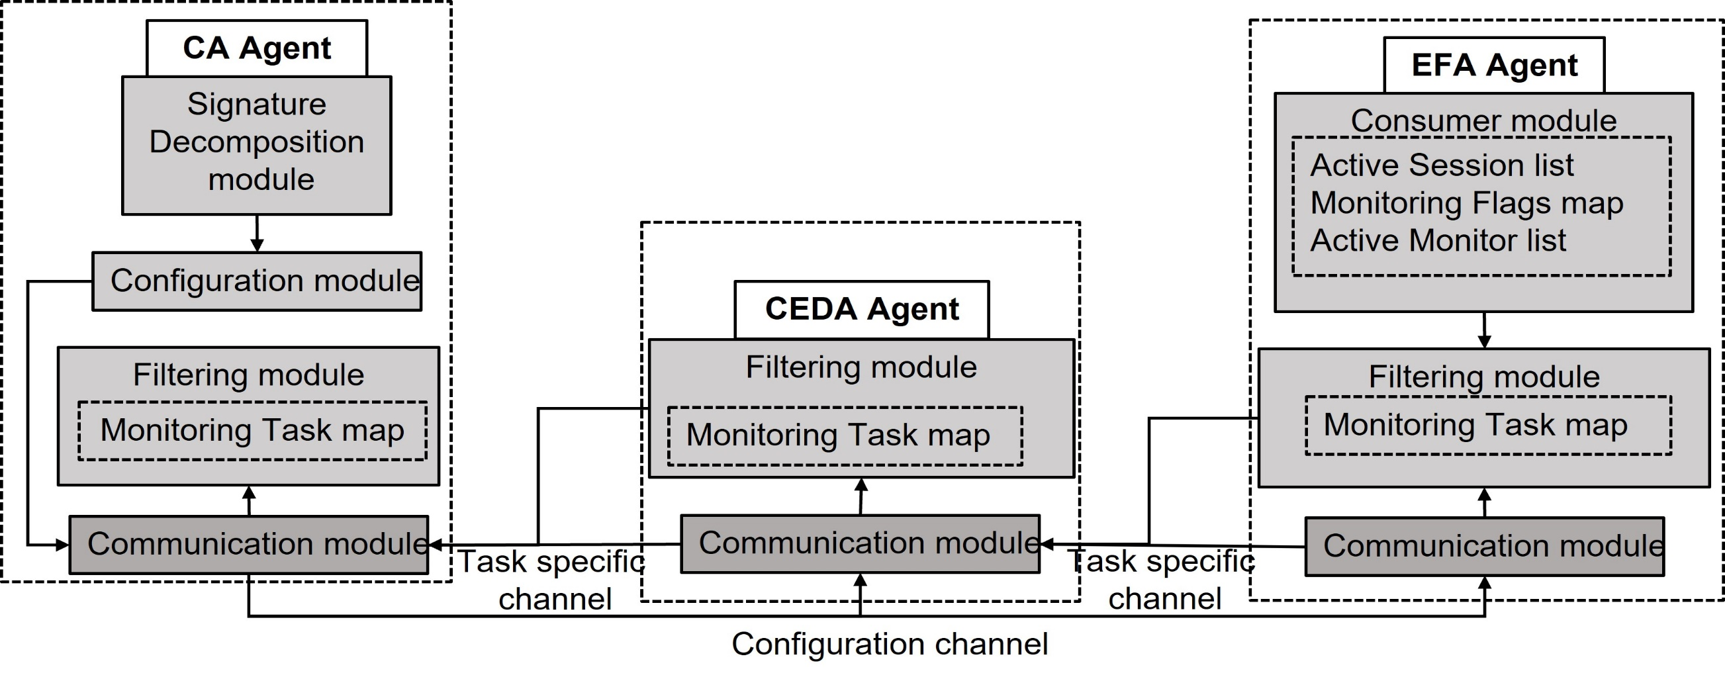
SCAHunter Approach and Implementation
6
Three Types of Agent
Console Agent (CA) or Manager,
Composite Event Detector Agent (CEDA),
Event Filtering Agent (EFA).
Common Modules-
Event Filtering Module,
Communication Module- RABBITMQ.
Agent specific Modules-
CA: Signature Decomposition Module and Configuration Module,
EFA: Consumer Module: ETW.
Fig 3: Proposed Hierarchical Agent Architecture
Fig 4: Agent Architecture Implementation
Notes:
SCAHunter consists of three types of agents- console agent or manager(CA), composite event detector agent (CEDA), event filtering agent (EFA), and data sources to monitor
The user of this agent architecture or a cyber threat hunter provides a single event or group of events or subscription requests such as attack signatures using the CA
The CA decomposes the subscription request based on the formalization provided
The CA also generates the required number of CEDAs using the decomposed subscription request.
It determines appropriate EFAs, and agent hierarchy such that communication overhead is minimum and subscription task monitoring is distributed across the hosts in the network.
Since the optimal agent hierarchy generation is an NP-hard problem, our CA uses an approximation algorithm to generate a near-optimal agent hierarchy
The CA sends the decomposed event subscription requests to the corresponding CEDAs and EFAs through a dedicated configuration channel
CEDA:
Composite event detector agent reduces network communication overhead (traffic flow) between the CA and EFAs by replying to the upper-level CEDA or the CA if a monitoring task or subscribed event is detected.
The hierarchical agent architecture can have multiple levels of CEDAs
EFA:
The event filtering agent is the lowest level of the agents in the SCAHunter. It monitors different data sources for events requested in the received event subscription request. These agents are static: we generate them initially and continue to work until closed or subscription requests are deleted
We developed EFA to monitor ETW trace, Netmon and Sysmon
14. For the communication among the agents, we used AMQ message queue framework- RabbitMQ

Slide 7
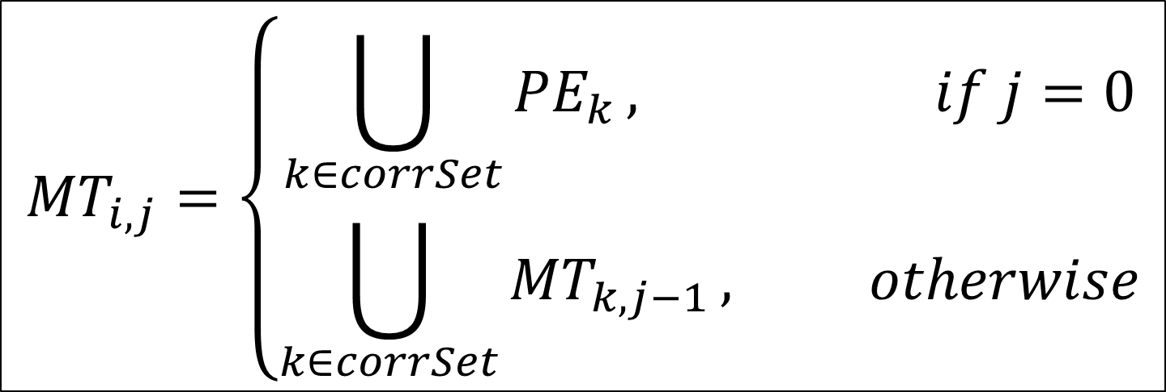
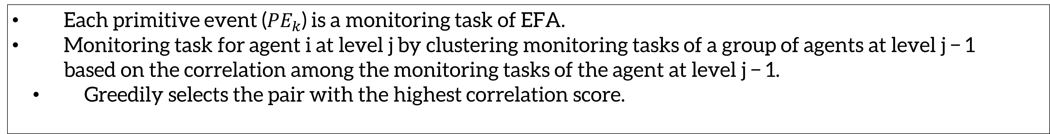
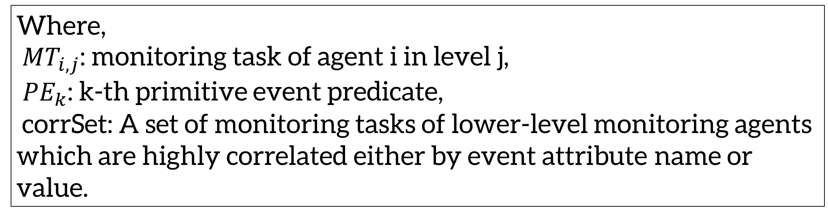
SCAHunter Approach: Approximation Algorithm to generate Agent Hierarchy
7
Each primitive event (${PE}_{k}$) is a monitoring task of EFA.
Monitoring task for agent i at level j by clustering monitoring tasks of a group of agents at level j − 1 based on the correlation among the monitoring tasks of the agent at level j − 1.
Greedily selects the pair with the highest correlation score.
$${MT}_{i,j}=\left\{\begin{aligned}\bigcup_{k∈corrSet}{{PE}_{k}}, if j=0 \\ \bigcup_{k∈corrSet}{{MT}_{k, j−1}}, otherwise\end{aligned}\right.$$
Where,
${MT}_{i,j}$: monitoring task of agent i in level j,
${PE}_{k}$: k-th primitive event predicate,
corrSet: A set of monitoring tasks of lower-level monitoring agents
which are highly correlated either by event attribute name or value.
Approximation algorithm for Agent Hierarchy generation requires O(${(N∗log}_{2}{N)}^{2})$time and $O(N^{2}$) additional memory where N is the number of primitive event predicates to monitor.
Notes:
Our approximation algorithm starts by decomposing event subscription request to primitive events
Each primitive event will be a monitoring task for the EFA
we can determine the monitoring task for agent i at level j by clustering monitoring tasks of a group of agents at level j − 1 based on the correlation among the monitoring tasks of the agent at level j − 1
Our approximation algorithm calculates the correlation score for every pair of monitoring task and sorts the estimated correlation score
Next, the approximation algorithm greedily selects the pair with the highest correlation score.
This process continues until single cluster is generated which is the original signature and monitoring task of CAs

Slide 8
Evaluation
8
Dataset:
Three Simulated Attack Scenarios (multiple attacker activity sequences expressed in MITRE ATT&CK Techniques),
Atomic Red team’s atomic testcases.
DARPA OpTC attack Dataset.
To evaluate the SCAHunter threat hunting approach, Questions to answer:
Can threat hunting with distributed hierarchical monitoring detect multi-step attacker activities with the accuracy of state-of-the-art centralized threat hunting approaches?
Does threat hunting with distributed hierarchical monitoring reduce communication overhead and storage requirement compared to the state-of-the-art centralized threat hunting approaches?
Is the proposed hierarchical monitoring architecture scalable?
The number of required CEDA for different network size and monitoring capacity.
Notes:
1. In order to evaluate, the SCAHunter threat hunting approach, we simulate three attack scenarios using three host VM by following Mitre attack TTPs
2. The simulated attacks are executed using atomic red times atomic test cases.
3. We also used DARPA OpTc attack dataset to evaluate SCAHunter
4. We evaluate SCAHunter based on three criteria- Accuracy compared to the sate-of-the-art approaches, Communication overhead and storage requirement compared to the centralized approaches and Scalability in terms of required number of CEDA agent

Slide 9
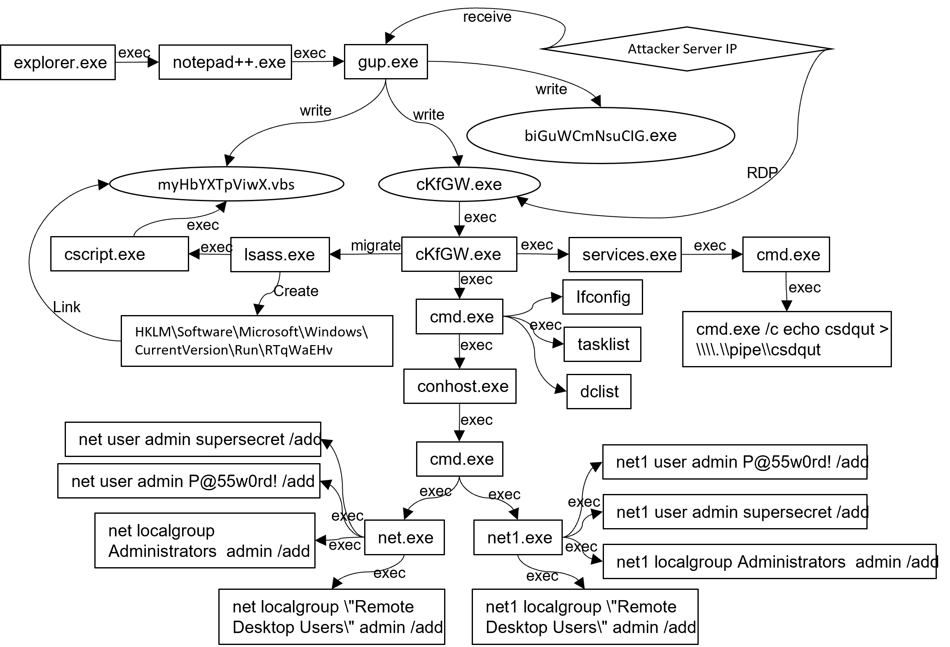
Evaluation Result: Attacker activities detected in OpTC attack Dataset
9
Downloading malicious binary (Meterpreter payload) through notepad++ update
Named pipe impersonation in memory to get system module via Meterpreter
Establish persistence by setting Autorun registry key
Discover installed applications,
domain controller
RDP connection to host from attacker server
Create backdoors by adding malicious user accounts
Notes:
The OpTC dataset contains 290 gigabytes event logs collected on five hundred to one thousand hosts over three days.
2. During these three days, the red team performed three APT scenarios. Our evaluation uses one scenario that consists of around 70 gigabites of log data corresponding to 1.3 billion events
3. We developed attack signatures corresponding to each red team activities and feed it to SCAHunter
4. First, the read team installs meterpreter payload by updating notepad++ which is detected through interactions of gup.exe process
5. The red team performed Named pipe impersonation in memory which is detected by monitoring command line arguments related signatures
6. Similarly, discovering installed applications and domain controller is detected by monitoring command line arguments
7. Backdoor creation is also detected by monitoring command line arguments.
8. Setting autorun registry key for persistence is detected by registry modification signature
9. During this process, we also record how many messages are exchanged among the agents, how much memory is used and how many CEDA is required

Slide 10
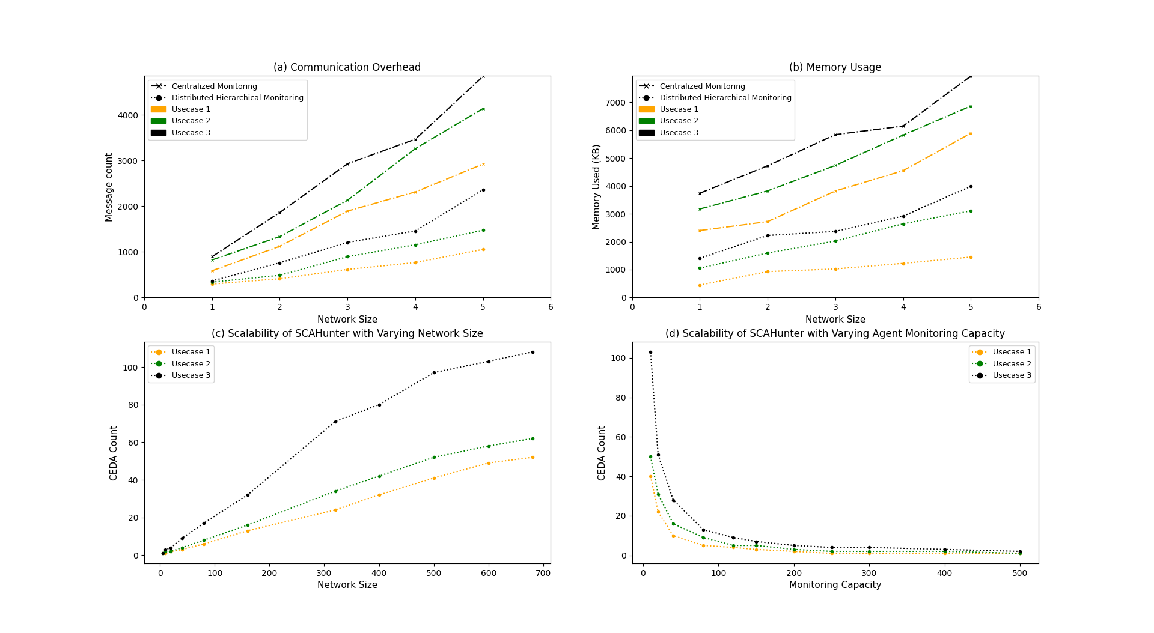
Evaluation Result: Simulated Attack Scenarios
10
The number of exchanged messages among agents (event count) decreases around 49% - 67% for three simulated attack scenarios, from the centralized approach.
Total memory usage decreases around 49% - 81% on average for three simulated attack scenarios.
A 20% - 25% increase in network size, the number of required CEDAs increases 12% - 32% on average for three simulated attack scenarios.
The number of required CEDAs is linearly increasing with the increasing size of the network topology.
Notes:
To confirm the decrease in communication overhead, we measure the number of exchanged messages (alerts, configuration messages) among the agents in three simulated attack scenarios for both centralized and distributed approaches
For the centralized monitoring approach, we collected event logs from only data sources related to the attack signature
In Figure a, we see that number of message exchanged among the agents are much lower than centralized approaches for all three simulated attack scenarios
We can also see that the decrease becomes more and more significant as the network size increases
we measure the memory used by the agents to store the events corresponding to the detected monitoring tasks in the centralized approach and our SCAHunter approach.
The amount of memory used is the number of event logs times the average size of each event log. we estimate average single event log size as 500 bytes based on event logs from the ETW Sysmon provider
In Figure b, we see that memory usages for all agents are much lower for SCAHunter compared to the centralized approach for all three simulated attack scenarios
To measure the scalability, We also measure the number of required CEDAs for the three simulated attack scenarios with varying network size and monitoring capacity. From figure c , we see that The number of required CEDAs is linearly increasing with the increasing size of the network topology

Slide 11
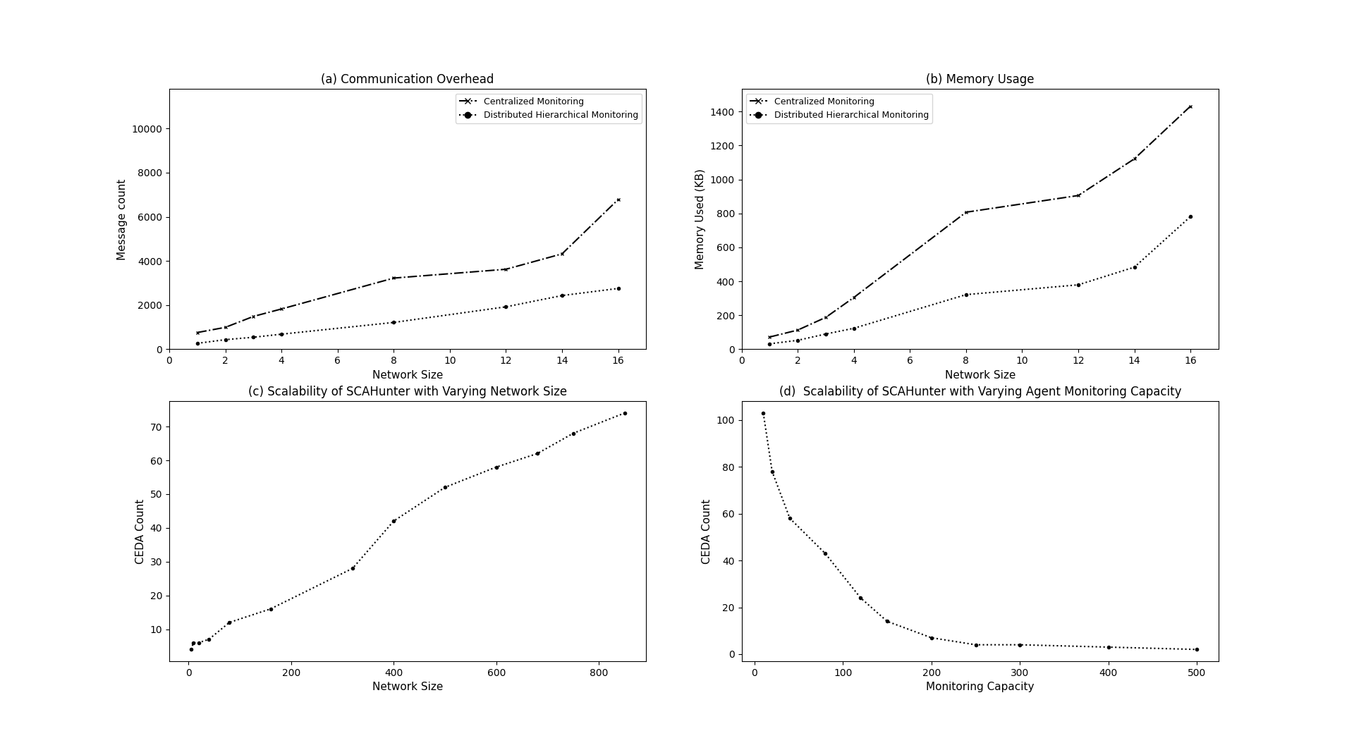
Evaluation Result: DARPA OpTC Dataset
11
The number of exchanged messages among agents (event count) decreases around 44% - 64% for DARPA OpTC Dataset, from the centralized approach.
Total memory usage decreases around 45% - 60% on average for DARPA OpTC Dataset, respectively.
A 20% - 25% increase in network size, the number of required CEDAs increases 8% - 24% on average for DARPA OpTC Dataset.
The number of required CEDAs is linearly increasing with the increasing size of the network topology.
Notes:
Similar to the simulated attack scenarios, we measure the number of exchanged messages (alerts, configuration messages) among the agents , average memory usage by each agents in OpTC attack dataset for both centralized and proposed distributed approaches
In Figure a, we see that number of message exchanged among the agents are much lower than centralized approaches for DARPA OPTC dataset
In Figure b, we see that memory usages for all agents are much lower for SCAHunter compared to the centralized approach for DARPA OPTC dataset
To measure the scalability, We also measure the number of required CEDAs with varying network size and monitoring capacity.
From figure c, we see that The number of required CEDAs is linearly increasing with the increasing size of the network topology

Slide 12
Conclusions and Future Works
12
In Summary, this presentation describes-
Distributed hierarchical monitoring architecture for threat hunting using the MITRE ATT&CK framework as a guideline of attacker activities.
Formalize the scalable threat hunting problem and provide an approximation algorithm to generate agent hierarchy.
Evaluate with three simulated attack Scenarios and DARPA OpTC attack dataset with varying network size and monitoring capacity, and a threat hunting demonstration using the SCAHunter.
In future, we plan to –
Develop additional EFA agent to cover more data sources and MITRE ATT&CK Techniques.
Solve the problem of single-point-of-failure through consensus mechanism.
Notes:
In Summary, we provide a distributed hierarchical threat hunting approach which reduces communication overhead and memory usages by filtering events at host level by distributing tasks among agents and on-demand monitoring.
2. We evaluate our approach on three simulated attack scenarios and DARPA OpTC dataset
3. In future, we want to develop addition EFA agents to cover more attack TTPS. We will also incorporate consensus mechanism to alleviate single point of failure

Slide 13

Questions?
13
Mohiuddin Ahmed
mahmed27@uncc.edu
WWW
https://mohiuddinsohel.github.io/
Notes:
Thank you so much for attending the presentation. I provided my email address. If you have any questions, please feel free to reach out to me.

