Slide 1
Finsight: Your Personal Finance Tracker
Mohmadzaid Delawala – 20210702020

Slide 2
Agenda
INTRODUCTION 3
OBJECTIVES & FEATURES 4
METHODOLOGY 6
RESULT & FUTURE WORK 9
REFERENCES & CONCLUSION 14

Slide 3
Introduction:
In today's fast-paced world, effective management of personal finances has become increasingly important.
“Finsight : Your Personal Finance Tracker” aims to give users the tools they need to manage their financial lives.
Finsight works as a complete and user-friendly personal financial monitoring solution that provides the features you need to track expenses, set budgets, visualize consumption patterns and track financial goals.

Slide 4
Objectives:
Comprehensive Financial Tracking
Finsight offers a wide range of personal money management features, making it a one-stop solution for managing your finances.
Secure Financial Record Keeping
Users can easily record and securely preserve their financial transactions, ensuring a comprehensive financial history for better financial control.
Insightful Spending Analysis
Through interactive visualizations, Finsight helps users better understand their spending habits and identifies potential areas for cost savings.
Financial Goal Management
Finsight empowers users to define, manage, and achieve their financial objectives, promoting long-term financial stability and progress.

Slide 5
Features:
Insightful spending analysis through interactive visualization
Expense Tracking
Expense REport
bill reminder
Budgeting and Saving goals

Slide 6
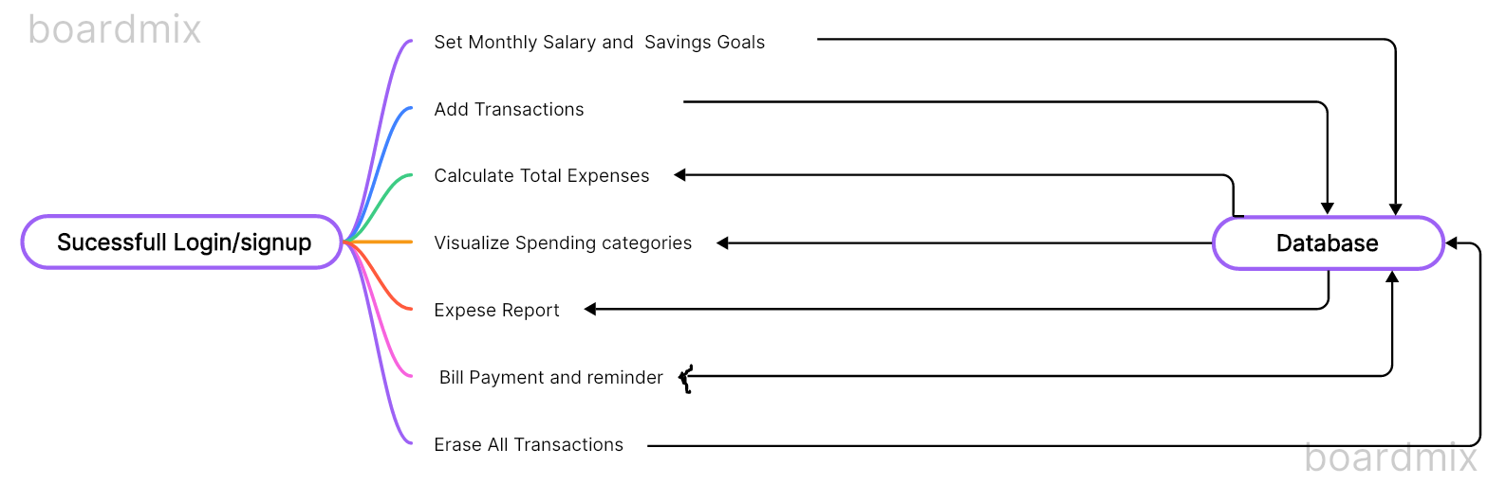
Architecture Diagram :

Slide 7
Technical Specification:
1. Front-End:
Shiny: R web application framework for building interactive web applications.
Shinydashboard: R package for creating dashboards with Shiny.
Plotly: R package for creating interactive web-based plots.
HTML Widgets: R package used to bind interactive JavaScript visualizations to R objects.
JavaScript (via Plotly): Plotly uses JavaScript to render interactive plots on the web.
2. Back-End:
RMySQL: R package for interacting with MySQL databases from R.
dplyr: R package for data manipulation.
openxlsx: R package for reading, writing, and editing Excel files.
MySQL: Relational database management system for storing financial data.
R (Programming Language): Backend logic and data processing are implemented using R.

Slide 8
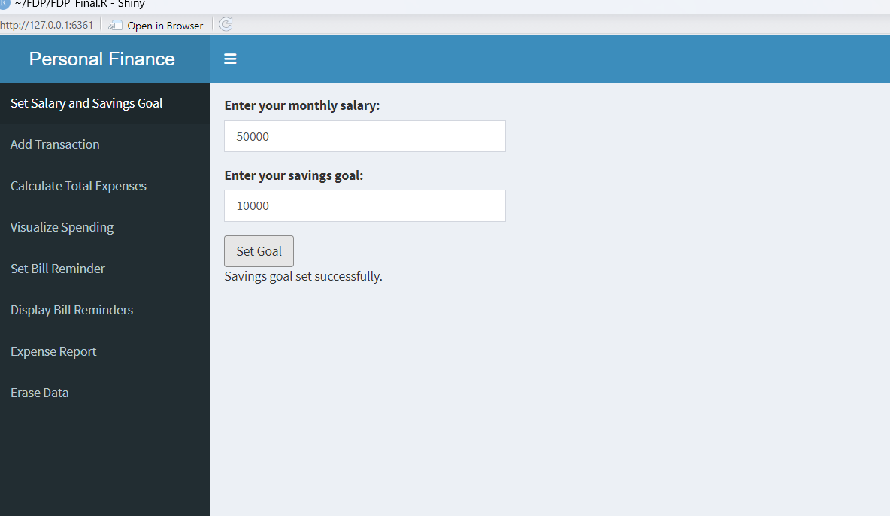
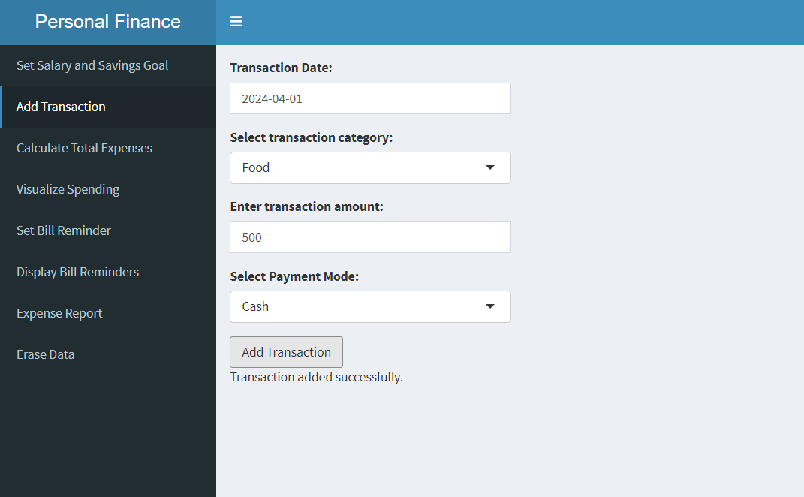
Result:
1.Set Monthly Salary And Saving Goals.
2.Add Transactions

Slide 9
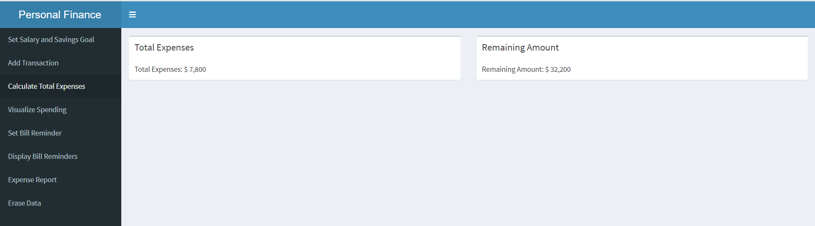
3.Calculating Total Expenses.

Slide 10
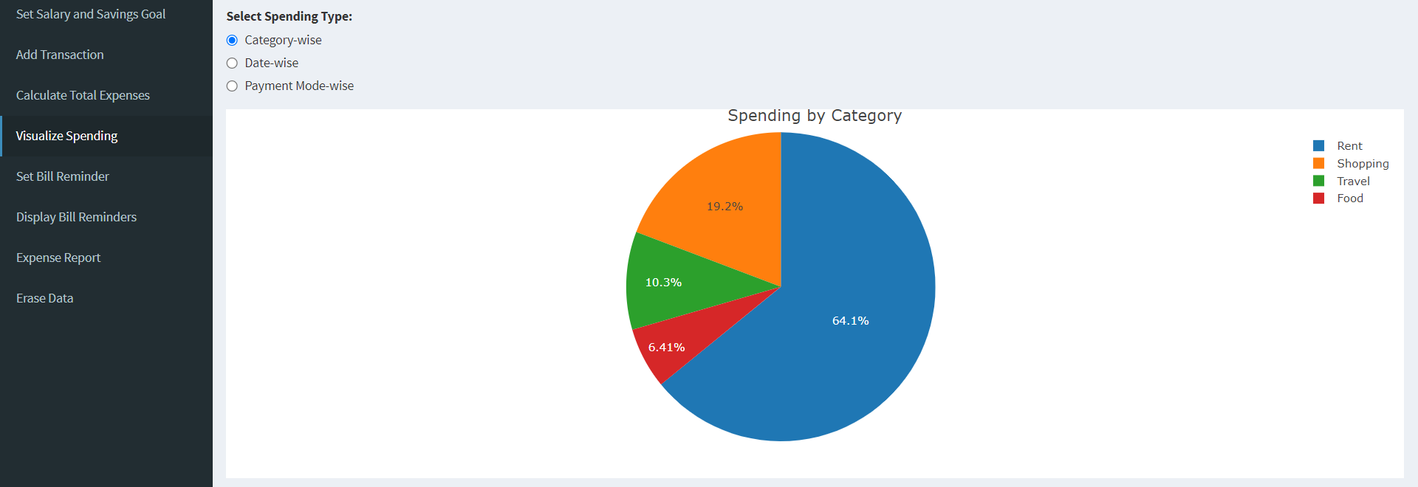
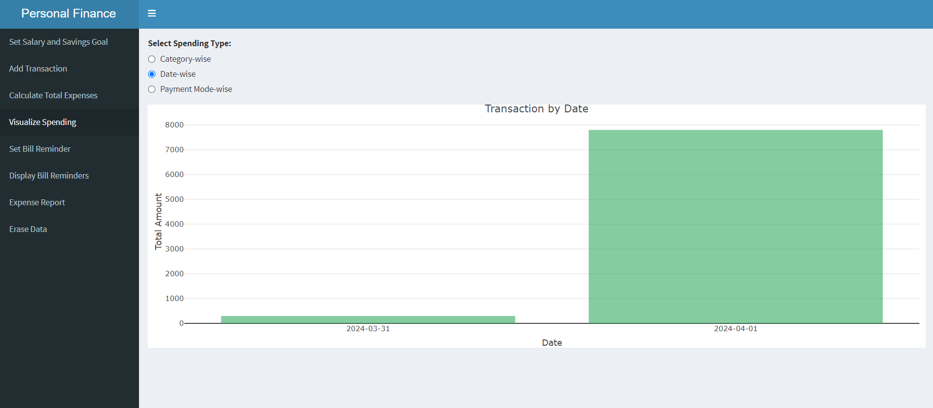
4.Visualize Spending

Slide 11
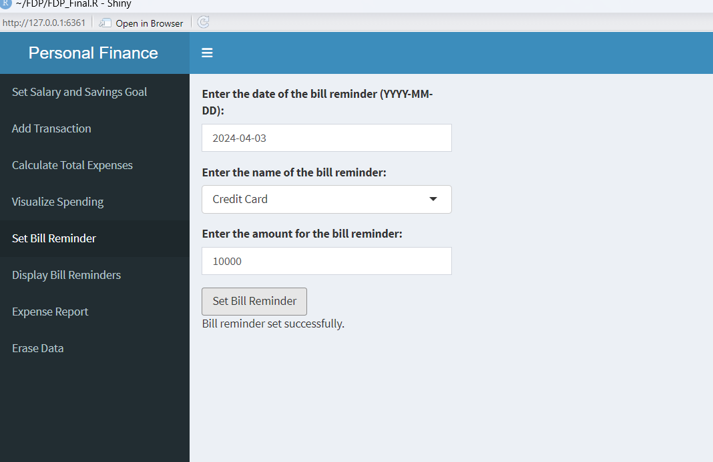
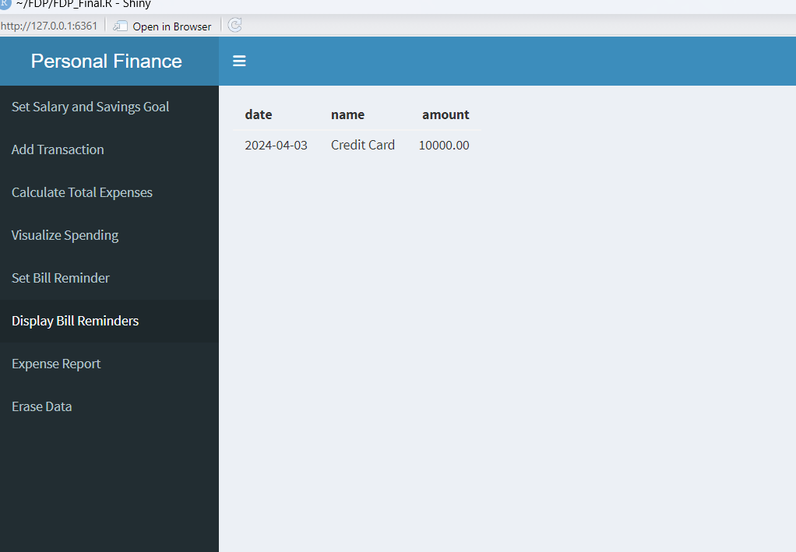
6.Display Bill Reminder
5.Set Bill Reminder

Slide 12
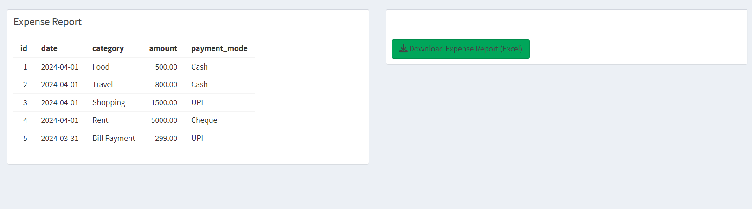
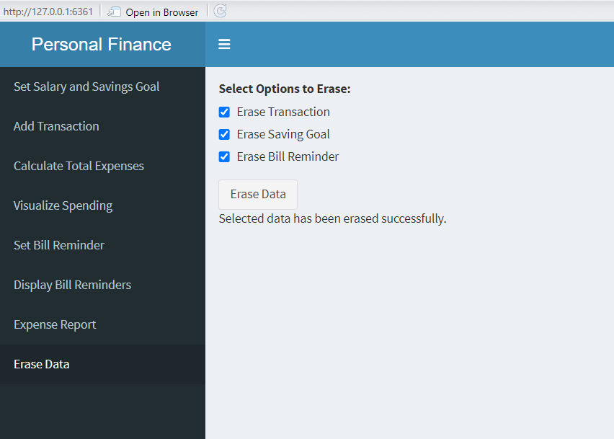
7.Generate Expense Report
8 .Erase All Transactions

Slide 13
Future Work:
Bill Reminder Notifications
Security Enhancement
Enhance
REPORTING
Mobile APPLICATION OF FINSIGHT
Collaborative Features

Slide 14
Conclusion:
"Finsight: Your Personal Finance Tracker" is a complete solution that aims to empower users to manage their finances effectively. With features like real-time expense tracking, in-depth visualizations, budget integration and goal setting, Finsight not only increases financial awareness, but also promotes responsible spending and long-term financial stability. Offering customizable reports and robust protection, it gives users the tools they need to make informed financial decisions and achieve their financial goals, thereby promoting greater financial wellness.

Slide 15
Thank you

