Slide 1
Module-4
UNSUPERVISED LEARNING

Slide 2
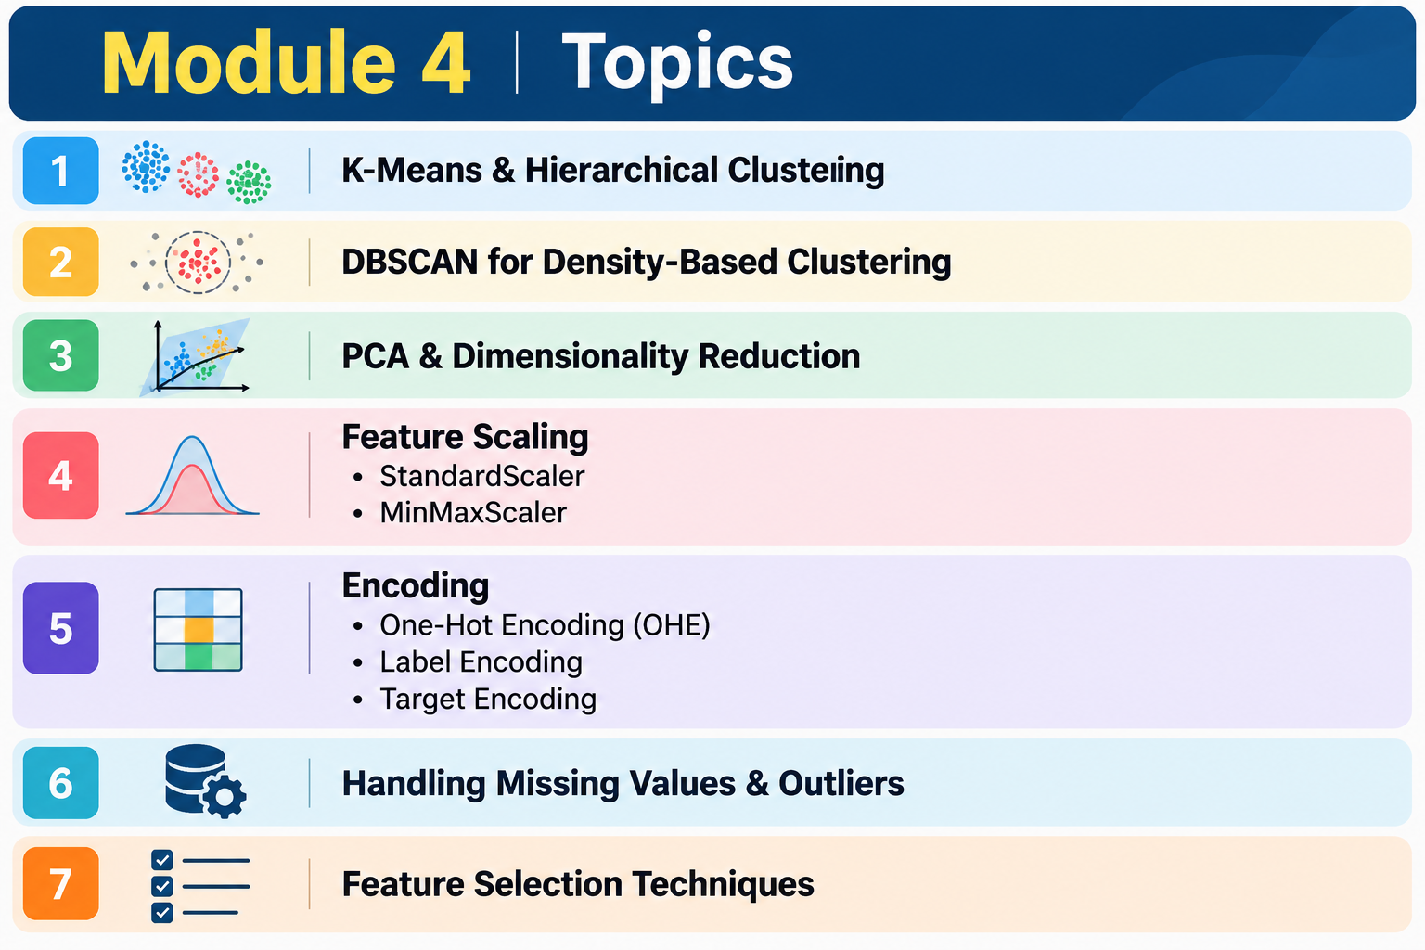

Slide 3
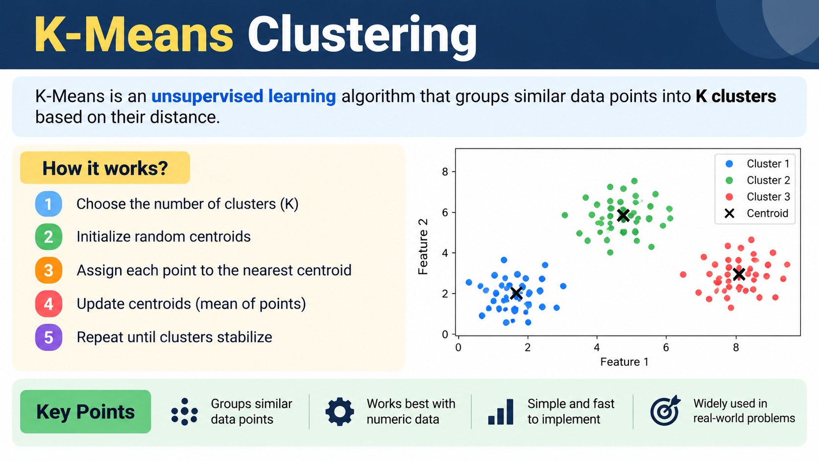

Slide 4
