Slide 1

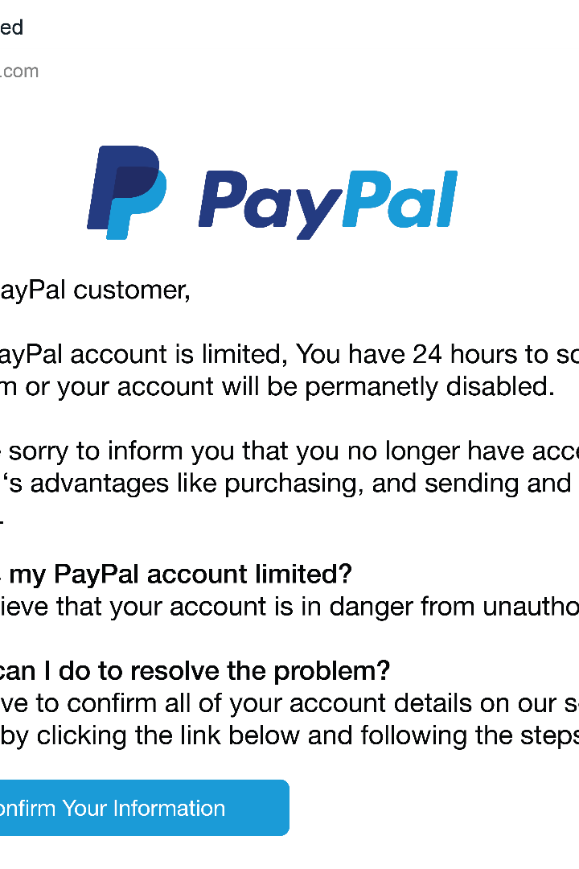
Introduction to Phishing
Phishing is a malicious attempt to obtain sensitive information, such as login credentials or financial information, by disguising oneself as a trustworthy entity. This type of cyber attack can have serious consequences for individuals and organizations.

Slide 2
How Phishing Works
Deception
Bait and Hook
Phishing attempts to deceive victims into revealing sensitive information or executing harmful actions by disguising the attacker as a trustworthy entity.
Phishers use enticing lures, such as fake login pages or urgent messages, to trick victims into taking the "bait" and revealing their credentials.
Wide Net Casting
Automated Exploitation
Phishing campaigns often cast a wide net, targeting large numbers of potential victims in the hopes that some will fall for the scam.
Once a victim's information is obtained, phishers can automate the process of exploiting that data for financial gain or other malicious purposes.

Slide 3
Red Flags to Look For
Urgent or threatening language prompting immediate action
Requests for sensitive information like login credentials or financial details
Sender email address that doesn't match the company it claims to be from
Suspicious attachments or links that could install malware
Poor grammar, spelling, or formatting that seems unprofessional

Slide 4
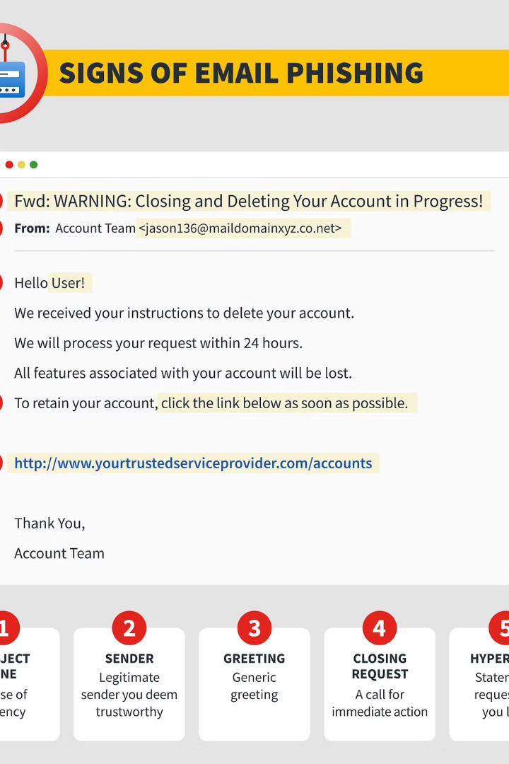
Identifying Phishing Emails
Phishing emails often contain suspicious links, request sensitive information, or have poor spelling and grammar. Look for red flags like urgent deadlines, generic greetings, and odd sender email addresses. Verify the authenticity of any requests before responding.
Scrutinize email headers, sender details, and the overall tone and content to detect potential phishing attempts. When in doubt, contact the supposed sender through a verified channel to confirm the legitimacy of the message.

Slide 5




Protecting against Phishing
Use Strong Email Filters
Employ robust email filters to identify and block suspicious messages before they reach your inbox.
Verify Links and Attachments
Carefully scrutinize any links or attachments in emails, as these are common vectors for phishing attacks.
Enable Two-Factor Authentication
Activate two-factor authentication on your accounts to add an extra layer of security against unauthorized access.

Slide 6
Reporting Suspected Phishing Attempts
If you believe you have received a phishing email or have fallen victim to a phishing scam, it's important to report it promptly. Reporting helps protect others and aids in the ongoing fight against cybercrime.
Reports Per Day
On average, over 15,000 phishing reports are submitted to the relevant authorities each day.
The first step is to report the suspicious email or activity to your organization's IT department or security team. They can investigate the issue and take appropriate action to mitigate any potential harm.
You should also consider reporting the incident to government agencies like the Federal Trade Commission (FTC) or the Anti-Phishing Working Group (APWG). These organizations collect data on phishing attacks to help identify trends and disrupt criminal operations.

Slide 7
Techniques for Identifying Phishing
Sender Verification
Link Inspection
Attachment Caution
Tone and Urgency
Hover over any links to see the actual URL before clicking. Beware of links that don't match the claimed destination.
Check the sender's email address to ensure it's from a legitimate source, not a spoofed domain meant to mimic a trusted organization.
Be cautious of unexpected attachments, which could contain malware. Verify the attachment is from a known and trusted source.
Watch for emails with a heightened sense of urgency or threatening tone, which are common phishing tactics to elicit a quick response.

Slide 8



Consequences of Falling for Phishing Scams
Financial Loss
1
Stolen money, identity theft, and damaged credit
Data Breaches
2
Hackers gaining access to sensitive information
Damage to Reputation
3
Tarnished personal or professional image
Falling victim to a phishing scam can have severe consequences, both financially and personally. Victims can suffer direct monetary losses, have their identities stolen, and experience long-lasting damage to their credit. The breach of sensitive data can also lead to further exploitation and reputational harm. Protecting against phishing is crucial to safeguard one's assets and well-being.

Slide 9

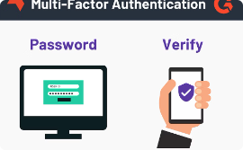

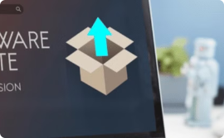
Best Practices for Phishing Prevention
Security Awareness Training
Use Multi-Factor Authentication
Email Filtering and Spam Protection
Keep Software Updated
Require the use of multi-factor authentication for all accounts to add an extra layer of security and make it harder for attackers to gain access.
Ensure all software, operating systems, and applications are kept up-to-date with the latest security patches to close vulnerabilities that phishers may try to exploit.
Educate employees on how to identify and report phishing attempts through regular security awareness training. This helps build a strong human firewall against phishing attacks.
Implement robust email filtering and spam protection solutions to automatically detect and block known phishing emails before they reach employee inboxes.

Slide 10
Conclusion and Key Takeaways
Vigilance is Key
Continuous Education
Staying alert and being cautious when receiving unexpected or suspicious emails is crucial to protect against phishing attacks.
Regular phishing awareness training and updates on the latest scam tactics can empower employees to identify and report potential threats.
Robust Security Measures
Prompt Reporting
Implementing strong email filters, multi-factor authentication, and other cybersecurity best practices can significantly reduce the risk of falling victim to phishing scams.
Encouraging employees to report any suspected phishing attempts can help the organization quickly address the issue and protect others.

