Slide 1
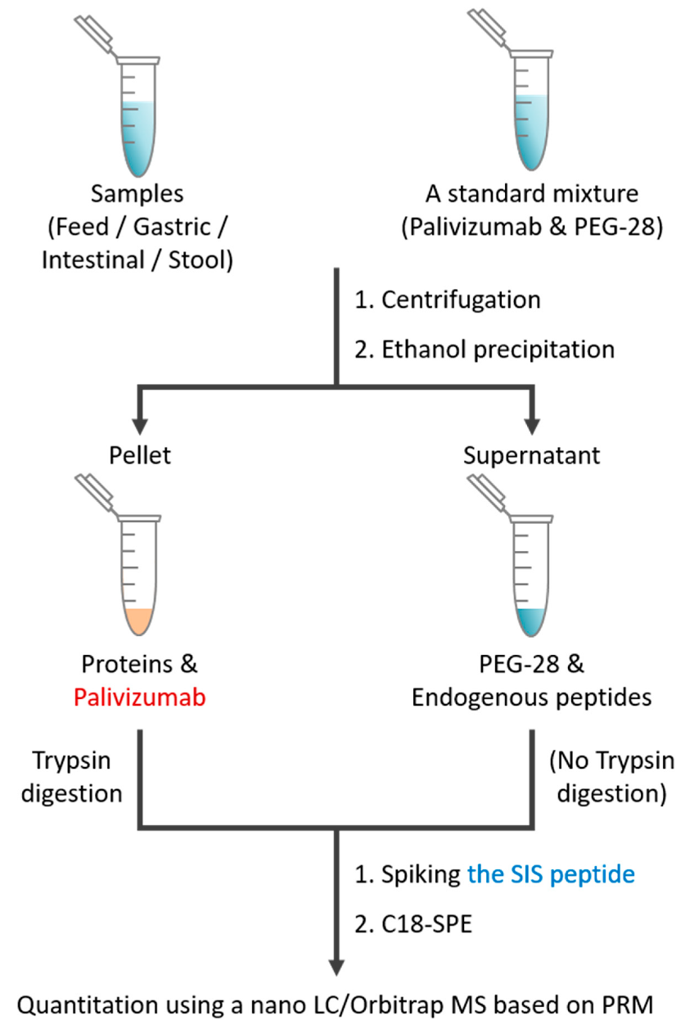
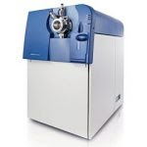
Samples

Slide 2
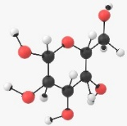
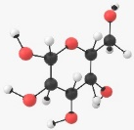
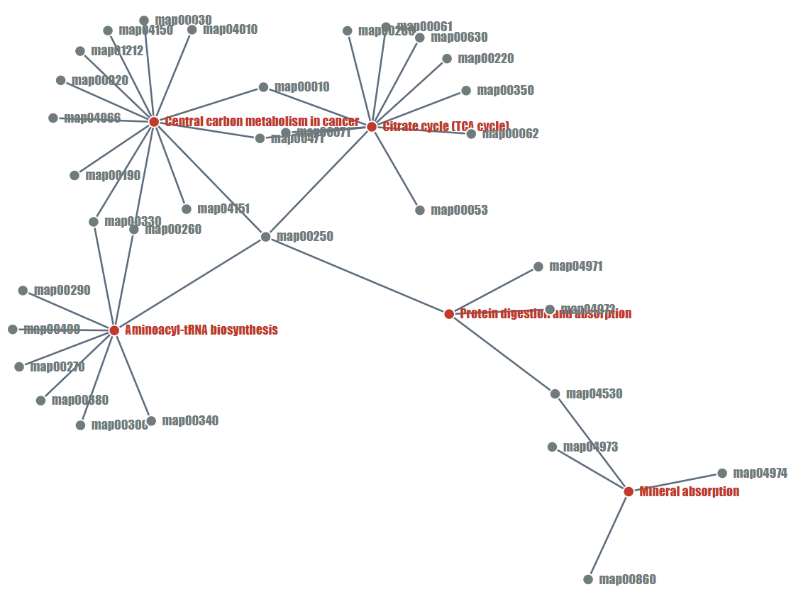
Input compounds list
Pathway Enrichment Analysis
adj. p-value < α
Pathways list
Central carbon metabolism in cancer
Protein digestion and absorption
Biosynthesis of amino acids
Aminoacyl-tRNA biosynthesis
Citrate cycle (TCA cycle) ……..
i₁
i₂
i₃
i₄
i₅
…
i_{n}
Extract all the CPDs except CPDs in the input list
j₁ j₂ j₃ j₄ j₅ … j_{n}
# i_{n}+ij_{n} | # ij_{n}
# i_{n} | # total compounds
Pathway Association Enrichment Analysis
Combined compounds list
Fisher test
p-value < α
p-value >= α
Associated compounds list

