Slide 1





Mohammed Sadiq Industries
Home
Content
Contact
Presentation to:
FILE MONITORING SERVICE
FULL OVERVIEW DEMO

Slide 2




Mohammed Sadiq Industries
Home
Content
Contact
sources
destination
A lightweight Windows service operates in the background without a user interface, monitoring one or more directories.
When a new file or folder is added, it is automatically renamed using a GUID (Globally Unique Identifier) and relocated to the target folder.
DEFINING A SERVICE

Slide 3
Mohammed Sadiq Industries
Home
Content
Contact
Before starting the service, you must configure the source, destination, and logging directories.
Pre-build configurations can be defined in the app.config file.
At runtime, you can modify these settings via the FileMonitoringService Project 1.exe.config file located in the installation directory.
If any setting is omitted, the service will automatically apply default values.
CONFIGURE TO START

Slide 4
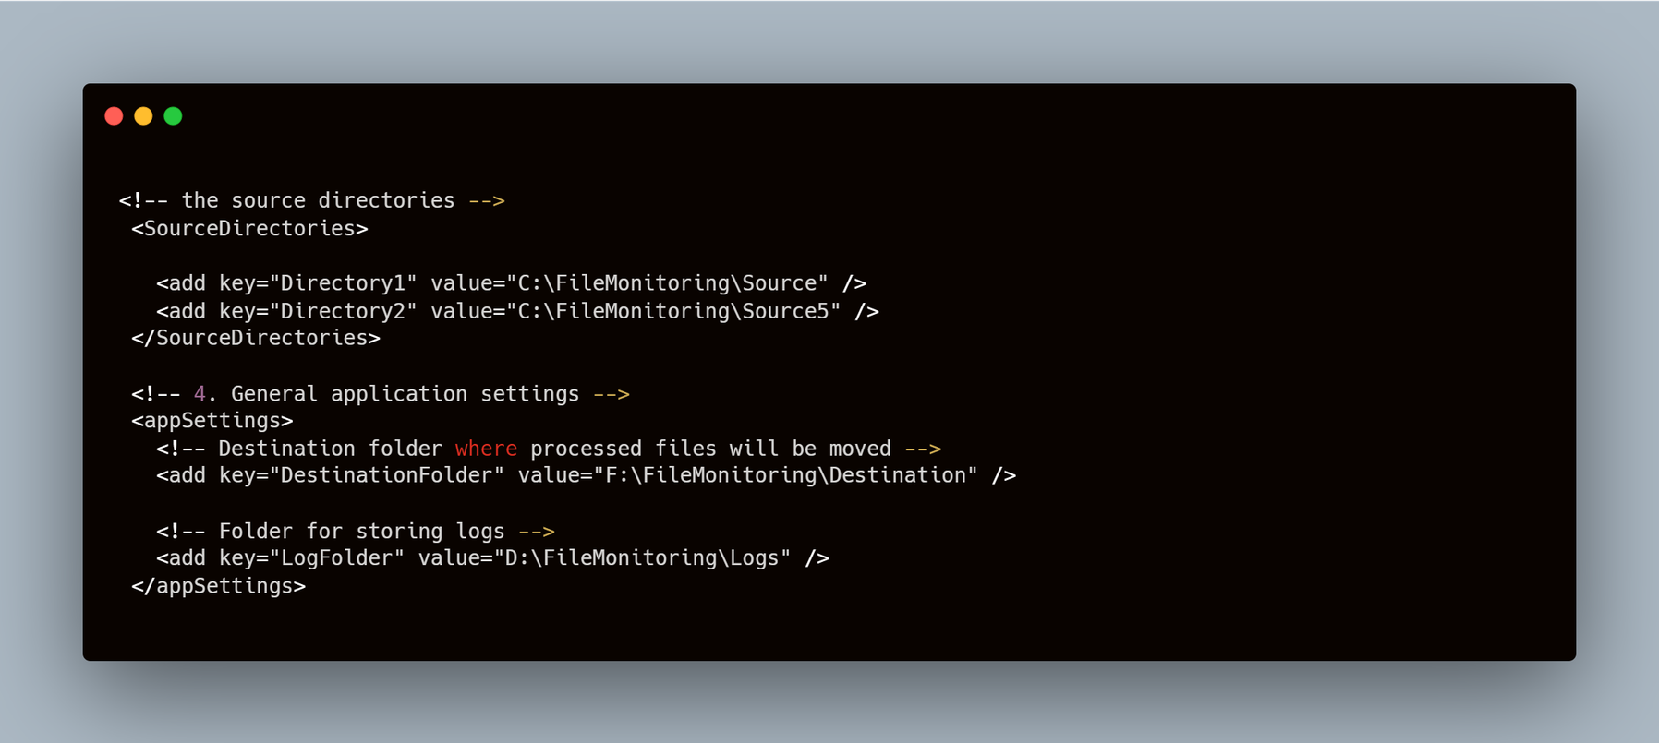
Mohammed Sadiq Industries
Home
Content
Contact
CONFIG EXAMPLE

Slide 5


Mohammed Sadiq Industries
Home
Content
Contact
Open FileMonitoringService Project 1.sln in Visual Studio.
Select the appropriate build configuration: Debug (for local testing) or Release (for deployment).
Navigate to Build > Build Solution to compile the project.
After a successful build, both the executable and the configuration file will be located in (bin\Debug||bin\Release).
How To Build The Project?
Open the Developer Command Prompt for Visual Studio as an Administrator.
Navigate to the project directory.
Execute the following command: dotnet build "FileMonitoringService Project 1.sln" -c Release
If the primary build fails, use MSBuild as a fallback: msbuild "FileMonitoringService Project 1.sln" /p:Configuration=Release /p:Platform=AnyCPU
Using Visual Studio
from the command line

Slide 6
Mohammed Sadiq Industries
Home
Content
Contact
USING SETUP PROJECT (MSI):
SERVICE DEPLOYMENT
USING
InstallUtil:

Slide 7

Mohammed Sadiq Industries
Home
Content
Contact
USING
InstallUtil:
1. Install the Service
64-bit / 32-bit: Run InstallUtil.exe followed by your executable path.
InstallUtil.exe "<Path_to_Executable>.exe"
2. Control the Service
Start: net start Service1 Or sc start Service1
Stop: net stop Service1 Or sc stop Service1
3. Uninstall the Service
Note: Always stop the service before uninstalling.
InstallUtil.exe /u "<Path_to_Executable>.exe"

Slide 8
Mohammed Sadiq Industries
Home
Content
Contact
USING SETUP PROJECT (MSI):
Install: Run the .msi file and follow the wizard.
Manage: Start/Stop the service via Command Line
Uninstall: Remove via Windows Control Panel.

Slide 9


Mohammed Sadiq Industries
Home
Content
Contact
UNDER THE HOOD:
SYSTEM ARCHITECTURE

Slide 10
Mohammed Sadiq Industries
Home
Content
Contact
BUILT WITH ROBUST TECHNOLOGIES
Language: C#
Framework: .NET (Windows Service)
Configuration: XML-based App.config
File management: System.IO (For comprehensive file management)
Core Engine: Uses FileSystemWatcher for real-time directory monitoring with minimal resource consumption.

Slide 11
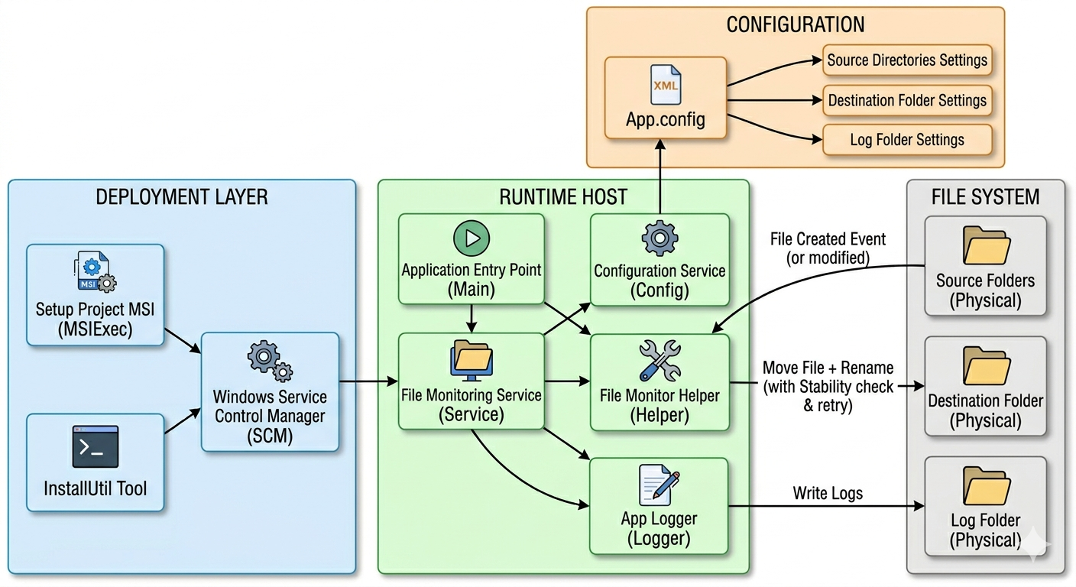
Mohammed Sadiq Industries
SYSTEM ARCHITECTURE DIAGRAM

Slide 12
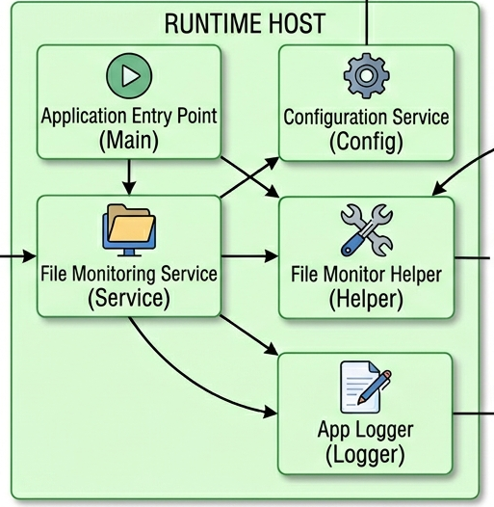
Mohammed Sadiq Industries
Home
Content
Contact
INSIDE THE RUNTIME HOST
File Monitoring Service: Inherits from ServiceBase. Acts as the main orchestrator connecting components.
Configuration Service: Dynamically parses App.config to fetch source, destination, and log paths.
App Logger: A dedicated class for writing detailed execution steps and errors to the physical Log Folder.

Slide 13
Mohammed Sadiq Industries
Home
Content
Contact
THE SYSTEM HEART: FILESYSTEMWATCHER
We utilize the FileSystemWatcher class for real-time, low-resource monitoring.
Trigger: Listens strictly for the Created event in the Source Folders.
Stability Check: Implements a retry mechanism to ensure the file is completely written and unlocked by the OS before processing.
Transformation: Renames the file using a generated GUID to guarantee zero naming collisions.
Execution: Moves the renamed file safely to the Destination Folder.

Slide 14
Mohammed Sadiq Industries
SYSTEM ARCHITECTURE DIAGRAM

Slide 15

Mohammed Sadiq Industries
Home
Content
Contact
THE CHALLENGE: RUNNING BLIND
Windows Services run entirely in the background without a User Interface (UI).
Without logs, tracking system behavior or diagnosing failures is impossible.

Slide 16
Mohammed Sadiq Industries
Home
Content
Contact
THE SOLUTION: APPLOGGER
Acts as the "eyes and ears" of the system, acting like a black box recorder.
Writes real-time activities to physical log files for easy monitoring.

Slide 17
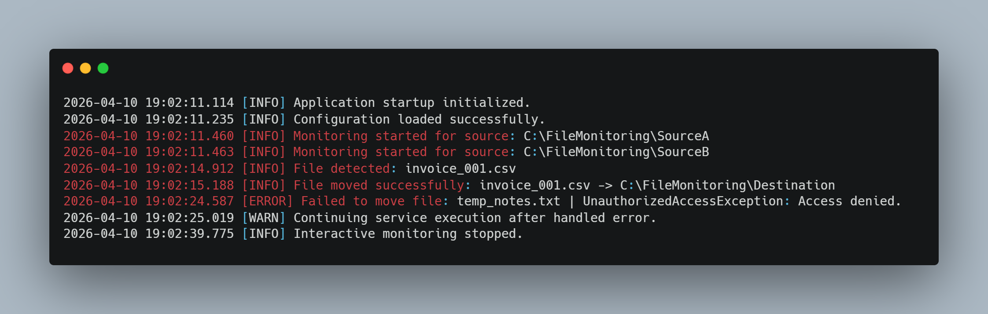
Mohammed Sadiq Industries
Home
Content
Contact
INSIDE OUR LOG FILES (AS SEEN IN THE IMAGE)
Timestamps: Pinpoints exactly when an event occurred.
Severity Levels: Categorizes events as [INFO], [WARN], or [ERROR].
Traceability: Tracks successful file moves and captures specific exceptions (e.g., UnauthorizedAccessException) for quick debugging.

Slide 18



Mohammed Sadiq Industries
Home
Content
Contact
THANKS FOR WHATCHING
QUESTIONS & SUGGESTIONS?
IF YOU HAVE QUESTIONS, FEEDBACK, OR IDEAS FOR IMPROVEMENT CONTACT ME.
mohmmadsadiq2030@gmail.com
@MohmmadSadiq
@mohammed-al-shaepi

