Slide 1
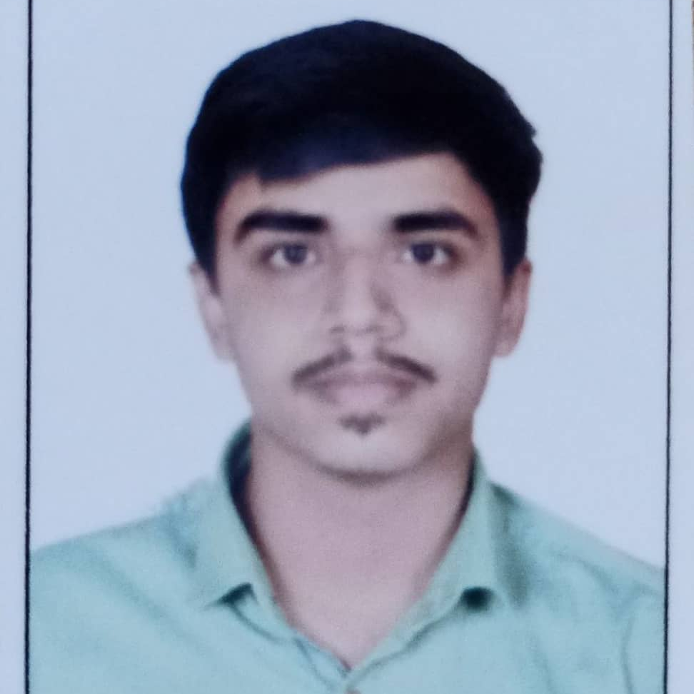



Mohnish Bhonde
Analyst/Software Engineer
Bachelor of Engineering
Mechanical Engineering : 2018 - 2022
Skills
Java 8 /J2EE | Java Basics, OOPS, Generics, Collections, Arrays, Loops, Lambda Exp, Stream API Junit, Mockito, Servlets
Spring core | IOC & Dependency Injection, Autowire
Spring REST | REST controllers, Implementation of GET, POST, PUT & DELETE, Bean Validation & Exception Handling, Testing Services, Controller & Repository layer
Spring Data JPA | Implement DAO layer using spring Data repositories, Transaction Management
Spring Boot Microservices | Spring Boot Starters, annotations, Messaging Service, Sync/Async comms, Swagger API documents
Spring Cloud | Eureka, Netflix Ribbon, Feign Client, Netflix Hystrix, Netflix Zuul & Config Server
Angular | Components, Services, Modules, Routing, Forms & Validation, Testing using Jasmine & Karma
Database | MongoDB No Sql Basics My SQL RDS Basics
UI Tech | HTML 5 & CSS 3,JavaScript, ES6 & TypeScript Reusable templates, Optimized UI Designed
Tools | Git, Postman, Maven, IDE
Devops | CI/CD, Jenkins configuration, Build Pipelines, notifications, quality gate understanding
Add On skills | Communications, Team management. Peer learning,Leadership
Mumbai
MOHNISH.PRAMOD-BHONDE@CAPGEMINI.COM
+91 8668338072
A4
Full Stack Developer
Hands on experience in creating microservices with Springboot, Spring Security, Spring Cloud API Gateway, Eureka server, resilience 4J, load balancing, hystrix dashboard
Proficient in creating Single page Web Application in Angular with Authentication with route guards, Angular reactive forms, angular routing, Tailwind CSS
Hands on experience in implementing polyglot architecture with spring boot
Experience in creating documentation with Java docs and swagger and in unit testing using Junit, Mockito including code quality compliance using Sonar cube
Development experience in creating docker images and pushing to Docker Hub with containerized applications using Docker SWARM
In-depth understanding of deploying spring boot applications in AWS Cloud environment
Deals And Coupons Finder App
Completed end to end case study of Deals And Coupons Finder Application along with JWT authentication, Swagger and payment testing using mockito, CSS and Angular used for user interface. Mongo Db used for database
Check out my work on GitHub & Video Profile

