Slide 1
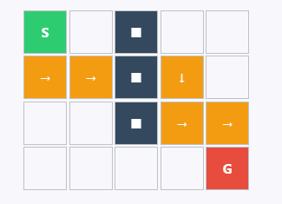
A* (A-Star) Algorithm
Name | : | Mohotasir Al Mamun
Registration ID | : | 22101036
Section | : | A

Slide 2
Objective
1
Implement A* algorithm for robot navigation with terrain costs
Support 8-directional movement (with diagonal penalty)
Compare three heuristics: Manhattan, Diagonal, Euclidean
Analyze path optimality, efficiency, and runtime
Understand heuristic trade-offs in pathfinding
2
3
4
5

Slide 3
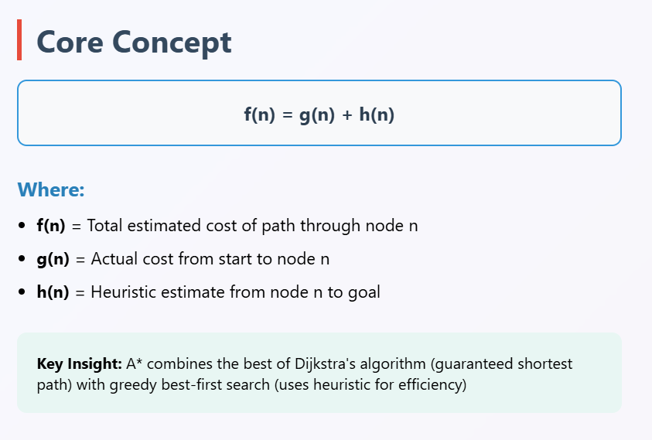

Slide 4
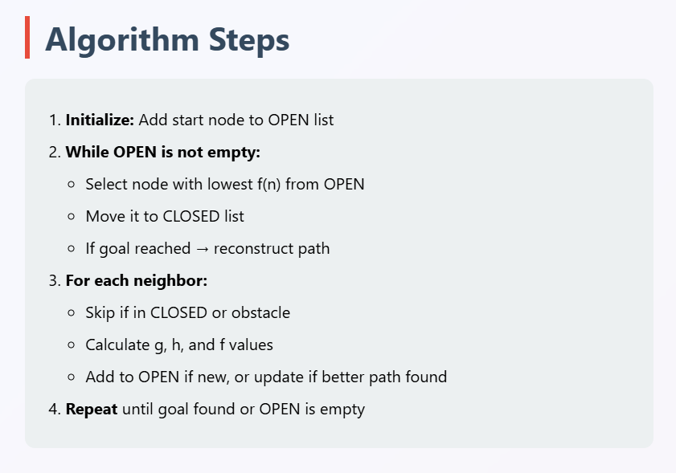

Slide 5
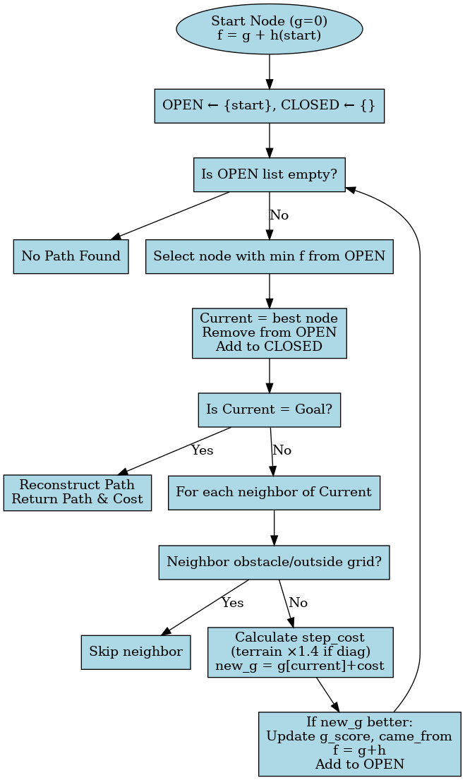

Slide 6
Heuristic
Manhattan Distance
Euclidean Distance
h(n) = |x₁ - x₂| + |y₁ - y₂|
Best for: Grid-based movement (4-directional)
h(n) = √[(x₁-x₂)² + (y₁-y₂)²]
Best for: Continuous space, any-direction movement
Diagonal Distance
h(n) = max(|x₁-x₂|, |y₁-y₂|)
Best for: 8-directional movement (like chess king)

Slide 7
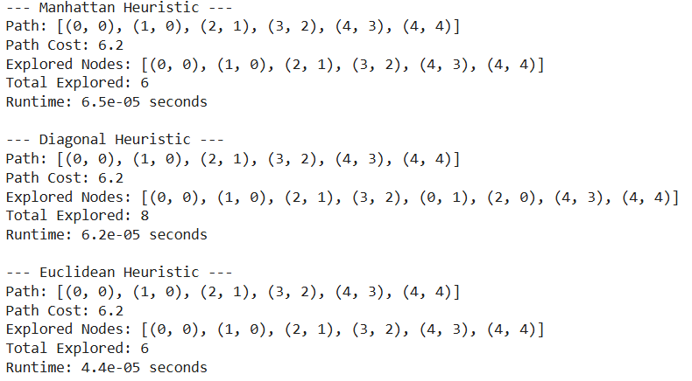
Result

Slide 8
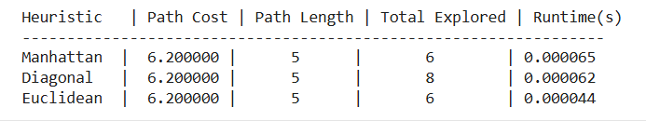
Result
All heuristics → same optimal path.
Manhattan: less efficient in 8-direction grids.
Diagonal & Euclidean: fewer explored nodes, faster.
Terrain cost influences path choice.

Slide 9
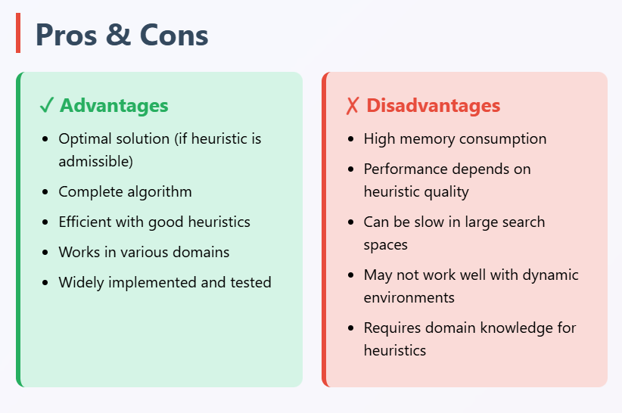

Slide 10
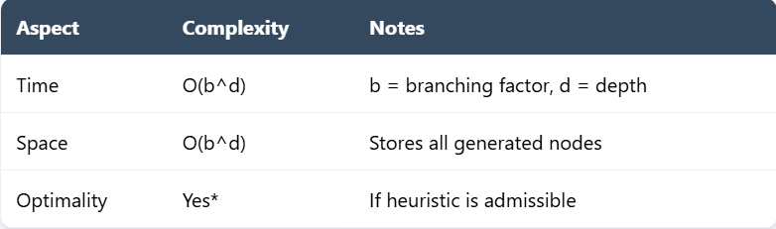
Complexity

Slide 11
Real-World Applications
GPS navigation systems : Finding shortest route
Game AI : NPC pathfinding
Robotics : Robot navigation and planning
Network Routing : Optimal data packet path
Puzzle Solving : 8 puzzle , 15 puzzle solve

Slide 12
Conclusion
1
A* finds optimal path with obstacles and terrain costs.
2
Heuristic choice affects efficiency, not correctness.
3
Euclidean performs best in this setup.

Slide 13
THANK YOU

