Slide 1


Job Recommender System
Presented By :
Mohotasir Al Mamun
ID : 22101036
Section : A
Presented To :
Nahida Marzan
Lecturer, Department of CSE,
University of Asia Pacific

Slide 2
Contents|
Problem statement
ER diagram
Facts
Rules
Conclusion

Slide 3
Problem Statement
Many job seekers struggle to find positions that match their skills, experience, and interests. They also often lack clarity on which skills they are missing for specific jobs. This project recommends relevant jobs and suggests courses to fill skill gaps.
Date

Slide 4
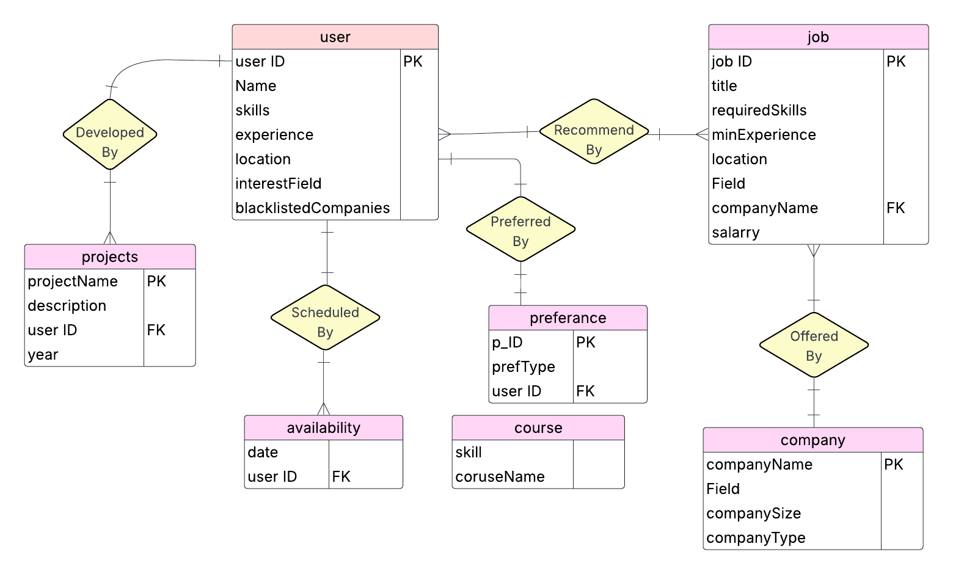

Slide 5
Facts
01
02
User ()
course()
03
04
job()
preference()
05
06
company()
availability()
07
project()

Slide 6
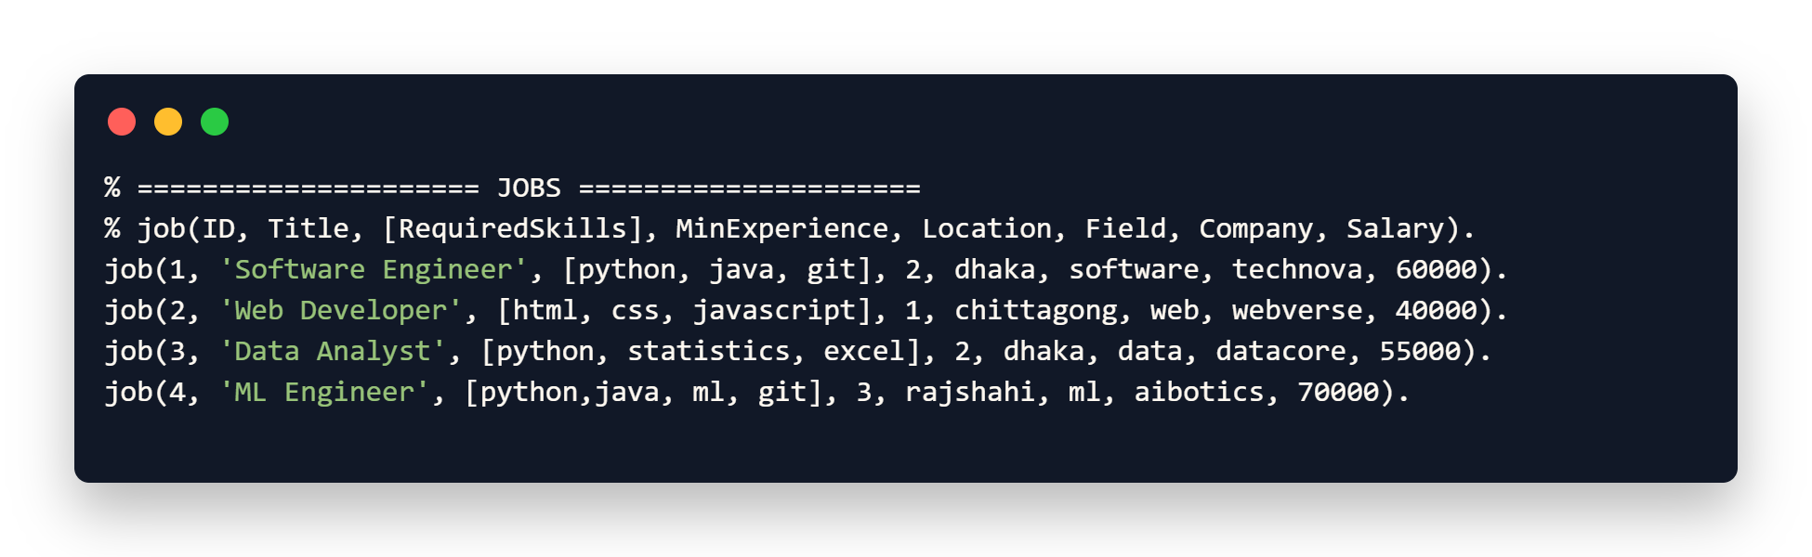
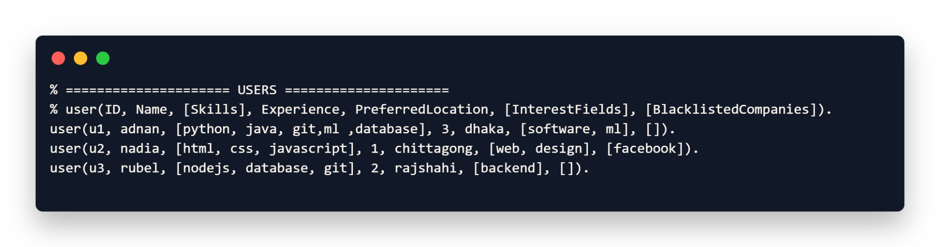
Facts

Slide 7
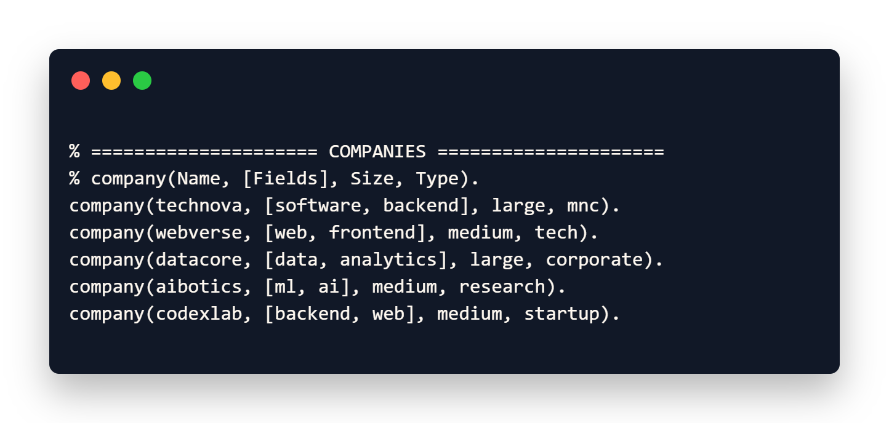
Facts

Slide 8
Rules
recommend_jobs(Uid, UniqueJobIDs)
recommend_and_show(Uid)
suggest_courses_for_job(Uid, JobID)
count_candidates_for_job(JobID, Count)

Slide 9
Rules
count_remote_perf(Count)
company_details(Name)
count_eligible_jobs(Uid, Count)
add_job(ID, Title, Skills, Exp, Loc, Field, Company, Salary)

Slide 10
Rules
remove_job(ID)
add_company(Name, Field, Size, Type)
show_all_jobs :-
show_all_company :-

Slide 11
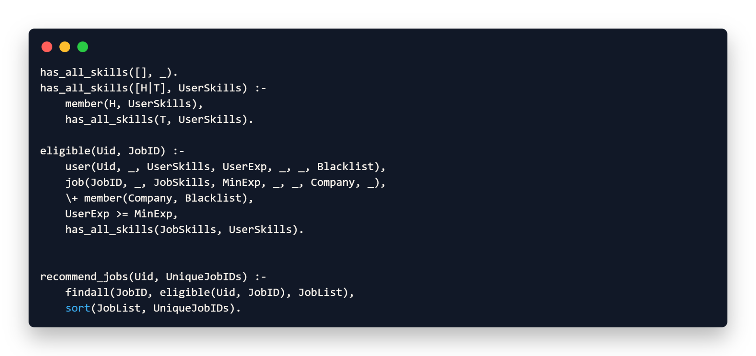
Rules

Slide 12
Source code
Technical REport
code_link
report_link

Slide 13
Conclusion
Our ER diagram form the backbone of the Job Recommender System. By clearly defining entities like users, jobs, companies, preferences, and courses, we ensure that data is stored in a structured and logical way.
This design allows us to efficiently match job seekers with the most relevant opportunities, taking into account their skills, experience, and preferences while also filtering out jobs from blacklisted companies.
Additionally, the system can suggest targeted training courses to fill any skill gaps, which makes it not just a matching tool but also a skill improvement platform. Overall, this design ensures better performance, scalability, and accuracy, which are essential for real-world job recommendation applications.

Slide 14
THANK YOU!

