Slide 1
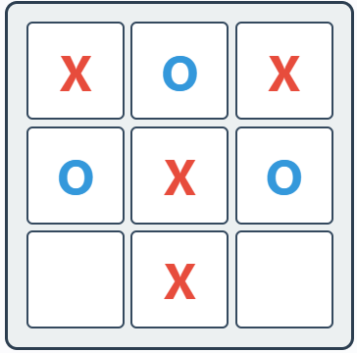
Adversarial Search
Tic Tac Toe with Minimax and Alpha-Beta Pruning

Slide 2


Team Members
Mohotasir Al Mamun
ID : 22101036
Section : A
Khaleduzzaman Antu
ID : 22101022
Section : A

Slide 3
Objective
1
To study adversarial search as applied in two-player games.
To design a Tic-Tac-Toe AI using the Minimax Algorithm.
To implement Alpha-Beta Pruning to optimize search efficiency.
To define and use an evaluation function for game state assessment.
To experimentally verify that the AI always guarantees at least a draw against a rational opponent.
2
3
4
5

Slide 4
Minimax Algorithm
1
Goal: Choose the best move assuming the opponent also plays optimally.
Process:
Generate the game tree of all possible moves.
Maximizing player (AI): tries to maximize the score.
Minimizing player (Human): tries to minimize the score.
2
3
Evaluation Function:
+10 → AI wins
–10 → Human wins
0 → Draw or non-terminal state

Slide 5
Alpha Beta Pruning
1
Improvement over Minimax — cuts off branches that won’t affect the final decision.
Key values:
Alpha (α): Best score the maximizer (AI) can guarantee.
Beta (β): Best score the minimizer (opponent) can guarantee.
If β ≤ α, prune (stop exploring that branch).
2
3
Benefits:
Same result as Minimax
Much faster and more efficient
Enables deeper searches in complex games

Slide 6
Result
The key outcomes of the Tic Tac Toe AI are:
Game works correctly in both Human vs Computer and Computer vs Computer modes.
With max depth (9) → AI plays perfectly and never loses.
AI vs AI (depth 9 vs depth 9) → always ends in a draw.
Lower-depth AI often loses against higher-depth AI.
Alpha-Beta pruning reduces explored states → much faster AI decisions.

Slide 7
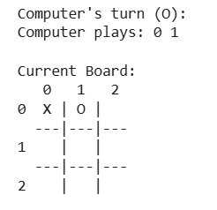
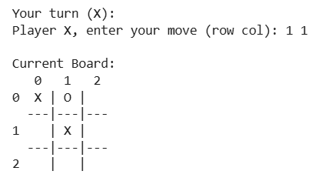
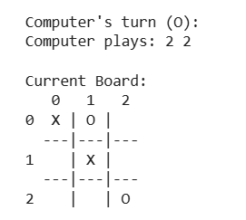
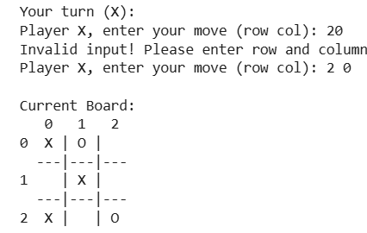
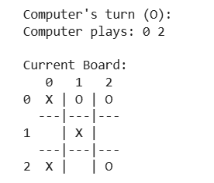
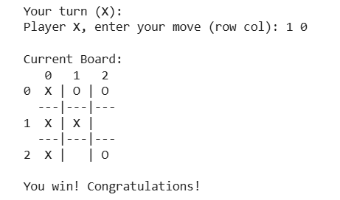
Result

Slide 8
Pros & Cons
Pros | Cons
Guarantees optimal play (never loses at full depth) | Exponential growth of states (O(b^d))
Easy to understand and implement | Still computationally heavy for large games (e.g., Chess, Go)
Alpha-Beta pruning reduces search space | Efficiency depends on move ordering
Adjustable depth = different difficulty levels | Limited to deterministic, perfect-information games
Provides strong foundation for AI game theory | Not adaptive → doesn’t “learn” from experience

Slide 9
Complexity
🔢 Minimax Algorithm
Time Complexity: O(b^d)
b = branching factor (max 9 in Tic Tac Toe)
d = depth of search tree (up to 9)
Space Complexity: O(b·d) (due to recursion stack)
⚡ Alpha-Beta Pruning
Best Case: O(b^(d/2)) → explores far fewer nodes.
Effectiveness depends on move ordering (center/corners first).

Slide 10
Real-World Applications
Game AI → Chess, Checkers, Connect Four, Go, video games.
Decision-Making Systems → Business strategy, auctions, negotiations.
Cybersecurity → Attacker vs defender simulations for network security.
Robotics & Autonomous Systems → Multi-robot coordination, competitive drones.
Military Strategy → War-gaming and enemy counter-strategy planning.
AI Research → Basis for Reinforcement Learning & GANs (Generative Adversarial Networks).

Slide 11
Conclusion
1
Implemented Minimax algorithm with Alpha-Beta pruning in Tic Tac Toe.
2
I plays optimally → never loses at maximum depth.
3
Alpha-Beta pruning improves efficiency without changing results.
4
Demonstrates how adversarial search forms the foundation of modern game-playing AI and decision-making systems.

Slide 12
THANK YOU

