Slide 1

Data Camp
Professional Data Analysis Certificate Presentation
Presented By:
Mohsen Kheirabadi

Slide 2
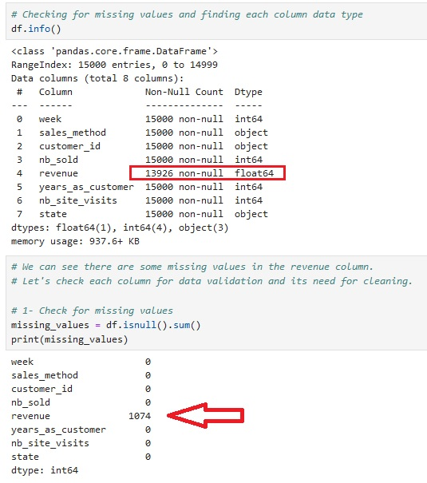
This project is part of the practical exam required to receive a professional data analytics certificate from DataCamp.
Data Validation and Cleaning
Checking for data validation shows there are 1074 missing values in the revenue column. In the sales_method column we see 5 different methods which is wrong (we should have 3 type of methods, and there are outliers in years_as_customer, because the company founded in 1984 and we can't have a customer since 63 years ago.

Slide 3
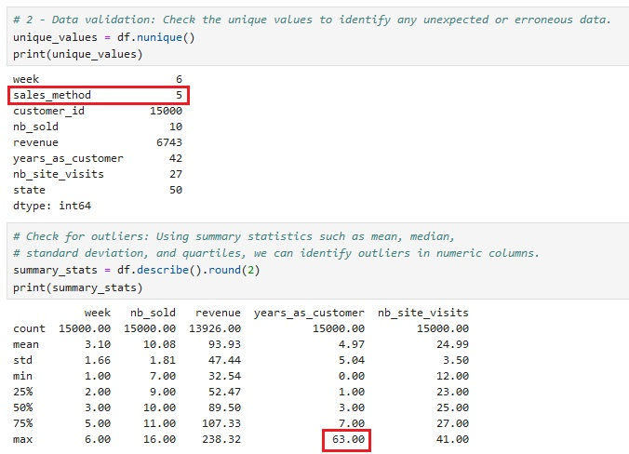

Slide 4
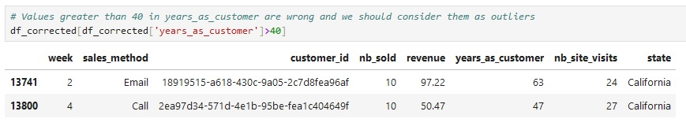
There are more than 5 percent missing values in revenue column (7.71 %), so we can not easily drop them unless we examine randomness of missing values. If they are missing completely at random (MCAR) or missing at random (MAR), dropping them may be less problematic. However, if they are missing not at random (MNAR), dropping them could introduce bias.
Instead of three unique sales method we have five as follow: ['Email' 'Email + Call' 'Call' 'em + call' 'email'].After correcting typos (replacing with correct ones) in the sales_method column, unique values are as follows: ['Email' 'Email + Call' 'Call']. The business started 40 years ago; therefore, if the values in years_as_customer show numbers greater than 40, they are incorrect. Fortunately, there are only two incorrect values, and because there are 15,000 records, dropping them doesn't make our analysis biased.

Slide 5
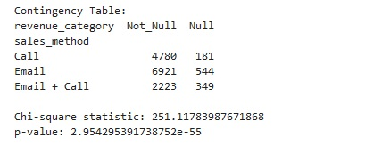
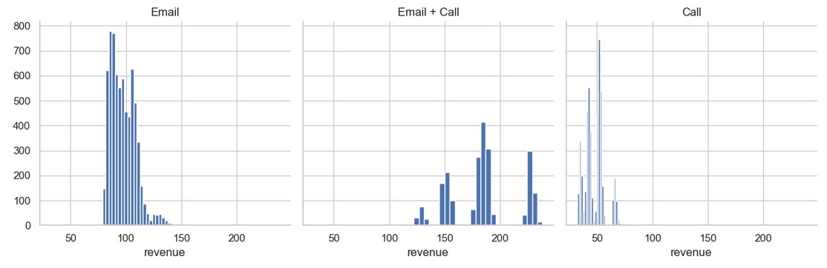
To conduct a statistical test to determine if there is a relationship between missing values in the 'revenue' column and the 'sales_method' column, we can use a chi-square test of independence. This test is appropriate when both variables are categorical, so we first create a categorical revenue column, then we create a contingency table representing the frequencies of each combination of categories. At the end we can use the chi2_contingency function from the scipy.stats module to perform the test.
AS you can see there is a significant relationship between 'sales_method' and 'revenue_category', therefore we can't easily drop missing values. To avoid bias, let's look at the distribution of revenue for each sales method.

Slide 6
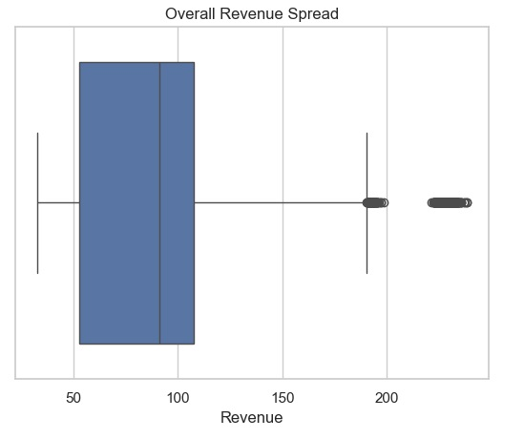
When the distribution of revenue for each sales method is not normal, it is generally advisable to use the median for imputation rather than the mean.
Exploratory Data Analysis
Now, our data is ready for exploratory data analysis. Let's see the overall revenue spread and the revenue spread for each sales method.

Slide 7
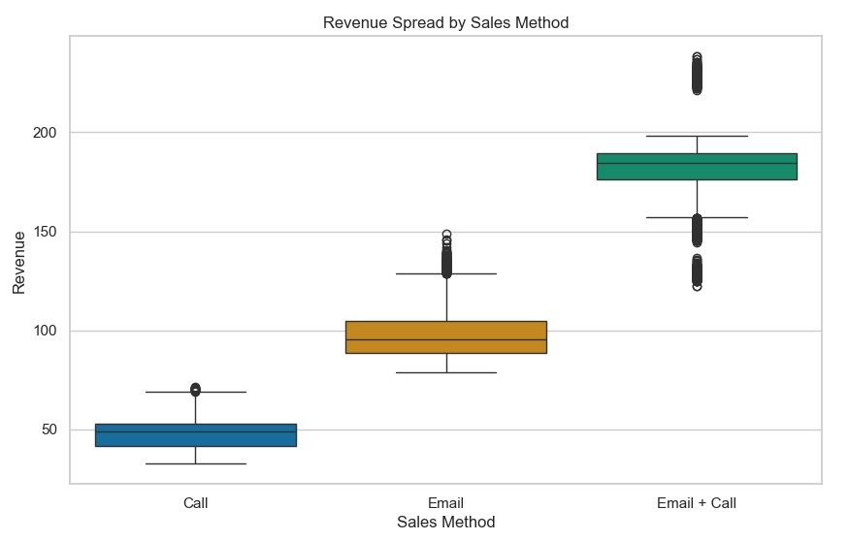
Median revenue for each sales method is as follows:
Sales Method | Median Revenue
Call | 49.05
Email | 95.58
Email + Call | 184.74

Slide 8
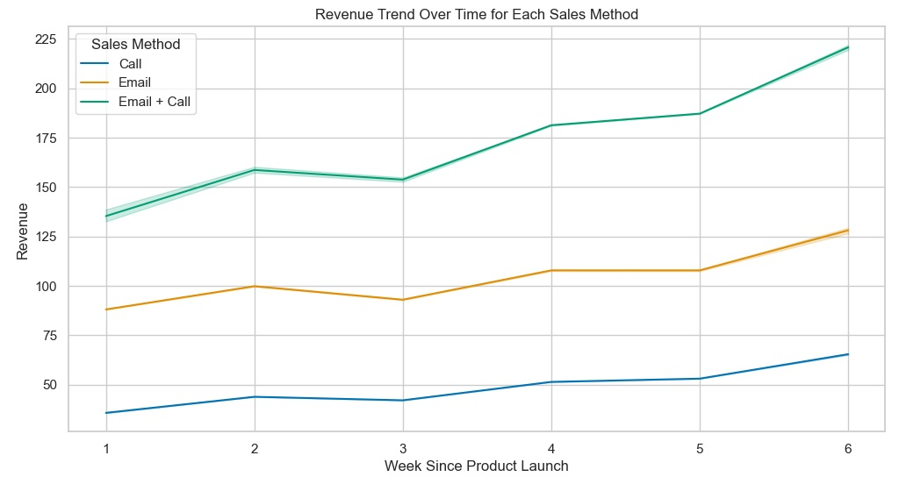
To analyze the difference in median revenue over time for each sales method, we can create line plots showing the trend of revenue over the weeks since the product launch.

Slide 9
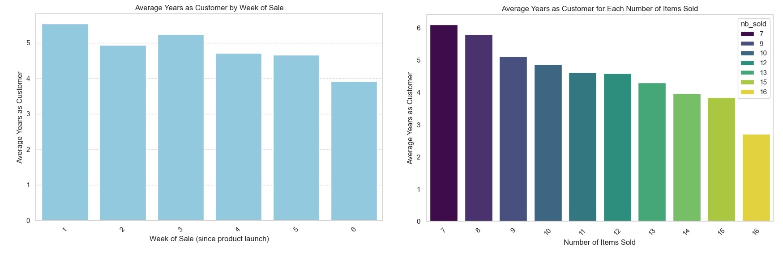
Analysis of the number of items sold and who bought earlier shows that older customers tend to buy earlier and more than new customers, which makes sense and shows that our long-term relationships with customers are healthy and that they trust us.

Slide 10
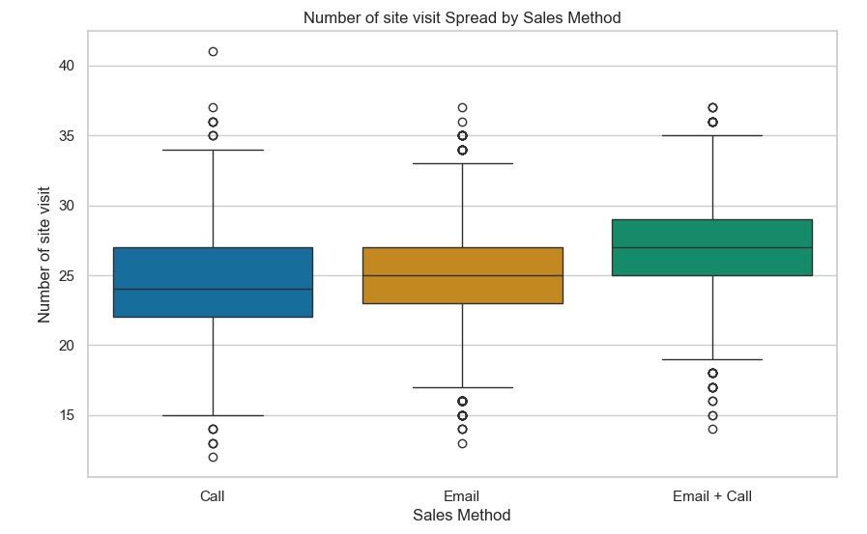
Metric
Average Revenue per Customer Visit is a metric that measures the average amount of revenue generated by each visit to the company's website. It helps in understanding the effectiveness of the company's online sales strategy and the value derived from each interaction with customers on the website.
Sales Method | Initial Average Revenue per Visit
Call | 1.951001
Email | 3.919088
Email + Call | 6.865501

Slide 11
Conclusion
Based on these findings, it appears that the "Email + Call" method is the most effective in generating revenue per visit. However, we need to monitor metrics for all sales methods for a longer period to make informed decisions and optimize sales strategies.
There are other metrics that can be used like Conversion Rate, Customer Acquisition Cost (CAC), Customer Lifetime Value (CLV), Churn Rate, Return on Investment (ROI), Average Order Value (AOV). In future analyses, using more detailed data, we can provide more specific metrics, which are crucial for decision-making.

