Slide 1

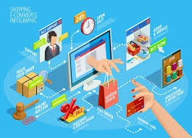
preparedby Saeed Ismaail Rzgar Khether Muhsin Haji Gulistan Ahmad
Kurdistan Regional Government
Ministry of Higher Education
Duhok Technical College
Bardarash Technical Institute
Department of Business Administration
seminar/E .busness
2022__ 2023
D . Muhammed

Slide 2
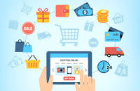
the introduction
Electronic Business, often referred to as e-Business, refers to all commercial activities that use information and communication technology such as the Internet, communications, and others. The term e-business includes all other electronic activities such as: (e-commerce - e-marketing - electronic communications, including e-mail - e-payment - B2B), which is the exchange of products and services between companies, groups and individuals, as it can be seen as one of the basic activities in any a job. E-commerce focuses on the use of information and communication technology to enable companies to benefit from external activities and relationships with individuals, groups and other businesses. (Read on)

Slide 3
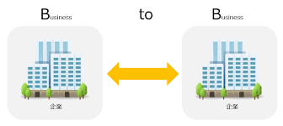
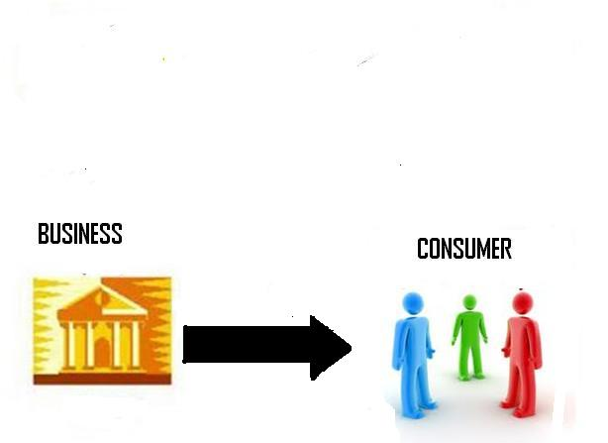
Types of E. BUSINESS
B2B
Business-to-business is the commercial relationship between two companies. In the case of e-business, this can take place on communication platforms between partners, or even in the online purchase of products and services.
B2C
Business-to-consumer is one of the most common models in commercial relationships. This is when a company offers a product or a service for an end consumer. An online store is a classic example of this model

Slide 4
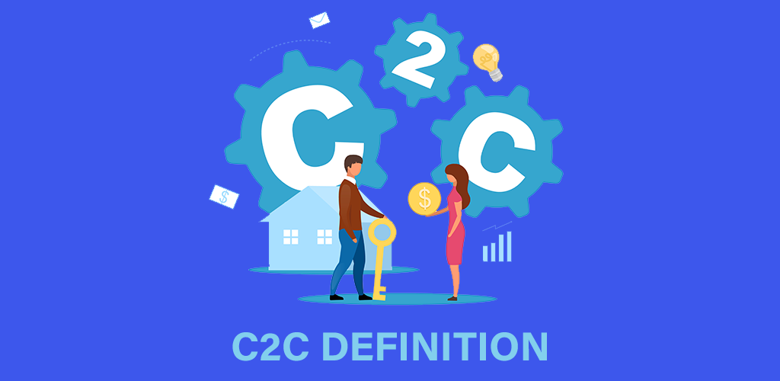
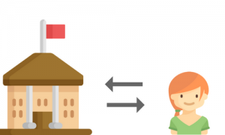
C2C
There are consumer-to-consumer platforms, whose prime examples are websites for classified ads – in other words, an end consumer doing business with another end consumer.
G2C
In the government-to-consumer model, the government implements ways to communicate with citizens, as in the case of issuing a clearance certificate or online payment of taxes and fines.

Slide 5

Advantages E . Business 1-When looking at e-business we have many advantages, which are mostly connected to making doing business easier. The benefits of implementing e-business tools are in the streamlining of business processes and not so much in the use of technology. Here are some: Easy to set up: electronic business is easy to set up even from home, the only requirements are software, a device and an internet connection.

Slide 6
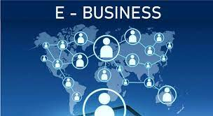
2-Flexible business hours: There are no time barriers that a location-based business can encounter since the internet is available to everyone all the time. Your products and services can be accessed by everyone with an internet connection.

Slide 7

3-Cheaper than traditional business: Electronic business is less costly than a traditional business, but it is more expensive to set up. Transactions cost are also cheaper.
No geographical boundaries: The greatest benefit is the possibility of geographical dispersion. Anyone can order anything from anywhere at any time.
Government subsidies: Digitalisation is very encouraged by the government and they provide the necessary support.

Slide 8
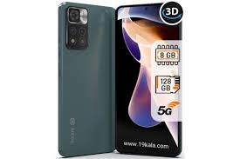
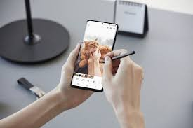
Disadvantages E. Business
1-Despite all the limits, there are also some disadvantages that we need to address. The most common limitations of electronic business are:
Lack of personal touch: The products cannot be examined or felt before the final purchase. In the traditional model, we have a more personal customer experience, while in the electronic business that is mostly not the case. Another missing factor of personal touch could also be in

Slide 9
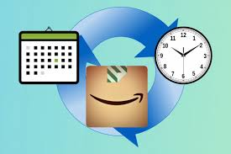
2-Delivery time: Traditional business enables instant satisfaction as you obtain the product the moment you purchase it, while in electronic business that is not possible. There will always be a waiting period before you receive the product. For example, Amazon assures one-day delivery. This does not resolve the issue completely, but it is an improvement.
48 hour

Slide 10
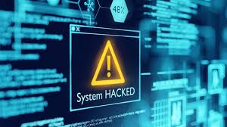
3-Security issues: Scams could be mentioned as a factor for people's distrust in electronic business. Hackers can easily get customers' financial and personal details. Some customer still finds it hard to trust electronic businesses because of the lack of security, reliability and integrity issues

Slide 11
Source
www.wikipedia.org
https:mawdoo3.com
https://almerja.com

